Slide 1
Elementary
Close Reading Using
Culturally Responsive Literacy
Los Angeles Unified School District
Academic English Mastery program

Slide 2
Learning Objectives
Explore strategies to use with culturally responsive literacy
Explore what makes literacy responsive to Standard English Learners (SELs) using Close Reading
Notes:
1 min

Slide 3
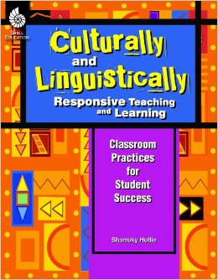
Culturally and Linguistically Responsive Pedagogy (CLR)
Sharroky Hollie
Pg 23
is the validation and affirmation of the home (indigenous) culture and home language for the purposes of building and bridging the student to success in the culture of academia and mainstream society.
VABB
Notes:
When our students fail to respond to instruction positively, Culturally and Linguistically Responsive Pedagogy can improve student responses.
[Click]
Ask for volunteer(s) to read the definition.
Ask participants: Which words and phrases stand out to you and why?
CLR is the validation and affirmation of the home (indigenous) culture and home language for the purposes of building and bridging the student to success in the culture of academia and mainstream society.
Focus on the validation and affirmation of home

Slide 4
Five CLR Pedagogical Areas
CLR
Expanding Academic Vocabulary (Responsive Vocabulary)
Increasing Student Engagement and Decreasing Classroom Management Challenges (Responsive Management)
Using all types of Texts Culturally and Linguistically (Responsive Literacy)
Infusing Situational Appropriateness with Language and Behavior
(Responsive Language)
Creating an Inviting Learning Environment for Student Success (Responsive Environment)
Notes:
1 minute
Today we are focusing on Responsive Literacy
Purpose: Brief overview of CLR- Culturally and Linguistically Responsive Pedagogy
In order to provide more opportunities for students to be more engaged and motivated, we employ various types of Culturally Responsive Complex Text.

Slide 5
Standards
RL 3.1 Ask and answer questions to demonstrate understanding of a text referring explicitly to the text as the basis for the answer.
RL 3.7 Explain how specific aspects of a text’s illustrations contribute to what is conveyed by the words in a story.
L 3.4 Determine or clarify the meaning of unknown and multiple-meaning words and phrases.
SL 3.1 Engage effectively in a range of collaborative discussions.
W 3.1 Write opinion pieces on topics or texts, supporting a point of view with reasons.
Notes:
1 minute
Though the text that we will use today can be used across many grade levels, we are focusing our sample lesson on the third grade. These are the standard we will address.

Slide 6
Standards
RL 3.1 Ask and answer questions to demonstrate understanding of a text referring explicitly to the text as the basis for the answer.
RL 3.7 Explain how specific aspects of a text’s illustrations contribute to what is conveyed by the words in a story.
L 3.4 Determine or clarify the meaning of unknown and multiple-meaning words and phrases.
SL 3.1 Engage effectively in a range of collaborative discussions.
W 3.1 Write opinion pieces on topics or texts, supporting a point of view with reasons.
Notes:
1 minute
Though the text that we will use today can be used across many grade levels, we are focusing our sample lesson on the third grade. These are the standard we will address.

Slide 7
Close Reading - Accelerated
Culminating Task
Notes:
2 mins
Tell the teachers that we are doing an accelerated version of close reading and that the activities that we engage in today, in less than an hour with actually occur over the course of several days in the classroom.

Slide 8
Close Reading - Accelerated
Culminating Task
Notes:
2 mins
Remind teachers that we are doing a very modified/adult speed version a small unit of study in order to highlight Listening and Speaking and the engagement strategies that are Culturally Relevant.

Slide 9
Preparing for the READ ALOUD
Fold your paper into 4 sections.
Use two sections to record two questions you may have.
Use the other two sections to write your favorite parts or special thoughts about the text.
QUESTION
QUESTION
FAVORITE PART OR THOUGHT
FAVORITE PART OR THOUGHT
Notes:
2 mins
Materials: paper, Close Reading poster
Let the participants know that they are going to experience a Read Aloud. In order to prepare to interact with the story, they will need to fold their paper in four and follow the instructions on the screen.

Slide 10
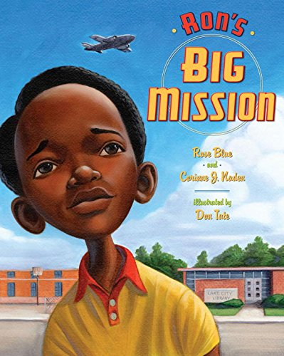
Read Aloud
Notes:
8 minute read aloud
Read aloud Ron’s Big Mission by Rose Blue and Corrine Naden, while teachers listen. Those that can take notes on their four-fold paper should do so.
An author's note explains that this is a fictionalized account of a real incident from the childhood of astronaut Ron McNair, who died in the 1986 Challenger explosion.

Slide 11
Moment of Silence
QUESTION
QUESTION
Write down at least two questions you have.
Record your favorite part
FAVORITE PART OR THOUGHT
FAVORITE PART OR THOUGHT
Notes:
1 min.
Purpose: Give teachers a moment to finish writing their annotations
Introduce the protocol- and model example if needed.
Ask participants to follow the instructions on the screen

Slide 12
Text-to-Self Connection
Share with your partner
Which character do you identify with most? Why?
Character choices
Ron
Ron’s Mom
Librarian
Police
Child watching
Notes:
3 mins
Purpose: The purpose of this slide is have participants personally identify with the characters and the climax of the story. The personal connection inspires the engagement out Standard English Learners need in Literacy instruction.
Still with their silent appointment, have the participants answer the question on the slide.
Debrief:
Ask who identified with ________ and why? Or Who did you identify with and why?

Slide 13
Silent Appointment Give One Get One
QUESTION
QUESTION
Work together to try to answer a question
Share a favorite part
FAVORITE PART OR THOUGHT
FAVORITE PART OR THOUGHT
Notes:
6 mins.
Purpose: To debrief their notes from the read aloud.
Introduce the protocol- and model example if needed.
Ask participants to follow the instructions on the screen

Slide 14
Close Reading - Accelerated
Number the paragraphs.
Culminating Task
Notes:
1 min
Remind teachers that we are doing a very modified/adult speed version a small unit of study in order to highlight Listening and Speaking and the engagement strategies that are Culturally Relevant.
For second read
Might introduce the word segregation and reread noting the key details that relate to segregation

Slide 15
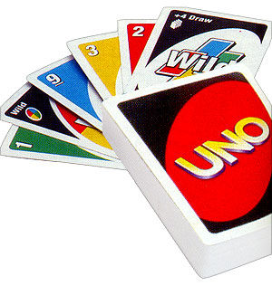
Text Dependent Questions
Find 3 other partners with the same number.
Answer the following question:
How does the author and illustrator help you understand that the story took place in the summer? Support with evidence from the text.
Uno Partners
Notes:
2 mins
Purpose: To have the participants engage in the TDQs (3rd read) of the story, using the various engagement strategies, along with considering which constructive conversation skills would be needed.

Slide 16
Using Text Structures and Features Pair-Share
Using the illustrations and text, tell what you believe the other characters were thinking when Ron decided to take a stand?
Notes:
2mins
Purpose: Model a TDQ that directly relates to the use of text features and structures.
Refer to page that starts with…”Now, Mrs. Scott called Ron’s mother…) Show illustration

Slide 17
Using Text Structures and Features Pair-Square
Using text and illustration details, explain what the author is trying to say about taking a stand?
Notes:
Possible responses:
Taking a stand
could be scary
could get angry, people might try to change your mind
could feel proud, people could be supportive
Refer to pages that starts with…”Two policeman came right over…”
“Now, Mrs. Scott called Ron’s mother…”
“Mrs. Scott returned and handed Ron…”
Share the illustrations on these pages

Slide 18
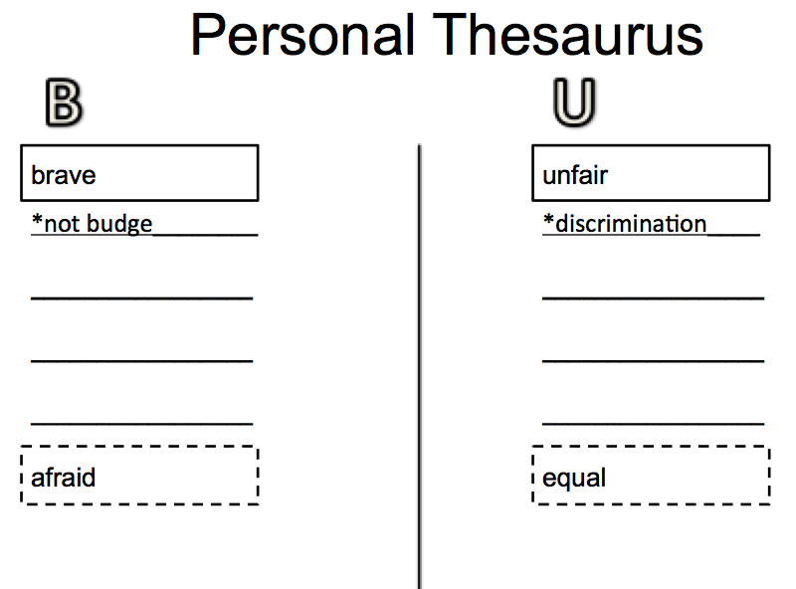
Text Dependent Questions and the Personal Thesaurus
What examples of discrimination were in the story?
Reread paragraphs 15-19. What words or phrases connect to Ron’s bravery?
Where would we add those words/phrases in our Personal Thesaurus?
Notes:
The Personal Thesaurus has the following components:
the students own word,
the target word
the box at the bottom for the antonym of the target word.
The use of the personal thesaurus is anchored in context.

Slide 19
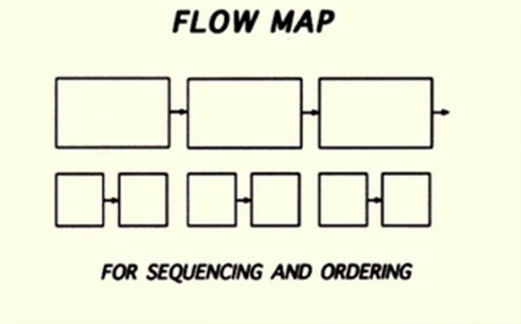
Think-Pair-Share-Sketch
THINK about the events in the narrative.
Using the appropriate Thinking Map, together sketch the major events in the order that they happened.
Notes:
1 min
This is created on the back of the four square paper- upper left hand corner

Slide 20
Eyes on the Stars
Video: Eyes on the Stars StoryCorp
Notes:
4 mins
Play video on youtube: Eyes on the Stars StoryCorp

Slide 21
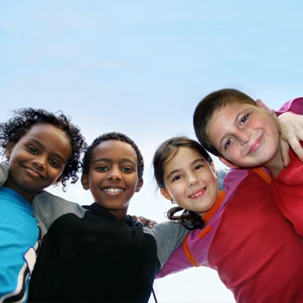
Video
Give a Shout out
Who’s telling the story in the video?
Pair Square
What was different about the book and the video? Provide evidence.
Notes:
3 mins
Give time for teachers to talk and share out

Slide 22
Think-Pair-Share-Sketch
THINK about the events in the video.
Using the appropriate Thinking Map, together sketch the major events, from the video, in the order that they happened.
Notes:
1 min
DON’T DO!!!!!

Slide 23
Close Viewing
Culminating Task
Notes:
1 min
As in doing a close read, we have multiple opportunities to read, in close “view” we have multiple opportunity to view the video.

Slide 24
Close Viewing Preparing for Discussion
Watch the video again. Using two quadrants on your 4 fold, take notes to help you discuss the following questions.
What did you notice about the setting?
What do you think about that?
Story
Video
What did you notice about the setting?
What do you think about that?
Notes:
2 mins
Materials: the back of the 4 fold paper
Follow the directions on the screen. The purpose of this viewing is to prepare the teachers (students) for a discussion about the video.

Slide 25
Close Viewing Preparing for Discussion
Share with your ‘face partner’.
What did you notice about the setting?
What do you think about that?
Story
Video
What did you notice about the setting?
What do you think about that?
Notes:
3 mins
Materials: the back of the 4 fold paper
Follow the directions on the screen. The purpose of this viewing is to prepare the teachers (students) for a discussion about the video.

Slide 26
Eyes on the Stars
Video: Eyes on the Stars StoryCorp
Notes:
4 mins
Play video on youtube: Eyes on the Stars StoryCorp
Only replay first portion of video- the library incident

Slide 27
Close Viewing
Culminating Task
Notes:
1 min

Slide 28
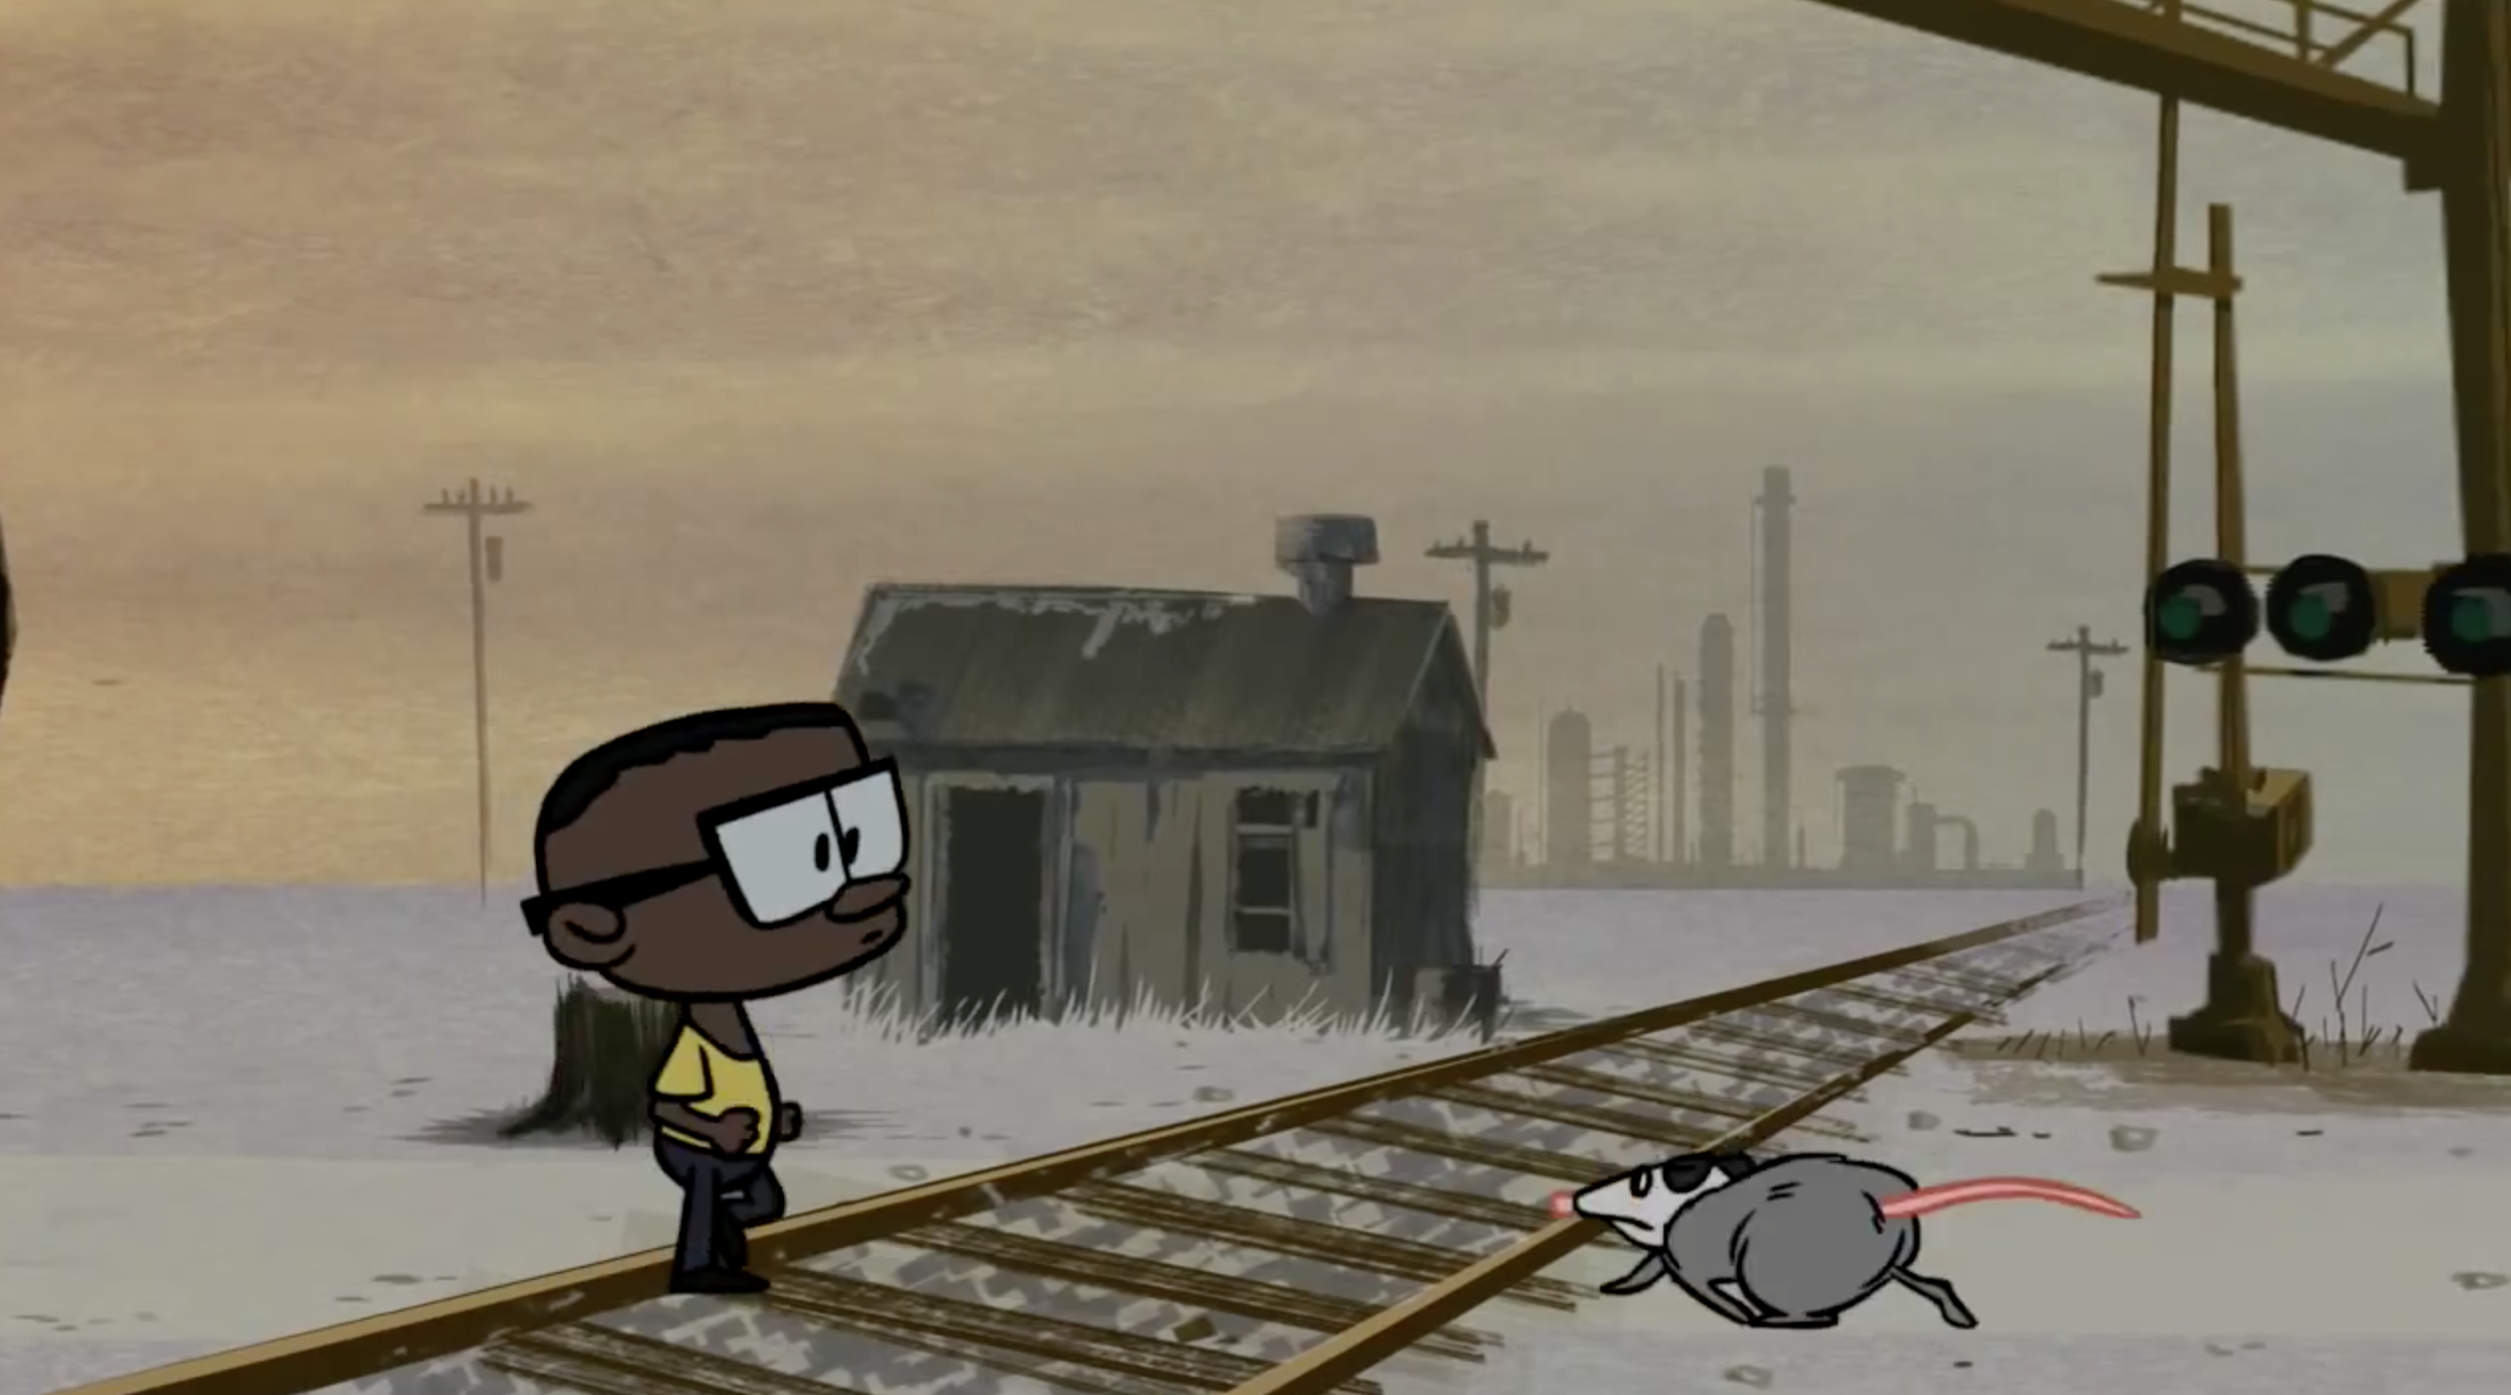
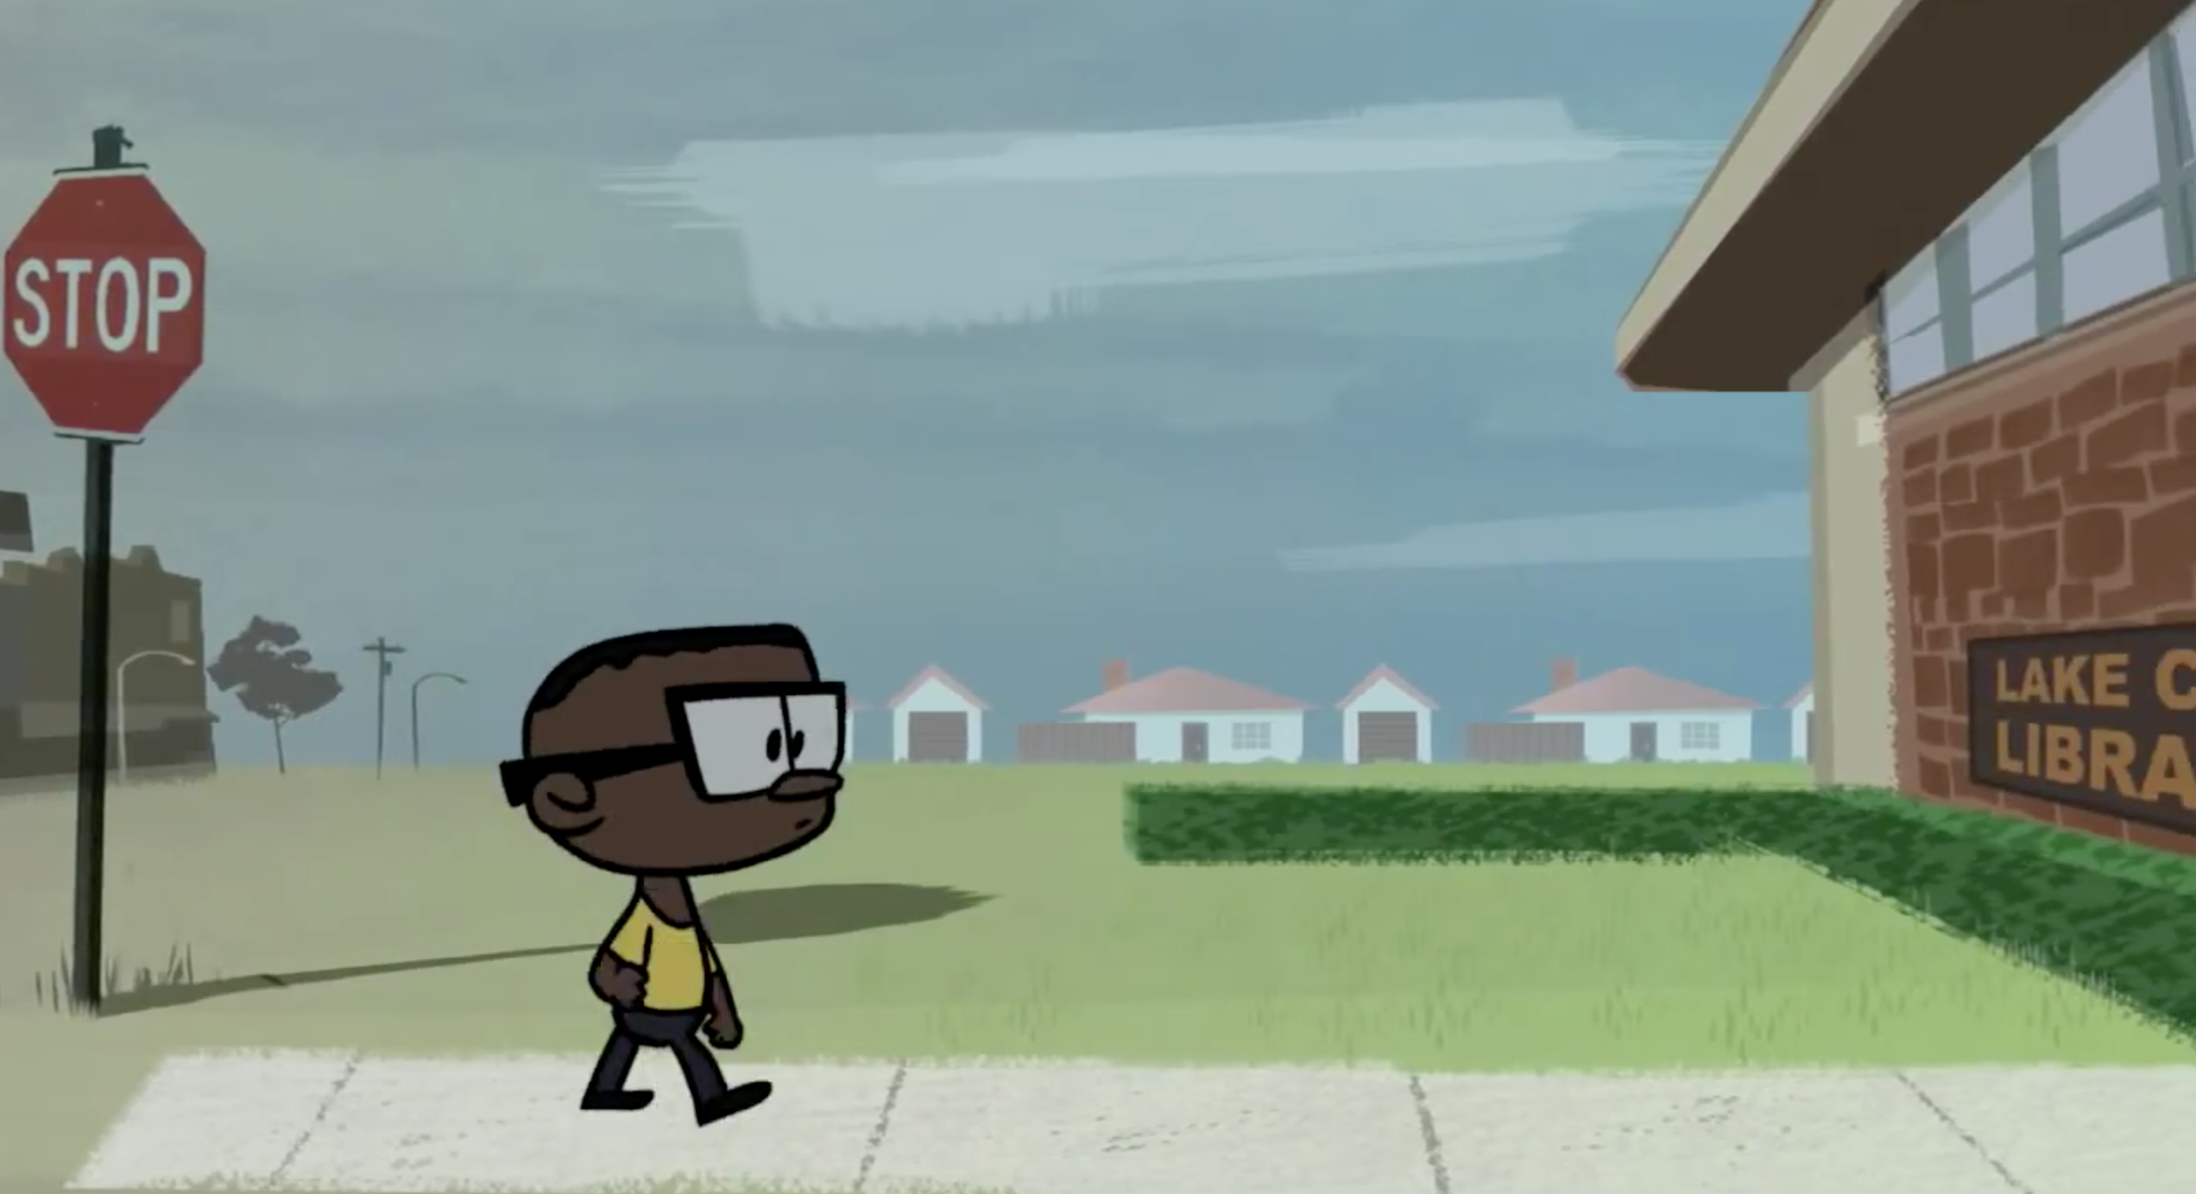
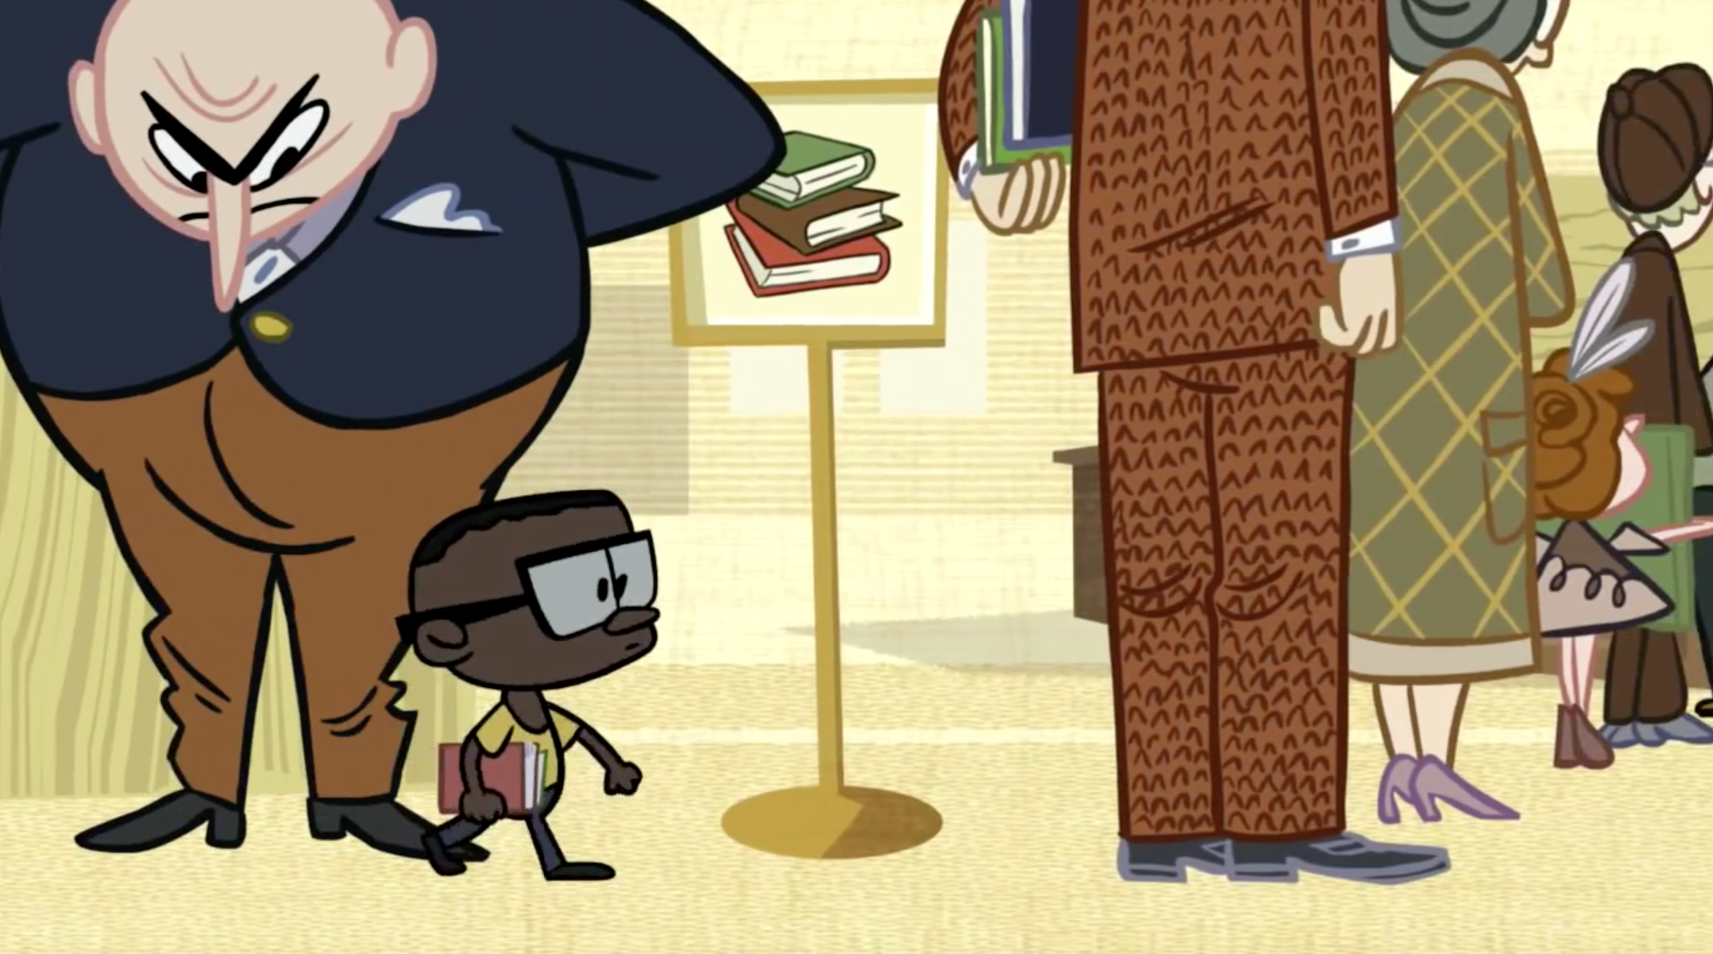
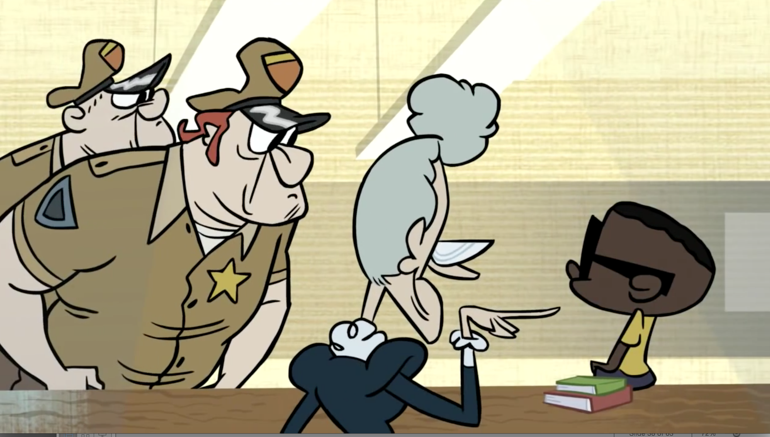
Text Dependent Questions
Discuss with your elbow partner.
How does the cartoonist illustrate the risks that Ron took? Support with evidence from the text.
Notes:
2 mins
Ask the team to identify the constructive conversation skill(s) needed for this task.

Slide 29
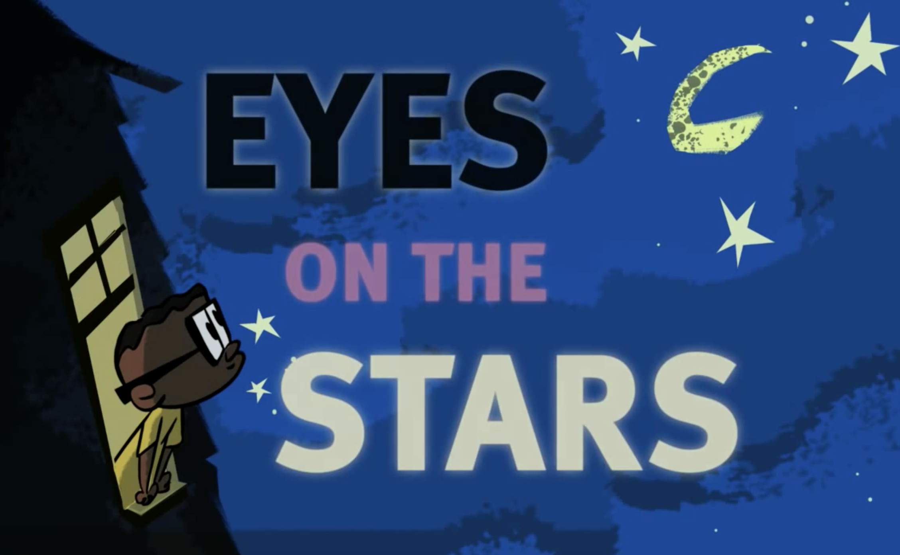
Text Dependent Questions
Pair Share
Whose account of Ron’s life seems most credible/believable? Support your claim.
Notes:
3 mins
Have teachers participate in this part

Slide 30
Close Viewing
Culminating Task
Notes:
1 min

Slide 31
Culminating Task
3rd -What do you believe both accounts of Ron’s story are trying to tell you about
‘taking a stand’? Support your opinion with evidence from both texts/sources.
5th –Whose account of Ron’s life seems most credible/believable? Support your claims.
Notes:
3 mins
What are the learning and teaching implications of this culminating task.

Slide 32
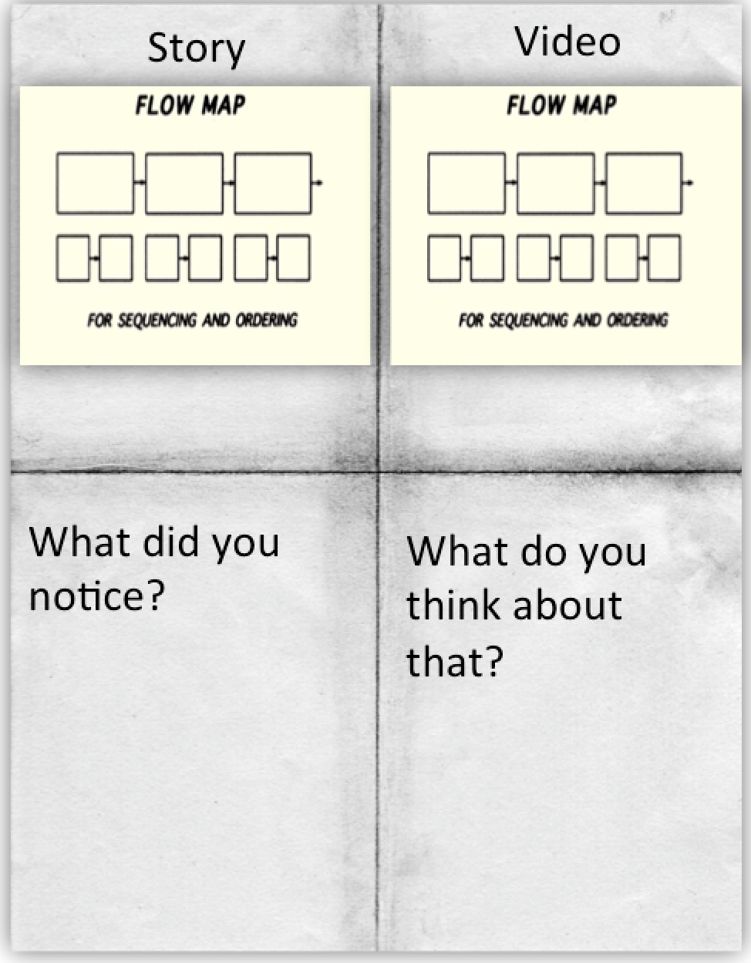
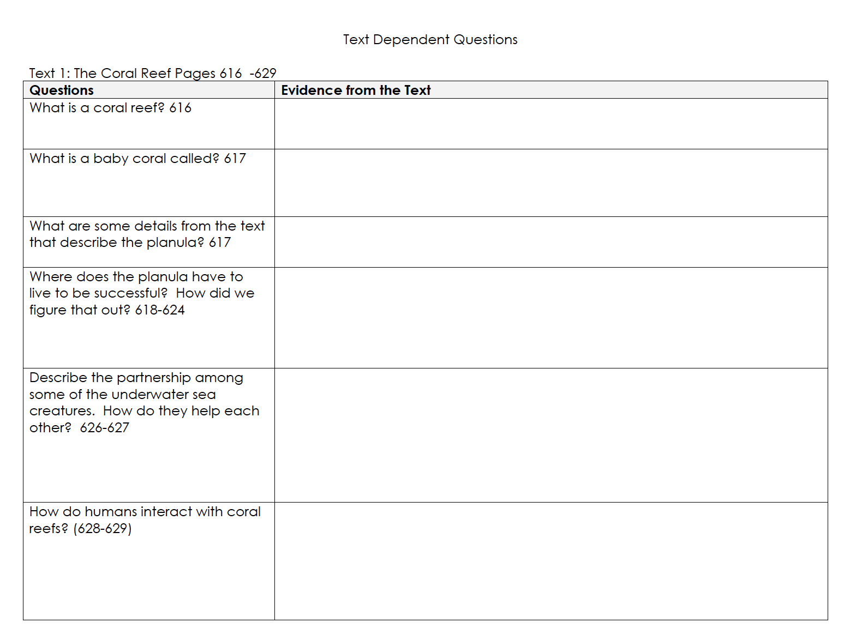
Source 1 Ron’s Big Mission
u
Read for Flow
v
Reread &
Annotated
w
Text Dependent
Questions
Culminating Task
Notes:
In order to meet the claims assessed by smarter balanced and provide sufficient evidence of meeting those targets, we need to engage our students in the close reading of complex text. That process should include multiple reads that require students to annotate for multiple reasons such as; key detail, vocabulary, central ideas, etc. We enhance that process by asking TDQs that require students to use evidence from the text and allow for ample collaboration and discussion before wrapping it up with a culminating task.

Slide 33
Source 2 Eyes On the Stars
u
Watch for Flow
v
v
Reread &
Annotated
w
Text Dependent
Questions
Culminating Task
Notes:
In order to meet the claims assessed by smarter balanced and provide sufficient evidence of meeting those targets, we need to engage our students in the close reading of complex text. That process should include multiple reads that require students to annotate for multiple reasons such as; key detail, vocabulary, central ideas, etc. We enhance that process by asking TDQs that require students to use evidence from the text and allow for ample collaboration and discussion before wrapping it up with a culminating task.

Slide 34
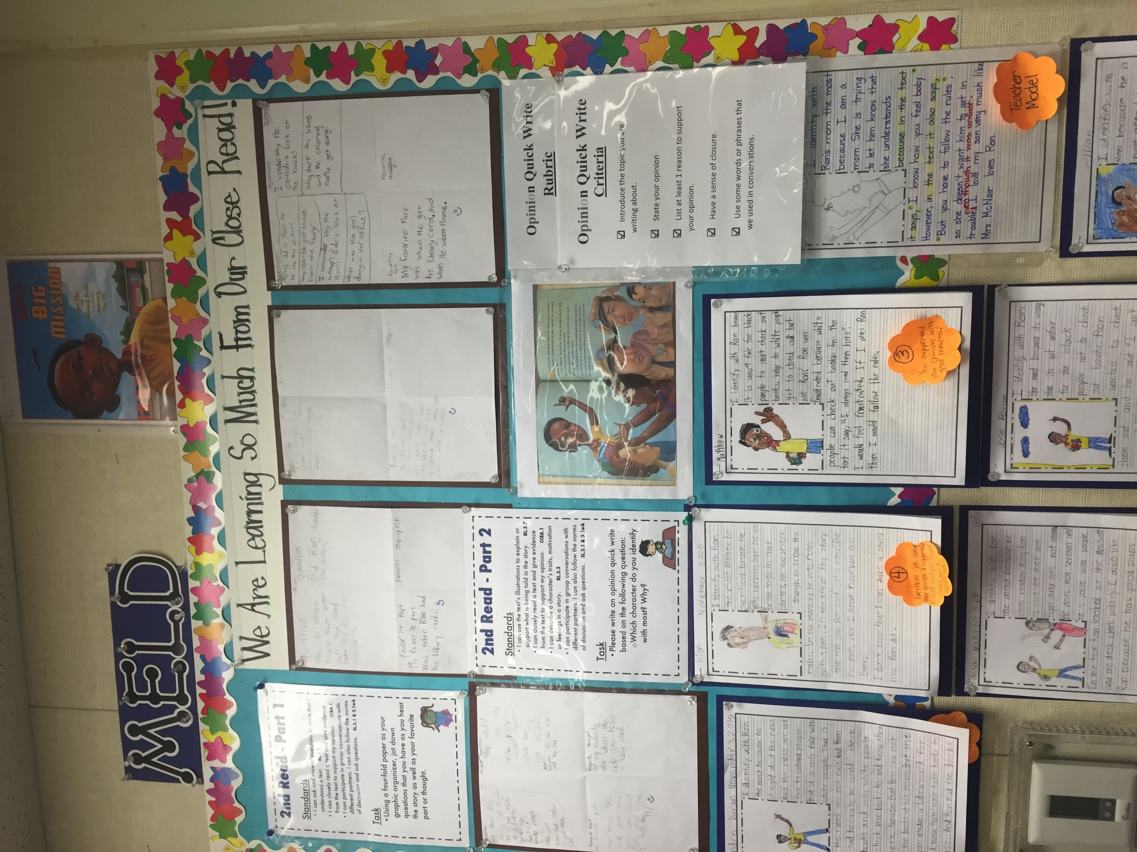
MELD In Action
Notes:
Examples of work produced when this was completed as a MELD lesson

Slide 35
Students Comparing and Contrasting the Story and Video
Notes:
Ron’s Big Mission
Examples of work produced when this was completed as a MELD lesson

Slide 36
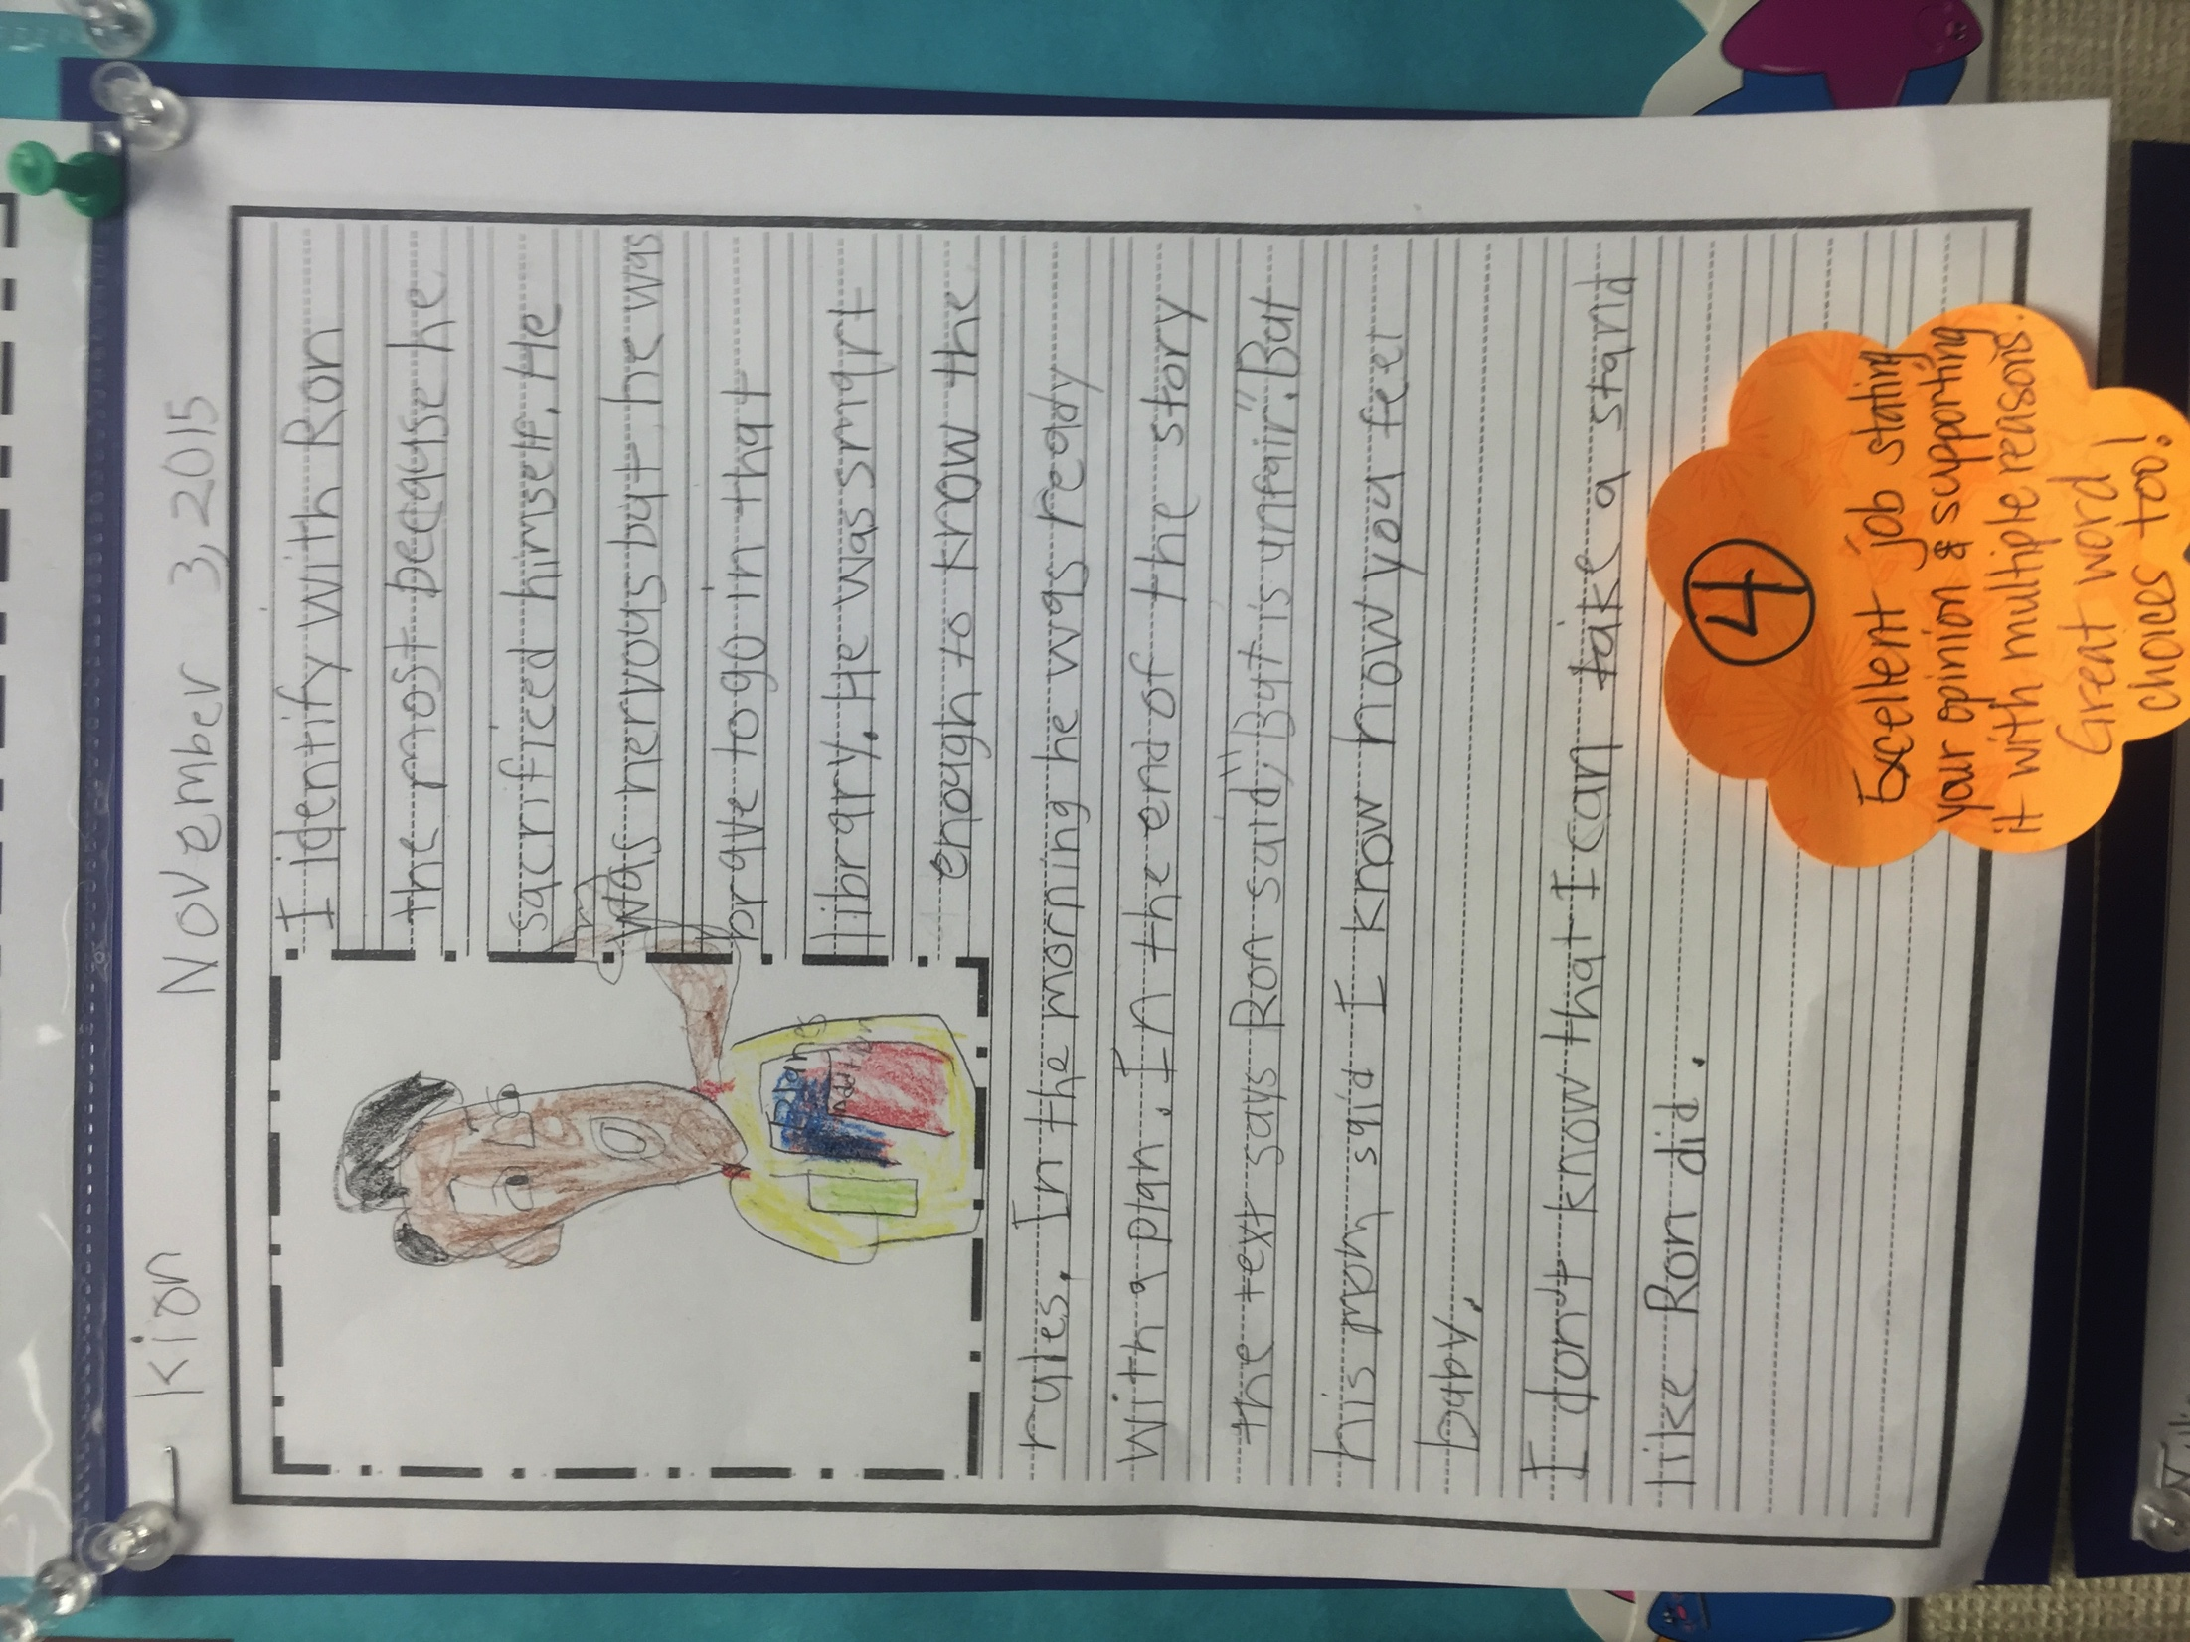
MELD In Action

Slide 37
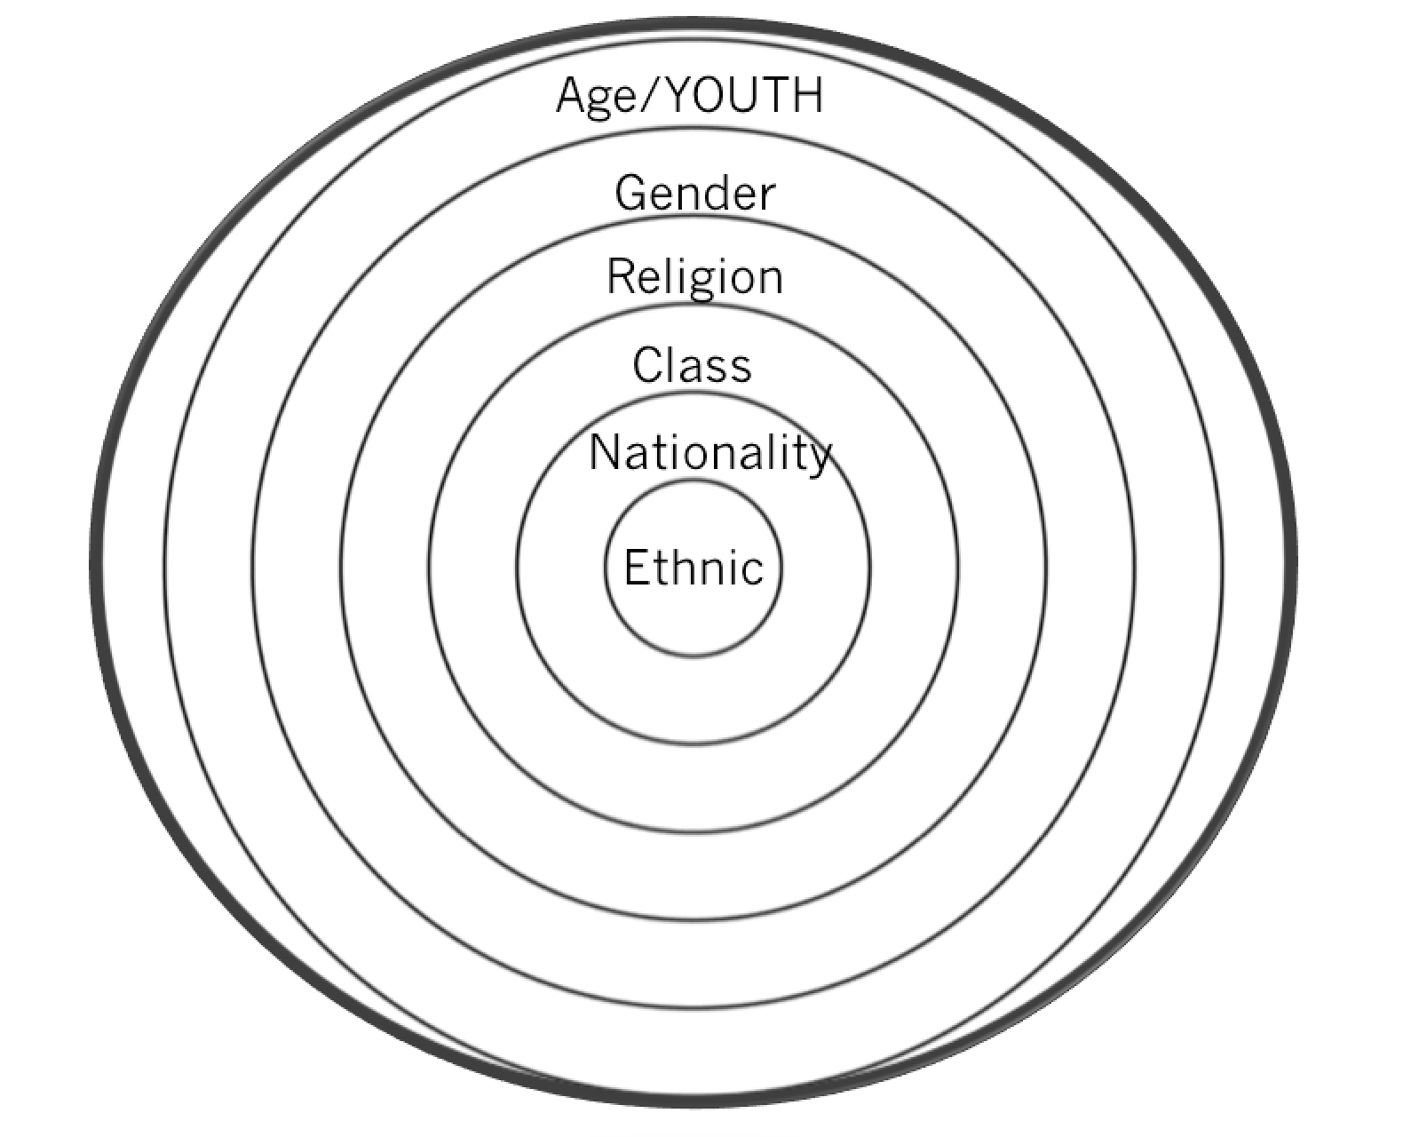
Rings of Culture
Notes:
2 mins
Which ring(s) of culture does Ron’s Big Mission address?
Possible answers:
Ethnic
Class
Age (in the 1950’s)
Gender (risk taken by a Black male in the 1950’s)

Slide 38
Mainstream English Language Development
What might you add to this lesson during MELD?
Listen to instructional conversations
Read students’ writing
Consider past tense markers
Notes:
2 mins
Consider what elements can be added to the lesson to address the linguistic features of the students. Ther

Slide 39
Text Sets
Notes:
2 mins
Separate is Never Equal
Almost 10 years before Brown vs. Board of Education, Sylvia Mendez and her parents helped end school segregation in California. An American citizen of Mexican and Puerto Rican heritage who spoke and wrote perfect English, Mendez was denied enrollment to a “Whites Only” school. Her parents took action by organizing the Hispanic community and filing a lawsuit in federal district court. Their success eventually brought an end to the era of segregated education in California.

Slide 40
Common Core 7 ELA/Literacy Competencies
Demonstrate independence
Build strong content knowledge
Respond to the varying demands of audience, task, purpose, and discipline
Comprehend as well as critique
Value evidence
Use technology and digital media strategically and capably
Come to understand other perspectives and cultures
Notes:
2-3 minutes
Connect CLR to the competencies of a Literate individual
These habits of mind practices speak directly to the the benefits of teachers using CLR pedagogies while instructing Standard English Learners.
7 competencies- habits of mind
Specifically looking at
#3. Respond to the varying demands of audience, task, purpose, and audience which relates to Responsive Language--Infusing Situational Appropriateness with Language and Behavior.
#4. Most students will engage more and therefore comprehend more when they are able to connect
#7. Come to understand other perspectives and cultures relates to Responsive Literacy- Using all types of texts culturally and linguistically.

Slide 41
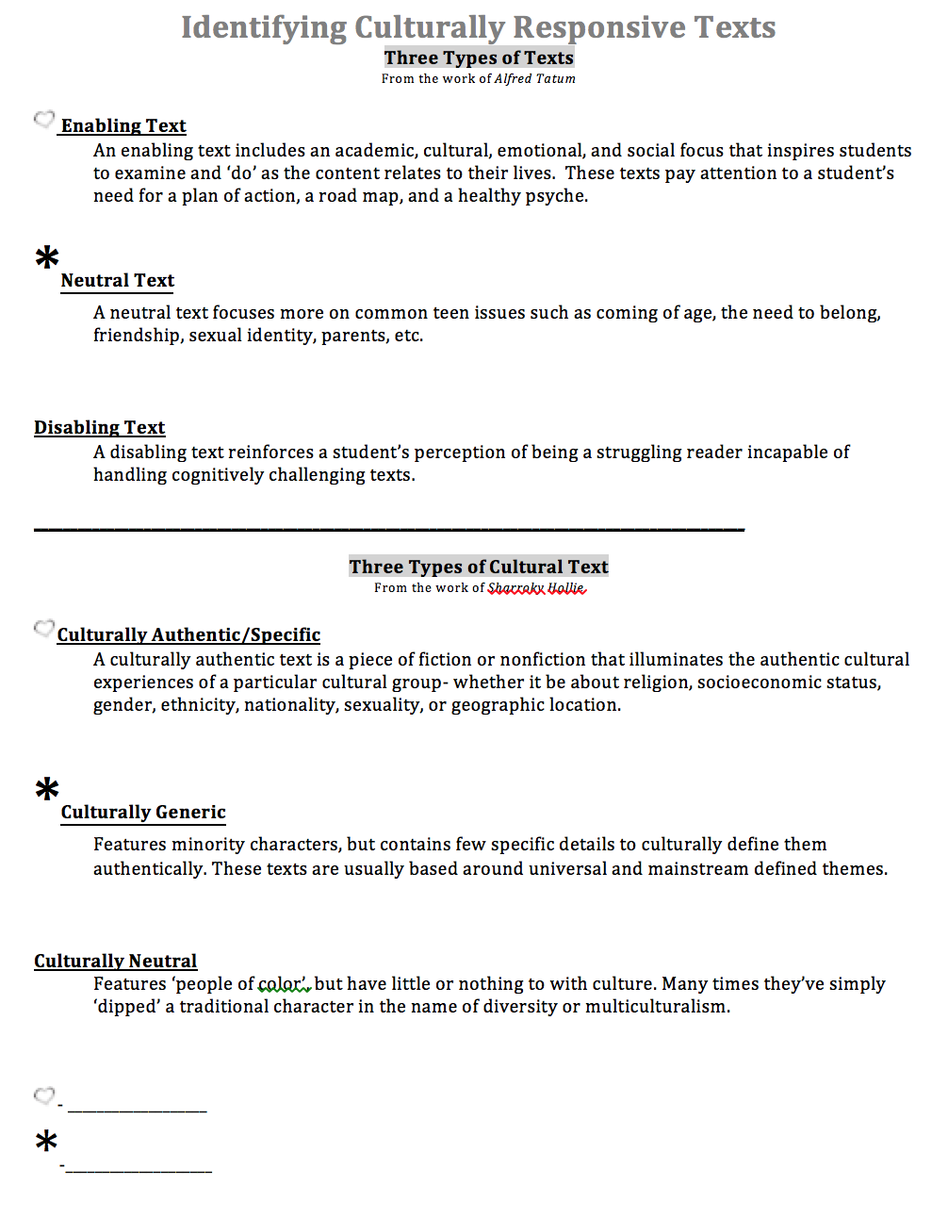
Culturally Responsive Text
Dr. Alfred Tatum classifies responsive texts in 3 ways.
Notes:
3 minutes
Tatum definition
Examples are following on the next slide.

Slide 42
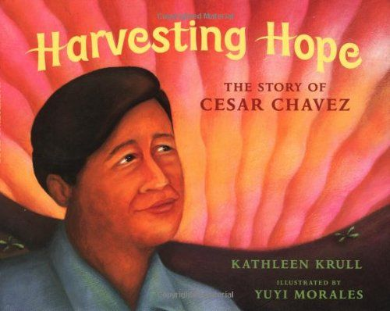
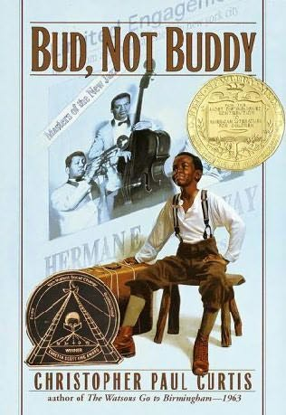
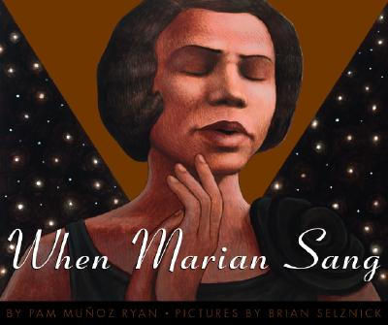
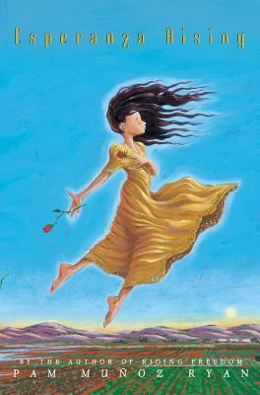
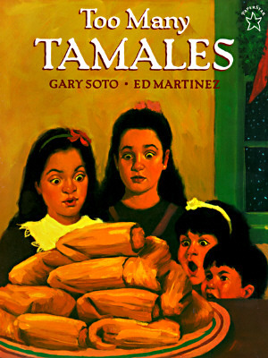
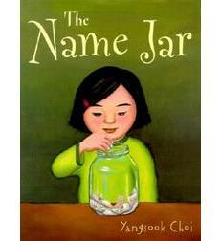
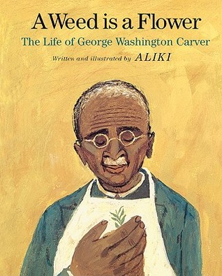
Elementary Titles Culturally Responsive Enabling Literature
4 Criteria
Promote a healthy psyche
Grounded in real world experiences
Focus on the collective struggle of people of color
Serve as a road map for being, doing, thinking, and acting
Notes:
(2-3 minutes)
Say: Here are some excellent examples of Culturally Responsive Enabling Literature. Each of these titles meet the Four criteria outlined by Dr. Tatum: 1) They promote a healthy psyche, 2) They are grounded in real world experiences; 3) They focus on the collective struggle of people of color; and (most importantly) 4) They serve as a road map for being, doing, thinking, and acting.

Slide 43
What is Culturally Responsive Text?
Dr. Sharroky Hollie also classifies responsive texts in 3 ways.
Notes:
1 min
Hollie’s definition
Purpose: Begin to explore Dr. Hollie’s definition of Culturally Responsive Texts.

Slide 44
Culturally Responsive Text
A culturally authentic text is a piece of fiction or nonfiction that illuminates the authentic, cultural experiences of a particular cultural group- whether it be about religion, socioeconomic status, gender, ethnicity, nationality, sexuality, or geographic location.
Rings of Culture
Notes:
3 minutes
Connect to the rings of culture.

Slide 45
Culturally Generic Texts
A culturally generic text is a piece of fiction or nonfiction that features minority characters, but contains few specific details to culturally define them authentically. Usually based around universal and mainstream defined themes.
Discuss the differences between “culturally generic” and “culturally responsive” text.
Unlock the difference
Notes:
2 mins
Table Talk
What’s different about culturally generic texts and culturally authentic/specific texts?

Slide 46
Culturally Neutral Texts
A culturally neutral text is a piece of fiction or nonfiction that features “people of color” but have little or nothing to with culture and many times simply have “dipped” a traditional character in the name of diversity or multiculturalism.
Most important point
Notes:
2 mins
Shout out the most important point of this one

Slide 47
Culturally Responsive Texts
Text that include the reader’s experience, and which draws on their background and culture…
Text that helps children understand who they are, where they come from, and where they can go
Text that connect to students’ lives, not just to their cultural heritage.
-based on the work of Alma Flor Ada
Notes:
1 min
Alma Flor Ada is a renowned author who is known for her culturally responsive books like, I Love Saturdays y Domingos. Her work is based on the definition that culturally responsive texts
text that include the reader’s experience, and which draws on their background and culture…
text that helps children understand who they are, where they come from, and where they can go
connect to students’ lives, not just to their cultural heritage.

Slide 48
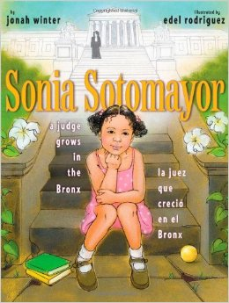
Which Type of Text?
Authentic
Phyllis Hunter Library
Latin American -Puerto Rico
Living in the Bronx, public housing
Mom worked day and night
Played Loteria with family
Authentic, cultural experiences of a particular cultural group
Notes:
2 mins
3rd grade
For example

Slide 49
Which Type of Text?
Phyllis Hunter Library
Four inner-city youth
African-American
Based on a true story
Foster youth experiences
Single parent home
Struggles of students living in the inner-city
Celebrates the success of the group working together despite the opposition
Authentic

Slide 50
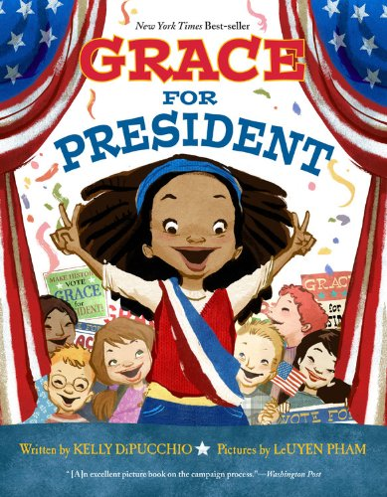
Which Type of Text?
Generic
Phyllis Hunter Library
Girl
African-American
Contains few details that define the character’s culture
The text can be about anyone, regardless of culture
Notes:
2 mins
3rd grade

Slide 51
Identifying Culturally Responsive Literacy
Form groups of 2-4.
Examine your texts.
Together determine if the book is culturally authentic, generic, or neutral. Prove with evidence.
Notes:
7 mins

Slide 52
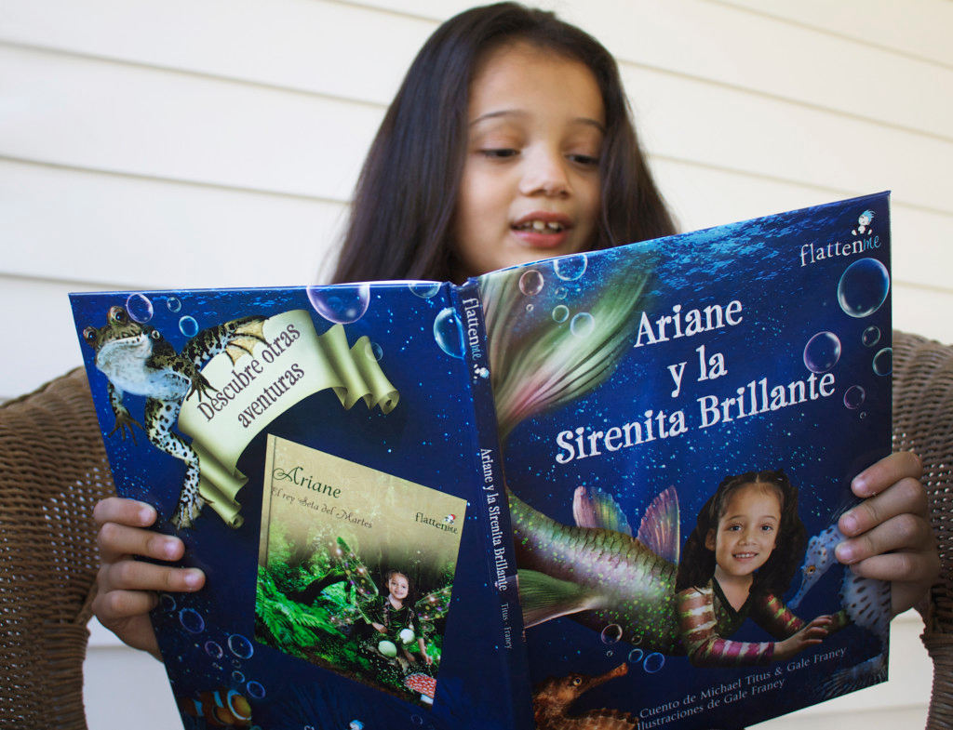
Why Culturally Responsive Text?
All children (people) need to see themselves reflected as part of humanity and have their cultural identity validated and affirmed.

Slide 53
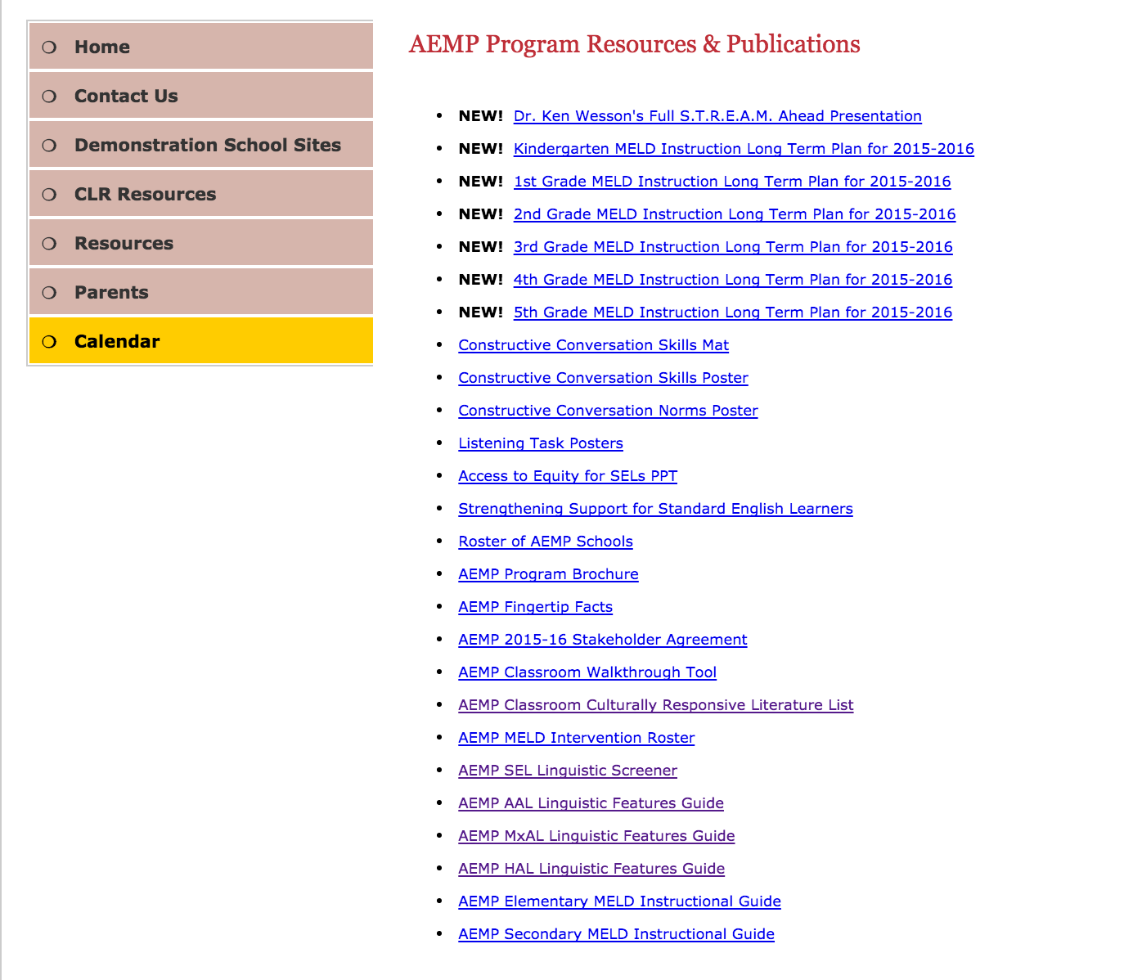
AEMP Classroom CLR Literature List
Notes:
Resource lists can be found on the AEMP website

Slide 54
AEMP Classroom CLR Literature List
Notes:
Special features are also identified

Slide 55
Taking it Back!
Think-Ink
How will you apply your new learning to your instruction this week?
Pair-Share
Share your thoughts with your elbow partner.
Notes:
3 min

Slide 56
Learning Objectives
Understand who are Standard English Learners (SELs)
Explore what makes literacy responsive to Standard English Learners (SELs) using Close Reading
Notes:
1 min

