Slide 1
Building Family Capacity to Support Literacy at Home
Erin Koning
Director of Literacy
National Literacy Initiatives
Scholastic Education
ekoning@scholastic.com

Slide 2
Notes:
https://www.youtube.com/watch?v=urU-a_FsS5Y

Slide 3
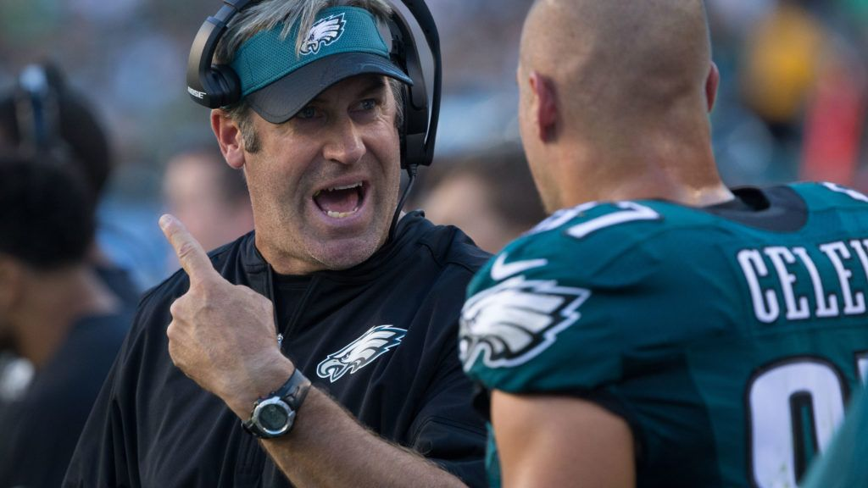
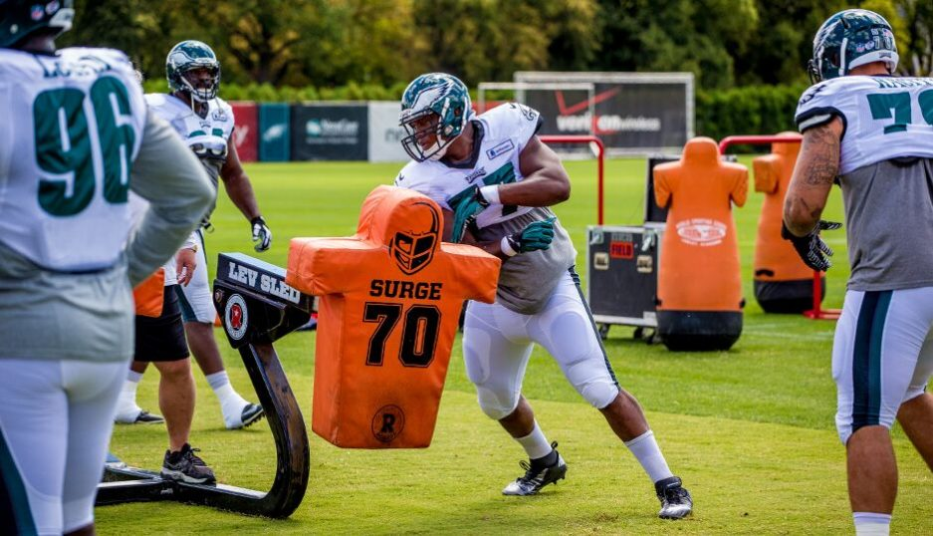
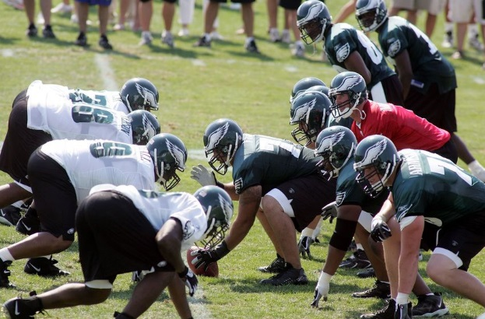
Build Adult Capacity

Slide 4
Families learn a new tip, tool or strategy
Families have a chance to practice the new tip, tool or strategy
Families have an opportunity to share with educators what works best when engaging their child at home or their ideas/strategies.

Slide 5
Imagine that…
You are all family members attending a family literacy event at your child’s school.
I am your child’s teacher.
I am leading an activity in which my goal is to build your capacity for reading aloud.

Slide 6
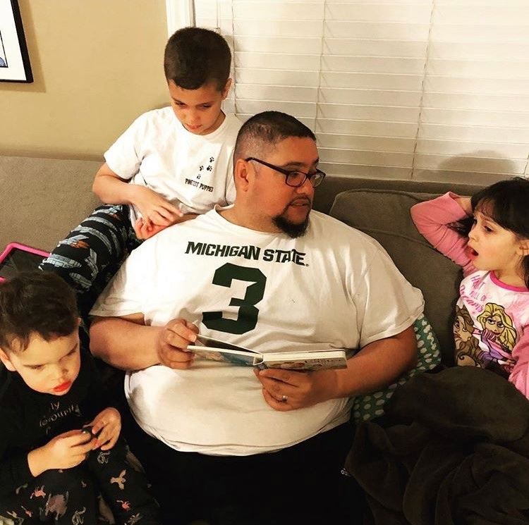
Family Literacy Night!

Slide 8
See
Hear

Slide 9
Partner up
One person be the family member, one person be the kid
“Family member”, read aloud to your “kid”, practicing the behaviors we charted.
What did the “family member” do well?
SWITCH!

Slide 10
Reflect
Did you…
Learn a new strategy?
Practice it?
Feel your particular knowledge as a family member was valued?

Slide 11
Literacy Event Kits
Teacher Guide
3 fun titles, 30 copies each
Family activity & tip sheet
Certificate of completion

Slide 12
TAKE ACTION

Slide 13
Erin Koning 310-433-8805 ekoning@scholastic.com
Twitter: @Erin_Koning
Andrea Anthony 562-480-2945 aanthony@scholastic.com

