Slide 1
IRP: New MiSiS
Documentation Process
Notes:
Time: 30 seconds
Say: The MMED department suggest that schools keep record of all meetings with parents and students. Schools may enter only one notification of establishment of IRP per school year however, you should revisit and document the IRP whenever you meet with parents and students. (Updated policy will be out in summer. Job aide will be available before school year begins.)

Slide 2
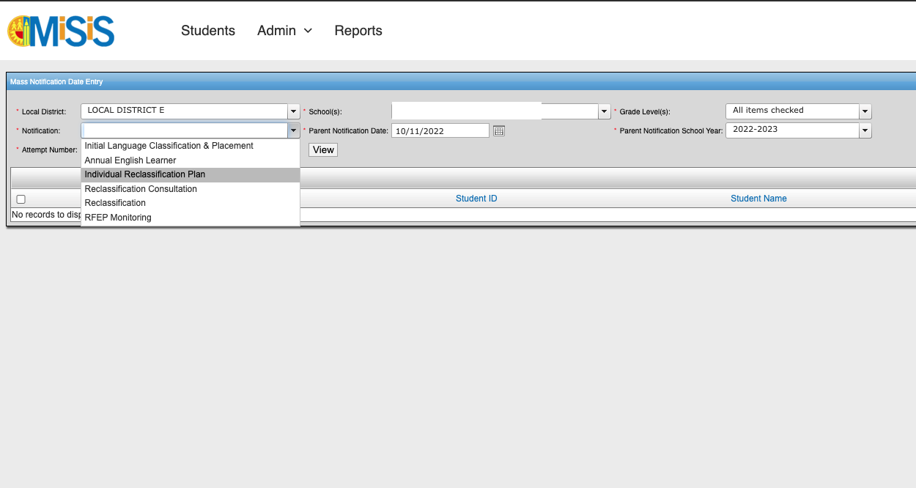
Documenting the IRP in MiSiS:
Mass Notification
2
Enter all fields and select “Individual Reclassification Plan” from the Notification drop down.
1
Notes:
Tech: Make sure to pay attention where it says CLICK FOR ANIMATION as this is an animated slide
Time: 1 minute
Say: There is a new enhancement where schools will be able to do Mass Entry under the English Learner screen. There are two ways to enter documentation. Mass entry and Individual entry. Mass entry is helpful when you meet with a whole class or a group of students. When you review the reclassification requirements, analyze data with students so that they understand where they are and can make commitments we go into MiSiS and note the date we established the IRP. The individual update is just that, going one by one for students you establish an IRP for. Let’s look at mass entry first.
So let’s take a look at the platform. From MiSiS landing platform make sure you are under a Coordinator or Scheduling Admin role. Go to English Learner TAB,
(Click for animation) select EL Typology,
(Click for animation) Click Search
(Click for animation). Select the all or click the students you meet with to create a group.
Click on Action (Click for animation) and from the drop down select Manage Counseling Communication.

Slide 3
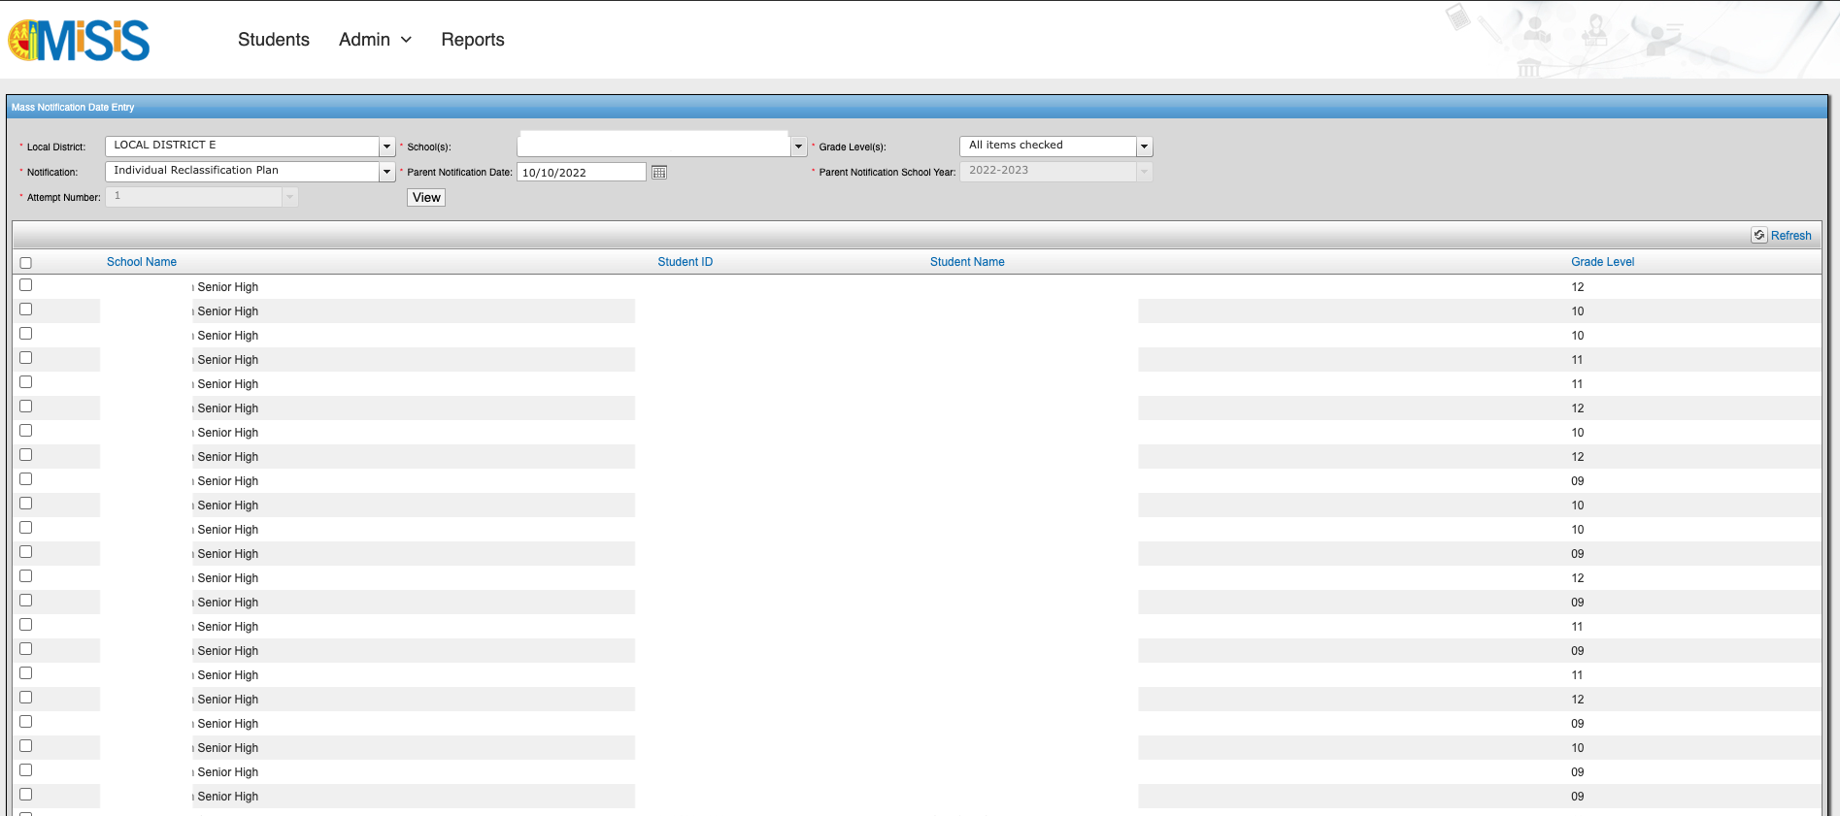
Documenting the IRP in MiSiS:
3
Select desired students
Notes:
Tech: Make sure to pay attention where it says CLICK FOR ANIMATION as this is an animated slide
Time: 1 minute
Say: There is a new enhancement where schools will be able to do Mass Entry under the English Learner screen. There are two ways to enter documentation. Mass entry and Individual entry. Mass entry is helpful when you meet with a whole class or a group of students. When you review the reclassification requirements, analyze data with students so that they understand where they are and can make commitments we go into MiSiS and note the date we established the IRP. The individual update is just that, going one by one for students you establish an IRP for. Let’s look at mass entry first.
So let’s take a look at the platform. From MiSiS landing platform make sure you are under a Coordinator or Scheduling Admin role. Go to English Learner TAB,
(Click for animation) select EL Typology,
(Click for animation) Click Search
(Click for animation). Select the all or click the students you meet with to create a group.
Click on Action (Click for animation) and from the drop down select Manage Counseling Communication.

Slide 4
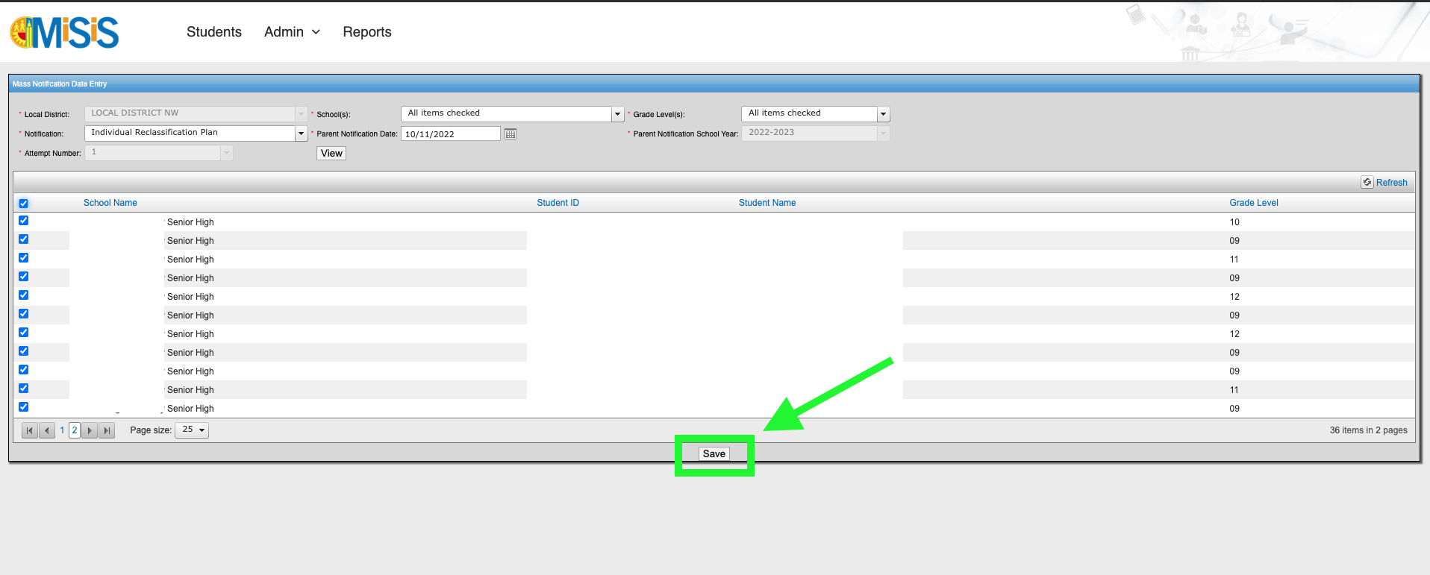
Documenting the IRP in MiSiS:
Remember to click “SAVE”
Notes:
Time: 30 seconds
Say: What if I happen to meet with one student? We can do an individual update. This is a new process from last year. Now, IRP parent notifications will be inputted in MiSiS under EL Services, the same as you would input your annual notifications and the reclassification consultations.
And similarly, the student’s name will disappear once you have saved a notification date for them.

Slide 5
Notes:
Evaluation/Sign Out Link: https://survey.alchemer.com/s3/7064624/2022-23-MMED-AEA-Professional-Learning-Evaluation-MMED-EL-Designee-Meetings

