Slide 1
CCSS
Implications for English Learners

Slide 2
Common Core State Standards
ELA Shifts

Slide 3
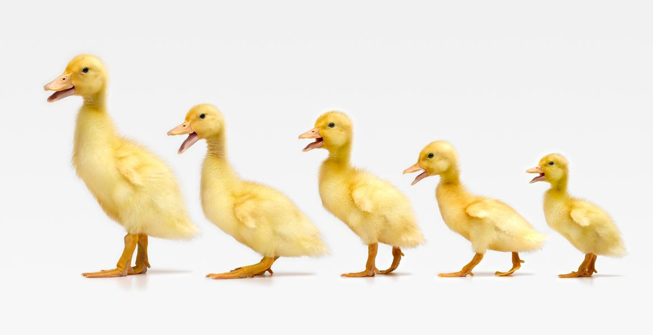
Texts
COMPLEXITY

Slide 4
CCSS Shift 3—Text Complexity
Preparing students for the complexity of college and career ready texts
Grade appropriate text
Allowing more time and space for close and careful reading
Scaffolding and supports for students reading below grade level

Slide 5
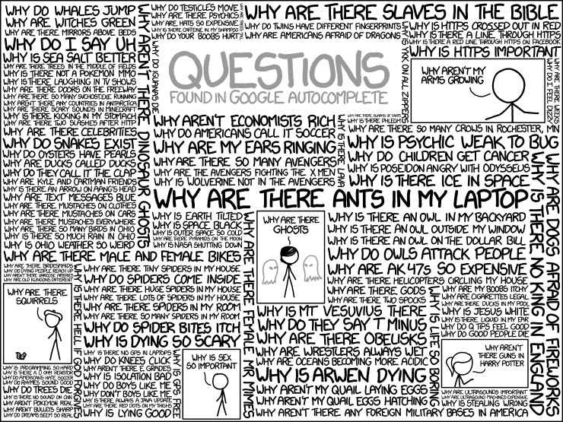
QUESTIONS

Slide 6
CCSS Shift 4—Text-based Answers
Text-based conversations
Classroom connections to text
Students develop evidentiary arguments

Slide 7
OPPORTUNITIES

Slide 8
CREATING OPPORTUNITIES
Shift 1—Balancing Informational and Literary Texts
Increase opportunities for students to read informational texts
Shift 2—Knowledge of the Disciplines
Create opportunities to emphasize literacy in all content areas
Shift 5—Writing from Sources
Involve students in opportunities to respond to ideas, events, facts, and arguments presented in texts
Shift 6—Academic Vocabulary
Provide opportunities for students to develop academic vocabulary with an emphasis on commonly found academic words

Slide 9
Texts
COMPLEXITY

Slide 10
Text Complexity
Implications for ELs and Teachers of ELs

Slide 11
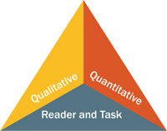
Standard 10: Range, Quality, and Complexity
For further information access the following webpage by clicking on the following link: http://www.corestandards.org/ELA-Literacy/standard-10-range-quality-complexity/measuring-text-complexity-three-factors/
Measuring Text Complexity: Three Factors

Slide 12
What will the more demanding complex texts implied by the Common Core State Standards (CCSS) mean for those students who are already having trouble with existing standards?
Take a moment to reflect on the possible implications for English learners and teachers of English learners.
What Does Text Complexity Mean for English Learners and Language Minority Students?
Lily Wong Fillmore, University of California, Berkeley
Charles J. Fillmore, University of California, Berkeley
© Stanford University

Slide 13
Reader and Task
English learners’ challenge is in the task itself
All English learners are expected to perform at grade-level regardless of their ELD levels (CELDT and/or LAUSD ELD course)
English learners are learning both language and content simultaneously
The language demand of the task is high
Language instruction is needed
Content instruction differentiated
Language instruction needs to be differentiated
Scaffold instruction and activities to have English learners reach the task
Do not bring instruction/task down to the student level (Can’t Model)

Slide 14
CCSS Tasks
Tasks
(Constant)
Scaffolds
Take a moment to analyze this visual text. Your task is to analyze it and orally explain your analysis to a partner. What is your interpretation?
Students
(Variable)

Slide 15
QUESTIONS

Slide 16
Questioning the Text
Implications for ELs and Teachers of ELs

Slide 17
The Right Questions, The Right Way
For further information access the following webpage by clicking on the following link: http://www.ascd.org/publications/educational-leadership/mar14/vol71/num06/The-Right-Questions,-The-Right-Way.aspx

Slide 18
What do the questions teachers ask in class really reveal about student learning?
Dylan William
March 2014 | Volume 71 | Number 6 Using Assessments Thoughtfully Pages 16-19

Slide 19
Please Read
A Good Place to Start
Questioning and discussion are key aspects of teachers' work in classrooms, and yet too often, classroom discussions involve only the most confident students, ignore what is happening in the heads of those not volunteering to participate, and rely on prompts and questions that have not been planned in advance. By picking students at random and by using all-student response systems at least once in every 20 to 30 minutes of group instruction, teachers can ensure that their decisions are based on the learning needs of the whole class. By planning their questions, teachers can ensure they are tapping into deep issues of learning, rather than skating across the surface.

Slide 20
Questioning and discussion are key aspects of teachers' work in classrooms, and yet too often, classroom discussions involve only the most confident students, ignore what is happening in the heads of those not volunteering to participate, and rely on prompts and questions that have not been planned in advance.
Think English Learners!
Look at the words in bold. As an English learner advocate, what would you want to emphasize, add, or change about this quote. Why?

Slide 21
Please Read
A Good Place to Start
These three ideas—no hands up, all-student response systems, and planning questions—are not the only, or even the most, important aspects of teaching. Trying to manage the learning that is happening in 30 different minds at the same time will always be extraordinarily challenging. But by increasing the engagement of students, and thus improving the feedback from the teacher, we can make a real difference. One teacher described the process as making the students' voices louder and making the teacher's hearing better. Sounds like a good place to start.

Slide 22
A significant shift, not just for education For most teachers and students, using the approach is a significant shift in practice. The teacher’s role is simply to facilitate that process. Now the students are asking all the questions.
Steve Denning
Learning To Ask The Right Question
Leadership, 2011
Forbes.com
http://www.forbes.com/sites/stevedenning/2011/09/11/learning-to-ask-the-right-question-2/

Slide 23
Can our ELs perform the language function of asking questions?
How rigorous is performing this language function?
Can our English learners question the text? Why or why not?
How difficult is it to ask relevant questions?
Do they have enough language awareness, knowledge, or skills to ask the right questions?
If not, what are the implications for teachers of English learners?

Slide 24
OPPORTUNITIES

Slide 25
Opportunities
Implications for ELs and Teachers of ELs

Slide 26
In particular these shifts increase the fraction of time students spend interacting and talking with one another around content. The challenge is then to ensure that ELLs become full participants in this discourse.
Understanding Language, Challenges and Opportunities for Language Learning in the Context of Common Core State Standards and Next Generation Science Standards
Conference Overview Paper, Stanford University, April 2012
http://ell.stanford.edu/sites/default/files/Conference%20Summary_0.pdf

Slide 27
Understanding Language
Take out your Understanding Language handout
Scan the document (2 minutes)
Turn to page 4 and page 5 and look for the headings
Read the subtitles and create a question from the subtitle. Write your question and focus on that question while you read pages 4-5
Read and Highlight pages 4-5
Use the graphic organizer for next steps

Slide 28
Understanding Language
Locate the graphic organizer provided
Turn the heading into a question and write your question in the first box
Write your answer (in your own words) in the first column
Turn and Talk—AB Protocol
Listen actively to your partner and paraphrase what he/she said
Write his/her answer in the second column
Rewrite your answer using new learnings from your partner(s)
Make text connections—How is this knowledge applicable to your current position?

Slide 29
Technology can equip students to independently organize their learning process. So, instead of being passive recipients of information, students using technology become active users.
Integrating Technology with Student-Centered Learning
A Report To The Nellie Mae Education Foundation, Prepared by Babette Moeller & Tim Reitzes, July 2011
http://www.nmefoundation.org/getmedia/befa9751-d8ad-47e9-949d-bd649f7c0044/integrating

Slide 30
Can technology help to address the needs of English Learners?
Have you had experiences where technology in the classroom helped teachers accelerate the language production of ELs? How?
What are some possible implications for teachers of English Learners attempting to use technology in the classroom?
When using technology, do we prepare students to be college and career ready and ready for the 21st Century?

Slide 31
CCSS Grade-Level Progression
Your facilitator will give you a packet containing a CCSS anchor standard and grade level standards (strips of paper).
Your task is to manipulate the grade-level standards from Kinder to Grade 12
Justify your answer and use text to explain your rationale for placing one grade-level standard above or below another grade-level standard

Slide 32
Resource: Grade Level Progression Document
You may get a copy of the document used for the grade level progression exercise by clicking on the following link:
http://browardsecondaryliteracycoaches.pds-hrd.wikispaces.net/file/view/CCSS-ELA%20Spiral%20Progression.pdf/398867348/CCSS-ELA%20Spiral%20Progression.pdf

Slide 33
Evaluation
Please fill out the evaluation form
Thank you for attending today

