Slide 1
Culturally Responsive Literacy
Los Angeles Unified School District

Slide 2
Learning Objectives
Experience what makes the use of culturally responsive literature engaging for Standard English Learners (SELs)
Understand how to select Culturally Responsive Literature
Notes:
1 min
Give participants a moment to read the objectives and let them know that the PD will provide for them an experience that

Slide 3
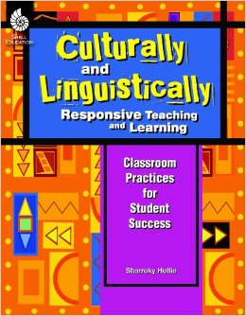
Culturally and Linguistically Responsive Pedagogy (CLR)
Sharroky Hollie
Pg 23
is the validation and affirmation of the home (indigenous) culture and home language for the purposes of building and bridging the student to success in the culture of academia and mainstream society.
VABB
Notes:
When our students fail to respond to instruction positively, Culturally and Linguistically Responsive Pedagogy can improve student responses.
[Click]
Ask for volunteer(s) to read the definition.
Ask participants: Which words and phrases stand out to you and why?
Highlight that a huge part of CLR is the validation and affirmation in or to build and bridge- hence the acronym VABB

Slide 4
Five CLR Pedagogical Areas When looking at instruction from the what and the how perspective there are five general areas that we have identified where CLR can have immediate impact by increasing student motivation and engagement.
CLR
Expanding Academic Vocabulary (Responsive Vocabulary)
Increasing Student Engagement and Decreasing Classroom Management Challenges (Responsive Management)
Using all types of Texts Culturally and Linguistically (Responsive Literacy)
Infusing Situational Appropriateness with Language and Behavior
(Responsive Language)
Creating an Inviting Learning Environment for Student Success (Responsive Environment)
Notes:
1 minute
Today we are focusing on Responsive Literacy
Purpose: Brief overview of CLR- Culturally and Linguistically Responsive Pedagogy
In order to provide more opportunities for students to be more engaged and motivated, we employ various types of Culturally & Linguistically Responsive Pedagogies. Today will focus on Responsive Literacy. [click] Specifically Culturally Responsive Literature.

Slide 5
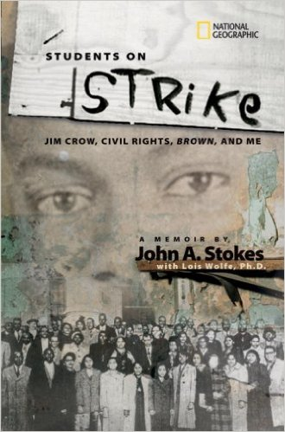
Secondary Text Set Examples
Notes:
3 mins
Say- What would students say if you told them that they will be studying two chapter books, identifying the them, comparing various sources about the same topic, and writing an argument piece as a culminating activity?
Possible Answers:
students may moan
Students may complain about the amount of work
Students may ask ‘How many pages do we have to read?’
[click]
Say- Even if the books are considered culturally responsive, like the texts on the screen, students may still initially have a less favorable response. It’s all about HOW you engage them in the text and the purpose for studying the texts.
But, before we engage them in these texts, how about engaging students in an opening that gives them an idea of what they may be asked to do with a more complex text and spark their curiosity/interest.
[click]
Information on the two books on the screen
Amazon book summaries
3 week Unit of study-
Culminating task will assess how students are able to:
RL 7.7- Compare and contrast a written story, drama, or poem to its audio, filmed, staged, or multimedia version, analyzing the effects of techniques unique to each medium (e.g., lighting, sound, color, or camera focus and angles in a film).
RL 7.3- Analyze how particular elements of a story or drama interact (e.g., how setting shapes the characters or plot).
The Revolution of Evelyn Serrano
There are two secrets Evelyn Serrano is keeping from her Mami and Papo? Her true feelings about growing up in her Spanish Harlem neighborhood, and her attitude about Abuela, her sassy grandmother who’s come from Puerto Rico to live with them. Then, like an urgent ticking clock, events erupt that change everthing. The Young Lords, a Puerto Rican activist group, dump garbage in the street and set it on fire, igniting a powerful protest. When Abuela steps in to take charge, Evelyn is thrust into the action. Tempers flare, loyalties are tested. Through it all, Evelyn learns important things about her Latino heritage and the history makers who shaped a nation. Infused with actual news accounts from the time period, Sonia Manzano has crafted a gripping work of fiction based on her own life growing up during a fiery, unforgettable time in America, when young Latinos took control of their destinies.
Students on Strike by John A. Stokes
This is a first-person narrative from a period of radical change in American history. Stokes recounts the plannin fo the student walkout, the secret meetings, the plot to send the principal on a wild good chase after “truant” students, and the strategy to boycott classes until conditions improved. The author recalls the challenges in persuading teachers and parents to support the strike, and the intimidation that came in the form of threats and a cross-burning on school grounds. Archival illustrations from Stokes’ scrapbook add to the emotional impact of his story. The narrative follows the course of the lawsuits filed by the NAACP, which would become part of the historic Brown v Board of Education ruling of the U.S. Supreme Court and the subsequent end to segregation in America.

Slide 6
‘Bundled’ Standards
RL & RI.7.1- Cite several pieces of textual evidence to support analysis of what the text says explicitly as well as inferences drawn from the text.
RL.7.3- Analyze how particular elements of a story or drama interact (e.g., how setting shapes the characters or plot).
RL.7.9- Compare and contrast a fictional portrayal of a time, place, or character and a historical account of the same period as a means of understanding how authors of fiction use or alter history.
RI.7.9- Analyze how two or more authors writing about the same topic shape their presentations of key information by emphasizing different evidence or advancing different interpretations of facts.
W.7.1 Write arguments to support claims with clear reasons and relevant evidence.
Notes:
2 mins
Say- Before we experience the opening, let’s review the bundle of standards that the opening will preview and that the unit of study with the other two books would allow us to cover.
Read and provide any clarification of the standards on the slide.

Slide 7
Preparing for the READ ALOUD
Fold your paper into 4 sections.
Use two sections to record two questions you may have.
Use the other two sections to write your favorite parts or special thoughts about the text.
QUESTION
QUESTION
FAVORITE PART OR THOUGHT
FAVORITE PART OR THOUGHT
Notes:
2 mins
Materials: paper
Let the participants know that they are going to experience a Read Aloud. In order to prepare to interact with the story, they will need to fold their paper in four and follow the instructions on the screen.

Slide 8
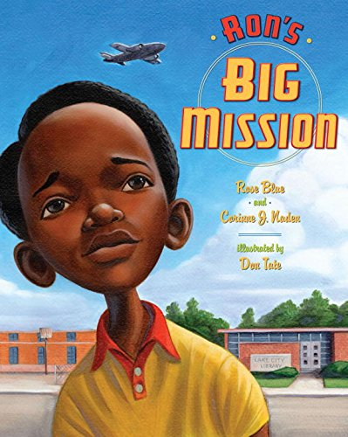
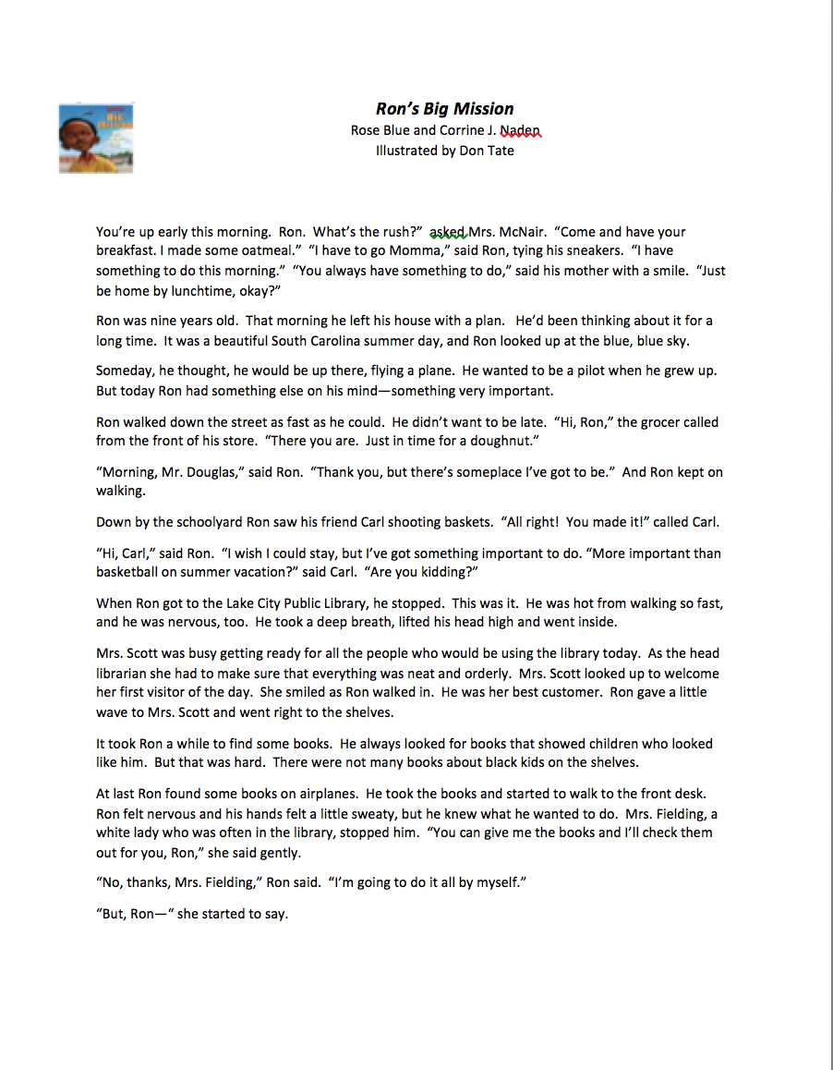
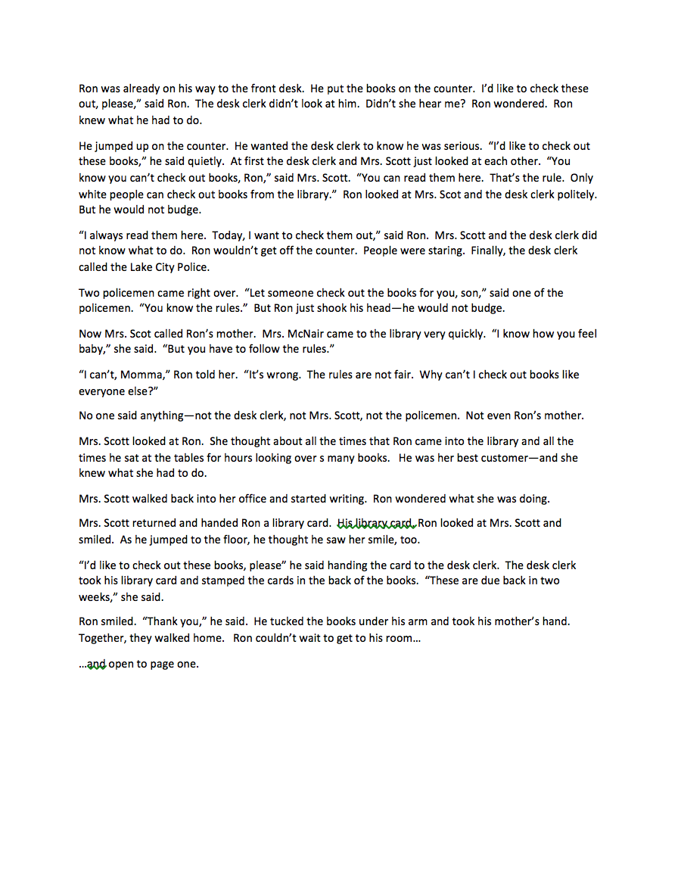
Jiggy Opening Read Aloud
Notes:
12 minute read aloud
Handout- typed copy of the selection (you can purchase the book on Amazon or Barnes and Noble)
Read Ron’s Big Mission while teachers listen. Those that can take notes on their four-fold paper should do so.

Slide 9
Moment of Silence
QUESTION
QUESTION
Record your favorite parts
Write down at least two questions you have
FAVORITE PART OR THOUGHT
FAVORITE PART OR THOUGHT
Notes:
2 min.
Purpose: Give teachers a moment to finish writing their annotations
Introduce the protocol (Moment of Silence) and model example if needed.
Ask participants to follow the instructions on the screen

Slide 10
Silent Appointment Give one Get One
QUESTION
QUESTION
Share a favorite part
Work together to try to answer a question
FAVORITE PART OR THOUGHT
FAVORITE PART OR THOUGHT
Notes:
6 mins.
Purpose: To debrief their notes from the read aloud.
Introduce the protocol (Silent Appointment & Give One Get One)- and model example if needed.
Ask participants to follow the instructions on the screen

Slide 11
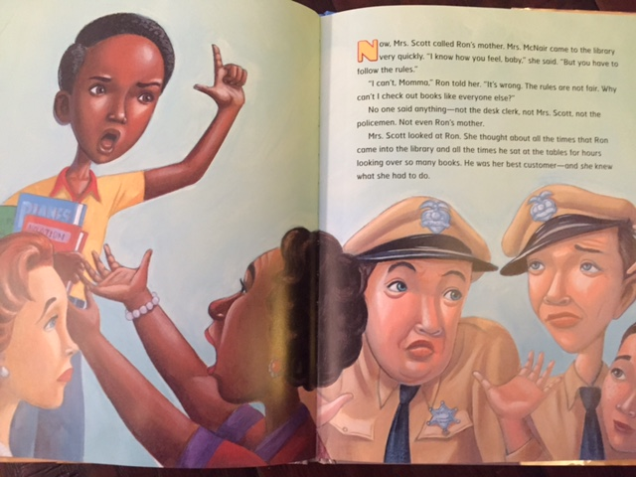
Text-to-Self Connection
Share with your partner
Which character do you identify with most? Why?
Character choices
Ron
Ron’s Mom
Librarian
Police
Child watching
Notes:
3 mins
Purpose: The purpose of this slide is have participants personally identify with the characters and the climax of the story. The personal connection inspires the engagement out Standard English Learners need in Literacy instruction.
Still with their silent appointment, have the participants answer the question on the slide.
Debrief:
Ask who identified with ________ and why? Or Who did you identify with and why?

Slide 12
Close Reading - Accelerated
Notes:
1 min
Remind teachers that we are doing a very modified/adult speed version an opening that involves some close reading. The next few slides will be examples of some text dependent questions and culturally relevant engagement strategies that will target our bundled standards.

Slide 13
Close Viewing - Accelerated
Text
Dependent
Questions

Slide 14
Text Dependent Questions
Number the Paragraphs
What was Ron’s Big Mission? Support your answer with explicit text evidence and any inferences you can draw from the text (RL.7.1.)
Notes:
2 mins
Have participants number the paragraphs- (spaced sections). There should be 26
Then have participants read the question, think on their own, then Raise a Righteous Hand to answer the first question.

Slide 15
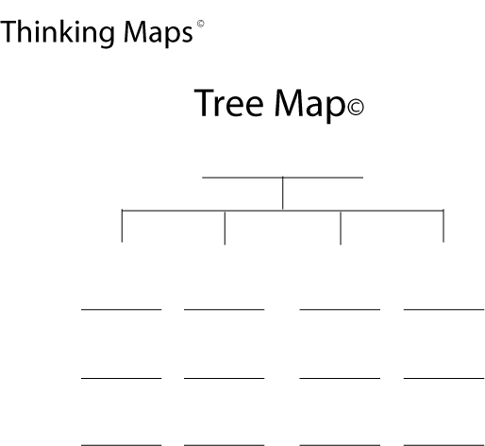
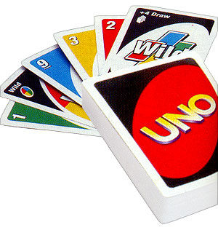
Text Dependent Questions
Find 3 other partners with the same number.
Discuss the settings of the major events. Record your information on the appropriate Thinking Map. Remember to discuss all levels of setting.
Where the story takes place:
In time
In the world
In the community/home
Uno Partners
Notes:
2 mins
Materials: uno cardsm model of the Tree Map with three categories- in time– in the world– in the community/home
Purpose: To have the participants engage in the TDQs, using the various engagement strategies.
Follow the directions on the slide

Slide 16
Text Dependent Questions
Find 3 other partners with the same color.
How does the setting shape who Ron is and what he was so determined to do (RL 7.3)?
Uno Partners
Notes:
2 mins
Purpose: To have the participants engage in the TDQs using the various engagement strategies.

Slide 17
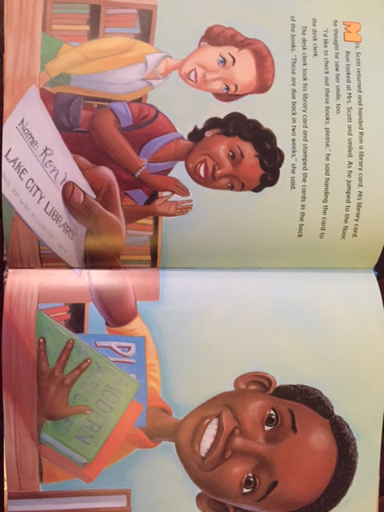
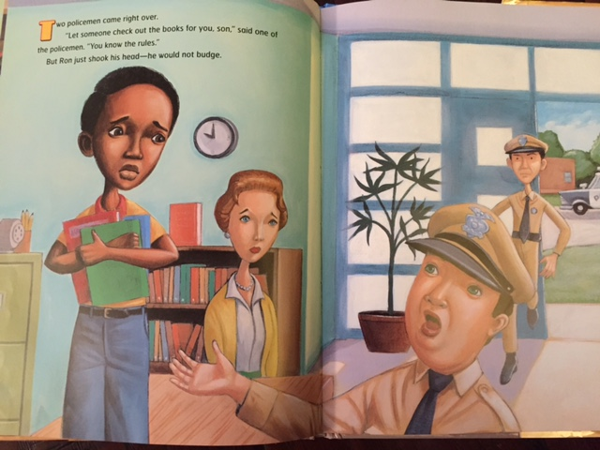
Text Dependent Questions Pair-Share
What is the theme or central idea of this text? How did it develop over the course of the major events? (RL 7.2)
Notes:
2min
Have participants pair share the question on the slide.

Slide 18
Ron McNair- Another Perspective Another Perspective
Insert video
Notes:
4 mins
Let the participants know that they are going to experience Ron McNair’s life from another source. Allow them to watch for the flow as a first read.

Slide 19
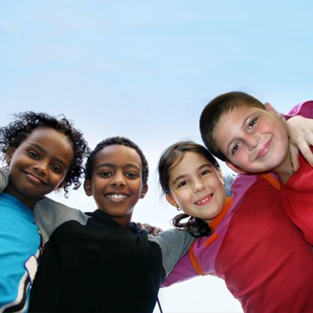
Ron McNair Another Perspective
Give a Shout out
Who’s telling the story in the video?
Pair Square
What was different about the book and the video? Provide evidence.
Notes:
3 mins
Say: Who’s telling the story in the video?
*We want the participants to keep in mind that the reliability of the source is important to the validity of the story.
[Click]
Say: Pair square and discuss what the differences are between the book and the video. Be prepared to share evidence from both texts.

Slide 20
Close Reading - Accelerated
Notes:
1 min
Remind teachers that we are doing a very modified/adult speed version an opening that involves some close reading- this read will focus on annotating a video.

Slide 21
Close Viewing & Preparing for Discussion
Watch the video again. Using two quadrants on your 4 fold, take notes to help you discuss the following questions.
What did you notice about the setting?
What do you think about that?
What did you notice about the setting?
What do you think about that?
What did you notice about the setting?
What do you think about that?
Notes:
2 mins
Materials: the back of the 4 fold paper
Follow the directions on the screen. The purpose of this viewing is to prepare the teachers (students) for a discussion about the video.

Slide 22
Ron McNair Another Perspective
Insert video
Notes:
4 mins

Slide 23
Close Viewing & Preparing for Discussion
Share with your ‘face partner’.
What did you notice about the setting?
What do you think about that?
What did you notice about the setting?
What do you think about that?
What did you notice about the setting?
What do you think about that?
Notes:
3 mins
Materials: the back of the 4 fold paper
Follow the directions on the screen. The purpose of this viewing is to prepare the teachers (students) for a discussion about the video.

Slide 24
Close Reading - Accelerated
Notes:
1 min
Remind teachers that we are doing a very modified/adult speed version an opening that involves some close reading.
Click for the man and arrow to move down to the Third Read.
Say- Now we will experience a couple examples of text dependent questions based on a video.

Slide 25
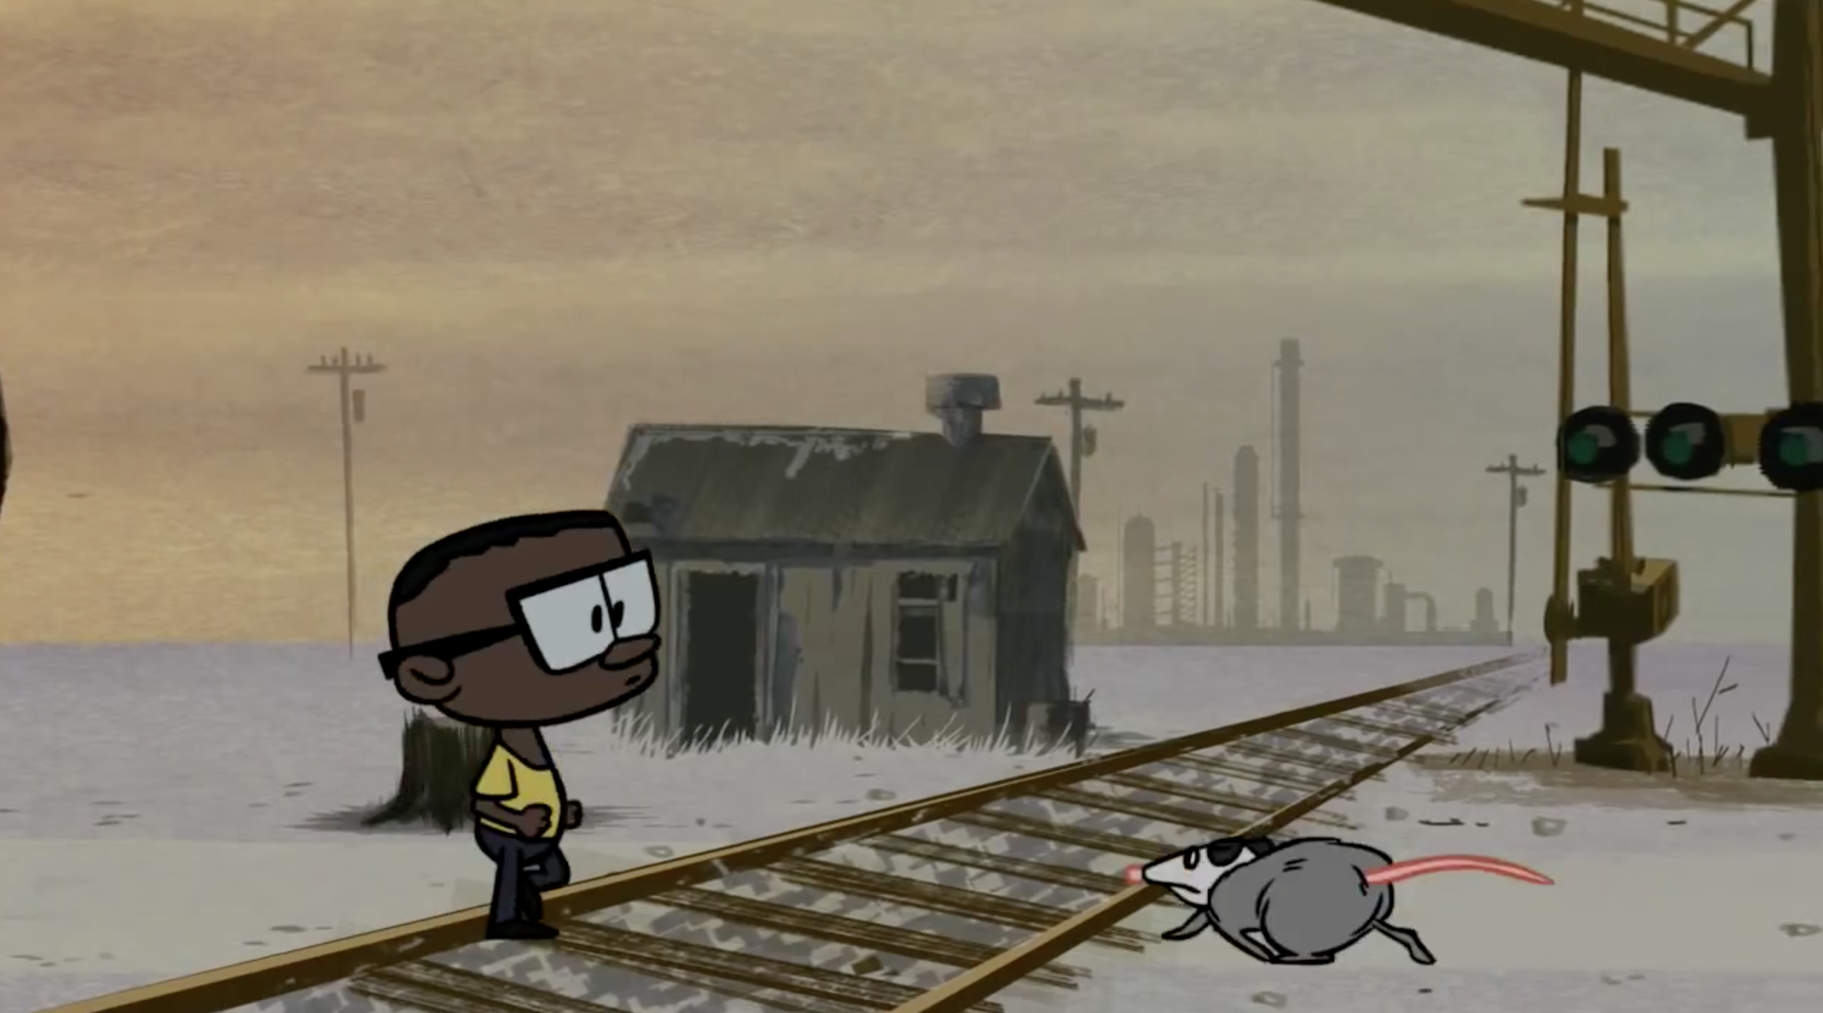
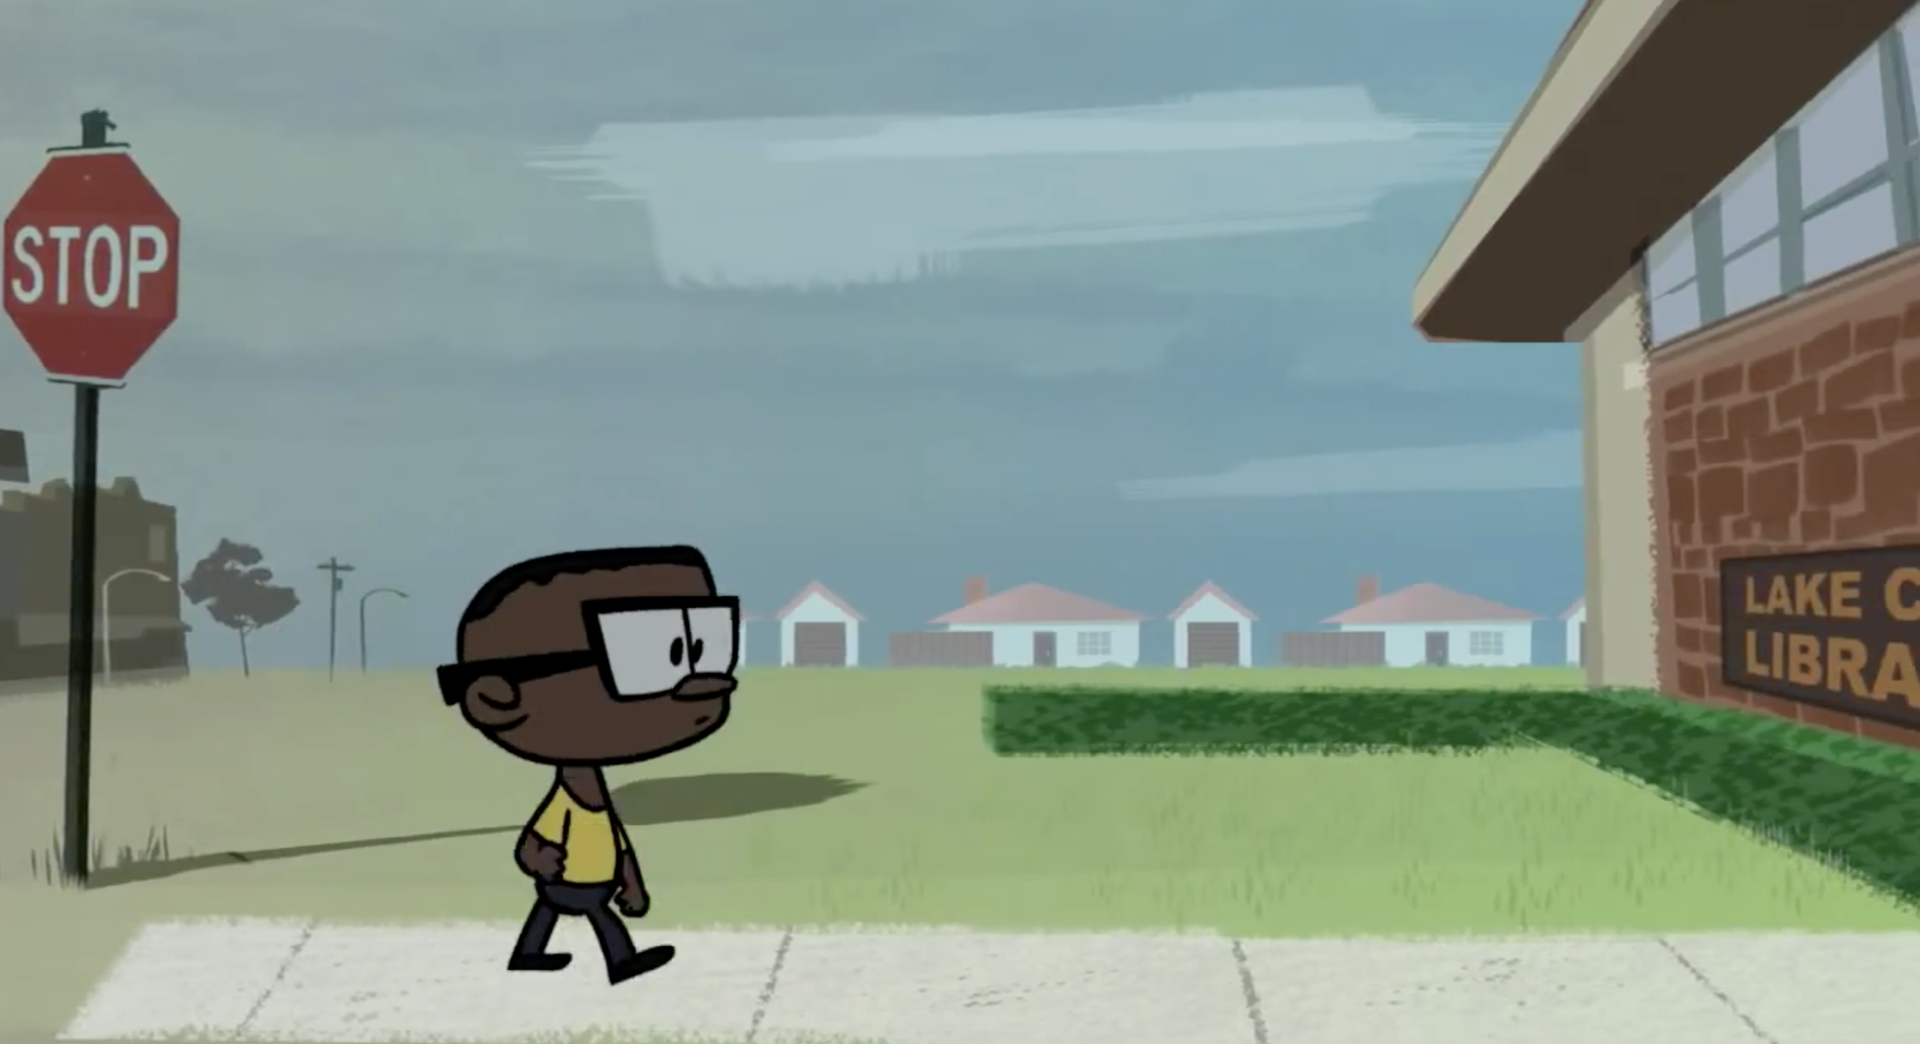
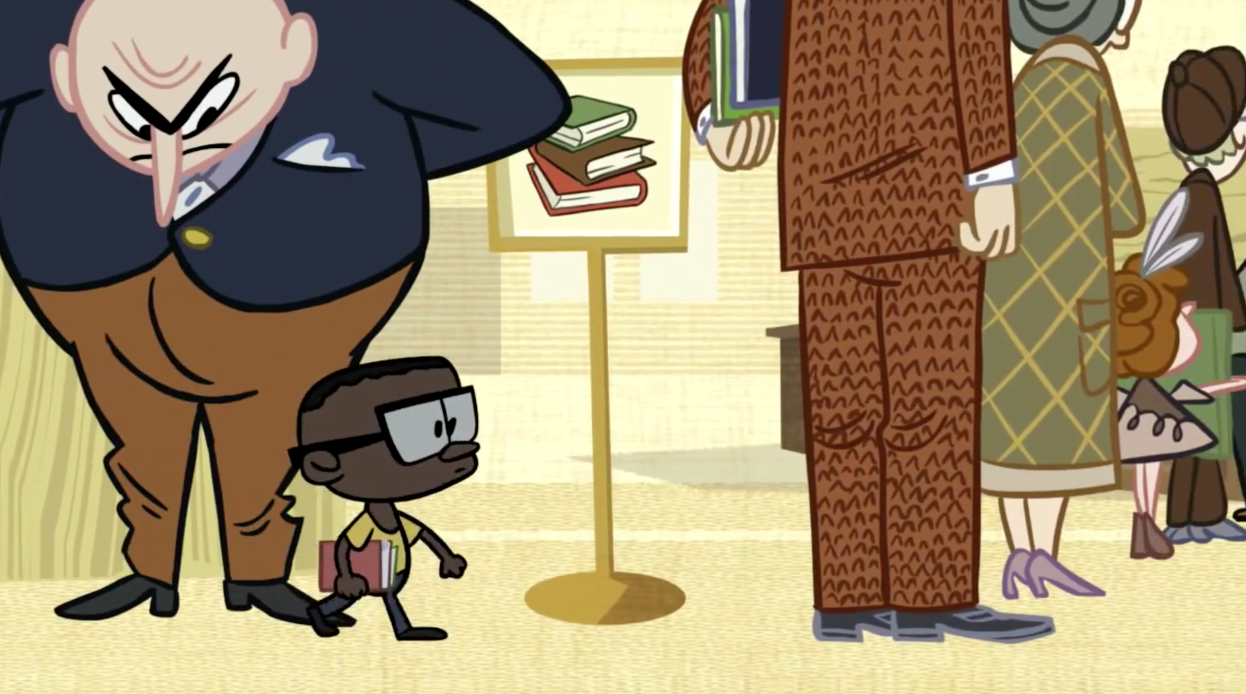
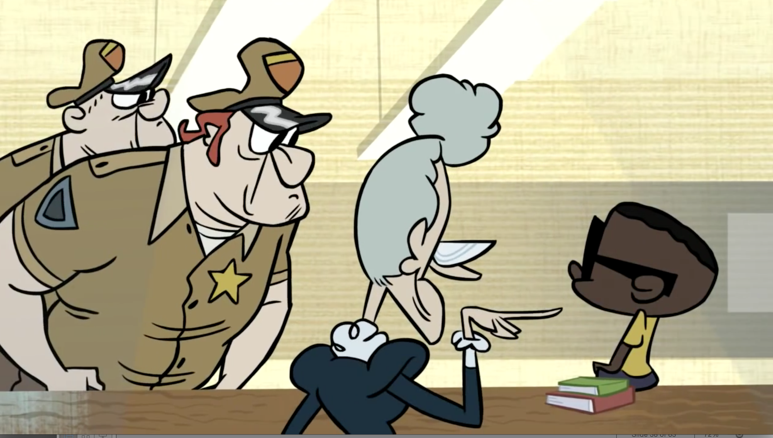
Text Dependent Questions
Discuss with your elbow partner.
How does the cartoonist use the setting and characters to illustrate the risks that Ron took (RL.7.3)? Support with evidence from the text.
Notes:
2 mins

Slide 26
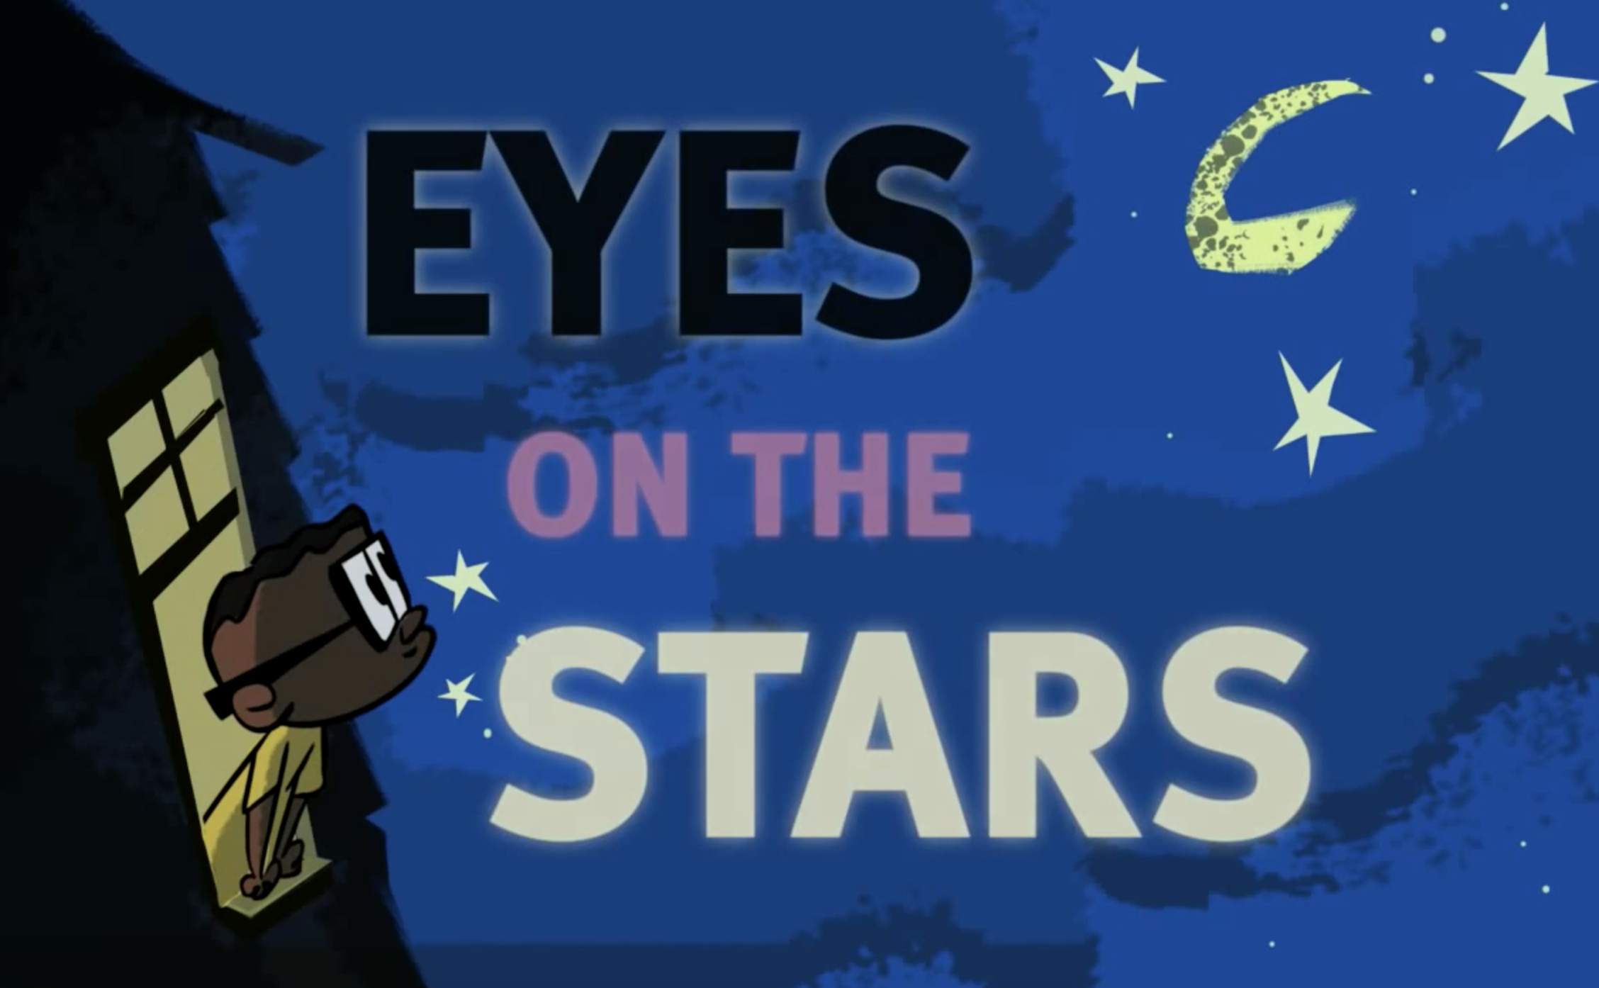
Ron McNair Another Perspective Text Dependent Questions
Pair Share
Whose account of Ron’s life seems most credible? Support your claims.
DO
Notes:
3 mins
Have teachers participate in this part

Slide 27
Close Reading - Accelerated
Notes:
1 min
Remind teachers that we are doing a very modified/adult speed version an opening that involves some close reading.
Click for man and arrow to move to Culminating Task

Slide 28
Culminating Task
QUICK WRITE
W 7.1
In your opinion, whose account of Ron McNair’s life is most reliable and why? How does the source impact the theme? Support your claims with evidence and address the counterarguments.
Notes:
3 mins
The purpose of this slide is to show an example of a culminating tasks that incorporates both sources. Doing this task after the many exposures to the text and conversations about the text should lend a student to more success.

Slide 29
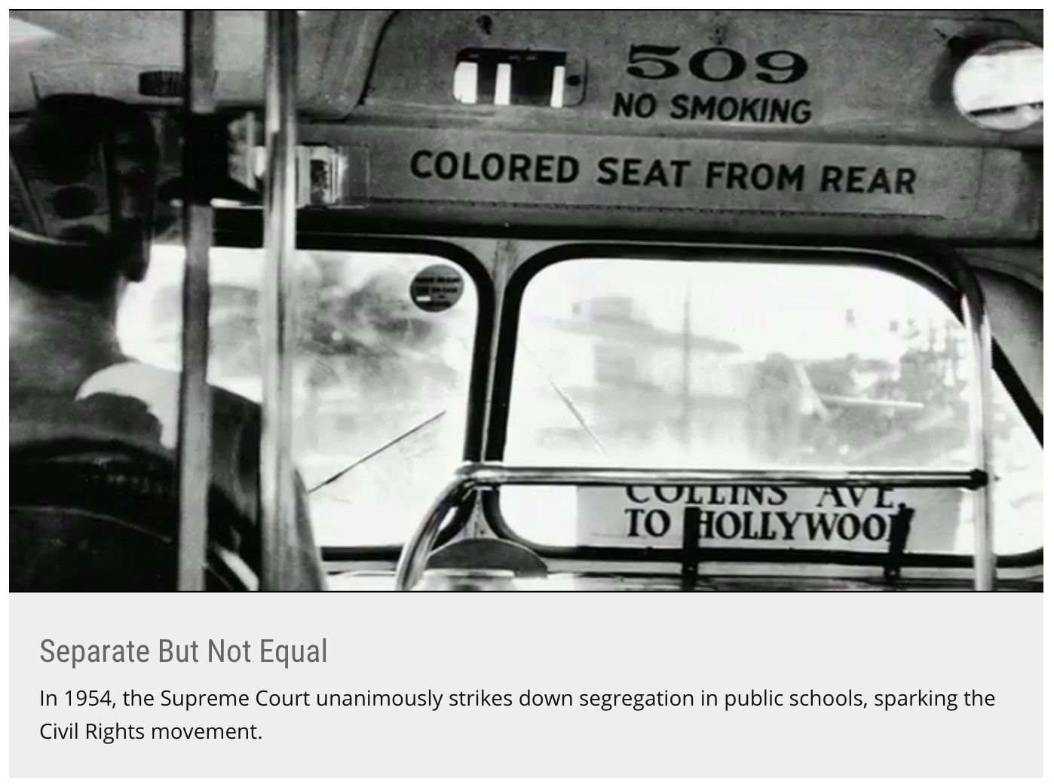
Secondary Text Set Examples
Text
Text
Video
Video
Notes:
What you see on the slide are two possible ‘multi-source’ sets that can be used as the unit of study.
Amazon book summaries
The Revolution of Evelyn Serrano
There are two secrets Evelyn Serrano is keeping from her Mami and Papo? Her true feelings about growing up in her Spanish Harlem neighborhood, and her attitude about Abuela, her sassy grandmother who’s come from Puerto Rico to live with them. Then, like an urgent ticking clock, events erupt that change everthing. The Young Lords, a Puerto Rican activist group, dump garbage in the street and set it on fire, igniting a powerful protest. When Abuela steps in to take charge, Evelyn is thrust into the action. Tempers flare, loyalties are tested. Through it all, Evelyn learns important through about her Latino heritage and the history makers who shaped a nation. Infused with actual news accounts from the time period, Sonia Manzano has crafted a gripping work of fiction based on her own life growing up during a fiery, unforgettable time in America, when young Latinos took control of their destinies.
Students on Strike by John A. Stokes
This is a first-person narrative from a period of radical change in American history. Stokes recounts the planning for the student walkout, the secret meetings, the plot to send the principal on a wild good chase after “truant” students, and the strategy to boycott classes until conditions improved. The author recalls the challenges in persuading teachers and parents to support the strike, and the intimidation that came in the form of threats and a cross-burning on school grounds. Archival illustrations from Stokes’ scrapbook add to the emotional impact of his story. The narrative follows the course of the lawsuits filed by the NAACP, which would become part of the historic Brown v Board of Education ruling of the U.S. Supreme Court and the subsequent end to segregation in America.
Video Links
Young Lords- http://pix11.com/2015/07/30/from-1969-the-young-lords-take-over-historic-east-harlem-church/
Brown-v-board- http://www.history.com/news/10-things-you-should-know-about-brown-v-board-of-education

Slide 30
Ron McNair Another Perspective
Which text was most compelling to you and why?
What did you enjoy about the experience with the two texts?
Notes:
3 mins
Pose the two questions:
Which text was most compelling to you and why?
What did you enjoy about the experience with the two texts?
Possible answers:
I could relate to Ron because I am from a minority background that has been discriminated against.
I can relate to Ron because I know what it was like to not be from the privileged class.
The video was most compelling because it was more realistic and/or most accurate considering the time
The video was most compelling because I am a visual learner who likes videos and movies
I enjoyed comparing the two texts
I enjoyed being able to talk to various partners
I liked examining the texts in groups and using different strategies to collect notes.
**Remind teachers that the various reasons for which they were engaged are very similar to why students will be engaged. Moreover, using texts, participation, and discussion protocols that are directly connected to the various rings of culture, makes instruction more responsive to the students. [click]

Slide 31
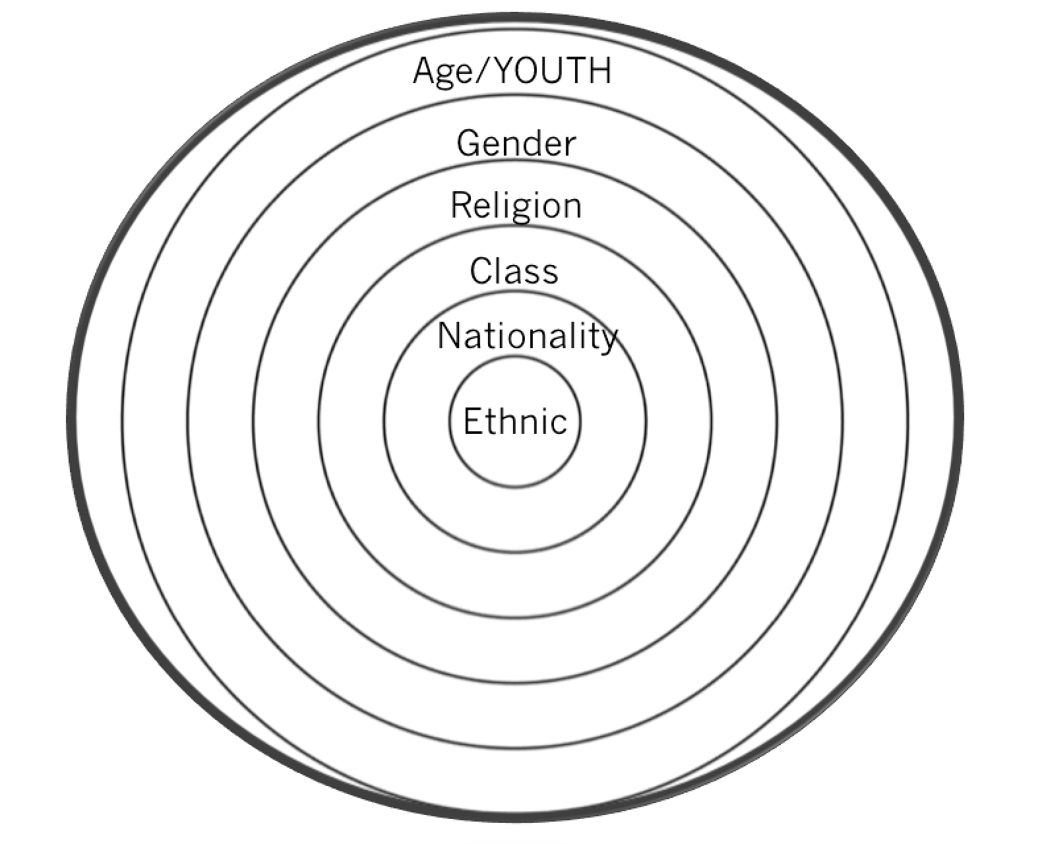
Rings of Culture
Notes:
2 mins
Which ring(s) of culture does Ron’s Big Mission address?
Possible answers:
Ethnic
Class
Age (in the 1950’s)
Gender (risk taken by a Black male in the 1950’s)

Slide 32
Common Core 7 ELA/Literacy Competencies
Demonstrate independence
Build strong content knowledge
Respond to the varying demands of audience, task, purpose, and discipline
Comprehend as well as critique
Value evidence
Use technology and digital media strategically and capably
Come to understand other perspectives and cultures
Notes:
2-3 minutes
Connect CLR to the competencies of a Literate individual
These habits of mind practices speak directly to the the benefits of teachers using CLR pedagogies while instructing Standard English Learners.
7 competencies- habits of mind
Specifically looking at
#3. Respond to the varying demands of audience, task, purpose, and audience which relates to Responsive Language--Infusing Situational Appropriateness with Language and Behavior.
#4. Most students will engage more and therefore comprehend more when they are able to connect and have opportunities to critique
#7. Come to understand other perspectives and cultures relates to Responsive Literacy- Using all types of texts culturally and linguistically.

Slide 33
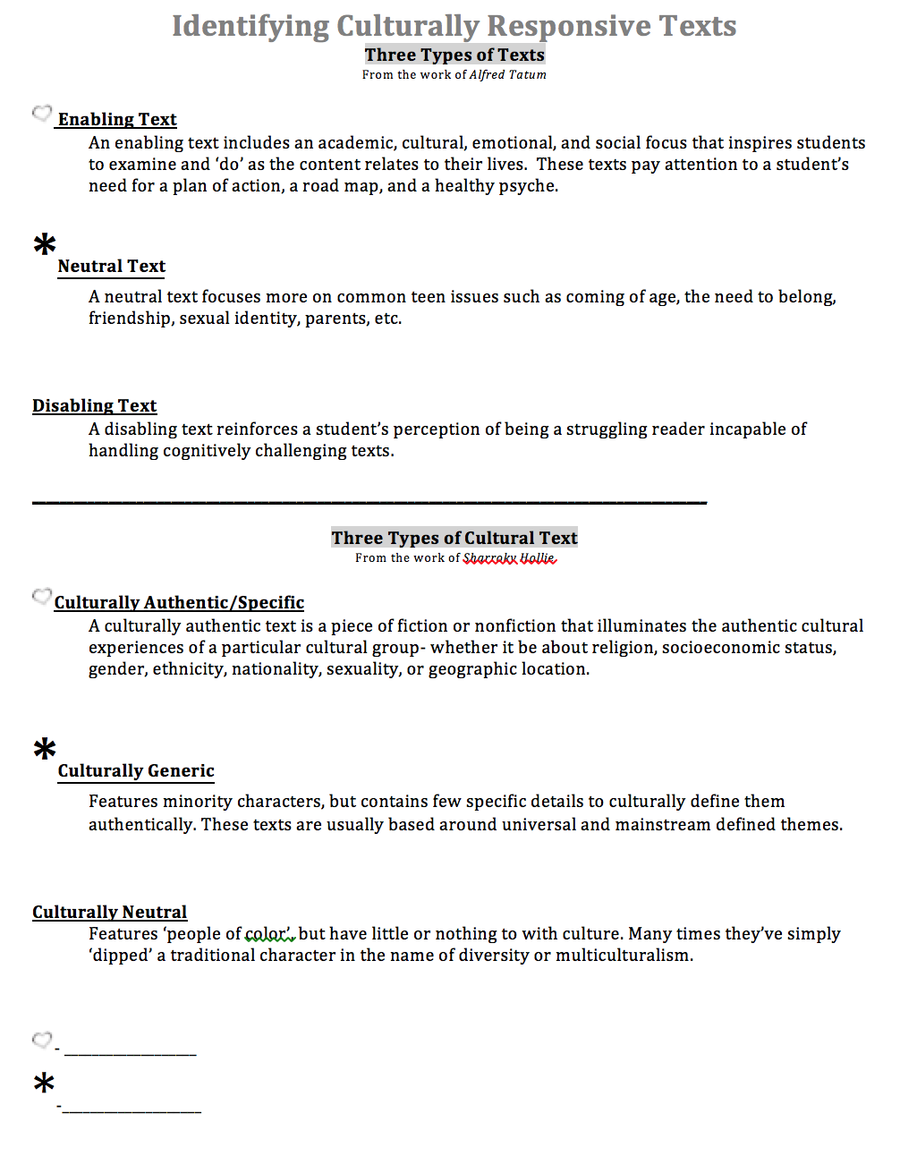
Culturally Responsive Text
Dr. Alfred Tatum classifies responsive texts in 3 ways.
Notes:
3 minutes
Tatum definition
Examples are following on the next slide.

Slide 34
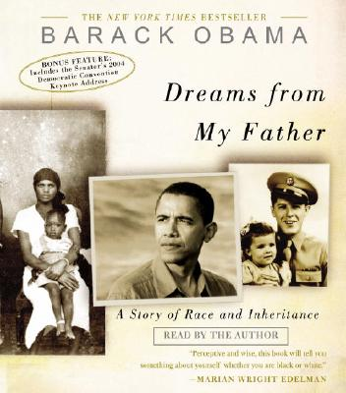
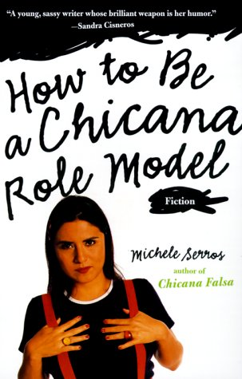
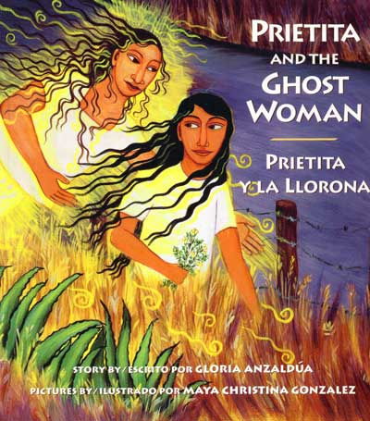
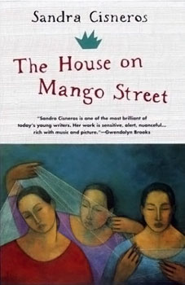
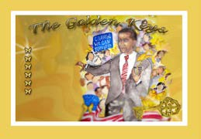
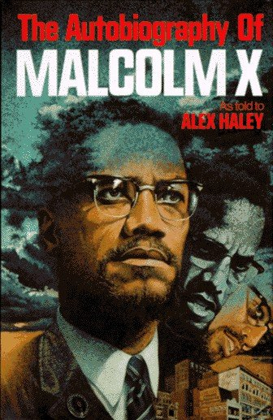
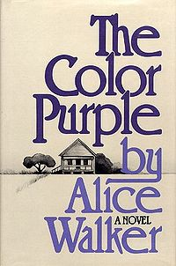
Secondary Titles Culturally Responsive Enabling Literature
4 Criteria
Promote a healthy psyche
Grounded in real world experiences
Focus on the collective struggle of people of color
Serve as a road map for being, doing, thinking, and acting
Written by K.H. Hamilton
Notes:
(2-3 minutes)
Say: Here are some excellent examples of Culturally Responsive Enabling Literature. Each of these titles meet the Four criteria outlined by Dr. Tatum: 1) They promote a healthy psyche, 2) They are grounded in real world experiences; 3) They focus on the collective struggle of people of color; and (most importantly) 4) They serve as a road map for being, doing, thinking, and acting.

Slide 35
What is Culturally Responsive Text?
Dr. Sharroky Hollie also classifies responsive texts in 3 ways.
Notes:
1 min
Hollie’s definition
Purpose: Begin to explore Dr. Hollie’s definition of Culturally Responsive Texts.

Slide 36
Culturally Responsive Text
A culturally authentic text is a piece of fiction or nonfiction that illuminates the authentic, cultural experiences of a particular cultural group- whether it be about religion, socioeconomic status, gender, ethnicity, nationality, sexuality, or geographic location.
Rings of Culture
Notes:
3 minutes
Connect to the rings of culture.

Slide 37
Culturally Generic Texts
A culturally generic text features minority characters, but contains few specific details to culturally define them authentically. Usually based around universal and mainstream defined themes.
Unlock the difference
Notes:
2 mins
What’s different about culturally generic texts and culturally authentic/specific texts?
Possible Answers:
Contains ‘few’ specific details about the culture

Slide 38
Culturally Neutral Texts
Features “people of color” but have little or nothing to with culture and many times simply have “dipped” a traditional character in the name of diversity or multiculturalism.
Most important point
Notes:
2 mins
What is the most important point about this definition?
Possible Answer(s):
- This definition says that the people of color is dipped

Slide 39
Culturally Responsive Texts
text that include the reader’s experience, and which draws on their background and culture…
text that helps children understand who they are, where they come from, and where they can go
connect to students’ lives, not just to their cultural heritage.
-based on the work of Alma Flor Ada
Notes:
1 min
Alma Flor Ada is a renowned author who is known for her culturally responsive books like, I Love Saturdays y Domingos. Her work is based on the definition that culturally responsive texts
text that include the reader’s experience, and which draws on their background and culture…
text that helps children understand who they are, where they come from, and where they can go
connect to students’ lives, not just to their cultural heritage.

Slide 40
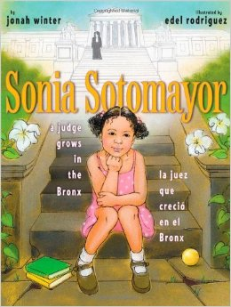
Which Type of Text?
Authentic
Phyllis Hunter Library
Latin American -Puerto Rico
Living in the Bronx, public housing
Mom worked day and night
Played Loteria with family
Authentic, cultural experiences of a particular cultural group
Notes:
2 mins
3rd grade – from the Phyllis Hunter Library (AEMP School Teachers received these libraries IF they attended the CLR Institute)
Practice identifying the type of culturally responsive text based on the information and using Dr. Hollie’s definition.
[Click] to reveal the answer. This book is authentic based on a few things ethnic, class, etc. Have the participants identify which rings of culture they believe the book addresses.

Slide 41
Which Type of Text?
Phyllis Hunter Library
Four inner-city youth
African-American
Based on a true story
Foster youth experiences
Single parent home
Struggles of students living in the inner-city
Celebrates the success of the group working together despite the opposition
Authentic
Notes:
2 mins
Secondary– from the Phyllis Hunter Library (AEMP School Teachers received these libraries IF they attended the CLR Institute)
Practice identifying the type of culturally responsive text based on the information and using Dr. Hollie’s definition.
[Click] to reveal the answer. This book is authentic based on a few things ethnic, class, etc. Have the participants identify which rings of culture they believe the book addresses.

Slide 42
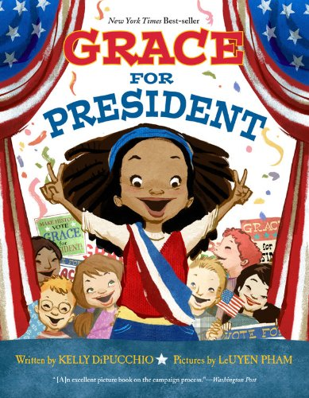
Which Type of Text?
Generic
Phyllis Hunter Library
Girl
African-American
Contains few details that define the character’s culture
The text can be about anyone, regardless of culture
Notes:
2 mins
3rd grade – from the Phyllis Hunter Library (AEMP School Teachers received these libraries IF they attended the CLR Institute)
Practice identifying the type of culturally responsive text based on the information and using Dr. Hollie’s definition.
[Click] to reveal the answer.
**This book is generic. Although the book features a main character who is a minority, the book has few details that share authentic cultural information with the reader. This book is great for teaching young readers about the process of voting for presidents and it is great for young minority girls to see more of themselves in texts. However, this book is a generic source for teaching anything about African American culture or Female Culture.
Have the participants identify which rings of culture they believe the book addresses.

Slide 43
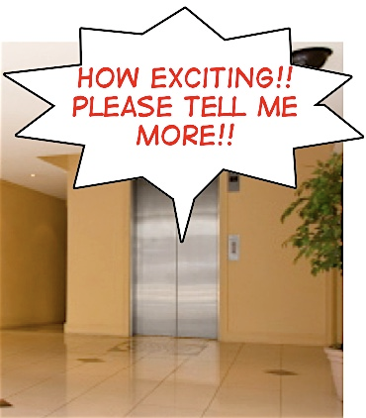
Elevator Music…
How might you explain culturally responsive text and how to identify it?
Notes:
2 minutes
Give participants processing time using the question and activity on the slide.

Slide 44
AEMP Website
resources

Slide 45
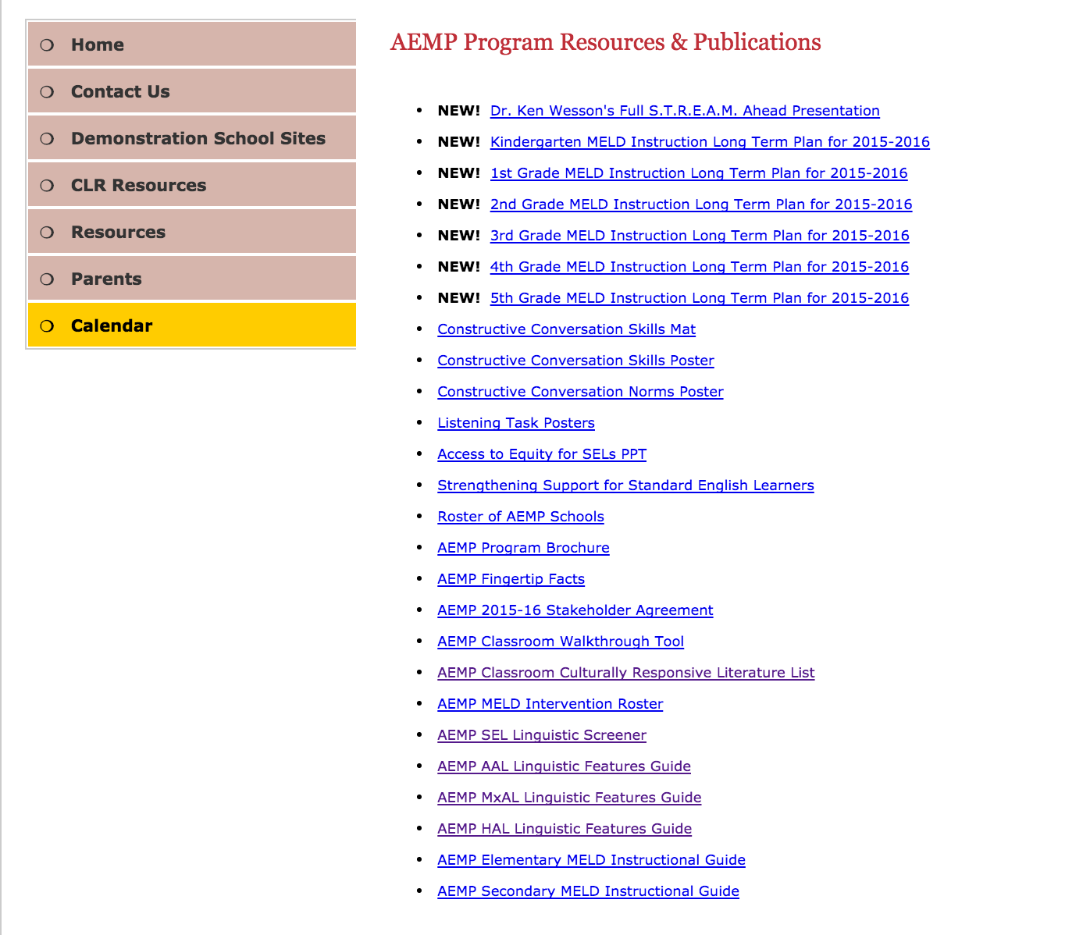
AEMP Classroom CLR Literature List

Slide 46
AEMP Classroom CLR Literature List
Notes:
1 min
The list is organized by grade level [click]
There are also some special remarks listed for further information [click]

Slide 47
Taking it Back!
Think-Ink
How will you apply your new learning to your instruction this week?
Pair-Share
Share your thoughts with your elbow partner.
Notes:
3 min

Slide 48
Learning Objectives
Explore the what makes literacy responsive to Standard English Learners (SELs)
Understand how to select Culturally Responsive Literature
Notes:
1min

