Slide 1
LOS ANGELES UNIFIED SCHOOL DISTRICT
STUDENT HEALTH AND HUMAN SERVICES
PUPIL SERVICES
Picking Up the Pieces: A Look into School Aged Foster Youth Dealing with Trauma and its Connection to High School Completion
Picking Up the Pieces: A Look into School Aged Foster Youth Dealing with Trauma and its Connection to High School Completion
Picking Up the Pieces: A Look into School Aged Foster Youth Dealing with Trauma and its Connection to High School Completion
Local District West Parent Engagement Summit
Engaging Foster Youth
Foster Youth Educational Rights & Policy
May 16, 2018
Valeska Cosci, LCSW
April P. Jones, LCSW
Los Angeles Unified School District

Slide 2
Objectives
To learn about Los Angeles Unified School District (LAUSD) foster youth population and the related challenges for students
Services and responsibilities of the Foster Youth Achievement Program
Share some practical strategies to use with foster youth to create a welcoming environment and improve outcomes
Notes:
Invisible video: https://www.youtube.com/watch?v=tII8XbQp56A&feature=youtu.be

Slide 3
Invisible
Notes:
Invisible video: https://www.youtube.com/watch?v=tII8XbQp56A&feature=youtu.be

Slide 4
The Los Angeles Unified School District
Second largest school district in the nation
Total K-12 Enrollment: 655,716
60,000 Employees
Schools/Centers: 1,309
80% Free/Reduced Lunch
92 languages other than English
Total Expenses: $6.47 Billion

Slide 5
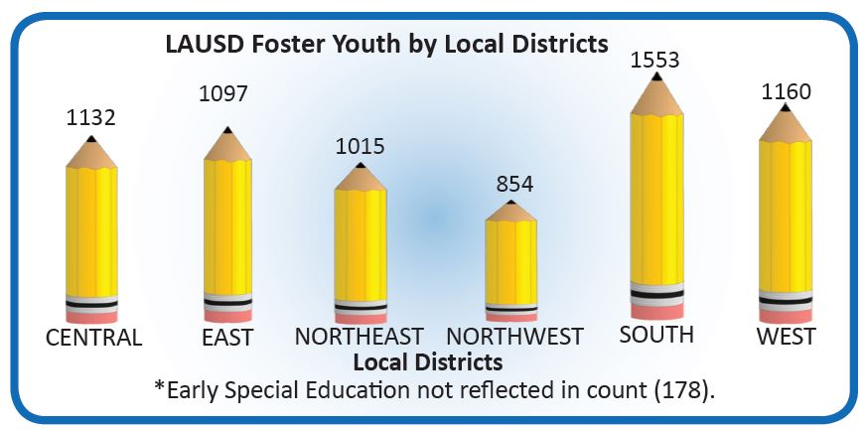
Foster Youth by Local District 2017 – 2018 School Year
Source: Consolidation of CALPADS, DCFS Data Match and Probation List
Notes:
The Foster Youth Achievement Program supports all foster youth with an open court case at every school in the district. There is an assigned FYAP counselor at every school.

Slide 6
LAUSD Foster Youth by School Type 2017 – 2018 School Year
Early Education Centers | 539 | 7.60%
Elementary Schools | 3,803 | 53.63%
Middle Schools | 1,011 | 14.26%
High Schools | 1,183 | 16.68%
Non Traditional School Types | 555 | 7.83%
Total | 7,091
Source: Consolidation of CALPADS, DCFS Data Match and Probation List
*Non traditional School Type includes: Alternative Education Work Centers, Community Day Schools, Home & Hospital, Opportunity Schools, SPAN, Special Ed Early Education and Special Education Schools
School-Based Support Determined By Need

Slide 7
TYPES OF FOSTER CARE PLACEMENTS
Foster Youth may reside with
Unrelated foster parents
Relative caregivers & Biological parents
Families who plan to adopt
Large residential facilities
Group home providers

Slide 8
Foster Care Placement Types for LAUSD Youth 2017– 2018 School Year
Source: Consolidation of CALPADS, DCFS Data Match and Probation List

Slide 9
Foster Youth by Ethnicity 2017– 2018 School Year
Source: Consolidation of CALPADS, DCFS Data Match and Probation List

Slide 10
Foster Youth with an Individualized Education Program 2017– 2018 School Year
Source: Consolidation of CALPADS, DCFS Data Match and Probation List

Slide 11
EXPECTED OUTCOMES
It is expected that the comprehensive academic assessments conducted and
interventions implemented by counselors within the Foster Youth Achievement
Program will serve to:
Attendance Rates
Performance on State Tests
Graduation Rates
Chronic Absenteeism
Number of Suspensions
Drop Out Rates
Notes:
Elementary School – All foster youth will have a comprehensive academic assessment that incorporates attendance and behavior.
Middle School- In addition to a comprehensive academic assessment, all foster youth in middle school will receive an Individual Graduation Plan (IGP)
High School- In addition to a comprehensive academic assessment, all foster youth in middle school will receive an Individual Graduation Plan (IGP)

Slide 12
Nationwide Research Shows
Students in foster care:
Experience much higher rates of school mobility than other students
Have higher rates of absenteeism
Perform lower on state testing
Are twice as likely to be eligible for special education services
Only 58% graduate from high school as compared to the statewide average of 84%
In California, less than 3% go on to earn a college degree
Barrat, V. X., & Berliner, B. (2013). The Invisible Achievement Gap, Part 1: Education Outcomes of Students in Foster Care in California’s Public Schools. San
Francisco: WestEd. Pecora, et al. (2005) Improving Family Foster Care: Findings from the Northwest Foster Care Alumni Study.

Slide 13
What are the potential strengths and challenges Foster Youth bring?
Strengths:
Skilled at reading people
Varied life experiences
Resilient/Transferable skills
Independent/mature
Challenges:
Numerous, rotating people in their life
Experienced adversity/Trauma
Building Trust
Unpredictable, frequent changes in homes and schools

Slide 14
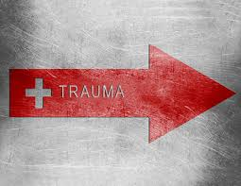
Foster Youth & Trauma
Foster youth, by definition have all experienced at least one traumatic experience in being removed from their parents.
Most foster youth have also experienced additional traumatic experiences including abuse & neglect, exposure to domestic violence, or death of a loved one.
Over 70% of foster youth aged 7 and above present with trauma and/or mental health symptoms.
Notes:
Additional source for statistics: Jim Casey Youth Opportunities Initiative: Issue Brief #5, Trauma Informed Practice with Youth People in Foster Care, available at: http://www.aecf.org/resources/trauma-informed-practice-with-young-people-in-foster-care/

Slide 15
Manifestations of Child Trauma
Self Regulation | Shut-down, inattentive, bored or listless Hyperactive, impulsive, aggressive, reactive or silly May range from guarded to restricted and intense
Interpersonal | Socially withdrawn or isolated Difficulty developing close or lasting friendships
Intrapersonal | Hesitant in approaching new tasks. Unwilling to take risks Easily frustrated or giving-up in the face of failure
Cognitive | Difficulty understanding information and following directions Trouble asking for or accepting help or overly dependent Trouble generating ideas and solving problems
Adapted from LAUSD School Mental Health PowerPoint: Trauma Informed Schools
Notes:
Not all foster youth may manifest their experience of Trauma.
Furthermore, while we are not asking you to be able to diagnose a child or an individual you come across, here are some of the ways trauma manifests itself. Look for the behavior, rather than the diagnosis and let that guide you.
The difference is that "interpersonal" refers to relationships or actions that take place between two or more people while "intrapersonal" refers to things that go on exclusively within one person. Intrapersonal communication is a communicator's internal use of language or thought.

Slide 16
What does ‘Trauma Informed’ look like?
A person or organization has knowledge of how trauma impacts a person and mindfully avoids re-traumatization actions
A person adjusts their teaching or discipline style to meet the needs of a traumatized student/child
Has flexibility
Empathy
Has a growth mindset
Offers brain-based strategies
Notes:
A teacher or caregiver implements flexibility when working with, teaching or disciplining a student. Has the ability to try other solutions- for which we will go through some examples later.
Growth mindset= believing that understanding and intelligence can be developed, it is not static. One‘s future is not limited by their past experiences- research by Carol Dweck

Slide 17
Shifting to a Trauma Lens
Children act in a way that makes sense according to their understanding of how the world works
Understands that a child is not ‘out to get us’
“A child whose behavior is creating issues is not trying to cause a problem. They’re trying to solve a problem.”-American Journal of Pediatrics, Nov. 1956
Instead of asking, “What is wrong with you?”, ask “What happened to you?”
Adapted from LAUSD School Mental Health PowerPoint: Trauma Informed Schools
Notes:
Remember how we discussed that trauma changes a person’s ‘world-view’? When a child believes based on experience that adults can’t be trusted, don’t take care of them, they will behave in an untrusting or even aggressive ways towards adults. Children who have been neglected may behave in ways that are trying to just get basic needs met because they can’t believe others will do that for them.
The trauma lens is a mindset- you are not necessarily ASKING- ‘what happened to you’, but you are approaching a student from this frame of reference, ‘I wonder what happened to this child that is causing/contributing to this behavior or reaction now’…

Slide 18
Schools Can Mitigate the Negative Effects of Trauma
Schools and adults can:
Create a sense of safety
Provide a sense of control
Foster connections
Teach and model self-regulation techniques
Adapted from Toolkit for Foster Youth Education Success: Trauma Informed Education, March 17 2016; Catherine DeRidder; Alaina Mooves-Leb; Danielle Tenner
Notes:
Many times teachers ask: ‘Okay, even though I know a student has experienced trauma, I’m not a therapist, so what can I do?’ Actually teachers and school can do a lot to help create a sense of safety and support for a student.

Slide 19
Create a Sense of Safety
Provide a safe environment: Predictable structure with consistent routines
School wide positive behavior programs
Expectations are clear and consistent
Provide transition opportunities
Provide clear pathways to emotional support
Build self-esteem:
Focus on activities the student excels at
Give the student prep time
Celebrate even the smallest successes
Thank the student for coming on time
Write a positive note for turning in homework
Adapted from Toolkit for Foster Youth Education Success: Trauma Informed Education, March 17 2016; Catherine DeRidder; Alaina Mooves-Leb; Danielle Tenner
Notes:
Trauma results in a loss of sense of safety, keep boundaries and expectations consistent to foster school safety.
Transitions: reading a book, quiet music, mindful breathing etc..
Differentiated teaching- give the student projects in areas of strength or interest
Prep-time- if a student will be asked a question in front of the class, give to them ahead of time so they are ready
If the student likes football, relate geometry to it

Slide 20
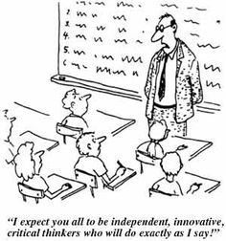
Provide a Sense of Control
Give students choices rather than ultimatums
Engage in semi-private conversations
Offer adequate personal space
Keep escape routes open
Limit the number of personnel or adults involved
Keep verbal interactions calm: use simple and direct language
Allow the student to engage in the problem-solving process
Adapted from Toolkit for Foster Youth Education Success: Trauma Informed Education, March 17 2016; Catherine DeRidder; Alaina Mooves-Leb; Danielle Tenner
Notes:
Try to give an example for each bullet point here.

Slide 21
Foster Connections
Create opportunities to develop meaningful relationships: peers and adults
FYAP developed Foster Youth Leadership and Empowerment Council at high schools
FYAP developed Shadow Day for opportunity to mentor foster youth interested certain career path
FYAP developed summer camp for primary, and winter leadership retreat for high school foster youth students to attend annually to connect with other students within similar dynamics as them for empowerment
Allow students to share feelings and experiences on their own timeline
If a student is struggling, be empathetic
Offer support: academic and/or emotional
Be ready for proactive interventions
Adapted from Toolkit for Foster Youth Education Success: Trauma Informed Education, March 17 2016; Catherine DeRidder; Alaina Mooves-Leb; Danielle Tenner
Notes:
Relationships: classroom group work, pairing, sports, clubs, mentoring
Proactive interventions, we will discuss some of these. Have options ready for students like a quiet area of the classroom, a sensory table, coping strategies

Slide 22
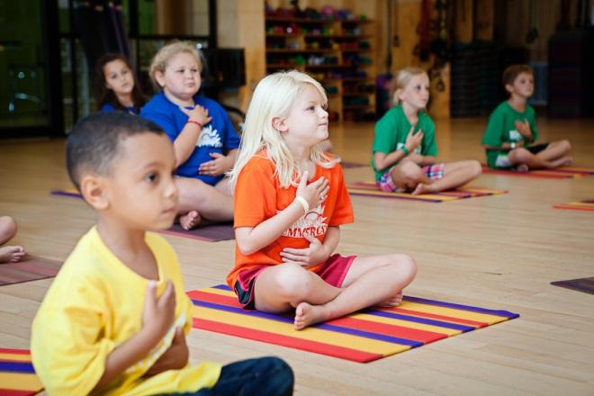
Teach and Model Self-Regulation
Incorporate techniques into classroom routines
Breathing exercises
Mindfulness
Taking breaks
Feeling charts and journals
Sensory objects
Quiet spaces
Adapted from Toolkit for Foster Youth Education Success: Trauma Informed Education, March 17 2016; Catherine DeRidder; Alaina Mooves-Leb; Danielle Tenner
Notes:
Some ideas that other teachers have tried is having a quiet space in the room with maybe a bean bag and some books or drawing materials, feeling faces posted on the wall. A table with a basket of sensory items like stress balls, play dough. Teaching the students mindful breathing.
Model behavior: think before reacting. Mindfully-’how can I bring this down and get back to learning
Offer card that already says, ‘I need a break’ that students can use

Slide 23
What’s Behind the Behavior?
Often times a child’s behavior is a reaction to a deeper feeling or belief, or trying to avoid uncomfortable feelings
Feelings
Looks like
Behavior
Hurt
Avoid rejection
Avoid feeling/emotions
Holding feelings in
Depression
Unloved (tests the relationship, avoids rejection)
Trauma trigger, heightened internal alarm
Aggression
Oppositional
Overly compliant
Outburst
Hopeless/helpless
Argumentative
Rapid Escalation
Adapted from San Diego County Office of Education: TRAUMA INFORMED PRACTICES FOR SCHOOLS – TIPS: Susie Terry, MPH; Michelle Lustig, Ed.D, MSW, PPSC: Foster Youth & Homeless Education Services
Notes:
Behavior is a form of communication: what is the behavior telling you about the child? What is the child trying to tell you through his behavior?
UNDERSTANDING THAT ….
TRAUMA EXPLAINS BEHAVIOR IT DOES NOT EXCUSE BEHAVIOR

Slide 24
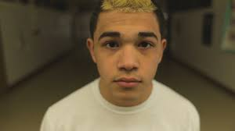
Under the Surface
Video
Notes:
Play this video only if we have more than an hour- it’s only 3 minutes
Ask the participants what they thought of the video? Have a discussion about this
https://www.youtube.com/watch?v=AZ-pU7ozt3g

Slide 25
Implementation Examples
Student’s Who Have Difficulty With Self-Regulation:
You Might See
Aggressive
Over-reactive
You Might Try
Teach self-regulation, deep breathing
Model mood regulation
Try to Avoid
Raising your voice
Tantrum
Lack of impulse control
Irritability
Difficulty with transitions
Teach emotional awareness: feeling faces, charts
Establish a schedule, give warnings to changes in the routine
Give the child control where possible
Allowing or ignoring bullying, name calling or outbursts
Punishments, threats or put-downs
Minimizing feelings or behavior
Adapted from: Helping Traumatized Children Learn, 2009 Massachusetts Advocates for Children
Notes:
The next few slides will discuss some of the common concerning behaviors students present with. We will try to identify strategies to try to help a student who is presenting with these behaviors. Also we will discuss reactions to avoid and why.
Try to give specific examples for the ‘you might try’ strategies. For example for teaching emotional awareness, 2nd step program has great curriculum that can be used in part with pictures of children to teach and emotional vocabulary.

Slide 26
Implementation Examples
Students Who Don’t Perceive Safety
You Might See
Inability to focus
You Might Try
Take time to teach routines
Try to Avoid
Inconsistency
Withdrawal
Needy
Lack of boundaries
Trouble with transitions
Post schedules
Practice transitions
Connect with the student each day in a similar fashion
Kind & firm classroom leadership
Requiring students to read or present out loud or in front of the class
Punishments or threats
Angry outbursts in class
Surprises-even good ones
Not keeping promises, or not following through
Adapted from: Helping Traumatized Children Learn, 2009 Massachusetts Advocates for Children
Notes:
Consistency is most important.

Slide 27
Implementation Examples
Students who Struggle Academically
You May See
Disruptive behavior
You May Try
Assess student’s prerequisite skills
Post schedule and homework where it is easily visible
Try to Avoid
Embarrassing/shaming or blaming
Excuses
Attention seeking behavior
Absences
Lack of participation
Lack of supplies
Sleeping
Difficulty working independently or in a group
Difficulty remembering previous skills
Difficulty linking concepts
Develop a system to augment prerequisite skills
Use written and verbal instructions
Help the student set achievable goals-start short term
Help the student to notice success
Differentiate instruction
Problem solve with the student
Learn about the student’s life
Ask your support team for help
Communicate regularly with the family/caregivers
Empower rather than enable
Listen deeply
Not following through with the students
Threats
Comparing to others
Giving up on the student
Pointing out faults publicly
Adapted from: Helping Traumatized Children Learn, 2009 Massachusetts Advocates for Children
Notes:
Prerequisite skills: a student can’t succeed in algebra without number fluency

Slide 28
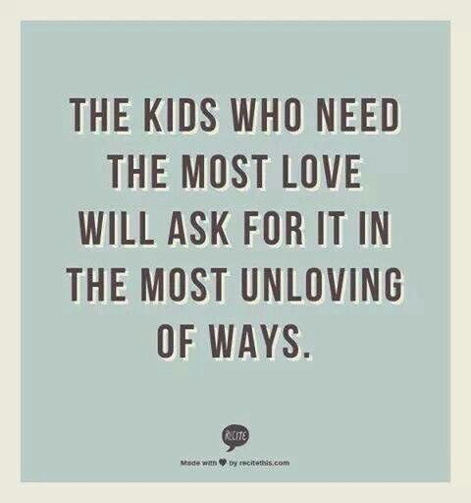
Two-By-Ten
The teacher focuses on a student who is being the most challenging
For two minutes each day, for ten days in a row
Have a personal conversation with the student about anything the student is interested in
“Assuming the Best”, by R.Smith & M. Lambert, Educational Leadership, Sep. 2008
Notes:
Researcher Raymond Wlodkowski found 85% improvement in the students behavior. In addition, he found the behavior of all the other students in the class also improved

Slide 29
Questions?

Slide 30
How To Reach Us
Foster Youth Achievement Program
La Shona Jenkins, LCSW
Coordinator
Lashona.jenkins@lausd.net
(213) 241-3552

