Slide 1
How to Write a Salary Point Course Proposal
Ingrid Gunnell
Jennifer Villaryo
Professional Development Adviser

Slide 2
Why Salary Point Classes?
1 salary point course is equivalent to 1 semester unit and is recognized by LAUSD for salary table movement.
Salary Point courses address educators’ practical needs.
More cost effective for participants.
Convenient hours and locations.
Benefits for both NBC Teachers and participants.
Allows teachers to share Professional Development topics of high interest with their colleagues.

Slide 3
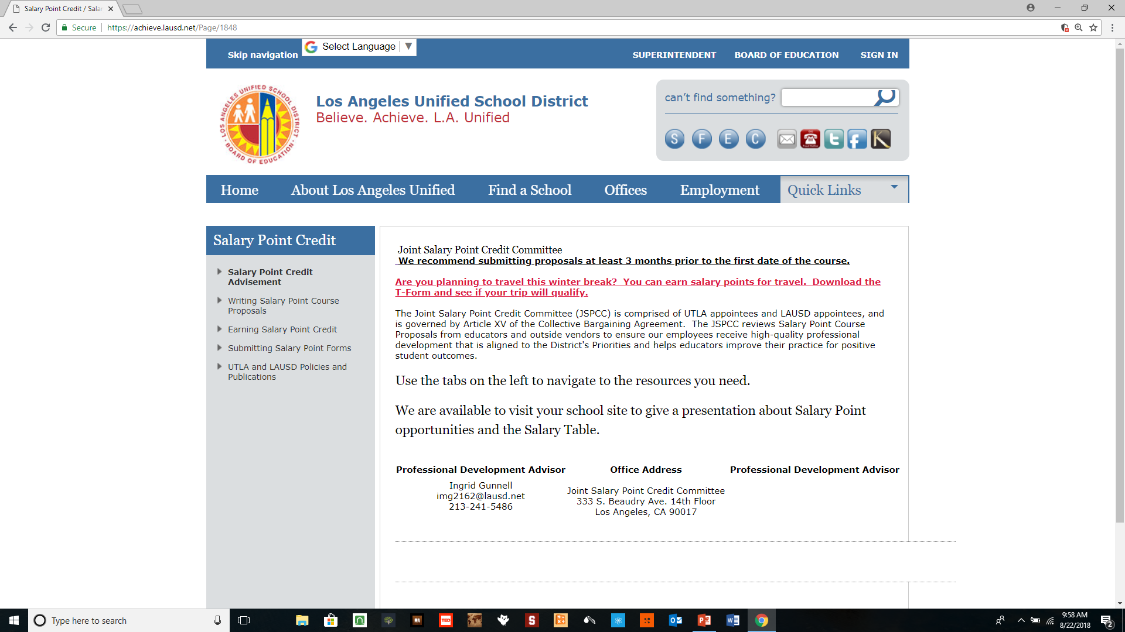
Where is the Proposal Form?
Go to achieve.lausd.net/salary-point
Click on the “Writing Salary Point Course Proposals” tab.

Slide 4
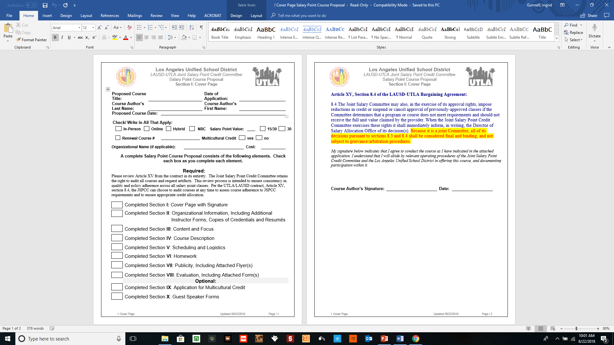
Notes:
The Proposed Course Title, Date, and Course Author Name sections are all the same for each section.
Choose a title that is concise.
This section is a check-off sheet for all of the other sections.
Be sure to sign your name at the bottom!

Slide 5
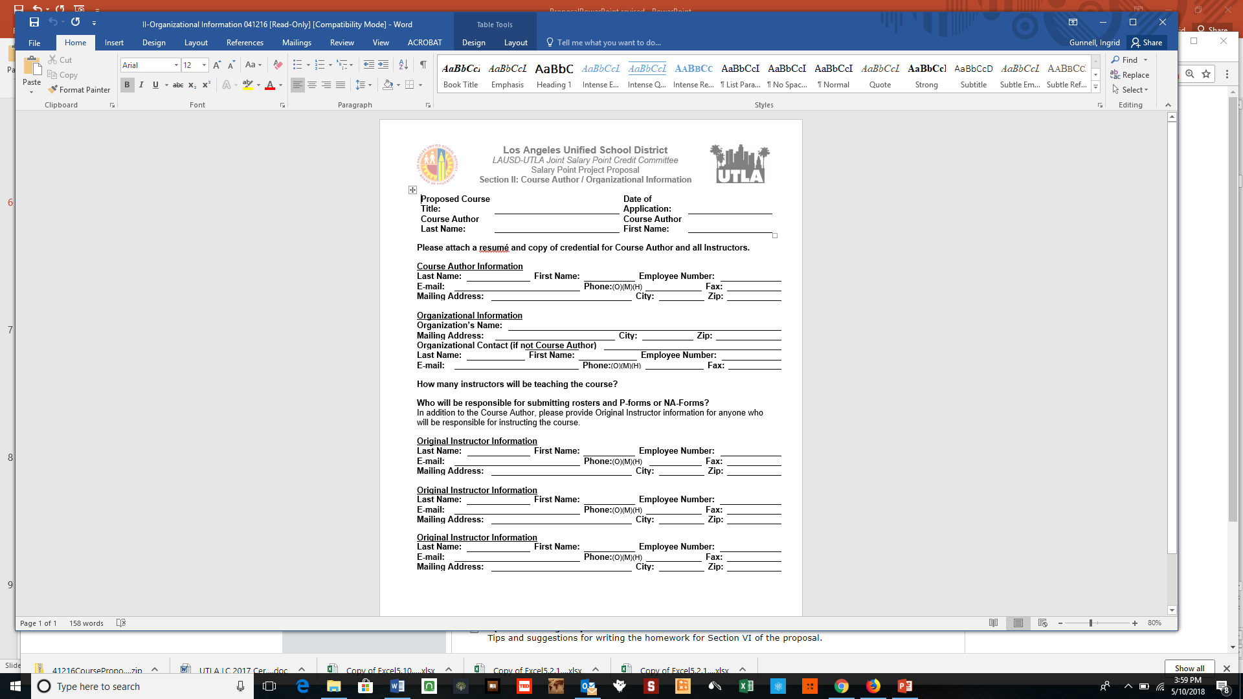
Notes:
Choose one Course Author for the proposal. If the author does not have an employee number, please enter NONE.
The Original Instructors are the individuals who are authorized to submit rosters and P- or NA-forms.
Credentials doesn’t refer to teaching credentials – rather, it’s what skills, knowledge, or experience that the person has to make them qualified to be involved with the teaching of the course. Please include a resume or evidence of a teaching credential.

Slide 6
What Topics Are Accepted?
Under Section III Content Focus you choose which area your course will be addressing.
There are 23:
Art
Business
Early Childhood Education Elementary Subjects
Language Arts/Reading
English as a Second Language
World Languages
Guidance
Health Education Industrial Education
Interdisciplinary Leadership Training
Mathematics Multicultural Education
Music Parent Education
Psychology Science
Social Science Volunteer Computer Education
Staff Development
Special Education
Notes:
The Primary Content Area is the major area of focus for the course content.

Slide 8
Your Course Must Address 1 of the District Priorities and you must be able to speak about how it relates to this priority.
District Priority (Select only one) :
Improved student achievement in core academic subjects
Improved student physical fitness and health
Standards-based Instruction and appropriate pedagogy
Multicultural Education
Teacher leadership and collaboration with school personnel, parents and community
School climate, safety and discipline and classroom management
Language Acquisition/Development
Special Education
Emphasis on academic knowledge in the core academic subjects outlined in NCLB
Other (explain)
Notes:
The District Priority: Providing a clear description of how the course will help educators accomplish the priority will strengthen the proposal.

Slide 9
Choosing a Standard
Which one will you be addressing?
List one representative standard from the Common Core State Standards,
California Standards for the Teaching Profession, ISTE Standards, NGSS, etc.
that can be addressed by this course.
Notes:
One representative standard: You can pick a standard (or two) from one of these three places:
the California Common Core State Standards
the California Standards for the Teaching Profession
the National Board Standards for Teaching
NGSS
Early Childhood Foundations
CA Content Standards

Slide 10
Section III: Content and Focus
Addressing the needs of the following student populations:
English Learners
Standard English Learners
Special Education Students
Culturally Diverse Students
Gifted and Talented Students
Foster and/or Homeless Students
This section causes the most delays to approval!
Under each section, write about SPECIFIC techniques that the course will cover to support that subgroup – (describing that in Section IV makes this much easier!)
Notes:
Please go to the LAUSD website for the most current Salary Point Course Proposal Form. We will be making slight changes to the proposal.
Finish going through Section III (reference hybrid online option)

Slide 11
Class Formats for Each Salary Point
Option 1: 15 hours of synchronous instruction, with an additional 30 hours of homework. (NBC Teachers Earn 15 Hours for Prep + 15 Hours for Presentation and 10 hours for writing the course the same year. )
Option 2: 30 hours of synchronous instruction with no homework. (NBC Teachers receive 30 Hours of Prep, 30 Hours for presentation and 10 hours for writing it, the first time, in the same year.)
Option 3: Online Only 37.5 hours with the opportunity for interaction. (NBC Teachers get 37.5 hours for presenting with a minimum of 12 hours synchronous + 10 hours the first time for writing the course.

Slide 12
Let’s Put Our Learning into Practice
Which of the following courses qualify for salary point and for how many points?

Slide 13
Let’s Begin
A course where the participants and instructor meet for eight four-hour sessions.
A course where the participants and the instructor meet for three six-hour Saturdays, and complete 35 hours of homework.
A course where the participants meet for 30 1-hour sessions during Tuesday banked-time meetings.
A course where participants watch 43 hours of videos.
A course that offers 14 hours of direct interaction and 30 hours of homework.
8- 4hour sessions = 32 contact hours.
Qualifies for 1 Salary Point
3 x 6hr sessions= 18 contact hours, and 35 hours of homework.
Qualifies for 1 Salary Point
30- 1 hour sessions qualifies but NOT on paid time.
DOES NOT QUALIFY FOR SALARY PT.
43 hours of video watching.
DOES NOT QUALIFY FOR SALARY PT.
DOES NOT QUALIFY FOR SALARY PT. Do you know why it wouldn’t?

Slide 14
Notes:
P Courses are offered through the District. They are limited to a $25 materials fee.
NA Courses are offered through outside vendors and organizations. LAUSD doesn’t track the fees (though excessive fees are a red flag for the JSPCC).
The Course Syllabus should describe what presenters are doing and what participants are doing for each 1-to-2 hour block. Structure the activities for adult learners! References to subpopulations in Section V will strengthen this section. Also, keep blocks in half-hour increments (no 15 minute sections!)

Slide 15
Notes:
In determining the Cost, consider that P classes are limited to $25 for materials (like a book or reader.)
In determining Compensation, be aware that there is no District funding for Prof. Ex pay; this would have to be allocated in a school site budget.
Dates can be estimated, but precise dates are appreciated. Make sure that if there is homework that the Course Completion Date is the date that the homework is due.

Slide 16
Section VI: Homework
Homework should be college level and linked to the goals of the course.
Provide a clear description of each activity that participants need to complete. Include (for each activity) an estimate of the number of hours that it would take for a person unfamiliar with the course content to complete.
You can attach a “Homework Sheet” that you would distribute to participants as part of the application.
Notes:
Instructor keeps homework for 5 years for reference, stored electronically or hard copies.
Menu of optional, mandatory, or both.
Must be linked to learning

Slide 17
Notes:
Publicity- Please submit a new flyer each time your course is given. This way we are aware and can update the LAUSD Records. Please indicate the Course # on your flyer and the format (15/30 or 30).
When you fill out the information, be sure to check your entry for grammar and accuracy.
Do not forget to attach the flyer – it is a critical element!

Slide 18
Section VIII: Evaluation
Notes:
Make sure you attach any forms that you will use to obtain participant feedback, and how you might use the information to modify the course.
Evaluations do not need to be turned in, but need to be kept by the instructor for 5 years.

Slide 19
Optional Section IX: Credit Application
Study one or more specific identity or demographic group(s).
Provide a description of how the course addresses 3 of 6 areas:
Provide general information on the concepts of culture, assimilation, acculturation, intersectionality, and identity formation.
Provide instructional strategies to infuse positive representations and culturally relevant and responsive content focused on diversity, race and culture, human relations and/or equity concepts into units of study or curriculum.
Provide academic resources applicable to student diversity.
Study one or more specific identity or demographic group(s).
Address the history, achievements, and challenges related to the experiences of one or more identity or demographic groups.
Examine patterns of current or historical oppression and marginalization that perpetuate systems of inequality.

Slide 20
Optional Section X: Guest Speaker Forms
This form is required for all guest speakers.
The form is to ensure that presenters are connected to the course work (and to make sure that a class session doesn’t devolve into a sales pitch.)
Copy the table of information and use it for each of the Guest Speakers.
Notes:
Run through Proposal Section X

Slide 21
The Approval Process
The JSPCC meets once per month (although sometimes more frequently when member schedules permit).
Representatives from LAUSD and UTLA review the documentation.
If a proposal is not approved, the author is contacted and informed of the areas where the proposal needs revision(s).
If the Salary Point Course Proposal is approved the author will receive an email that includes a Salary Point Course number, a roster, a blank P/NA form, and additional information if needed.
If listing on MyPLN, the process requires no physical documents, as it will be electronic.

Slide 22
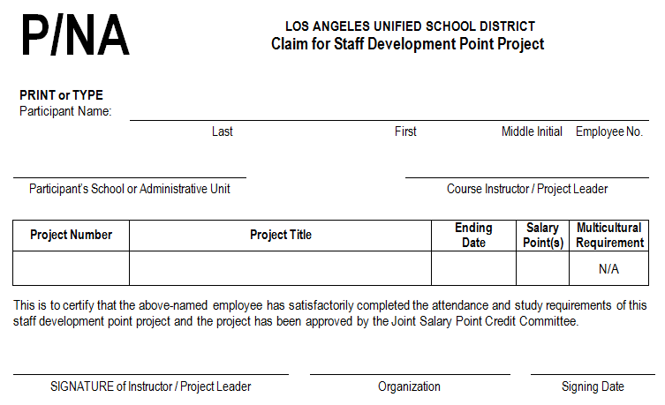
Approved Salary Point Course Proposals Receive the Following Forms and Course #
Notes:
If course is on MyPLN this isn’t necessary.

Slide 23
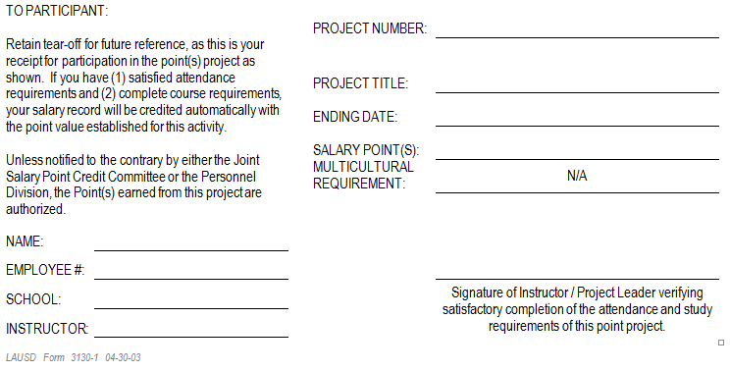
P/NA Form: Send Participants the Rest

Slide 24
After You Teach the Course…
Type up the roster in alphabetical order with the
required information (keep your sign-ins for your
records), and SIGN IT.
The date you sign must be the SAME AS OR AFTER
the completion date of the course.
Type the information on the P or NA forms and
SIGN
THE UPPER PORTION on each one.
Send us the SIGNED roster and SIGNED P or NA
forms.
MyPLN will require e-mail correspondence with the Salary Point Advisers.

Slide 25
Technical Detail: Completion Date
When is the course considered complete?
Can your participants turn in late homework?
The SIGNING DATE on the P-NA form MUST be AFTER the COMPLETION DATE!
When will your participants see the posting of their points?
Notes:
Once the homework is turned in OR the last day of class, whichever is later. Participants should typically have 4-6 weeks from the first day of class to complete their homework.
Your assigned due date is the completion date unless the homework is late. Give people with late homework a completion date based on when you receive the homework.
Their points will post 6-8 weeks AFTER the completion date.

Slide 26
A Word about NBCTs
National Board Certified Teachers can create and teach salary point classes as part of their 92 hour requirement. Some guidelines:
of prep for each hour of presentation for eligible
PD sessions.
You get an additional 10 hours for writing a new
salary point class provided that you get it approved and
present it in the same academic year.
Each NBCT must have 10 participants.
NBCTs may teach the same class more than once (courses are approved for five years.)
Notes:
you do not reduce hours to ½ prep if you present more than once.

Slide 27
Wrap-Up
Please fill out the evaluation form.
Notes:
Now that we’ve gone through the presentation please think about the topics that our educators need PD in and your expertise to guide you in writing your Salary Point Course Proposal.

Slide 28
Contact Information
Ingrid Gunnell
(213) 241-5486
img2162@lausd.net
Jennifer Villaryo
213-241-5149
jjv4481@lausd.net
Salary Point Credit Advisement
333 S. Beaudry Ave
14th Floor
Los Angeles, CA 90017

