Slide 1
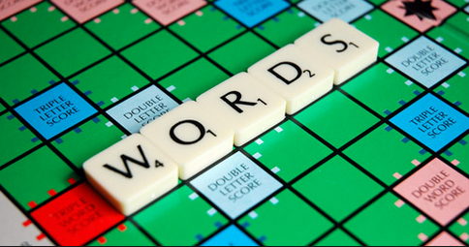
Culturally Responsive Vocabulary
The Academic English Mastery Program
Presents
The Equal Access Series
Notes:
Prior to the PD you will need to give every teacher an uno card for the jigsaw activity.
1 minute
Welcome participants and introduce yourselves.

Slide 2
Learning Outcomes
Explore a process for identifying academic and content-area vocabulary
Identify Responsive Vocabulary Instructional Strategies
Notes:
1 minute
Ask the group to read the learning outcomes chorally or ask for a volunteer.

Slide 3
Five CLR Pedagogical Areas When looking at instruction from the what and the how perspective, there are five general areas that we have identified where CLR can have immediate impact, by increasing student motivation and engagement.
CLR
Expanding Academic Vocabulary (Responsive Vocabulary)
Increasing Student Engagement and Decreasing Classroom Management Challenges
(Responsive Management)
Using all types of Texts Culturally and Linguistically (Responsive Literacy)
Infusing Situational Appropriateness with Language and Behavior
(Responsive Language)
Creating an Inviting Learning Environment for Student Success (Responsive Environment)
Notes:
1 minutes 5 CLR Pedagogical Areas
Say: We will now delve into Responsive vocabulary.

Slide 4
What is Responsive Vocabulary?
“Responsive vocabulary teaching acknowledges that students have a comprehensive conceptual knowledge base rooted in their culture, community, and life experiences that can be used to build academic vocabulary.”
Dr. Sharokie Hollie
Culturally and Linguistically Responsive Teaching and Learning:
Classroom Practices for Student Success
Notes:
2 minutes
Choral Read
What does this quote mean to you? Discuss with your chicken wing partner.
It is important to highlight that students have vocabulary, more importantly they have given their own labels, names and words to these concepts. Students have vast conceptual vocabularies upon which strategic vocabulary instruction can be built.

Slide 5
What words do I teach?
ELA
Math
Science
Social Studies/History
Notes:
2 minutes
Say
We know we have to teach vocabulary on a weekly basis, the real question is what words do we teach? Turn to your elbow partner and take 30 seconds to discuss how you select the vocabulary words you teach.

Slide 6
Let’s get Jiggy with it!
Jigsaw
Form triads
Read your assigned section
Debrief the members of your group on the salient points of your section
Notes:
Say
Ask participants to raise their hands if they are familiar with the process of “tiering words”
Validate participants knowledge, say they will be the experts in the group.
Let’s get jiggy with it! Click on the speaker and let participants groove to the music.
Ask participants to read the directions aloud.
Have participants turn to the article in their packet.
Click

Slide 7
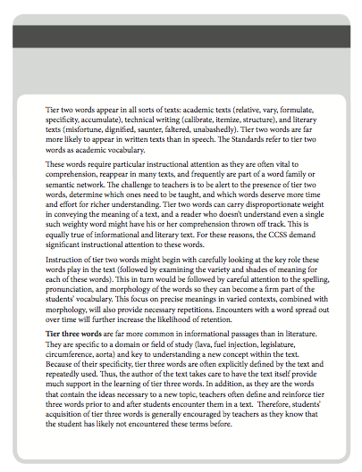
Jigsaw
Everyone
2
1
3
Notes:
6-8 minutes
Click
Let participants know they will read the section that corresponds to the number of their uno cards. They will have 2 minutes to read on their own and then they will have 1 minute each to debrief their section with the group.
Say
Everyone reads the first two paragraphs
1’s read Tier 1
2’s read Tier 2
3’s read Tier 3
Ask
What tier should we focus one? Give a shout out!
Tier 2 and 3

Slide 8
English Proficiency Vocabulary
I’m hungry!
I’m famished!
implement
pencil
feline
cat
Basic
Advance
Tier 1 Words
Tier 2 Words
Notes:
1 minute
Explain
This slide explains English language proficiency vocabulary. We SELs already possess Tier 1 words, our challenge is to validate and affirm the concepts they come with and build and bridge to the Tier 2 vocabulary.
Advanced:
related to basic vocabulary but have lower frequency of use.
essential to English language proficiency
Tier 2 words.
Words that are of higher frequency
-Found across a variety of domains
-Come from interaction with the text

Slide 9
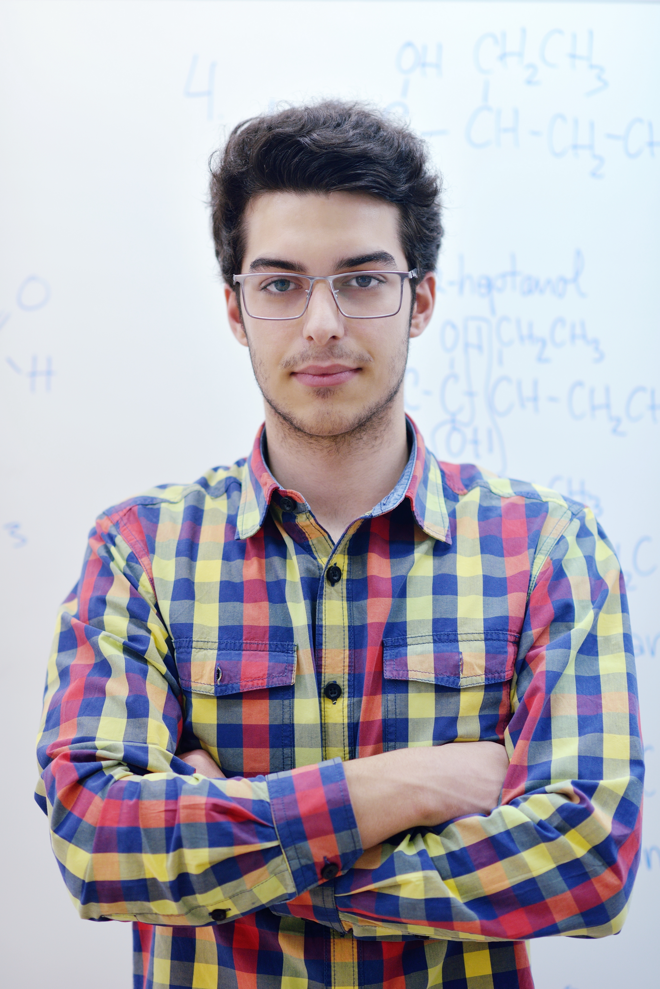
English Proficiency Vocabulary
I’m hungry!
I’m famished!
I need writing
Implements.
I need a
pencil.
Felines make
fabulous pets.
Cats are good pets.
Basic
Advance
Tier 1 Words
Tier 2 Words
Notes:
1 minute
Explain
This slide explains English language proficiency vocabulary. SELs already possess Tier 1 words, our charge is to validate and affirm their existing concepts in order to build and bridge to the Tier 2 vocabulary.
Advanced:
essential to standard English language proficiency
Tier 2 words.
Words that are of higher frequency
-Found across a variety of domains
-Come from interaction with the text

Slide 10
Thermometer Words
Shades of Intensity
voracious
ravenous
famished
starved
hungry
Notes:
2 mins
Vocabulary Thermometer: Another CLR activity that can be implemented as part of the responsive vocabulary strategy is the vocabulary thermometer. The vocabulary thermometer helps students understand the shades of intensity conveyed by synonyms. It is a simple tool that demonstrates how different words convey intensity rather than using intensifiers in the way that many SELs do.
Standard English: angry>livid
SEL Language: mad>all mad

Slide 11
Personal Thesaurus
Vocabulary Instruction for
Tier 2
Tier 3
Notes:
The PT is a tool to develop knowledge of synonyms and antonyms.

Slide 12
Personal Thesaurus
student’s word
student’s word
_________________
_________________
_________________
_________________
_________________
_________________
Target word
Target word
antonym
antonym
Notes:
The Personal thesaurus has the following components: the students own word, the target word and the box at the bottom is for the antonym of the target word.
The use of the personal thesaursus is anchored in context.

Slide 13
Using the Personal Thesaurus in Context
When violence erupted in our nation a man named Dr. Martin Luther King Jr. taught us unyielding compassion.
Which words might students add to their Personal Thesaurus based on this excerpt?
Notes:
We begin by reading and identifying words student need to understand; this connects to the close reading process, we would read and annotate for unknown words and students add the words to their PT.

Slide 14
Personal Thesaurus
K
S
student’s word
student’s word
kind
solid
*compassion
_________________
_________________
_________________
* unyielding
_________________
_________________
_________________
Target word
Target word
antonym
antonym
harsh
soft
Notes:
Here is an example:
These are two entries that students have already have started. Perhaps they wanted a stronger word for Noise and a non slang word for hang out.
Later they read this passage from Thee I Sing Add this to your thesaurus

Slide 15
Using the Personal Thesaurus in Context
He gave us a dream that all races and creeds would walk hand in hand. He marched and prayed and, one at a time, opened hearts and saw the birth of his dreams in us.
Which additional words might students add to their Personal Thesaurus based on this excerpt?
Notes:
We continue with our reading, are there additional words students might add?

Slide 16
Marzano’s Six Step Process
The first three steps are the initial teaching of the word.
Step 1
Provide a student friendly description, explanation, or example of new term.
Ask students to restate the description, explanation, or example in their own words.
Step 2
Step 3
Ask students to construct a picture, symbol, or graphic representing the term or phrase.
Handout
Notes:
1 Min.
Say
Marzano suggests a six step process for vocabulary acquisition; this 6-step process guarantees your students’ mastery of learning vocabulary words.
Take a minute to look at your handout
Explain
The first three steps typically take place during a single class period. Graphic with with 3 steps
The first 3 steps are all direct instruction
Say
We are going to engage in the 6-step process

Slide 17
Our vocabulary word for today is …
migration
Notes:
Kathy
Example:
Explain:
Show this slide with the word: “migration”
“Our new term is peripatetic. Does anyone know what that means?” (access prior knowledge).
migration is when you go from one place to another . For example, at our school we have many students whose parents migrated from Mexico to California.

Slide 18
Our vocabulary word for today is …
nefarious
Notes:
Kathy
Example:
Explain:
Show this slide with the word: “nefarious”
“Our new term is nefarious. Does anyone know what that means?” (access prior knowledge).

Slide 19
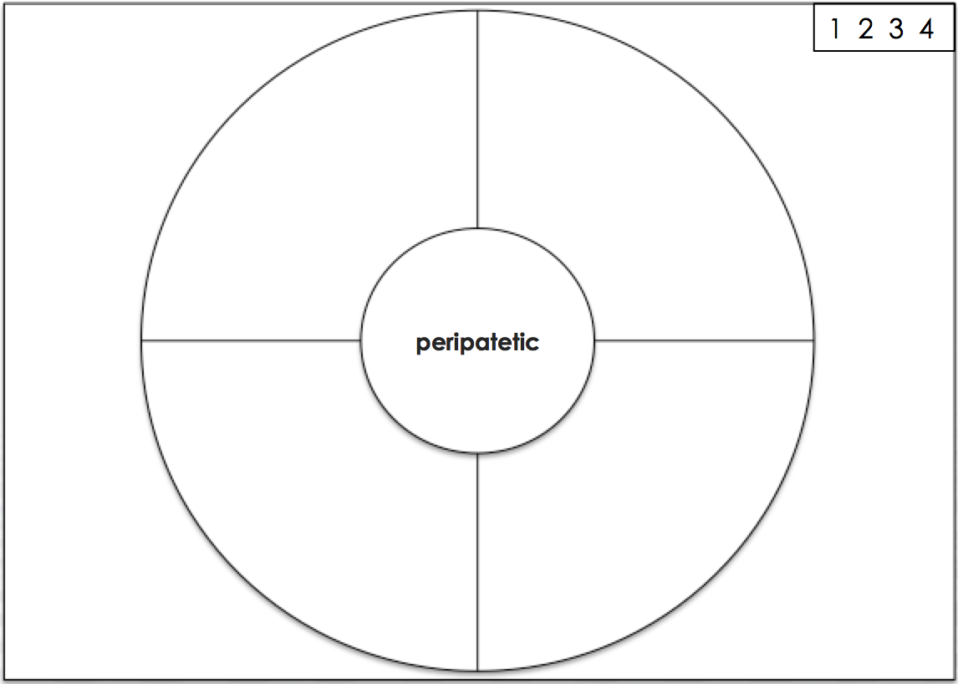
nefarious
Notes:
2 Mins.
Explain:
Please grab a blank sheet of paper from the center of the table and create a circle map with quadrants; include the frame of reference; include the rubric you see on the upper right hand corner; circle the number that represents your knowledge of the word; 1 being your are not familiar with this word at all to 4 which means you know the word well, can explain it to others and use it in a sentence.

Slide 20
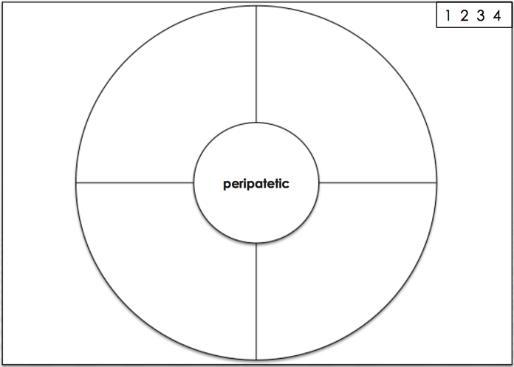
migration
Provide 1
Synonyms and Clarifying Words/Phrases:
Journey
Voyage
Movement
Synonyms and Clarifying Words/Phrases:
migation
Synonyms
Notes:
Silvia
2 Mins.
Explain: Here are some other words or synonyms which you can use to describe the word peripatetic. Based on what you know about peripatetic so far, add some of these synonyms to your circle map. We will be watching a short video clip next, so keep these synonyms in your mind, as you might want to add to your list after continuing to clarify the word peripatetic

Slide 21
nefarious
Provide 1
Synonyms and Clarifying Words/Phrases:
odious
heinous
atrocious
infamous
wicked
Synonyms and Clarifying Words/Phrases:
nefarious
Synonyms
Notes:
Silvia
2 Mins.
Explain: Here are some other words or synonyms which you can use to describe the word nefarious. Based on what you know about nefarious so far, add some of these synonyms to your circle map. keep these synonyms in your mind, as you might want to add to your list after continuing to clarify the word peripatetic

Slide 22
 Think – Pair – Share
migration
Discuss your own description, explanation, or example for migration with your partner.
Restate
2
Notes:
3 Mins.
Explain:
Facilitate the process presented on the slide. Participants should pair share their description, explanation or example.

Slide 23
 Think – Pair – Share
nefarious
Discuss your own description, explanation, or example for nefarious with your partner.
Restate
2
Notes:
3 Mins.
Explain:
Facilitate the process presented on the slide. Participants should pair share their description, explanation or example.
Use Raise a Righteous Hand Protocol to debrief two examples

Slide 24
migration
Restate
2
Write your own description, explanation, or example for migration.
migration
Explanation, Description or Example
Notes:
3 Mins.
Explain:
Facilitate the process presented on the slide. Participants should be working independently on filling in the circle map, before talking to a neighbor about their description
Have participants write red words in the frame of reference for each of the steps.

Slide 25
nefarious
Restate
2
Write your own description, explanation, or example for nefarious.
nefarious
I know the list
of nefarious uses
of the internet.
Explanation, Description or Example
Notes:
3 Mins.
Explain:
Facilitate the process presented on the slide. Participants should be working independently on filling in the circle map, before talking to a neighbor about their description
Have participants write red words in the frame of reference for each of the steps.

Slide 26
migration
Construct 3
Construct a picture, symbol, or graphic for migration.
Picture or symbol
migration
Notes:
3 Mins.
Explain: Facilitate the process presented on the slide. Have participants add a picture or symbol to their circle map.
Have participants write red words in the frame of reference for each of the steps.

Slide 27
nefarious
Construct 3
Construct a picture, symbol, or graphic for nefarious.
Picture or symbol
nefarious
Notes:
3 Mins.
Explain: Facilitate the process presented on the slide. Have participants add a picture or symbol to their circle map.
Have participants write red words in the frame of reference for each of the steps.

Slide 28
migration
Construct 3
Construct a picture, symbol, or graphic for peripatetic.
{
Graphic
migration
Notes:
Kathy
2 Min.
Explain: We are going to use a brace map as a graphic for breaking our word into word parts. See below for the entymology for the word peripatetic

Slide 29
Brace Map
migrare (around)
migration
tion (the act of)
Notes:
This is a large visual representation of the previous quadrant.
If the word can’t be broken up into its individual components o root/base and affix then you might provide antonyms of the word.

Slide 30
nefarious
Construct 3
Construct a picture, symbol, or graphic for nefarious.
{
Graphic
nefarious
Notes:
2 Min.
Explain: We are going to use a brace map as a graphic for breaking our word into word parts. See below for the entymology for the word nefarious:
Ne-not
Fas-divine law
Ious- full of, characterized by

Slide 31
Brace Map
ne (not)
nefarious
fas (divine law)
ous (characterized by; full of)
Notes:
This is a large visual representation of the previous quadrant.
If the word can’t be broken up into its individual components o root/base and affix then you might provide antonyms of the word.

Slide 32
{
Graphic
Illustration
or
Symbol
ne
nefarious
fas
ous
nefarious
I know the list
of nefarious uses
of the internet.
heinous
wicked
atrocious
The nefarious king succeeded with his wicked plans.
Explanation, Description or Example
Synonyms
Notes:
2 Mins.
Explain: After going through the first 3 steps of the process, this would be an example of what students might have in their vocabulary journals.

Slide 33
{
Graphic
Illustration
or
Symbol
migrare
migration
tion
Migration
Migration is the
Movement of
People, animals,
and things
In the fall, there is a
migration of birds
flying south
movement
journey
voyage
Explanation, Description or Example
Synonyms
Notes:
2 Mins.
Explain: After going through the first 3 steps of the process, this would be an example of what students might have in their vocabulary journals.

Slide 34
{
Graphic
Illustration
or
Symbol
migrare
migration
tion
Migration
Migration is the
Movement of
People, animals,
and things
In the fall, there is a
migration of birds
flying south
movement
journey
voyage
Explanation, Description or Example
Synonyms
Notes:
2 Mins.
Explain: After going through the first 3 steps of the process, this would be an example of what students might have in their vocabulary journals.
Example is In packet

Slide 35
Illustration
or
Symbol
{
poly
Graphic
polygon
gon
Polygon
A
two- dimensional
plane shape with
straight sides
All of the traffic signs
on the side of the
road are
polygons
shape
Form
plane
figure
Explanation, Description or Example
Synonyms
Notes:
Here is another example, we can’t forget about math!
Example is in packet

Slide 36
Marzano’s Six Step Process
The second three steps are for reinforcing the word.
Step 4
Engage students periodically in activities that help them add to their knowledge of the terms in their notebooks.
Periodically ask students to discuss the terms with one another.
Involve students periodically in games that allow them to play with terms.
Step 5
Step 6
Notes:
2 Mins.
Explain:
Steps 4-6 do not have to take place sequentially. Later, we will learn about a vocabulary cycle. These three steps in the process ensure deep understanding of vocabulary terms.
The word periodically indicates that these three steps are for ensuring deep level understanding of each vocabulary term. These last 3 steps are done over time and are used to really cement the learning throughout the school year.

Slide 37
Alike or Different
Nefarious
Unethical
Notes:
Give me a shout out!
In the classroom I would ask students to pair share if the words are alike or different and to justify their thinking, then I would ask for a shout out, or I could do the same activity in reverse order, give me a shout out then talk with your elbow partner and fortify your thinking and negotiate.

Slide 38
Alike or Different
Migration
Immigration
Notes:
Give me a shout out!
In the classroom I would ask students to pair share if the words are alike or different and to justify their thinking, then I would ask for a shout out, or I could do the same activity in reverse order, give me a shout out then talk with your elbow partner and fortify your thinking and negotiate.

Slide 39
Alike or Different
Nefarious
Virtuous
Notes:
Give me a shout out!
In the classroom I would ask students to pair share if the words are alike or different and to justify their thinking, then I would ask for a shout out, or I could do the same activity in reverse order, give me a shout out then talk with your elbow partner and fortify your thinking and negotiate.

Slide 40
Alike or Different
Migration
Relocation
Notes:
Give me a shout out!
In the classroom I would ask students to pair share if the words are alike or different and to justify their thinking, then I would ask for a shout out, or I could do the same activity in reverse order, give me a shout out then talk with your elbow partner and fortify your thinking and negotiate.

Slide 41
Shout the Word!
Migration
Relocation
Notes:
1 minute
Give me a shout out!
In the classroom I would ask students to pair share if the words are alike or different and to justify their thinking, then I would ask for a shout out, or I could do the same activity in reverse order, give me a shout out then talk with your elbow partner and fortify your thinking and negotiate.

Slide 42
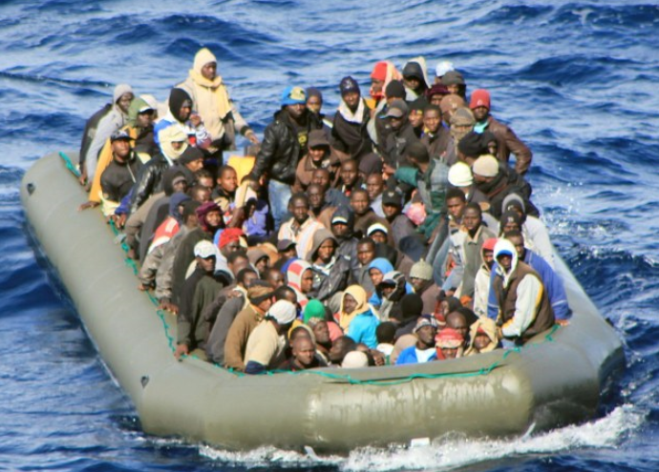
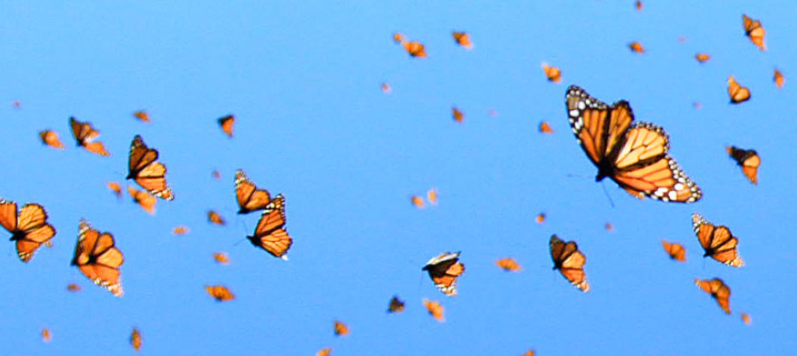
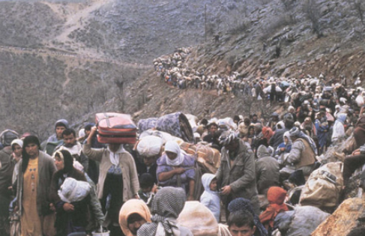
Shout the Word!
Migration
Relocation
Notes:
1 minute
Give me a shout out!
Look at the pictures and shout out the word that best describes the action being taken.

Slide 43
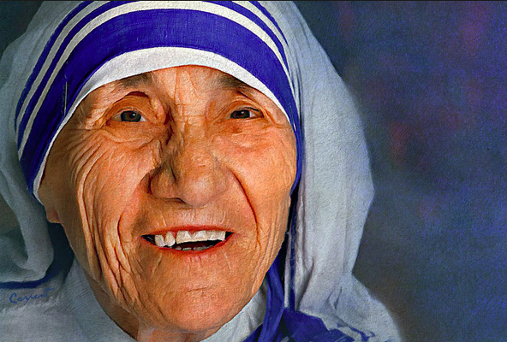
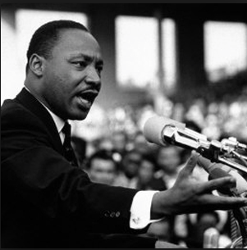
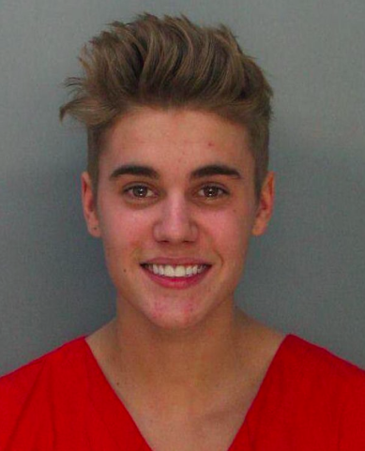
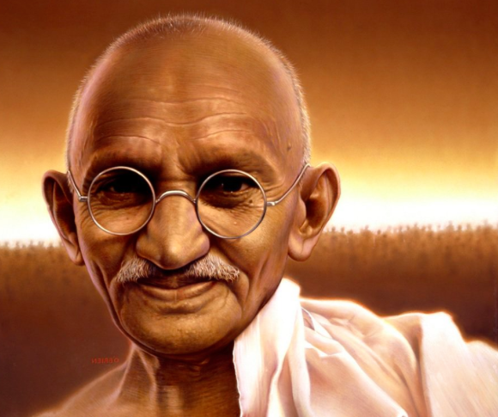
Shout the Word!
Nefarious
Virtuous
Notes:
1 minute
Give me a shout out!
Our two words are: Nefarious and virtuous, look at the picture and shout out the word that best describes the person.
Mother Theresa-virtuous
Gandi-Virtuous
Justin Biber-Nefarious
MLK-Virtuous

Slide 44
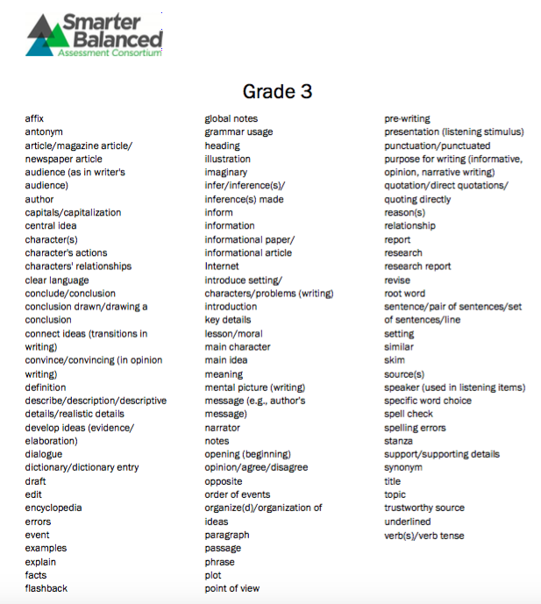
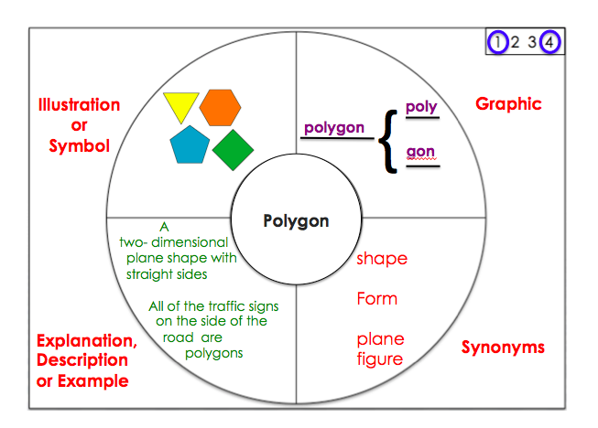
Your Turn!
Triads
Select a word from the vocabulary list
Create a circle map
Notes:
S
2 Min.
Explain: If I am classifying and categorizing the best advanced graphic organizer is “a tree map”; here’s an example of a word that appears on sba and I know my students need to understand and be very familiar with.
Refer participants to the grade level list from SBAC and have them select a word and create a tree map to identify all the categories of that word. Example-genre, text

Slide 45
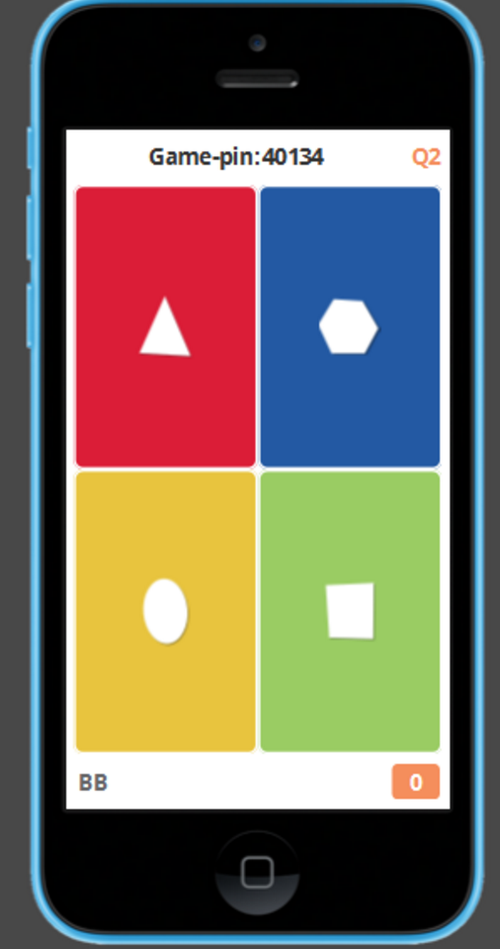
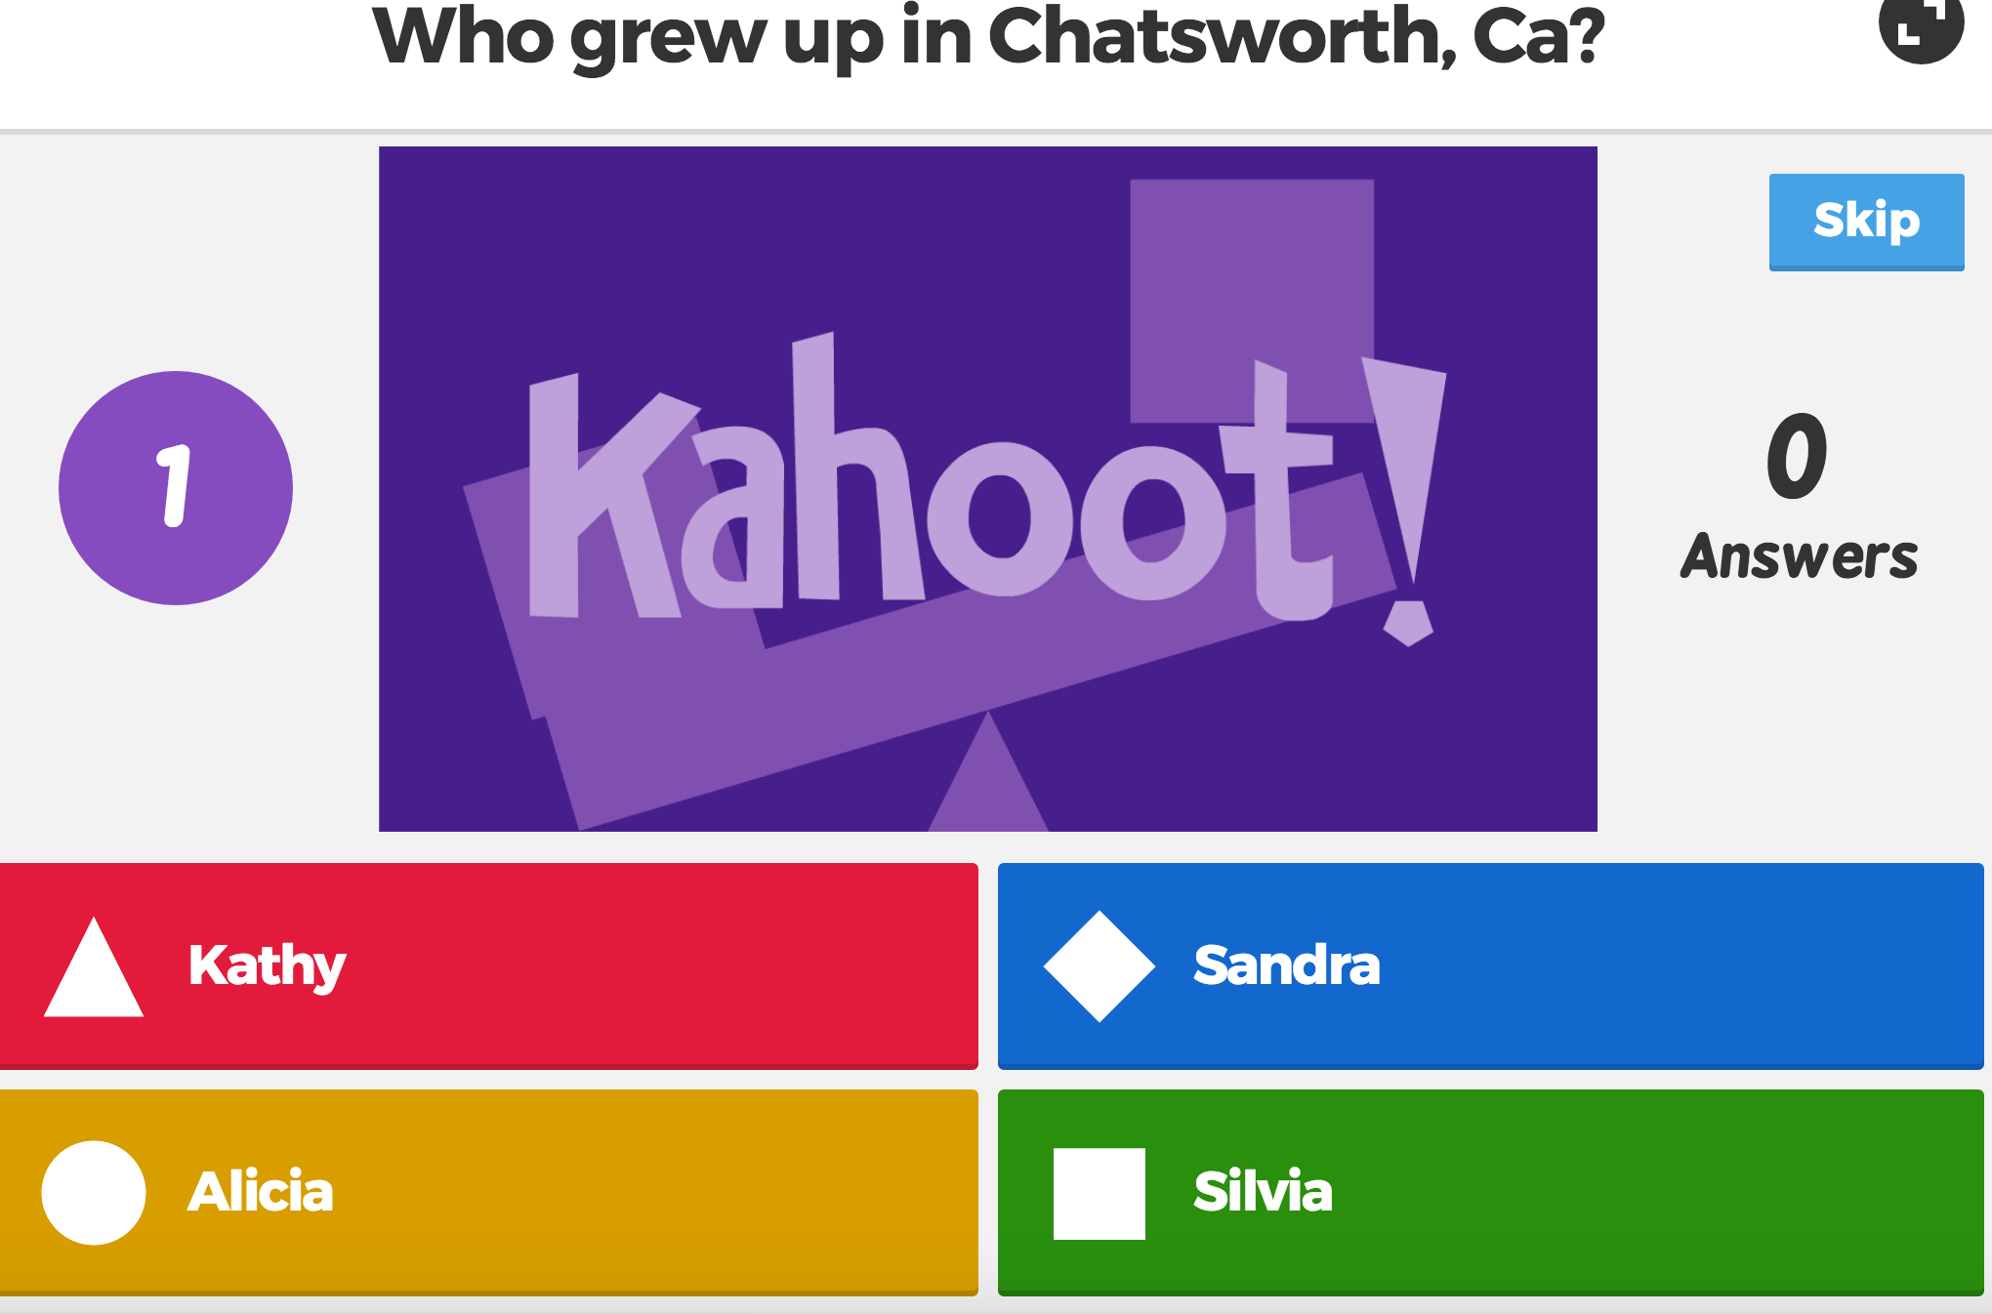
Kahoot.it
Today is…
Saturday
Friday
Sunday
Monday
Notes:
This is what the screen will look like…
This is what your phone will look like…
This is a free interactive game on getkahoot.com
Presenter, ensure you have clicked on the following link, this will give you access to the Responsive Vocabulary Game
Ask participants to:
Designate a table/group team name
Select a team leader
Team leader uses a mobile device to log into play.kahoot.it
They need to enter the game pin number that will appear on the screen when you launch the game
They need to enter their team name
They will read the question on the screen then they will enter their response on their device;
Their device will only display shapes
In order to win they need to be right and fast
https://play.kahoot.it/#/?quizId=34e483d3-1ec5-4100-84bd-a345528be6df

Slide 46
Click on the link below to begin the game
https://play.kahoot.it/#/?quizId=34e483d3-1ec5-4100-84bd-a345528be6df
Notes:
Make sure you are connected to the internet, otherwise the game will not work.

Slide 47
Musical Shares Rally!
Discuss
How will you use Responsive Vocabulary Strategies?
Each person has 1 minute to share.
Notes:
Explain the slide
Click on the speaker to paly music.
Allow participants to share 2 times.

Slide 48
Resources
Notes:
The following are resources to help us. Many of us have received these resources during our teaching career. If you don’t have these resources check with your out of classroom staff to see if they have the resources available in a storage bin or PD library.

Slide 49
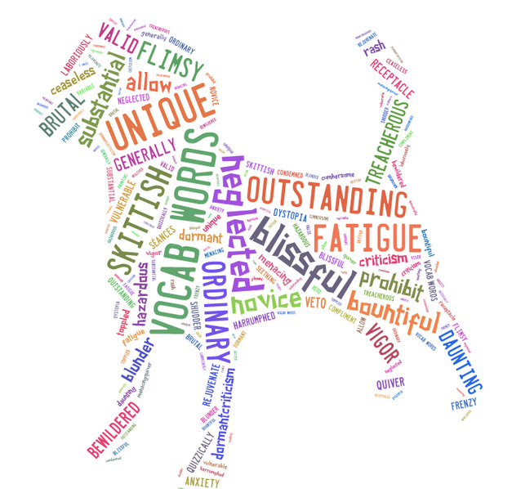
Shout- out!
Thank you!
Gratitude!
Bless you
Much obliged
Gracias
Notes:
Thank you!

