Slide 1
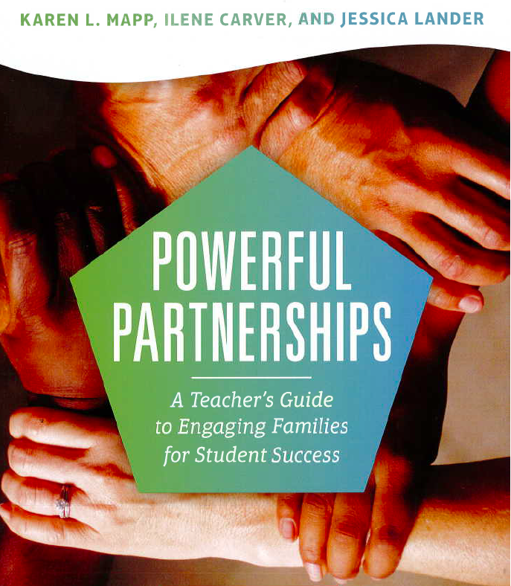

Slide 2
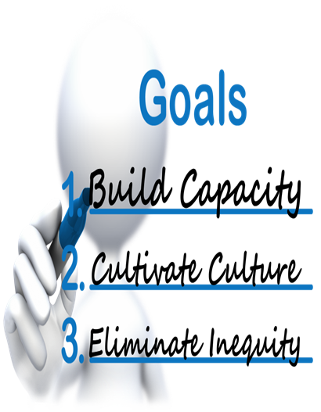
Outcomes
Educators will:
Develop community.
Identify beliefs, values, and assumptions educators have toward their students and their students’ families.
Develop an understanding of what culturally responsive parent involvement is.
Develop structures that build powerful partnerships with parents.
Notes:
Designed for teachers and focused more on approach than listing ideas, this book hopes to redefine the idea of successful engagement.
Data clearly shows that a meaningfully engaged family provides the support necessary to develop a student who is successful academically, developmentally, and socially.

Slide 3
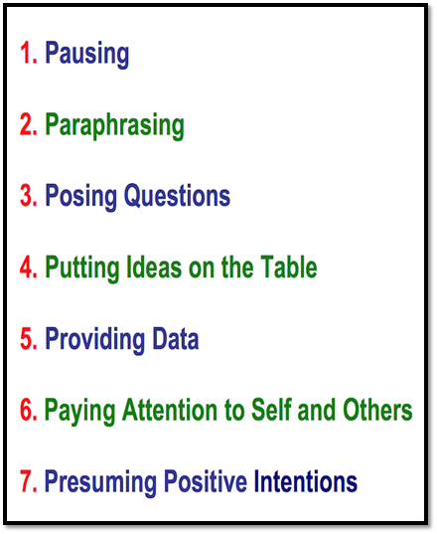
Norms of Collaboration
To develop and sustain productive group interaction.
To enhance the quality and productivity of all forms of conversation in any group.

Slide 4
Chapter 1 Summary
Examine Your Core Beliefs
Chapter 1 engages you in conversation about your core beliefs and the roles of families in the education of the students in your classroom. Becoming a skilled practitioner in family partnerships does not start with in-depth knowledge of the research on family partnerships, it starts with YOU!

Slide 5
What do you know about students’ lives?
What do you know about their families?
Examine
Your Core Beliefs
Your assumptions about your students’ educational values
Your assumptions
about your students’ homes
Notes:
The most important component for building successful partnerships with families is YOU.
The best place to begin this work is with self-examination. Much of what we do as practitioners is shaped by our beliefs and values. Your decisions about how to engage with families will be anchored by your beliefs about them and their communities.
While we might not always recognize it, many past experiences, both positive and negative shape, our interaction with families.
Let's examine our biases and assumptions that we may have about the families of our children because if we left them unexamined, they can hamper our ability to create effective partnerships with them.
Your own family’s experiences with your elementary school teacher, your memories of how welcoming your school was to you as a child; your previous conversations with parents of your students, strained or relaxed, all subtly affect how you will approach this work.
Think back to your own childhood and own school experience. How was your family connected or not connected to your school and educational experiences?
Have the participants examine their biases and assumptions by engaging them in answering the following questions:
How might these past experiences, positive or negative, shape your beliefs as a teacher about family engagement?
What fears, hesitations, or apprehensions do you have about this work?
What barriers will you have to overcome?
What passions, beliefs, and commitments do you bring that will help you do this work?
Encourage them to be as honest and detailed as they can be. Affirm them that no one else is going to read this.
As a teacher you have to believe that no matter your families’ race, ethnicity, socioeconomic background and circumstances, home language, and education background, that they can, especially with your willing, support, enhance their already existing ability to encourage and foster their children’s learning.

Slide 6
Essential Core Values
to Build Vibrant Partnerships with Families
All families have dreams for their children.
All families have the capacity to support their children's learning.
Families and staff are equal partners.
The responsibility for cultivating and sustaining partnerships among school, home, and community rest primarily with the school staff, especially school leaders.
Notes:
Have a participant read the Four Essential Core Beliefs aloud from the slide. Tell participants that Karen L. Mapp stated that school leaders and teachers who were exemplary family engagement practitioners have a set of beliefs that guided their work with families.
Ask them the following question:
Which of the Four Core Beliefs is most reflected in the work your school does with families?
Throughout this book, we aim to enhance your skills, knowledge and mindset to do this work well. Let’s focus on these dispositions and beliefs to partner effectively with families.

Slide 7
Core Belief 1:
What prevents parents from getting involved?
Past and current disrespectful and discriminatory interaction parents may have experienced at school
All families have dreams for their children and want the best for them.
A family goes
bankrupt.
Notes:
Too often, teachers are skeptical because they know parents who do not show up for Parent Night or who do not return our phone calls. Too often, they assume that they “just don’t care.” Such conclusions are too often made about parents of color, parents who come from poor neighborhoods, or parents who have come her from other countries.
We need to acknowledge that these families are facing challenges that may prevent them from taking more active roles in their children’s education, as well as the past and current disrespectful and discriminatory interactions they may have experienced in schools.
Families have different priorities, but all have dreams for their children and want them to succeed. They have high expectations for their educational achievement, which is important to acknowledge and validate. Poverty, mental health issues, housing, and other systemic and structural factors impact families’ engagement in their children’s education, but we have seen time and time again in our work with families that they DO care and want the best for their children.
Believing that parents are not invested in their children’s future because they do not seem to engage with the school couldn’t be further from the truth.

Slide 8
Core Belief 2:
Deficit-Based Lens vs Strength-Based Lens
Did you utilize all the strengths and assets your families have to offer?
How might you gather information from families to expand this list?
Everyone Has a Tool Kit
All families have the capacity to support their children’s education.
ACTIVITY
Make a list of the positive characteristics that describe your school families
Use Asset-Based Language
Notes:
Engage the attendants in the following exercise as a way of examining the implicit biases and assumptions they may have about families at their schools.
Explain that according to Karen L. Mapp, schools often use a deficit-based lens versus a strength-based lens as it relates to families and community.
Have the following categories written on a paper. Participants will make a list of the strengths and different types of knowledge and abilities that their families have for each of the categories. Have participants focus on the positive characteristics that describe their families.
Race and ethnic diversity
Socioeconomic diversity
Occupational diversity
Educational diversity
Religious diversity
Political diversity
Talents
Other
After they finish creating the lists, have them answer the following questions:
Did you utilize all the strengths and assets your families have to offer?
How might you gather information from families to expand this list?
What are the risk of Deficit-Based Thinking?
When we use negative lens or “deficit-based thinking,” we primarily see problems. We don’t believe that our families have the skills and capacities they need to help their children; rather we see their lack of education or English skills as impossible barriers to overcome and prohibitive of any attempts to cultivate and maintain effective home-school partnerships.
Seeing our families through this deficit-lens may also make us think that it is our job to “rescue” or “save” our students from what we regard as awful circumstances, neighborhoods, and families. Resisting the savior mentality - the feeling that we need to rescue our students and their families from themselves - can be difficult. But believing that our students need to be saved from their culture, their communities, or their families runs counter to building relationships with families and respecting the valuable knowledge that they bring to the learning in the classroom.
The second of the two lenses, Strength-Based Thinking,” allows us to see the strengths of our families. Parents have tremendous capacity and knowledge that can contribute to their children’s learning and growth. They have a tremendous treasure trove of skills that schools all too often don’t acknowledge, respect, or tap. Families are a trove of information about their children - their learning habits, their interests, the subjects that they enjoy, and even the things that set them off and the things that they don’t like -and all this information is valuable to you.
We offer you the analogy of a tool kit- everyone has a tool kit, but our tools are different. By sharing our tools, we cultivate a wonderful system of support for the children. Seeing the value of everyone’s tools - their skills and knowledge - is what it means to have a strength- or asset-based mindset.

Slide 9
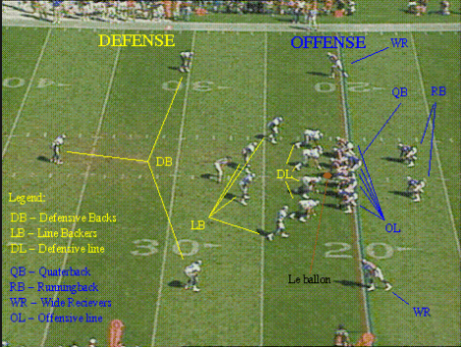
Core Belief 3:
Parents Are “Equal Partners”
American Style Football Team
Families and school staff are equal partners.
Notes:
Explain to participants that to create the best experiences for students, we need the knowledge that only families can provide. Embracing equal partnership as a core belief means that you know that your families have skills, ideas, and knowledge about the their children and community that are of value to you. Karen L. Mapp uses the metaphor of an American-style football team when she talks about about parents as “equal partners.” She says:
“Even if you are not into football, you might know that the team consists of two parts, the offense and defense. The offensive part of the team moves the football down the field and scores the touchdowns (the points). The defensive part of the team has the job of stopping the opponent’s offense from scoring points. Imagine if the two parts of the same team didn’t respect each other and the skills each brought to the task at hand. Imagine if the offensive team said: “Hey, we do all of the work to score the points! Those guys on the defensive part of the team aren’t half as important as we are. NO way is their importance equal to ours!
Is the team going to be successful? Probably not, because the two parts of the same team - a team that has specific goals to meet - don’t see themselves as equal partners in the work. Each player on the team, whether he or she is on the offensive or defensive side has to value the skills and knowledge of every single one of his or her teammates. Even though each member has different roles to play, all are important to a successful outcome.
When families see that you value them as members of “the same team” of student achievement and development, they will also value your skills and knowledge as their children’s first teacher.
Have teachers read silently A TEACHER’S STORY: Shifting My Core beliefs on page 27. Then have participants share their reactions/thinking about this teacher’s story.

Slide 10
Core Belief 4:
Building trust
takes time and persistence.
The responsibility for cultivating and sustaining partnerships among school, home, and community rests primarily with school staff, especially school leaders.
Notes:
Explain to participants that according to Karen L. Mapp, in most schools there exists a hierarchy between school staff and families, which often reflects historical racial, class, and educational hierarchies and divisions. School staff must be willing to reach out and break through existing barriers.
Ensure teachers understand that they have to be persistant. Families will not just greet you with open arms and pile into your classroom just because you made one call or sent home a nice letter (though such welcoming invitations are important). It may take repeated tries with some families before they understand that you authentically care about their children. Building trust takes time and persistence.
Interest and motivation alone would not facilitate positive working relationships with families. We need to be patient and persistent.
When students and parents experience trauma and violence, it should not come as a surprise that the effort to engage them requires patience, understanding, and the development of trust. When parents are not responsive, it is not because they do not care, but because, “We have not yet proven that we can be trusted.”

Slide 11
Reflection
Which of the Core Beliefs might you embrace more closely?
Notes:
Reflection:
Have participants TPS to reflect by asking them the following questions:
Which of the core beliefs might you embrace more closely?
What is your experience with building partnerships with families across race and class lines?
Say: Your core beliefs are the foundation of your ability to partner with families and meaningfully engage in this work. If you approach the work with families with a strength-based mindset, you will succeed in your efforts to build positive, meaningful relationships with parents.
We hope we also raised the issue of the importance of taking time to analyze some of your stereotypes and prejudices. This is particularly important if you come from a racial, ethnic, socioeconomic, or religious background that is different from that of your families.
According to Karen, we all have prejudices, not because we want them, but simply because we are so continually exposed to misinformation about others. For additional information, see pages 33 and 34.

Slide 12
Learning Walks
Student Led Conferences
Engage in authentic conversations with families (e.g., Donuts with Dad, Muffins with Moms, Coffee with the Principal etc.)
Make personal invitations and phone calls
FACE-TO-FACE INTERACTIONS
Traditional Power Dynamics
Teachers as experts and families as passive recipients
Authentic Teacher-Parent Relationships
“We need to prove that we can be trusted.”
Parent-Teacher Conference
Bake Sales
Open House
Cultivating Authentic Teacher-Parent Relationships
Notes:
Dr. Soo Hung, Associate Professor of Education at Wellesley College, describes what she learned from her research on cultivating authentic teacher-parent relationships.
Teachers often work in schools where traditional power dynamics - teachers are experts and families are passive recipients of information - are pervasive. The parent-teacher conference, bake sales, the fall open house.These practices are ingrained in the life and culture of every school and often perpetuate these unexamined, traditional relationships. In schools that serve marginalized communities the unbalance of power can be even more severe when educators’ beliefs are framed by deficit views.
If time permits, have participants read and talk about other teachers’ experiences and how these experiences contributed to changing their mindset about engaging families, pages 32-33.

Slide 13
Family Engagement Is Worth It!
l
Try it out, feel successful, and that will make you want to continue.
Notes:
As teachers we put our energy into working with students, so they can be successful. We may feel that we do not have time to work with parents and we may believe the returns are not worth it. But be aware that some families have had terrible experiences with schools, and for them, this is going to be a new starting point. We need to train ourselves to be respectful to a parent, even under the most difficult circumstances.This will help us to connect with parents and to work together for the rest of the year and transform their child.
We need to organize opportunities for family members to be able to show their support, to stand up and be counted. You might not change your belief until you experience what happens when you reach parents with respect.

Slide 14
Building Meaningful Partnerships
You serve as an important building block to greater family engagement in your school.
Your success will inspire others.
Notes:
We all know that engaging families is easiest with the backing and support of the school administration. Your outreach to families may serve as an important building block to greater family engagement in your whole school. As your colleagues begin to see your success in building meaningful partnerships with families, others may want to join in.

Slide 15
Chapter 2 Summary
Harness the Power of Partnerships
This chapter builds our understanding of what great partnerships look and feel like. Powerful partnerships are the foundation of successful family engagement in your classroom and your school. While we have already examined the mindset you need to engage successfully with families, it is also important to understand that education is a team sport, and the more in sync the team, the better the results.

Slide 16
A Quick Thought
Walk around the classroom and focus your attention on the four posters displayed on the walls.
Stop by the poster that best describes where you and your school are on the path to effective family-school partnerships.
Have a discussion with the others and describe why you believe your school is at this level.
Use the Fortress through Partnership School description to support your discussion (Powerful Partnerships-Chapter 2).
Be ready to share your thoughts with the whole group.
Where are you and your school on the path to effective family partnerships?
Notes:
Explain to participants that as educators, we all know that education is a team sport, and the more in sync the team, the better the results. .
Engage participants in a “Quick Thought Experiment” and have them write their thoughts down. Say: “Think about someone in your work or at home with whom you enjoy collaborating. This could be your husband, colleague, a friend, or even a sibling. What makes it a productive relationship? How might you collaborate or share different task? How might your strengths and weaknesses complement one another?”
Now look at your list - share with us one of your lists- and the qualities you identified- are the same traits that you can use to help foster effective partnerships with parents, creating working relationships that complement and build on each other as equals.
Ask them;
How do we create these partnerships?
What do they look like in practice?
And what skills and capacities will we need?
After they finished sharing their lists, explain to participants that when Karen L. Mapp and Ann Herderson were discussing the materials for their book Beyond the Bake Sale (2007), they created a tool/rubric the describe what one would see, hear, and experience in a school at various partnership levels. This rubric is outlined in Chapter Two of Beyond the Bake Sale: The Essential Guide to Family-School Partnerships describes the four categories of schools to help us understand how welcoming and active they are in partnering with families.
Display the posters describing the Four Types of Partnerships:
Partnership School
Open Door School
Come If We Call School
Fortress School
Have a participant read the content of each poster aloud.
Then have them:
Walk around the classroom and focus your attention on the four posters displayed on the walls: Fortress School, Come If We Call You, Open Door to Door School, and Partnership School.
Stop by the poster that best describes where you and your school are on the path to effective family school partnerships.
Have a discussion with the others and describe why you believe your school is at the level.
Use the Fortress through Partnership School description to support your discussion (Powerful Partnerships-Chapter 2.)
Be ready to share your thoughts with the whole group.
It is recommended to have the participants read chapter two: Harness the Power of Partnerships before they attend the professional development

Slide 17
Which Kind of School Is Yours?
Pp
BELOW BASIC
BASIC
PROFICIENT
ADVANCED
Fortress School
Come-If-We-Call You School
Open-Door School
Partnership School
Family Engagement Is a Priority
Family Engagement Is a Commitment
Family Engagement Is a Low Priority
Don’t Call Us, We’ll Call You Culture
High priority on engaging families
Recognizes its role in student success
Parents are welcome to visit the school
Family Engagement is at a high level. Teachers and Parents are working in partnership.
Families are actively engaged in decisions of school improvement
Low priority on engaging families
Most basic effort, mainly compliance events
Positive about engaging families, but the schools sets the terms of engaging.
Notes:
Say: You might be feeling unprepared to build stronger partnerships with families. You may have never received extensive training in how to engage families. You may even think that it is very challenging. You are not alone. In a U.S.-based 2009 survey (Markow and Pieters, 2009), teachers and principals identified family engagement as the most challenging component of their responsibilities. Families, too, may feel unprepared to be powerful partners. They might face cultural and structural barriers that make it hard to connect with teachers and schools. They might find it challenging or intimidating to navigate our complex educational system, or they may feel unwelcome or not trusted in our school halls and classrooms.

Slide 18
The Five Process Conditions for Parent Engagement
Link to Learning
Relational
Developmental
Collaborative
Interactive
Align all events to the learning and developmental goals for the students.
Strive to bulid and develop relationships between teachers and parents, and between parents.
Assume families already have strengths and knowledge.
Honor families’ home languages, cultures, and experiences. Relationships between families and teachers are reciprocal.
Strive to be interactive, providing many and varied opportunities to practice and learn together.
Notes:
Introduce the researched-based dual capacity Framework, which identifies five process conditions that align with the practices at Partnership Schools.
These conditions articulate what we know about the steps we need to build into our planning of a family engagement event, program, or initiative to ensure success.
Five Process Conditions:
Linked to learning
Whatever we plan must be aligned with the learning and developmental goals for the students. Ask yourself the following questions: “Do my families leave the events at our school or in my classroom knowing more about what children should know and be able to do? Did we provide opportunities for our families to learn and master a new skill in support of a particular learning goal? If you answer “no” to any of these questions, you are not alone. Many schools events are out of alignment with the teaching and learning goals of the schools.
Rational
Our effort must be intentional about building relationships of trust and respect with families. Families and school have to be given the opportunity to share stories and build partnerships that are built on respect in order to create strong partnerships.
Developmental
Assume families already have strengths,skills and knowledge that can help us to develop and grow as practitioners.
Collaborative
The relationships between families and schools are reciprocal and builds on the strengths on both parties. Everyone is viewed through the asset-based lens. Under the collaborative process conditions, everyone is listened to , contributes, and is empowered.
These five guiding principles have help other teachers to transform traditional approaches into approaches that are grounded in the belief that parents are equal partners rather than observers.

Slide 19
Chapter 3 Summary
Welcome, Honor, and Connect With Our Families
This chapter will guide your thinking and practices as you build powerful partnerships. It will provide you with an outline of the strategies you can employ to get off to a great start with your families.

Slide 20
Rethinking Parent Engagement
The Four A Protocols
Directions:
Sit in a circle.
Read Chapter 3 silently.
Highlight the text and write notes in the margins or on “Post-it” notes in response to the following questions:
What Assumptions does the author hold?
What do you Agree with in this chapter?
What do you want to Argue with in this chapter?
What do you want to Ask the author?
What parts of the text do you want to Aspire to (or Act upon)?
.
What parts of the text do you want to Aspire to (or, Act upon)?
Notes:
It is recommended to have the attendants read this chapter before attending the professional development. If they have not read chapter 3, you need to give them time to read it during the PD.

Slide 21
Getting Started: The Joining Process
Welcome
Provide a list of school calendar reminders
Provide tips for the first week of school
Make a good first impression
Embrace and invite their engagement
Honor
Acknowledge their varied backgrounds, beliefs, and values
Have them give you information about their children’s needs and capabilities
Discard negative and inaccurate assumptions
Make a strong commitment to working with parents
Assume parents have their children’s best interest in mind
Value their knowledge of their children
Connect
First contact: Welcome phone calls
Provide opportunities for face-to-face interactions
Schedule home visits
Invite them into the classroom
HS teachers: Start with your advisory students or homeroom students
Welcome phone calls/Good news phone calls/
Conduct home visits in pairs
Reach out to families before the event (e.g., Back to School Night or Open House)
Have parents write a “Hopes and Dreams” Letter for their children
Notes:
When school staff welcomes parent participation in their children’s education, honors families’ unique contributions and engagement styles, and connects families to their children, families feel empowered to be engaged with their children and excited about building partnerships with school staff. These components make up the joining process, which provides you with an outline of the strategies you can employ to get off to a great start with your families.

Slide 22
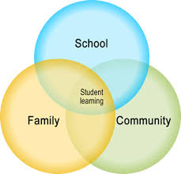
In this chapter, we focus on two essential and more formal educator/family meetings - Family Conference and Individualized Education Plan (IEP) meetings. Families’ voices and opinions have not always been valued in these meetings, and we want to stress here that they must be in order to help you transform these meetings into meaningful opportunities to partner with families.
Chapter 4 Summary
Transform Your Family Conferences and IEP Meetings

Slide 23
First Turn-Last Turn
Form groups of four of eight individuals
Assign some groups to silently read pages 74 to 83 (Parent Conferences). Other groups will read pages 83 to 100 (IEP Meetings).
Have each group select a facilitator.
Have members highlight three or four ideas that may help them transform their parent conferences or IEP meetings.
Ask facilitators to call on a person to start sharing ideas.
In turn, members share their ideas but without commenting on them. They simply name them.
In round-robin fashion, group members comment without cross-talk.
The initial person called on now shares his or her thinking about the item and therefore gets the last turn.
Repeat the pattern around the table.
SUGGESTION: Have members read the text before coming to the meeting.
Notes:
Before engaging participants in the First Turn-Last Turn protocol, ask them the following questions:
Why do we implement Parent-Teacher Conferences and/or IEP Meetings?
Do they expand understanding and skills?
What would happen if we no longer required Parent Conferences or IEP Meetings?
Who benefits from Parent-Teacher Conferences and IEP Meetings?
Who does not?

Slide 24
Existing State - Desired State Map
In your groups (table), create a desired-state map for your selected topic (Family Conferences or IEP Meetings).
What is your desired goal?
What would one see and hear when the desired goal is achieved?
Identify the resources required to achieve the desired result. Consider skills, knowledge, and assumptions about families, core values, and behavior.
Identify the structure of a Family Conference/IEP, list the resources, and develop a plan for creating them.
Notes:
Ask participants:
How Can You Transform Your Parent Teacher Conferences and IEP Meeting
What is your desired goal?
Say: We are seeing a movement away from parent conferences to parent-student-conferences or student-led conferences. Such conferences can take many forms and often involve students reflecting on their work, progress, and struggles in the weeks leading up to the conferences, and then presenting this materials and analysis to both their family members and their teacher.
Although student conferences are big improvements over the traditional parent-teacher conferences, we would like to provide a model that we feel really builds on the fundamental knowledge of all stakeholders. It is the Family Conference Model.
The family conferences model is more inclusive; it includes the student but also may include any of the people who are more important in the child’s life, for example, a grandfather, an aunt, or uncle, a godfather, or a cousin at the conference. By calling them family conference, we signal to families that we want to include whichever members of the child’s whole support network that the family wants present. We see the purpose of these conferences as creating space for collaboration.
Family conferences also provide opportunities for students to reflect on their learning. In this way, the student presentation helps builds strong relationships between school and home and creates an extended learning family.
In preparing for these meetings, we suggest you gather examples of your students’ work so you have enough on hand to review with families.
Have the participants review the Structure of the Family Conference in page 79.
Beginning
Middle
Ending
Give participants time to develop a plan. Even if their school does not provide time, we need to encourage participants to try to set up a meeting with every family they can.

Slide 25
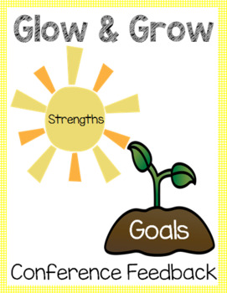
Existing Practices - Desired Practices
Desired-Practices
Resources
Family Conferences
Student-Led Conferences
Parent-Teacher Conferences
Waiting in line to meet any teacher in the school for 20-30 minutes.
Collaborative discussion about their children’s strengths and areas of growth.
Notes:
Stress the importance of starting a relationships with their students’ families early and on the right foot. Remind them if you take the time to build these partnerships early in the school year. Parents are willing to participate in events later in the semester, like family conferences, if you take the time to build relationships early in the school year. If you find the attendance at these events is low, ask yourself if you have started to build relationships of trust and respect with your families.

Slide 26
Existing Practices - Desired Practices
Desired Practices
IEP Meetings
Using the IEP Process to Collaborate
Resources
Notes:
Give participants time to work on their desired practices during the IEP meetings.
Say: Teachers can and must reject the traditional power hierarchy in the IEP process, and commit to partnering with families to make the process inclusive and reflective of the expertise that both families and professional staff possess.
Have participants read this section silently. Say: The simple yet powerful strategies that you will read about in this section center around two essential ideas:
Mindset: Believing that families must be partners in supporting students with disabilities.
Communication: Thinking intentionally about how best to ensure students’ and families’ legal rights; how to ensure fluid and regular two-way communication; and how to consistently create opportunities for increased collaboration.
Using the IEP Process to Collaborate
Remind them that it makes a big difference if a teacher or member of the special education team reaches out to the family in advance and talks to them about what questions and concerns they have.
Help families to understand the language of special education and work hard to keep out the jargon.
It is also important to include a lot of stories and examples of student work so that everyone can access and contribute to the picture that is being created.
When parents are asked to address how they see their child now and in the future, teachers and other staff should listen attentively. IEP meetings should be as much about listening as talking and sharing information.
Family and professional staff

Slide 27
Chapter 5 Summary
Maintaining Strong Family Ties Throughout the Year
This chapter presents four examples of strategies from teachers working in elementary, middle, and high schools. These strategies are aligned with the five process conditions of the framework we laid out and discussed in chapter 2. The goal is to inspire you to create or reshape strategies and events that you can use to maintain strong family ties during the school year.

Slide 28
Strategy Harvest
PROCESS
With a partner, review and clarify the list of strategies given in chapter 5.
Select two or three strategies and develop an application for your work.
Record your strategies on flip charts.
Be ready to present and explain how these strategies will help you build strong families ties throughout the year.
CHAPTER 5
Re-imagining Traditional Strategies
Notes:
Say: As you think about maintaining strong family ties during the school year, this chapter presents you with four examples of strategies from teachers working in elementary, middle, and high schools:
We Are All History Makers: The Family Story Project
Breaking Bread: A Case for Family Potlucks
Global Connection: Building Partnerships With Immigrant Parents Through Text Messaging
Middle School Passage Presentation
Say: As you read these teachers’ ideas, we suggest that you make a mental list of ideas, strategies, and approaches that you might wish to replicate.
What two or three ideas will you take from these teachers’ strategies to add to your own practice?

Slide 29
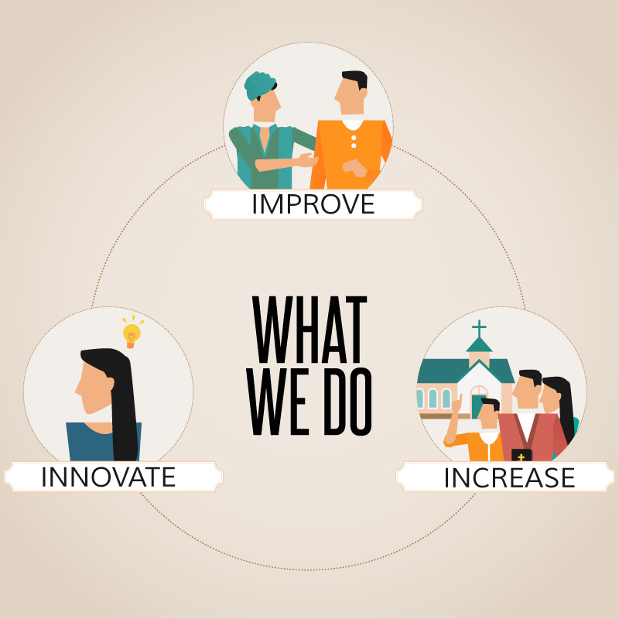
What is your Vision for Parent Engagement?
What strategies would you implement to initiate and maintain strong family ties during the school year?
Notes:
Say: Engaging families is not done in isolation. It is about building relationships, which means there should be a variety of opportunities to connect built into the school year.
Give them time to reflect by asking the following questions:
How do your current family engagement activities integrate the culture and stories of the children’s families?
Do your family engagement events create opportunities for families to engage with each other?
How often do your students get to see you interact with their families in the way described in the strategy: Breaking Bread?
What two or three ideas will you take from this book to add to your own practice?
What is your Vision for Parent Engagement?

Slide 30
Powerful Family Engagement tends to have a ripple effect across a school community, transforming mindsets and approaches
REMEMBER
The work you do can have an enormous and positive long-term impact on helping to change the culture of your entire school.

Slide 31
Thank you

