Slide 1
Engaging Families in Secondary Literacy
Erin Koning
Director of Literacy
National Literacy Initiatives
Scholastic Education
ekoning@scholastic.com

Slide 2
Notes:
https://www.youtube.com/watch?v=urU-a_FsS5Y

Slide 3
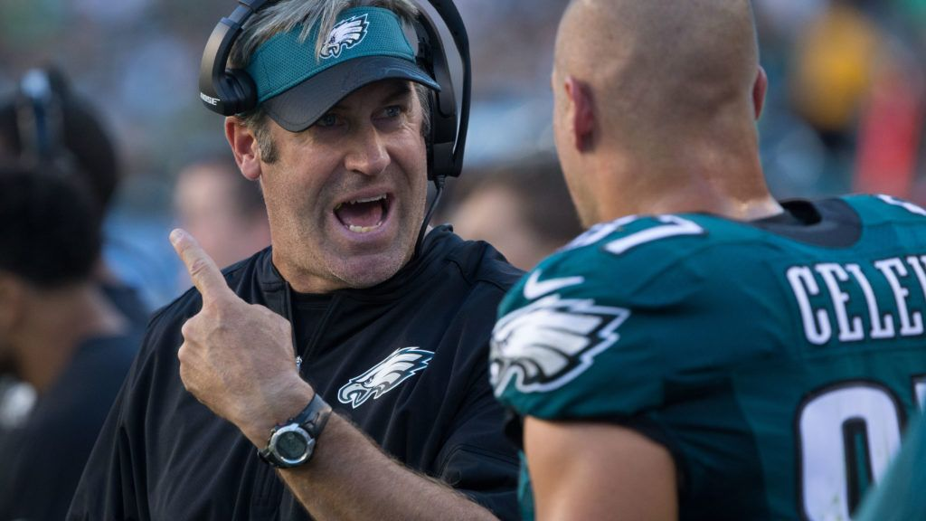
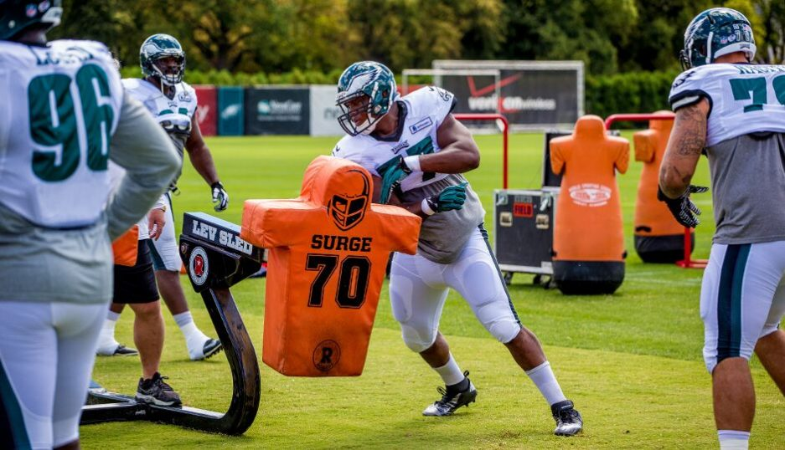
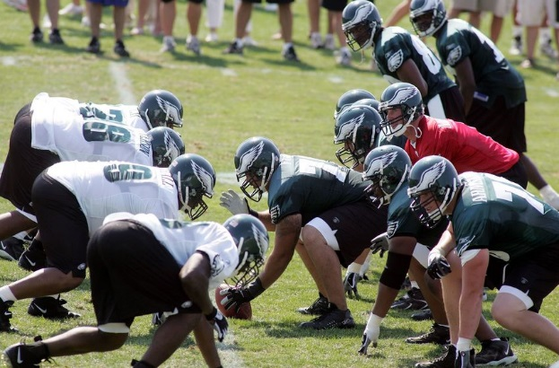
Build Adult Capacity

Slide 4
Families learn a new tip, tool or strategy.
They practice it.
They share what works best when engaging their child at home or their ideas/strategies.

Slide 5
Imagine that…
You are all family members attending a family literacy event at your child’s school.
I am your child’s teacher.
I am leading an activity in which my goal is to deepen your capacity to engage in acts of literacy with your high schooler.

Slide 6
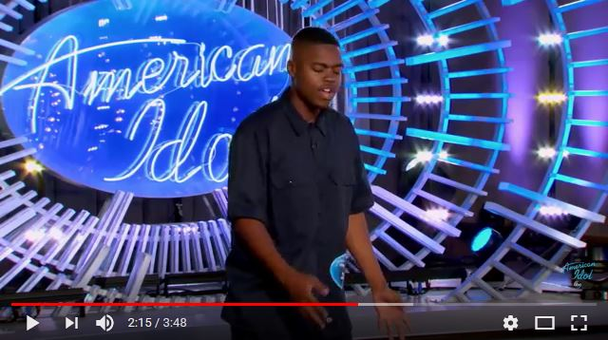
Literacy is Everywhere

Slide 7
Big Questions & Little Questions
Can he win the competition?
Why?
How do you know?
Do you think he has talent?
Why?
How do you know?
“…cite specific textual evidence when writing or speaking to support conclusions drawn from the text.”

Slide 8
Big Questions & Little Questions
Can he win the competition?
Why?
How do you know?
Do you think he has talent?
Why?
How do you know?
“Integrate and evaluate content presented in diverse media & formats, including visually and quantitatively, as well as in words.”

Slide 9
Big Questions & Little Questions
Can he win the competition?
Why?
How do you know?
Do you think he has talent?
Why?
How do you know?
“Present information, findings, and supporting evidence such that listeners can follow the line of reasoning and the organization, development and style are appropriate to task, purpose and audience.”

Slide 10
Partner up
One person be the family member, one person be the kid
Listen to the TedTalk together, and ask a big question and some little questions.

Slide 11
Big Questions & Little Questions

Slide 13
Reflect
Did you…
Learn a new strategy?
Practice it?
Feel your particular knowledge as a family member was valued?

Slide 14
TAKE ACTION

Slide 15
Erin Koning 310-433-8805 ekoning@scholastic.com
Twitter: @Erin_Koning
Andrea Anthony 562-480-2945 aanthony@scholastic.com

