Slide 1
Promoting Wellness in our School Community
Kezia Miller, Mental Health Coordinator
LaThanya Thomas-Carr, LCSW
Nicole McMahon, LCSW, M.A. Ed.
Notes:
Welcome participants.
Introduce presenters.
2 mins

Slide 2
Workshop Objectives
Participant will learn ways to create “Wellness” in our school community (home and school)
Participants will experience a workshop on Wellness designed to be delivered to parents.
Participant will plan the implementation of the workshop at their school site.
Notes:
2 mins

Slide 3
Workshop 1: Inclusion Activity
Small Fires
Gather in a small groups of four.
Stand in a small circle within arms length of each other.
Choose a Starter and a Reporter.
The person who has the closest birthdate will be the Starter.
The person who traveled the farthest will be the Reporter.
Each person will share beginning with the Starter:
Name
Role
How you feel about being here (positive or negative)
Your expectation about the workshop.
The Reporter will summarize the responses for the large group.
Notes:
10 minutes Maximum
Facilitator explains the purpose of an inclusion activity:
It allows participants to connect with one another.
It focuses participants attention on the workshop topic.

Slide 4
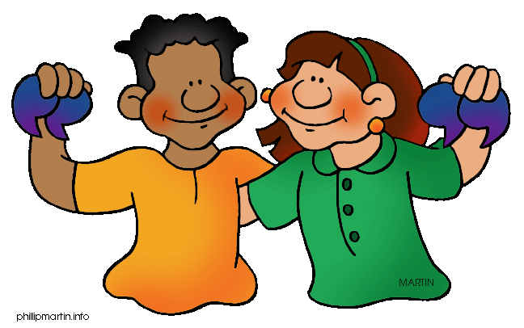
Workshop 2: Inclusion Activity
Quote Corners
Read the four quotes posted around the room.
Select a quote that resonates with you.
Move to that corner.
Share your perspectives about the quote with one other person in your corner.
Notes:
10 minutes Maximum
Facilitator explains the purpose of an inclusion activity:
It allows participants to connect with one another.
It focuses participants attention on the workshop topic.
QUOTE CORNERS DIRECTIONS
Find four quotes related to the workshop topic.:
Success is not final, failure is not fatal; it is the courage to continue that counts – W Churchill
Without a sense of caring, there can be no sense of community – Anthony J D’Angelo
If I have the belief that I can do it, I shall surely acquire the capacity to do it even if I may not have it at the beginning -M Gandhi
A mentor is someone who allows you to see the hope inside yourself - Oprah
2. Give participants a list of all four quotes and label each corner of the room accordingly.
3. Invite participants to move to the corner that contains the quote that most resonates with them.

Slide 5
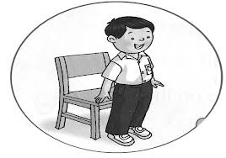
Workshop 3: Inclusion Activity
Like Me
Listen as the presenter makes
a statement.
Stand up if the statement describes you.
Look around the room and notice the other participants who are standing.
Notes:
10 minutes Maximum
Facilitator explains the purpose of an inclusion activity:
It allows participants to connect with one another.
It focuses participants attention on the workshop topic.
LIKE ME DIRECTIONS
Workshop facilitator selects 7 categories related to the topic to which participants will respond.
- “I have volunteered at a school.”
- “I can name an adult that believed in me”
“I hold a leadership role at my school”
“I believe every child has the capacity to be successful.”
“I exercise regularly”
“I attended an LAUSD school “
“I enjoy dancing”
2. Ask participants to stand when they hear a category
3. Announce the categories to the group.
4. As people stand, remind them to look around and see who else is also in that group.
5. Facilitator the experience and roles of participants in the room.

Slide 6
What is Mental Health?
Continuum
What does this look like?
State of Well Being
Notes:
Mental health is a continuum ranging from having a good mental health to having mental disorders.
A person will vary along this continuum at different points in his or her life.
At one end of the continuum -A person with good mental health will feel in control of their emotions, will have good cognitive functioning, and will have positive interactions with people around him or her.
This person performs well at work, in their studies, and in family and other social relationships.
When life gets challenging, it can compromise how well we work, study or interact with others- moving us down the continuum
Good coping skills can help us get back to wellness- resilience

Slide 7
Resilience
“Resilience” is the ability to bounce back from, or to successfully adapt to, adverse conditions such as personal issues, community problems, loss or adversity.

Slide 8
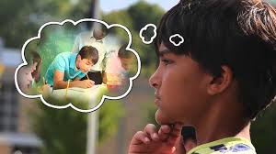
How Resilience is Built
Notes:
https://youtu.be/xSf7pRpOgu8

Slide 10
Keys Elements to Support Resilience
Sense of safety
Ability to be calm
Self-efficacy and community-efficacy
Connectedness
Hope

Slide 11
Sense of Safety
What you can do…
Provide structure at home and in the classroom
Create predictable routines that they can plan on
Provide clear expectations on their behavior in different situations
Provide consistency in daily routines, rules and when providing reinforcement
Notes:
ASK: How do we create a sense of safety in the classroom?
-structure
-routines
-rules
-expectations
These strategies also help students who have suffered trauma. Safety is created by having predictability, transitions, rules, schedules, etc in the classroom. These children, and all children, frankly, feel safe when they know what’s happening next.

Slide 12
Ability to be Calm
What you can do…
Teach children that self-soothing is an important part of self-regulation. Have frequent conversations with them about what they can do to feel better.
Use “mini check-ins” and “breath breaks” for deep breathing to help children remain mindful of how they are feeling and what they need to stay on task.
Use purposeful interactions with children to help them achieve emotional regulation and self-agency.
(Craig, 2016)
Notes:
Exercise – Smell in the rose, and blow out the birthday candle
It is crucial to help students calm down before we expect them to respond to questions, problem solve or engage in an assignment.

Slide 13
Self-Efficacy/Community Efficacy
What you can do…
Help children direct their attention to positive experiences happening in real time.
Provide children with opportunities to care for one another by providing a needed service or support.
Encourage children to notice and acknowledge the positive attributes of one another.
Provide children with opportunities to explore their interests through enrichment activities that broaden their experience and expose them to alternative ways of imagining a future. (Craig, 2016)
Notes:
What is self-efficacy?
-belief that one can: succeed, accomplish a task, complete an assignment, ect
It is strongly linked to their self esteem and confidence.

Slide 14
Connectedness
What you can do…
Be that healthy adult in the life of a student.
Engage children in partnership-building activities that help them acquire the self-confidence needed to participate in give-and-take relationships.
Notes:
speak to the challenge that teachers may face connecting with students that exhibit aggressive, defiant and disruptive behavior.
Establishing positive relationships with students can yield beneficial results, including: students are more likely to comply with rules and expectations, complete tasks and assignments, and want to please the teacher.

Slide 15
Hope
What you can do…
Cultivate optimism as this can counter the pull toward negativity, while offering students hope for the future.
Engage students in mindfulness activities (gratitude journals, fill your bucket wall)
Notes:
Optimism – can’t imagine, need to be taught
We create Hope by cultivating optimist in students. By providing opportunities to succeed and connect. By teaching to manage their emotions and not allow their emotions to control them. By recognizing that we can learn from our errors, choose better next time and take reparative steps toward resolution of an event.
In time, and with practice, students learn to interrupt the habitual path of negativity and compulsive re-enactments.

Slide 16
Parent Involvement Opportunities: Volunteering
Attend “Coffee with the Principal” meeting
Volunteer to help with school activities/events
Attend Parent Workshops
Help with “Drop-off” or Safety Valet
Help in the classroom
Notes:
10 minutes maximum for the 3 Parent Involvement slides.

Slide 17
Parent Involvement Opportunities: School Governance and Committees
Assist with school-wide events that promote wellness
Volunteer to be part of the School Site Counsel
Join the PTA
Notes:
10 minutes maximum for the 3 Parent Involvement slides.

Slide 18
Parent Involvement Opportunities: Parenting at Home
Listen to your children. Let them tell you about their friends, how their day went, what they are feeling, what their dreams and aspirations are
Enroll your child in extra-curricular activities (art, music, sports)
Eat at least one meal daily as a family
Regularly do things with your child – chores, fun activities and/or service projects
Spend time taking care of yourself; model for your children healthy ways of caring for oneself
Notes:
10 minutes maximum for the 3 Parent Involvement slides.

Slide 19
Resources
40 Developmental Assets Checklist
Echo Parenting & Education www.echoparenting.org
LAUSD’s Student Health and Human Services webpage at lausd.net
LAUSD’s School Mental Health webpage – smh.lausd.net
Family First website at www.familyfirst.net
Children Now website at www.childrennow.org
Notes:
2 minutes
Review steps in how to search within lausd.net
Parent centers have computers to use
http://www.got40.org/documents/ChkListEng.pdf

Slide 20
Next Steps/Evaluation
Pick one way you will help create wellness at school or at home
Share with your elbow partner what you have chosen
What do you need to get started
Who will you ask for help?
Notes:
5 minutes

