Slide 1
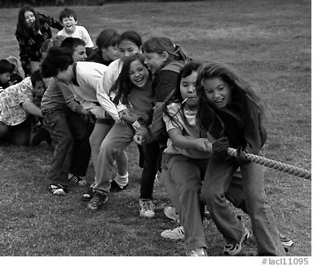
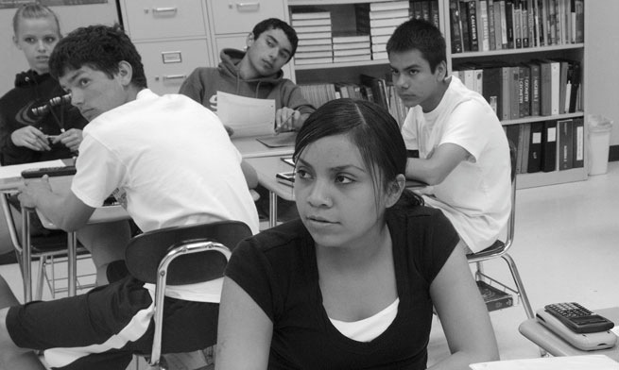
Through the Eyes of a Diverse Learner
English Learners (ELs), Standard English Learners (SEL), Students with Disabilities (SWDs)

Slide 2
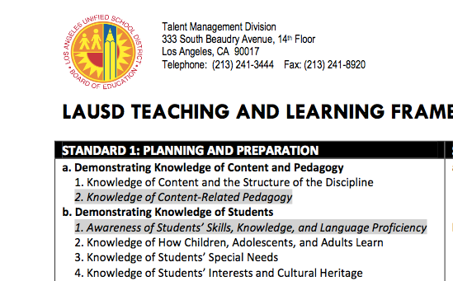
Teaching and Learning Framework
Standard 1: Planning & Preparation
b. Demonstrating Knowledge of Students
1. Awareness of Students’ Skills, Knowledge , and Language Proficiency

Slide 3
Today’s Session
Three-part session
Original sessions are part of English Language Development (ELD) Professional Development (PD) modules with the following topics:
Long-Term English Learners (LTELs)
English Learners (ELs) with Disabilities (ELWD)
Standard English Learners (SELs)
Resources available at ESCWEST.NET under English Learners Programs—ELD Instruction Secondary

Slide 4
LAUSD Students
LAUSD Classrooms
Standard English Learner Programs
57 Schools
Reclassified English Learners
138,000
Dual Language and Bilingual Programs
79 programs
English Learners
157,000
Long Term English Learners
38,000
Notes:
Slides 5: (1 minute)
Why/Purpose: To get an understanding for the need and purpose of the new ELD Standards by reviewing the diversity of LAUSD student population
How: Walk participants through the number of students in each program that are reflective in the Master plan.

Slide 5
Building a Network of Support
Objective: Discover the potential within ourselves to teach our diverse learners how to be resilient and bounce back when faced with adversity
Language Mode: Interpretive
Processing Activity: “Learn What I Can Do!”
Material: Student profiles “Learn what I can do!” worksheet Writing tool

Slide 6
“Learn What I Can Do!”
Locate the “Learn What I Can Do!” worksheet
Instructions:
Read and listen for directions
Listen for facilitator’s time cues as this is a timed activity
Use space provided in your worksheet to brainstorm and write ideas
Use sentence frame to orally share your answer with the group

Slide 7
“Learn What I Can Do!”
Protocol:
READ independently your student profile
WRITE your answers in the space provided
SPEAK only when it is your turn to share
LISTEN attentively when others share-out

Slide 8
“Learn What I Can Do!”
Resiliency: Student Profiles
Processing Activity: “Learn What I Can Do!”
Language Mode: A. Collaborative
6th Grade ELD Strand: 1. Exchanging information and ideas with others through oral collaborative discussions on a range of social and academic topics
6th Grade ELD Standard:
Bridging Level—A.1) Contribute to class, group, and partner discussions by following turn‐taking rules, asking relevant questions, affirming others, adding relevant information and evidence, paraphrasing key ideas, building on responses, and providing useful feedback.

Slide 9
LTEL Framework Review

Slide 10
Motivation
Objective: Examine the effects of demotivation on diverse learners
Language Mode: Collaborative
Processing Activity: Four Corners
Material: Four Posters with excerpts from Good to Great by Jim Collins Writing Tool

Slide 11
Four Corners
Locate the Four Corners Graphic Organizer
Instructions:
Listen for directions
Listen for facilitator’s time cues as this is a timed activity
Use space provided in your worksheet to brainstorm and write ideas
Identify motivator moves
Look for and discuss motivator moves
Complete Graphic Organizer

Slide 12
Four Corners
Protocol:
READ in collaboration with your group members
WRITE your answers in the space provided
SPEAK only when it is your turn to share
LISTEN attentively when others share-out

Slide 13
Four Corners
Motivation: From Good to Great by Jim Collins
Processing Activity: Four Corners
Language Mode: B. Interpretive
6th Grade ELD Strand: 6. Reading closely literary informational texts and viewing multimedia to determine how meaning is conveyed explicitly and implicitly through language
6th Grade ELD Standard:
Bridging Level—B.6.b) Express inferences and conclusions drawn based on close reading of grade‐level texts and viewing of multimedia using a variety of precise academic verbs (e.g., indicates that, influences).

Slide 14
Demotivation
Demotivation is relatively new and has not been fully adopted yet in the field of L2 (second language) research. However, Dörnyei [3] has attempted to provide a definition for it. Accordingly, demotivation “concerns specific external forces that reduce or diminish the motivational basis of a behavioral intention or an ongoing action” ([3, page 143]). Thus, demotivation could be regarded as the negative counterpart of motivation. Similarly, demotivators could be regarded as the negative counterparts of motives.

Slide 15
Demotivation
Four types of demotivation factors were discovered:
The teacher’s personal relationship with the students.
The teacher’s attitude towards the course or the material.
Style conflicts between teachers and students.
The nature of the classroom activities.
R. L. Oxford, “The unravelling tapestry: teacher and course characteristics associated with demotivation in the language classroom. Demotivation in Foreign Language Learning,” in Proceedings of the Teaching English to Speakers of Other Languages Congress (TESOL '98), Seattle, Wash, USA, 1998.

Slide 16
Causes of Demotivation Gillen-O' Neel & Fuligni, 2012; Jensen, 2005; Payne, 2008
Demotivation
Lack of positive relationships.
Awareness of disrespect toward one’s culture or ethnicity.
Perception that class assignments or tasks are irrelevant.
Perception of threats.

Slide 17
Question
“How do you manage in such a way as not to de-motivate people?” p. 74

Slide 18
Four Basic Practices
Lead with questions, not answers
Engage in dialogue and debate, not coercion
Conduct autopsies, without blame
Build “red flag” mechanisms

Slide 19
It’s all about language!
Objective: Produce an awareness plan addressing the students’ skills, knowledge, and language proficiency
Language Mode: Productive
Processing Activity: Decoding Complex Text
Material: “It’s all Greek to Me!” worksheet “Awareness Plan” Graphic Organizer Writing Tool

Slide 20
“It’s All Greek To Me!”
Locate the “It’s All Greek To Me!” worksheet
Instructions:
Read and listen for directions
Listen for facilitator’s time cues as this is a timed activity
Use space provided in your worksheet to brainstorm and write ideas
Use sentence frame to orally share your answer with the group

Slide 21
“It’s All Greek To Me”
Protocol:
READ independently and complete the task
WRITE your answers in the space provided
SPEAK only when it is your turn to share
LISTEN attentively when others share-out

Slide 22
It’s All About Language
Complex Text: Decoding
Processing Activity: Breaking the Code
ELD Standards Part III: Using Foundational Skills
The NEW California ELD Standards include a section (Part III) which highlights the importance of native language literacy and Foundational Literacy Skills.

Slide 23
SDAIE
The next slides will present a typical recommended SDAIE strategy for a sheltered course.
Can SDAIE help students gain access to the content?
Will SDAIE help students gain sufficient language to master CCSS standards and complete CCSS aligned tasks such as close reading, evidence-based questions, and understanding complex texts?

Slide 24
Ρεδ Χαρ

Slide 25
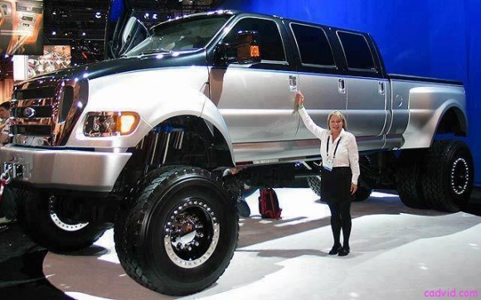
Λιττλε Χαρ
Βιγ Χαρ

Slide 26
Λιττλε Ρεδ Ριδινγ Ηοοδ

Slide 27
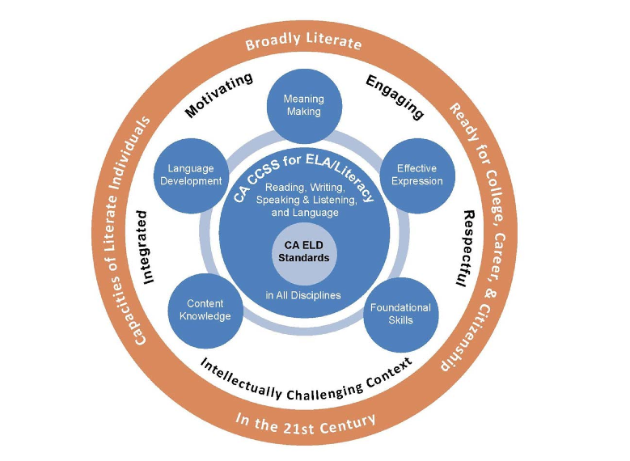
Meaning
Making
Language Development
Effective Expression
Content Knowledge
Foundational Skills
Notes:
(2 minutes)
Key Themes of ELA/ELD Framework Graphic
Say: This particular graphic helps teachers understand the goals, context, and purpose of the ELA/ELD Framework. If you look at the the middle (white ring) of the graphic you will see the words: Motivating, Engaging, Respectful, Intellectually Challenging Context, and Integrated. This middle ring speaks to the Instructional Context for Learning within the Framework. This context is culturally and linguistically responsive as it is outlined in the framework. We will spend the balance of the next hour introducing you to what CLR or Culturally and Linguistically Responsive pedagogy is.

Slide 28
ELA CCSS
 |  |  | RL 8.4 Determine the meaning of words and phrases as they are used in a text, including figurative and connotative meanings; analyze the impact of specific word choices on meaning and tone, including analogies or allusions to other texts.
C) Use knowledge of morphology (e.g., affixes, roots, and base words), context, reference materials, and visual cues to determine the meaning of unknown and multiple-meaning words on familiar topics. | C) Use knowledge of morphology (e.g., affixes, roots, and base words), context, reference materials, and visual cues to determine the meaning of unknown and multiple-meaning words on familiar and new topics | C) Use knowledge of morphology (e.g., affixes, roots, and base words), context, reference materials, and visual cues to determine the meaning, including figurative and connotative meanings, of unknown and multiple-meaning words on a variety of new topics. | RL 7.4 Determine the meaning of words and phrases as they are used in a text, including figurative and connotative meanings; analyze the impact of rhymes and other repetitions of sounds (e.g., alliteration) on a specific verse or stanza of a poem or section of a story or drama.
 |  |  | RL 6.4 Determine the meaning of words and phrases as they are used in a text, including figurative and connotative meanings; analyze the impact of a specific word choice on meaning and tone
 |  |  | RL 5.4 Determine the meaning of words and phrases as they are used in a text, including figurative language such as metaphors and similes.
CA ELDS

Slide 29
Planning for Diverse Learners
Planning Template: Planning for Diverse Learners
Processing Activity: Graphic Organizer
Language Mode: Productive
6th Grade ELD Strand: 10. Writing literary and informational texts to present, describe, and explain ideas and information, using appropriate technology
6th Grade ELD Standard:
Bridging Level—C.10.a) Write longer and more detailed literary and informational texts (e.g., an argument for protecting the rainforests) collaboratively (e.g., with peers) and independently using appropriate text organization and growing understanding of register.

Slide 30
“It’s All About Language!”
Locate the “It’s All About Language!” worksheet
Instructions:
Read and listen for directions
Listen for facilitator’s time cues as this is a timed activity
Use space provided in your worksheet to brainstorm and write ideas
Complete the graphic organizer to start developing your Awareness Plan to address students’ skills, knowledge, and language proficiency

Slide 31
Resources
Available at:
ESCWEST.NET

Slide 32
Instructional Support
Lester Malta, Secondary EL Instruction Coordinator, lester.malta@lausd.net, 310-914-2146
Robin Aaron, Least Restrictive Environment Specialist, rdc0157@lausd.net, 310-235-3775
Manuela Herrera, Least Restrictive Environment Specialist, mxh0774@lausd.net, 310-235-3732

