Slide 1
SPSA
How to Add or Delete a Designee

Slide 2
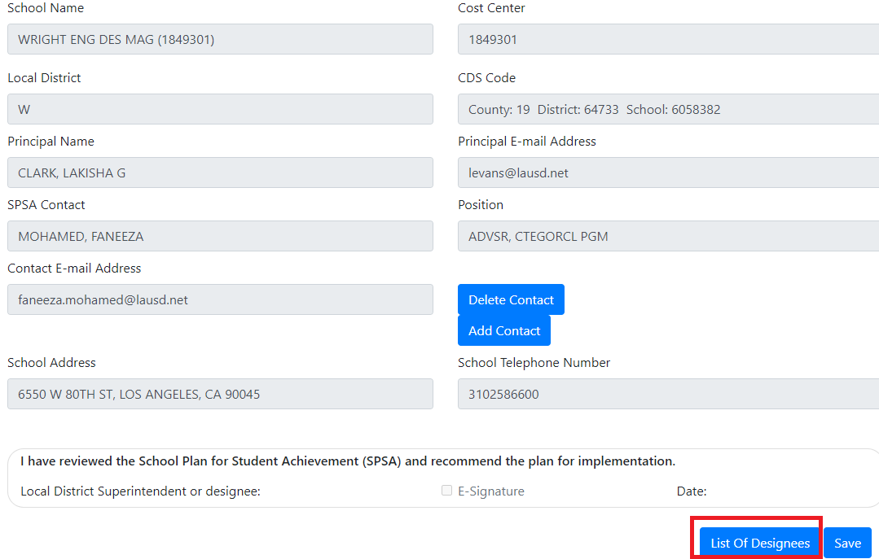
The Principal and his/her Assistant Principal are the only people who can add or delete a designee. After logging into the SPSA, to add a new designee or to remove an existing designee, navigate to the School Identification page and click on the List of Designees located at the bottom of the page.

Slide 3
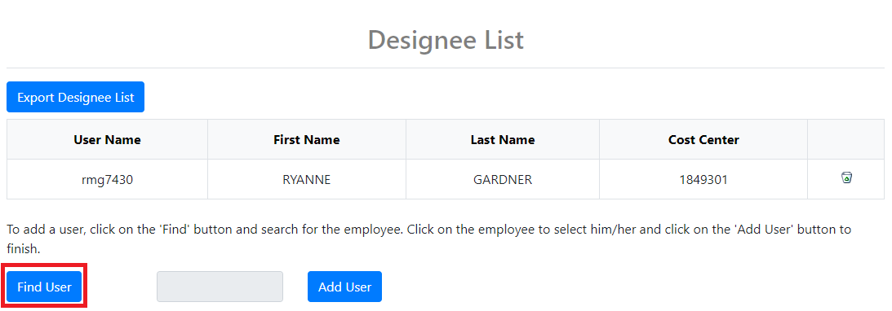
To add a new designee, click the Find button as shown.

Slide 4
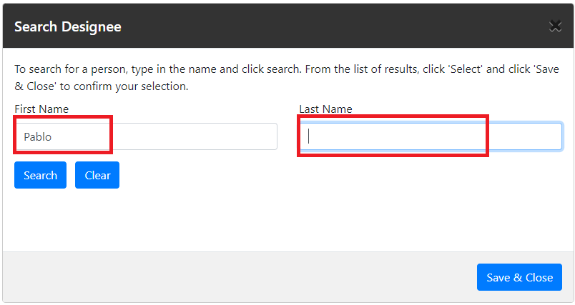
Enter the person’s first name in the First Name text box, or you can add their last name in the Last Name text box. You can enter both their first and last name also, to narrow the search.

Slide 5
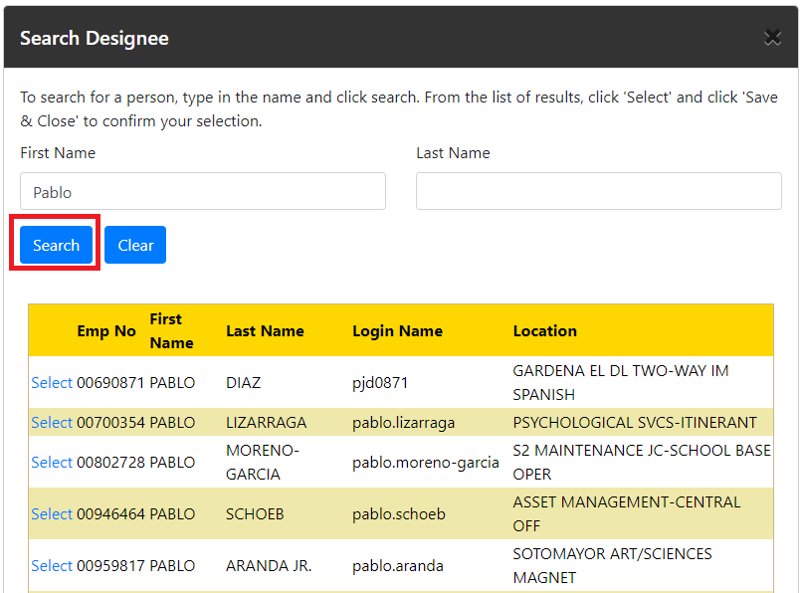
Click Search to see all the matches. Additional pages are located at the bottom of the search results.

Slide 6
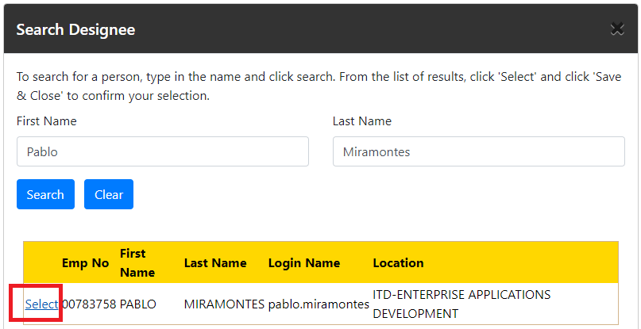
When the person searched for has been located, click the word ‘Select’ link as shown.

Slide 7
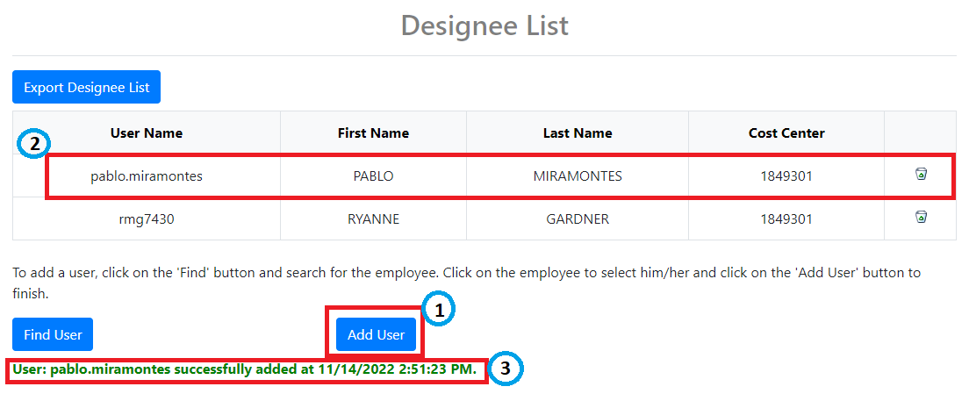
Click the Add User button.
See the new designee listed.
See the datestamp details. Note that the new designee has been auto-saved when the Add User button is clicked.

Slide 8
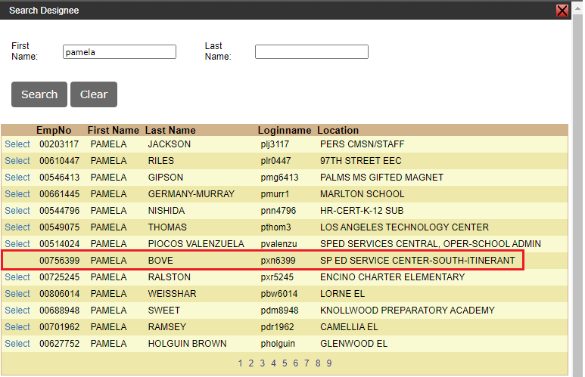
Note that you cannot select an Assistant Principal as a designee because the Assistant Principal has the same privilege as the Principal and already has the same read-write role. The word ‘Select’ will not appear for Assistant Principals and they cannot be selected, as shown.

Slide 9
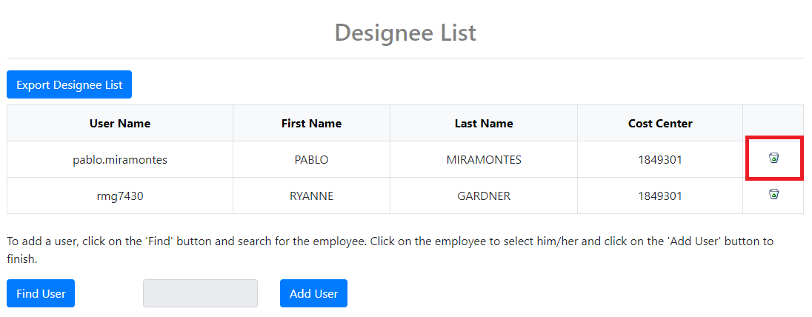
To delete a designee, click the trash can as shown. The system will prompt you to verify you want to delete before deleting the designee.

