Slide 1
Parent, Community and Student Engagement Strategic Plan’s Key Initiative: Welcoming and Engaging Environment
May 16, 2018
Notes:
Display slide and welcome participants.
Add presenter’s information to the slide.

Slide 2
Objectives
Identify benefits of creating a welcoming environment
Promote and sustain a welcoming school culture
Identify the components of the SMILE Campaign
Identify who is responsible for creating a welcoming environment
Identify different methods of communicating
Learn how to assess a school’s environment and develop a plan for developing a welcoming school culture
Notes:
Display slide and read the objective.

Slide 3
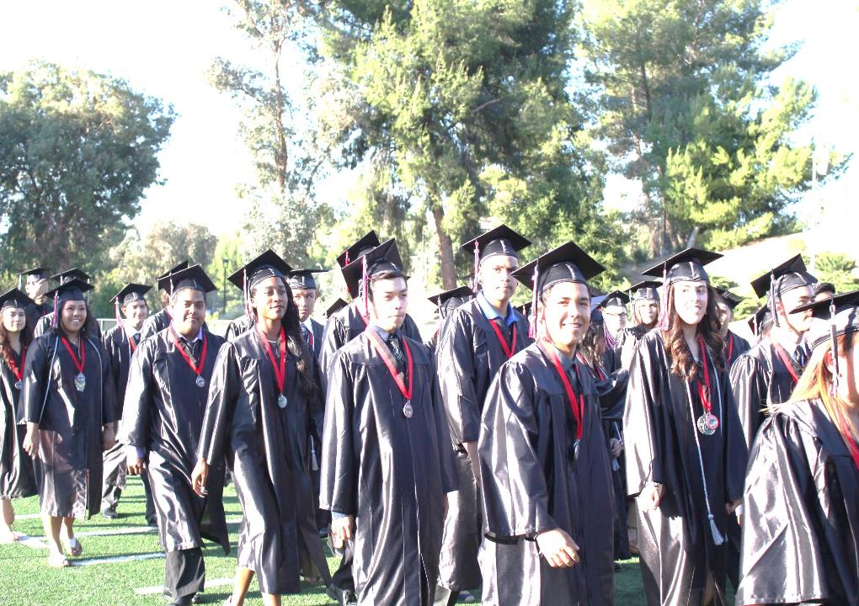
100% Graduation
Build a Solid Foundation for Early Learners
Parent, Community and Student Engagement
School Safety
100% Attendance
Proficiency For All
Strategic Plan Priorities
“Destination Graduation” Strategic Plan
2016-2019
LOS ANGELES UNIFIED SCHOOL DISTRICT
Notes:
Remind all participants that the Superintendent has established a goal of 100% graduation. There are 5 key priorities. Parent and Community and Student Engagement is one.

Slide 4
Key Initiatives
LAUSD Strategic Plan
Parent, Community, and Student Engagement
Welcoming Environment
Build Capacity to Engage
Promote Collaboration Between the District, Schools, and Community Partners
Notes:
Remind the audience that the Superintendent’s Implementation has 3 major areas:
Creating Welcoming, Engaging Environment for Parents, Community and Students
Build Capacity to Engage
Promote Collaboration Between the District, schools, and Community Partners

Slide 5
Goal Achievement Team (GAT) identified problems that were barriers to achieving our definition of success, and identified the root causes of those problems.
Central-based Root Cause Identification
Internal
Problem Statements | Central-based Root Causes
#1: We offer one level of parent engagement but do not differentiate parent engagement for our most vulnerable, high-need students and families. | RC #1: The district has not established an accountability expectation for engaging parents with high needs students through differentiation of services provided. RC #2: The district has been using a compliance lens to build capacity and therefore no districtwide plan has been developed for a school-based model that includes action steps for parent activities/meetings. RC #3: While we have a structure in place, we do not have parent outreach model/professional development in place within schools.
#2: Parent engagement training is not prioritized for principals and is not revisited after initial trainings. | RC #1: PCS and district leadership have not made parent engagement connected to academic achievement and accountability measures. RC #2: We have not created a defined process for school sites to collect, review, and report on their data from inputs to outcomes. RC #3: Measures and outcomes of parent engagement have not been an accountability measure up to this point.
#3: There is no cycle of process improvement for parent engagement. | RC #1: We have not looked at developing a process improvement model comprehensively, AND we have not looked at follow-up comprehensively.
Notes:
Important to stress the Central Based Root Causes and the problem statements

Slide 6
Strategic Plan Goal Achievement Team (GAT) DRAFT
The definition of success includes five aggregate measures that help to define success.
Definition of Success
Internal
Parents/guardians and school/district staff respect each other, and continuously commit to work as equal partners. Furthermore, all school/district staff and parents/guardians of students at each grade level will partner to support their students in meeting the milestones to graduate from our District being college, career and life ready (with a focus of our Student Need Index populations).
As measured by Parent/caregiver engagement in the following critical areas…
Significant parent/guardian participation in parent events, parent-teacher meetings, and services offered by LAUSD.
Significant parent/guardian awareness and/or responsiveness to student academics, behavior, and attendance (positive/negative) to graduate college, career, and life ready students.
Significant utilization of Parent Access Support System Portal (PASSport) in ways that reflect appropriate parent awareness and/or responsiveness of student academics, behavior, and attendance.
Significant degree of parents/guardians reporting welcoming and responsive schools and all school staff.
Significant number of parents/guardians report being supported to be equal partners, informed decision-makers, and advocates in school site and district leadership roles.

Slide 7
Decades of Research Shows…
In a 2005 meta-analysis study, William Jeynes found…
Family and community involvement in education correlates with higher student achievement outcomes.
School improvement occurs regardless of the parent’s education, family income, or background.
Parent involvement significantly affects academic achievement across all races, including African American and Latino children.
Notes:
A meta-analysis study uses a statistical approach to combine the results from multiple studies in an effort to increase power (over individual studies), improve estimates of the size of the effect and/or to resolve uncertainty when reports disagree.
Williams Jeynes

Slide 8
Decades of Research Shows…
The influence of parental involvement overall is significant for secondary school children.
The results indicate a considerable and consistent relationship between parental involvement and academic achievement among urban students, and it holds when disaggregated by gender and racial minority status.
Parent involvement as a whole affects academic outcomes… such as grades and academic achievement
Jeynes, W.H. (2005) A meta-analysis: The effects of parental involvement on
minority children’s academic achievement, 2005
Elbow partner
Notes:
Discuss bullets

Slide 9
What does the research say?
Students with involved parents, no matter what their
income or background, are more likely to:
earn higher grades and test scores, and enroll in higher-level programs
be promoted, pass their classes, and earn credits
attend school regularly
have better social skills, show improved behavior, and adapt well to school
-National Center for Family and Community Connections with Schools
Notes:
Share research

Slide 10
The 4C’s of Parent Engagement:
Parent Engagement: 4 C’s
Customer Service
Communication
Connections
Capacity Building
4 C’s -- Dr. Higgins, acquiring skills and characteristics that are time specific
Notes:
In the Dual Capacity Framework the work of Dr. Monica Higgins, the 4 C’s, is discussed. Professor Monica Higgins mentions, Career imprinting which is the process by which people in organizations cultivate and acquire common sets of skills and characteristics that are time and place-specific. The imprint is defined by what is called the 4Cs: Capabilities, which are the skill sets we acquire; Connections, or networks and alliances; Confidence regarding particular ways of learning; and Cognition – what we learn or assume about the best ways in which to work in order to accomplish our objectives.
In LAUSD we have our own time specific skills and characteristics that will frame and focus our work around parent engagement:
Customer Service
Communication
Connections
Capacity Building
Each of these focus areas have key components which need to be addressed to support parent engagement

Slide 11
Customer Service: Provide Support and Assistance
Customer Service
Welcoming environment
Following up on parent requests regarding student’s academic, social-emotional, or physical needs
Inviting parents as equal partners in decision making
Initiating providing information to parents required for student success
Notes:
The focus area of Customer Service has 4 components that we will review in this session.
Welcoming Environment
Follow up on parent requests regarding their children’s academic, social, emotional and physical needs
Invite parents to be equal partners in decision making
Taking initiative to provide parent information regarding what is required for students to succeed.
Today we will review what is needed for each one of the areas.

Slide 12
Welcoming Environment
A Welcoming Environment
For all!
Notes:
First we will look at A Welcoming Environment For All

Slide 13
Benefits for Creating a Welcoming Environment
Customer Service
Parents and families gain trust in the school and staff
Parents become stronger partners with both teachers and administrators when they feel welcomed and respected
Parents and community have a sense of belonging and become loyal members of the school community.
Notes:
The benefit of a welcoming environment is that parents gain TRUST in the schools and staff
Parents become stronger partners when they feel welcomed
Parent and community get a sense of belonging and become loyal members of the school.
It is important to remember that Parents are involved with their children education by being listeners as to what happened during the school day and supporting the extension of the school day through learning activities at home

Slide 14
Customer Service
Physical Environment
Customer Service
SMILE Campaign
Communication
COMPONENTS
Notes:
Here 4 components of a Welcoming Environment. Share the 4 components.

Slide 15
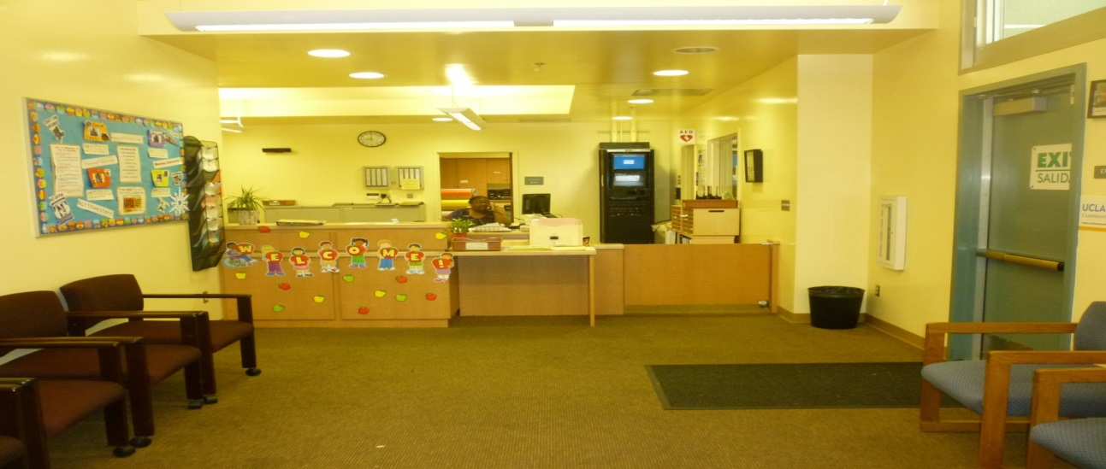
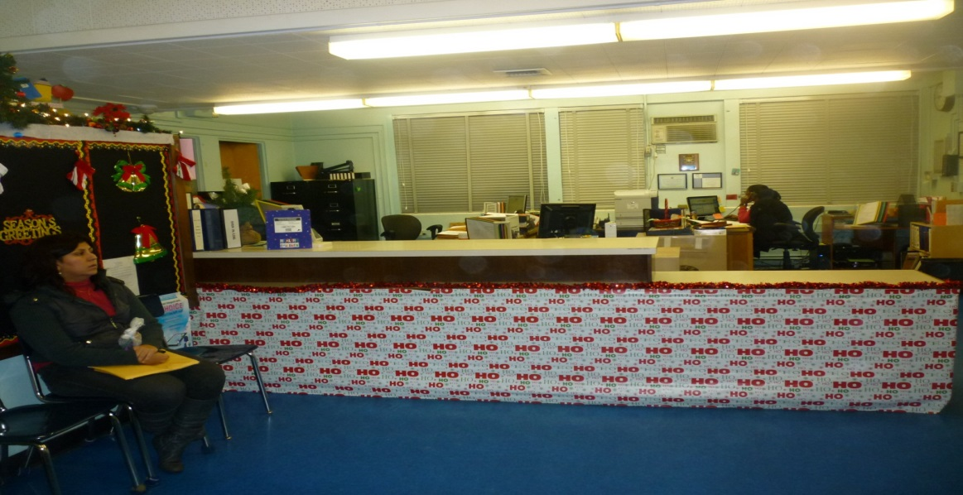
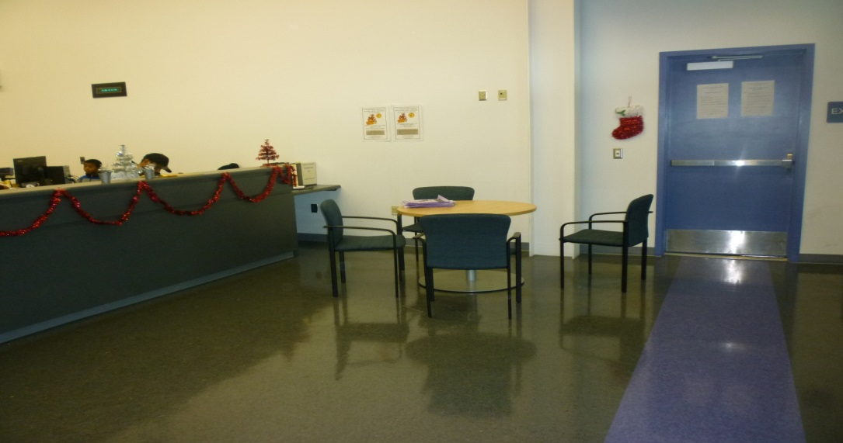
Physical Environment: Office
Notes:
The main office should feature some of the following:
College bound messaging (banners, pennants)
School focus areas: (STEAM, Dual Language, etc.)
Welcoming signage for parents
School/Parent Compact brochures out and available

Slide 16
Physical Environment: Curb Appeal: First Impression/Signage
Curb Appeal:
Front of school (clean, cement power washed periodically, plants, shrubs)
Speak to CPM about the curb appeal of your school
Signage: Welcome to parents, directions on how to get to Main Office, name of school
Notes:
Maintenance & Operations is key in helping you create a Welcoming Environment.
The CPM can help you create a welcoming environment for your community . It may take time but asking the CPM for shrubbery, painting of the front of the school, power washing can spruce up your campus.
In addition, partnering with community groups (e.g. Big Sunday) and your parents and staff for beautification events can also help your curb appeal.

Slide 17
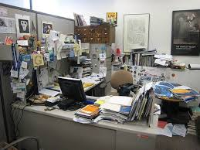
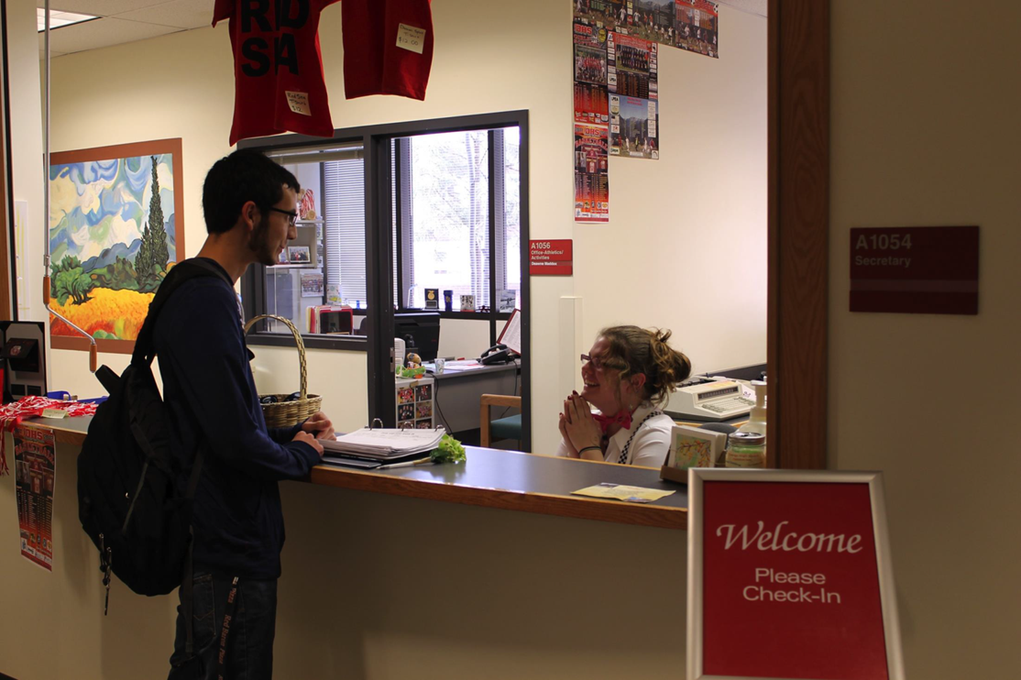
Physical Environment: Clear the Clutter
=
The School Entry is Clean with Clear Directions for Common Destinations!
Notes:
The office should be clutter free
The counter should be clear so parents can feel comfortable approaching the office

Slide 18
Physical environment should reflect the diversity of families included in the school.
Notes:
It is important for your school to reflect your student body. This could be done with pictures, books, student work.

Slide 19
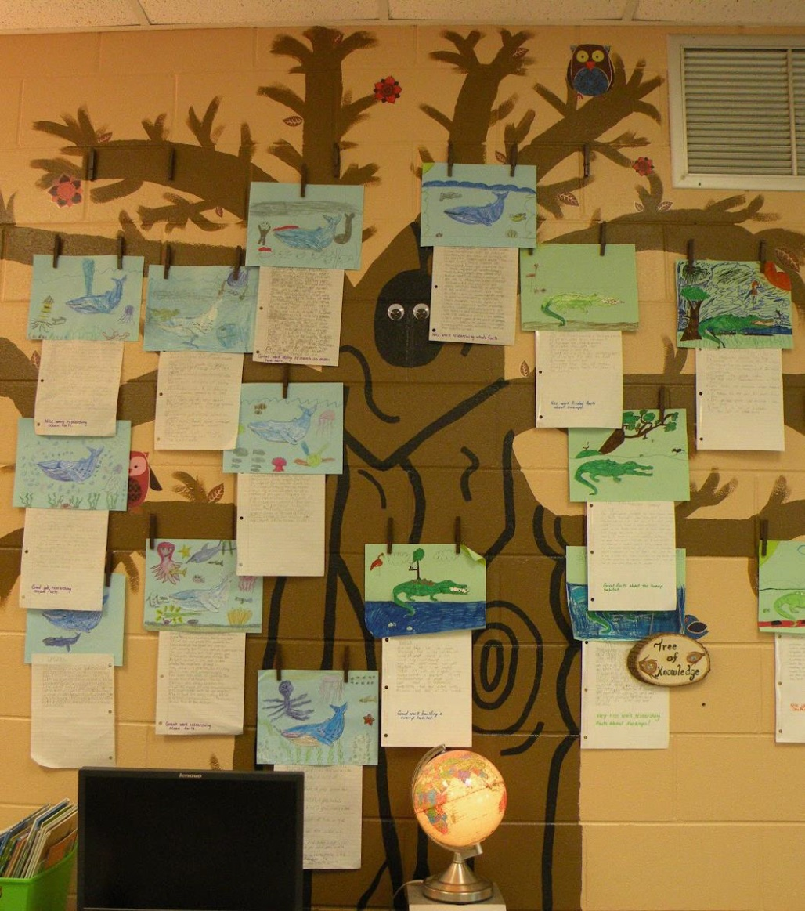
Physical Environment: Hallways With Current Student Work Posted
Notes:
Current student work in the hallways, main office will show off the work your students and teachers are doing. The work says a lot about your student and school culture.
If the work is torn and not replaced or outdated then a message could be made to the parents that staff has little care for the way the hall ways look.
Students should be reminded to take care of all work posted.

Slide 20
Physical Environment: The Parent Bill of Rights Displayed in the Main Office
Notes:
In 2010 the District passed the Parents as Equal Partners resolution. Part of this resolution was the Parents Bill of Rights.

Slide 21
Welcoming Environments
Notes:
Discuss Nordstrom and the customer service foundation that the company’s business was built on
Contrast to Ross, which has great deals, but may not offer the same level of service and support.
What type of customer service do you have at your school?

Slide 22
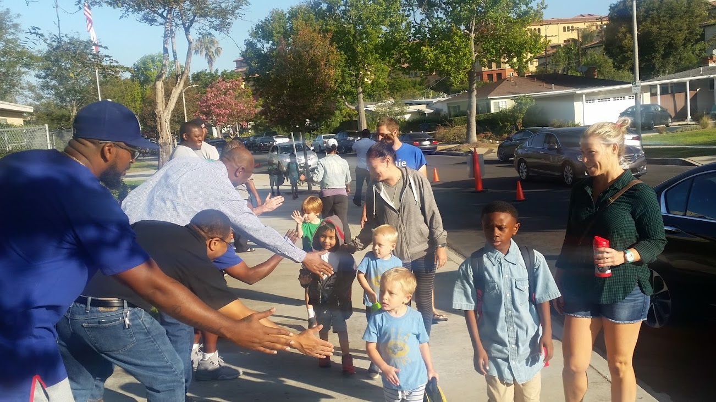
Notes:
How are children welcomed to the school when they arrive.
Who greets them?
What are the first people they see?
How do they start off the day by the smiles they see?
Loyola Village Elementary invites their dad’s to greet students arriving at school. A simple way to help build community.

Slide 23
WELCOMING STAFF
Notes:
Welcoming school staff – Key components include phone etiquette and interactions between staff, students, and parents.

Slide 24
Who is Responsible for Creating a Welcoming Environment?
In groups of 4 identify the people at a school responsible for creating a welcoming environment.
Under each position list what actions they need to take to create and maintain that environment.
Prepare to report to entire group
Group Work
Notes:
Have School Teams work together and share out

Slide 25
Report
Each group will chart a list of those responsible for creating a welcoming environment at schools.
Add ideas to your list that you hear from other groups.
Notes:
Have School Teams create a chart. Allow them to add ideas from other groups to their chart.

Slide 26
Who is Responsible for Creating a Welcoming Environment in a LAUSD School?
Principal
Office Staff
Custodians
Nurse
Librarian
Community Representative
Teachers
Teacher Assistant
School Parents
Building and Ground Workers
Cafeteria Manager
Plant Manager
Cafeteria Workers
Coordinators
Gardeners
Itinerant Staff
Assistant Principals
Assistant Principal-EIS
Coaches
Special Education Aides
Volunteers
Notes:
Are there any folks on this list who were not part of your team’s list? Discuss how they could impact Welcoming Environment.

Slide 27
Who is Responsible for Creating a Welcoming Environment in a LAUSD School?
Local District
LAUSD Central Office
Maintenance and Operations CPM, IOS
Food Services Supervisor
Local District Superintendent
Local District Directors
Local District Operations Coordinators
Local District PACE Administrators
Nurse Supervisor
District Parent and Community Engagement Staff
Bus Drivers
Division of Instruction
Division of School Operations
Associate Superintendent of Support Services
Superintendent
Notes:
Are there any folks on this list who were not part of your team’s list? Discuss how they could impact Welcoming Environment.
The bottom line: Everybody has a role to play in Welcoming Environment

Slide 28
Role of School Administrator in Creating a Welcoming Environment
School administrators should:
Be available to parents by phone and in person
Be respectful, including listening to parents’ ideas and concerns
Provide follow up actions to concerns
Provide training to parents
Communicate expectations for all staff
to be respectful to parents
Not have posted office hours for parents
Suggestion: If a principal is visiting classrooms or doing supervision, transparent communication would include posting notification in the office so that parents know why principal is not available.
Notes:
Read and discuss. Ask for feedback.

Slide 29
2. Follow up on parent request regarding student’s academic, social-emotional, or physical needs
Notes:
We will now review the 2nd subcomponent of the area of Customer Service: Following up on parent request regarding student’s academic, social emotional or physical needs.

Slide 30
Follow Up on Parent Requests Regarding Student’s Academic, Social-Emotional, or Physical Needs
Customer Service
How Does Your School Follow Up?
In your school teams describe how your school follows up with parents’ requests?
Chart your response by section:
Academic Request
Social-Emotional Request
Physical Needs
Gallery Walk with response
School Team Work
Notes:
Following up on parent concerns is part of customer service.
In your school teams describe how your school follows up on parent concerns.
What systems do you have to deal with parent concerns?
Chart responses by sections:
Academic Request
Social Emotional
Physical Needs
Ask School Teams to post their charts grouped by section topic.

Slide 31
Gallery Walk
As a group you will walk to each poster and discuss any new ideas
As you review the charts, check to see if there was information not mentioned in your charts
Notes:
Review the procedure for a Gallery Walk

Slide 32
Invite Parents As Equal Partners in Making Decisions
Notes:
How is your school honoring parents as equal partners in decision making? Is it more than just compliant councils?
Have participants share Best Practices.

Slide 33
Invite Parents as Equal Partners in Decision Making
Decision Making Around Student’s Instructional /Social-Emotional Needs
Intervention
Student Support and Progress Team (SSPT)
Counseling
Conflict resolution with other students
Gifted and talented
Notes:
Here are some possible options.

Slide 34
Invite Parents as Equal Partners in Decision Making
Decision-making around school governance:
School Site Council
English Learner Advisory Committee
Local School Leadership Council or Governing School Council
How to make the parents feel like equal partners?:
Provide them extra training
Provide parents with information on budgets
Provide parents with school data
Provide training on parliamentary procedures
Notes:
Here are some possible options.

Slide 35
4. Initiate providing information to parents required for student success
Notes:
How is your school disseminating information to parents? Is it working? How do you know? What could be improved?

Slide 36
Initiate Providing to Parents Information Required for Student Success
The first phone call/communication from the teacher to the parent should be done early in the first semester of school, building a relationship with parents around students’ successes and positive communication.
Schools should initiate providing the following information:
Intervention
Acceleration
Counseling Information
Notes:
Discuss: How often is a parent contacted early on and with a positive message? What would be the benefit?
*Postcards

Slide 37
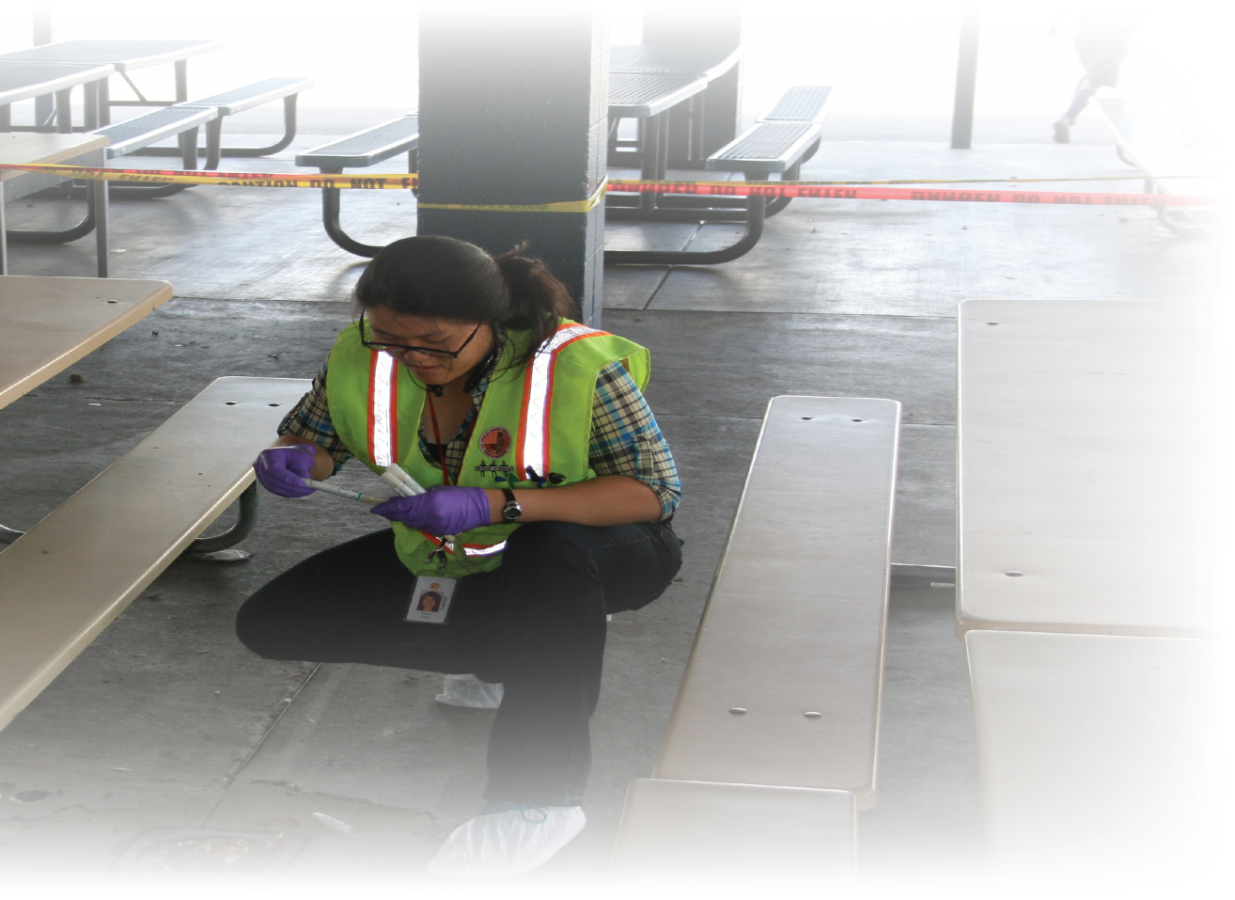
SMILE Customer Service Training

Slide 38
Positive Customer Service Experience
Share a recent positive customer service experience you received.
What made it so positive?
Make a list of why it was positive.
Table Sharing
Notes:
Do a Think, Pair, Share and ask volunteers to share with the group.

Slide 39
Why Smile?
Because how we treat each other matters!
https://www.youtube.com/watch?v=VxyxywShewI
Notes:
Share video

Slide 40
Why SMILE?
“When you smile, your brain is aware of the activity and actually keeps track of it. The more you smile, the more effective you are at breaking the brain’s natural tendency to think negatively. If you smile often enough, you end up rewiring your brain to make positive patterns more often than it does negative ones.”
Notes:
According to a “Fast Company” Magazine article, there was recently a study conducted on the effects of smiling on the human brain.

Slide 41
SMILE Campaign
What does SMILE stand for?
Smile
Make eye contact
Introduce yourself/Initiate a conversation
Let them know your ‘why’
Everyone is a customer
Notes:
Explain the acronym

Slide 42
What Is The SMILE Campaign?
Smile
Notes:
What does a smile signify in an initial meeting? Smiling as you answer the phone can be detected in your voice; even unseen smiles matter.

Slide 43
What Is SMILE?
Make eye contact.
Notes:
Why might this be important?

Slide 44
What Is SMILE?
Introduce yourself.
Initiate a conversation.
Ask how can you help them.

Slide 45
What Is SMILE?
Let them know your why.

Slide 46
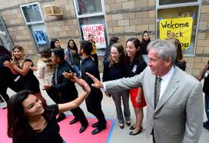
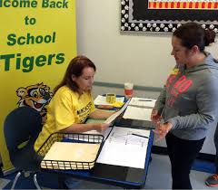
What is SMILE?
Everyone is a customer!
Notes:
All our stakeholders are customers.

Slide 47
How Do You Protect Your SMILE?
Get it into your muscle memory (practice makes perfect).
Keep it in front of you.
Have a game plan for “challenging customers.”
Remember your WHY.
Notes:
Get it into your muscle memory (arm activity)
Practice it everywhere with everyone
Elevator
Coworkers
Site visits
Keep it in front of you (wristband, pen, tent card)
Have a game plan for challenging “customers”

Slide 48
Muscle Memory: Table Talk
Discuss a customer service scenario or challenge that you often encounter. How can you apply SMILE to this situation in the future?
Notes:
Have Table Groups discuss

Slide 49
Keep it in front of you: Reminders
NOTE: Reminder table card given to each attendee
Smile
Make eye contact
Introduce yourself/
Initiate a conversation
Let them know your ‘why’
Everyone is a customer
Notes:
TELL:
Despite your best efforts, customers may still be dissatisfied with the level of service received. Address any issues quickly by utilizing the BLAST model:
Begin by believing their complaint and accept it with an open mind. Listen to the customers by utilizing active listening techniques such as visual cues and body language.
Next, apologize for the mistake, whether you personally made the mistake or not. Own the mistake and empathize with their situation. The next step is to satisfy your customer. Do not immediately offer a solution, rather ask the customers for a solution to the issue. If you cannot grant what the customer has requested, suggest an alternative and decide on a solution. Finish by thanking the customer for bringing the complaint to your attention, letting the customer know you appreciate them for expressing their concerns and for giving you the opportunity to correct the issue. By utilizing the BLAST model, we can make a lasting impression with the customer!
CLICK NEXT SLIDE

Slide 50
Game Plan: BLAST Model
Despite your best efforts, customers may still be dissatisfied with the level of service received. Address any issues quickly by utilizing the BLAST model:
B – Believe
L – Listen
A – Apologize
S – Satisfy
T – Thank
Notes:
Despite your best efforts, customers may still be dissatisfied with the level of service received. Address any issues quickly by utilizing the BLAST model:
Begin by believing their complaint and accept it with an open mind. Listen to the customers by utilizing active listening techniques such as visual cues and body language.
Next, apologize for the mistake, whether you personally made the mistake or not. Own the mistake and empathize with their situation. The next step is to satisfy your customer. Do not immediately offer a solution, rather ask the customers for a solution to the issue. If you cannot grant what the customer has requested, suggest an alternative and decide on a solution. Finish by thanking the customer for bringing the complaint to your attention, letting the customer know you appreciate them for expressing their concerns and for giving you the opportunity to correct the issue. By utilizing the BLAST model, we can make a lasting impression with the customer!

Slide 51
Believe
It is important to understand that your customer believes that your establishment has not met their needs.
Legitimacy of the complaint is irrelevant.
Every person is different.
Personal perception affects the perception of the service.
BLAST Model
Believe
L
A
S
T
Notes:
It is important to understand that the customer believes that your school has not met their needs. When listening to a complaint, know that the legitimacy of the complaint is irrelevant, what effects one person, may effect another person in a different way. The way a person feels could affect the perception of the service, so believe them before moving on to the listening phase.

Slide 52
Listen
BLAST Model
B
Listen
A
S
T
To properly address a customer complaint, first identify the actual issue.
Listen attentively to the customers concern.
Do not become defensive.
Clarify your interpretation of the issue.
These actions will provide the insight necessary to rectify the issue.
Notes:
To properly address a customer complaint, first identify the actual issue. Listen attentively to the customers concerns and write them down if you need to remember what was said. Do not become defensive, remember that the customer has the right to complain. Next, clarify your interpretation of the issue. Repeat back to them what you remember about the conversation or read back your notes you took. These actions will provide the insight necessary to rectify the issue in the future

Slide 53
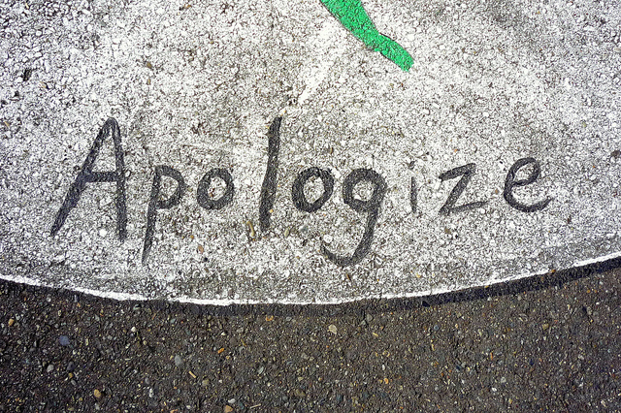
Apologize
A sincere apology shows the customers that you empathize with their concerns.
Offering a sincere apology can diffuse the situation and eliminate any further frustration.
When you apologize you:
Take ownership of the issue.
Comfort the customer.
Show you care about their needs.
BLAST Model
B
L
Apologize
S
T
Notes:
A sincere apology shows the customers that you empathize with their concerns. When you apologize you acknowledge and take ownership of the issue. This validates the concern and comforts the customer. Apologizing will also show that you care about the customer’s needs. A sincere apology can diffuse the situation and eliminate any further frustration, but remember, apologizing is not great customer service, fixing it is.

Slide 54
Satisfy
BLAST Model
B
L
A
Satisfy
T
The customers’ perception of service is based on how the experience matches their expectations.
Satisfactory customer service occurs when expectations are met.
High satisfaction occurs when service exceeds expectations.
Low satisfaction occurs when service falls short of expectations.
Note: We only notice experiences that are different than what we expect.
Notes:
The customer’s perception of service is based on how the experience matches their expectations. Satisfactory customer service occurs when expectations are met. High satisfaction occurs when service exceeds expectations. Low satisfaction occurs when service falls short of expectations.
Note: We only notice experiences that are different than what we expect.

Slide 55
Thank
BLAST Model
B
L
A
S
Thank
Thank your customers genuinely and sincerely.
Thank the customer for:
Bringing the situation to your attention
Caring enough to provide you with an opportunity to improve
Giving you a chance to correct it
Notes:
Thank your customers genuinely and sincerely. According to the White House Office of Consumer Affairs, for every 1 customer that complains, 26 other customers remain silent. When a customer complaints, thank them for bringing the situation to your attention. This says that they care enough to provide you with an opportunity to improve their experience. This is your chance to correct it and win the customer back.

Slide 56
Remember Your WHY: Be Inspired

Slide 58
Welcoming Environment Walkthrough
The Walkthrough is a visual tour that a team of staff and/or parents and community takes to assess the key components of a welcoming environment at the school.
A Welcoming Environment Checklist is used by each team member to record his findings to provide input for recommendations on enhancing the school’s environment.
Notes:
Read slide
Review Welcoming Environment Checklist

Slide 59
Recommended Walkthrough Process
Conduct training on school expectations for a welcoming environment.
Create a team to establish a welcoming environment.
Conduct a Welcoming Environment Walkthrough.
Each team member completes the Welcoming
Environment Checklist.
Team debriefs and collaborates to complete the Welcoming Environment Recommendation Form.
School develops and implements Welcoming Environment Plan.
Reevaluate school’s welcoming environment at the beginning of each semester.
Notes:
It is recommended that the walkthrough be completed at the beginning of each semester, or more often as needed. This allows time to implement the plan before another walkthrough. The ongoing process ensures that the school’s environment is being attended to regularly.
The same team or a new team can do the walkthrough each time.

Slide 60
Communication
Notes:
Now we are going to talk about communication and how school communication will help your school with Customer Service, Welcoming your parents and having them feel a part of the school

Slide 61
First impressions aren’t determined by what you say but HOW you say it.
Notes:
First impressions matter. Make it count.

Slide 62
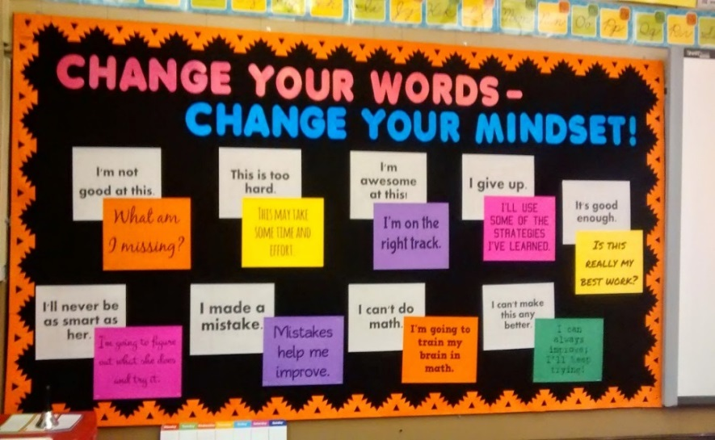
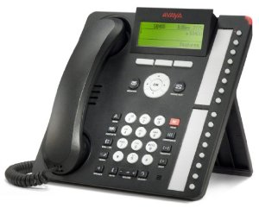
Effective Differentiated COMMUNICATION
Notes:
Communication – key for schools to provide information. Key components include phone calls, newsletters, forms, bulletin boards, and the school’s website. What other forms of communication are you using?

Slide 63
Multiple Ways to Communicate
Notes:
Here are some other ways of communicating with families.

Slide 64
Multiple Ways to Communicate

Slide 65
Effective Communication Practices
Communication method by office staff, whether by phone or in person
Tone: Friendly, respectful
Words: Professional, respectful
“May I help you?”
“Thank you.”
“I will leave a message for the teacher.”
“Let me get the information you need.”
“Good morning” “Good afternoon”
Notes:
Office staff represents first point of contact with parents. A timely greeting is important.

Slide 66
Effective Communication Practices
Communication method by teachers, whether by phone, email or in person
Tone: Friendly
Words: Professional, respectful. Teachers should tell parents:
Your child has many talents.
Your child has a great sense of humor.
Your child needs help with knowing his basic
sight words. Let me give you a list of words
he can use.
Notes:
Training teachers to work with parents may be necessary. Use the 2 staff trainings requirement of Title 1 to build these skills.

Slide 67
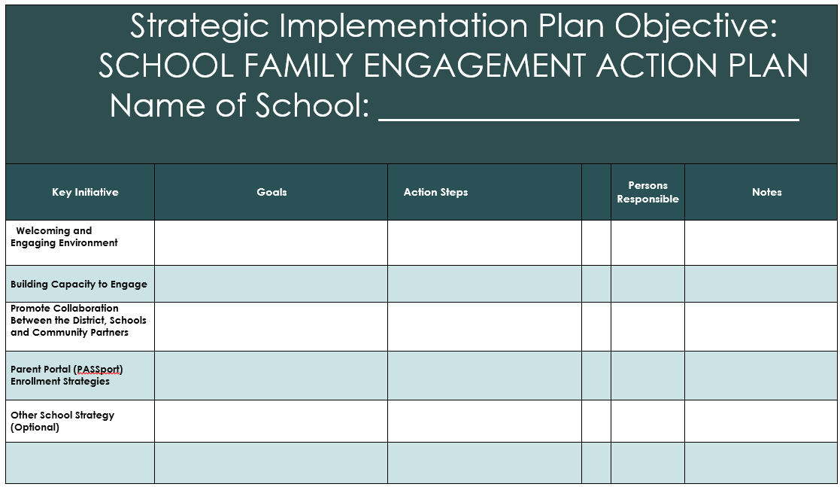
Call To Action
Assess your school’s welcoming school culture
With your team, complete the School Family Engagement Plan’s section on Welcoming Environment to determine next steps for strengthening your school’s welcoming environment
Notes:
There should be a call to action….
Align to the Single Plan for Student Achievement (SPSA)

Slide 68
Objectives
Identify benefits of creating a welcoming environment
Learn how to establish a welcoming school culture
Identify who is responsible for creating a welcoming environment
Learn how to assess a school’s environment and develop a plan for developing a welcoming school culture
Notes:
Display slide and read the objective.
Ask if objectives were met

Slide 69
Contact Information for Presenter
Notes:
Add your contact information to the slide

