Slide 1
Welcome
Directions:
In a chat to the panelists, please include your name, email, child’s school, and grade level.
Something to think about…
Do you know what is a Zone of Choice?
Do you know that you have several options in high schools and middle schools?
Notes:
Soft Start- This slide can be up on the screen as parents arrive. Have them discuss this question with their “elbow partner.”
Discuss this question with your neighbor or in your group.

Slide 2
Parent Orientation
October 2024

Slide 3
Objectives for Today
Get a better understanding of Zones of Choice.
Find out how to apply and select a high school or middle school.
Explore some ways in which you and your child can make the best high school or middle school selection.

Slide 4
ZOC Video
Powtoon (English): https://lausd.wistia.com/medias/28h9iuyjcq
Notes:
Turn up volume in full screen

Slide 5
Zones of Choice

Slide 6
What is a Zone of Choice?
Geographic areas comprised of multiple school options.
Offer exciting programs in the arts, business, science, humanities, social justice and more right in your neighborhood.
School options include, large campuses, small learning communities, academies, and more.

Slide 7
How does it work?
Students residing in a Zone of Choice are eligible to attend any school in the Zone.
No home school – home zone.
Students can select and rank the schools within their residential area.
There are17 Zones of Choice with 98 school options.
Notes:
Summer 2006: Belmont Zone of Choice is created to provide students with quality, theme-based public school options.
January 10, 2012: The School Board passes the Resolution on Expanding Enrollment and Equal Access through LAUSD Choice (Expands overall district enrollment at least 5% over three years.)
January 17, 2012: The School Board passes the Resolution to Examine Increasing Choice and Removing Boundaries for Neighborhood Schools. (Examines the potential impact on equity and quality of schools by transitioning to a full choice school system.)
Future: In the future ZOC will expand to include more middle school Zones of Choice
Resolutions??????

Slide 8
17 Zones of Choice
ZONE | SCHOOL COMPLEX
BELL | Bell HS ♦︎ Elizabeth LC ︎♦︎ Legacy HS Complex: STEAM, VAPA ♦︎ Maywood Academy HS
BELMONT | Belmont HS ♦︎ Edward Roybal LC ♦︎ Miguel Contreras LC Complex: Academic Leadership Community School, Los Angeles School of Global Studies, School of Business & Tourism, School of Social Justice ♦︎ Ramon Cortines VAPA
BERNSTEIN | Bernstein HS Complex: Bernstein HS, STEM Academy
BOYLE HEIGHTS | Mendez HS ♦︎ Roosevelt HS
CARSON | Carson HS ♦︎ Carson HS Complex: Academy of Education & Empowerment, Academy of Medical Arts
EASTSIDE | Garfield HS ♦︎ Boyle Heights Hilda Solis HS ♦︎ Torres HS Complex: East Los Angeles Renaissance Academy, Engineering and Technology STEM Academy, Humanitas Academy of Art & Technology
FREMONT | Dymally HS ♦︎ Fremont HS ♦︎ Diego Rivera LC Complex: Communications & Technology School, Green Design Community School, Performing Arts Community School, Public Service Community School
HUNTINGTON PARK | Huntington Park HS ♦︎ Linda Marquez HS Complex: Huntington Park Institute of Applied Medicine, LIBRA Academy, School of Social Justice
JEFFERSON | Maya Angelou Community HS ♦︎ Jefferson HS Complex: Jefferson High School, Nava College Preparatory Academy ♦︎ Santee EC
NARBONNE | Narbonne HS Complex: Narbonne HS Academies ♦︎ Humanities and Arts Academy of Los Angeles (HArts)
NORTH VALLEY | Chavez LA Complex: Academy of Scientific Exploration, Social Justice Humanitas Academy, Technology Preparatory Academy ♦︎ San Fernando HS ♦︎ Sylmar Charter HS
NORTHEAST | Lincoln HS ♦︎ Wilson HS
NORTHWEST | Northridge Academy HS ♦︎ Valley Academy of Arts and Sciences
RFK | RFK Community Schools: Ambassador School of Global Leadership ♦︎ Los Angeles High School of the Arts ♦︎ New Open World Academy ♦︎ School for the Visual Arts & Humanities ♦︎ UCLA Community School
SOUTH GATE HIGH SCHOOL | Legacy HS Complex: International Studies, STEAM, VAPA ♦︎ South East HS ♦︎ South Gate HS
SOUTH GATE MIDDLE SCHOOL | International Studies LC ♦︎ South Gate MS ♦︎ Southeast MS
San Fernando Area MS ZOC | San Fernando Middle School ♦ San Fernando Institute for Applied Media (SFIAM)

Slide 9
Out of Zone vs. In a Zone
Out of Zone: Traditional Attendance Boundary
In a Zone of Choice
Student’s residential address determines the HOME SCHOOL of attendance.
No choice in school options.
Students must change residence to change schools.
Student’s residential address determines the HOME ZONE of attendance.
Student’s preference is considered.
Students are allowed to transfer once during MS or HS within their Zone.

Slide 10
Application Process
Proceso Para Aplicar

Slide 11
On-Time Application
On-Time Application Period
October 1 – November 15, 2024
HOW TO APPLY?
Student Application: Middle students currently enrolled in the 8th grade will complete the online application at their middle school location (check with your school).
Parent Application: All parents can submit an online application using their parent portal account at Apply.LAUSD.net.
Paper Application: Paper applications will be available after November 18, 2024 (ZOC website or school).
Notes:
If time allows, demonstrate the application site.

Slide 12
ZOC Website
LAUSD.org/ZOC
Notes:
Demonstration of ZOC website

Slide 13
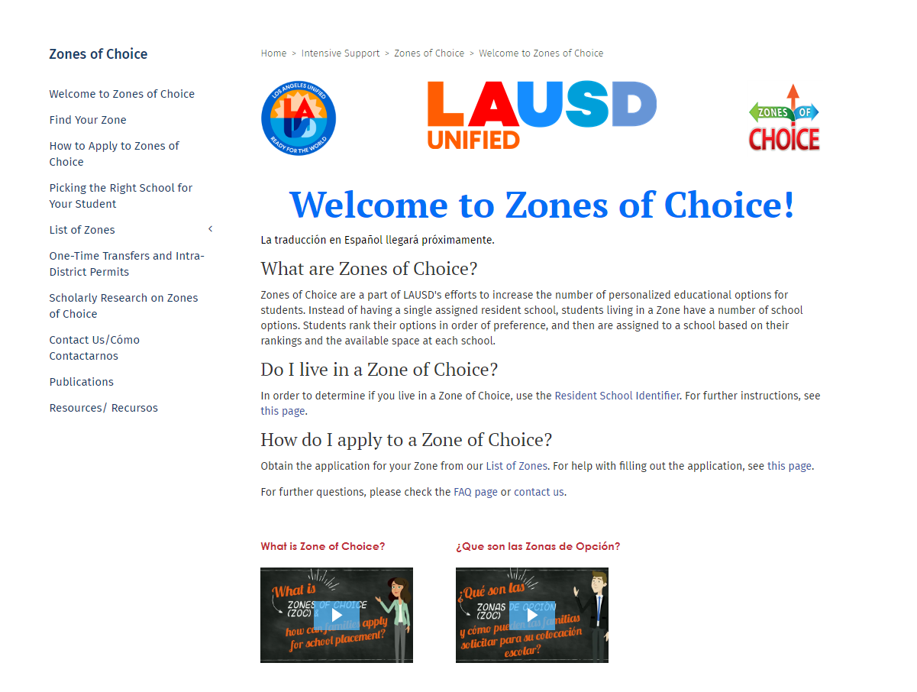
ZOC Homepage
Notes:
Go to ZOC website.

Slide 14
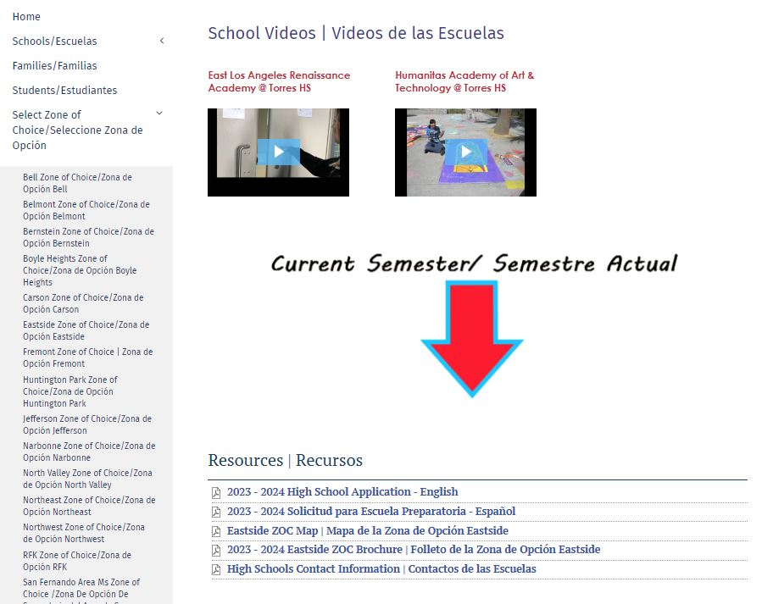
ZOC Resources
Notes:
Demonstration of ZOC website

Slide 15
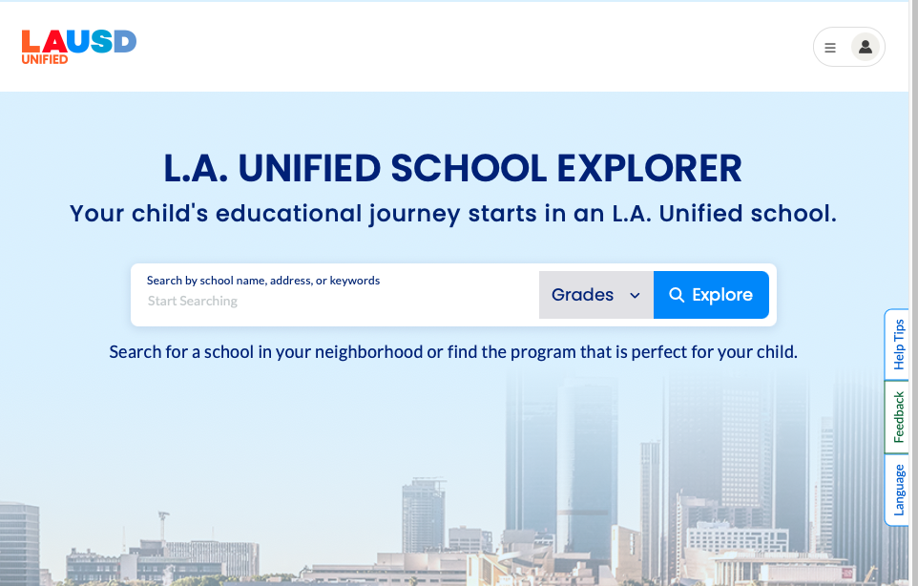
. School Explorer
Explore.LAUSD.net
Notes:
Demonstration of School Search Tool.

Slide 16
Apply to Zones of Choice
Apply.LAUSD.net
Log in/Apply
If your Parent Portal account is active, you may use your email and password to log in.
You may create an account (Register) and follow the instructions
Notes:
Demonstration of ZOC website

Slide 17
Activation Email

Slide 18
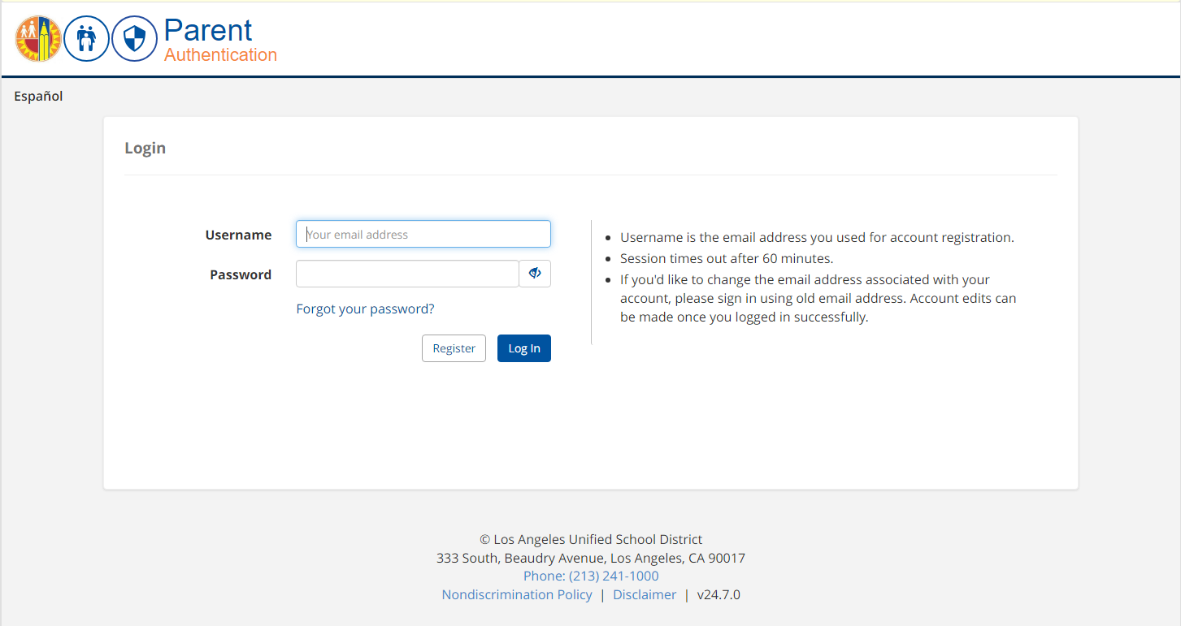
Start Application

Slide 19
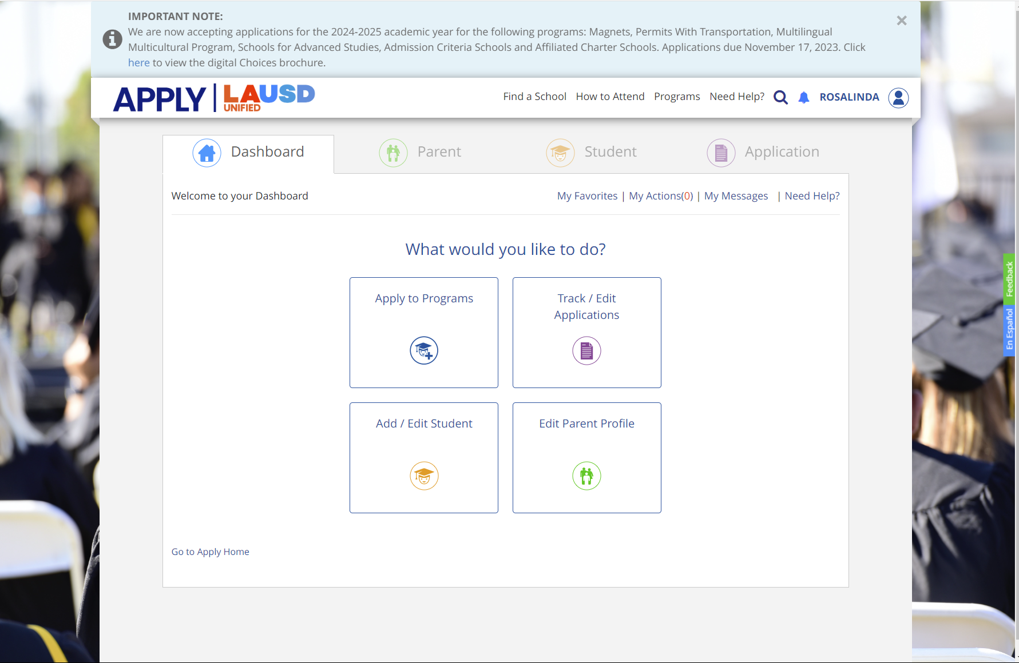
Steps on How to Complete ZOC Application
3
2
1

Slide 20
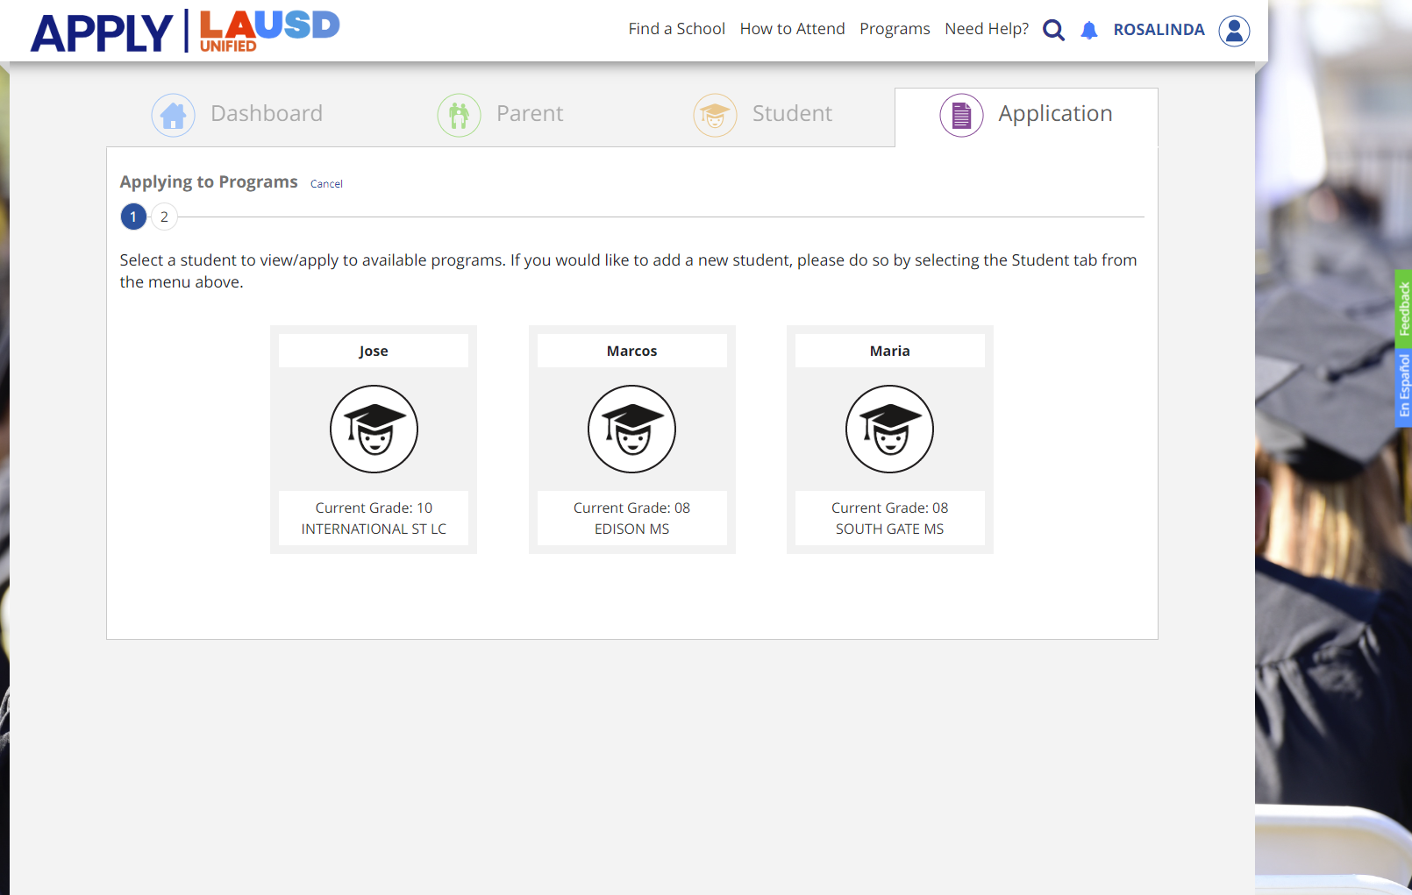
Steps on How to Complete ZOC Application
*Ensure siblings are added.

Slide 21
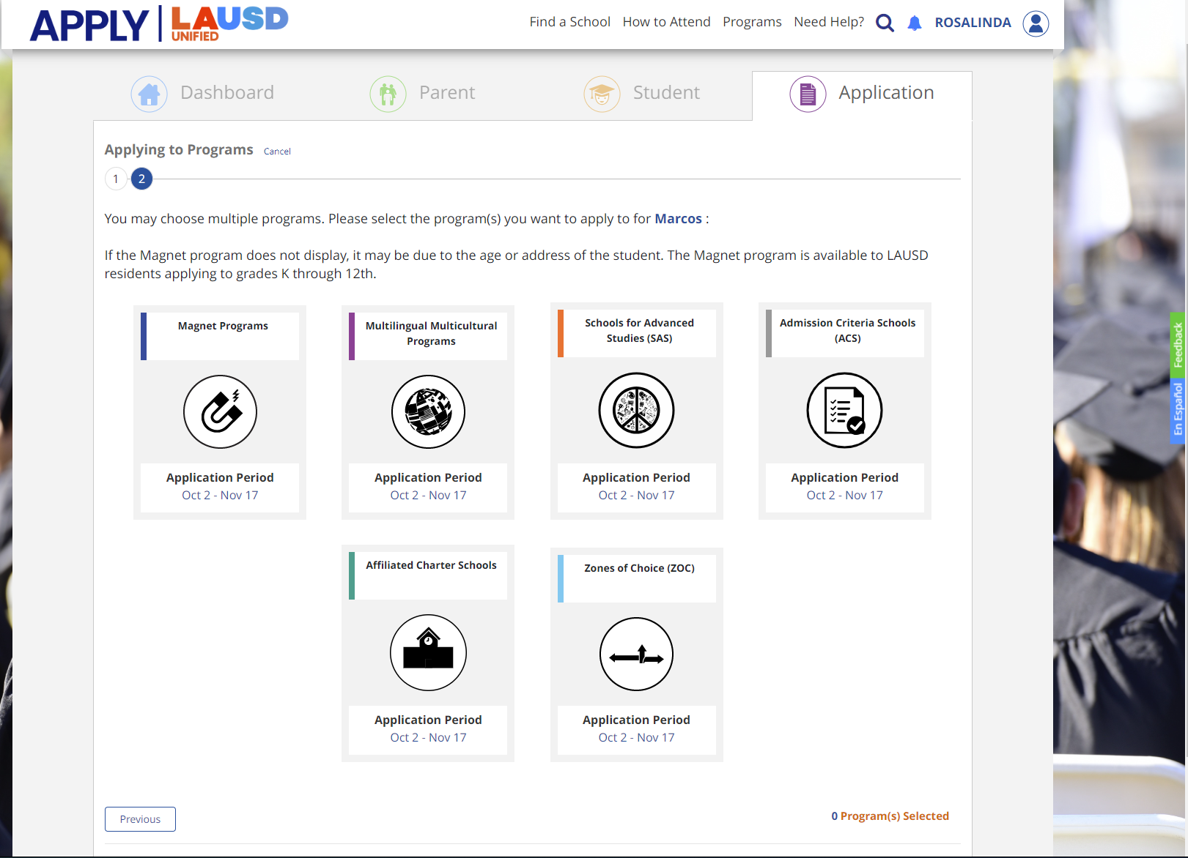
Steps on How to Complete ZOC Application

Slide 22
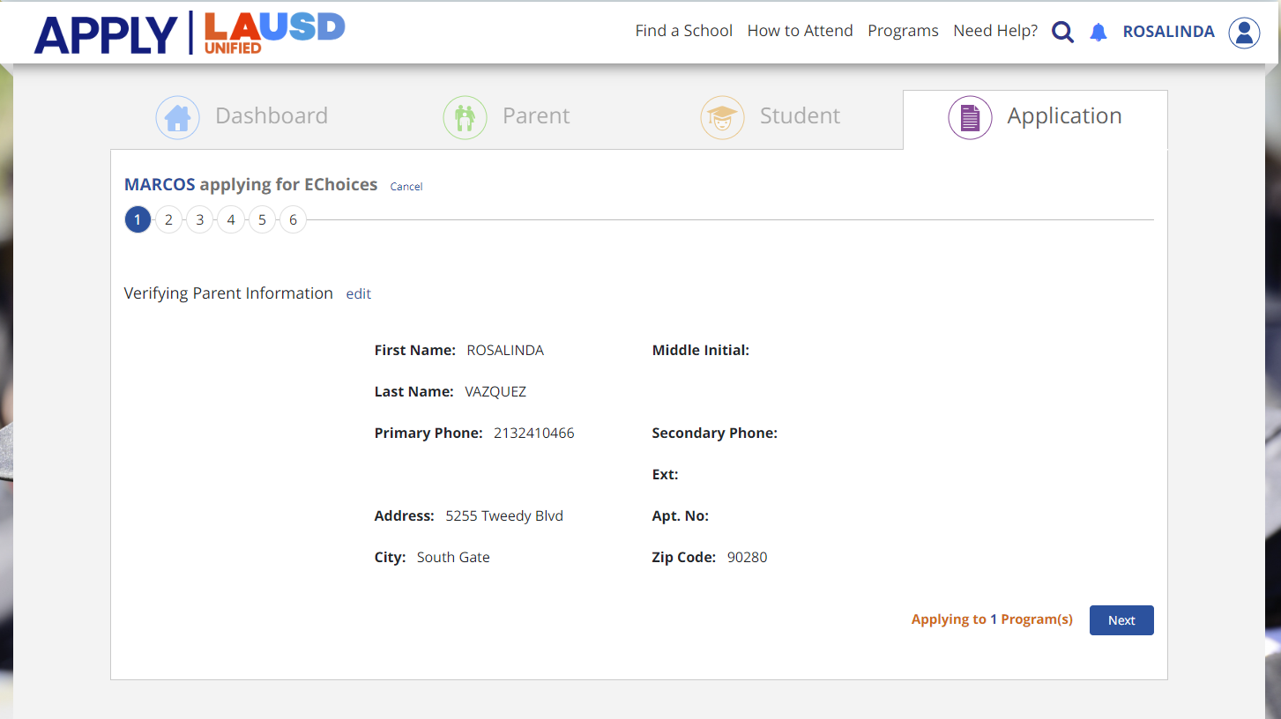
Steps on How to Complete ZOC Application

Slide 23
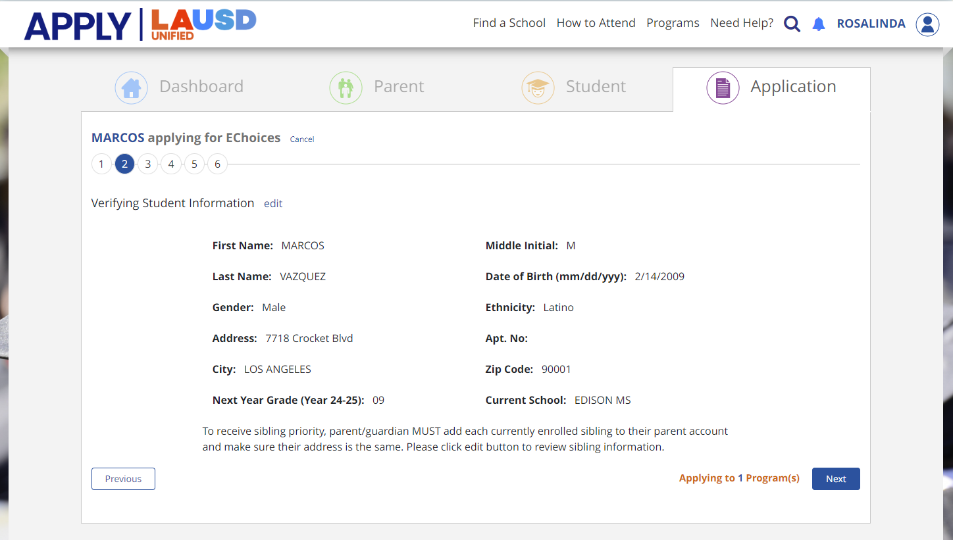
Steps on How to Complete ZOC Application

Slide 24
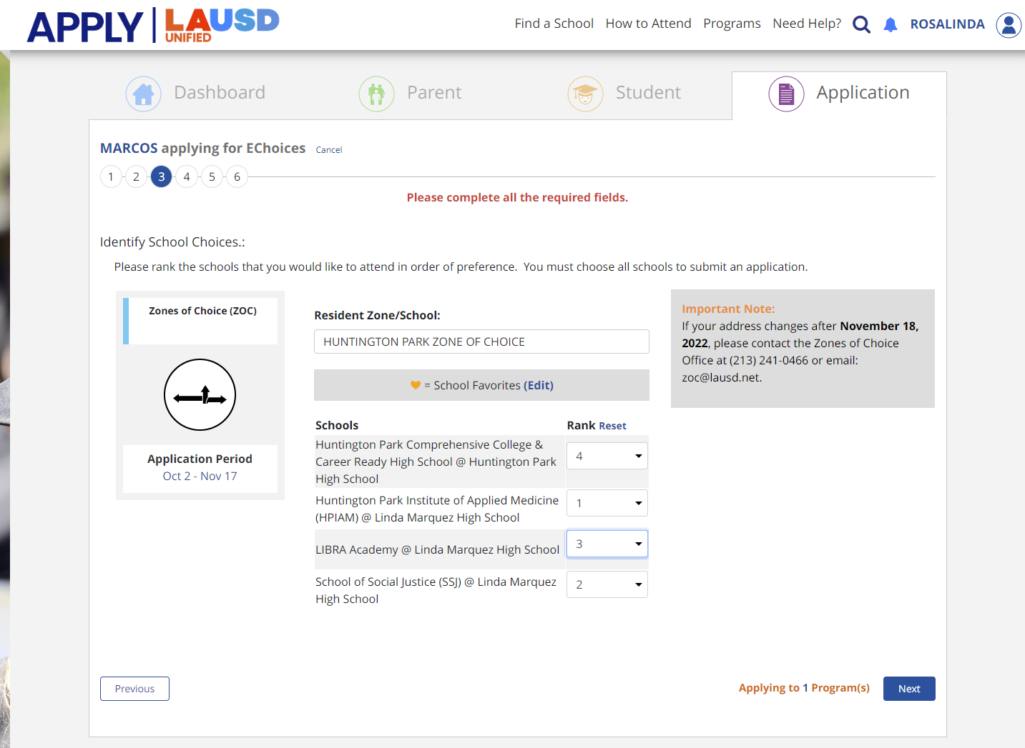
Steps on How to Complete ZOC Application

Slide 25
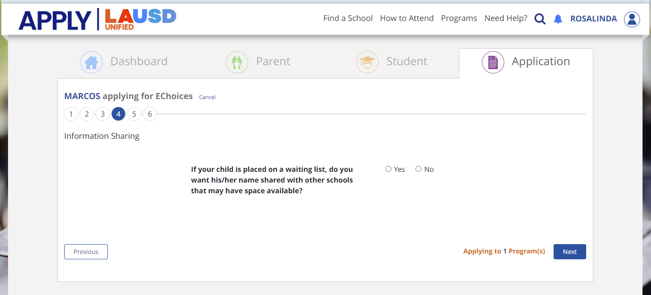
Steps on How to Complete ZOC Application

Slide 26
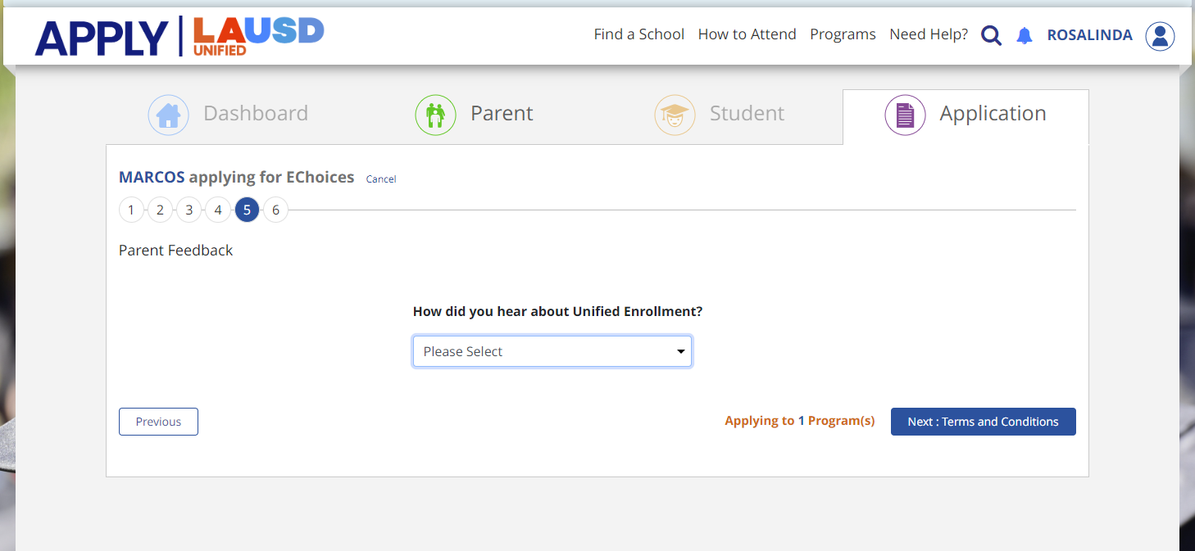
Steps on How to Complete ZOC Application

Slide 27
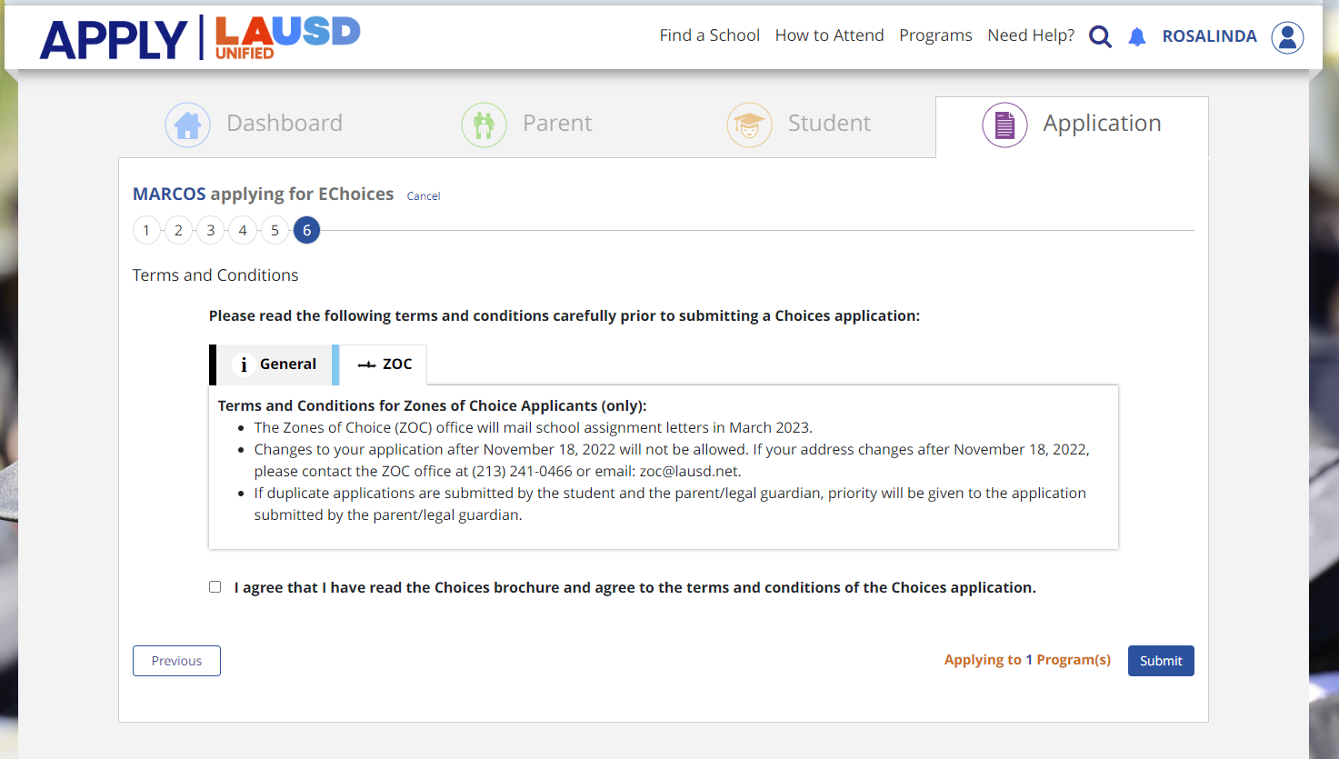
Steps on How to Complete ZOC Application

Slide 28
Confirmation Email
17, 2023.

Slide 29
How to Choose the Right School?

Slide 30
What Should I Ask?
Let’s take a few minutes to review the questions you may want to ask when exploring your high school or middle school (South Gate/ SFAMS) options.
Notes:
What is the theme or focus of your school?
¿Cuál es el tema o enfoque de su escuela?
What partnerships does your school have?
¿Qué asociaciones tiene su escuela?
How do you help 9th graders adjust to high school life?
¿Cómo le ayudan a los estudiantes del 9º grado con la transición a la escuela preparatoria?
How many teachers do you have? How many are new?
¿Cuántos maestros tienen? ¿Cuántos son nuevos?
What AP courses are offered?
¿Qué clases avanzadas ofrecen?
What is your graduation rate?
¿Cuál es su índice de graduación?
What colleges/universities do your graduating seniors attend?
¿A cuales colegios/universidades asisten sus alumnos al graduarse?
How many of your 9th grade students become 10th graders?
¿Cuántos de sus alumnos en el grado 9 son promovidos al grado 10?
What extra-curricular activities or sports are offered?
¿Qué actividades extracurriculares o deportes ofrecen?
How do you engage and communicate with parents?
¿Cómo se comunican y desarrollan relaciones con los padres de familia?

Slide 31
What Should I Ask?
What is the theme or focus of your school?
What partnerships does your school have?
How do you help 6th and 9th graders adjust to school life?
What AP courses are offered?
What is your graduation rate?
What colleges/universities do your graduating seniors attend?
What extracurricular activities or sports are offered?
How do you engage and communicate with parents?
Notes:
What is the theme or focus of your school?
¿Cuál es el tema o enfoque de su escuela?
What partnerships does your school have?
¿Qué asociaciones tiene su escuela?
How do you help 9th graders adjust to high school life?
¿Cómo le ayudan a los estudiantes del 9º grado con la transición a la escuela preparatoria?
How many teachers do you have? How many are new?
¿Cuántos maestros tienen? ¿Cuántos son nuevos?
What AP courses are offered?
¿Qué clases avanzadas ofrecen?
What is your graduation rate?
¿Cuál es su índice de graduación?
What colleges/universities do your graduating seniors attend?
¿A cuales colegios/universidades asisten sus alumnos al graduarse?
How many of your 9th grade students become 10th graders?
¿Cuántos de sus alumnos en el grado 9 son promovidos al grado 10?
What extra-curricular activities or sports are offered?
¿Qué actividades extracurriculares o deportes ofrecen?
How do you engage and communicate with parents?
¿Cómo se comunican y desarrollan relaciones con los padres de familia?

Slide 32
Other Factors to Consider
What programs/supports are offered for Students With Disabilities or English Language Learners?
Have you visited the school? Consider a campus tour.
Is the school too far? What are your transportation needs?
Do other siblings attend the same high school or middle school?

Slide 33
What’s Next?

Slide 34
School Assignment
February 2025: School assignment by ZOC office.
March 2025: Assignment letter mailed home.
April-June 2025: Enrollment packets available at the high school and middle school.

Slide 35
Next Steps
Talk with your child about high school or middle school options.
Ask questions.
Visit the Zones of Choice website: School Video | Brochure LAUSD.org/ZOC
Visit the school profile and the school website: Explore.LAUSD.net
Develop an action plan.
Make a list of preferred schools.
Parents can submit an online application: October 1 – Nov. 15, 2024, at Apply.LAUSD.net

Slide 36
Contact Information
ZONES OF CHOICE
333 S. Beaudry Avenue
Los Angeles, CA 90017
Phone: (213) 241-0466
Fax: (213) 241-4108
ZOC@lausd.net
LAUSD.net/zoc
Angelica Cabrera, Facilitator
amc7753@lausd.net
(213) 241-0461
Rosalinda Vazquez, Facilitator
rosalinda.vazquez@lausd.net
(213) 241-0554
Sabrina Huizar, Facilitator
sabrina.huizar@lausd.net
(213) 241-0589

Slide 37
Thank you!

