Slide 1
ELD Standards Document Overview and Phase In Plan minutes
5 minutes
Clock Partners
4 minutes
Lily Wong Fillmore Video with Reflective Questions
6 minutes
Prior Knowledge – Labeling ELD Standards using ELD Standards Word Wall
(partner work then sneak-a-peak)
30 minutes
Review Layout
15 minutes
Quotes from Appendix C
30 minutes
Chunked Reading of Appendix C
45 minutes
Visualization Reflection
20 minutes
Publish Our Strategies and Evaluations
10 minutes

Slide 2
CA ELD Standards
An Overview
ESC West-2014

Slide 3
Adapted from George Washington University
Guiding Principles
English Learners (ELs) are held to the same high expectations of learning established for all students.
ELs develop full receptive and productive proficiencies in English in the domains of listening, speaking, reading & writing.
ELs are taught challenging academic content that enables them to meet performance standards in all content areas.
ELs receive instruction that builds on their previous education and cognitive abilities and that reflects their language proficiency levels.
ELs are evaluated with appropriate and valid assessments that are aligned to state and local standards and that take into account the language development stages & cultural backgrounds of the students.
The academic success of ELs is a responsibility shared by all educators, the family and the community.
English Learner Master Plan, 2012,
Pages 2-3
Notes:
8:06 – 8:07

Slide 4
Learner Objectives
Participants will:
Review the key components of the New California ELD Standards including the layout of the ELD document
Develop a deeper understanding about the theoretical foundations and research base for the standards
Engage in various student-to-student interaction protocols

Slide 5
Phase-In Plan for ELD Standards
2013-2014
2014-2015
2015-2016
Awareness
Transition
Implementation
Notes:
Let’s take a few minutes to take a look at the phase in plan
Our phase in plan is aligned to the state’s plan and as the state releases additional information we will continue to upate this plan…our office will be convening a working group to identify additional needs and tools that we may develop
As you can see in the awareness stage there is mention of brokers of expertise.. unveiled their brokers of expertise website which has additional resources for us to use, you can see from this plan that CELDT is also being revamped and we are expecting a new assessment in 2017.
Take a look at this plan and see the various components of each stage….
Purpose: To know what the standards are
Engagement with the new CELDS by exploration of the new CELDS by engagement through practical applications
Timeline reflects the STATES ELD standards implementation actions
Awareness – is introduction of ELD standards planning systems of implementation and establishing collaborations in this stage we have identified the need to put together a WORKING group
Transition – building resources, implementing needs assessments, and continued learning
Implementation – expansion of professional learning and alignment of curriculum instruction and assessment along with integration throughout the district

Slide 6
Phase-In Plan

Slide 7
CA ELD Standards Overview
Overview & Proficiency Level Descriptors (PLDs):
Alignment to CCSS for ELA & Literacy
CA’s EL Student
Proficiency Level Descriptors (PLDs)
Structure of the grade level standards
Grade Level Standards
Section 1: Goal, Critical Principles, At-a-glance Overview
Section 2: Elaboration on Critical Principles
Part I: Interacting in Meaningful Ways
Part II: Learning About How English Works
Part III: Using Foundation Skills
Appendices:
Appendix A: Foundational Literacy Skills
Appendix B: Learning About How English Works
Appendix C: Theory and Research
Appendix D: Context, Development, Validation
Glossary of Key Terms
Notes:
9:56 – 10:00

Slide 8
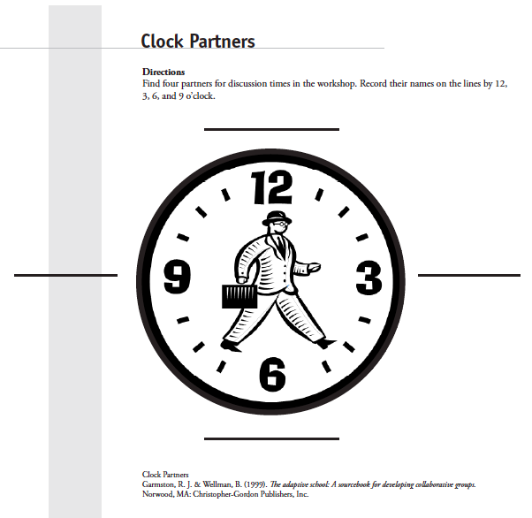
Building a Community of Learners: Clock Partners

Slide 9
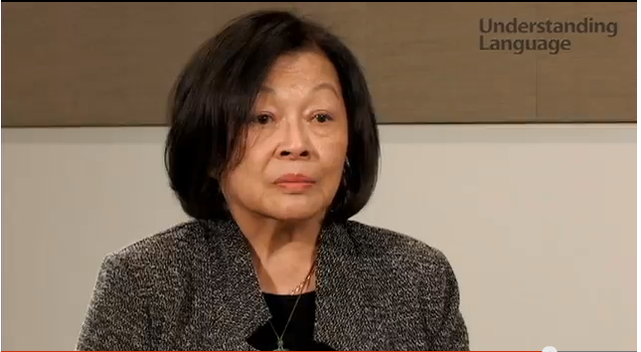
Dr. Lily Wong Fillmore: Text Complexity, Common Core, and ELLs
https://www.youtube.com/watch?v=STFTX7UiBz0
Notes:
9:43 – 9:46

Slide 10
Why do we have ELD Standards?
What do you think?
Get with your 12 O'clock Partner and discuss the need for ELD Standards.
The CCSS specify that the standards are intended to apply to all students including English learners
All students should be held to the same high expectations outlined in the Common Core Standards--- However,
English Learner students may require additional time, appropriate instructional support and aligned assessments as they acquire both English language proficiency along with content area knowledge…
The ELD standards are designed to address the dual challenge faced by ELs as they learn both language and content (EL Master Plan- Guiding Principle #1)
Notes:
If language is embedded within CCSS, then why do we have ELD Standards? The CCSS specify that the standards are intended to apply to all students including English learners additionally both the National Governors Association Center for Best Practices and the Council of Chief State school officers believe that all students should be held to the same high expectations outlined in the Common Core Standards, this includes English Learners--- However these students may require additional time, appropriate instructional support and aligned assessments as they acquire both English language proficiency along with content area knowledge… The ELD standards are designed to address the dual challenge faced by Els as they learn both language and content… Master plan guiding principle #1
Els are a complex group of students with a variety of needs and they come with varying levels of both language and literacy proficiency. ALL teachers are responsible for addressing the needs of Els through knowing and using the ELD standards for English learners

Slide 11
Purpose of ELD Standards
Designed to be used in tandem with CCSS for ELA & Literacy
Highlight and amplify the critical knowledge about language and skills using language in CCSS for ELA/Literacy necessary for ELs to be successful in school and life
Provide fewer, clearer, higher standards so teachers can focus on what’s most important
Strengthen ELD opportunities in core content instruction and in targeted ELD in light of new content standards

Slide 12
District Instructional Priorities
Master Plan
(The Who)
TGDC Teaching &
Learning
Framework
(The How)
Common Core
(The What)
CCTP
Common Core
Technology Project
(The How)
Notes:
8:07 – 8:08

Slide 13
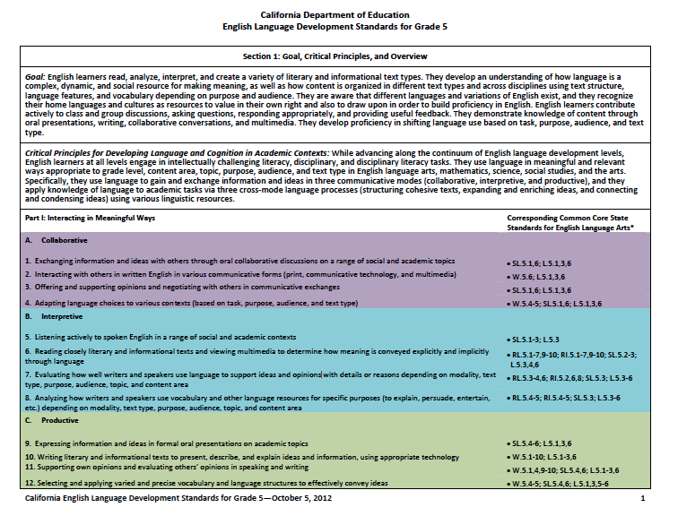
Accessing Prior Knowledge
Get together with your 3 o’clock partner
Locate your 6th Grade ELD Standards

Slide 14
Sneak-A-Peak
Sit with your 3 o’clock partner. Working together, label the 6th grade ELD Standards document with the words from the ELD Standards word wall.
When the teacher calls “Sneak-a-peak,” share your work with another pair. You may add ideas to your document from what you saw on their work.

Slide 15
ELD Standards Word Wall
STANDARDS
Using Foundational Literacy Skills
Interpretive
7
Emerging
3
TEACHER
RESOURCES
Language Processes
Communicative Modes
Critical principles
Productive
Connecting and condensing ideas
STRANDS
collaborative
Bridging
Expanding and Enriching ideas
Expanding
Structuring Cohesive Text
Goal
11*
12
Proficiency Levels
* Extra Credit
Notes:
Use the words on this slide to complete the ELD Sheet

Slide 16
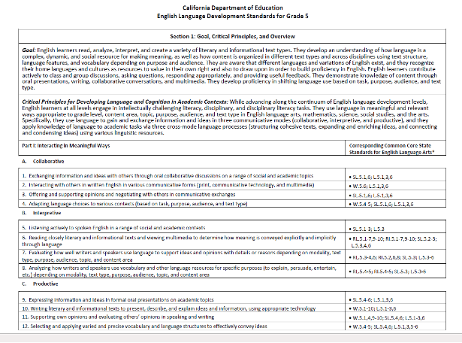
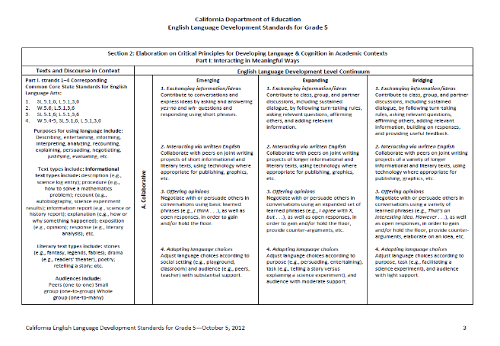
Review of ELD Standards: Part I, II & III
Because CONTENT & LANGUAGE are inextricably linked, the three parts of the CA ELD Standards should be interpreted as complimentary and interrelated dimensions of what must be addressed in a robust instructional program for ELs.
Part I & II are intentionally presented separately in order to call attention to the need for both a focus on meaning and interaction and a focus on building knowledge about the linguistic features and structures of English.
Part III outlines the foundational literacy skills ELs may need, depending on their previous literacy and educational experiences.
Notes:
10:37 – 10:40

Slide 17
For every Grade level, the ELD Standards have the same ‘Section 1’
{
The same Goal is listed at each grade level
The same Critical Principles for Developing Language and Cognition in Academic Contexts is at each grade level
{
Part I of the ELD Standards: Interacting in Meaningful Ways is the same at each grade level.
It lists 3 Modes (Ways of Using Language)
Collaborative- engagement in dialogue with others
Interpretive- comprehension & analysis of written & spoken texts
Productive- creation of oral presentations & written texts
The Strands appear underneath
Notes:
10:15 – 10:20

Slide 18
The only thing that differs on page 1-2 of the ELD Standards for each grade level is the CCSS standards it corresponds to.
Notes:
10:20 – 10:23

Slide 19
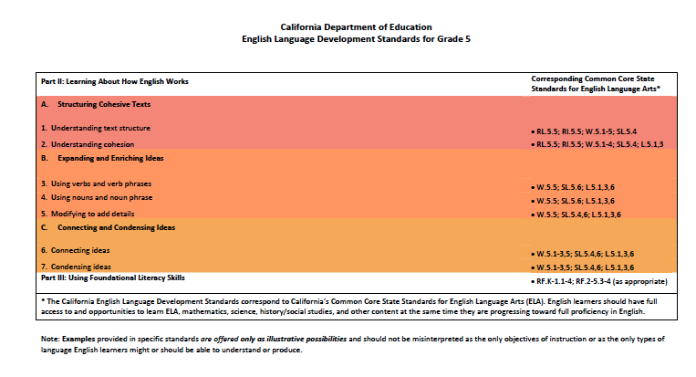
The Strands appear beneath.
Part II: Learning about How English Works is the same at each grade level.
It lists 3 Key Language Processes (Purpose for using Language)
Structuring Cohesive Texts
Expanding and Enriching Ideas
Connecting and Condensing Ideas
Part III: Using Foundational Literacy Skills
Notes:
10:23 – 10:26

Slide 20
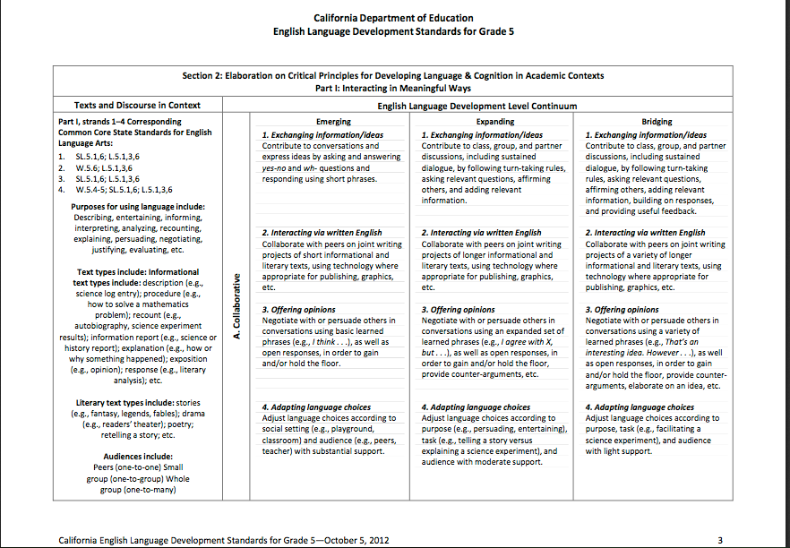
Section II
Proficiency levels
Teacher Resources-
Variables to consider in designing & implementing instruction for EL
Strands
Mode
Language of the Standards
Notes:
10:26 – 10:29 Now we will review Section 2. Section 2 is the Elaboration on Critical Principles for Developing Language & Cognition in Academic Contexts-
It unpacks the Critical Principles via a set of standards for each grade level K-8 and for the grade spans 9-10 & 11-12.
On the right side we begin with the ELD Level Continuum that distinguishes three overall levels- Emerging, Expanding & Bridging.
In this sheet we are looking at only one MODE- Collaborative. The pages that follow unpack the standards for the other 2 MODES as well as the 3 PROCESSES in Part II Learning About How English Works
The STRANDS are listed above the specific standard in number format. There are 4 STRANDS to the Collaborative Mode.
The Standards are identified for each strand within each proficiency level of the key knowledge, skills, and abilities in English Language Development. Each grade with have standards for each proficiency level in each of the 19 strands.
The left side identifies the Teacher Resources that are to be considered in designing and implementing instruction for ELs-
Corresponding ELA CC Standards,
Purpose for Using the Language- featured in CC- Teachers support ELs to develop an awareness of these purposed for language as they progress in language proficiency & through the grades
Text Types- Each text has particular language features- based on discipline, content, purpose, and audience. Informational are presented first to emphasize their importance in College & career Ready
Audiences- ELs need to consider the audience, partner, small collaborative group or whole group audience.

Slide 21
CA ELD Standards Overview
Overview & Proficiency Level Descriptors (PLDs):
Alignment to CCSS for ELA & Literacy
CA’s EL Student
Proficiency Level Descriptors (PLDs)
Structure of the grade level standards
Grade Level Standards
Section 1: Goal, Critical Principles, At-a-glance Overview
Section 2: Elaboration on Critical Principles
Part I: Interacting in Meaningful Ways
Part II: Learning About How English Works
Part III: Using Foundation Skills
Appendices:
Appendix A: Foundational Literacy Skills
Appendix B: Learning About How English Works
Appendix C: Theory and Research
Appendix D: Context, Development, Validation
Glossary of Key Terms
Notes:
9:56 – 10:00

Slide 22
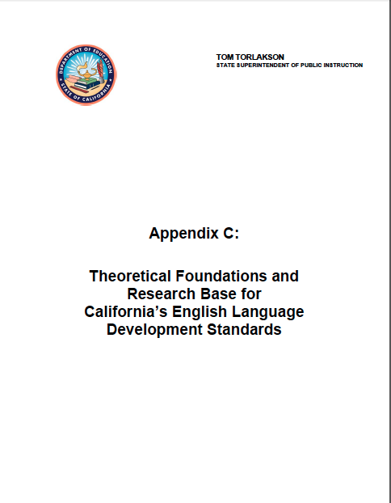
CA 2012 ELD Standards: Appendix C
Notes:
9:13- 9:43

Slide 23
Before we move on… Review the Protocol
One participant will read the quote aloud for the team.
The other participants listen actively.
In order, the next participants will start to speak using sentence frames (if needed) to share their understanding.
Switch roles and start a new round with a new quote.

Slide 24
Text Comprehension Protocol Student to Student Interaction
2
#1 Reads
#2 Paraphrases
#3 Connects
1
Reads the Quote
1
3
Envelope Contains Quotes
Blue: Must Do
Salmon: May Do
Notes:
SCRIBE #1 read the text and paraphrase (student)
SCRIBE #2 listened to SCRIBE #1 and paraphrase (student #2)
SCRIBE #3 listened to assess if SCRIBE #2 paraphrased correctly (teacher)

Slide 25
CELDS Information Processing Appendix C
Take out Quotes
With your triad (each person takes turns in each role):
Person 1- Reads the quote aloud
Person 2- What I heard you say is ___ (1 min)
Person 3- An implication for teaching or learning is __ (1 min)
Person 1- An additional implication is ___ (1 min)
Repeat the process by rotating roles until time is called
Notes:
8:53 – 8:56

Slide 26
What about the strategy?
Think about the strategy that we just used to process information
What happened during the activity?
What did we do?
How did we do it?
What worked?
Was it useful for processing the information?
What language domain (listening, speaking, reading, writing) was the focus of this activity?
Why do you think we focused on this language domain?

Slide 27
CA 2012 ELD Standards: Appendix C—With your 6 o’clock partner
Notes:
9:13- 9:43

Slide 28
Reading Appendix C: Chunking the Text
Chunking the text is a strategy that works for English learners because it allows for processing time and reflection before moving on to the next sections.
Notice that your text has been pre-marked and “chunked” marking a stopping point.
Every participant will read the same text.
Every participant will stop and reflect with guidance of the question posted.
Facilitator will provide sufficient time to finish the “chunk” of text.
Wait for the facilitator to give you time to interact with your 6 o’clock partner

Slide 29
What about the strategy?
Think about the strategy that we just used to process information
What happened during the activity?
What did we do?
How did we do it?
What worked?
Was it useful for processing the information?
What language domain (listening, speaking, reading, writing) was the focus of this activity?
Why do you think we focused on this language domain?

Slide 30
Reflection Strategy: Visualization
Think about your new learnings today and draw a visual representation. You may use the back of the agenda.
Facilitator will provide sufficient time to draw.
When indicated, please go to your 9 o’clock partner and decide who will be partner A and who will be partner B.
When indicated, partner A will start to share his/her visual and explain it while partner B listens actively.
After a reasonable time, switch roles and now it will be partner B’s turn to share his/her visual and explain it while A listens actively.

Slide 31
Reflection Strategy: Visualization
Now, you and your partner will get together with another pair and share new learnings.
A
B
A
B

Slide 32
What about the strategy?
Think about the strategy that we just used to process information
What happened during the activity?
What did we do?
How did we do it?
What worked?
Was it useful for processing the information?
What language domain (listening, speaking, reading, writing) was the focus of this activity?
Why do you think we focused on this language domain?

Slide 33
What strategies did we use today?
Strategies

Slide 34
Did we learn these objectives?
Participants will:
Review the key components of the New California ELD Standards including the layout of the ELD document
Develop a deeper understanding about the theoretical foundations and research base for the standards
Engage in various student-to-student interaction protocols

Slide 35
Evaluations
Please fill-out the evaluations in your packet for today’s session
We appreciate your feedback

Slide 36
Thank You!
Alana Cortes email: alana.cortes@lauds.net
Coordinator, Elementary EL Instruction
Lester Malta email: lester.malta@lausd.net
Coordinator, Secondary EL Instruction

