Slide 1
Start Smart 2.0
Conversation Practices
FIRST GRADE
PART 1: SETTING THE FOUNDATION
LESSONS 1-6

Slide 2
LESSON 1
REVIEW NORMS & SKILLS
Notes:
In this lesson students will be able to engage in a Constructive Conversation to discuss their understanding of the Constructive Conversation Norms and Skills with a partner.

Slide 3

ELD OBJECTIVE
In this lesson, we will...
  share what we know about Constructive Conversations
  have a conversation with a partner
STUDENT FRIENDLY ELD OBJECTIVES
Notes:
Point to and read charted Student-Friendly ELD Objective.
We have already learned about the Constructive Conversation Norms and Skills. We use the norms and skills when we have a Constructive Conversation with a partner. Let’s review what we already know about Constructive Conversations, so we can begin learning how to use them better.

Slide 4
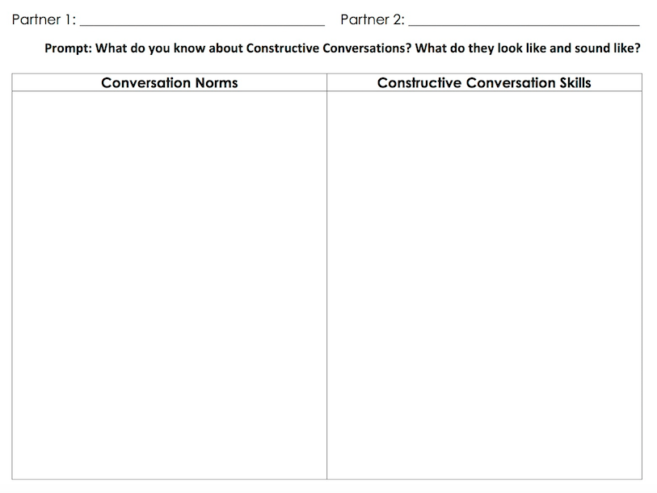
What do we already know about Constructive Conversation Norms and Skills?
REVIEW ARTIFACTS
Notes:
CREATE AND DISPLAY A TWO-COLUMN CLASS CHART WHERE YOU WILL CHART STUDENT RESPONSES. LABEL ONE COLUMN NORMS AND THE OTHER SKILLS.
Students will be able to engage in a Constructive Conversation to discuss their understanding of the Constructive Conversation Norms and Skills with a partner.
Students will engage in a conversation using the following prompts:
⚫️What do we already know about the Constructive Conversation Skills? Turn and talk to your partner.
⚫️What do we already know about the Constructive Conversation Norms? Turn and talk to your partner.

Slide 5
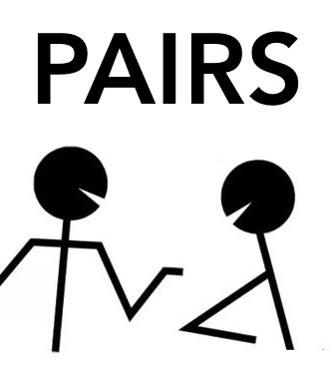
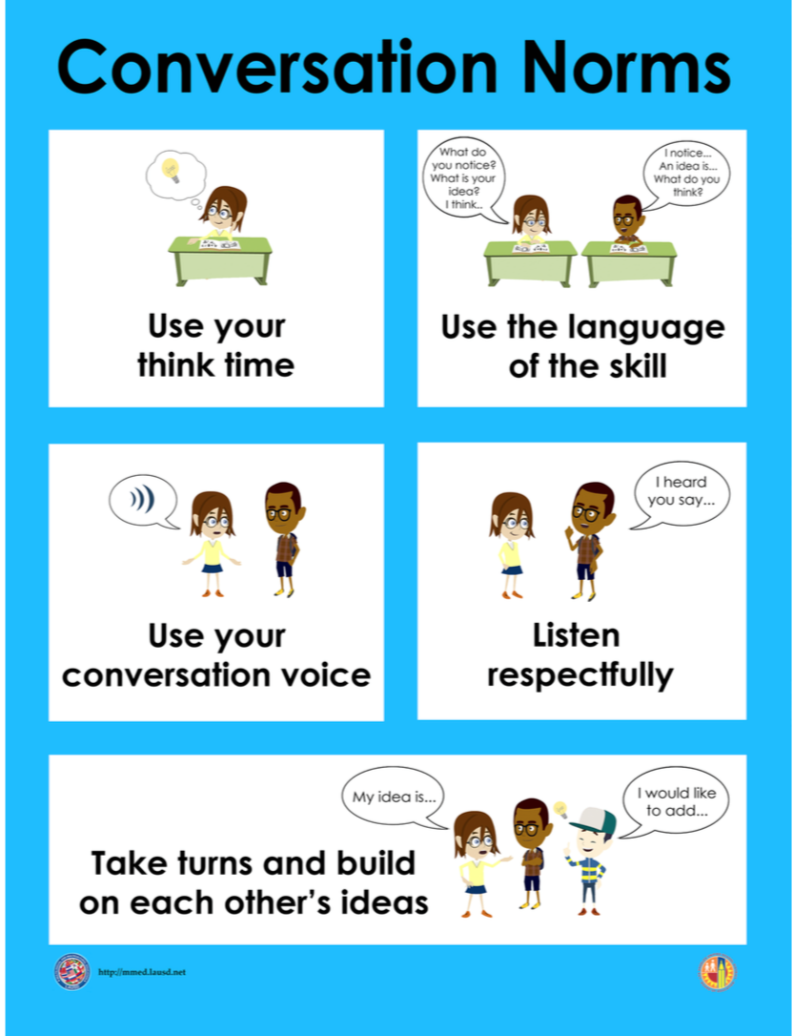

What do we already know about Constructive Conversation Norms?
TURN & TALK
REVIEW ARTIFACTS
Notes:
NOTE: artifacts may include Conversation Norms Poster, Constructive Conversations Skills Poster, Constructive Conversation Game Cards, Listening Task Posters, and additional artifacts such as student-created posters from Start Smart 1.0 Lesson 14 to use as a reference as they engage in a review of norms and skills.
NOTE: K-1 version of the Conversation Norms Poster and Constructive Conversations Skills Poster are included in the SS 2.0 unit resources for these lessons and also available on our www.mmed.lausd.net website.
Ask students to discuss the following prompt in pairs:
⚫️What do we already know about the Constructive Conversation Norms? Turn and talk to your partner.
.

Slide 6
What do we already know about Constructive Conversation Norms?
Listen respectfully
Take turns
REVIEW ARTIFACTS
Notes:
After student have had a few minutes to discuss with a partner, call on one or two individuals to share out with the whole group. Chart student responses on the class two-column chart under the Norms column

Slide 7
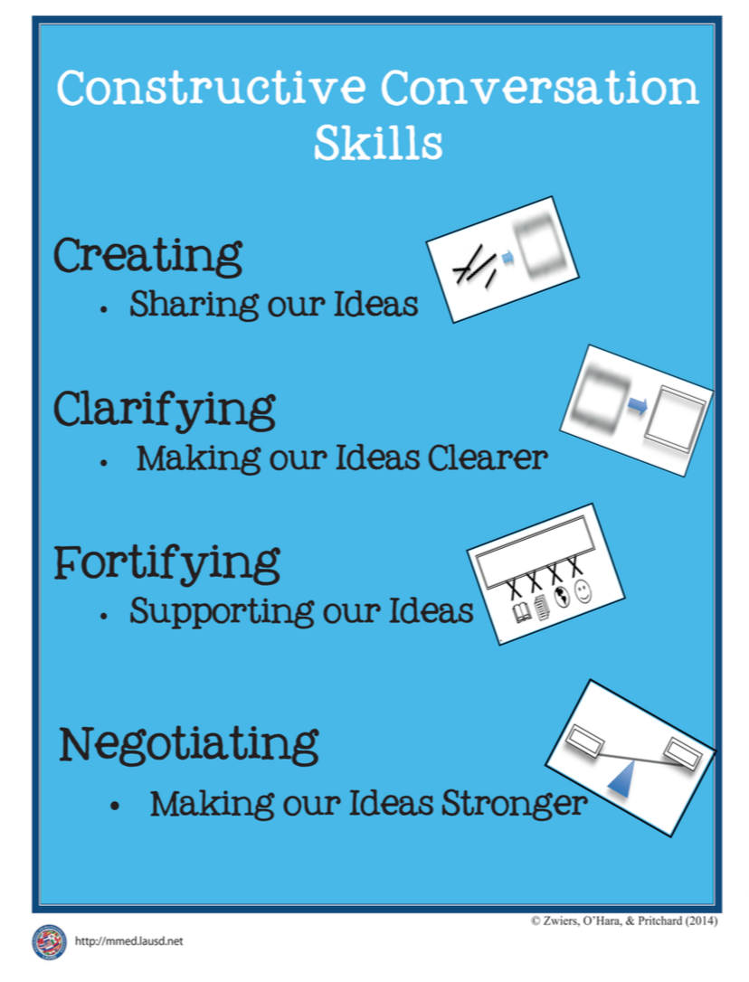
What do we already know about Constructive Conversation Skills?
TURN & TALK
REVIEW ARTIFACTS
Notes:
NOTE: artifacts may include Constructive Conversation Norms Poster, Constructive Conversations Skills Poster, Constructive Conversation Game Cards, Listening Task Posters, and additional artifacts such as student-created posters from Start Smart 1.0 Lesson 14 to use as a reference as they engage in a review of norms and skills.
Display the Constructive Conversation artifacts and ask the following question:
What do we already know about the Constructive Conversation Norms and Skills? Turn and
talk to your partner.
After students have had a few minutes to discuss with a partner, call on one or two individuals to share out with the whole group.

Slide 8
What do we already know about Constructive Conversation Skills?
Listen respectfully
Take turns
Create
REVIEW ARTIFACTS
Notes:
After student have had a few minutes to discuss with a partner, call on one or two individuals to share out with the whole group. Chart student responses on the class two-column chart under the Skills column

Slide 9
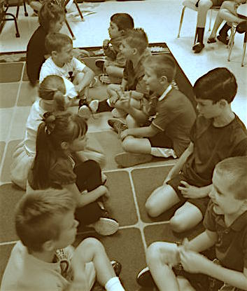
Review Conversation Norms
Now you will work with your partners to review all you know about the Conversation Norms.
We will use the ideas we charted together and our Norms Poster to discuss with our partners.
The prompt is:
What do you know about Conversation NORMS?
What does it look like and sound like when you use them?
rows of communication
Form two rows (Row A & Row B) facing each other so that each person has a partner.
Sit down so that you are facing your partner from the other row.
Think about the prompt.
Take turns sharing ideas with your partner.
Stand up and thank your partner.
Row A moves one position to the left. The partner at the end of Line A moves down the center aisle to the other end.
Repeat steps 2-5 with your new partner.
Repeat the process again to share with a third partner.
MODEL/GUIDED PRACTICE – ROWS OF COMMUNICATION- CONVERSATION NORMS
Notes:
Students will engage in the Rows of Communication protocol to discuss what they know about the following prompts:
What do you know about Conversation NORMS?
What does it look like and sound like when you use them?
Have students form two rows facing each other so that each student has a partner. Students will then sit down in front of their partner and discuss the prompt. Follow the directions for the protocol to allow students to discuss the prompts.

Slide 10
rows of communication
Form two rows (Row A & Row B) facing each other so that each person has a partner.
Sit down so that you are facing your partner from the other row.
Think about the prompt.
Take turns sharing ideas with your partner.
Stand up and thank your partner.
Row A moves one position to the left. The partner at the end of Line A moves down the center aisle to the other end.
Repeat steps 2-5 with your new partner.
Repeat the process again to share with a third partner.
ROWS OF COMMUNICATION PROTOCOL DIRECTIONS
Notes:
Read the directions for the Rows of Communication Protocol with students.

Slide 11
1. Form two rows (Row A & Row B) facing each other so that each person has a partner
2. Sit down so that you are facing your partner from the other row.
MODEL/GUIDED PRACTICE – ROWS OF COMMUNICATION- CONVERSATION NORMS
Notes:
Follow directions #1 and #2 of the Rows of Communication with students.

Slide 12
3. Think about the prompt.
Prompt: What do you know about the Conversation Norms?
What does it look like or sound like when you use them?
Hmmm. So, the prompt is: What do you know Conversation Norms? What does it look like and sound like when you use them?
I’m going to use the artifacts to remind me of what I know about the Norms.
One thing I know is that I need to use my think time just like I’m doing right now.
Now, you think of 1 or 2 ideas you have about the Conversation Norms.
MODEL/GUIDED PRACTICE – ROWS OF COMMUNICATION- CONVERSATION NORMS
Notes:
Follow direction #3 for the Rows of Communication with students.

Slide 13
4. Take turns sharing ideas with your partner
When you’re ready, take turns sharing your ideas with your partner.
Turn and face me when you’re done sharing.
MODEL/GUIDED PRACTICE – ROWS OF COMMUNICATION- CONVERSATION NORMS
Notes:
Follow direction #4 for the Rows of Communication with students.

Slide 14
5. Stand up and thank your partner (Row A).
6 . Row A moves one position to the left. The partner at the end of Line A moves down the center aisle to the end.
MODEL/GUIDED PRACTICE – ROWS OF COMMUNICATION- CONVERSATION NORMS
Notes:
Follow direction 5 and #6 for the Rows of Communication with students.
Have students stand up. Have one row move one place to the right, while the other row stays in place, so that each student is now facing a new partner. Instruct students to sit down in front of their partner and discuss the prompt again.

Slide 15
7. Repeat steps 2-5 with your new partner.
Now you will share any ideas you have with a new partner.
Maybe you have new ideas or your last partner helped you think of another idea.
8. Repeat the process again to share with a third partner.
MODEL/GUIDED PRACTICE – ROWS OF COMMUNICATION- CONVERSATION NORMS
Notes:
Follow direction #7 and #8 for the Rows of Communication with students.
Allow enough time for students to share their ideas with their new partners. Thank your partner. Turn and face me when you’re ready.

Slide 16
What do we already know about Constructive Conversation NORMS?
Listen respectfully
Take turns
Create
REVIEW ARTIFACTS
Notes:
After student have had a few minutes to discuss with a partner, call on one or two individuals to share out with the whole group. Chart student responses on the class two-column chart under the Norms column

Slide 17
Review Conversation Skills
Now you will work with your partners to review all you know about the Conversation Skills.
We will use the ideas we charted together and our Skills Poster to discuss with our partners.
The prompt is:
What do you know about Conversation Skills?
What does it look like and sound like when you use them?
rows of communication
Form two rows (Row A & Row B) facing each other so that each person has a partner.
Sit down so that you are facing your partner from the other row.
Think about the prompt.
Take turns sharing ideas with your partner.
Stand up and thank your partner.
Row A moves one position to the left. The partner at the end of Line A moves down the center aisle to the other end.
Repeat steps 2-5 with your new partner.
Repeat the process again to share with a third partner.
MODEL/GUIDED PRACTICE – ROWS OF COMMUNICATION- CONSTRUCTIVE CONVERSATION SKILLS
Notes:
Students will engage in the Rows of Communication protocol to discuss what they know about the following prompts:
What do you know about Conversation Skills?
What does it look like and sound like when you use them?
Have students form two rows facing each other so that each student has a partner. Students will then sit down in front of their partner and discuss the prompt. Follow the directions for the protocol to allow students to discuss the prompts.

Slide 18
1. Form two rows (Row A & Row B) facing each other so that each person has a partner
2. Sit down so that you are facing your partner from the other row.
MODEL/GUIDED PRACTICE – ROWS OF COMMUNICATION- CONSTRUCTIVE CONVERSATION SKILLS
Notes:
Follow directions #1 and #2 of the Rows of Communication with students.

Slide 19
3. Think about the prompt.
Prompt: What do you know about the Constructive Conversation Skills?
What does it look like or sound like when you use them?
Hmmm. So, I’m going to use the artifacts to remember what I know about the skills.
One thing I know is that when I CLARIFY I make my ideas clearer, so my partner knows what I am trying to say.
I can ask, “Does this make sense?” so I will know if my partner understands my idea.
MODEL/GUIDED PRACTICE – ROWS OF COMMUNICATION- CONSTRUCTIVE CONVERSATION SKILLS
Notes:
Follow direction #3 for the Rows of Communication with students.

Slide 20
4. Take turns sharing ideas with your partner
When you’re ready, take turns sharing your ideas with your partner.
Turn and face me when you’re done sharing.
MODEL/GUIDED PRACTICE – ROWS OF COMMUNICATION- CONSTRUCTIVE CONVERSATION SKILLS
Notes:
Follow direction #4 for the Rows of Communication with students.

Slide 21
5. Stand up and thank your partner (ROW A).
6 . Row A moves one position to the left. The partner at the end of Line A moves down the center aisle to the end.
MODEL/GUIDED PRACTICE – ROWS OF COMMUNICATION- CONSTRUCTIVE CONVERSATION SKILLS
Notes:
Follow direction 5 and #6 for the Rows of Communication with students.
Have students stand up. Have one row move one place to the right, while the other row stays in place, so that each student is now facing a new partner. Instruct students to sit down in front of their partner and discuss the prompt again.

Slide 22
7. Repeat steps 2-5 with your new partner.
Now you will share any ideas you have with a new partner.
Maybe you have new ideas or your last partner helped you think of another idea.
8. Repeat the process again to share with a third partner.
MODEL/GUIDED PRACTICE – ROWS OF COMMUNICATION- CONSTRUCTIVE CONVERSATION SKILLS
Notes:
Follow direction #7 and #8 for the Rows of Communication with students.
Allow enough time for students to share their ideas with their new partners. Thank your partner. Turn and face me when you’re ready.

Slide 23
What do we already know about Constructive Conversation SKILLS?
Listen respectfully
Take turns
Create
REVIEW ARTIFACTS
Notes:
After student have had a few minutes to discuss with a partner, call on one or two individuals to share out with the whole group. Chart student responses on the class two-column chart under the Skills column

Slide 24

What do we already know about Conversation Norms and Constructive Conversation Skills?
We charted many new ideas about the Norms and many ideas about the Skills.
I can draw or write using these ideas.
Now you will work with your partner to draw and/or write:
One idea about the Norms here
One idea about the Skills here
STUDENT PRACTICE – TWO COLUMN WORKSHEET – REVIEW CONSTRUCTIVE CONVERSATIONS
Notes:
Have students work with a partner to draw and/or write one idea about the Norms and one idea about the Skills on the Two-Column Worksheet.
Note: Students who are working at Expanding (EX) and Bridging (BR) Levels may draw/write multiple ideas.
Select one or two pairs to come up to the front to present their work to the class.

Slide 25
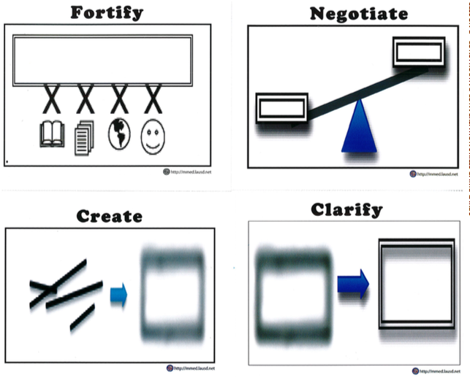

CONSTRUCTIVE CONVERSATION
GAME WITH VISUAL TEXT
PROMPT:
What do you know about Constructive Conversations? What do they look like and sound like?
Form pairs
Each of you needs two cards for CREATE & CLARIFY
You are now going to practice the Constructive Conversation Skills while playing the game
You will have two cards for each skill of CREATE and CLARIFY
Remember to use the norms and the skills as you play the Constructive Conversation Game
PREPARE TO PLAY THE GAME – TEACHER COLLECTS LANGUAGE SAMPLE SPF 1.0
Notes:
Place students in pairs to play the Constructive Conversation Game using the Game Cards. Give each student two cards for CREATE and two cards for CLARIFY. You are now going to practice the Constructive Conversation Skills while playing the game. You will have two cards for each skill of CREATE and CLARIFY. Remember to use the norms and the skills as you play the Constructive Conversation Game.
Constructive Conversation Game – Students use cards to take turns as they engage in a Constructive Conversation in pairs or quads in response to a prompt given by the teacher. The purpose of this protocol is to provide students with a structured opportunity to practice using the language of the skills and the conversation norms.

Slide 26

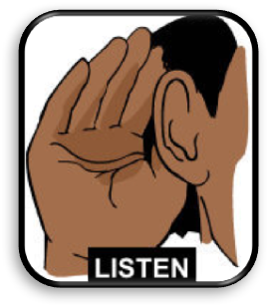
PROMPT:
What do you know about Constructive Conversations? What do they look like and sound like?
CONSTRUCTIVE CONVERSATION FISHBOWL MODEL
Listen actively as two of your peers model how to have a Constructive Conversation
How did they use the Conversation Norms?
How did they use the Constructive Conversation Skills?
FORMATIVE ASSESSMENT– TEACHER COLLECTS LANGUAGE SAMPLE SPF 1.0
Notes:
Fishbowl Model – The teacher selects a pair or group of students to demonstrate how to complete a specific task while the rest of the class listens and observes. The teacher debriefs the model, which provides students with specific feedback of what is expected. This is also an opportunity for the teacher to collect a language sample for the students who are providing the Fishbowl Model. The purpose of this protocol is to provide students with a structured opportunity to develop active listening skills.
Monitor students as they play the game and select two students who will Fishbowl Model in front of the class when they’re done playing the game. Use the SPF 1.0 to collect a Constructive Conversation Language Sample as they model in front of the class.
Debrief Whole Group Discussion - Fishbowl
Facilitate a whole group discussion using the following questions:
How did they use the Conversation Norms?
How did hey use the Constructive Conversation Skills?

Slide 27

REVIEW ELD OBJECTIVE & SELF-ASSESS
In this lesson, we…
    shared what we know about Constructive Conversations
    had a conversation with a partner
Think…
    How did the norms and skills help us to have Constructive Conversation?
Think about…
One think you did well
One thing you want to improve
TURN & TALK
TURN & TALK - THEN WHOLE GROUP DISCUSSION
Notes:
After students have had a few minutes to discuss with a partner, call on one or two individuals to share out with the whole group. Students Review ELD Objective and self assess by turning and talking with a partner

Slide 28
LESSON 2
CLARIFY BY PARAPHRASING
Notes:
In this lesson students will be able to build their knowledge of the skill of CLARIFY by learning and applying the subskill of paraphrase during a Constructive Conversation based on a visual text with a partner.

Slide 29
ELD OBJECTIVE
In this lesson, we will...
  learn the Conversation Pattern
  practice paraphrasing
  have a conversation with a partner using a visual text
STUDENT FRIENDLY ELD OBJECTIVES
Notes:
Point to and read charted Student-Friendly ELD Objective. We are going to get better at CLARIFYING our ideas. We will learn the Conversation Pattern. This will help us when we have Constructive Conversations.

Slide 30
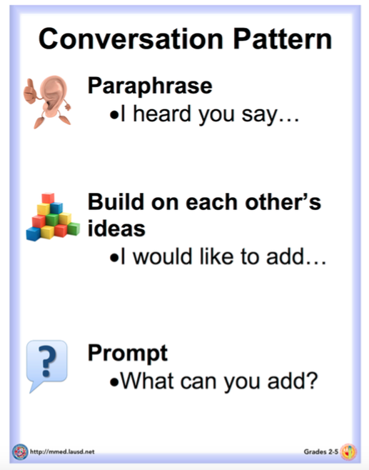
Conversation Pattern
Our first objective today is to learn about the Conversation Pattern.
This speaking pattern will help us to improve our Constructive Conversations
MODEL – INTRODUCE THE CONVERSATION PATTERN
Notes:
We will learn the Conversation Pattern—which includes paraphrasing, building on, and prompting each time we speak.
This pattern will help us CLARIFY our ideas when we have a conversation. One way to CLARIFY is to repeat our partner’s thoughts in our own words after we listen to them attentively. Today’s lesson will focus on learning and practicing how to paraphrase your partner’s ideas during a Constructive Conversation.

Slide 31
Let’s Learn the
Conversation Pattern
Paraphrase:
This means you listen to your partner. Then, you restate your partner’s ideas in your own words. Paraphrasing helps you to CLARIFY and make sure you understand what your partner said.
Build on each other’s ideas:
This means you listen to what your partner says. Then, add details to the ideas. Details help to make the ideas better.
Prompt:
This means you tell your partner to give you more information.
MODEL – INTRODUCE THE CONVERSATION PATTERN
Notes:
Display the Conversation Pattern Poster and refer to it as you explain the following:
Our first objective today is to learn about the new Conversation Pattern. This speaking pattern will help us to get even better at clarifying during our Constructive Conversations.
Let’s look at the pattern:
• Paraphrase:
o This means to listen and then we repeat our partner’s thoughts in our own words. We
paraphrase to CLARIFY and make sure we understand what our partner said. (Gesture: Point index finger to ear and whoosh hand out in front of mouth to symbolize listening and then paraphrasing what was heard.)
• Build on each other’s ideas:
o This means that we listen to what our partner says and add details and other information
to their ideas to make a clearer and more complete idea. (Gesture: Make stacking motion
with hands.)
• Prompt:
o This means we get more information, ask for clarification or for new ideas to continue the
Constructive Conversation. When prompting, we think about what we did understand and what more we need to understand fully. (Gesture: Shrug shoulders then point to partner with index finger.)
Now that we know the pattern, we will focus on how to make our ideas clearer by paraphrasing. When we paraphrase we use our own words to repeat our partner’s ideas. This means we need to listen to them attentively.

Slide 32
Conversation Pattern – CLARIFY by Paraphrasing
We will learn the Conversation Pattern.
This will help us when we have Constructive Conversations.
One way to CLARIFY is to repeat our partner’s thought in our own words.
MODEL – INTRODUCE THE CONVERSATION PATTERN
Notes:
We will learn the Conversation Pattern—which includes paraphrasing, building on, and prompting each time we speak.
This pattern will help us CLARIFY our ideas when we have a conversation. One way to CLARIFY is to repeat our partner’s thoughts in our own words after we listen to them attentively. Today’s lesson will focus on learning and practicing how to paraphrase your partner’s ideas during a Constructive Conversation.

Slide 33
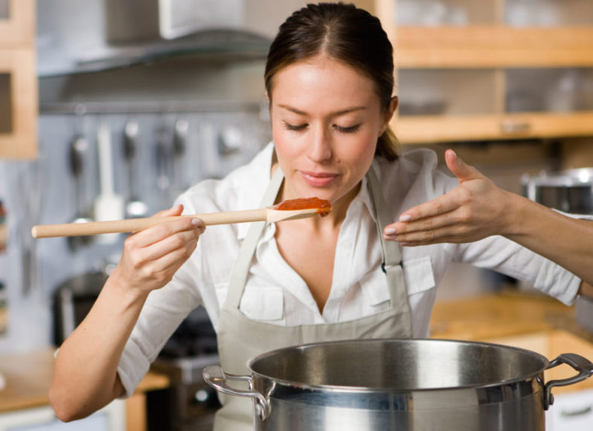
What does it mean to paraphrase?
For Example:
If my partner says, “The dinner my mom made last night was so delicious!”
How could I restate this idea?
I could paraphrase by saying, “I think you said that what your mom cooked was very tasty.”
Notes:
Provide students with an example of a paraphrased idea.

Slide 34
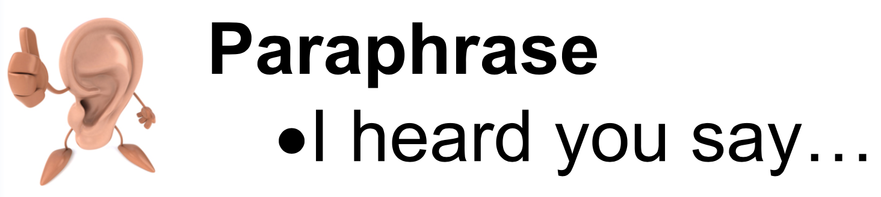
How will listening respectfully help you today? Why?
TURN & TALK
I heard many of you say…
LESSON OPENING – REVIEW NORMS – TURN AND TALK
Notes:
Review conversation norms and affirm all responses

Slide 35
Paraphrase Gesture: Point index finger to ear and whoosh hand out in front of mouth to symbolize listening and then paraphrasing what was heard.
Do the gesture with me…
INTRODUCE PARAPHRASE
Notes:
NOTE: Select one or two response starters that correspond to the proficiency level of the majority of your students. Pre-chart your selected prompt and response starters on your Conversation Pattern Poster or Class Conversation Pattern Guide to display and use during the lesson.

Slide 36

What will you say to paraphrase?
RESPONSE STARTERS
Paraphrasing
I heard you say… I think you said…
EXPANDING
For example
If someone says, “I notice that the dog’s tail is moving side to side.”
I could restate by saying, “I heard you say the puppy is wagging its tail.”
MODEL – INTRODUCE RESPONSE STARTERS
Notes:
To help us focus on paraphrasing to CLARIFY we will use our own words to repeat our partners’ ideas. We can use these response starters during our conversations to help us paraphrase.
For example, if someone says, “I notice that the dog is wagging its tail.” Which response starter could you use to help you paraphrase? (Point to pre-charted response starters.)
Turn & talk to a partner. Which response starter would you use? Call on one or two students to share which response starter they might use and what prompt or response starter they might use to continue the conversation.

Slide 37
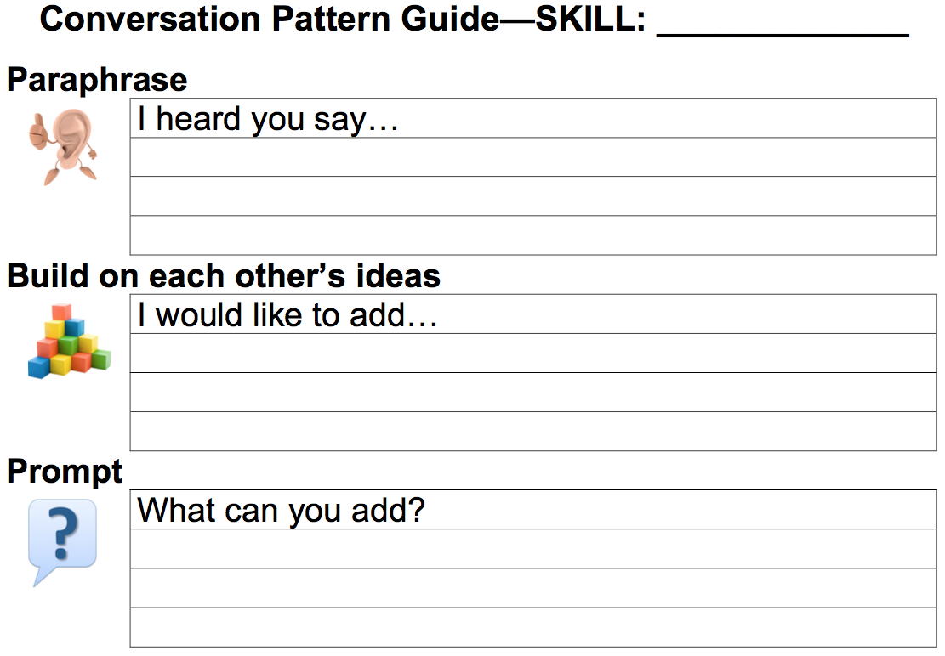
Which response starter will you use today?
RESPONSE STARTERS
Paraphrasing
I heard you say… I think you said…
EXPANDING
CLARIFY
I think you said…
You will use the Class Conversation Pattern Guide to remind you of the pattern.
MODEL – INTRODUCE RESPONSE STARTERS
Notes:
You will use the Conversation Pattern Poster or the Class Conversation Pattern Guide (point to pre-charted response starters) to remind you of the pattern. Chorally read the response starters again.
Display the response starters for students. Use the Conversation Pattern Guide to help students identify the prompt starters for their Proficiency Level.

Slide 38
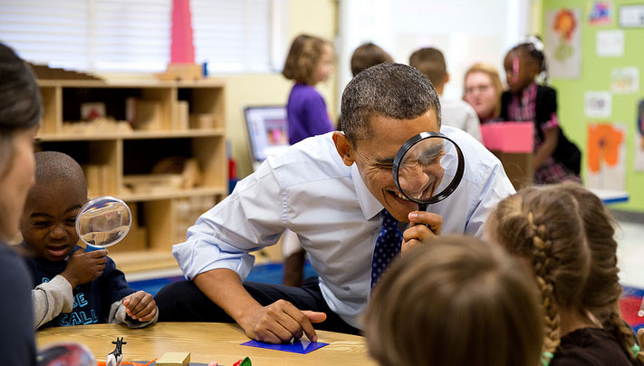
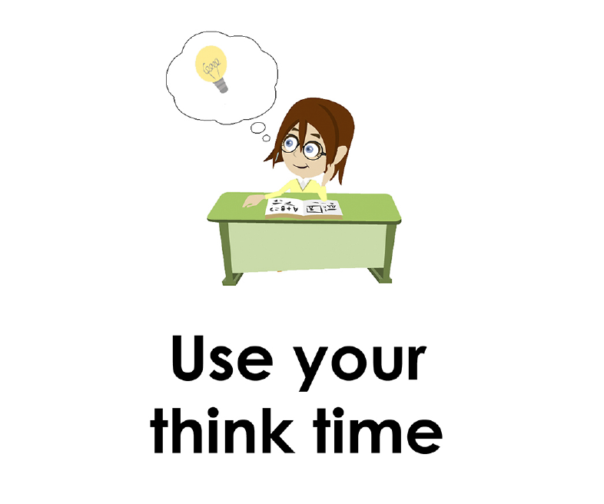
Prompt:
What do you notice in the visual text?
CLARIFY by paraphrasing what your partner said.
GUIDED PRACTICE
Notes:
Display the Teacher Visual Text for Conversation Pattern to practice how to paraphrase:
Model using Think Time

Slide 39

Listen actively to what two partners say to each other.
EXCHANGE #1 – MODEL/GUIDED PRACTICE – PARAPHRASING
Notes:
Use the conversation exchange provided below, to provide guided practice on how to paraphrase:
Listen to me as I read what two partners say to each other in a turn where this pattern is used. Here is what the partners say:
Exchange #1:
Student A:
I notice the President is using a tool with the children in a classroom.
Student B:
I think you said that President Obama is using a magnifying glass with the students.

Slide 40

Hmmm. Student B began by saying, “I think you said… “Why did he say that?”
Oh yes. “I think you said” is one way we can begin to restate a partner’s idea.
Then, what did he say? Let’s listen again.
Oh he used his own words to paraphrase what his partner said.
Student A: | I notice the President is using a tool with the children in a classroom.
Student B: | I think you said that President Obama is using a magnifying glass with the students.
EXCHANGE #1 – TEACHER THINK ALOUD – PARAPHRASE
Notes:
Practice Exchange #1 with students once more.

Slide 41
Let’s practice paraphrasing again. I will be Student A and you will be Student B.
RESPONSE STARTERS
Paraphrasing
I heard you say… I think you said…
EXPANDING
TURN & TALK
Student A: | I notice the President is using a tool with the children in a classroom.
Student B:
Now, what does Student B say?
Notes:
Guide students as needed.
Have one or two students share their examples of paraphrasing to make ideas clearer.

Slide 42
Listen actively to what two partners say to each other.
EXCHANGE #2– MODEL/GUIDED PRACTICE – PARAPHRASING
Notes:
Let’s practice paraphrasing again. Listen to me as I read what two partners say.
EXCHANGE #2
Student A: I notice the boy is also looking through a magnifying glass just like the President.
Student B:I think you said the boy is doing the same thing as President Obama.

Slide 43
Hmmm. Student B began by saying, “I think you said… “Why did he say that?”
Oh yes. “I think you said” is one way we can begin to restate a partner’s idea.
Then, what did he say? Let’s listen again.
He used his own words to paraphrase what his partner said.
RESPONSE STARTERS
Paraphrasing
I heard you say… I think you said…
EXPANDING
Student A: | I notice the boy next to the man is also looking through a magnifying glass.
Student B: | I think you said that the boy is also using a magnifying glass.
EXCHANGE #2 – TEACHER THINK ALOUD – PARAPHRASE
Notes:
Let’s practice paraphrasing again. Listen to me as I read what two partners say.
EXCHANGE #2
Student A: I notice the boy is also looking through a magnifying glass just like the President.
Student B:I think you said the boy is doing the same thing as President Obama.

Slide 44
Let’s practice paraphrasing again. I will be Student A and you will be Student B.
TURN & TALK
Student A: | I notice the boy next to the man is also looking through a magnifying glass.
Student B:
Now, what does Student B say?
Notes:
Guide students as needed.
Have one or two students share their examples of paraphrasing to make ideas clearer.

Slide 45
Listen actively!
Student A: | I notice that there are two more children and another adult at the table.
EXCHANGE #3 – MODEL/GUIDED PRACTICE – PARAPHRASING
Notes:
EXCHANGE #3
Let’s continue practicing with another example. This time will be different because I will ask you to choose which paraphrase is best and why. Listen to me as I read what one partner says to another:
Let’s continue practicing with another example.
This time will be different because I will ask you to choose which paraphrase is best and why?

Slide 46
Let’s listen to two different responses and think about which is the best paraphrase:
Student A: | I notice that there are two more children and another adult at the table.
Choice #1: Should Student B say… | OR | Choice 2: Should Student B say…
I think you said you notice that there are two more children and another adult at the table. |  | I think you said that there are three more people at the table.
EXCHANGE #3 – MODEL/GUIDED PRACTICE – PARAPHRASING
Notes:
Read both responses and have students decide which of the two responses is the best.

Slide 47
Which one restates Student A’s ideas using their own words? Why?
TURN & TALK
Student A: | I notice that there are two more children and another adult at the table.
Choice #1: Should Student B say… | OR | Choice 2: Should Student B say…
I think you said you notice that there are two more children and another adult at the table. |  | I think you said that there are three more people at the table.
EXCHANGE #3 – MODEL/GUIDED PRACTICE – PARAPHRASING
Notes:
Have students turn and talk to a partner to discuss the following:
Which one restates Student A’s idea using their own words? Why?
Read or play both responses and have students decide which of the two responses is the best.

Slide 48
Student A: | I notice that there are two more children and another adult at the table.
If you think Choice #1 is the better paraphrase, you will move to this side of the room/rug.
If you think Choice #2 is the better paraphrase, you will move to this side of the room/rug.
Choice #1: Should Student B say… | OR | Choice 2: Should Student B say…
I think you said you notice that there are two more children and another adult at the table. |  | I think you said that there are three more people at the table.
EXCHANGE #3 – MODEL/GUIDED PRACTICE – PARAPHRASING
Notes:
Gesture to where you want students to move.
Read both responses and have students decide which of the two responses is the best.

Slide 49
Which one uses their own words to restate Student A’s idea?
Choice #1 is just repeating using the same words.
Choice #2 uses their own words to restate.
I think Choice #2 is the better paraphrase.
Student A: | I notice that there are two more children and another adult at the table.
Choice #1: Should Student B say… | OR | Choice 2: Should Student B say…
I think you said you notice that there are two more children and another adult at the table. |  | I think you said that there are three more people at the table.
EXCHANGE #3 – MODEL/GUIDED PRACTICE – PARAPHRASING
Notes:
Gesture to where you want students to move.
Read both responses and have students decide which of the two responses is the best.

Slide 50
Let’s read what Student A and Student B say to each other.
Student A: | I notice that there are two more children and another adult at the table.
Student B: | I think you said that there are three more people at the table.
EXCHANGE #3 – MODEL/GUIDED PRACTICE – PARAPHRASING
Notes:
Chorally read Updated Exchange #3 now that you’ve selected Choice #2.

Slide 51
Listen actively!
Student A: | I notice that there are four children standing around a grown-up in the back of the classroom.
EXCHANGE #4 – MODEL/GUIDED PRACTICE – PARAPHRASING
Notes:
EXCHANGE #3
Let’s continue practicing with another example. This time will be different because I will ask you to choose which paraphrase is best and why. Listen to me as I read what one partner says to another: Let’s continue practicing with another example.
Listen to me as I read what one partner says to another:

Slide 52
Let’s listen to two different responses and think about which is the best paraphrase:
Student A: | I notice that there are four children standing around a grown-up in the back of the classroom.
Choice #1: Should Student B say… | OR | Choice #2: Should Student B say…
I think you said there is a small group of students standing around an adult. |  | I think you said that there are four children standing around a grown-up in the back of the classroom.
EXCHANGE #4 – MODEL/GUIDED PRACTICE – PARAPHRASING
Notes:
Read or play both responses and have students decide which of the two responses is the best.

Slide 53
Which one restates Student A’s ideas using their own words? Why?
TURN & TALK
Student A: | I notice that there are four children standing around a grown-up in the back of the classroom.
Choice #1: Should Student B say… | OR | Choice #2: Should Student B say…
I think you said there is a small group of students standing around an adult. |  | I think you said that there are four children standing around a grown-up in the back of the classroom.
EXCHANGE #4 – MODEL/GUIDED PRACTICE – PARAPHRASING
Notes:
Have students turn and talk to a partner to discuss the following:
Which one restates Student A’s idea using their own words? Why?

Slide 54
Student A: | I notice that there are four children standing around a blonde woman. They are behind the other group in the classroom.
If you think Choice #1 is the better paraphrase, you will move to this side of the room/rug.
If you think Choice #2 is the better paraphrase, you will move to this side of the room/rug.
Choice #1: Should Student B say… | OR | Choice #2: Should Student B say…
I think you said that there is another group of people in the classroom. |  | I think you notice that there are four children standing around a blonde woman. They are behind the other group in the classroom.
EXCHANGE #4 – MODEL/GUIDED PRACTICE – PARAPHRASING
Notes:
Gesture to where you want students to move.
Read both responses and have students decide which of the two responses is the best.

Slide 55
Which one uses their own words to restate Student A’s idea?
Choice #1 uses their own words to restate..
Choice #2 is just repeating
I think Choice #1 is the better paraphrase.
Student A: | I notice that there are four children standing around a blonde woman. They are behind the other group in the classroom.
Choice #1: Should Student B say… | OR | Choice #2: Should Student B say…
I think you said that there is another group of people in the classroom. |  | I think you notice that there are four children standing around a blonde woman. They are behind the other group in the classroom.
EXCHANGE #4 – MODEL/GUIDED PRACTICE – PARAPHRASING
Notes:
Gesture to where you want students to move.
Read both responses and have students decide which of the two responses is the best.

Slide 56
Let’s read what Student A and Student B say to each other.
Student A: | I notice that there are four children standing around a blonde woman. They are behind the other group in the classroom.
Student B: | I think you said that there is another group of people in the classroom.
EXCHANGE #4 – MODEL/GUIDED PRACTICE – PARAPHRASING
Notes:
Chorally read Updated Exchange #4 now that you’ve selected Choice #1.

Slide 57
Prompt: What do you notice in the visual text? CLARIFY by paraphrasing what your partner said.
What examples of paraphrasing did you hear?
How do you know?
REVIEW MODEL CONVERSATION – CLARIFY BY PARAPHRASING
Notes:
Call on one or two students to share.

Slide 58
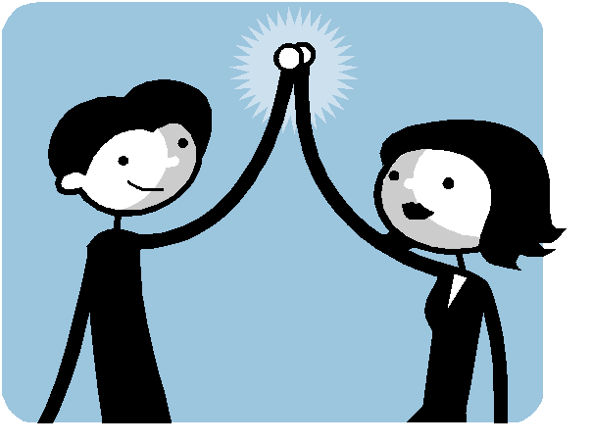
Stand Up, Hand Up, Pair Up
Stand Up – Look for a partner
Hand Up – Raise one hand in the air and walk across the room to find a partner
Pair Up – Connect your hand with your partner
STUDENT PRACTICE: STAND UP, HAND UP, PAIR UP STRATEGY
Notes:
We will now meet with a partner to practice paraphrasing to CLARIFY ideas about the visual text.
Stand Up, Hand Up, Pair Up – This is a strategy for pairing students up with a different conversation/learning partner. Students stand up, raise one hand in the air, and walk across the room in search of a partner. Students then simulate a “silent high five” to indicate that they have selected a partner. The purpose of this protocol is to provide students with a structured opportunity to engage with diverse partners and practice learning from others.
Show how to use the Stand Up, Hand Up, Pair Up Strategy to find a new partner. Model looking standing up (Stand Up), raising one hand in the air (Hand Up), and walking across the room to find a partner (Pair Up). Demonstrate how to connect your hand to your partner’s hand to confirm that you’ve selected each other. Have students do the same. You may have students sit down once they have a partner.
I will walk around and listen to notice who is paraphrasing. Use the Conversation Pattern Poster or the Class Conversation Pattern Guide (point to pre-charted response starters) to remind you of the pattern. Chorally read the response starters again. The prompt is:
What do you notice in the visual text? CLARIFY by paraphrasing what your partner said.

Slide 59
Prompt:
What do you notice in the visual text?
CLARIFY by paraphrasing what your partner said.
STUDENT PRACTICE
Notes:
Display the Student Visual Text
Direct students to use their Think Time
Now with your partner you will engage in a Constructive Conversation using the following prompt:
What do you notice in the visual text? CLARIFY by paraphrasing what your partner said.

Slide 60
Student
Practice
Prompt:
What do you notice in the visual text?
CLARIFY by paraphrasing what your partner said.
CONSTRUCTIVE CONVERSATION – TEACHER COLLECTS LANGUAGE SAMPLE SPF 1.0
Notes:
Now with your partner you will engage in a Constructive Conversation using the following prompt:
What do you notice in the visual text? CLARIFY by paraphrasing what your partner said.
As you have your conversations, I will walk around and listen to notice who is using the language of the skill and making sure to CLARIFY their partner’s ideas by paraphrasing. Remember to use your Prompt and Response Starters.

Slide 61


CONSTRUCTIVE CONVERSATION
FISHBOWL MODEL
PROMPT: What do you notice in the visual text? CLARIFY by paraphrasing what your partner said.
Listen actively to what two partners say to each other.
How did they paraphrase?
What language did they use?
FORMATIVE ASSESSMENT– TEACHER COLLECTS LANGUAGE SAMPLE SPF 1.0
Notes:
Select two students to Fishbowl Model a Constructive Conversation in front of the class. Students will address the following prompt: What do you notice in the visual text? Clarify by paraphrasing what your partner said.
Collect a language sample from the two students using the SPF 1.0. The language sample must be at least four turns in length.
Facilitate a whole-group discussion to debrief how the students did the following:
How did they CLARIFY by paraphrasing?
What language did they use?

Slide 62
REVIEW ELD OBJECTIVE & SELF-ASSESS
In this lesson, we…
    learned the Conversation Pattern
    practiced paraphrasing
    had a conversation with a partner using a visual text
Think…
    How did paraphrasing help you and your partner CLARIFY your ideas?
Think about…
One think you did well
One thing you want to improve
TURN & TALK
TURN & TALK - THEN WHOLE GROUP DISCUSSION
Notes:
Students will think about the objective and self-assess. After students have had a few minutes to discuss with a partner call on one or two individuals to share out with the whole group.

Slide 63
LESSON 3
CLARIFY BY BUILDING ON
Notes:
Students will be able to build their knowledge of the skill of CLARIFY by learning and applying the subskill of adding details to build on each other’s ideas during a Constructive Conversation based on a visual text with a partner.

Slide 64
ELD OBJECTIVE
In this lesson, we will...
  review the Conversation Pattern
  practice building on each other’s ideas
  have a conversation with a partner using a visual text
STUDENT FRIENDLY ELD OBJECTIVES
Notes:
In the last lesson we learned about the Conversation Pattern and focused on clarifying by paraphrasing, which is when we use our own words to repeat or restate our partners’ ideas. Today, we are going to build on our understanding of the skill of CLARIFY. (Point to and read charted Student-Friendly ELD Objective.)

Slide 65
Let’s Review the
Conversation Pattern
Paraphrase:
This means you listen to your partner. Then, you restate your partner’s ideas in your own words. Paraphrasing helps you to CLARIFY and make sure you understand what your partner said.
Build on each other’s ideas:
This means you listen to what your partner says. Then, add details to the ideas. Details help to make the ideas better.
Prompt:
This means you tell your partner to give you more information.
MODEL – INTRODUCE THE CONVERSATION PATTERN
Notes:
Display the Conversation Pattern Poster and refer to it as you explain the following:
Our first objective today is to learn about the new Conversation Pattern. This speaking pattern will help us to get even better at clarifying during our Constructive Conversations.
Let’s look at the pattern:
• Paraphrase:
o This means to listen and then we repeat our partner’s thoughts in our own words. We
paraphrase to CLARIFY and make sure we understand what our partner said. (Gesture: Point index finger to ear and whoosh hand out in front of mouth to symbolize listening and then paraphrasing what was heard.)
• Build on each other’s ideas:
o This means that we listen to what our partner says and add details and other information
to their ideas to make a clearer and more complete idea. (Gesture: Make stacking motion
with hands.)
• Prompt:
o This means we get more information, ask for clarification or for new ideas to continue the
Constructive Conversation. When prompting, we think about what we did understand and what more we need to understand fully. (Gesture: Shrug shoulders then point to partner with index finger.)
Now that we know the pattern, we will focus on how to make our ideas clearer by paraphrasing. When we paraphrase we use our own words to repeat our partner’s ideas. This means we need to listen to them attentively.

Slide 66
Let’s review what it means to paraphrase?
Paraphrase:
We use our own words to restate our partner’s ideas.
PARAPHRASING PRACTICE
Notes:
In the last lesson we learned how to paraphrase. Let’s review what it means to paraphrase. When we paraphrase, we restate our partner’s ideas using our own words.

Slide 67
Which one restates Student A’s ideas using their own words? Why?
Student A: | I notice that there are two more children and another adult at the table.
Choice #1: Should Student B say… | OR | Choice 2: Should Student B say…
I think you said you notice that there are two more children and another adult at the table. |  | I think you said that there are three more people at the table.
EXCHANGE #3 – MODEL/GUIDED PRACTICE – PARAPHRASING
Notes:
Have students listen to Student A’s exchange:
Student A: I notice that there are two more children and another adult at the table.
Have students turn and talk to a partner to discuss the following:
Which one restates Student A’s idea using their own words? Why?

Slide 68
Which one restates Student A’s ideas using their own words? Why?
TURN & TALK
Student A: | I notice that there are two more children and another adult at the table.
Choice #1: Should Student B say… | OR | Choice 2: Should Student B say…
I think you said you notice that there are two more children and another adult at the table. |  | I think you said that there are three more people at the table.
PARAPRASHING PRACTICE
Notes:
Have students turn and talk to a partner to discuss the following:
Which one restates Student A’s idea using their own words? Why?

Slide 69
Student A: | I notice that there are two more children and another adult at the table.
If you think Choice #1 is the better paraphrase, you will move to this side of the room/rug.
If you think Choice #2 is the better paraphrase, you will move to this side of the room/rug.
Choice #1: Should Student B say… | OR | Choice 2: Should Student B say…
I think you said you notice that there are two more children and another adult at the table. |  | I think you said that there are three more people at the table.
PARAPHRASING PRACTICE
Notes:
Tell students to move to one side of the room for Choice #1 and a different side of the room for Choice #2. Gesture to where you want students to move.
After students make a choice have them think and talk about why that is the best choice.

Slide 70
Which one uses their own words to restate Student A’s idea?
Choice #1 is just repeating using the same words.
Choice #2 uses their own words to restate.
I think Choice #2 is the better paraphrase.
Student A: | I notice that there are two more children and another adult at the table.
Choice #1: Should Student B say… | OR | Choice 2: Should Student B say…
I think you said you notice that there are two more children and another adult at the table. |  | I think you said that there are three more people at the table.
PARAPHRASING PRACTICE
Notes:
Think Aloud:
Which one uses their own words to restate Student A’s idea?
Choice #1 is just repeating using the same words.
Choice #2 uses their own words to restate.
I think Choice #2 is the better paraphrase.

Slide 71
Let’s read what Student A and Student B say to each other.
Student A: | I notice that there are two more children and another adult at the table.
Student B: | I think you said that there are three more people at the table.
PARAPHRASING PRACTICE
Notes:
Chorally read Updated Exchange #3 now that you’ve selected Choice #2.

Slide 72
Conversation Pattern – CLARIFY by Building On
The Conversation Pattern helps us improve our Constructive Conversation.
We will learn and practice how to add details to build on your own and your partner’s ideas.
We will also remember to follow the Conversation Norms.
LESSON OPENING
Notes:
We will continue working on the Conversation Pattern—which includes paraphrasing, building on, and prompting each time we speak.
This pattern will help us CLARIFY our ideas when we have a conversation. Another way to CLARIFY is to Build On. When we Build On, we develop a clearer and more complete idea.
Today’s lesson will focus on learning and practicing how to build on an partner’s idea during a Constructive Conversation.

Slide 73
How will “Take turns and build on each other’s ideas,” help you today? Why?
TURN & TALK
I heard many of you say…
LESSON OPENING – REVIEW NORMS – TURN AND TALK
Notes:
NOTE: Teacher can use the Conversation Norms Poster or the K-1 Conversation Poster. Affirm all responses

Slide 74
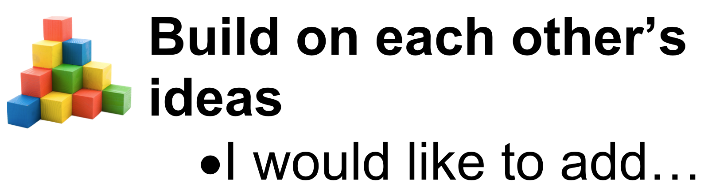
Build On Gesture: Make stacking motion with hands.
What does it mean to build on each other’s ideas?
Example
Someone says, “I notice that the puppy is wagging its tail.”
I could build on by saying, “ I would like to add…that the dog’s tails is long and white.”
Build on to CLARIFY to develop a clearer and more complete idea.
  listen actively to your partner’s ideas
  add details to what your partner said.
INTRODUCE BUILDING ON

Slide 75
What will you say to build on?
RESPONSE STARTERS
BUILD ON
I would like to add… I also think…
EXPANDING
TURN & TALK
MODEL – INTRODUCE RESPONSE STARTERS
Notes:
Call on one or two students to share which response starter they might use.
You can use these response starters to help you build on each other’s ideas.

Slide 76
Which response starter will you use today?
RESPONSE STARTERS
BUILD ON
I would like to add… I also think…
EXPANDING
CLARIFY
I think you said…
I also think…
You will use the Conversation Pattern Guide to remind you of the pattern.
MODEL – INTRODUCE RESPONSE STARTERS
Notes:
You will use the Conversation Pattern Guide to remind you of the pattern. Let’s add the response starter(s) we learned to our Conversation Pattern Guides.
Model adding one or two prompt and response starters to your Conversation Pattern Guide and distribute the Conversation Patterns Guides to students and the prompt and response starters you charted.

Slide 77
Prompt:
What do you notice in the visual text?
CLARIFY by building on what your partner said.
GUIDED PRACTICE
Notes:
Display the Teacher Visual Text
Model using Think Time

Slide 78
Listen actively to what two partners say to each other.
EXCHANGE #1 – MODEL/GUIDED PRACTICE – BUILDING ON
Notes:
Listen to me as I read what two partners say to each other in a turn where this pattern is used. Here is what the partners say:
EXCHANGE #1
Student A: I notice the man is looking through a black magnifying glass.
Student B: I would like to add that his nose is pressed on the magnifying glass.

Slide 79
Hmmm. Student B began by saying, “I would like to add… “Why did he say that?”
“I would like to add…” is one way we can begin build on the idea.
Then, what did he say? Let’s listen again.
Oh. He thought about what her partner said and added details.
RESPONSE STARTERS
BUILD ON
I would like to add… I also think…
EXPANDING
Student A: | I notice the man is looking through a black magnifying glass.
Student B: | I would like to add that his nose is pressed on the magnifying glass.
EXCHANGE #1 – TEACHER THINK ALOUD – BUILDING ON
Notes:
Practice Exchange #1 with students once more.
Student A: I notice the man is looking through a black magnifying glass.
Student B: I would like to add that his nose is pressed on the magnifying glass.

Slide 80
TURN & TALK
Student A: | I notice the man is looking through a black magnifying glass.
Student B:
Now, what does Student B say?
EXCHANGE #1 – TEACHER THINK ALOUD – BUILDING ON
Notes:
Guide students as needed.
Have one or two students share their examples of paraphrasing to make ideas clearer.
Let’s practice building on again. I will be Student A and you will be Student B.

Slide 81
Listen actively to what two partners say to each other.
EXCHANGE #2 – MODEL/GUIDED PRACTICE – BUILDING ON
Notes:
Let’s practice building on again
Student A:I notice the boy next to the man is also looking through a magnifying glass.
Student B:I would like to add that the magnifying glass is silver and is smaller than the man’s.

Slide 82
Hmmm. Student B began by saying, “I would like to add… “Why did he say that?”
Oh yes. “I would like to add…” is one way we can begin to build on the idea.
Then, what did he say? Let’s listen again.
Oh. He thought about what her partner said and added details.
RESPONSE STARTERS
BUILD ON
I would like to add… I also think…
EXPANDING
Student A: | I notice the boy next to the man is also looking through a magnifying glass.
Student B: | I would like to add that the magnifying glass is silver and is smaller than the man’s.
EXCHANGE #2 – TEACHER THINK ALOUD – BUILDING ON
Notes:
Practice Exchange #2 with students once more.

Slide 83
TURN & TALK
Student A: | I notice the boy next to the man is also looking through a magnifying glass.
Student B:
Now, what does Student B say?
EXCHANGE #2 – TEACHER THINK ALOUD – BUILDING ON
Notes:
Guide students as needed.
Have one or two students share their examples of building on to make ideas clearer.
Let’s practice building on again. I will be Student A and you will be Student B.

Slide 84
Listen actively!
Student A: | I notice that there are two more children and another adult at the table.
EXCHANGE #3 – MODEL/GUIDED PRACTICE – BUILDING ON
Notes:
EXCHANGE #3
Let’s continue practicing with another example. This time will be different because I will ask you to choose which paraphrase is best and why. Listen to me as I read what one partner says to another:

Slide 85
Let’s listen to two different responses and think about which is the best example of building on:
Student A: | I notice that there are two more children and another adult at the table.
Choice #1: Should Student B say… | OR | Choice 2: Should Student B say…
I would like to add that I like using a magnifying glass because it’s fun. |  | I would like to add that the people at the table are focused on the magnifying glasses.
EXCHANGE #3 – MODEL/GUIDED PRACTICE – BUILDING ON
Notes:
Let’s listen to two different responses and think about which is the best example of building on:
Student A:
I notice that there are two more children and another adult at the table.
Students will identify the best choice for Build On.

Slide 86
Which one adds details to build on Student A’s idea? Why?
TURN & TALK
Student A: | I notice that there are two more children and another adult at the table.
Choice #1: Should Student B say… | OR | Choice 2: Should Student B say…
I would like to add that I like using a magnifying glass because it’s fun. |  | I would like to add that the people at the table are focused on the magnifying glasses.
EXCHANGE #3 – MODEL/GUIDED PRACTICE – BUILDING ON
Notes:
Have students turn and talk to a partner to discuss the following:
Which one restates Student A’s idea using their own words? Why?

Slide 87
Student A: | I notice that there are two more children and another adult at the table.
If you think Choice #1 is the better example of building on, you will move to this side of the room/rug.
If you think Choice #2 is the better example of building on, you will move to this side of the room/rug.
Choice #1: Should Student B say… | OR | Choice 2: Should Student B say…
I would like to add that I like using a magnifying glass because it’s fun. |  | I would like to add that the people at the table are focused on the magnifying glasses.
EXCHANGE #3 – MODEL/GUIDED PRACTICE – BUILDING ON
Notes:
Tell students to move to one side of the room for Choice #1 and a different side of the room for Choice #2. Gesture to where you want students to move.
After students make a choice have them think and talk about why that is the best choice.

Slide 88
Which one adds details to build on Student A’s idea?
Choice #1 is not building on Partner A’s idea from the visual text. Instead he is sharing what he likes.
Choice #2 builds on Student A’s idea using the visual text.
I think Choice #2 is the better example of building on.
Student A: | I notice that there are two more children and another adult at the table.
Choice #1: Should Student B say… | OR | Choice 2: Should Student B say…
I would like to add that I like using a magnifying glass because it’s fun. |  | I would like to add that the people at the table are focused on the magnifying glasses.
EXCHANGE #3 – MODEL/GUIDED PRACTICE – BUILDING ON
Notes:
Think Aloud:
Which one builds on Student A’s idea?
Choice #1 is adding what he likes to do with a magnifying glass without using the visual text.
Choice #2 is building on to Student's A idea
I think Choice #2 is the better example of Building on

Slide 89
Let’s read what Student A and Student B say to each other.
Student A: | I notice that there are two more children and another adult at the table.
Student B: | I would like to add that the people at the table are focused on the magnifying glasses.
EXCHANGE #3 – MODEL/GUIDED PRACTICE – BUILDING ON
Notes:
Chorally read Updated Exchange #3 now that you’ve selected Choice #2.

Slide 90
Listen actively!
Student A: | I notice that there are four children standing around another adult. They are behind the other group in the classroom.
EXCHANGE #4 – MODEL/GUIDED PRACTICE – BUILDING ON
Notes:
Let’s continue practicing with another example.
Listen to me as I read what one partner says to another:

Slide 91
Let’s listen to two different responses and think about which is the best example of building on:
Student A: | I notice that there are four children standing around another adult. They are behind the other group in the classroom.
Choice #1: Should Student B say… | OR | Choice #2: Should Student B say…
I would like to add that the four children are looking toward the lady. |  | I would like to add that during the lesson I focus on my teacher.
EXCHANGE #4 – MODEL/GUIDED PRACTICE – BUILDING ON
Notes:
Let’s listen to two different responses and think about which is the best example of building on:
Student A:
I notice that there are four children standing around another adult. They are behind the other group in the classroom.
Students will identify the best choice for Build On.

Slide 92
Which one adds details to build on Student A’s idea? Why?
TURN & TALK
Student A: | I notice that there are four children standing around another adult. They are behind the other group in the classroom.
Choice #1: Should Student B say… | OR | Choice #2: Should Student B say…
I would like to add that the four children are looking toward the lady. |  | I would like to add that during the lesson I focus on my teacher.
EXCHANGE #4 – MODEL/GUIDED PRACTICE – BUILDING ON
Notes:
Have students turn and talk to a partner to discuss the following:
Which one restates Student A’s idea using their own words? Why?

Slide 93
Student A: | I notice that there are four children standing around a blonde woman. They are behind the other group in the classroom.
If you think Choice #1 is the better example of building on, you will move to this side of the room/rug.
If you think Choice #2 is the better example of building on, you will move to this side of the room/rug.
Choice #1: Should Student B say… | OR | Choice #2: Should Student B say…
I would like to add that the four children are looking toward the lady. |  | I would like to add that during the lesson I focus on my teacher.
EXCHANGE #4 – MODEL/GUIDED PRACTICE – BUILDING ON
Notes:
Gesture to where you want students to move.

Slide 94
Which one adds details to build on Student A’s idea?
Choice #1 builds on Student A’s idea using the visual text.
Choice #2 is not building on Student A’s idea from the visual text. Instead he is sharing what he does in school.
I think Choice #1 is the better example of building on.
Student A: | I notice that there are four children standing around a blonde woman. They are behind the other group in the classroom.
Choice #1: Should Student B say… | OR | Choice #2: Should Student B say…
I would like to add that the four children are looking toward the lady. |  | I would like to add that during the lesson I focus on my teacher.
EXCHANGE #4 – MODEL/GUIDED PRACTICE – BUILDING ON
Notes:
Think Aloud:
Which one uses their own words to restate Student A’s idea?
Choice #1 uses their own words to restate.
Choice #2 is not building an idea using the visual text.
I think Choice #1 is the better example of Building on

Slide 95
Let’s read what Student A and Student B say to each other.
Student A: | I notice that there are four children standing around a blonde woman. They are behind the other group in the classroom.
Student B: | I would like to add that the four children are looking toward the lady.
EXCHANGE #4 – MODEL/GUIDED PRACTICE – BUILDING ON
Notes:
Chorally read Updated Exchange #4 now that you’ve selected Choice #1.

Slide 96
Prompt: What do you notice in the visual text? CLARIFY by building on what your partner said.
What examples of building on did you hear? How do you know?
REVIEW MODEL CONVERSATION – CLARIFY BY BUILDING ON
Notes:
Call on one or two students to share.

Slide 97
Stand Up, Hand Up, Pair Up
Stand Up – Look for a partner
Hand Up – Raise one hand in the air and walk across the room to find a partner
Pair Up – Connect your hand with your partner
STAND UP, HAND UP, PAIR UP STRATEGY
Notes:
We will now meet with a partner to practice Building On to CLARIFY ideas about the visual text.
Stand Up, Hand Up, Pair Up – This is a strategy for pairing students up with a different conversation/learning partner. Students stand up, raise one hand in the air, and walk across the room in search of a partner. Students then simulate a “silent high five” to indicate that they have selected a partner. The purpose of this protocol is to provide students with a structured opportunity to engage with diverse partners and practice learning from others.
Show how to use the Stand Up, Hand Up, Pair Up Strategy to find a new partner. Model looking standing up (Stand Up), raising one hand in the air (Hand Up), and walking across the room to find a partner (Pair Up). Demonstrate how to connect your hand to your partner’s hand to confirm that you’ve selected each other. Have students do the same. You may have students sit down once they have a partner.
I will walk around and listen to notice who is Building on. Use the Conversation Pattern Poster or the Class Conversation Pattern Guide (point to pre-charted response starters) to remind you of the pattern. Chorally read the response starters again. The prompt is:
What do you notice in the visual text? CLARIFY by building on what your partner said.

Slide 98
Prompt:
What do you notice in the visual text?
CLARIFY by building on what your partner said.
STUDENT PRACTICE
Notes:
Display the Student Visual Text
Direct students to use their Think Time
Now with your partner you will engage in a Constructive Conversation using the following prompt:
What do you notice in the visual text? CLARIFY by building on each other’s ideas.

Slide 99
Student
Practice
Prompt:
What do you notice in the visual text?
CLARIFY by building on
what your partner said.
CONSTRUCTIVE CONVERSATION – TEACHER COLLECTS LANGUAGE SAMPLE SPF 1.0
Notes:
I will walk around and listen to notice who is building on. Use the Conversation Pattern Poster or the Class Conversation Pattern Guide (point to pre-charted response starters) to remind you of the pattern. Chorally read the response starters again.
Prompt: What do you notice in the visual text? CLARIFY by building on what your partner said.

Slide 100
CONSTRUCTIVE CONVERSATION
FISHBOWL MODEL
PROMPT: What do you notice in the visual text? CLARIFY by adding details to build on each other’s ideas.
Listen actively to what two partners say to each other.
How did they CLARIFY by adding details to build on each other’s ideas?
What language did they use?
FORMATIVE ASSESSMENT– TEACHER COLLECTS LANGUAGE SAMPLE SPF 1.0
Notes:
Select two students to Fishbowl Model a Constructive Conversation in front of the class. Students will address the following prompt: What do you notice in the visual text? CLARIFY by building on what your partner said.
Collect a language sample from the two students using the SPF 1.0. The language sample must be at least four turns in length.
Facilitate a whole-group discussion to debrief how the students did the following:
How did they CLARIFY by adding details to build on each other’s ideas?
What language did they use?

Slide 101
REVIEW ELD OBJECTIVE & SELF-ASSESS
In this lesson, we…
    reviewed the Conversation Pattern
    practiced building on each other’s ideas
    had a conversation with a partner using a visual text
Think…
    How did building on help and your partner CLARIFY your ideas?
Think about…
One think you did well
One thing you want to improve
TURN & TALK
TURN & TALK - THEN WHOLE GROUP DISCUSSION
Notes:
Students will think about the objective and self-assess. After students have had a few minutes to discuss with a partner call on one or two individuals to share out with the whole group.

Slide 102
LESSON 4
CLARIFY BY PROMPTING
Notes:
Students will be able to build their knowledge of the skill of CLARIFY by learning and applying the subskill of prompting during a Constructive Conversation based on a visual text with a partner.

Slide 103
ELD OBJECTIVE
In this lesson, we will...
  review the Conversation Pattern
  practice clarifying by prompting
  have a conversation with a partner using a visual text
STUDENT FRIENDLY ELD OBJECTIVES
Notes:
Today we are going to build on our understanding of the skill of CLARIFY. (Point to and read charted Student-Friendly ELD Objective.) As we engage in our conversations, we will also remember to follow our Conversation Norms (Point to Conversation Norms Poster.)

Slide 104
Let’s Review the
Conversation Pattern
Paraphrase:
This means you listen to your partner. Then, you restate your partner’s ideas in your own words. Paraphrasing helps you to CLARIFY and make sure you understand what your partner said.
Build on each other’s ideas:
This means you listen to what your partner says. Then, add details to the ideas. Details help to make the ideas better.
Prompt:
This means you tell your partner to give you more information.
MODEL – REVIEW THE CONVERSATION PATTERN
Notes:
Let’s review the pattern together. Who can lead us as we practice the gestures? Choose two student volunteers.
Paraphrase (Gesture: Point index finger to ear and whoosh hand out in front of mouth to symbolize listening and then paraphrasing what was heard.)
Build on each other’s ideas (Gesture: Make stacking motion with hands.)
Prompt (Gesture: Shrug shoulders then point to partner with index finger.)

Slide 105
Let’s review what it means to build on?
Build on each other’s ideas:
We add details to make an idea better.
BUILD ON PRACTICE
Notes:
In the last lesson we learned how to build on. Let’s review what it means to build on. When we build, we add details to make an idea better. Let’s practice building on.

Slide 106
Which one adds details to build on Student A’s idea? Why?
TURN & TALK
Student A: | I notice that there are two more children and another adult at the table.
Choice #1: Should Student B say… | OR | Choice #2: Should Student B say…
I would like to add that I like using a magnifying glass because it’s fun. |  | I would like to add that the people at the table are focused on the magnifying glasses.
BUILD ON PRACTICE
Notes:
Have students turn and talk to a partner to discuss the following:
Which one restates Student A’s idea using their own words? Why?

Slide 107
Let’s listen to two different responses and think about which is the best example of building on:
Listen Again
Which one adds details to build on Student A’s idea? Why?
Student A: | I notice that there are two more children and another adult at the table.
Choice #1: Should Student B say… | OR | Choice 2: Should Student B say…
I would like to add that I like using a magnifying glass because it’s fun. |  | I would like to add that the people at the table are focused on the magnifying glasses.
EXCHANGE #3 – REVIEW– BUILDING ON

Slide 108
Student A: | I notice that there are two more children and another adult at the table.
If you think Choice #1 is the better paraphrase, you will move to this side of the room/rug.
If you think Choice #2 is the better paraphrase, you will move to this side of the room/rug.
Choice #1: Should Student B say… | OR | Choice #2: Should Student B say…
I would like to add that I like using a magnifying glass because it’s fun. |  | I would like to add that the people at the table are focused on the magnifying glasses.
BUILD ON PRACTICE
Notes:
Gesture to where you want students to move.

Slide 109
Which one adds details to build on Student A’s idea?
Choice #1 is not building on Student A’s idea from the visual text. Instead he is sharing what he likes.
Choice #2 builds on Student A’s idea using the visual text.
I think Choice #2 is the better example of building on.
Student A: | I notice that there are two more children and another adult at the table.
Choice #1: Should Student B say… | OR | Choice #2: Should Student B say…
I would like to add that I like using a magnifying glass because it’s fun. |  | I would like to add that the people at the table are focused on the magnifying glasses.
BUILD ON PRACTICE
Notes:
Think Aloud:
Which one builds on Student A’s idea?
Choice #1 is adding what he likes to do with a magnifying glass without using the visual text.
Choice #2 is building on to Student's A idea
I think Choice #2 is the better example of Building on

Slide 110
Let’s read what Student A and Student B say to each other.
Student A: | I notice that there are two more children and another adult at the table.
Student B: | I would like to add that the people at the table are focused on the magnifying glasses.
EXCHANGE #4 – MODEL/GUIDED PRACTICE – BUILDING ON
Notes:
Chorally read Updated Build On Practice now that you’ve selected Choice #2.

Slide 111
Conversation Pattern – CLARIFY by Prompting
The Conversation Pattern helps us improve our Constructive Conversations.
We will learn how to prompt our partner for more information.
We will also remember to follow the Conversation Norms.
LESSON OPENING
Notes:
One way to CLARIFY is to prompt to get more information. We will review our new Conversation Pattern—which includes paraphrasing, building on, and prompting during each turn. Today’s lesson will focus on learning and practicing how to prompt your partner to get more information during a Constructive Conversation.

Slide 112
How will you “Use your Think Time” to help you today? Why?
TURN & TALK
I heard many of you say…
LESSON OPENING – REVIEW NORMS – TURN AND TALK
Notes:
Affirm all responses and say: I heard many of you say that you would “Use your Think Time” (point to poster). When you use your think time, you will be able to think about what you did understand and what more you may need to understand. So, we will make sure to (point to Norms Poster), “Use our Think Time,” during our conversations.

Slide 113

What does it mean prompt your partner for more information?
Example
Someone says, “I notice that the puppy is wagging its tail.”
I could prompt by saying, “ What else do you notice?”
Prompt or question your partner to get more information.
listen actively to your partner’s ideas
then ask a question
Prompting Gesture: Shrug shoulders then point to partner with index finger.
INTRODUCE PROMPTING

Slide 114
What will you say to prompt your partner for more information?
PROMPT STARTER
PROMPT
What can you add? What else do you notice?
EXPANDING
TURN & TALK
MODEL – INTRODUCE RESPONSE STARTERS
Notes:
Call on one or two students to share which response starter they might use.
You can use this response starter to help you prompt your partner for more information.

Slide 115
Which response starter will you use today?
CLARIFY
I think you said…
RESPONSE STARTERS
PROMPT
What can you add? What else do you notice?
EXPANDING
I also think…
What else do you notice?
MODEL – INTRODUCE RESPONSE STARTERS
Notes:
You will use the Conversation Pattern Guide to remind you of the pattern. Let’s add the prompt starter we learned to our Conversation Pattern Guides.
Model adding the prompt starter to your Conversation Pattern Guide and distribute the Conversation Patterns Guides to students and the prompt and response starters you charted.

Slide 116
Prompt:
What do you notice in the visual text?
CLARIFY by building on what your partner said.
GUIDED PRACTICE
Notes:
Display the Teacher Visual Text
Model using Think Time

Slide 117
Listen actively to what two partners say to each other.
EXCHANGE #1 – MODEL/GUIDED PRACTICE – PROMPTING
Notes:
Student A:I notice a man wearing a blue tie with his sleeve rolled up. He is looking through a black magnifying glass.
Student B: What else do you notice?

Slide 118
Hmmm. Student B began by saying, “What else do you notice?” Why did he say that?
“What else do you notice?” is one way we can prompt our partner to give us more information.
Let’s listen again.
RESPONSE STARTERS
PROMPT
What can you add? What else do you notice?
EXPANDING
Student A: | I notice President Obama wearing a blue tie with his sleeve rolled up. He is looking through a black magnifying glass.
Student B: | What else do you notice?
EXCHANGE #1 – TEACHER THINK ALOUD – PROMPTING
Notes:
Practice Exchange #1 with students once more.

Slide 119
TURN & TALK
Student A: | I notice President Obama wearing a blue tie with his sleeve rolled up. He is looking through a black magnifying glass.
Student B:
Now, what does Student B say?
EXCHANGE #1 – TEACHER THINK ALOUD – PROMPTING
Notes:
Guide students as needed.
Have one or two students share their examples of prompting to get more information and make ideas clearer.
Let’s practice prompting again. I will be Student A and you will be Student B.

Slide 120
Listen actively to what two partners say to each other.
Student A: | I notice the boy next to the man is also looking at the magnifying glass.
Student B: | What else can you add?
EXCHANGE #2 – MODEL/GUIDED PRACTICE – PROMPTING

Slide 121
Hmmm. Student B began by saying, “What else can you add?” Why did he say that?
“What else can you add?” is one way we can prompt our partner to give us more information.
Let’s listen again.
RESPONSE STARTERS
PROMPT
What can you add? What else do you notice?
EXPANDING
Student A: | I notice the boy next to the man is also looking at the magnifying glass.
Student B: | What else can you add?
EXCHANGE #2 – TEACHER THINK ALOUD – PROMPTING
Notes:
Practice Exchange #2 with students once more.

Slide 122
TURN & TALK
Student A: | I notice the boy next to the man is also looking at the magnifying glass.
Student B:
Now, what does Student B say?
EXCHANGE #2 – TEACHER THINK ALOUD – PROMPTING
Notes:
Guide students as needed.
Have one or two students share their examples of prompting to get more information and make ideas clearer.
Let’s practice prompting again. I will be Student A and you will be Student B.

Slide 123
Listen actively!
Student A: | I notice that there are two more children and another adult at the table.
EXCHANGE #3 – MODEL/GUIDED PRACTICE – PROMPTING
Notes:
EXCHANGE #3
Let’s continue practicing with another example.
This time will be different because I will ask you to choose which example of prompting is best and why?

Slide 124
Let’s listen to two different responses and think about which is the best example of prompting:
Student A: | I notice that there are two more children and another adult at the table.
Choice #1: Should Student B say… | OR | Choice 2: Should Student B say…
They are at the table. |  | What else do you notice in the visual text?
EXCHANGE #3 – MODEL/GUIDED PRACTICE – PROMPTING

Slide 125
Which choice prompts Student A for more information about the visual text? Why?
TURN & TALK
Student A: | I notice that there are two more children and another adult at the table.
Choice #1: Should Student B say… | OR | Choice 2: Should Student B say…
They are at the table. |  | What else do you notice in the visual text?
EXCHANGE #3 – MODEL/GUIDED PRACTICE – PROMPTING
Notes:
Have students turn and talk to a partner to discuss the following:
Which choice prompts students for more information about the visual text? Why?

Slide 126
Student A: | I notice that there are two more children and another adult at the table.
If you think Choice #1 is the better paraphrase, you will move to this side of the room/rug.
If you think Choice #2 is the better paraphrase, you will move to this side of the room/rug.
Choice #1: Should Student B say… | OR | Choice #2: Should Student B say…
They are at the table. |  | What else do you notice in the visual text?
EXCHANGE #3 – MODEL/GUIDED PRACTICE – PROMPTING
Notes:
Gesture to where you want students to move.

Slide 127
Which choice prompts for more information?
Choice #1 is not prompting for more information about the visual text.
Choice #2 prompts for more information by asking, “What else do you notice in the visual text?”
I think Choice #2 is the better example of prompting.
Student A: | I notice that there are two more children and another adult at the table.
Choice #1: Should Student B say… | OR | Choice 2: Should Student B say…
They are at the table. |  | What else do you notice in the visual text?
EXCHANGE #3 – MODEL/GUIDED PRACTICE – PROMPTING
Notes:
Think Aloud:
Which one uses their own words to prompt Student A’s idea?
Choice #1 is not asking for more information.
Choice #2 is asking their partner for more information.
I think Choice #2 is the better example of Prompting

Slide 128
Let’s read what Student A and Student B say to each other.
Student A: | I notice that there are two more children and another adult at the table.
Student B: | What else do you notice in the visual text?
EXCHANGE #3 – MODEL/GUIDED PRACTICE – PROMPTING
Notes:
Chorally read Updated Exchange #4 now that you’ve selected Choice #1.

Slide 129
Listen actively!
Student A: | I notice that there are four children standing around another adult. They are behind the other group in the classroom.
EXCHANGE #4 – MODEL/GUIDED PRACTICE – PROMPTING
Notes:
EXCHANGE #4
Student A:
I notice that there are four children standing around another adult. They are behind the other group in the classroom.

Slide 130
Let’s listen to two different responses and think about which is the best example of prompting:
Which choice prompts Student A for more information about the visual text? Why?
Student A: | I notice that there are four children standing around a blonde woman. They are behind the other group in the classroom.
Choice #1: Should Student B say… | OR | Choice 2: Should Student B say…
What else do you notice? |  | Do you like working in groups?
EXCHANGE #4 – MODEL/GUIDED PRACTICE – PROMPTING

Slide 131
Student A: | I notice that there are four children standing around a blonde woman. They are behind the other group in the classroom.
If you think Choice #1 is the better paraphrase, you will move to this side of the room/rug.
If you think Choice #2 is the better paraphrase, you will move to this side of the room/rug.
Choice #1: Should Student B say… | OR | Choice 2: Should Student B say…
What else do you notice? |  | Do you like working in groups?
EXCHANGE #4 – MODEL/GUIDED PRACTICE – PROMPTING
Notes:
Gesture to where you want students to move.

Slide 132
Which choice prompts Student A for more information?
Choice #1 prompts for more information about the visual text.
Choice #2 is not prompting for more information about the visual text. Instead Student A is asking about what the other student likes.
I think Choice #1 is the better example of prompting.
Student A: | I notice that there are four children standing around a blonde woman. They are behind the other group in the classroom.
Choice #1: Should Student B say… | OR | Choice 2: Should Student B say…
What else do you notice? |  | Do you like working in groups?
EXCHANGE #4 – MODEL/GUIDED PRACTICE – PROMPTING

Slide 133
Let’s read what Student A and Student B say to each other.
Student A: | I notice that there are four children standing around a blonde woman. They are behind the other group in the classroom.
Student B: | What else do you notice?
EXCHANGE #4 – MODEL/GUIDED PRACTICE – PROMPTING
Notes:
Chorally read Updated Exchange #4 now that you’ve selected Choice #1.

Slide 134
Prompt: What do you notice in the visual text? CLARIFY by prompting for more information.
What examples of prompting did you hear? How do you know?
REVIEW MODEL CONVERSATION – CLARIFY BY BUILDING ON
Notes:
Ask students to respond to the following prompt:
What examples of prompting did you hear? How do you know?
Call on one or two students to share.

Slide 135
Stand Up, Hand Up, Pair Up
Stand Up – Look for a partner
Hand Up – Raise one hand in the air and walk across the room to find a partner
Pair Up – Connect your hand with your partner
STAND UP, HAND UP, PAIR UP STRATEGY
Notes:
We will now meet with a partner to practice prompting to CLARIFY ideas about the visual text.
Stand Up, Hand Up, Pair Up – This is a strategy for pairing students up with a different conversation/learning partner. Students stand up, raise one hand in the air, and walk across the room in search of a partner. Students then simulate a “silent high five” to indicate that they have selected a partner. The purpose of this protocol is to provide students with a structured opportunity to engage with diverse partners and practice learning from others.
Show how to use the Stand Up, Hand Up, Pair Up Strategy to find a new partner. Model looking standing up (Stand Up), raising one hand in the air (Hand Up), and walking across the room to find a partner (Pair Up). Demonstrate how to connect your hand to your partner’s hand to confirm that you’ve selected each other. Have students do the same. You may have students sit down once they have a partner.
I will walk around and listen to notice who is Prompting. Use the Conversation Pattern Poster or the Class Conversation Pattern Guide (point to pre-charted response starters) to remind you of the pattern. Chorally read the response starters again. The prompt is:
What do you notice in the visual text? CLARIFY by prompting for more information.

Slide 136
Prompt:
What do you notice in the visual text?
CLARIFY by prompting for more information.
STUDENT PRACTICE
Notes:
Display the Student Visual Text
Direct students to use their Think Time
Now with your partner you will engage in a Constructive Conversation using the following prompt:
What do you notice in the visual text? CLARIFY by prompting for more information.

Slide 137
Student
Practice
Prompt:
What do you notice in the visual text?
CLARIFY by prompting for more information.
CONSTRUCTIVE CONVERSATION – TEACHER COLLECTS LANGUAGE SAMPLE SPF 1.0
Notes:
I will walk around and listen to notice who is prompting. Use the Conversation Pattern Poster or the Class Conversation Pattern Guide (point to pre-charted response starters) to remind you of the pattern. Chorally read the response starters again.
What do you notice in the visual text? CLARIFY by prompting for more information.

Slide 138
CONSTRUCTIVE CONVERSATION
FISHBOWL MODEL
PROMPT: What do you notice in the visual text? CLARIFY by prompting for more information.
Listen actively to what two partners say to each other.
How did they CLARIFY ideas by prompting for more information?
What language did they use?
FORMATIVE ASSESSMENT– TEACHER COLLECTS LANGUAGE SAMPLE SPF 1.0
Notes:
Select two students to Fishbowl Model a Constructive Conversation in front of the class. Students will address the following prompt: What do you notice in the visual text? CLARIFY by prompting for more information.
Collect a language sample from the two students using the SPF 1.0. The language sample must be at least four turns in length.
Facilitate a whole-group discussion to debrief how the students did the following:
How did they CLARIFY ideas by prompting for more information?
What language did they use?

Slide 139
REVIEW ELD OBJECTIVE & SELF-ASSESS
In this lesson, we…
    reviewed the Conversation Pattern
    practiced prompting your partner for more information
    had a conversation with a partner using a visual text
Think…
    How did prompting for more information help you?
Think about…
One think you did well
One thing you want to improve
TURN & TALK
TURN & TALK - THEN WHOLE GROUP DISCUSSION
Notes:
Students will think about the objective and self-assess. After students have had a few minutes to discuss with a partner call on one or two individuals to share out with the whole group.

Slide 140
LESSON 5
PRACTICE CONVERSATON PATTERN WITH VISUAL TEXT
Notes:
Students will review and practice the Conversation Pattern in paired and whole group discussions using a visual text.

Slide 141
ELD OBJECTIVE
In this lesson, we will...
  review the Conversation Pattern
  practice using the Conversation Pattern with a visual text
  have a conversation with a partner
STUDENT FRIENDLY ELD OBJECTIVES
Notes:
In this lesson we will review the Constructive Conversation Skills-CREATE and CLARIFY. When we CREATE we say what we think or notice about something. When we CLARIFY we make our ideas clearer for ourselves and our partners. We CLARIFY each other’s ideas by paraphrasing, building on, and prompting. During conversations, remember to follow our conversation norms (point to poster).

Slide 142
Conversation Pattern – Practice CREATE & CLARIFY
This lesson is the first time we will use all parts of the Conversation Pattern.
We will focus on using the Conversation Pattern to help us have better conversations.
We will also remember to follow our Conversation Norms.
LESSON OPENING
Notes:
In this lesson we will review the Constructive Conversation Skills-CREATE and CLARIFY. When we CREATE we say what we think or notice about something. When we CLARIFY we make our ideas clearer for ourselves and our partners. We CLARIFY each other’s ideas by paraphrasing, building on, and prompting. During conversations, remember to follow our conversation norms (point to poster).

Slide 143
Let’s Review the
Conversation Pattern
Paraphrase:
This means you listen to your partner. Then, you restate your partner’s ideas in your own words. Paraphrasing helps you to CLARIFY and make sure you understand what your partner said.
Build on each other’s ideas:
This means you listen to what your partner says. Then, add details to the ideas. Details help to make the ideas better.
Prompt:
This means you tell your partner to give you more information.
MODEL – INTRODUCE THE CONVERSATION PATTERN
Notes:
Display the Conversation Pattern Poster and refer to it as you explain the following:
Our first objective today is to learn about the new Conversation Pattern. This speaking pattern will help us to get even better at clarifying during our Constructive Conversations.
Let’s look at the pattern:
• Paraphrase:
o This means to listen and then we repeat our partner’s thoughts in our own words. We
paraphrase to CLARIFY and make sure we understand what our partner said. (Gesture: Point index finger to ear and whoosh hand out in front of mouth to symbolize listening and then paraphrasing what was heard.)
• Build on each other’s ideas:
o This means that we listen to what our partner says and add details and other information
to their ideas to make a clearer and more complete idea. (Gesture: Make stacking motion
with hands.)
• Prompt:
o This means we get more information, ask for clarification or for new ideas to continue the
Constructive Conversation. When prompting, we think about what we did understand and what more we need to understand fully. (Gesture: Shrug shoulders then point to partner with index finger.)
Now that we know the pattern, we will focus on how to make our ideas clearer by paraphrasing. When we paraphrase we use our own words to repeat our partner’s ideas. This means we need to listen to them attentively.

Slide 144
How will the language of the skill help you with your conversation? Why?
TURN & TALK
I heard many of you say….
LESSON OPENING – REVIEW NORMS – TURN AND TALK
Notes:
Which conversation norm will help us to CREATE and CLARIFY? Turn and talk to your partner. Give students 1 minute to talk to a partner.
Affirm all responses and say: I heard many of you say that you would “Use the language of the skill” (point to poster) to speak in complete sentences as we CREATE and CLARIFY ideas. We will use prompt and response starters to help us.

Slide 145
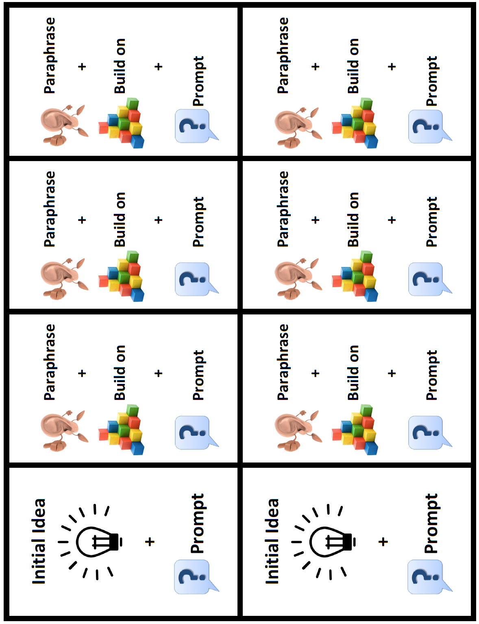
What is the first step?
MODEL – REVIEW THE CONVERSATION PATTERN
Notes:
Teacher Think Aloud: We know the pattern helps us to CLARIFY, but if we haven’t shared our idea, we have nothing to CLARIFY. So, the very first step of a Constructive Conversation is to CREATE and share an idea. Then, we can use the Conversation Pattern to develop our idea fully.

Slide 146
Which response starter will you use today?
CLARIFY
PROMPT & RESPONSE STARTERS
INITIAL IDEA
I notice that…
PARAPHRASE
I heard you say… I think you said…
BUILD ON
I would like to add… I also think…
PROMPT
What else do you notice? What else can you add?
EXPANDING
I think you said…
I also think…
What else can you add?
MODEL – INTRODUCE RESPONSE STARTERS
Notes:
Today you are going to engage in a Constructive Conversation for the Skills-CREATE and CLARIFY using a visual text. Do your best to follow the Conversation Pattern as you CLARIFY your ideas.
You will use the Conversation Pattern Guide to remind you of the pattern. Let’s review the prompt and response starters that you may use to help you during your conversations and add them to our Conversation Pattern Guides.
Model adding one or two prompt and response starters to your Conversation Pattern Guide and have students add to their guides.

Slide 147
Constructive Conversations Listening Task Poster
While you are listening to me and my partner, listen for the following…
INTRODUCE THE CONSTRUCTIVE CONVERSATION LISTENING TASK POSTER
Notes:
Display the Conversations Listening Task Poster and read each of the questions.
While you are listening to me and my partner, listen for the following:
How did we…
acknowledge a partner’s ideas?
build on a partner’s ideas?
prompt a partner to CLARIFY ideas?
use evidence to support ideas?
use academic words (notice, in other words, etc.) to convey ideas?
use domain-specific words (visual text, paraphrase, elaborate, etc.) to convey ideas?

Slide 148
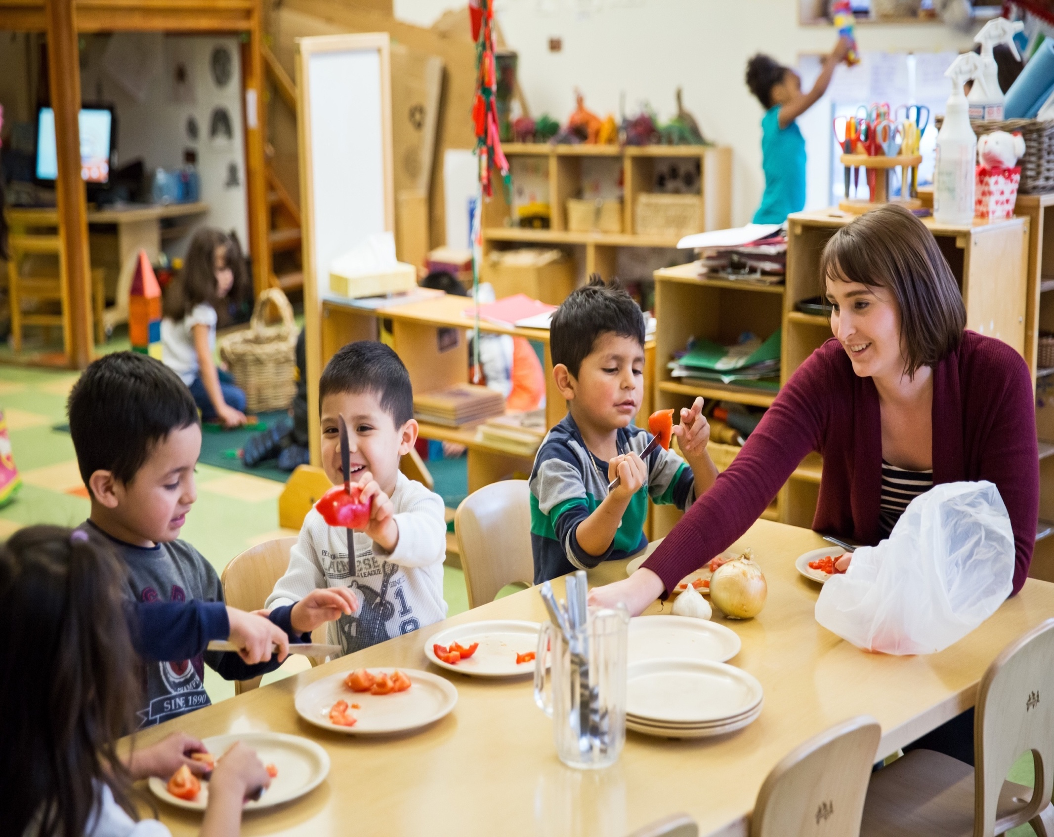
What do you notice in the visual text? Cite details to CLARIFY your ideas
MODEL- GUIDED PRACTICE
Notes:
Display the Teacher Visual Text
Model using Think Time

Slide 149
Listen to the Model Constructive Conversation
WHAT DO YOU NOTICE IN THE VISUAL TEXT? CITE DETAILS TO CLARIFY YOUR IDEAS.
Notes:
Display the Teacher Visual Text. Model using think time and pointing at key elements in the visual text before listening to the Model Constructive Conversation.
Three Listens Protocol
We will listen to the conversation three times. Each time we will focus on something different.
Prompt: What do you notice in the visual text? Use details to CLARIFY your ideas.
1st Listen (Listen for Context – Message Level Understanding)
Teacher reads the prompt
Teacher models using think time and pointing at key elements of the visual text before reading the script or playing the audio
Students listen to the entire conversation to get the gist—the message
The first time we listen, we will listen actively to understand what Student A and Student B are talking about. Are they answering the prompt?
Read the entire model or play audio. Have students engage in a conversation after each Listen. Use the following prompt to Talk to a partner:
What were the students talking about? How do you know? Use your think time. Give students some think time. Turn and talk to your partner. Give students 1 minute to talk to a partner. Call on one or two students to share.
2nd Listen: (Listen for the Language of the Skill – Sentence Level)
Teacher and students chorally read the prompt
Teacher models consulting the Prompt and Response Starters for the language of skill (See Coded Model and Conversation Coding Key for your reference)
Students listen to the first two full turns of the conversation
Teacher stops at key moments to make sure students hear the language of the skill
Students chorally chant the prompt or response starter they heard
This time we will listen actively for the language of the skills. What prompt and response starters are they using to speak in complete sentences?
Read each student’s turn or play audio. Pause after each prompt or response starter. Have students chorally chant the prompt or response starter they just hear.
3rd Listen: (Listen for the Conversation Pattern)
Teacher and students chorally read the prompt
Teacher models using think time and pointing at key elements of the Class Conversation Pattern Guide or the Conversation Pattern Poster throughout the 3rd listen
Students listen to the entire conversation turn by turn
Teacher stops at key moments to make sure students understand the pattern
Students will show what they heard using the gestures and the Conversation Pattern Game Cards
Let’s listen actively to what Student A says. Make the gestures for what you hear.

Slide 150
What makes this a model for CLARIFY?
What specific language did you hear?
TURN & TALK
Student A1: | I notice that there is a woman with four children sitting at the table in a classroom. What do you notice?
Student B1: | I notice that they are sitting at the table around nine plates and a clear pitcher with knives in it. What else do you notice?
DEBRIEF THE MODEL CONSTRUCTIVE CONVERSATION
Notes:
Debrief the Model Conversation
Guide students through an analysis of what makes this a Model Constructive Conversation for the skills of CREATE and CLARIFY. (See Coded Model and Conversation Coding Key for your reference.) Use the Conversations Listening Task Poster and the Conversation Pattern Guide as a reference.
What makes this a model for CLARIFY? What specific language did you hear? Use your think time then turn and talk to your partner.

Slide 151

What makes this a model for CLARIFY?
What specific language did you hear?
CONVERSATION CODING KEY CREATE & CLARIFY
ID | INITIAL IDEA
PAR | PARAPHRASE
BO | BUILD ON
PR | PROMPT
UNDERLINE Prompt & Response STARTERS
Student A1: | I notice that there is a woman with four children sitting at the table in a classroom. [ID] What do you notice? [PR]
Student B1: | I notice that they are sitting at the table around nine plates and a clear pitcher with knives in it. [ID] What else do you notice? [PR]
DEBRIEF THE MODEL CONSTRUCTIVE CONVERSATION
Notes:
Debrief the Model Conversation
Guide students through an analysis of what makes this a Model Constructive Conversation for the skills of CREATE and CLARIFY. (See Coded Model and Conversation Coding Key for your reference.) Use the Conversations Listening Task Poster and the Conversation Pattern Guide as a reference.
Have one or two students share out.

Slide 152
What makes this a model for CLARIFY?
What specific language did you hear?
TURN & TALK
Student A2: | I think you said that there are plates and utensils on the table in front of the people. I want to add that there are tomato slices on the white plates in front of everyone at the table. What else do you notice?
Student B2: | I think you said that there are pieces of tomato on everyone’s plate. I want to add that three kids are holding knives. Two children are cutting tomatoes and the boy with the striped shirt is using the knife to hold the tomato slice. What else do you notice?
DEBRIEF THE MODEL CONSTRUCTIVE CONVERSATION
Notes:
Debrief the Model Conversation
Guide students through an analysis of what makes this a Model Constructive Conversation for the skills of CREATE and CLARIFY. (See Coded Model and Conversation Coding Key for your reference.) Use the Conversations Listening Task Poster and the Conversation Pattern Guide as a reference.
What makes this a model for CLARIFY? What specific language did you hear? Use your think time then turn and talk to your partner. Remember to refer to the Listening Task Poster and the Conversation Pattern Guide. Have one or two students share out.
Using noun phrases to add details makes your ideas clearer. Let’s take another listen/look at the language the two speakers used to add details. (Refer to highlighted examples.) How did they add details? Turn and talk to your partner. Have one or two students share out.

Slide 153
What makes this a model for CLARIFY?
What specific language did you hear?
Student A2: | I think you said that there are plates and utensils on the table in front of the people. [PAR] I want to add that there are tomato slices on the white plates in front of everyone at the table. [BO] What else do you notice?[PR]
Student B2: | I think you said that there are pieces of tomato on everyone’s plate. [PAR] I want to add that three kids are holding knives. [BO] Two children are cutting tomatoes and the boy with the striped shirt is using the knife to hold the tomato slice. [BO] What else do you notice? [PR]
CONVERSATION CODING KEY CREATE & CLARIFY
ID | INITIAL IDEA
PAR | PARAPHRASE
BO | BUILD ON
PR | PROMPT
UNDERLINE Prompt & Response STARTERS
DEBRIEF THE MODEL CONSTRUCTIVE CONVERSATION
Notes:
Debrief the Model Conversation
Guide students through an analysis of what makes this a Model Constructive Conversation for the skills of CREATE and CLARIFY. (See Coded Model and Conversation Coding Key for your reference.) Use the Conversations Listening Task Poster and the Conversation Pattern Guide as a reference.
Have one or two students share out.

Slide 154
What makes this a model for CLARIFY?
What specific language did you hear?
TURN & TALK
Student A3: | I think you said that some of the children use their knives for slicing tomatoes. I want to add that the boy in the striped shirt is looking carefully at his red tomato slice. What else do you notice?
Student B3: | I think you said that the boy is studying his tomato slice. I want to add that the boy with the white shirt is holding out his tomato with the knife stuck through it. What else do you notice?
DEBRIEF THE MODEL CONSTRUCTIVE CONVERSATION
Notes:
Debrief the Model Conversation
Guide students through an analysis of what makes this a Model Constructive Conversation for the skills of CREATE and CLARIFY. (See Coded Model and Conversation Coding Key for your reference.) Use the Conversations Listening Task Poster and the Conversation Pattern Guide as a reference.
Remember to refer to the Listening Task Poster and the Conversation Pattern Guide. Have one or two students share out.

Slide 155
What makes this a model for CLARIFY?
What specific language did you hear?
CONVERSATION CODING KEY CREATE & CLARIFY
ID | INITIAL IDEA
PAR | PARAPHRASE
BO | BUILD ON
PR | PROMPT
UNDERLINE Prompt & Response STARTERS
Student A3: | I think you said that some of the children use their knives for slicing tomatoes. [PAR] I want to add that the boy in the striped shirt is looking carefully at his red tomato slice. [BO] What else do you notice? [PR]
Student B3: | I think you said that the boy is studying his tomato slice. [PAR] I want to add that the boy with the white shirt is holding out his tomato with the knife stuck through it. [BO] What else do you notice? [PR]
DEBRIEF THE MODEL CONSTRUCTIVE CONVERSATION
Notes:
Debrief the Model Conversation
Guide students through an analysis of what makes this a Model Constructive Conversation for the skills of CREATE and CLARIFY. (See Coded Model and Conversation Coding Key for your reference.) Use the Conversations Listening Task Poster and the Conversation Pattern Guide as a reference.
Have one or two students share out.

Slide 156
What makes this a model for CLARIFY?
What specific language did you hear?
TURN & TALK
Student A4: | I think you said that the boy with the white shirt is playing with his tomato instead of slicing it. I want to add that the boy with the white shirt is smiling while he shows his tomato to the other boy. What else do you notice?
Student B4: | I think you said that the boy is having fun with the tomato instead of focusing on his work. I want to add that the boy with the gray shirt is not looking at the boy with the white shirt. What else do you notice?
DEBRIEF THE MODEL CONSTRUCTIVE CONVERSATION
Notes:
Debrief the Model Conversation
Guide students through an analysis of what makes this a Model Constructive Conversation for the skills of CREATE and CLARIFY. (See Coded Model and Conversation Coding Key for your reference.) Use the Conversations Listening Task Poster and the Conversation Pattern Guide as a reference.
What makes this a model for CLARIFY? What specific language did you hear? Use your think time then turn and talk to your partner. Remember to refer to the Listening Task Poster and the Conversation Pattern Guide. Have one or two students share out.

Slide 157
What makes this a model for CLARIFY?
What specific language did you hear?
CONVERSATION CODING KEY CREATE & CLARIFY
ID | INITIAL IDEA
PAR | PARAPHRASE
BO | BUILD ON
PR | PROMPT
UNDERLINE Prompt & Response STARTERS
Student A4: | I think you said that the boy with the white shirt is playing with his tomato instead of slicing it. [PAR] I want to add that the boy with the white shirt is smiling while he shows his tomato to the other boy. [BO] What else do you notice? [PR]
Student B4: | I think you said that the boy is having fun with the tomato instead of focusing on his work. [PAR] I want to add that the boy with the gray shirt is not looking at the boy with the white shirt. [BO] What else do you notice? [PR]
DEBRIEF THE MODEL CONSTRUCTIVE CONVERSATION
Notes:
Debrief the Model Conversation
Guide students through an analysis of what makes this a Model Constructive Conversation for the skills of CREATE and CLARIFY. (See Coded Model and Conversation Coding Key for your reference.) Use the Conversations Listening Task Poster and the Conversation Pattern Guide as a reference.
Have one or two students share out.

Slide 158

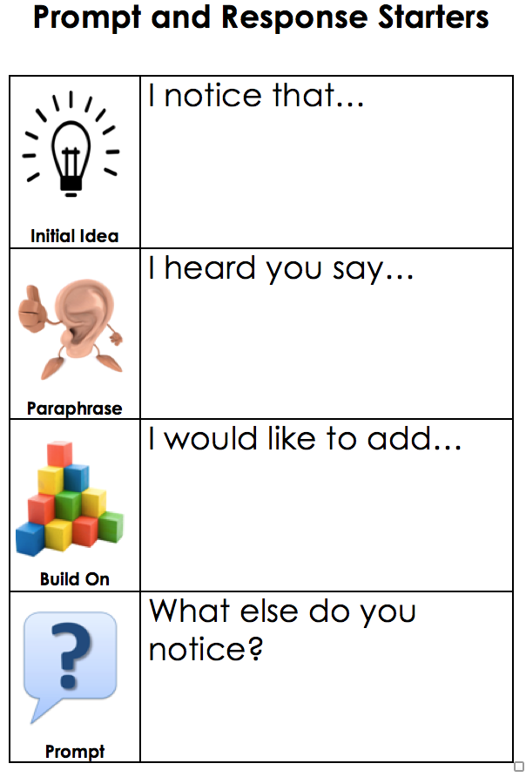
CONSTRUCTIVE CONVERSATION GAME WITH VISUAL TEXT
PREPARE TO PLAY THE GAME – TEACHER COLLECTS LANGUAGE SAMPLE SPF 1.0
Notes:
Constructive Conversation Game with Visual Text
Organize students into pairs and distribute the Conversation Pattern Game Cards.
Now you will play the Constructive Conversation Game with your partner.
Each of you will have one card for your initial idea and 3 cards to cite details as you follow the Conversation Pattern.
You will use the visual text. First you must share an initial idea and prompt your partner. Then, take turns and use the Conversation Pattern.
I will walk around and listen to notice who is using the Conversation Pattern. Remember to use your Prompt and Response Starters.
Prompt: What do you notice in the visual text? Cite details to CLARIFY your ideas.
Formative Assessment
Monitor students as they play the game and provide feedback as needed. Then select two students who will Fishbowl Model in front of the class when they’re done playing the game. Use the SPF 1.0 to collect a Constructive Conversation Language Sample as they model in front of the class.

Slide 159
CONSTRUCTIVE CONVERSATION GAME WITH VISUAL TEXT
PROMPT:
What do you notice in the visual text?
Cite details to CLARIFY your ideas.
STUDENT PRACTICE
Notes:
Constructive Conversation Game with Visual Text
Prompt: What do you notice in the visual text? Cite details to CLARIFY your ideas.
Formative Assessment
Monitor students as they play the game and provide feedback as needed. Then select two students who will Fishbowl Model in front of the class when they’re done playing the game. Use the SPF 1.0 to collect a Constructive Conversation Language Sample as they model in front of the class.

Slide 160
PROMPT:
What do you notice in the visual text? Cite details to CLARIFY your ideas.
CONSTRUCTIVE CONVERSATION FISHBOWL MODEL
How did they use the Conversation Pattern?
What language did they use?
FORMATIVE ASSESSMENT– TEACHER COLLECTS LANGUAGE SAMPLE SPF 1.0
Notes:
Select two students to Fishbowl Model a Constructive Conversation in front of the class. Students will address the following prompt: What do you notice in the visual text? Cite details to CLARIFY your ideas.
Collect a language sample from the two students using the SPF 1.0. The language sample must be at least four turns in length.
Have the students Listen actively as two of your peers model how to have a Constructive Conversation

Slide 161

How do noun phrases add details?
TURN & TALK
Student A1: | I notice that there is a woman and four children sitting at the table in a classroom. [ID] What do you notice? [PR]
Student B1: | I notice that they are sitting at the table around nine plates and a clear pitcher with knives in it. [ID] What else do you notice? [PR]
DEBRIEF THE MODEL CONSTRUCTIVE CONVERSATION
Notes:
Using noun phrases to add details makes your ideas clearer. Let’s take another listen/look at the language the two speakers used to add details. (Refer to highlighted examples.) How did they add details? Turn and talk to your partner. Have one or two students share out.

Slide 162
How do noun phrases add details?
TURN & TALK
Student A2: | I think you said that there are plates and utensils on the table in front of the people. [PAR] I want to add that there are tomato slices on the white plates in front of everyone at the table. [BO] What else do you notice? [PR]
Student B2: | I think you said that there are pieces of tomato on everyone’s plate. [PAR] I want to add that three kids are holding knives. [BO] Two children are cutting tomatoes and the boy with the striped shirt is using the knife to hold the tomato slice. [BO] What else do you notice? [PR]
DEBRIEF THE MODEL CONSTRUCTIVE CONVERSATION
Notes:
Using noun phrases to add details makes your ideas clearer. Let’s take another listen/look at the language the two speakers used to add details. (Refer to highlighted examples.) How did they add details? Turn and talk to your partner. Have one or two students share out.

Slide 163
How do noun phrases add details?
TURN & TALK
Student A3: | I think you said that some of the children use their knives for slicing tomatoes. [PAR] I want to add that the boy in the striped shirt is looking carefully at his red tomato slice. [BO] What else do you notice? [PR]
Student B3: | I think you said that the boy is studying his tomato slice. [PAR] I want to add that the boy with the white shirt is holding out his tomato with the knife stuck through it. [BO] What else do you notice? [PR]
DEBRIEF THE MODEL CONSTRUCTIVE CONVERSATION
Notes:
Using noun phrases to add details makes your ideas clearer. Let’s take another listen/look at the language the two speakers used to add details. (Refer to highlighted examples.) How did they add details? Turn and talk to your partner. Have one or two students share out.

Slide 164
How do noun phrases add details?
TURN & TALK
Student A4: | I think you said that the boy with the white shirt is playing with his tomato instead of slicing it. [PAR] I want to add that the boy with the white shirt is smiling while he shows his tomato to the other boy. [BO] What else do you notice? [PR]
Student B4: | I think you said that the boy is having fun with the tomato instead of focusing on his work. [PAR] I want to add that the boy with the gray shirt is not looking at the boy with the white shirt. [BO] What else do you notice? [PR]
DEBRIEF THE MODEL CONSTRUCTIVE CONVERSATION
Notes:
Using noun phrases to add details makes your ideas clearer. Let’s take another listen/look at the language the two speakers used to add details. (Refer to highlighted examples.) How did they add details? Turn and talk to your partner. Have one or two students share out.

Slide 165
REVIEW ELD OBJECTIVE & SELF-ASSESS
In this lesson, we…
    reviewed the Conversation Pattern
    practiced using the Conversation Pattern with a visual text
    had a conversation with a partner
    Think about …
    How did the Conversation Pattern help us?
One thing you did well
One thing you want to improve.
TURN & TALK
TURN & TALK - THEN WHOLE GROUP DISCUSSION
Notes:
After students have had a few minutes to discuss with a partner, call on one or two individuals to share out with the whole group.

Slide 166
LESSON 6
Practice Conversation pattern WITH infographic
Notes:
Students will review and practice the Conversation Pattern in paired and whole group discussions using a infographic.

Slide 167
ELD OBJECTIVE
In this lesson, we will...
  review the Conversation Pattern
  practice using the Conversation Pattern with an Infographic
  have a conversation with a partner
STUDENT FRIENDLY ELD OBJECTIVES
Notes:
In this lesson we will review the Conversation Skills-CREATE and CLARIFY. When we CREATE we say what we think or notice about something. When we CLARIFY we make our ideas clearer for ourselves and our partners. We CLARIFY each other’s ideas by paraphrasing, building on, and prompting. During conversations, remember to follow our conversation norms (point to poster).

Slide 168
Conversation Pattern – Practice CREATE & CLARIFY
We have learned and practiced how to CLARIFY our ideas by using the Conversation Pattern.
Today’s lesson will focus on reviewing the Constructive Conversation Skills- CREATE & CLARIFY
When we CLARIFY we make our ideas clearer for ourselves and our partners.
We CLARIFY each other’s ideas by paraphrasing, building on, and prompting each other.
We will use what we know about CLARIFY and CREATE ideas with an infographic.
LESSON OPENING
Notes:
In this lesson we will review the Constructive Conversation Skills-CREATE and CLARIFY. When we CREATE we say what we think or notice about something. When we CLARIFY we make our ideas clearer for ourselves and our partners. We CLARIFY each other’s ideas by paraphrasing, building on, and prompting. During conversations, remember to follow our conversation norms (point to poster).

Slide 169
Let’s Review the
Conversation Pattern
Paraphrase:
This means you listen to your partner. Then, you restate your partner’s ideas in your own words. Paraphrasing helps you to CLARIFY and make sure you understand what your partner said.
Build on each other’s ideas:
This means you listen to what your partner says. Then, add details to the ideas. Details help to make the ideas better.
Prompt:
This means you tell your partner to give you more information.
MODEL – INTRODUCE THE CONVERSATION PATTERN
Notes:
Display the Conversation Pattern Poster and refer to it as you explain the following:
Our first objective today is to learn about the new Conversation Pattern. This speaking pattern will help us to get even better at clarifying during our Constructive Conversations.
Let’s look at the pattern:
• Paraphrase:
o This means to listen and then we repeat our partner’s thoughts in our own words. We
paraphrase to CLARIFY and make sure we understand what our partner said. (Gesture: Point index finger to ear and whoosh hand out in front of mouth to symbolize listening and then paraphrasing what was heard.)
• Build on each other’s ideas:
o This means that we listen to what our partner says and add details and other information
to their ideas to make a clearer and more complete idea. (Gesture: Make stacking motion
with hands.)
• Prompt:
o This means we get more information, ask for clarification or for new ideas to continue the
Constructive Conversation. When prompting, we think about what we did understand and what more we need to understand fully. (Gesture: Shrug shoulders then point to partner with index finger.)
Now that we know the pattern, we will focus on how to make our ideas clearer by paraphrasing. When we paraphrase we use our own words to repeat our partner’s ideas. This means we need to listen to them attentively.

Slide 170
Which Conversation Norm will help you to CREATE and CLARIFY? Why?
TURN & TALK
I heard many of you say…
LESSON OPENING – REVIEW NORMS – TURN AND TALK
Notes:
Which conversation norm will help us to CREATE and CLARIFY? Turn and talk to your partner. Give students 1 minute to talk to a partner.
Affirm all responses and say: I heard many of you say that you would “Use the language of the skill” (point to poster) to speak in complete sentences as we CREATE and CLARIFY ideas. We will use prompt and response starters to help us.

Slide 171
What is the first step?
MODEL – REVIEW THE CONVERSATION PATTERN
Notes:
Teacher Think Aloud: We know the pattern helps us to CLARIFY, but if we haven’t shared our idea, we have nothing to CLARIFY. So, the very first step of a Constructive Conversation is to CREATE and share an idea. Then, we can use the Conversation Pattern to develop our idea fully.

Slide 172
Which response starter will you use today?
CLARIFY
PROMPT & RESPONSE STARTERS
INITIAL IDEA
I notice that…
PARAPHRASE
I heard you say… I think you said…
BUILD ON
I would like to add… I also think…
PROMPT
What else do you notice? What else can you add?
EXPANDING
I think you said…
I also think…
How else can you add?
MODEL – INTRODUCE RESPONSE STARTERS
Notes:
Today you are going to engage in a Constructive Conversation for the Skills-CREATE and CLARIFY using an Infographic. Do your best to follow the Conversation Pattern as you CLARIFY your ideas.
You will use the Conversation Pattern Guide to remind you of the pattern. Let’s review the prompt and response starters that you may use to help you during your conversations and add them to our Conversation Pattern Guides.

Slide 173
Constructive Conversations Listening Task Poster
While you are listening to me and my partner, listen for the following…
REVIEW THE CONSTRUCTIVE CONVERSATION LISTENING TASK POSTER
Notes:
Display the Conversations Listening Task Poster and read each of the questions.
While you are listening to me and my partner, listen for the following:
How did we…
acknowledge a partner’s ideas?
build on a partner’s ideas?
prompt a partner to CLARIFY ideas?
use evidence to support ideas?
use academic words (notice, in other words, etc.) to convey ideas?
use domain-specific words (visual text, paraphrase, elaborate, etc.) to convey ideas?

Slide 174
What is an infographic?
An informational text that combines visuals and words.
The information about a topic is clear and concise.
INTRODUCE- INFOGRAPHIC
Notes:
Display the Teacher Infographic. In past lessons we used a visual text. From now on we will also use a
new source of information called an infographic. An infographic is an informational text that combines visuals and words to provide information about a topic clearly and concisely.

Slide 175
What do you notice in the infographic? Cite details to CLARIFY your ideas.
MODEL- GUIDED PRACTICE
Notes:
Display the Teacher Visual Text
Model using Think Time

Slide 176
Listen to the Model Constructive Conversation
WHAT DO YOU NOTICE IN THE VISUAL TEXT? CITE DETAILS TO CLARIFY YOUR IDEAS.
Notes:
Display the Teacher Visual Text. Model using think time and pointing at key elements in the visual text before listening to the Model Constructive Conversation.
Three Listens Protocol
We will listen to the conversation three times. Each time we will focus on something different.
Prompt: What do you notice in the visual text? Use details to CLARIFY your ideas.
1st Listen (Listen for Context – Message Level Understanding)
Teacher reads the prompt
Teacher models using think time and pointing at key elements of the visual text before reading the script or playing the audio
Students listen to the entire conversation to get the gist—the message
The first time we listen, we will listen actively to understand what Student A and Student B are talking about. Are they answering the prompt?
Read the entire model or play audio. Have students engage in a conversation after each Listen. Use the following prompt to Talk to a partner:
What were the students talking about? How do you know? Use your think time. Give students some think time. Turn and talk to your partner. Give students 1 minute to talk to a partner. Call on one or two students to share.
2nd Listen: (Listen for the Language of the Skill – Sentence Level)
Teacher and students chorally read the prompt
Teacher models consulting the Prompt and Response Starters for the language of skill (See Coded Model and Conversation Coding Key for your reference)
Students listen to the first two full turns of the conversation
Teacher stops at key moments to make sure students hear the language of the skill
Students chorally chant the prompt or response starter they heard
This time we will listen actively for the language of the skills. What prompt and response starters are they using to speak in complete sentences?
Read each student’s turn or play audio. Pause after each prompt or response starter. Have students chorally chant the prompt or response starter they just hear.
3rd Listen: (Listen for the Conversation Pattern)
Teacher and students chorally read the prompt
Teacher models using think time and pointing at key elements of the Class Conversation Pattern Guide or the Conversation Pattern Poster throughout the 3rd listen
Students listen to the entire conversation turn by turn
Teacher stops at key moments to make sure students understand the pattern
Students will show what they heard using the gestures and the Conversation Pattern Game Cards
Let’s listen actively to what Student A says. Make the gestures for what you hear.

Slide 177
What makes this a model for CLARIFY?
What specific language did you hear?
TURN & TALK
Student A1: | I notice that the title says “Be a Good Citizen!”. There are three rows with two pictures each. What can you add?
Student B1: | I notice that there are six pictures of children on a playground and in a classroom at school. There is a paragraph below each picture. What else can you add?
DEBRIEF THE MODEL CONSTRUCTIVE CONVERSATION
Notes:
Debrief the Model Conversation
Guide students through an analysis of what makes this a Model Constructive Conversation for the skills of CREATE and CLARIFY. (See Coded Model and Conversation Coding Key for your reference.) Use the Conversations Listening Task Poster and the Conversation Pattern Guide as a reference.
Remember to refer to the Listening Task Poster and the Conversation Pattern Guide. Have one or two students share out.

Slide 178
What makes this a model for CLARIFY?
What specific language did you hear?
CONVERSATION CODING KEY CREATE & CLARIFY
ID | INITIAL IDEA
PAR | PARAPHRASE
BO | BUILD ON
PR | PROMPT
UNDERLINE Prompt & Response STARTERS
Student A1: | I notice that the title says “Be a Good Citizen!”. [ID] There are three rows with two pictures each. [ID] What can you add? [PR]
Student B1: | I notice that there are six pictures of children on a playground and in a classroom at school. [ID] There is a paragraph below each picture. [ID] What else can you add? [PR]
DEBRIEF THE MODEL CONSTRUCTIVE CONVERSATION
Notes:
Debrief the Model Conversation
Guide students through an analysis of what makes this a Model Constructive Conversation for the skills of CREATE and CLARIFY. (See Coded Model and Conversation Coding Key for your reference.) Use the Conversations Listening Task Poster and the Conversation Pattern Guide as a reference.
Have one or two students share out.

Slide 179
What makes this a model for CLARIFY?
What specific language did you hear?
TURN & TALK
Student A2: | I heard you say that there are pictures with children in them and text below each picture explaining each one. I want to add that the subtitle says, “Be Safe” in the first row right under the title. What else can you add?
Student B2: | I heard you say that the first heading says to be safe. I want to add that there are two pictures underneath the heading. One of the pictures shows children playing on the playground waiting in line to go on the red slide. They are taking turns sliding down. The text says that they are cooperating. What else can you add?
DEBRIEF THE MODEL CONSTRUCTIVE CONVERSATION
Notes:
Debrief the Model Conversation
Guide students through an analysis of what makes this a Model Constructive Conversation for the skills of CREATE and CLARIFY. (See Coded Model and Conversation Coding Key for your reference.) Use the Conversations Listening Task Poster and the Conversation Pattern Guide as a reference.
Remember to refer to the Listening Task Poster and the Conversation Pattern Guide. Have one or two students share out.

Slide 180
What makes this a model for CLARIFY?
What specific language did you hear?
CONVERSATION CODING KEY CREATE & CLARIFY
ID | INITIAL IDEA
PAR | PARAPHRASE
BO | BUILD ON
PR | PROMPT
UNDERLINE Prompt & Response STARTERS
Student A2: | I heard you say that there are pictures with children in them and text below each picture explaining each one. [PAR] I want to add that the subtitle says, “Be Safe” in the first row right under the title. [BO] What else can you add? [PR]
Student B2: | I heard you say that the first heading says to be safe. [PAR] I want to add that there are two pictures underneath the heading. [BO] One of the pictures shows children playing on the playground waiting in line to go on the red slide. They are taking turns sliding down. [BO] The text says that they are cooperating. [BO] What else can you add? [PR]
DEBRIEF THE MODEL CONSTRUCTIVE CONVERSATION
Notes:
Debrief the Model Conversation
Guide students through an analysis of what makes this a Model Constructive Conversation for the skills of CREATE and CLARIFY. (See Coded Model and Conversation Coding Key for your reference.) Use the Conversations Listening Task Poster and the Conversation Pattern Guide as a reference.
Have one or two students share out.

Slide 181
What makes this a model for CLARIFY?
What specific language did you hear?
TURN & TALK
Student A3: | I heard you say that the students are playing safely by cooperating on the playground. I want to add that the picture next to it shows two students. The boy in the yellow shirt is yelling at the girl who is covering her ears. The text says the boy is bullying the other student by screaming. What else can you add?
Student B3: | I heard you say that the boy is being a bully because he is threatening the girl. I want to add that the next heading says “Be Respectful”. What else can you add?
DEBRIEF THE MODEL CONSTRUCTIVE CONVERSATION
Notes:
Debrief the Model Conversation
Guide students through an analysis of what makes this a Model Constructive Conversation for the skills of CREATE and CLARIFY. (See Coded Model and Conversation Coding Key for your reference.) Use the Conversations Listening Task Poster and the Conversation Pattern Guide as a reference.
Remember to refer to the Listening Task Poster and the Conversation Pattern Guide. Have one or two students share out.

Slide 182
What makes this a model for CLARIFY?
What specific language did you hear?
CONVERSATION CODING KEY CREATE & CLARIFY
ID | INITIAL IDEA
PAR | PARAPHRASE
BO | BUILD ON
PR | PROMPT
UNDERLINE Prompt & Response STARTERS
Student A3: | I heard you say that the students are playing safely by cooperating on the playground. [PAR] I want to add that the picture next to it shows two students. The boy in the yellow shirt is yelling at the girl who is covering her ears. [BO] The text says the boy is bullying the other student by screaming. [BO] What else can you add? [PR]
Student B3: | I heard you say that the boy is being a bully because he is threatening the girl. [PAR] I want to add that the next heading says “Be Respectful”. [BO] What else can you add? [PR]
DEBRIEF THE MODEL CONSTRUCTIVE CONVERSATION
Notes:
Debrief the Model Conversation
Guide students through an analysis of what makes this a Model Constructive Conversation for the skills of CREATE and CLARIFY. (See Coded Model and Conversation Coding Key for your reference.) Use the Conversations Listening Task Poster and the Conversation Pattern Guide as a reference.
Have one or two students share out.

Slide 183
What makes this a model for CLARIFY?
What specific language did you hear?
TURN & TALK
Student A4: | I heard you say that another subtitle in the infographic says to “Be Respectful.” I want to add that underneath the subtitle there is a picture of a boy who is making a silly face. What else can you add?
Student B4: | I heard you say there is a boy who is acting foolishly. I want to add that the text underneath that picture says “Respectful students do not distract others.” What else can you add?
DEBRIEF THE MODEL CONSTRUCTIVE CONVERSATION
Notes:
Debrief the Model Conversation
Guide students through an analysis of what makes this a Model Constructive Conversation for the skills of CREATE and CLARIFY. (See Coded Model and Conversation Coding Key for your reference.) Use the Conversations Listening Task Poster and the Conversation Pattern Guide as a reference.
Remember to refer to the Listening Task Poster and the Conversation Pattern Guide. Have one or two students share out.

Slide 184
What makes this a model for CLARIFY?
What specific language did you hear?
CONVERSATION CODING KEY CREATE & CLARIFY
ID | INITIAL IDEA
PAR | PARAPHRASE
BO | BUILD ON
PR | PROMPT
UNDERLINE Prompt & Response STARTERS
Student A4: | I heard you say that another subtitle in the infographic says to “Be Respectful.” [PAR] I want to add that underneath the subtitle there is a picture of a boy who is making a silly face. [BO] What else can you add? [PR]
Student B4: | I heard you say there is a boy who is acting foolishly. [PAR] I want to add that the text underneath that picture says “Respectful students do not distract others.” [BO] What else can you add? [PR]
DEBRIEF THE MODEL CONSTRUCTIVE CONVERSATION
Notes:
Debrief the Model Conversation
Guide students through an analysis of what makes this a Model Constructive Conversation for the skills of CREATE and CLARIFY. (See Coded Model and Conversation Coding Key for your reference.) Use the Conversations Listening Task Poster and the Conversation Pattern Guide as a reference.
Have one or two students share out.

Slide 185
CONSTRUCTIVE CONVERSATION GAME WITH INFOGRAPHIC
PREPARE TO PLAY THE GAME – TEACHER COLLECTS LANGUAGE SAMPLE SPF 1.0
Notes:
Constructive Conversation Game with Visual Text
Organize students into pairs and distribute the Conversation Pattern Game Cards.
Now you will play the Constructive Conversation Game with your partner.
Each of you will have one card for your initial idea and 3 cards to cite details as you follow the Conversation Pattern.
You will use the visual text. First you must share an initial idea and prompt your partner. Then, take turns and use the Conversation Pattern.
I will walk around and listen to notice who is using the Conversation Pattern. Remember to use your Prompt and Response Starters.
Prompt: What do you notice in the visual text? Cite details to CLARIFY your ideas.
Formative Assessment
Monitor students as they play the game and provide feedback as needed. Then select two students who will Fishbowl Model in front of the class when they’re done playing the game. Use the SPF 1.0 to collect a Constructive Conversation Language Sample as they model in front of the class.

Slide 186
CONSTRUCTIVE CONVERSATION GAME WITH INFOGRAPHIC
PROMPT:
What do you notice in the infographic?
Cite details to CLARIFY your ideas.
Notes:
Constructive Conversation Game with Infographic
Organize students into quads and distribute the Conversation Pattern Game Cards. Now you are going to play the Constructive Conversation Game. Your conversations will focus on the skills of CREATE and CLARIFY using the infographic. You will be in a group of four. Each of you will have one card for your initial idea and 3 cards to cite details as you follow the Conversation Pattern. You will take turns until all cards have been played. Remember to follow our Conversation Norms and use the Constructive Conversations Listening Task Poster.
Begin by stating your idea. Cite details to CLARIFY your ideas and use the Conversation Pattern.
Prompt: What do you notice in the infographic? Cite details to CLARIFY your ideas.
Formative Assessment
Monitor students as they play the game and provide feedback as needed. Then select two students who will Fishbowl Model in front of the class when they’re done playing the game. Use the SPF 1.0 to collect a Constructive Conversation Language Sample as they model in front of the class.

Slide 187
PROMPT:
What do you notice in the infographic? Cite details to CLARIFY your ideas.
CONSTRUCTIVE CONVERSATION FISHBOWL MODEL
How did they use the Conversation Pattern?
What language did they use?
FORMATIVE ASSESSMENT– TEACHER COLLECTS LANGUAGE SAMPLE SPF 1.0
Notes:
Select two students to Fishbowl Model a Constructive Conversation in front of the class. Students will address the following prompt: What do you notice in the visual text? Cite details to CLARIFY your ideas.
Collect a language sample from the two students using the SPF 1.0. The language sample must be at least four turns in length.
Have the students Listen actively as two of your peers model how to have a Constructive Conversation

Slide 188
How do noun phrases add details?
TURN & TALK
Student A1: | I notice that the title says “Be a Good Citizen!”. [ID] There are three rows with two pictures each. [ID] What can you add? [PR]
Student B1: | I notice that there are six pictures of children on a playground and in a classroom at school. [ID] There is a paragraph below each picture. [ID] What else can you add? [PR]
DEBRIEF THE MODEL CONSTRUCTIVE CONVERSATION
Notes:
Using noun phrases to add details makes your ideas clearer. Let’s take another listen/look at the language the two speakers used to add details. (Refer to highlighted examples.) How did they add details? Turn and talk to your partner. Have one or two students share out.

Slide 189
How do noun phrases add details?
TURN & TALK
Student A2: | I heard you say that there are pictures with children in them and text below each picture explaining each one. [PAR] I want to add that the subtitle says, “Be Safe” in the first row right under the title. What else can you add? [PR]
Student B2: | I heard you say that the first heading says to be safe. [PAR] I want to add that there are two pictures underneath the heading. [BO] One of the pictures shows children playing on the playground waiting in line to go on the red slide. They are taking turns sliding down. [BO] The text says that they are cooperating. [BO] What else can you add? [PR]
DEBRIEF THE MODEL CONSTRUCTIVE CONVERSATION
Notes:
Using noun phrases to add details makes your ideas clearer. Let’s take another listen/look at the language the two speakers used to add details. (Refer to highlighted examples.) How did they add details? Turn and talk to your partner. Have one or two students share out.

Slide 190
How do noun phrases add details?
TURN & TALK
Student A3: | I heard you say that the students are playing safely by cooperating on the playground. [PAR] I want to add that the picture next to it shows two students. The boy in the yellow shirt is yelling at the girl who is covering her ears. [BO] The text says the boy is bullying the other student by screaming. [BO] What else can you add? [PR]
Student B3: | I heard you say that the boy is being a bully because he is threatening the girl. [PAR] I want to add that the next heading says “Be Respectful”. [BO] What else can you add? [PR]
DEBRIEF THE MODEL CONSTRUCTIVE CONVERSATION
Notes:
Using noun phrases to add details makes your ideas clearer. Let’s take another listen/look at the language the two speakers used to add details. (Refer to highlighted examples.) How did they add details? Turn and talk to your partner. Have one or two students share out.

Slide 191
How do noun phrases add details?
TURN & TALK
Student A4: | I heard you say that another subtitle in the infographic says to “Be Respectful”. [PAR] I want to add that underneath the subtitle there is a picture of a boy who is making a silly face. [BO] What else can you add? [PR]
Student B4: | I heard you say there is a boy who is acting foolishly. [PAR] I want to add that the text underneath that picture says “Respectful students do not distract others”. [BO] What else can you add? [PR]
DEBRIEF THE MODEL CONSTRUCTIVE CONVERSATION
Notes:
Using noun phrases to add details makes your ideas clearer. Let’s take another listen/look at the language the two speakers used to add details. (Refer to highlighted examples.) How did they add details? Turn and talk to your partner. Have one or two students share out.

Slide 192
REVIEW ELD OBJECTIVE & SELF-ASSESS
In this lesson, we…
    reviewed the Conversation Pattern
    practiced CREATE and CLARIFY with an infographic
    had a conversation with a partner
    Think about …
    How did the Conversation Pattern help us?
One thing you did well
One thing you want to improve.
TURN & TALK
TURN & TALK - THEN WHOLE GROUP DISCUSSION
Notes:
Students will think about the objective and self-assess. After students have had a few minutes to discuss with a partner call on one or two individuals to share out with the whole group.

