Slide 1
Start Smart 2.0
Conversation Practices
GRADE 4
PART 1: SETTING THE FOUNDATION
LESSONS 1-6

Slide 2
LESSON 1
REVIEW NORMS & SKILLS

Slide 3

ELD OBJECTIVE
In this lesson, we will...
  share what we know about Constructive Conversations
  have a conversation with a partner and in a small group
STUDENT FRIENDLY ELD OBJECTIVES
Notes:
In this lesson we will review what we know about Constructive Conversations. In the past we have engaged in Constructive Conversations using visual texts and have learned about the Constructive Conversation Norms and Skills. Today, we will begin to learn how to use those norms and skills in a more complex way. But first, we will review what we already know about Constructive Conversations.

Slide 4

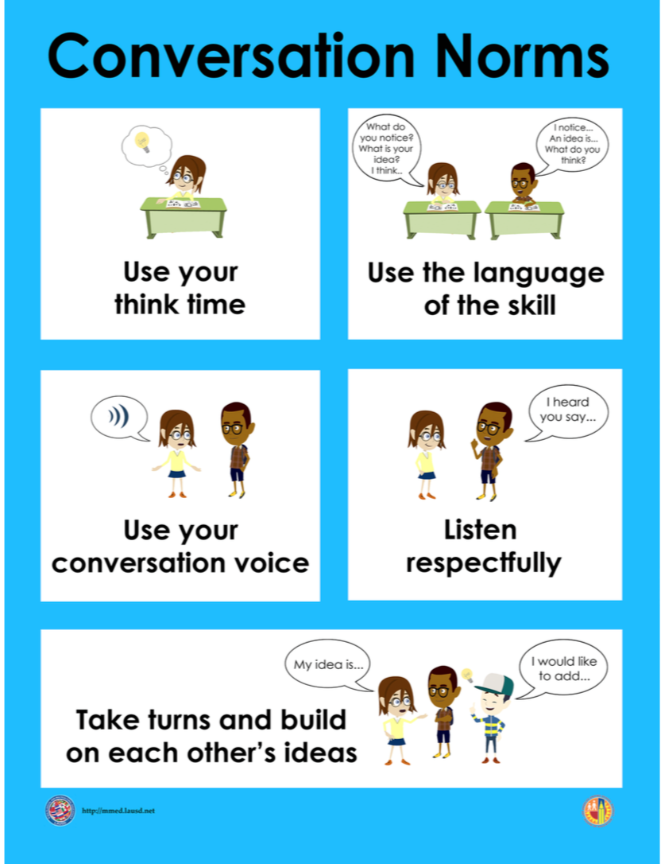
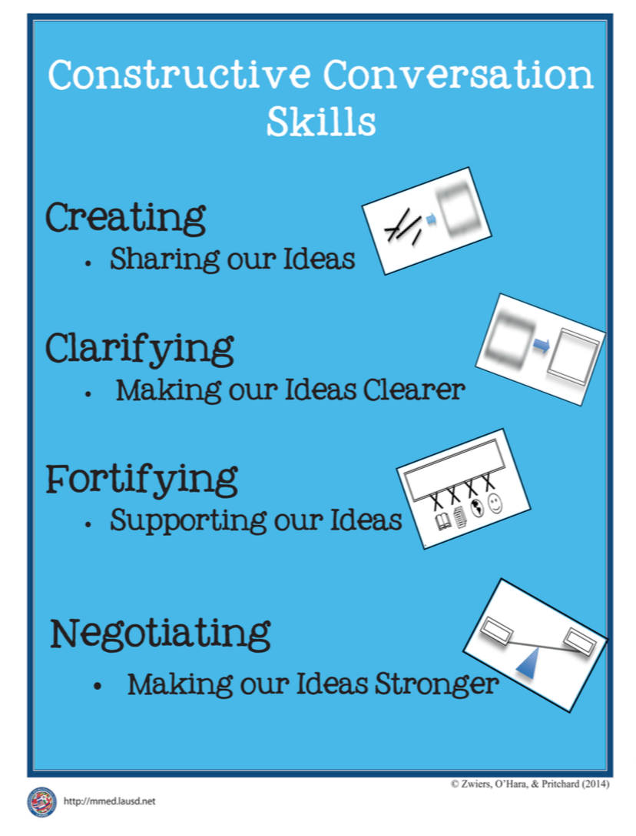

What do we already know about Constructive Conversation Norms and Skills?
TURN & TALK
REVIEW ARTIFACTS
Notes:
NOTE: artifacts may include Constructive Conversation Norms Poster, Constructive Conversations Skills Poster, Constructive Conversation Game Cards, Listening Task Posters, and additional artifacts such as student-created posters from Start Smart 1.0 Lesson 14 to use as a reference as they engage in a review of norms and skills.
Display the Constructive Conversation artifacts and ask the following question:
What do we already know about the Constructive Conversation Norms and Skills? Turn and
talk to your partner.
After students have had a few minutes to discuss with a partner, call on one or two individuals to share out with the whole group.

Slide 5
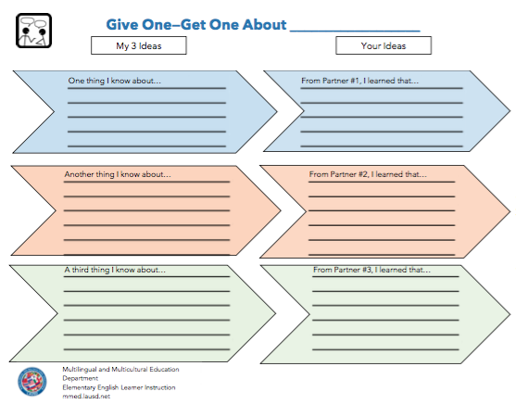
Review What You Know – Conversation Norms
We will use this graphic organizer to take notes about the following prompt:
What do you know about Conversation NORMS?
What does it look like and sound like when you use them?
MODEL/GUIDED PRACTICE - GIVE ONE-GET ONE - CONVERSATION NORMS
Notes:
Now you will work with your partners to review all you know about the Constructive Conversation Norms. We will use the Give One-Get One Graphic Organizer to think and take notes about the following prompt:
What do you know about the Constructive Conversation Norms? What does it look like and sound like when you use them?
Distribute the Give One-Get One Graphic Organizer to students. Display the directions for the Give One-Get One Protocol.

Slide 6
GIVE ONE-GET ONE PROTOCOL
Think about the prompt.
Write one idea in each box on the left under the heading “My 3 Ideas.”
Turn and face the teacher when ready to share.
At the signal, find Partner #1.
With your partner “Give One” idea and listen to “Get One” idea.
After you have both shared, write the new idea in the “Get One” column and write the initials of the person who gave the information.
At the signal, find Partner #2. Follow steps 5-6 with this partner.
At the signal, find Partner #3. Follow steps 5-6 with this partner.
GIVE ONE-GET ONE PROTOCOL DIRECTIONS
Notes:
Let’s read the directions for the Give One-Get One Protocol.

Slide 7


Think about the prompt.
What do you know about Conversation NORMS?
What does it look like and sound like when you use them?
Hmmm…I think I’m going to use the poster to remind me of what I know about the Norms.
One thing I know is that I need to use my think time just like I’m doing right now.
MODEL/GUIDED PRACTICE - TEACHER THINK ALOUD
Notes:
Now, let’s review the directions for the Give One-Get One Protocol as I model how to do it. The first step is, “Think about the prompt.”
Teacher Think Aloud

Slide 8
Step 2 is to write one idea in each box on the left under the heading, “My 3 Ideas.” I will write my ideas here
THE NORMS
the norms is that I need to use my think time to gather ideas.
Write one idea in each box on the left under the heading “My 3 Ideas.”
Turn and face the teacher when ready to share.
MODEL/GUIDED PRACTICE - GIVE ONE-GET ONE - CONVERSATION NORMS
Notes:
Step 2 is to write one idea in each box on the left under the heading, “My 3 Ideas.” I will write my ideas here (point to the first box in the graphic organizer and complete the statement, “One thing I know about…” the norms is that I need to use my think time to gather ideas).

Slide 9
THE NORMS
At the signal, find Partner #1.
With your partner Give One of your ideas and listen to Get One idea from your partner.
After you have both shared, write the new idea in the “Your Ideas” column and write the initials of the person who gave the information.
MODEL/GUIDED PRACTICE - GIVE ONE-GET ONE - CONVERSATION NORMS
Notes:
At the signal, I find Partner #1. I look for someone who does not have a partner and is ready to share.
Model following steps 5 and 6 from the Give One, Get One directions with a student.

Slide 10
THE NORMS
At the signal, find Partner #2. Follow steps 5-6 with this partner.
At the signal, find Partner #3. Follow steps 5-6 with this partner.
MODEL/GUIDED PRACTICE - GIVE ONE-GET ONE - CONVERSATION NORMS
Notes:
Remember to address the prompt.
What do you know about the Constructive Conversation Norms? What does it look like and sound like when you use them?
Once everyone has given and received information, lead students in a whole-group discussion of the information they have shared. Students should annotate/edit their notes when ideas are incorrect, such as drawing a line through them.

Slide 11
Review What You Know – Constructive Conversation Skills
We will use this graphic organizer to take notes about the following prompt:
What do you know about Constructive Conversation SKILLS?
What does it look like and sound like when you use them?
THE SKILLS
TURN YOUR PAPER OVER
MODEL/GUIDED PRACTICE - GIVE ONE-GET ONE - CONSTRUCTIVE CONVERSATION SKILLS
Notes:
Now we will use the Give One-Get One Graphic Organizer to review the Constructive Conversation Skills. Turn your paper over. We will review the directions for the Give One-Get One Protocol as I model how to do it with a different prompt

Slide 12
Think about the prompt.
What do you know about Constructive Conversation SKILLS?
What does it look like and sound like when you use them?
Hmmm. So, I’m going to use the poster to remember what I know about the skills.
One thing I know is that when I FORTIFY I support my ideas with evidence from the text. I can say, “In the text it says…” or “I know because…”
MODEL/GUIDED PRACTICE - TEACHER THINK ALOUD
Notes:
The first step is, “Think about the prompt.” The prompt is: What do you know about the Constructive Conversation Skills? What does it look like and sound like when you use them?
Teacher Think Aloud

Slide 13
Step 2 is to write one idea in each box on the left under the heading, “My 3 Ideas.” I will write my ideas here
THE SKILLS
the skills is that when I fortify I support my ideas with evidence from the text.
Write one idea in each box on the left under the heading “My 3 Ideas.”
Turn and face the teacher when ready to share.
MODEL/GUIDED PRACTICE - GIVE ONE-GET ONE - CONSTRUCTIVE CONVERSATION SKILLS
Notes:
Step 2 is to write one idea in each box on the left under the heading, “My 3 Ideas.” I will write my ideas here (point to the first box in the graphic organizer and complete the statement, “One thing I know about…” the SKILLS is that when I FORTIFY I support my ideas with evidence from the text. I can say, “In the text it says…” or “I know because…”

Slide 14
THE SKILLS
At the signal, find Partner #1.
With your partner Give One of your ideas and listen to Get One idea from your partner.
After you have both shared, write the new idea in the “Your Ideas” column and write the initials of the person who gave the information.
MODEL/GUIDED PRACTICE - GIVE ONE-GET ONE – CONSTRUCTIVE CONVERSATION SKILLS
Notes:
On the signal, I find Partner #1. I look for someone who does not have a partner and is ready to share. Model following steps 5 and 6 from the Give One, Get One directions with a student.

Slide 15
THE SKILLS
At the signal, find Partner #2. Follow steps 5-6 with this partner.
At the signal, find Partner #3. Follow steps 5-6 with this partner.
MODEL/GUIDED PRACTICE - GIVE ONE-GET ONE - CONSTRUCTIVE CONVERSATION SKILLS
Notes:
Remember to address the prompt.
What do you know about the Constructive Conversation Skills? What does it look like and sound like when you use them?
Once everyone has given and received information, lead students in a whole-group discussion of the information they have shared. Students should annotate/edit their notes when ideas are incorrect, such as drawing a line through them.

Slide 16

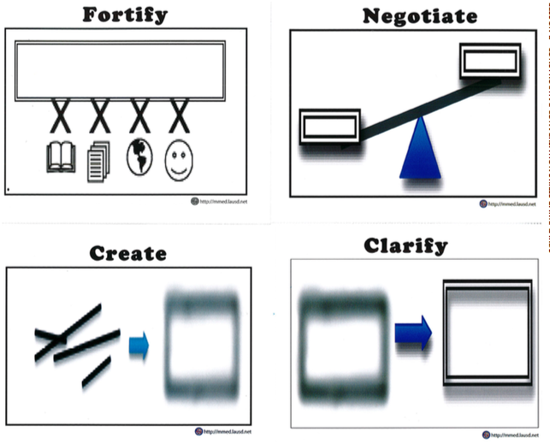

CONSTRUCTIVE CONVERSATION GAME WITH VISUAL TEXT
PROMPT:
What do you know about Constructive Conversations? What do they look like and sound like?
Form groups of four
Each of you needs two cards for CREATE, CLARIFY, & FORTIFY
Take turns sharing in round robin fashion until all cards have been played
Remember to use the Constructive Conversation Norms and Skills as you play the game
PREPARE TO PLAY THE GAME – TEACHER COLLECTS LANGUAGE SAMPLE SPF 1.0
Notes:
Constructive Conversation Game
Place students in groups of four to play the Constructive Conversation Game using the Game Cards. Give each student two cards for CREATE, CLARIFY, and FORTIFY. You are now going to have the opportunity to practice the Constructive Conversation Skills while playing the game. You will have two cards for each skill of CREATE, CLARIFY, and FORTIFY. Remember to use the norms and the skills as you play the Constructive Conversation Game.
Prompt: What do you know about Constructive Conversations? What do they look like and sound like?
Formative Assessment
Monitor students as they play the game and select two students who will Fishbowl Model in front of the class when they’re done playing the game. Use the SPF 1.0 to collect a Constructive Conversation Language Sample as they model in front of the class.
Debrief Whole Group Discussion - Fishbowl
Facilitate a whole group discussion using the following questions:
How did you demonstrate the use of the Conversation Norms?
How did you demonstrate the use of the Conversation Skills?

Slide 17


CONSTRUCTIVE CONVERSATION FISHBOWL MODEL
PROMPT:
What do you know about Constructive Conversations? What do they look like and sound like?
Listen actively as two of your peers model how to have a Constructive Conversation
How did they demonstrate the use of the Conversation Norms?
How did they demonstrate the use of the Constructive Conversation Skills?
FORMATIVE ASSESSMENT– TEACHER COLLECTS LANGUAGE SAMPLE SPF 1.0
Notes:
Select two students to Fishbowl Model a Constructive Conversation in front of the class. Students will address the following prompt: What do you know about Constructive Conversations? What do they look like and sound like?
Collect a language sample from the two students using the SPF 1.0. The language sample must be at least four turns in length.
Facilitate a whole group discussion using the following questions: How did you demonstrate the use of the Conversation Norms?
How did you demonstrate the use of the Conversation Skills?

Slide 18

REVIEW ELD OBJECTIVE & SELF-ASSESS
In this lesson, we…
    shared what we know about Constructive Conversations
    had a conversation with a partner and a small group
Think…
    How did we meet our objectives in this lesson?
    How did the Norms and Skills help us to have a Constructive Conversation?
Work with your Constructive Conversation partner to:
Identify one thing that you did well and one thing you want to improve
Share and explain to your partner
TURN & TALK
TURN & TALK - THEN WHOLE GROUP DISCUSSION
Notes:
After students have had a few minutes to discuss with a partner, call on one or two individuals to share out with the whole group.

Slide 19
LESSON 2
CLARIFY BY PARAPHRASING

Slide 20
ELD OBJECTIVE
In this lesson, we will...
  introduce the Conversation Pattern
  have a Constructive Conversation with a partner based on a visual text
  listen to partner’s ideas
  learn to CLARIFY by paraphrasing a partner’s ideas
STUDENT FRIENDLY ELD OBJECTIVES
Notes:
Today we are going to build on our understanding of the skill of CLARIFY. (Point to and read charted Student-Friendly ELD Objective).

Slide 21
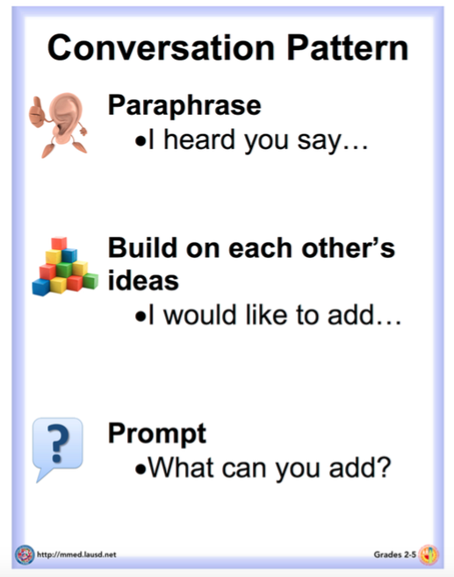
Conversation Pattern – CLARIFY by Paraphrasing
We will learn the Conversation Pattern—which includes paraphrasing, building on, and prompting each time we speak.
This pattern will help you CLARIFY your ideas when you have a Constructive Conversation.
One way to CLARIFY is to repeat or paraphrase your partner’s thoughts in your own words after you listen to them.
Today’s lesson will focus on learning and practicing how to paraphrase your partner’s ideas during a Constructive Conversation.
LESSON OPENING
Notes:
Display the Conversation Pattern and refer to it as you introduce and explain the Conversation Pattern.

Slide 22
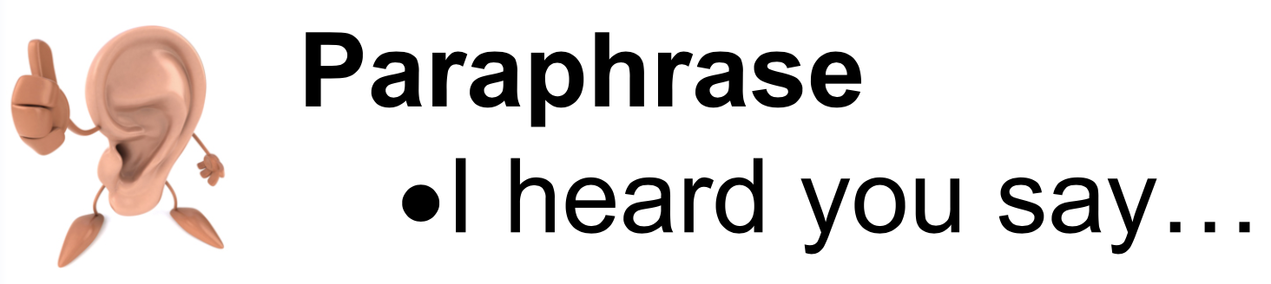
Which Conversation Norm will help you to paraphrase? Why?
TURN & TALK
I heard many of you say that you would “Listen respectfully.”
Listening respectfully will help you to understand what your partner said, so that you can restate or paraphrase their idea.
LESSON OPENING – REVIEW NORMS – TURN AND TALK
Notes:
As we engage in our conversations, we will also remember to follow our Constructive Conversation Norms. (Point to Constructive Conversation Norms Poster.)
Which Conversation Norm will help us to paraphrase? Why? Turn and talk to your partner. Give students 1 minute to talk to a partner.
Affirm all responses and say: I heard many of you say that you would “Listen respectfully,” (point to poster) so we will make sure to, “Listen respectfully,” during our conversations.

Slide 23
Let’s Learn the
Conversation Pattern
Paraphrase:
This means to listen and then we repeat our partner’s thoughts in our own words. We paraphrase to CLARIFY and make sure we understand what our partner said.
Build on each other’s ideas:
This means that we listen to what our partner says and add details and other information to their ideas to make a clearer and more complete idea.
Prompt:
This means we get more information, ask for clarification or for new ideas to continue the Constructive Conversation. When prompting, we think about what we did understand and what more we need to understand fully.
MODEL – INTRODUCE THE CONVERSATION PATTERN
Notes:
Display the Conversation Pattern Poster and refer to it as you explain the following:
Our first objective today is to learn about the new Conversation Pattern. This speaking pattern will help us to get even better at clarifying during our Constructive Conversations.
Let’s look at the pattern:
• Paraphrase:
o This means to listen and then we repeat our partner’s thoughts in our own words. We
paraphrase to CLARIFY and make sure we understand what our partner said. (Gesture: Point index finger to ear and whoosh hand out in front of mouth to symbolize listening and then paraphrasing what was heard.)
• Build on each other’s ideas:
o This means that we listen to what our partner says and add details and other information
to their ideas to make a clearer and more complete idea. (Gesture: Make stacking motion
with hands.)
• Prompt:
o This means we get more information, ask for clarification or for new ideas to continue the Constructive Conversation. When prompting, we think about what we did understand and what more we need to understand fully. (Gesture: Shrug shoulders then point to partner with index finger.)
Now that we know the pattern, we will focus on how to make our ideas clearer by paraphrasing. When we paraphrase we use our own words to repeat our partner’s ideas. This means we need to listen to them actively.

Slide 24
Paraphrase Gesture: Point index finger to ear and whoosh hand out in front of mouth to symbolize listening and then paraphrasing what was heard.
What does it mean to paraphrase?
Paraphrase to CLARIFY and make sure you understand what your partner said.
  listen actively to your partner
  restate your partner’s thoughts in our own words
We know that in order to paraphrase we need to listen to our partner’s ideas.
Why is it important to listen actively?
TURN & TALK
INTRODUCE PARAPHRASE
Notes:
Now that we know the pattern, we will focus on how to make our ideas clearer by paraphrasing. When we paraphrase we use our own words to repeat our partner’s ideas. This means we need to listen to them actively.
Let’s look at the pattern again and focus just on paraphrasing. Do the gesture with me.
Paraphrase Gesture: Point index finger to ear and whoosh hand out in front of mouth to symbolize listening and then paraphrasing what was heard.
We know that in order to paraphrase we need to listen to our partner’s ideas. Why is it important to listen actively? Turn and talk to your partner.
After students have had a few minutes to discuss with a partner, call on one or two individuals to share out with the whole group.
Yes. That’s right! During a conversation it’s important to listen actively to make sure we understand what our partner said. We use our own words to repeat their idea. This really helps us to CLARIFY.

Slide 25

What do we say when we paraphrase?
RESPONSE STARTERS
Paraphrasing
I heard you say… I think you said…
EXPANDING
Example
Someone says, “I notice that the dog is wagging its tail.”
Which response starter could you use to help you paraphrase?
You can use these response starters to help you paraphrase.
TURN & TALK
MODEL – INTRODUCE RESPONSE STARTERS
Notes:
To help us focus on paraphrasing to CLARIFY we will use our own words to repeat our partners’ ideas. We can use these response starters during our conversations to help us paraphrase.
For example, if someone says, “I notice that the dog is wagging its tail.” Which response starter could you use to help you paraphrase? (Point to pre-charted response starters.)
Turn & talk to a partner. Which response starter would you use? Call on one or two students to share which response starter they might use and what prompt or response starter they might use to continue the conversation.

Slide 26
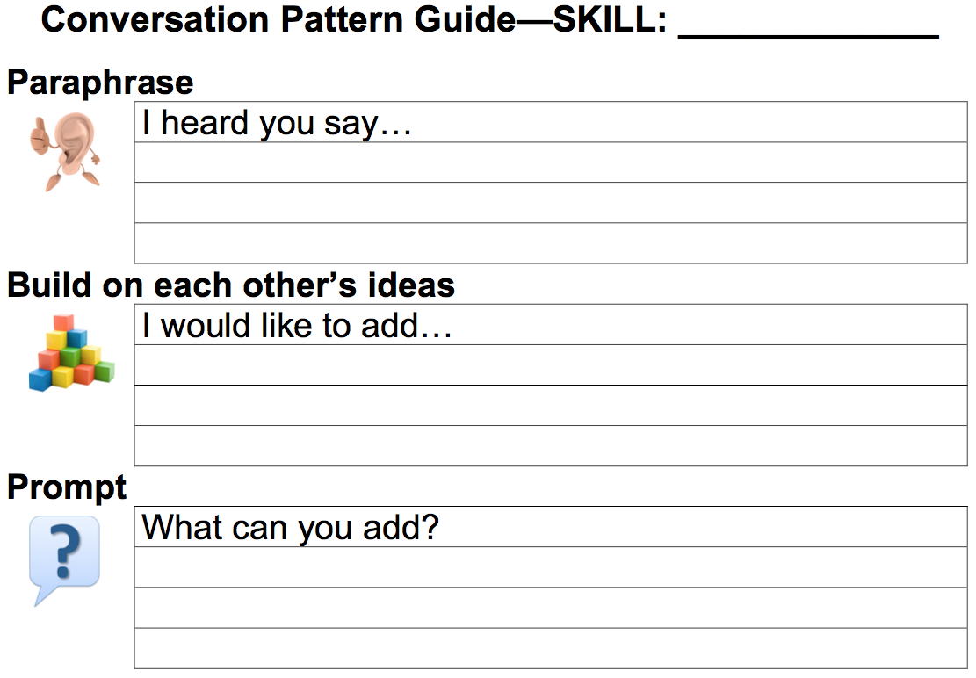
Which response starter will you use today?
RESPONSE STARTERS
Paraphrasing
I heard you say… I think you said…
EXPANDING
CLARIFY
I think you said…
You will use the Conversation Pattern Guide to remind you of the pattern.
Let’s add the response starter(s) we learned to our Conversation Pattern Guides.
MODEL – INTRODUCE RESPONSE STARTERS
Notes:
You will use the Conversation Pattern Guide to remind you of the pattern. Let’s add the response starter(s) we learned to our Conversation Pattern Guides.
Model adding one or two prompt and response starters to your Conversation Pattern Guide and distribute the Conversation Patterns Guides to students and the prompt and response starters you charted.

Slide 27
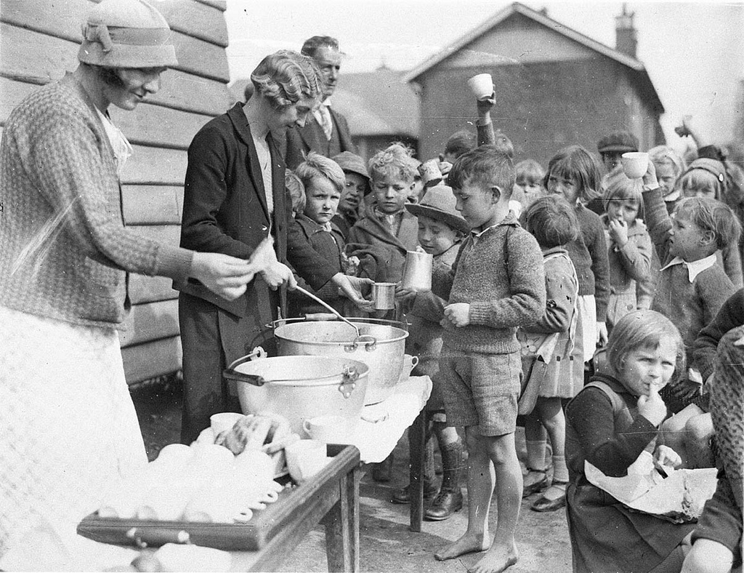
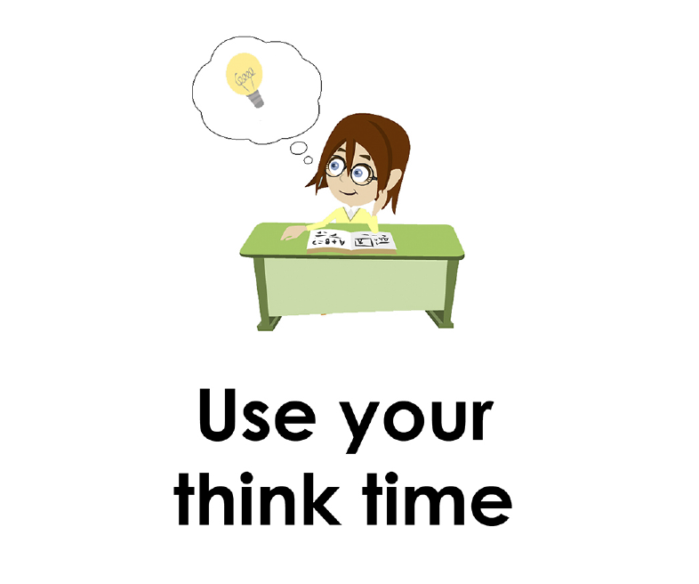
Prompt:
What do you notice in the visual text?
CLARIFY by paraphrasing what your partner said.
GUIDED PRACTICE
Notes:
Display the Teacher Visual Text for Conversation Pattern to practice how to paraphrase:
Model using Think Time

Slide 28
Listen actively to what two partners say to each other.
Student A: | I notice that there are two women holding things in their hands. One is holding a soup ladle while the other is holding a piece of bread.
Student B: | I heard you say that there are a couple of ladies and each has an item in their hands.
EXCHANGE #1 – MODEL/GUIDED PRACTICE – PARAPHRASING
Notes:
Use the conversation exchange provided below, to provide guided practice on how to paraphrase:
Listen to me as I read what two partners say to each other in a turn where this pattern is used. Here is what the partners say.
Read Exchange #1.

Slide 29
I notice that Student B paraphrased by using the response starter, “I heard you say...” and restated Student A’s idea.
Let’s use the response starter Student B used and practice using our own words to restate the idea.
TURN & TALK
Student A: | I notice that there are two women holding things in their hands. One is holding a soup ladle while the other is holding a piece of bread.
Student B: | I heard you say that there are a couple of ladies and each has an item in their hands.
EXCHANGE #1 – TEACHER THINK ALOUD – PARAPHRASE
Notes:
Teacher Think Aloud
Have students turn and talk to a partner as they complete the following statement:
Student B: I heard you say…
Have one or two students share their examples of CLARIFY by paraphrasing to make ideas clearer.

Slide 30
Listen actively to what two partners say to each other.
Student A: | I notice that the woman in the black jacket is scooping something out of the huge bowl with her right hand. She is holding a metal cup in her left hand while the boy at the front of the line is looking in the direction of the bowl.
Student B: | I heard you say that the woman is ladling something from a large bowl and the boy is watching.
EXCHANGE #2 – MODEL/GUIDED PRACTICE – PARAPHRASING
Notes:
Let’s practice paraphrasing with another exchange. Listen to me as I read what two partners say to each other in a turn where they continue to use the pattern. Here is what the partners say.
Read Exchange #2
After reading the A/B conversation turn, highlight language that serves to paraphrase.

Slide 31
I notice that Student B paraphrased by using the response starter, “I heard you say...” and restated Student A’s idea.
Let’s use the response starter Student B used and practice using our own words to restate the idea.
TURN & TALK
Student A: | I notice that the woman in the black jacket is scooping something out of the huge bowl with her right hand. She is holding a metal cup in her left hand while the boy at the front of the line is looking in the direction of the bowl.
Student B: | I heard you say that the woman is ladling something from a large bowl and the boy is watching.
EXCHANGE #2 – TEACHER THINK ALOUD – PARAPHRASE
Notes:
Teacher Think Aloud
Have students turn and talk to a partner as they complete the following statement:
Student B: I heard you say…
Have one or two students share their examples of CLARIFY by paraphrasing to make ideas clearer.

Slide 32
TURN & TALK
Student A: | I notice that the boy wearing the hat is holding a tall cup and is watching the woman as well.
Student B:
How would you paraphrase what Student A said?
EXCHANGE #3 – MODEL/GUIDED PRACTICE – PARAPHRASING
Notes:
Let’s continue practicing with another example. Listen to me as I read what one partner says to another:
Read Exchange #3:
Student A: I notice that the boy wearing the hat is holding a tall cup and is watching the woman as well.
Student B: Students should make the paraphrase gesture and paraphrase Student A’s idea above.
Have students turn and talk to a partner to discuss the following: How can you paraphrase what Student A said?
Have one or two students share their examples of CLARIFY by paraphrasing.

Slide 33
TURN & TALK
Student A: | I notice that there are other children standing in line holding cups in the air. The children toward the front of the line are crowded around the two large pots.
Student B:
How would you paraphrase what Student A said?
EXCHANGE #4 – MODEL/GUIDED PRACTICE – PARAPHRASING
Notes:
Let’s practice one last time. Listen to me as I read what one partner says to another:
Read Exchange #4:
Student A: I notice that there are other children standing in line holding cups in the air. The children toward the front of the line are crowded around the two large pots.
Student B: Students should make the paraphrase gesture and paraphrase Student A’s idea above.
Have students turn and talk to a partner as they discuss the following: How can you paraphrase what Student A said?
Have one or two students share their examples of CLARIFY by paraphrasing.

Slide 34

Stand Up, Hand Up, Pair Up
Stand Up – Look for a partner
Hand Up – Raise one hand in the air and walk across the room to find a partner
Pair Up – Connect your hand with your partner
STAND UP, HAND UP, PAIR UP STRATEGY
Notes:
Show how to use the Stand Up, Hand Up, Pair Up Strategy to find a new partner. Model looking standing up (Stand Up), raising one hand in the air (Hand Up), and walking across the room to find a partner (Pair Up). Demonstrate how to connect your hand to your partner’s hand to confirm that you’ve selected each other. Have students do the same.

Slide 35
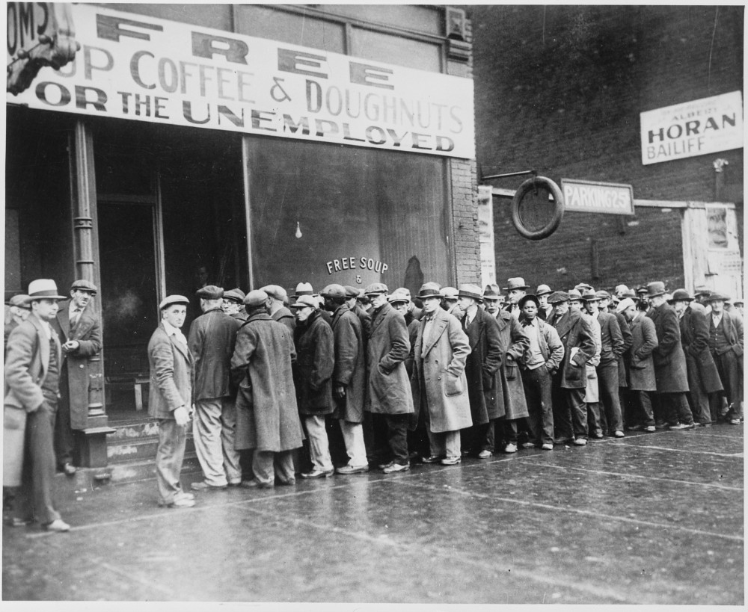
Prompt:
What do you notice in the visual text?
CLARIFY by paraphrasing what your partner said.
STUDENT PRACTICE
Notes:
Display the Student Visual Text
Direct students to use their Think Time
Now with your partner you will engage in a Constructive Conversation using the following prompt:
What do you notice in the visual text? CLARIFY by paraphrasing what your partner said.

Slide 36
Student
Practice
Prompt:
What do you notice in the visual text?
CLARIFY by paraphrasing what your partner said.
CONSTRUCTIVE CONVERSATION – TEACHER COLLECTS LANGUAGE SAMPLE SPF 1.0
Notes:
Now with your partner you will engage in a Constructive Conversation using the following prompt:
What do you notice in the visual text? CLARIFY by paraphrasing what your partner said.
As you have your conversations, I will walk around and listen to notice who is using the language of the skill and making sure to CLARIFY their partner’s ideas by paraphrasing. Remember to use your Prompt and Response Starters.

Slide 37


CONSTRUCTIVE CONVERSATION
FISHBOWL MODEL
PROMPT: What do you notice in the visual text? CLARIFY by paraphrasing what your partner said.
Listen actively to what two partners say to each other.
How did they CLARIFY by paraphrasing?
What language did they use?
FORMATIVE ASSESSMENT– TEACHER COLLECTS LANGUAGE SAMPLE SPF 1.0
Notes:
Select two students to Fishbowl Model a Constructive Conversation in front of the class. Students will address the following prompt: What do you notice in the visual text? Clarify by paraphrasing what your partner said.
Collect a language sample from the two students using the SPF 1.0. The language sample must be at least four turns in length.
Facilitate a whole-group discussion to debrief how the students did the following:
How did they CLARIFY by paraphrasing?
What language did they use?

Slide 38
REVIEW ELD OBJECTIVE &
SELF-ASSESS
In this lesson, we…
    had a Constructive Conversation with a partner based on a visual text
    listened to a partner’s ideas
    learned to CLARIFY by paraphrasing a partner’s ideas
Think…
    How did we meet today’s objectives?
    How did paraphrasing help you and your partner CLARIFY your ideas?
Work with your Constructive Conversation partner to:
Identify one thing you did to meet today’s objective and one thing you want to improve.
Share and explain to your partner
TURN & TALK
TURN & TALK - THEN WHOLE GROUP DISCUSSION
Notes:
After students have had a few minutes to discuss with a partner, call on one or two individuals to share out with the whole group.

Slide 39
LESSON 3
CLARIFY BY BUILDING ON

Slide 40
ELD OBJECTIVE
In this lesson, we will...
  have a Constructive Conversation with a partner based on a visual text
  practice clarifying by adding details
  learn to CLARIFY by building on our own and our partner’s ideas
STUDENT FRIENDLY ELD OBJECTIVES
Notes:
In the last lesson we learned about the Conversation Pattern and focused on clarifying by paraphrasing, which is when we use our own words to repeat or restate our partners’ ideas. Today, we are going to build on our understanding of the skill of CLARIFY. (Point to and read charted Student-Friendly ELD Objective.)

Slide 41
Conversation Pattern – CLARIFY by Building On
We will review the Conversation Pattern—which includes paraphrasing, building on, and prompting each time we speak.
This pattern will help you CLARIFY your ideas when you have a Constructive Conversation.
Another way to CLARIFY is to build on your own and your partner’s ideas
Today’s lesson will focus on learning and practicing how to build on each other’s ideas during a Constructive Conversation.
LESSON OPENING
Notes:
Another way to CLARIFY is to add details to build on what we hear others say. We will review our new Conversation Pattern—which includes paraphrasing, building on, and prompting during each turn. This lesson will focus on learning and practicing how to build on your own and your partner’s ideas during a Constructive Conversation.

Slide 42

Which Conversation Norm will help you to build on? Why?
TURN & TALK
I heard many of you say that you would “Take turns and build on each other’s ideas.”
Taking turns will help you and your partner Clarify and build up ideas that weren’t in your mind before talking.
LESSON OPENING – REVIEW NORMS – TURN AND TALK
Notes:
As we engage in our conversations, we will also remember to follow our Constructive Conversation Norms. (Point to Constructive Conversation Norms Poster.)
Which Conversation Norm will help us to build on each other’s ideas? Why? Turn and talk to your partner. Give students 1 minute to talk to a partner.
Affirm all responses and say: I heard many of you say that you would “Take turns and build on each other’s ideas,” (point to poster) so we will make sure to, “Take turns and build on each other’s ideas,” during our conversations.

Slide 43
Let’s Review the
Conversation Pattern
Paraphrase:
This means to listen and then we repeat our partner’s thoughts in our own words. We paraphrase to CLARIFY and make sure we understand what our partner said.
Build on each other’s ideas:
This means that we listen to what our partner says and add details and other information to their ideas to make a clearer and more complete idea.
Prompt:
This means we get more information, ask for clarification or for new ideas to continue the Constructive Conversation. When prompting, we think about what we did understand and what more we need to understand fully.
MODEL – INTRODUCE THE CONVERSATION PATTERN
Notes:
Display the Conversation Pattern Poster and refer to it as you explain the following:
Our first objective today is to review our Conversation Pattern.
Let’s review the pattern. Who can lead us as we practice the gestures? Choose two student volunteers.
Paraphrase (Gesture: Point index finger to ear and whoosh hand out in front of mouth to symbolize listening and then paraphrasing what was heard.)
Build on each other’s ideas (Gesture: Make stacking motion with hands.)
Prompt (Gesture: Shrug shoulders then point to partner with index finger.)
In the last lesson we worked on paraphrasing. What is paraphrasing? How does it help us? Turn and talk to your partner.
After students have had a few minutes to discuss with a partner, call on one or two individuals to share out with the whole group.
Yes. That’s right! When we paraphrase, we repeat our partner’s thoughts in our own words. We paraphrase to CLARIFY and make sure we understand what our partner said

Slide 44
Build On Gesture: Make stacking motion with hands.
What does it mean to build on each other’s ideas?
Build on to CLARIFY to develop a clearer, more precise and complete idea.
  listen actively to your partner’s ideas
  add details that build on your or your partner’s idea
In the last lesson we worked on paraphrasing. What is paraphrasing?
How will paraphrasing help you to build on each other’s ideas?
TURN & TALK
INTRODUCE BUILDING ON
Notes:
In this lesson, we will continue to build our knowledge of CLARIFY by focusing on adding details to build on each other’s ideas. Show me the gesture for building on each other’s ideas. Good!
In order to build on each other’s ideas, we listen to what our partner says and add details and other information to their ideas to develop a clearer, more precise and complete idea. (Do gesture with students and have them repeat the words—build on each other’s ideas.)
In a Constructive Conversation, we add details to build on one another’s ideas, so that at the end of our dialogue we have built up ideas that weren’t in our minds before talking. After we share our first idea, we can use the Conversation Pattern to make sure we listen to and use ideas from each other. This helps us develop a clearer, more precise and complete idea.
In the last lesson we worked on paraphrasing. What is paraphrasing? How does it help us? Turn and talk to your partner.
After students have had a few minutes to discuss with a partner, call on one or two individuals to share out with the whole group.
Yes. That’s right! When we paraphrase, we repeat our partner’s thoughts in our own words. We paraphrase to CLARIFY and make sure we understand what our partner said. If we don’t understand our partner’s thoughts, we won’t be able to build on their ideas.

Slide 45
What do we say when we build on?
RESPONSE STARTERS
BUILD ON
I would like to add… Another detail is… In addition,…
EXPANDING
Example
Someone says, “I notice that the dog is wagging its tail. How can you add to this idea?”
Which response starter could you use to help you build on?
You can use these response starters to help you build on each other’s ideas.
TURN & TALK
MODEL – INTRODUCE RESPONSE STARTERS
Notes:
To help us focus on clarifying by adding details to build on each other’s ideas, we will use these prompt and response starters during our conversations.
For example, if someone asks you, “How can you add to this idea?” How would you respond? (Point to pre- charted response starters.)
Turn & talk to a partner.
Which response starter would you use? Call on one or two students to share which response starter they might use and what prompt or response starter they might use to continue the conversation.

Slide 46
Which response starter will you use today?
RESPONSE STARTERS
BUILD ON
Another detail is… In addition,…
EXPANDING
CLARIFY
I think you said…
Another details is…
You will use the Conversation Pattern Guide to remind you of the pattern.
Let’s add the response starter(s) we learned to our Conversation Pattern Guides.
MODEL – INTRODUCE RESPONSE STARTERS
Notes:
You will use the Conversation Pattern Guide to remind you of the pattern. Let’s add the response starter(s) we learned to our Conversation Pattern Guides.
Model adding one or two prompt and response starters to your Conversation Pattern Guide and distribute the Conversation Patterns Guides to students and the prompt and response starters you charted.

Slide 47
Prompt:
What do you notice in the visual text?
CLARIFY by building on what your partner said.
GUIDED PRACTICE
Notes:
Display the Teacher Visual Text
Model using Think Time

Slide 48
Listen actively to what two partners say to each other.
Student A: | I notice that there are two women holding things in their hands. One is holding a soup ladle and the other is holding a piece of bread.
Student B: | I heard you say that there are a couple of ladies and each has an item in their hands. I would like to add that the woman in the dark jacket has a ladle in her right hand and is using it to scoop something out of the large pot while she holds a metal cup in her left hand.
EXCHANGE #1 – MODEL/GUIDED PRACTICE – BUILDING ON
Notes:
Listen to me as I read what two partners say to each other in a turn where this pattern is used. Here is what the partners say:
Exchange #1 and make the paraphrase and the build on gesture.

Slide 49
I notice that Student B first paraphrased what Student A said.
Then, Partner B built on the idea by using the response starter, “I would like to add ...” and provided specific details from the visual text.
Let’s use the response starter Student B used and practice adding our own details to build on the idea.
TURN & TALK
Student A: | I notice that there are two women holding things in their hands. One is holding a soup ladle and the other is holding a piece of bread.
Student B: | I heard you say that there are a couple of ladies and each has an item in their hands. I would like to add that the woman in the dark jacket has a ladle in her right hand and is using it to scoop something out of the large pot while she holds a metal cup in her left hand.
EXCHANGE #1 – TEACHER THINK ALOUD – BUILDING ON
Notes:
Teacher Think Aloud
Have students turn and talk to a partner as they complete the following statement:
Student B: I heard you say that there are a couple of ladies and each has an item in their hands. I would like to add…
Have one or two students share their examples of CLARIFY by adding details to build on each other’s Ideas.

Slide 50
Listen actively to what two partners say to each other.
Student A: | I notice that the boy at the front of the line does not have a cup and is looking down at the metal cup that the woman is holding.
Student B: | I heard you say that the boy doesn’t have a cup and is looking down at the cup in the woman’s hand. I would like to add that he is not wearing any shoes and is the only child in the photograph who appears to be barefoot.
EXCHANGE #2 – MODEL/GUIDED PRACTICE – BUILDING ON
Notes:
Listen to me as I read what two partners say to each other in a turn where this pattern is used. Here is what the partners say:
Read Exchange #2.

Slide 51
I notice that Student B first paraphrased what Student A said.
Then, Partner B built on the idea by using the response starter, “I would like to add ...” and provided specific details from the visual text.
Let’s use the response starter Student B used and practice adding our own details to build on the idea.
TURN & TALK
Student A: | I notice that the boy at the front of the line does not have a cup and is looking down at the metal cup that the woman is holding.
Student B: | I heard you say that the boy doesn’t have a cup and is looking down at the cup in the woman’s hand. I would like to add that he is not wearing any shoes and is the only child in the photograph who appears to be barefoot.
EXCHANGE #2 – TEACHER THINK ALOUD – BUILDING ON
Notes:
Teacher Think Aloud
Have students turn and talk to a partner as they complete the following statement:
Student B: I heard you say that there are a couple of ladies and each has an item in their hands. I would like to add…
Have one or two students share their examples of CLARIFY by adding details to build on each other’s Ideas.

Slide 52
TURN & TALK
Student A: | I notice that the boy with the hat is standing behind the barefoot boy. He has a tall cup and is watching the lady, too. There are other children standing in the line holding cups in the air.
Student B: | I heard you say that there are children in line holding cups including the boy wearing a hat.
How can you build on this idea by adding details? How would you respond to Student A?
EXCHANGE #3 – MODEL/GUIDED PRACTICE – BUILDING ON
Notes:
Let’s continue practicing with another example. Listen to me as I read what one partner says to another:
Exchange #3:
Student A: I notice that the boy with the hat is standing behind the barefoot boy. He has a tall cup and is watching the lady, too. There are other children standing in the line holding cups in the air.
Student B: I heard you say (make the paraphrase gesture) that there are children in line holding cups including the boy wearing a hat. Students should make the build on gesture and build on Student A’s idea above.
How can you build on this idea by adding details and information? How would you respond to Student A?
Have students turn and talk to a partner as they practice building on Student A’s idea.
Have one or two students share their examples of CLARIFY by adding details to build on each other’s Ideas.
.

Slide 53
TURN & TALK
Student A: | I notice that there is girl toward the right of the photograph who appears to be sitting down and looking away from the line.
Student B:
How can you build on this idea by adding details? How would you respond to Student A?
EXCHANGE #4 – MODEL/GUIDED PRACTICE – BUILDING ON
Notes:
Let’s continue practicing with our final example. Listen to me as I read what one partner says to another:
Exchange #4:
Student A: I notice that there is girl toward the right of the photograph who appears to be sitting down and looking away from the line.
Student B: I heard you say (make the paraphrase gesture) that there is one girl who is not in line. Students should make the build on gesture and build on Student A’s idea above.
How can you build on this idea by adding details and information? How would you respond to Student A?
Have one or two students share their examples of CLARIFY by adding details to build on each other’s Ideas.

Slide 54
Stand Up, Hand Up, Pair Up
Stand Up – Look for a partner
Hand Up – Raise one hand in the air and walk across the room to find a partner
Pair Up – Connect your hand with your partner
STAND UP, HAND UP, PAIR UP STRATEGY
Notes:
Show how to use the Stand Up, Hand Up, Pair Up Strategy to find a new partner. Model looking standing up (Stand Up), raising one hand in the air (Hand Up), and walking across the room to find a partner (Pair Up). Demonstrate how to connect your hand to your partner’s hand to confirm that you’ve selected each other. Have students do the same.

Slide 55
Prompt:
What do you notice in the visual text?
CLARIFY by building on each other’s ideas.
STUDENT PRACTICE
Notes:
Display the Student Visual Text
Direct students to use their Think Time
Now with your partner you will engage in a Constructive Conversation using the following prompt:
What do you notice in the visual text? CLARIFY by building on each other’s ideas.

Slide 56
Student
Practice
Prompt:
What do you notice in the visual text?
CLARIFY by building on each other’s ideas.
CONSTRUCTIVE CONVERSATION – TEACHER COLLECTS LANGUAGE SAMPLE SPF 1.0
Notes:
Now with your partner you will engage in a Constructive Conversation using the following prompt:
What do you notice in the visual text? CLARIFY by building on each other’s ideas.
As you have your conversations, I will walk around and listen to notice who is using the language of the skill and making sure to CLARIFY their partner’s ideas by building on each other’s ideas. Remember to use your Prompt and Response Starters.

Slide 57
CONSTRUCTIVE CONVERSATION
FISHBOWL MODEL
PROMPT: What do you notice in the visual text? CLARIFY by building on each other’s ideas.
Listen actively to what two partners say to each other.
How did they CLARIFY by building on each other’s ideas?
What language did they use?
FORMATIVE ASSESSMENT– TEACHER COLLECTS LANGUAGE SAMPLE SPF 1.0
Notes:
Select two students to Fishbowl Model a Constructive Conversation in front of the class. Students will address the following prompt: What do you notice in the visual text? Clarify by building on each other’s ideas.
Collect a language sample from the two students using the SPF 1.0. The language sample must be at least four turns in length.
Facilitate a whole-group discussion to debrief how the students did the following:
How did they CLARIFY by building on each other’s ideas?
What language did they use?

Slide 58
REVIEW ELD OBJECTIVE &
SELF-ASSESS
In this lesson, we…
    had a Constructive Conversation with a partner based on a visual text
    practiced clarifying by adding details
    learned to CLARIFY by building on each other’s ideas
Think…
    How did we meet today’s objectives?
    What is building on? How did we build on each other’s ideas?
Work with your Constructive Conversation partner to:
Identify one thing you did to meet today’s objective and one thing you want to improve.
Share and explain to your partner
TURN & TALK
TURN & TALK - THEN WHOLE GROUP DISCUSSION
Notes:
After students have had a few minutes to discuss with a partner, call on one or two individuals to share out with the whole group.

Slide 59
LESSON 4
CLARIFY BY PROMPTING

Slide 60
ELD OBJECTIVE
In this lesson, we will...
  have a Constructive Conversation with a partner based on a visual text
  learn to CLARIFY by prompting a partner
  practice clarifying by prompting
  learn to get clarification of our partners’ ideas
STUDENT FRIENDLY ELD OBJECTIVES
Notes:
Today we are going to build on our understanding of the skill of CLARIFY. (Point to and read charted Student-Friendly ELD Objective.) As we engage in our conversations, we will also remember to follow our Conversation Norms (Point to Conversation Norms Poster.)

Slide 61
Conversation Pattern – CLARIFY by Prompting
We will review the Conversation Pattern—which includes paraphrasing, building on, and prompting each time we speak.
This pattern will help you CLARIFY your ideas when you have a Constructive Conversation.
Another way to CLARIFY is to prompt your partner to get more information.
Today’s lesson will focus on learning and practicing how to prompt your partner during a Constructive Conversation.
LESSON OPENING
Notes:
One way to CLARIFY is to prompt to get more information. We will review our new Conversation Pattern—which includes paraphrasing, building on, and prompting during each turn. Today’s lesson will focus on learning and practicing how to prompt your partner to get more information during a Constructive Conversation.

Slide 62

Which Conversation Norm will help you to prompt your partner? Why?
TURN & TALK
I heard many of you say that you would “Use your think time,” to think about what you did understand and what more you want to know.
LESSON OPENING – REVIEW NORMS – TURN AND TALK
Notes:
As we engage in our conversations, we will also remember to follow our Conversation Norms (Point to Conversation Norms Poster.)
Which Conversation Norm will help us prompt our partner? Why? Turn and talk to your partner. Give students 1 minute to talk to a partner.
Affirm all responses and say: I heard many of you say that you would “Use your Think Time” (point to poster) to think about what we did understand and what more we need to understand. We will make sure to use our think time during our conversations.

Slide 63
Let’s Review the
Conversation Pattern
Paraphrase:
This means to listen and then we repeat our partner’s thoughts in our own words. We paraphrase to CLARIFY and make sure we understand what our partner said.
Build on each other’s ideas:
This means that we listen to what our partner says and add details and other information to their ideas to make a clearer and more complete idea.
Prompt:
This means we get more information, ask for clarification or for new ideas to continue the Constructive Conversation. When prompting, we think about what we did understand and what more we need to understand fully.
MODEL – INTRODUCE THE CONVERSATION PATTERN
Notes:
Display the Conversation Pattern Poster and refer to it as you explain the following:
In the last few days we have learned and practiced how to CLARIFY our ideas. We learned about the three subskills that will help us make our ideas clearer. Those subskills are paraphrasing, building on, and prompting each other.
After we share our first idea, we can use the Conversation Pattern. First, we paraphrase our understanding of our partner’s ideas. We then add details to build on one another’s ideas. Then, we need to prompt our partner. When we prompt, or ask questions, we get more information.
Let’s review the pattern. Show me the gestures:
Paraphrase (Gesture: Point index finger to ear and whoosh hand out in front of mouth to symbolize listening and then paraphrasing what was heard.)
Build on each other’s ideas (Gesture: Make stacking motion with hands.)
Prompt (Gesture: Shrug shoulders then point to partner with index finger.)
.

Slide 64
Prompting Gesture: Shrug shoulders then point to partner with index finger.
What does it mean to prompt your partner?
Prompt or question your partner to get more information.
listen actively to your partner’s ideas
think about what you understand and what you need more information about; then ask a question about it
In the last lesson we worked on building each other’s ideas.
What is building each other’s ideas? How does prompting help us build on each other’s ideas?
TURN & TALK
INTRODUCE PROMPTING
Notes:
In this lesson, we will continue to build our knowledge of CLARIFY by focusing on prompting, or questioning, our partner to get more information. Show me the gesture for prompting. Good!
In order to prompt, we need to think about what we did understand, and what more we need to understand fully. (Do gesture with students and have them repeat the words—prompting.)
In the last lesson we worked on building each other’s ideas. What is building each other’s ideas? How does it help us? Turn and talk to your partner.
After students have had a few minutes to discuss with a partner, call on one or two individuals to share out with the whole group.
Yes. That’s right! When we build on each other’s ideas, we listen to what our partner says and add details to make our ideas clearer. We can make a more complete idea

Slide 65
What do we say when we build on?
Example
Someone says, “I notice that the dog is wagging its tail.”
Which prompt starter could you use to help you prompt your partner?
PROMPT STARTER
PROMPT
How can you add to this idea?
EXPANDING
You can use this prompt starters to help you build on each other’s ideas.
TURN & TALK
MODEL – INTRODUCE RESPONSE STARTERS
Notes:
To help us focus on clarifying by prompting to get more information, we will use this prompt starter during our conversations.
For example
Someone says, “I notice that the dog is wagging its tail.”
Which prompt starter could you use to help you build on?
Call on one or two students to share which response starter they might use and what prompt or response starter they might use to continue the conversation.

Slide 66
Which response starter will you use today?
RESPONSE STARTERS
PROMPT
How can you add to this idea?
EXPANDING
CLARIFY
I think you said…
You will use the Conversation Pattern Guide to remind you of the pattern.
Let’s add the prompt starter we learned to our Conversation Pattern Guides.
Another details is…
How can you add to this idea?
MODEL – INTRODUCE RESPONSE STARTERS
Notes:
You will use the Conversation Pattern Guide to remind you of the pattern. Let’s add the prompt starter we learned to our Conversation Pattern Guides.
Model adding the prompt starter to your Conversation Pattern Guide and distribute the Conversation Patterns Guides to students and the prompt and response starters you charted.

Slide 67
Prompt:
What do you notice in the visual text?
CLARIFY by prompting your partner.
GUIDED PRACTICE
Notes:
Display the Teacher Visual Text
Model using Think Time

Slide 68
Listen actively to what two partners say to each other.
Student A: | I notice that there are two women holding things in their hands. One is holding a soup ladle and the other is holding a piece of bread.
Student B: | I heard you say that there are a couple of ladies and each has an item in their hands. I would like to add that the woman in the dark jacket has a ladle in her right hand and is using it to scoop something out of the large pot while she holds a metal cup in her left hand. What else do you notice?
EXCHANGE #1 – MODEL/GUIDED PRACTICE – PROMPTING
Notes:
Display the Conversation Pattern Poster to refer to as needed.
We’ve learned the first two subskills are paraphrase and build on. These two subskills help us CLARIFY our ideas. In this lesson, we will focus on Clarifying by prompting. When we don’t understand our partner or if we are not clear on the idea, we prompt our partner for more information or ask questions to make the ideas clearer. Let’s practice.
Display the Teacher Visual Text for Conversation Pattern to practice how to prompt.
Use the conversation exchange provided below, to provide guided practice on how to prompt:
Listen to me as I read what two partners say to each other in a turn where this pattern is used. Here is what the partners say.
Read the exchange. Make the prompting gesture and the build-on gesture.

Slide 69
I notice that Student B first paraphrased and then built the idea by adding details.
Then, Partner B prompted for more information by using the prompt starter “How can you add to this idea?” This will help Partner A know that more information is needed.
Let’s practice prompting.
TURN & TALK
Student A: | I notice that there are two women holding things in their hands. One is holding a soup ladle and the other is holding a piece of bread.
Student B: | I heard you say that there are a couple of ladies and each has an item in their hands. I would like to add that the woman in the dark jacket has a ladle in her right hand and is using it to scoop something out of the large pot while she holds a metal cup in her left hand. What else do you notice?
EXCHANGE #1 – TEACHER THINK ALOUD – PROMPTING
Notes:
Teacher Think Aloud
Point to the visual text and have students turn and talk to a partner as they complete the following statements:
If Student A says: I heard you say that there are two women holding things in their hands. One is holding a soup ladle and the other is holding a piece of bread How would you prompt for more information?
Have one or two students share their examples of CLARIFY by prompting to get more information.
How would Student B respond?
Have one or two students share their examples of the response using the Conversation Pattern.

Slide 70
Listen actively to what two partners say to each other.
Student A: | I notice that the boy in the front of the line does not have a cup and is looking down toward the metal cup that the woman in the dark jacket is holding.
Student B: | I heard you say that the boy without a cup is looking down at the cup in the woman’s hand. I would like to add that he is not wearing any shoes and is the only child in the photograph who appears to be barefoot. How can you add to this idea?
EXCHANGE #2 – MODEL/GUIDED PRACTICE – BUILDING ON
Notes:
Let’s practice prompting with another exchange. Listen to me as I read what two partners say to each other in a turn where they continue to use the pattern. Let’s pay close attention to the part of the conversation where they are prompting. Here is what the partners say.
Read the Exchange #2. Make paraphrase and prompting gestures.
After reading the A/B conversation turn, highlight language that serves to prompt the partner for more information and how the language shows we are adding more information to make our idea clearer.

Slide 71
I notice that Student B first paraphrased and then built the idea by adding details.
Then, Partner B prompted for more information by using the prompt starter “How can you add to this idea?” This will help Partner A know that more information is needed.
Let’s practice prompting.
TURN & TALK
Student A: | I notice that the boy in the front of the line does not have a cup and is looking down toward the metal cup that the woman in the dark jacket is holding.
Student B: | I heard you say that the boy without a cup is looking down at the cup in the woman’s hand. I would like to add that he is not wearing any shoes and is the only child in the photograph who appears to be barefoot. How can you add to this idea?
EXCHANGE #2 – TEACHER THINK ALOUD – PROMPTING
Notes:
Teacher Think Aloud
Have students turn and talk to a partner adding their own details to build on the idea as they complete the following statement:
Student B: I heard you say that there are a couple of ladies and each has an item in their hands. I would like to add…
Have one or two students share their examples of prompting.

Slide 72
TURN & TALK
Student A: | I notice that the boy with the hat is standing behind the barefoot boy. He has a tall cup and is watching the lady, too. There are other children standing in the line holding cups in the air.
Student B:
How can you prompt your partner for more information? How would you respond to Student A?
EXCHANGE #3 – MODEL/GUIDED PRACTICE – PROMPTING
Notes:
Let’s continue practicing with another example. Listen to me as I read what one partner says to another.
Read Exchange #3.

Slide 73
TURN & TALK
Student A: | I notice that there is girl toward the right of the photograph who appears to be sitting down and looking away from the line.
Student B:
How can you prompt your partner for more information? How would you respond to Student A?
EXCHANGE #4 – MODEL/GUIDED PRACTICE – PROMPTING
Notes:
Let’s continue practicing with our final example. Listen to me as I read what one partner says to another.
Read Exchange #4.

Slide 74
Stand Up, Hand Up, Pair Up
Stand Up – Look for a partner
Hand Up – Raise one hand in the air and walk across the room to find a partner
Pair Up – Connect your hand with your partner
STAND UP, HAND UP, PAIR UP STRATEGY
Notes:
Show how to use the Stand Up, Hand Up, Pair Up Strategy to find a new partner. Model looking standing up (Stand Up), raising one hand in the air (Hand Up), and walking across the room to find a partner (Pair Up). Demonstrate how to connect your hand to your partner’s hand to confirm that you’ve selected each other. Have students do the same.

Slide 75
Prompt:
What do you notice in the visual text?
CLARIFY by prompting your partner.
STUDENT PRACTICE
Notes:
Display the Student Visual Text
Direct students to use their Think Time
Now with your partner you will engage in a Constructive Conversation using the following prompt:
What do you notice in the visual text? CLARIFY by prompting your partner.

Slide 76
Student
Practice
Prompt:
What do you notice in the visual text?
CLARIFY by prompting your partner.
CONSTRUCTIVE CONVERSATION – TEACHER COLLECTS LANGUAGE SAMPLE SPF 1.0
Notes:
Now with your partner you will engage in a Constructive Conversation using the following prompt:
What do you notice in the visual text? CLARIFY by prompting your partner.
As you have your conversations, I will walk around and listen to notice who is using the language of the skill and making sure to CLARIFY their partner’s ideas by prompting your partner. Remember to use your Prompt and Response Starters.

Slide 77
CONSTRUCTIVE CONVERSATION
FISHBOWL MODEL
PROMPT: What do you notice in the visual text? CLARIFY by prompting your partner.
Listen actively to what two partners say to each other.
How did they CLARIFY by prompting their partner for more information?
What language did they use?
FORMATIVE ASSESSMENT– TEACHER COLLECTS LANGUAGE SAMPLE SPF 1.0
Notes:
Select two students to Fishbowl Model a Constructive Conversation in front of the class. Students will address the following prompt: What do you notice in the visual text? Clarify by prompting your partner.
Collect a language sample from the two students using the SPF 1.0. The language sample must be at least four turns in length.
Facilitate a whole-group discussion to debrief how the students did the following:
How did they CLARIFY by prompting others for more information?
What language did they use?

Slide 78
REVIEW ELD OBJECTIVE & SELF-ASSESS
In this lesson, we…
    had a Constructive Conversation with a partner based on a visual text
    practiced clarifying by prompting
    learned to CLARIFY by prompting a partner
Think…
    How did we meet our objectives in this lesson?
    What is prompting? How did we prompt?
Work with your Constructive Conversation partner to:
    Identify one thing you did to meet today’s objective and one thing you want to improve.
    Share and explain to your partner
TURN & TALK
TURN & TALK - THEN WHOLE GROUP DISCUSSION
Notes:
After students have had a few minutes to discuss with a partner, call on one or two individuals to share out with the whole group.

Slide 79
LESSON 5
CREATE & CLARIFY WITH VISUAL TEXT

Slide 80
ELD OBJECTIVE
In this lesson, we will...
  review the Conversation Pattern
  practice the skills of CREATE and CLARIFY using a visual text
  have a conversation with a partner and in a small group
STUDENT FRIENDLY ELD OBJECTIVES

Slide 81
Conversation Pattern – Practice CREATE & CLARIFY
We have learned and practiced how to CLARIFY our ideas by using the Conversation Pattern.
Today’s lesson will focus on reviewing the Constructive Conversation Skills- CREATE & CLARIFY
When we CLARIFY we make our ideas clearer for ourselves and our partners.
We CLARIFY by paraphrasing, building on, and prompting each other.
LESSON OPENING
Notes:
In this lesson we will review the Constructive Conversation Skills-CREATE and CLARIFY. When we CREATE we say what we think or notice about something. When we CLARIFY we make our ideas clearer for ourselves and our partners. We CLARIFY each other’s ideas by paraphrasing, building on, and prompting. During conversations, remember to follow our conversation norms (point to poster).

Slide 82
Which Conversation Norm will help you to CREATE and CLARIFY? Why?
TURN & TALK
I heard many of you say that you would “Use the language of the skill,” to speak in complete sentences as we CREATE and CLARIFY ideas.
LESSON OPENING – REVIEW NORMS – TURN AND TALK
Notes:
Which conversation norm will help us to CREATE and CLARIFY? Turn and talk to your partner. Give students 1 minute to talk to a partner.
Affirm all responses and say: I heard many of you say that you would “Use the language of the skill” (point to poster) to speak in complete sentences as we CREATE and CLARIFY ideas. We will use prompt and response starters to help us.

Slide 83
Let’s Review the
Conversation Pattern
When and how do we paraphrase in a Constructive Conversation?
TURN & TALK
Paraphrase:
This means to listen and then we repeat our partner’s thoughts in our own words. We paraphrase to CLARIFY and make sure we understand what our partner said.
MODEL – REVIEW THE CONVERSATION PATTERN
Notes:
When and how do we paraphrase in a Constructive Conversation? Turn and talk to your partner.

Slide 84
Let’s Review the
Conversation Pattern
When and how do we build an idea in a Constructive Conversation?
TURN & TALK
Build on each other’s ideas:
This means that we listen to what our partner says and add details and other information to their ideas to make a clearer and more complete idea.
MODEL – REVIEW THE CONVERSATION PATTERN
Notes:
When and how do we prompt in a Constructive Conversation? Turn and talk to your partner.

Slide 85
Let’s Review the
Conversation Pattern
When and how do we prompt in a Constructive Conversation?
TURN & TALK
Prompt:
This means we get more information, ask for clarification or for new ideas to continue the Constructive Conversation. When prompting, we think about what we did understand and what more we need to understand fully.
MODEL – REVIEW THE CONVERSATION PATTERN
Notes:
When and how do we paraphrase in a Constructive Conversation? Turn and talk to your partner.

Slide 86
What is the first step?
We know the pattern helps us to CLARIFY, but if we haven’t shared an initial idea, we have nothing to CLARIFY.
So, the very first step of a Constructive Conversation is to CREATE and share an idea.
Then, we can use the Conversation Pattern to develop our idea fully.
MODEL – REVIEW THE CONVERSATION PATTERN
Notes:
Teacher Think Aloud

Slide 87
Which response starter will you use today?
PROMPT & RESPONSE STARTERS
PARAPHRASE
I think you said…
BUILD ON
Another detail is…
PROMPT
How can you add to this idea?
EXPANDING
CLARIFY
I think you said…
Another detail is…
You will use the Conversation Pattern Guide to remind you of the pattern.
Let’s review the prompt and response starters.
How can you add to this idea?
MODEL – INTRODUCE RESPONSE STARTERS
Notes:
Today you are going to engage in a Constructive Conversation for the Skills-CREATE and CLARIFY using a visual text. Do your best to follow the Conversation Pattern as you CLARIFY your ideas.
You will use the Conversation Pattern Guide to remind you of the pattern. Let’s review the prompt and response starters that you may use to help you during your conversations and add them to our Conversation Pattern Guides.
Model adding one or two prompt and response starters to your Conversation Pattern Guide and have students add to their guides.

Slide 88
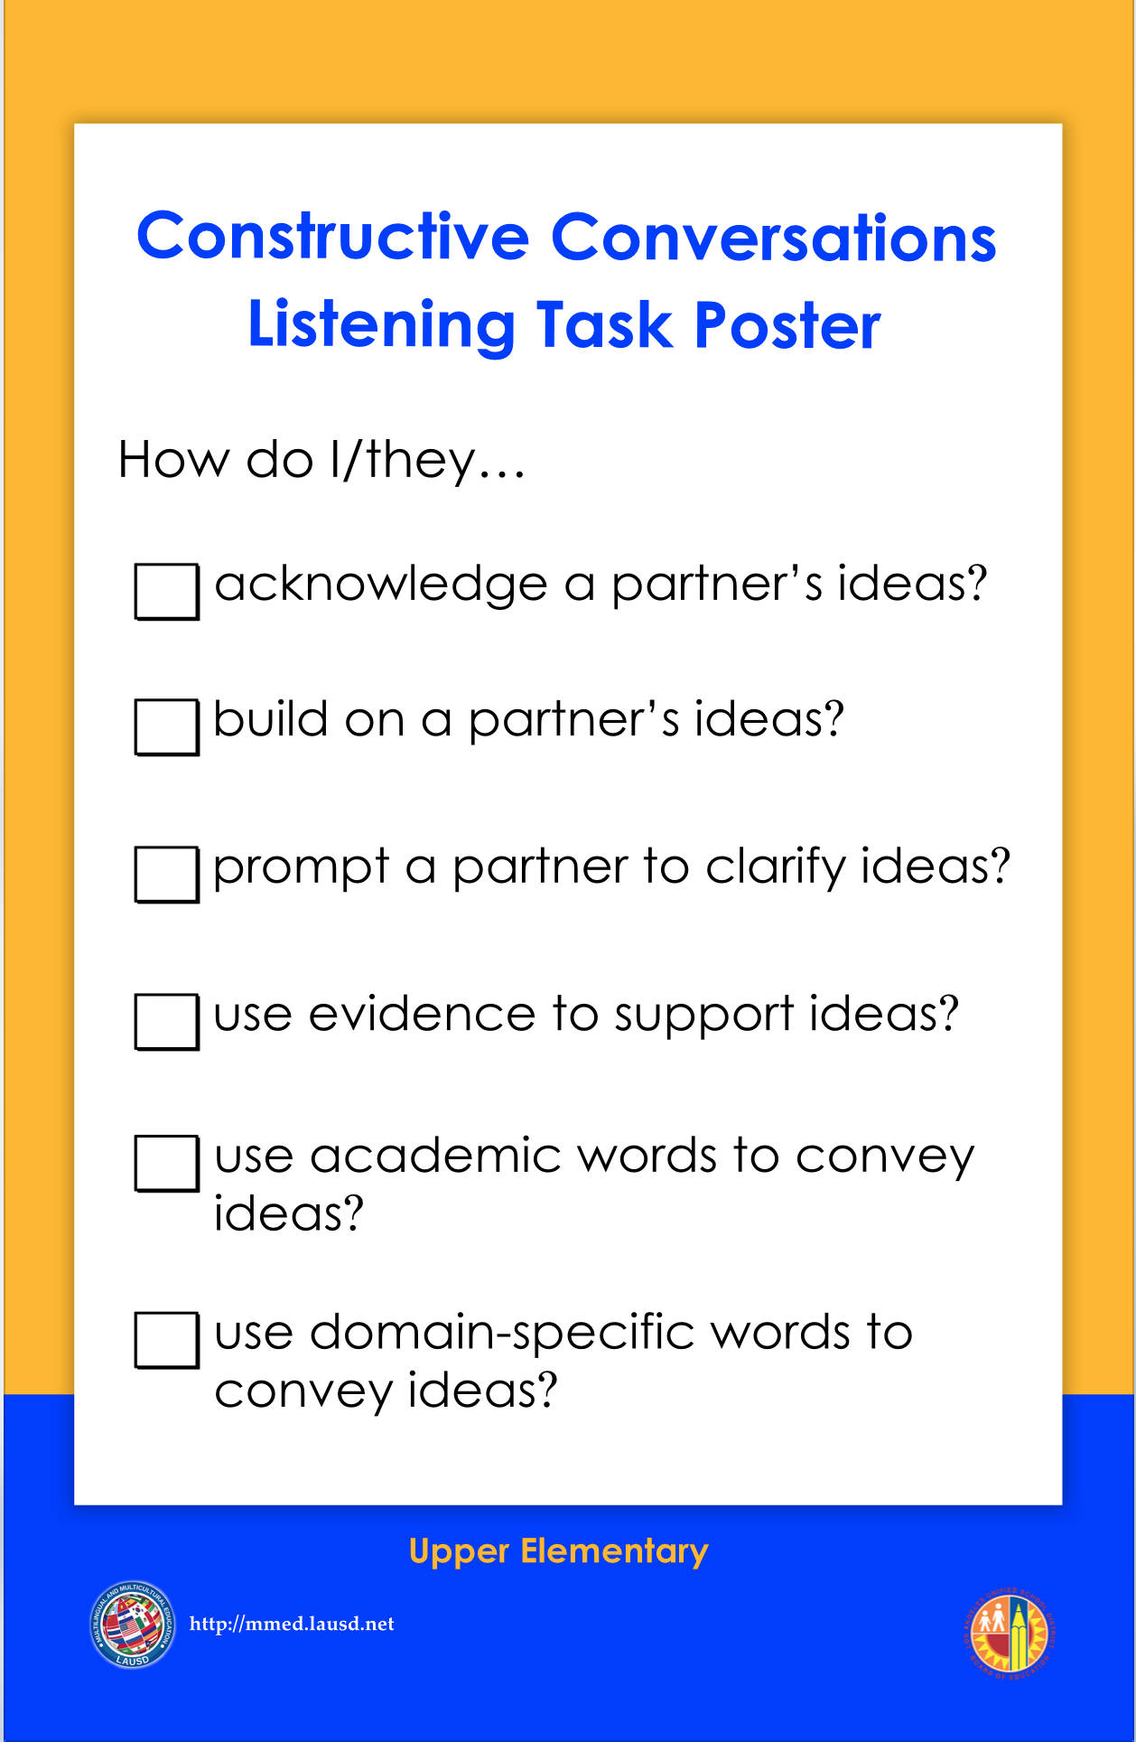
Constructive Conversations Listening Task Poster
While you are listening to me and my partner, listen for the following…
INTRODUCE THE CONSTRUCTIVE CONVERSATION LISTENING TASK POSTER
Notes:
Display the Conversations Listening Task Poster and read each of the questions.
While you are listening to me and my partner, listen for the following:
How did we…
acknowledge a partner’s ideas?
build on a partner’s ideas?
prompt a partner to CLARIFY ideas?
use evidence to support ideas?
use academic words (notice, in other words, etc.) to convey ideas?
use domain-specific words (visual text, paraphrase, elaborate, etc.) to convey ideas?

Slide 89
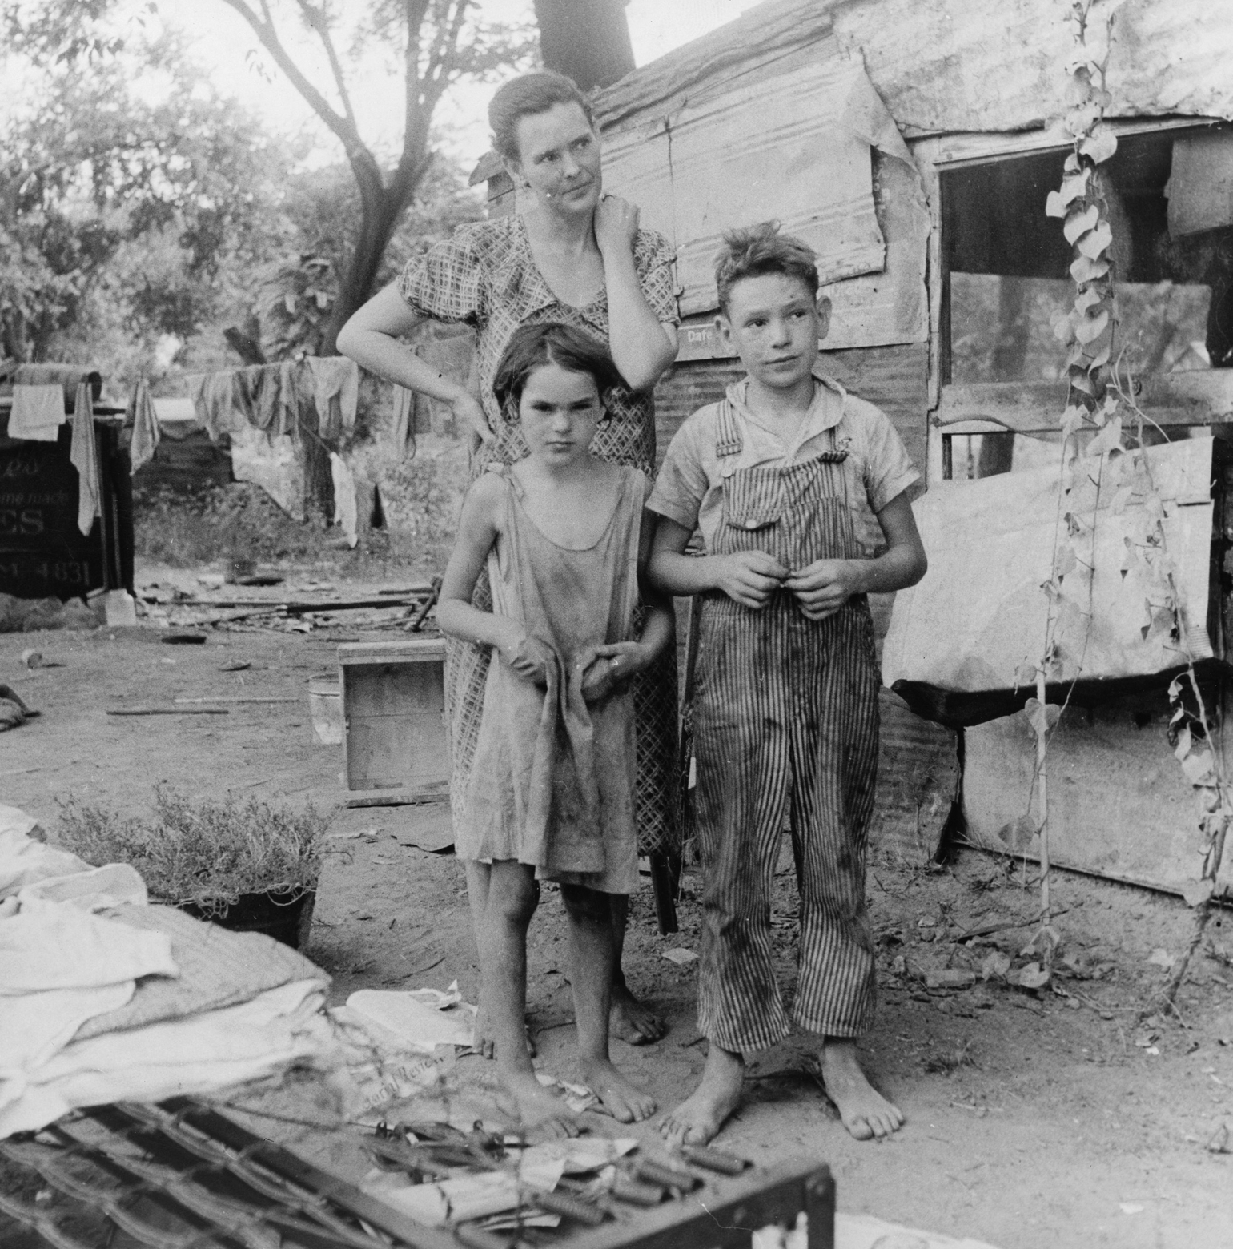
What do you notice in the visual text? Cite details to CLARIFY your ideas
MODEL- GUIDED PRACTICE
Notes:
Display the Teacher Visual Text
Model using Think Time

Slide 90

Listen to the Model Constructive Conversation
  Use your think time to study the visual text.
Listen actively to what two partners say to each other.
WHAT DO YOU NOTICE IN THE VISUAL TEXT? CITE DETAILS TO CLARIFY YOUR IDEAS.
Notes:
Display the Teacher Visual Text. Model using think time and pointing at key elements in the visual text before listening to the Model Constructive Conversation.
STUDENTS SHOULD LISTEN ACTIVELY

Slide 91
What makes this a model for CLARIFY?
What specific language did you hear?
TURN & TALK
Student A1: | I notice a dark-haired woman standing barefoot in an outside area. What do you notice?
Student B1: | I notice a dark-haired girl and a dark-haired boy. They are both standing in their bare feet in front of a dilapidated shack, which is surrounded by trees. What else do you notice?
DEBRIEF THE MODEL CONSTRUCTIVE CONVERSATION
Notes:
Debrief the Model Conversation
Guide students through an analysis of what makes this a Model Constructive Conversation for the skills of CREATE and CLARIFY. (See Coded Model and Conversation Coding Key for your reference.) Use the Conversations Listening Task Poster and the Conversation Pattern Guide as a reference.
What makes this a model for CLARIFY? What specific language did you hear? Use your think time then turn and talk to your partner.

Slide 92

What makes this a model for CLARIFY?
What specific language did you hear?
CONVERSATION CODING KEY CREATE & CLARIFY
ID | INITIAL IDEA
PAR | PARAPHRASE
BO | BUILD ON
PR | PROMPT
UNDERLINE Prompt & Response STARTERS
Student A1: | I notice a dark-haired woman standing barefoot in an outside area . [ID] What do you notice? [PR]
Student B1: | I notice a dark-haired girl and a dark-haired boy. They are both standing in their bare feet in front of a dilapidated shack, which is surrounded by trees. [ID] What else do you notice? [PR]
DEBRIEF THE MODEL CONSTRUCTIVE CONVERSATION
Notes:
Debrief the Model Conversation
Guide students through an analysis of what makes this a Model Constructive Conversation for the skills of CREATE and CLARIFY. (See Coded Model and Conversation Coding Key for your reference.) Use the Conversations Listening Task Poster and the Conversation Pattern Guide as a reference.
Have one or two students share out.

Slide 93
What makes this a model for CLARIFY?
What specific language did you hear?
TURN & TALK
Student A2: | I think you said a boy and girl are standing in front of a small, run-down house. I would like to add that the dilapidated shack is built in a dirt clearing located in a wooded area. What more do you notice?
Student B2: | I heard you say that the broken-down shack is located in a cleared-out section of the woods. Additionally, I notice clothes hanging on a line behind the barefoot people and part of a broken bed on the ground in front of them. How can you add to this idea?
DEBRIEF THE MODEL CONSTRUCTIVE CONVERSATION
Notes:
Debrief the Model Conversation
Guide students through an analysis of what makes this a Model Constructive Conversation for the skills of CREATE and CLARIFY. (See Coded Model and Conversation Coding Key for your reference.) Use the Conversations Listening Task Poster and the Conversation Pattern Guide as a reference.
What makes this a model for CLARIFY? What specific language did you hear? Use your think time then turn and talk to your partner. Remember to refer to the Listening Task Poster and the Conversation Pattern Guide. Have one or two students share out.
Using noun phrases to add details makes your ideas clearer. Let’s take another listen/look at the language the two speakers used to add details. (Refer to highlighted examples.) How did they add details? Turn and talk to your partner. Have one or two students share out.

Slide 94
What makes this a model for CLARIFY?
What specific language did you hear?
CONVERSATION CODING KEY CREATE & CLARIFY
ID | INITIAL IDEA
PAR | PARAPHRASE
BO | BUILD ON
PR | PROMPT
UNDERLINE Prompt & Response STARTERS
Student A2: | I think you said a boy and girl are standing in front of a small, run-down house. [PAR] I would like to add that the dilapidated shack is built in a dirt clearing located in a wooden area. [BO] What more do you notice? [PR]
Student B2: | I heard you say that the broken-down shack is located in a cleared-out section of the woods. [PAR] Additionally, I notice clothes hanging on a line behind the barefoot people and part of a broken bed on the ground in front of them. [BO] How can you add to this idea? [PR]
DEBRIEF THE MODEL CONSTRUCTIVE CONVERSATION
Notes:
Debrief the Model Conversation
Guide students through an analysis of what makes this a Model Constructive Conversation for the skills of CREATE and CLARIFY. (See Coded Model and Conversation Coding Key for your reference.) Use the Conversations Listening Task Poster and the Conversation Pattern Guide as a reference.
Have one or two students share out.

Slide 95
What makes this a model for CLARIFY?
What specific language did you hear?
TURN & TALK
Student A3: | I think you said that they are standing behind broken furniture that is on the bare ground. Another detail is that they are wearing worn and dirty clothing. What else can you add?
Student B3: | In other words, you are saying that these three people are wearing threadbare clothes. I also notice that it looks like they are in a shantytown. What else can you add about the people?
DEBRIEF THE MODEL CONSTRUCTIVE CONVERSATION
Notes:
Debrief the Model Conversation
Guide students through an analysis of what makes this a Model Constructive Conversation for the skills of CREATE and CLARIFY. (See Coded Model and Conversation Coding Key for your reference.) Use the Conversations Listening Task Poster and the Conversation Pattern Guide as a reference.
Remember to refer to the Listening Task Poster and the Conversation Pattern Guide. Have one or two students share out.

Slide 96
What makes this a model for CLARIFY?
What specific language did you hear?
CONVERSATION CODING KEY CREATE & CLARIFY
ID | INITIAL IDEA
PAR | PARAPHRASE
BO | BUILD ON
PR | PROMPT
UNDERLINE Prompt & Response STARTERS
Student A3: | I think you said that they are standing behind broken furniture that is on the bare ground [PAR] Another detail is that they are wearing worn and dirty clothing [BO] What else can you add? [PR]
Student B3: | In other words, you are saying that these three people are wearing threadbare clothes. [PAR] I also notice that it looks like they are in a shantytown. [BO] What else can you add about the people? [PR]
DEBRIEF THE MODEL CONSTRUCTIVE CONVERSATION
Notes:
Debrief the Model Conversation
Guide students through an analysis of what makes this a Model Constructive Conversation for the skills of CREATE and CLARIFY. (See Coded Model and Conversation Coding Key for your reference.) Use the Conversations Listening Task Poster and the Conversation Pattern Guide as a reference.
Have one or two students share out.

Slide 97
What makes this a model for CLARIFY?
What specific language did you hear?
TURN & TALK
Student A4: | In other words, you are saying that this is a rustic encampment where people live. I want to add that the boy and the woman are looking away from the camera in the same direction. The woman is rubbing her neck. The boy is holding his hands together. The girl has her hands in her pockets and is looking down. What else do you notice?
Student B4: | What I heard you say was the people are not looking at the photographer. They are looking away. I would like to add that there is debris in several areas on the ground.
DEBRIEF THE MODEL CONSTRUCTIVE CONVERSATION
Notes:
Debrief the Model Conversation
Guide students through an analysis of what makes this a Model Constructive Conversation for the skills of CREATE and CLARIFY. (See Coded Model and Conversation Coding Key for your reference.) Use the Conversations Listening Task Poster and the Conversation Pattern Guide as a reference.
What makes this a model for CLARIFY? What specific language did you hear? Use your think time then turn and talk to your partner. Remember to refer to the Listening Task Poster and the Conversation Pattern Guide. Have one or two students share out.

Slide 98
What makes this a model for CLARIFY?
What specific language did you hear?
CONVERSATION CODING KEY CREATE & CLARIFY
ID | INITIAL IDEA
PAR | PARAPHRASE
BO | BUILD ON
PR | PROMPT
UNDERLINE Prompt & Response STARTERS
Student A4: | In other words, you are saying that this is a rustic encampment where people live. [PAR] I want to add that the boy and the woman are looking away from the camera in the same direction. [BO] The woman is rubbing her neck. The boy is holding his hands together. [BO] The girl has her hands in her pockets and is looking down. [BO] What else do you notice? [PR]
Student B4: | What I heard you say was the people are not looking at the photographer. They are looking away. [PAR] I would like to add that there is debris in several areas on the ground. [BO]
DEBRIEF THE MODEL CONSTRUCTIVE CONVERSATION
Notes:
Debrief the Model Conversation
Guide students through an analysis of what makes this a Model Constructive Conversation for the skills of CREATE and CLARIFY. (See Coded Model and Conversation Coding Key for your reference.) Use the Conversations Listening Task Poster and the Conversation Pattern Guide as a reference.
Have one or two students share out.

Slide 99

How do noun phrases add details?
ELD
PART II
TURN & TALK
Student A1: | I notice a dark-haired woman standing barefoot in an outside area. What do you notice?
Student B1: | I notice a dark-haired girl and a dark-haired boy. They are both standing in their bare feet in front of a dilapidated shack, which is surrounded by trees. What else do you notice?
ROWS OF COMMUNICATION
DEBRIEF THE MODEL CONSTRUCTIVE CONVERSATION
Notes:
Using noun phrases to add details makes your ideas clearer. Let’s take another listen/look at the language the two speakers used to add details. (Refer to highlighted examples.) How did they add details? Turn and talk to your partner. Have one or two students share out.

Slide 100
How do noun phrases add details?
ELD
PART II
TURN & TALK
Student A2: | I think you said a boy and girl are standing in front of a small, run-down house. I would like to add that the dilapidated shack is built in a dirt clearing located in a wooded area. What more do you notice?
Student B2: | I heard you say that the broken-down shack is located in a cleared-out section of the woods. Additionally, I notice clothes hanging on a line behind the barefoot people and part of a broken bed on the ground in front of them. How can you add to this idea?
DEBRIEF THE MODEL CONSTRUCTIVE CONVERSATION
Notes:
Using noun phrases to add details makes your ideas clearer. Let’s take another listen/look at the language the two speakers used to add details. (Refer to highlighted examples.) How did they add details? Turn and talk to your partner. Have one or two students share out.

Slide 101
How do noun phrases add details?
ELD
PART II
TURN & TALK
Student A3: | I think you said that they are standing behind broken furniture that is on the bare ground. Another detail is that they are wearing worn and dirty clothing. What else can you add? [PR]
Student B3: | In other words, you are saying that these three people are wearing threadbare clothes. I also notice that it looks like they are in a shantytown. What else can you add about the people?
DEBRIEF THE MODEL CONSTRUCTIVE CONVERSATION
Notes:
Using noun phrases to add details makes your ideas clearer. Let’s take another listen/look at the language the two speakers used to add details. (Refer to highlighted examples.) How did they add details? Turn and talk to your partner. Have one or two students share out.

Slide 102
How do noun phrases add details?
ELD
PART II
TURN & TALK
Student A4: | In other words, you are saying that this is a rustic encampment where people live. I want to add that the boy and the woman are looking away from the camera in the same direction. The woman is rubbing her neck. The boy is holding his hands together. The girl has her hands in her pockets and is looking down. What else do you notice?
Student B4: | What I heard you say was the people are not looking at the photographer. They are looking away. I would like to add that there is debris in several areas on the ground.
DEBRIEF THE MODEL CONSTRUCTIVE CONVERSATION
Notes:
Using noun phrases to add details makes your ideas clearer. Let’s take another listen/look at the language the two speakers used to add details. (Refer to highlighted examples.) How did they add details? Turn and talk to your partner. Have one or two students share out.

Slide 103
Listen to the Non-Model Constructive Conversation
  Use your think time to study the visual text.
Listen actively to what two partners say to each other.
WHAT DO YOU NOTICE IN THE VISUAL TEXT? CITE DETAILS TO CLARIFY YOUR IDEAS.
Notes:
Display the Teacher Visual Text. Model using think time and pointing at key elements in the visual text before listening to the Non-Model Constructive Conversation.
STUDENTS SHOULD LISTEN ACTIVELY

Slide 104
What makes this a Non-Model Conversation?
How would you improve this Non-Model?
Student A1: | There is a dark-haired woman standing barefoot.
Student B1: | I notice a girl and a boy. What do you notice?
Student A2: | I think it is a camp because there is a shack. What do you think?
Student B2: | I agree with you. I notice clothes hanging on a line behind the people. What do you think about these people?
Student A3: | I think so, too. They are standing behind broken furniture. What else can you add?
Student B3: | The people are wearing threadbare clothes and are in a shantytown.
Student A4: | I agree. I want to add that the boy and the woman are looking away from the camera in the same direction.
Student B4: | No turn taken.
TURN & TALK
DEBRIEF THE NON-MODEL CONSTRUCTIVE CONVERSATION
Notes:
Debrief the Non-Model Conversation
Guide students through an analysis of what makes this a Non-Model Constructive Conversation for the skills of CREATE and CLARIFY. Use the Conversations Listening Task Poster and the Conversation Pattern Guide as a reference.
What makes this a Non-Model Conversation? How would you improve this Model? Use your think time. Remember to refer the Listening Task Poster and Conversation Pattern Guide (point to resources). Now, turn and talk to your partner.
How can you expand noun phrases to add details? What adjectives or other details would you add to CLARIFY ideas? Use your think time. Now, turn and talk to your partner. Have one or two students share out.

Slide 105
How can you expand noun phrases to add details?
What adjectives or other details would you add to CLARIFY ideas?
ELD
PART II
Student A1: | There is a dark-haired woman standing barefoot.
Student B1: | I notice a girl and a boy. What do you notice?
Student A2: | I think it is a camp because there is a shack. What do you think?
Student B2: | I agree with you. I notice clothes hanging on a line behind the people. What do you think about these people?
Student A3: | I think so, too. They are standing behind broken furniture. What else can you add?
Student B3: | The people are wearing threadbare clothes and are in a shantytown.
Student A4: | I agree. I want to add that the boy and the woman are looking away from the camera in the same direction.
Student B4: | No turn taken.
TURN & TALK
DEBRIEF THE NON-MODEL CONSTRUCTIVE CONVERSATION
Notes:
Debrief the Non-Model Conversation
How can you expand noun phrases to add details? What adjectives or other details would you add to CLARIFY ideas? Use your think time. Now, turn and talk to your partner. Have one or two students share out.

Slide 106
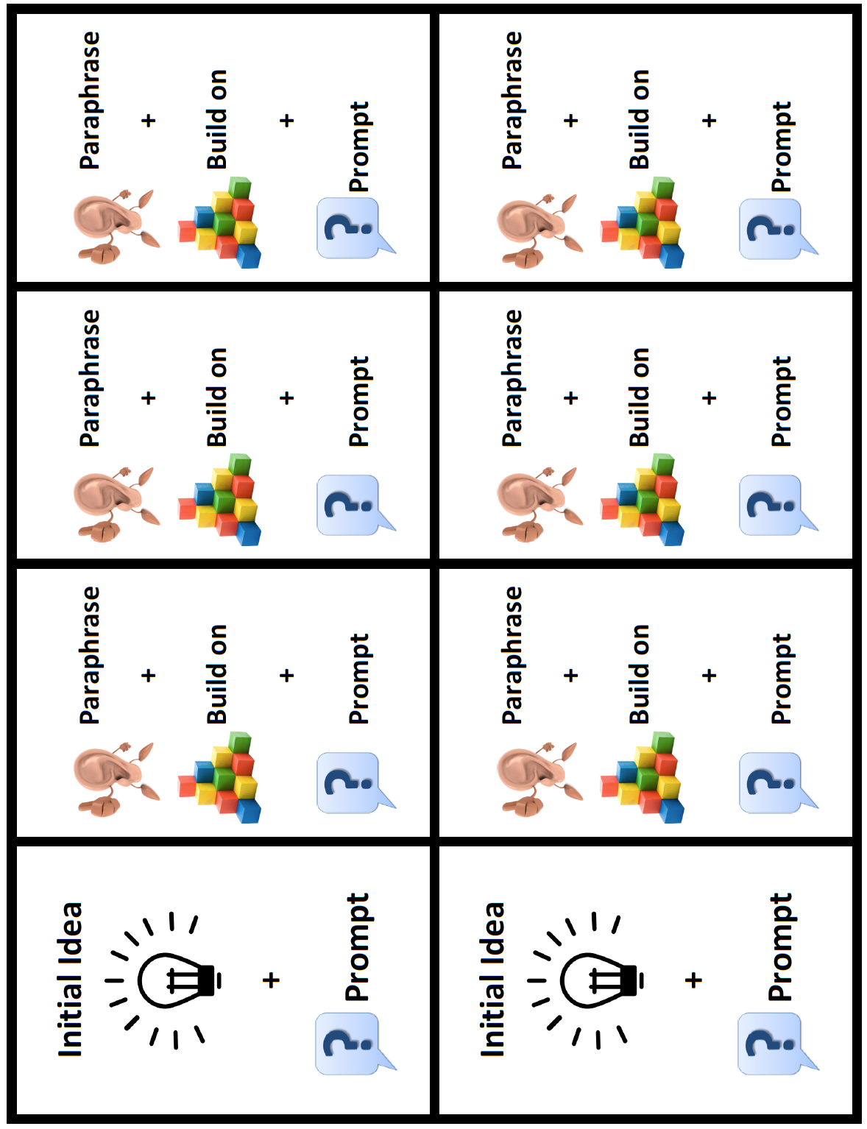
CONSTRUCTIVE CONVERSATION GAME WITH VISUAL TEXT – CREATE & CLARIFY
Form groups of four
Each of you needs to have one card for your initial idea and 3 cards to cite details as you follow the Conversation Pattern
Take turns sharing in round robin fashion until all cards have been played
Remember to follow our Constructive Conversation Norms and use the Constructive Conversations Listening Task Poster.
PREPARE TO PLAY THE GAME – TEACHER COLLECTS LANGUAGE SAMPLE SPF 1.0
Notes:
Constructive Conversation Game with Visual Text
Organize students into quads and distribute the Conversation Pattern Game Cards. Now you are going to play the Constructive Conversation Game. Your conversations will focus on the skills of CREATE and CLARIFY using the visual text. You will be in a group of four. Each of you will have one card for your initial idea and 3 cards to cite details as you follow the Conversation Pattern. You will take turns sharing in a Round Robin fashion until all cards have been played. Remember to follow our Constructive Conversation Norms and use the Constructive Conversations Listening Task Poster.
Begin by stating your idea. Cite details to CLARIFY your ideas. Remember to use the Conversation Pattern.
Prompt: What do you notice in the visual text? Cite details to CLARIFY your ideas.
Formative Assessment
Monitor students as they play the game and provide feedback as needed. Then select two students who will Fishbowl Model in front of the class when they’re done playing the game. Use the SPF 1.0 to collect a Constructive Conversation Language Sample as they model in front of the class.

Slide 107
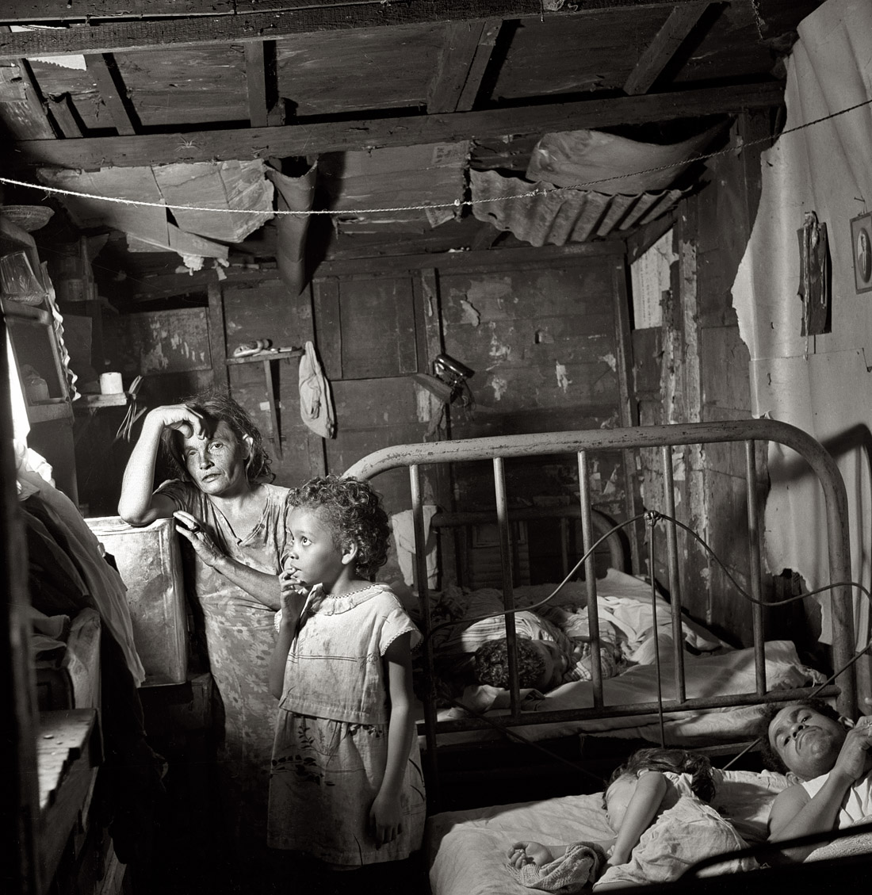
CONSTRUCTIVE CONVERSATION GAME WITH VISUAL TEXT
PROMPT:
What do you notice in the visual text?
Cite details to CLARIFY your ideas.
STUDENT PRACTICE
Notes:
Constructive Conversation Game with Visual Text
Prompt: What do you notice in the visual text? Cite details to CLARIFY your ideas.
Formative Assessment
Monitor students as they play the game and provide feedback as needed. Then select two students who will Fishbowl Model in front of the class when they’re done playing the game. Use the SPF 1.0 to collect a Constructive Conversation Language Sample as they model in front of the class.

Slide 108
CONSTRUCTIVE CONVERSATION FISHBOWL MODEL
PROMPT:
What do you notice in the visual text? Cite details to CLARIFY your ideas.
Listen actively as two of your peers model how to have a Constructive Conversation
How did they CLARIFY by citing details?
What language did they use?
FORMATIVE ASSESSMENT– TEACHER COLLECTS LANGUAGE SAMPLE SPF 1.0
Notes:
Select two students to Fishbowl Model a Constructive Conversation in front of the class. Students will address the following prompt: What do you notice in the visual text? Cite details to CLARIFY your ideas.
Collect a language sample from the two students using the SPF 1.0. The language sample must be at least four turns in length.

Slide 109
REVIEW ELD OBJECTIVE & SELF-ASSESS
In this lesson, we…
    reviewed the Conversation Pattern
    practiced the skills of CREATE and CLARIFY using a visual text
    had a conversation with a partner and in a small group
Think…
    How did we meet our lesson objectives?
    How did the Conversation Pattern help us to CLARIFY our ideas?
Work with your Constructive Conversation partner to:
Identify one thing you did to meet today’s objective and one thing you want to improve.
Share and explain to your partner
TURN & TALK
TURN & TALK - THEN WHOLE GROUP DISCUSSION
Notes:
After students have had a few minutes to discuss with a partner, call on one or two individuals to share out with the whole group.

Slide 110
LESSON 6
CREATE & CLARIFY WITH infographic

Slide 111
ELD OBJECTIVE
In this lesson, we will...
  review the Conversation Pattern
  listen to a Model and Non-Model for CREATE and CLARIFY
  practice CREATE and CLARIFY with an Infographic
  have a conversation with a partner and in a small group
STUDENT FRIENDLY ELD OBJECTIVES

Slide 112
Conversation Pattern – Practice CREATE & CLARIFY
We have learned and practiced how to CLARIFY our ideas by using the Conversation Pattern.
Today’s lesson will focus on reviewing the Constructive Conversation Skills- CREATE & CLARIFY
When we CLARIFY we make our ideas clearer for ourselves and our partners.
We CLARIFY each other’s ideas by paraphrasing, building on, and prompting each other.
We will use what we know about CLARIFY and CREATE ideas with an infographic.
LESSON OPENING
Notes:
In this lesson we will review the Constructive Conversation Skills-CREATE and CLARIFY. When we CREATE we say what we think or notice about something. When we CLARIFY we make our ideas clearer for ourselves and our partners. We CLARIFY each other’s ideas by paraphrasing, building on, and prompting. During conversations, remember to follow our conversation norms (point to poster).

Slide 113
Which Conversation Norm will help you to CREATE and CLARIFY? Why?
TURN & TALK
I heard many of you say that you would “Use your think time,” to think about what we notice.
LESSON OPENING – REVIEW NORMS – TURN AND TALK
Notes:
Which conversation norm will help us to CREATE and CLARIFY? Turn and talk to your partner. Give students 1 minute to talk to a partner.
Affirm all responses and say: I heard many of you say that you would “Use the language of the skill” (point to poster) to speak in complete sentences as we CREATE and CLARIFY ideas. We will use prompt and response starters to help us.

Slide 114
Let’s Review the
Conversation Pattern
When and how do we paraphrase in a Constructive Conversation?
TURN & TALK
Paraphrase:
This means to listen and then we repeat our partner’s thoughts in our own words. We paraphrase to CLARIFY and make sure we understand what our partner said.
MODEL – REVIEW THE CONVERSATION PATTERN
Notes:
When and how do we paraphrase in a Constructive Conversation? Turn and talk to your partner.

Slide 115
Let’s Review the
Conversation Pattern
When and how do we build an idea in a Constructive Conversation?
TURN & TALK
Build on each other’s ideas:
This means that we listen to what our partner says and add details and other information to their ideas to make a clearer and more complete idea.
MODEL – REVIEW THE CONVERSATION PATTERN
Notes:
When and how do we build on in a Constructive Conversation? Turn and talk to your partner.

Slide 116
Let’s Review the
Conversation Pattern
When and how do we prompt in a Constructive Conversation?
TURN & TALK
Prompt:
This means we get more information, ask for clarification or for new ideas to continue the Constructive Conversation. When prompting, we think about what we did understand and what more we need to understand fully.
MODEL – REVIEW THE CONVERSATION PATTERN
Notes:
When and how do we prompt in a Constructive Conversation? Turn and talk to your partner.

Slide 117
What is the first step?
We know the pattern helps us to CLARIFY, but if we haven’t shared an initial idea, we have nothing to CLARIFY.
So, the very first step of a Constructive Conversation is to CREATE and share an idea.
Then, we can use the Conversation Pattern to develop our idea fully.
MODEL – REVIEW THE CONVERSATION PATTERN
Notes:
Teacher Think Aloud.

Slide 118
Which response starter will you use today?
PROMPT & RESPONSE STARTERS
PARAPHRASE
I think you said…
BUILD ON
Another detail is…
PROMPT
How can you add to this idea?
EXPANDING
CLARIFY
I think you said…
Another details is…
You will use the Conversation Pattern Guide to remind you of the pattern.
Let’s review the prompt and response starters.
How can you add to this idea?
MODEL – INTRODUCE RESPONSE STARTERS
Notes:
Today you are going to engage in a Constructive Conversation for the Skills-CREATE and CLARIFY using an Infographic. Do your best to follow the Conversation Pattern as you CLARIFY your ideas.
You will use the Conversation Pattern Guide to remind you of the pattern. Let’s review the prompt and response starters that you may use to help you during your conversations and add them to our Conversation Pattern Guides.

Slide 119
Constructive Conversations Listening Task Poster
While you are listening to me and my partner, listen for the following…
REVIEW THE CONSTRUCTIVE CONVERSATION LISTENING TASK POSTER
Notes:
Display the Conversations Listening Task Poster and read each of the questions.
While you are listening to me and my partner, listen for the following:
How did we…
acknowledge a partner’s ideas?
build on a partner’s ideas?
prompt a partner to CLARIFY ideas?
use evidence to support ideas?
use academic words (notice, in other words, etc.) to convey ideas?
use domain-specific words (visual text, paraphrase, elaborate, etc.) to convey ideas?

Slide 120
What is an infographic?
An infographic is an informational text that combines visuals and words.
The information about a topic is communicaed clearly and concisely.
INTRODUCE- INFOGRAPHIC
Notes:
Display the Teacher Infographic. In past lessons we used a visual text. From now on we will also use a new source of information called an infographic. An infographic is an informational text that combines visuals and words to provide information about a topic clearly and concisely.

Slide 121
What do you notice in the infographic? Cite details to CLARIFY your ideas.
MODEL- GUIDED PRACTICE
Notes:
Display the Teacher Visual Text
Model using Think Time

Slide 122
Listen to the Model Constructive Conversation
  Use your think time to study the infographic
Listen actively to what two partners say to each other.
WHAT DO YOU NOTICE IN THE INFOGRAPHIC? CITE DETAILS TO CLARIFY YOUR IDEAS.
Notes:
Display the Infographic. Model using think time and pointing at key elements in the infographic before listening to the Model Constructive Conversation.
STUDENTS SHOULD LISTEN ACTIVELY

Slide 123
What makes this a model for CLARIFY?
What specific language did you hear?
TURN & TALK
Student A1: | I notice the title indicates that the Great Depression lasted for ten years. What do you notice?
Student B1: | I notice it says that workers lost their jobs and families became poorer. What else do you notice?
DEBRIEF THE MODEL CONSTRUCTIVE CONVERSATION
Notes:
Debrief the Model Conversation
Guide students through an analysis of what makes this a Model Constructive Conversation for the skills of CREATE and CLARIFY. (See Coded Model and Conversation Coding Key for your reference.) Use the Conversations Listening Task Poster and the Conversation Pattern Guide as a reference.
Remember to refer to the Listening Task Poster and the Conversation Pattern Guide. Have one or two students share out.

Slide 124
What makes this a model for CLARIFY?
What specific language did you hear?
CONVERSATION CODING KEY CREATE & CLARIFY
ID | INITIAL IDEA
PAR | PARAPHRASE
BO | BUILD ON
PR | PROMPT
UNDERLINE Prompt & Response STARTERS
Student A1: | I notice the title indicates that the Great Depression lasted for ten years. [ID] What do you notice? [PR]
Student B1: | I notice it says that workers lost their jobs and families became poorer. [ID] What else do you notice? [PR]
DEBRIEF THE MODEL CONSTRUCTIVE CONVERSATION
Notes:
Debrief the Model Conversation
Guide students through an analysis of what makes this a Model Constructive Conversation for the skills of CREATE and CLARIFY. (See Coded Model and Conversation Coding Key for your reference.) Use the Conversations Listening Task Poster and the Conversation Pattern Guide as a reference.
Have one or two students share out.

Slide 125
What makes this a model for CLARIFY?
What specific language did you hear?
TURN & TALK
Student A2: | I heard you say that people were unemployed and became impoverished. I would like to add that the newspaper headlines say that there was a great market crash and prices tumbled like an avalanche. What details can you cite?
Student B2: | I heard you say that prices fell very fast like an avalanche. Another detail is that it says the market was overwhelmed with panic selling. What details can you cite?
DEBRIEF THE MODEL CONSTRUCTIVE CONVERSATION
Notes:
Debrief the Model Conversation
Guide students through an analysis of what makes this a Model Constructive Conversation for the skills of CREATE and CLARIFY. (See Coded Model and Conversation Coding Key for your reference.) Use the Conversations Listening Task Poster and the Conversation Pattern Guide as a reference.
Remember to refer to the Listening Task Poster and the Conversation Pattern Guide. Have one or two students share out.

Slide 126
What makes this a model for CLARIFY?
What specific language did you hear?
CONVERSATION CODING KEY CREATE & CLARIFY
ID | INITIAL IDEA
PAR | PARAPHRASE
BO | BUILD ON
PR | PROMPT
UNDERLINE Prompt & Response STARTERS
Student A2: | I heard you say that people were unemployed and became impoverished. [PAR] I would like to add that the newspaper headlines say that there was a great market crash and prices tumbled like an avalanche. [BO] What details can you cite? [PR]
Student B2: | I heard you say that prices fell very fast like an avalanche. [PAR] Another detail is that it says the market was overwhelmed with panic selling. [BO] What details can you cite? [PR]
DEBRIEF THE MODEL CONSTRUCTIVE CONVERSATION
Notes:
Debrief the Model Conversation
Guide students through an analysis of what makes this a Model Constructive Conversation for the skills of CREATE and CLARIFY. (See Coded Model and Conversation Coding Key for your reference.) Use the Conversations Listening Task Poster and the Conversation Pattern Guide as a reference.
Have one or two students share out.

Slide 127
What makes this a model for CLARIFY?
What specific language did you hear?
TURN & TALK
Student A3: | In other words, the newspaper reported about a big price crash and people were scared, so they sold their shares. Another detail is the caption says that banks closed after the stock market crash. How can you elaborate?
Student B3: | In other words, is that banks closed because the market crashed. To elaborate, when banks closed they lost their customers’ money, so businesses and people couldn’t back the money they had deposited. What can you add?
DEBRIEF THE MODEL CONSTRUCTIVE CONVERSATION
Notes:
Debrief the Model Conversation
Guide students through an analysis of what makes this a Model Constructive Conversation for the skills of CREATE and CLARIFY. (See Coded Model and Conversation Coding Key for your reference.) Use the Conversations Listening Task Poster and the Conversation Pattern Guide as a reference.
Remember to refer to the Listening Task Poster and the Conversation Pattern Guide. Have one or two students share out.

Slide 128
What makes this a model for CLARIFY?
What specific language did you hear?
CONVERSATION CODING KEY CREATE & CLARIFY
ID | INITIAL IDEA
PAR | PARAPHRASE
BO | BUILD ON
PR | PROMPT
UNDERLINE Prompt & Response STARTERS
Student A3: | In other words, the newspaper reported about a big price crash and people were scared, so they sold their shares. [PAR] Another detail is the caption says that banks closed after the stock market crash. [BO] How can you elaborate? [PR]
Student B3: | I think you said the banks went out of business because the market crashed. [PAR] To elaborate, when banks closed they lost their customers’ money, so businesses and people couldn’t pay back the money they had deposited. [BO] What can you add? [PR]
DEBRIEF THE MODEL CONSTRUCTIVE CONVERSATION
Notes:
Debrief the Model Conversation
Guide students through an analysis of what makes this a Model Constructive Conversation for the skills of CREATE and CLARIFY. (See Coded Model and Conversation Coding Key for your reference.) Use the Conversations Listening Task Poster and the Conversation Pattern Guide as a reference.
Have one or two students share out.

Slide 129
What makes this a model for CLARIFY?
What specific language did you hear?
TURN & TALK
Student A4: | In other words, banks closed so people couldn’t recover their money. I would like to add that it says many companies were forced to fire workers to stay in business. The unemployed workers couldn’t pay their rent. What else can you add?
Student B4: | So what you are saying is that struggling companies fired workers, so they had no money for rent. In addition, people who couldn’t pay for proper housing camped in makeshift encampments like Pipe City for shelter. How can you add to this idea?
Student A5: | I think you said that Pipe City is an example of an encampment or shantytown where people in need went to live when they couldn’t afford rent. Additionally, these shantytowns were found all over vacant land across the state.
DEBRIEF THE MODEL CONSTRUCTIVE CONVERSATION
Notes:
Debrief the Model Conversation
Guide students through an analysis of what makes this a Model Constructive Conversation for the skills of CREATE and CLARIFY. (See Coded Model and Conversation Coding Key for your reference.) Use the Conversations Listening Task Poster and the Conversation Pattern Guide as a reference.
Remember to refer to the Listening Task Poster and the Conversation Pattern Guide. Have one or two students share out.

Slide 130
What makes this a model for CLARIFY?
What specific language did you hear?
CONVERSATION CODING KEY CREATE & CLARIFY
ID | INITIAL IDEA
PAR | PARAPHRASE
BO | BUILD ON
PR | PROMPT
UNDERLINE Prompt & Response STARTERS
Student A4: | In other words, banks closed so people couldn’t recover their money. [PAR] I would like to add that it says many companies were forced to fire workers to stay in business. [BO] The unemployed workers couldn’t pay their rent. [BO] What else can you add? [PR]
Student B4: | So what you are saying is that struggling companies fired workers, so they had no money for rent. [PAR] In addition, people who couldn’t pay for proper housing camped in makeshift encampments like Pipe City for shelter. [BO] How can you add to this idea? [PR]
Student A5: | I think you said that Pipe City is an example of an encampment or shantytown where people in need went to live when they couldn’t afford rent. [PAR] Additionally, these shantytowns were found all over vacant land across the state. [BO]
DEBRIEF THE MODEL CONSTRUCTIVE CONVERSATION
Notes:
Debrief the Model Conversation
Guide students through an analysis of what makes this a Model Constructive Conversation for the skills of CREATE and CLARIFY. (See Coded Model and Conversation Coding Key for your reference.) Use the Conversations Listening Task Poster and the Conversation Pattern Guide as a reference.
Have one or two students share out.

Slide 131
How do noun phrases
add details?
ELD
PART II
TURN & TALK
Student A1: | I notice the title indicates that the Great Depression lasted for ten years. What do you notice?
Student B1: | I notice it says that workers lost their jobs and families became poorer. What else do you notice?
DEBRIEF THE MODEL CONSTRUCTIVE CONVERSATION
Notes:
Using noun phrases to add details makes your ideas clearer. Let’s take another listen/look at the language the two speakers used to add details. (Refer to highlighted examples.) How did they add details? Turn and talk to your partner. Have one or two students share out.

Slide 132
How do noun phrases add details?
ELD
PART II
TURN & TALK
Student A2: | I heard you say that people were unemployed and became impoverished. I would like to add that the newspaper headlines say that there was a great market crash and prices tumbled like an avalanche. What details can you cite?
Student B2: | I heard you say that prices fell very fast like an avalanche. Another detail is that it says the market was overwhelmed with panic selling. What details can you cite?
DEBRIEF THE MODEL CONSTRUCTIVE CONVERSATION
Notes:
Using noun phrases to add details makes your ideas clearer. Let’s take another listen/look at the language the two speakers used to add details. (Refer to highlighted examples.) How did they add details? Turn and talk to your partner. Have one or two students share out.

Slide 133
How do noun phrases add details?
ELD
PART II
TURN & TALK
Student A3: | In other words, the newspaper reported about a big price crash and people were scared, so they sold their shares. Another detail is the caption says that banks closed after the stock market crash. How can you elaborate?
Student B3: | I think you said the banks went out of business because the market crashed. To elaborate, when banks closed they lost their customers’ money, so businesses and people couldn’t pay back the money they had deposited. What can you add?
DEBRIEF THE MODEL CONSTRUCTIVE CONVERSATION
Notes:
Using noun phrases to add details makes your ideas clearer. Let’s take another listen/look at the language the two speakers used to add details. (Refer to highlighted examples.) How did they add details? Turn and talk to your partner. Have one or two students share out.

Slide 134
How do noun phrases add details?
ELD
PART II
TURN & TALK
Student A4: | In other words, banks closed so people couldn’t recover their money. I would like to add that it says many companies were forced to fire workers to stay in business. The unemployed workers couldn’t pay their rent. What else can you add?
Student B4: | So what you are saying is that struggling companies fired workers, so they had no money for rent. In addition, people who couldn’t pay for proper housing camped in makeshift encampments like Pipe City for shelter. How can you add to this idea? [PR]
Student A5: | I think you said that Pipe City is an example of an encampment or shantytown where people in need went to live when they couldn’t afford rent. Additionally, these shantytowns were found all over vacant land across the state.
DEBRIEF THE MODEL CONSTRUCTIVE CONVERSATION
Notes:
Using noun phrases to add details makes your ideas clearer. Let’s take another listen/look at the language the two speakers used to add details. (Refer to highlighted examples.) How did they add details? Turn and talk to your partner. Have one or two students share out.

Slide 135
Listen to the Non-Model Constructive Conversation
  Use your think time to study the infographic
Listen actively to what two partners say to each other.
WHAT DO YOU NOTICE IN THE INFOGRAPHIC? CITE DETAILS TO CLARIFY YOUR IDEAS.
Notes:
Display the Infographic. Model using think time and pointing at key elements in the infographic before listening to the Non-Model Constructive Conversation.
STUDENTS SHOULD LISTEN ACTIVELY

Slide 136
What makes this a Non-Model Conversation?
How would you improve this Non-Model?
Prompt: What do you notice in the infographic? Cite details to CLARIFY your ideas.
Student A1: | There is a picture of a newspaper and the headline reads “GREATEST CRASH”.
Student B1: | I notice a graph with years at the bottom. What do you notice?
Student A2: | I think it is about unemployment and how people were poor. What do you think?
Student B2: | I agree with you. I notice the boy holding a sign that says “Why can’t you give my Dad a job?”. What do you think about this picture?
Student A3: | I think they are protesting. They are standing holding signs. What else can you add?
Student B3: | There are people standing in line getting free food.
Student A4: | I agree. I want to add that impoverished families waited in bread lines.
Student B4: | Some people donated the food.
TURN & TALK
DEBRIEF THE NON-MODEL CONSTRUCTIVE CONVERSATION
Notes:
Debrief the Non-Model Conversation
Guide students through an analysis of what makes this a Non-Model Constructive Conversation for the skills of CREATE and CLARIFY. Use the Conversations Listening Task Poster and the Conversation Pattern Guide as a reference.
What makes this a Non-Model Conversation? How would you improve this Model? Use your think time. Remember to refer the Listening Task Poster and Conversation Pattern Guide (point to resources). Now, turn and talk to your partner.

Slide 137
How can you expand noun phrases to add details?
What adjectives or other details would you add to CLARIFY ideas?
ELD
PART II
Prompt: What do you notice in the infographic? Cite details to CLARIFY your ideas.
Student A1: | There is a picture of a newspaper and the headline reads “GREATEST CRASH”.
Student B1: | I notice a graph with years at the bottom. What do you notice?
Student A2: | I think it is about unemployment and how people were poor. What do you think?
Student B2: | I agree with you. I notice the boy holding a sign that says “Why can’t you give my Dad a job?”. What do you think about this picture?
Student A3: | I think they are protesting. They are standing holding signs. What else can you add?
Student B3: | There are people standing in line getting free food.
Student A4: | I agree. I want to add that impoverished families waited in bread lines.
Student B4: | Some people donated the food.
TURN & TALK
DEBRIEF THE NON-MODEL CONSTRUCTIVE CONVERSATION
Notes:
Debrief the Non-Model Conversation
How can you expand noun phrases to add details? What adjectives or other details would you add to CLARIFY ideas? Use your think time. Now, turn and talk to your partner. Have one or two students share out.

Slide 138
CONSTRUCTIVE CONVERSATION GAME WITH VISUAL TEXT – CREATE & CLARIFY
Form groups of four
Each of you needs to have one card for your initial idea and 3 cards to cite details as you follow the Conversation Pattern
Take turns sharing in round robin fashion until all cards have been played
Remember to follow our Constructive Conversation Norms and use the Constructive Conversations Listening Task Poster.
PREPARE TO PLAY THE GAME – TEACHER COLLECTS LANGUAGE SAMPLE
Notes:
Constructive Conversation Game with Infographic
Organize students into quads and distribute the Conversation Pattern Game Cards. Now you are going to play the Constructive Conversation Game. Your conversations will focus on the skills of CREATE and CLARIFY using the infographic. You will be in a group of four. Each of you will have one card for your initial idea and 3 cards to cite details as you follow the Conversation Pattern. You will take turns until all cards have been played. Remember to follow our Conversation Norms and use the Constructive Conversations Listening Task Poster.
Begin by stating your idea. Cite details to CLARIFY your ideas and use the Conversation Pattern.
Prompt: What do you notice in the infographic? Cite details to CLARIFY your ideas.
Formative Assessment
Monitor students as they play the game and provide feedback as needed. Then select two students who will Fishbowl Model in front of the class when they’re done playing the game. Use the SPF 1.0 to collect a Constructive Conversation Language Sample as they model in front of the class.

Slide 139
CONSTRUCTIVE CONVERSATION GAME WITH VISUAL INFOGRAPHIC
PROMPT:
What do you notice in the infographic?
Cite details to CLARIFY your ideas.
Notes:
Constructive Conversation Game with Infographic
Organize students into quads and distribute the Conversation Pattern Game Cards. Now you are going to play the Constructive Conversation Game. Your conversations will focus on the skills of CREATE and CLARIFY using the infographic. You will be in a group of four. Each of you will have one card for your initial idea and 3 cards to cite details as you follow the Conversation Pattern. You will take turns until all cards have been played. Remember to follow our Conversation Norms and use the Constructive Conversations Listening Task Poster.
Begin by stating your idea. Cite details to CLARIFY your ideas and use the Conversation Pattern.
Prompt: What do you notice in the infographic? Cite details to CLARIFY your ideas.
Formative Assessment
Monitor students as they play the game and provide feedback as needed. Then select two students who will Fishbowl Model in front of the class when they’re done playing the game. Use the SPF 1.0 to collect a Constructive Conversation Language Sample as they model in front of the class.

Slide 140
CONSTRUCTIVE CONVERSATION FISHBOWL MODEL
PROMPT:
What do you notice in the infographic? Cite details to CLARIFY your ideas.
Listen actively as two of your peers model how to have a Constructive Conversation
How did they CLARIFY by citing details?
What language did they use?
FORMATIVE ASSESSMENT– TEACHER COLLECTS LANGUAGE SAMPLE SPF 1.0
Notes:
Select two students to Fishbowl Model a Constructive Conversation in front of the class. Students will address the following prompt: What do you notice in the infographic? Cite details to CLARIFY your ideas.
Collect a language sample from the two students using the SPF 1.0. The language sample must be at least four turns in length.

Slide 141
REVIEW ELD OBJECTIVE & SELF-ASSESS
In this lesson, we…
    reviewed the Conversation Pattern
    listened to a Model and Non-Model for CREATE and CLARIFY
    practiced CREATE and CLARIFY with an infographic
    had a conversation with a partner and in a small group
Think…
    How did we meet our lesson objectives?
    How did the Conversation Pattern help us to CLARIFY our ideas?
Work with your Constructive Conversation partner to:
Identify one thing you did to meet today’s objective and one thing you want to improve.
Share and explain to your partner
TURN & TALK
TURN & TALK - THEN WHOLE GROUP DISCUSSION
Notes:
After students have had a few minutes to discuss with a partner, call on one or two individuals to share out with the whole group.

