Slide 1
Power Point Tutorials:
Dear Teacher,
The following short Power Points have been created as resources to aid in your support for your students in creating Multimedia. They are:
Create a Power Point (Lesson 22)
Insert Images from the Internet into a PowerPoint Slide (Lesson 22)
Insert a Web Link into a PowerPoint Slide (Lesson 23)
Adding a Voiceover to PowerPoint Slides (Lesson 25 Celebration)

Slide 2
Power Point Tutorial 1: Create a PowerPoint
Multilingual and Multicultural Education Department
Division of Instruction
LAUSD

Slide 3
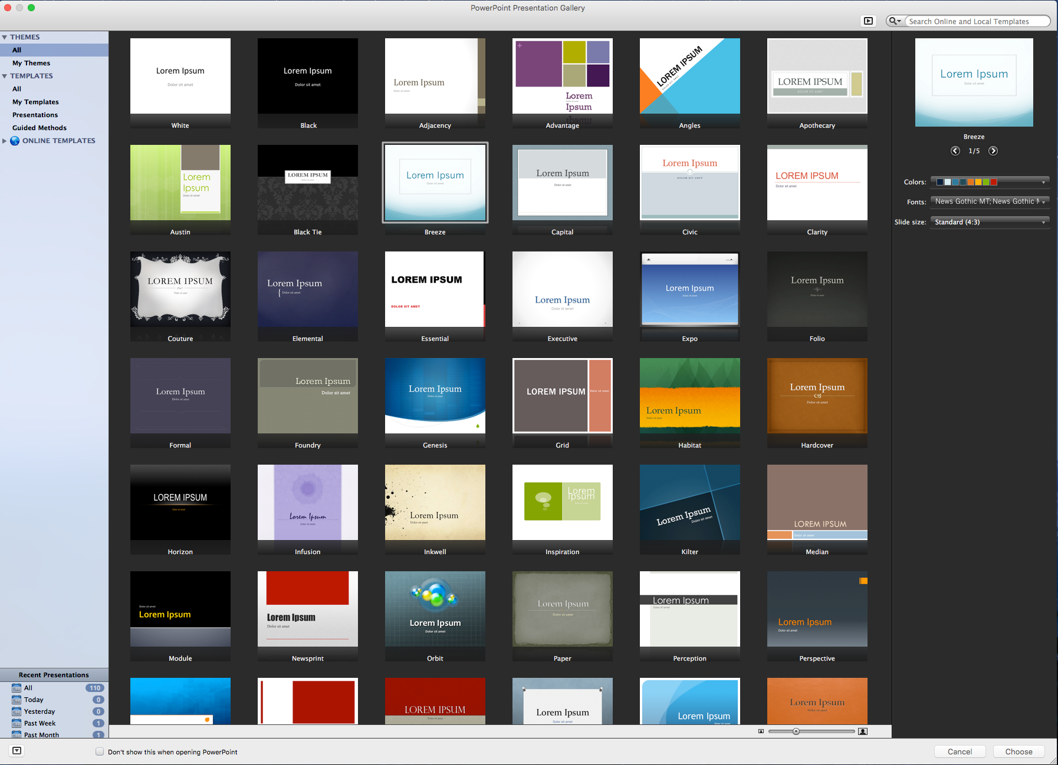
Select a theme
1.
Choose a theme
Double click on the theme

Slide 4
Add text to slide
Double click the rectangular box to add text
1.

Slide 5
Format text font, size, and color
Double click to highlight text
1.

Slide 6
Format text font, size, and color
Click Format to access font style
1.
Click arrow to select font size
4.
3.
5.
Click
B: Bold
I: Italicize
U: Underline
Click arrow to select font style
2.
Click
Change color

Slide 7
Add new slide
1.
Click New Slide
2.
Click on a template for your new slide

Slide 8
Power Point Tutorial 2: Insert Images from the Internet into a PowerPoint Slide
Multilingual and Multicultural Education Department
Division of Instruction
LAUSD

Slide 9
Search for Images on the Internet
Type in a search word then click the magnify glass.
Click on Search tools
Select Image Size
Click on the desired image
1.
magnify glass
2.
3.
4.

Slide 10
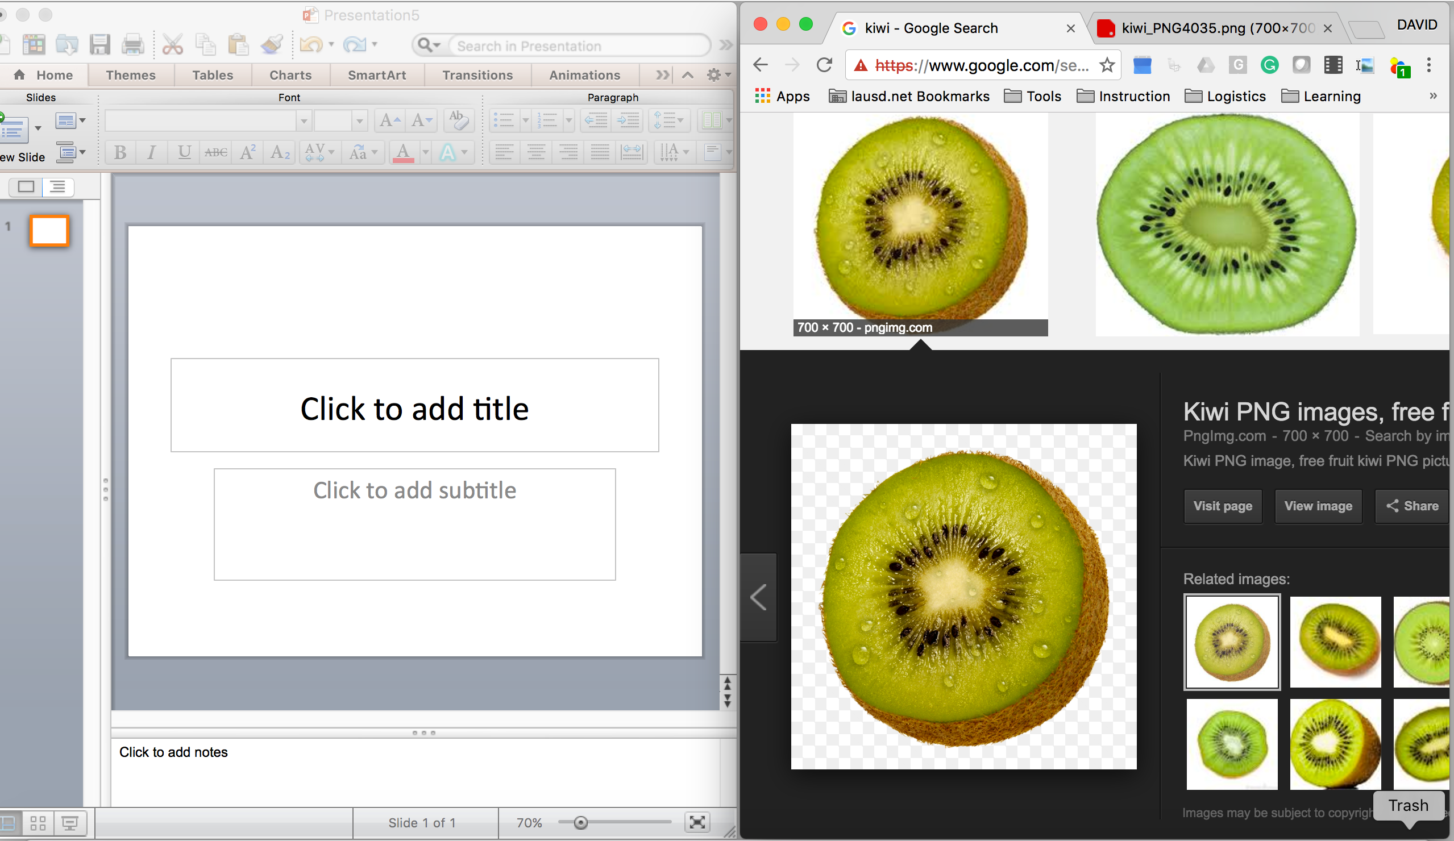
Insert Image into a PowerPoint Slide
Position PowerPoint and web browser side by side.
Click, hold, and drag the image with your mouse into PowerPoint slide.

Slide 11
Power Point Tutorial 3: Insert a Web Link into a PowerPoint Slide
Multilingual and Multicultural Education Department
Division of Instruction
LAUSD

Slide 12
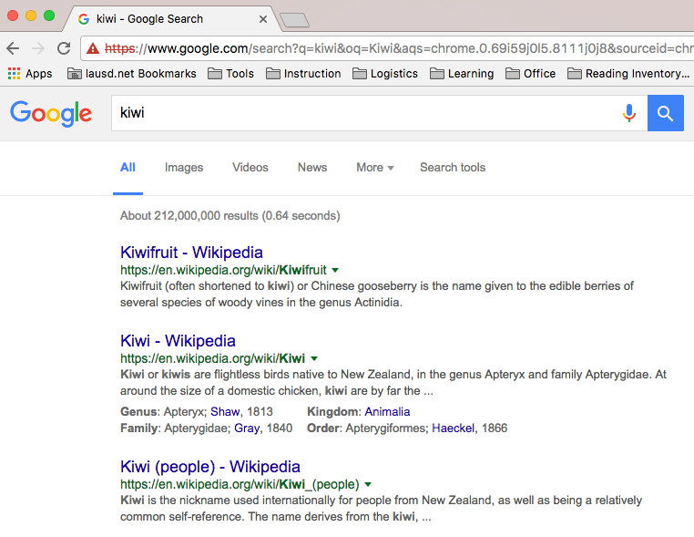
Search for Topics on the Internet
Type in a search word then click on the magnify glass.
Click on the link that you want to view.
1.
magnify glass
2.

Slide 13
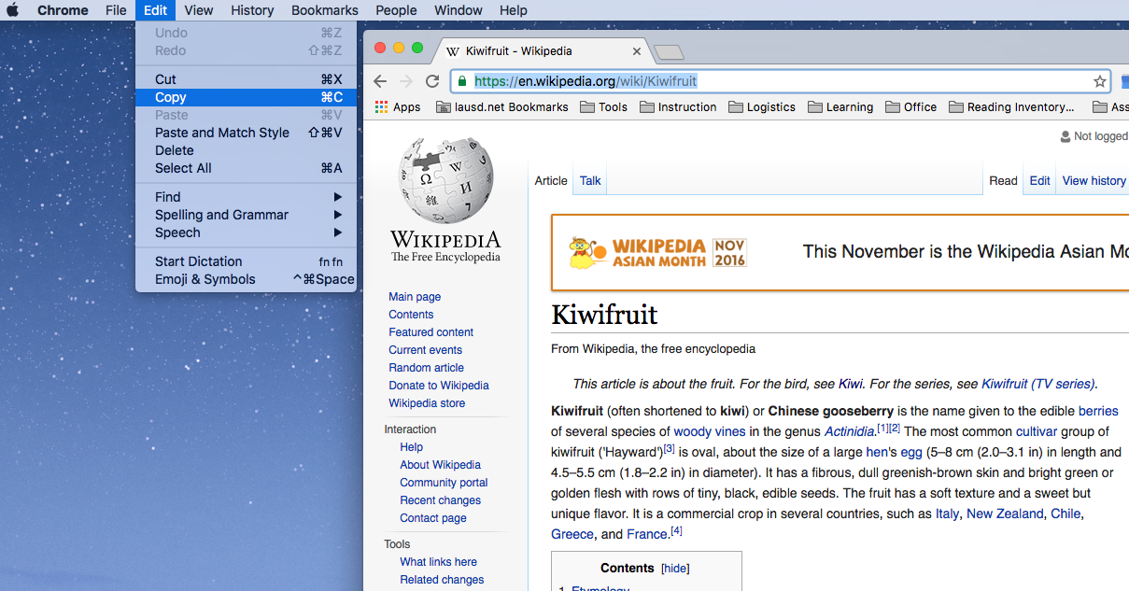
Highlight and Copy URL
Chrome menu
Click on the URL with your mouse twice to highlight URL.
From the Chrome menu click Edit.
Move your cursor to highlight Copy.
Click Copy.
1.
2.

Slide 14
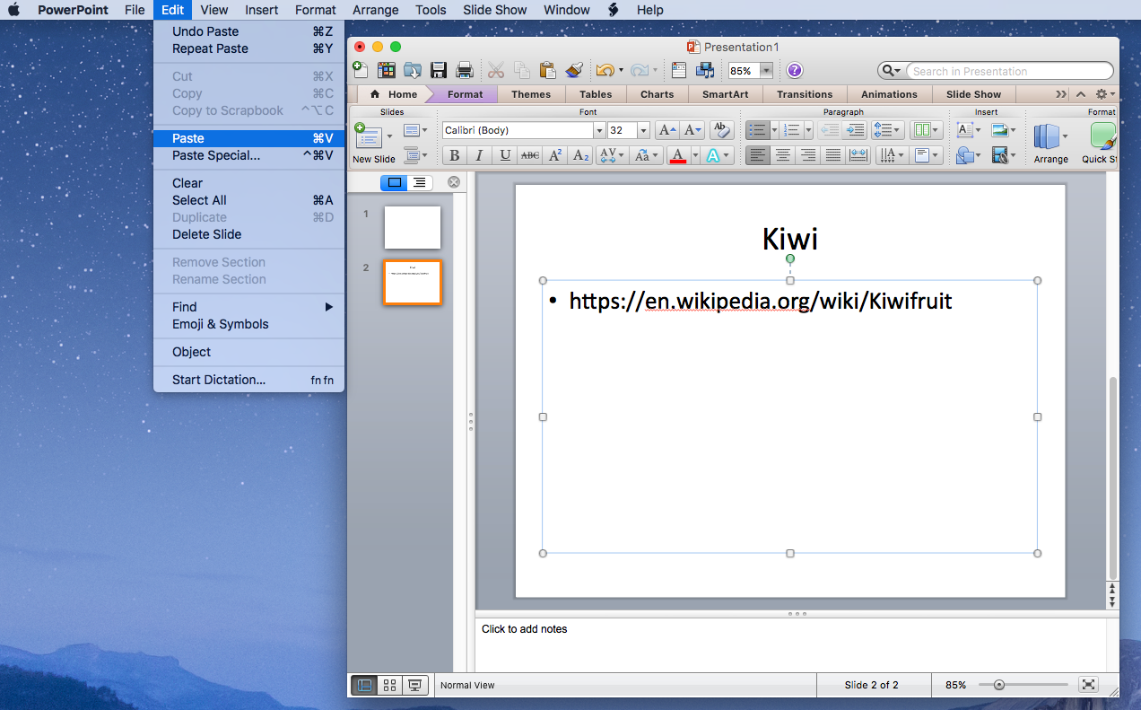
Paste URL into a PowerPoint Slide
PowerPointmenu
3.
Open PowerPoint
Double click on the text box.
Click Edit on the PowerPoint menu.
Move your cursor to highlight Paste.
Click Paste.
You can also click the Paste icon located on the toolbar.
2.
1.

Slide 15
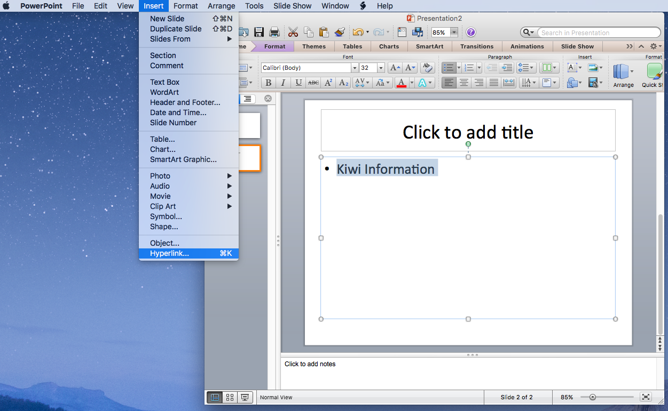
Embedding Link in Text
PowerPointmenu
Click on a textbox
Type your text
Highlight text by double click on text.
Click Insert on the PowerPoint menu.
Move your cursor to highlight Hyperlink…
Click on Hyperlink
1.
2.

Slide 16
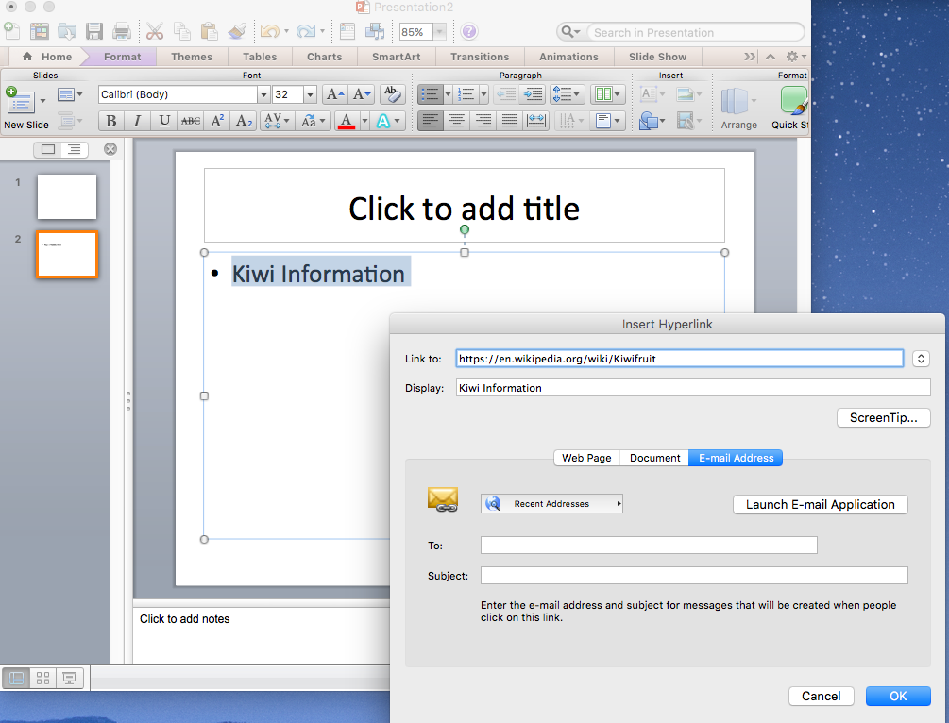
Embedding Link into Text
Click on the Link to: field.
On your keyboard push down command and V together.
Click OK to insert link.
1.
2.

Slide 17
Power Point Tutorial 4: Adding a Voiceover to PowerPoint Slides
Multilingual and Multicultural Education Department
Division of Instruction
LAUSD

Slide 18
Add voice to PowerPoint Slide
1.
Click Media drop down
2.
Click Record Audio

Slide 19
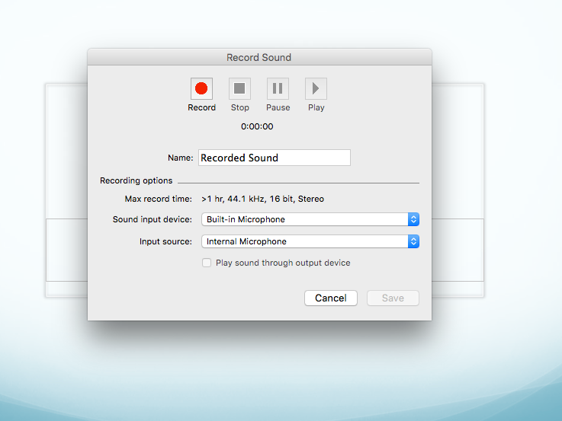
Start recording
Click Record Audio and Start Speaking
Click stop or pause recording

Slide 20
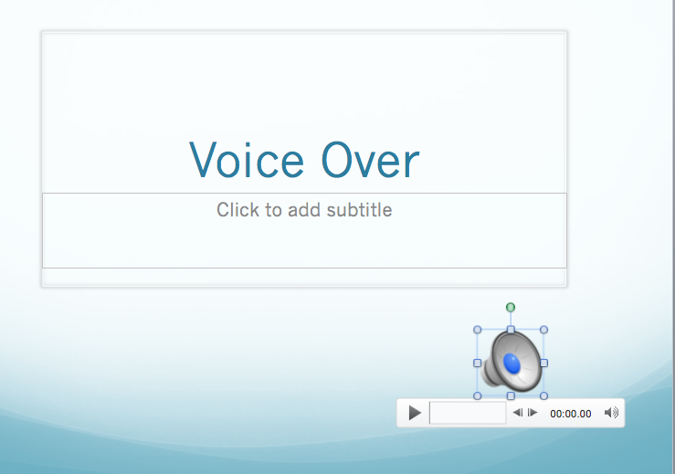
Replay recording
Click play to replay recording

