Slide 1
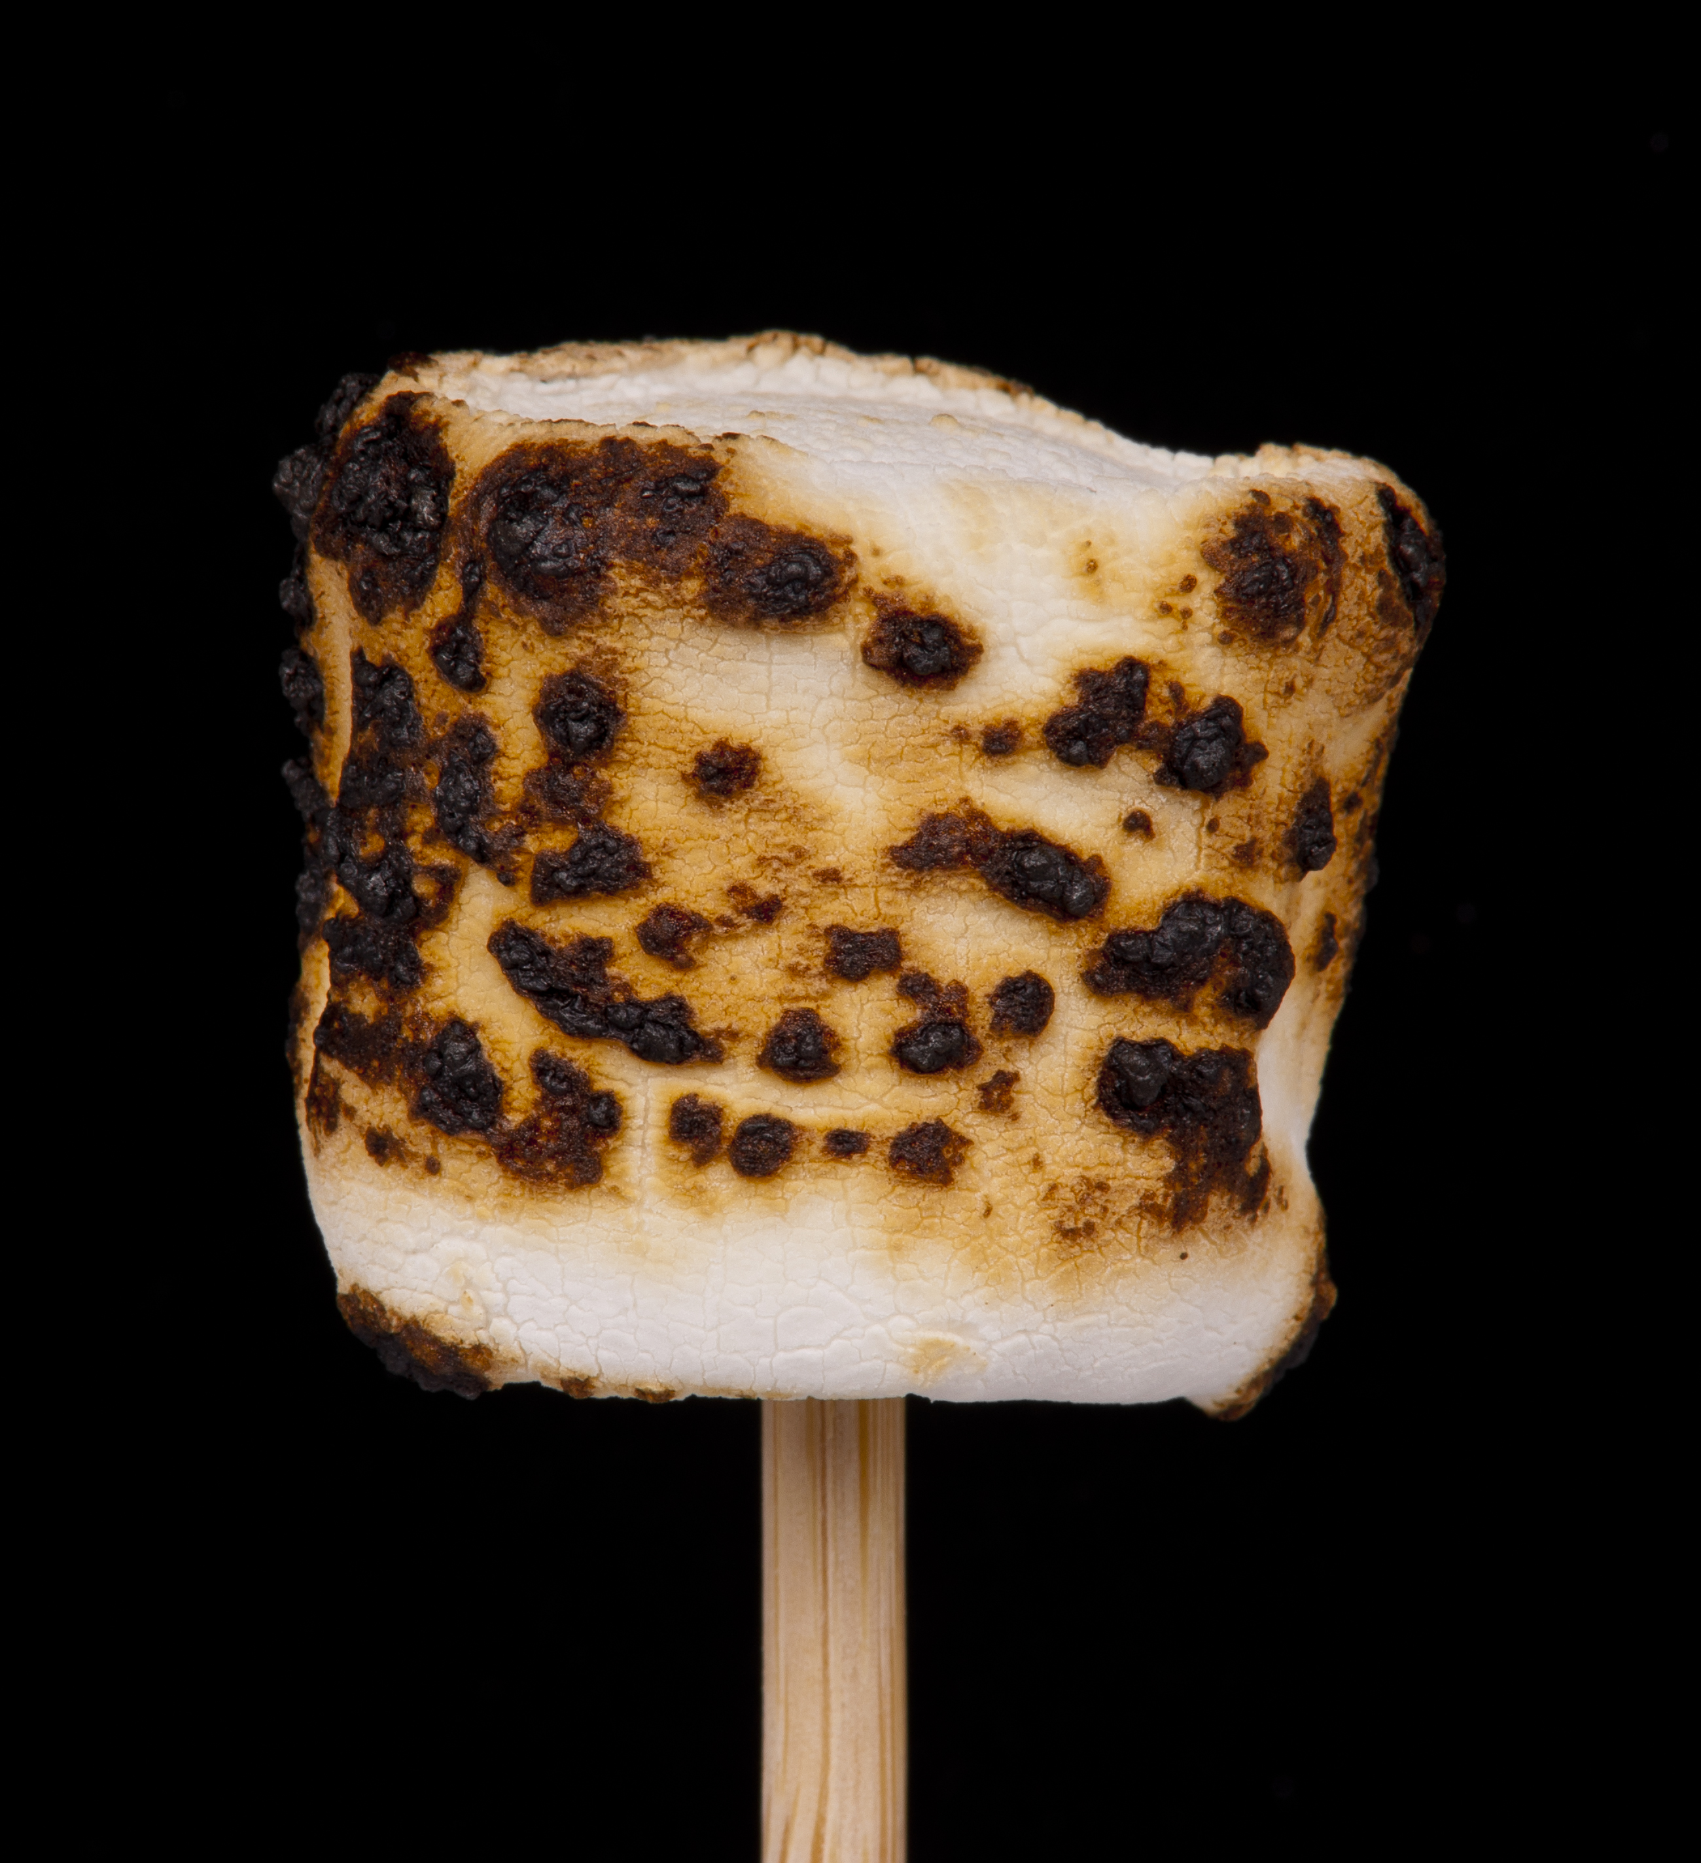
When your classmate is getting roasted…
A guide to being a better person
Health and Human Services
Human Relations Diversity Equity
July 2022
Notes:
Teacher, please feel free to encourage student participation whichever way you are most comfortable: in the Zoom chat, on a previously shared Jamboard, in break out groups, or all together in a grid view.
This lesson is about being thoughtful with our words. Youth will mess around .. but how will they know if they've gone too far? Avoid using the word "bully." People will admit to roasting, teasing, playing around.. But never to bullying. Besides, the "bully" is always the other person.

Slide 2
Learning Objectives:
Understanding the difference between bullying and teasing
How to tell if others like participating in roasting
What you could do if you witness bullying or unwanted roasting
Understanding and reflecting on empathy
Writing Reflection

Slide 3
What is Teasing?
Teasing- can be harmful but it's not on purpose. A teaser wants to friends with that person. Be careful with teasing, though. You never want to hurt someone's feelings or humiliate them.
Usually the person teasing will feel badly for hurting your feelings afterwards.
Notes:
Teasing is actually a sign of closeness. We teaser our close friends and family members in ways that would NEVER be ok with a stranger. Does your family have fun names for each other?

Slide 4


What is Bullying?
Bullying- is unwanted attention that is often non-stop. The people involved are not friends and the goal is to cause harm. Bullying can be verbal, emotional, and physical.
The person bullying usually does not feel badly afterwards.
Notes:
Bullying is actually trying to hurt someone. It's laughing AT someone instead of with them. We all know the difference. It's easier to explain it in terms of how it made us feel.

Slide 5
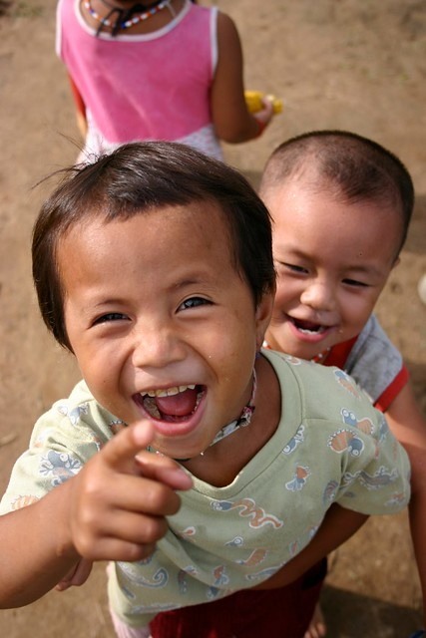
So what is Roasting?
Roasting is saying things to/about a person in a playful way . It may not be mean-spirited but it can still hurt their feelings. It is not always considered bullying.
When in doubt, say something else!
Notes:
Roasting is messing around with people with whom you're friends.

Slide 6
When is it ok to roast/tease?
Make sure you only roast friends and that your friend is ok with it.
Are you roasting each other or is it one way?
If you are roasting to be mean or do you want them to feel happy and cared about?

Slide 7
What to avoid when Joking around:
Avoid joking about someone's identity:
  Race or Nationality (skin color, country born in)
  Religion
  Sexual orientation (gay, lesbian)
  Gender identity (transgender, boyish, girly)
  Class (where they live, how much money they have, clothes, shoes)
  Body (skinny, fat, short, tall, hair/hairline)
  Age (too old, too young)
  Disabilities including mental illnesses (in a wheelchair has learning disabilities is depressed)
  These are things you cannot change, and that make us unique individuals!
Be sure your friend is OK with the way you're joking with them. If you are not sure, you can just ask first!
This way, you also avoid getting into any type of trouble either by your friend or the staff!

Slide 8
Roasting isn’t the only type of bullying!
Common forms of Bullying:
  Leaving others out on purpose.
  Not listening to others because you want to do it your way.
  Not including a peer in a text message group and trying to hide it.
What you could do instead:
  Check in with those that might be left out to see if they want to join you
  Listen to their concerns to avoid hurting their feelings
  Be honest. Instead of hiding text messages, talk about why you left them out and how you can include next time

Slide 9
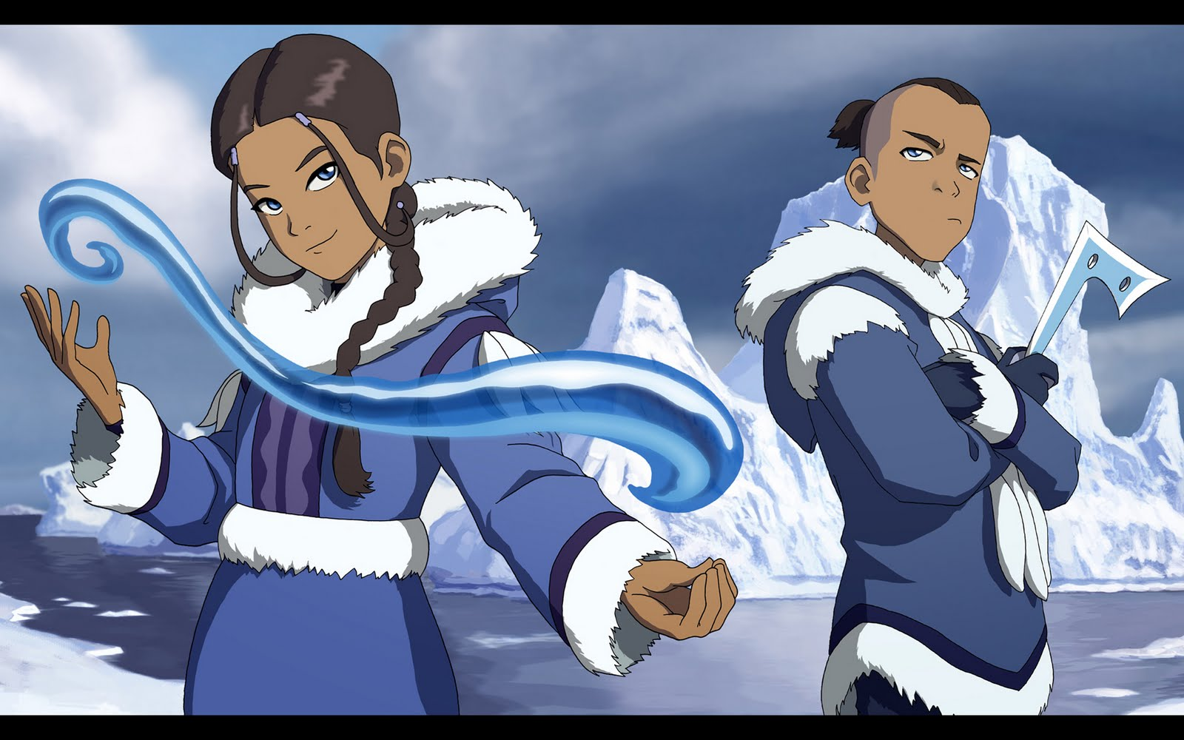
All this talk and focus on bullying, what about me?
If you witness bullying, but are not directly involved, you still have a very important role!
This means you have an opportunity to interfere and stand up for your classmate!
If others stand up to bullies and say something when they are hurting others, it shows the bully that their behavior will not be tolerated!
Katara and Sokka from the Water Nation stood up to injustice on Avatar by being peace-keepers between the nations!

Slide 10
What if I see and hear someone get roasted?
Make sure you check in with the student first, maybe they are playing around too and are not upset by the other person roasting them.
If this is making your classmate upset, then speak up for them by asking the other person to stop. If this doesn’t work you can ask again and let them know you will need to get back up, or some help. If they continue, get help from an adult or staff member.
When we stick up for one another, we set the standards for how we expect others to be treated.

Slide 11

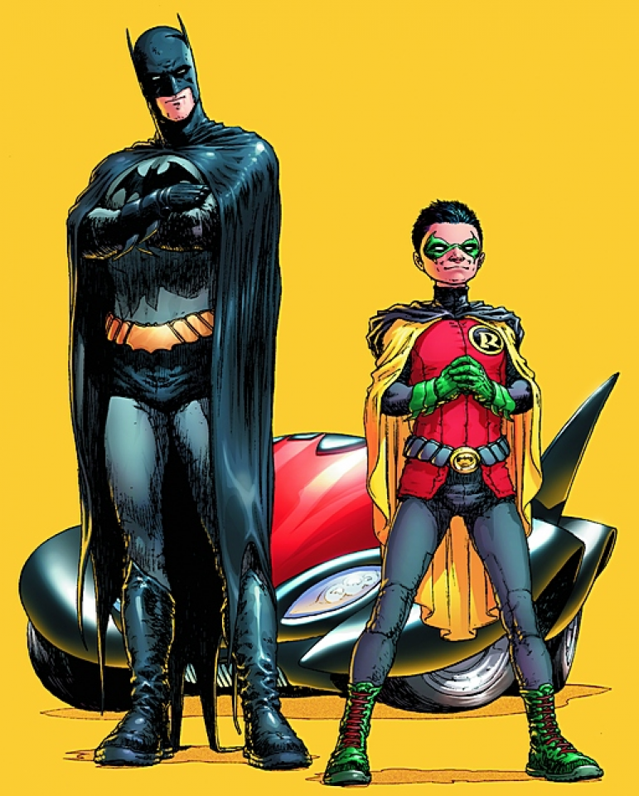

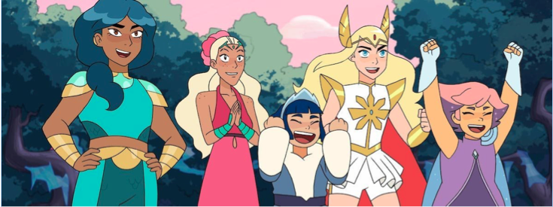
What characters are peace makers and stand up for each other?
All these characters have Empathy!
Notes:
This could be a good time to get the students thinking about recent book characters or classroom examples of empathy too!

Slide 12

Emphasize the EMPATHY
Empathy is when you put yourself in someone else’s shoes and listen to how they feel without any judgement.
This can be difficult at first, but with practice, you can be an empathic super star!
Notes:
There is an embedded video here called All about Empathy for Kids, approx. 5 mins
https://youtu.be/Itp21tly8nM

Slide 13
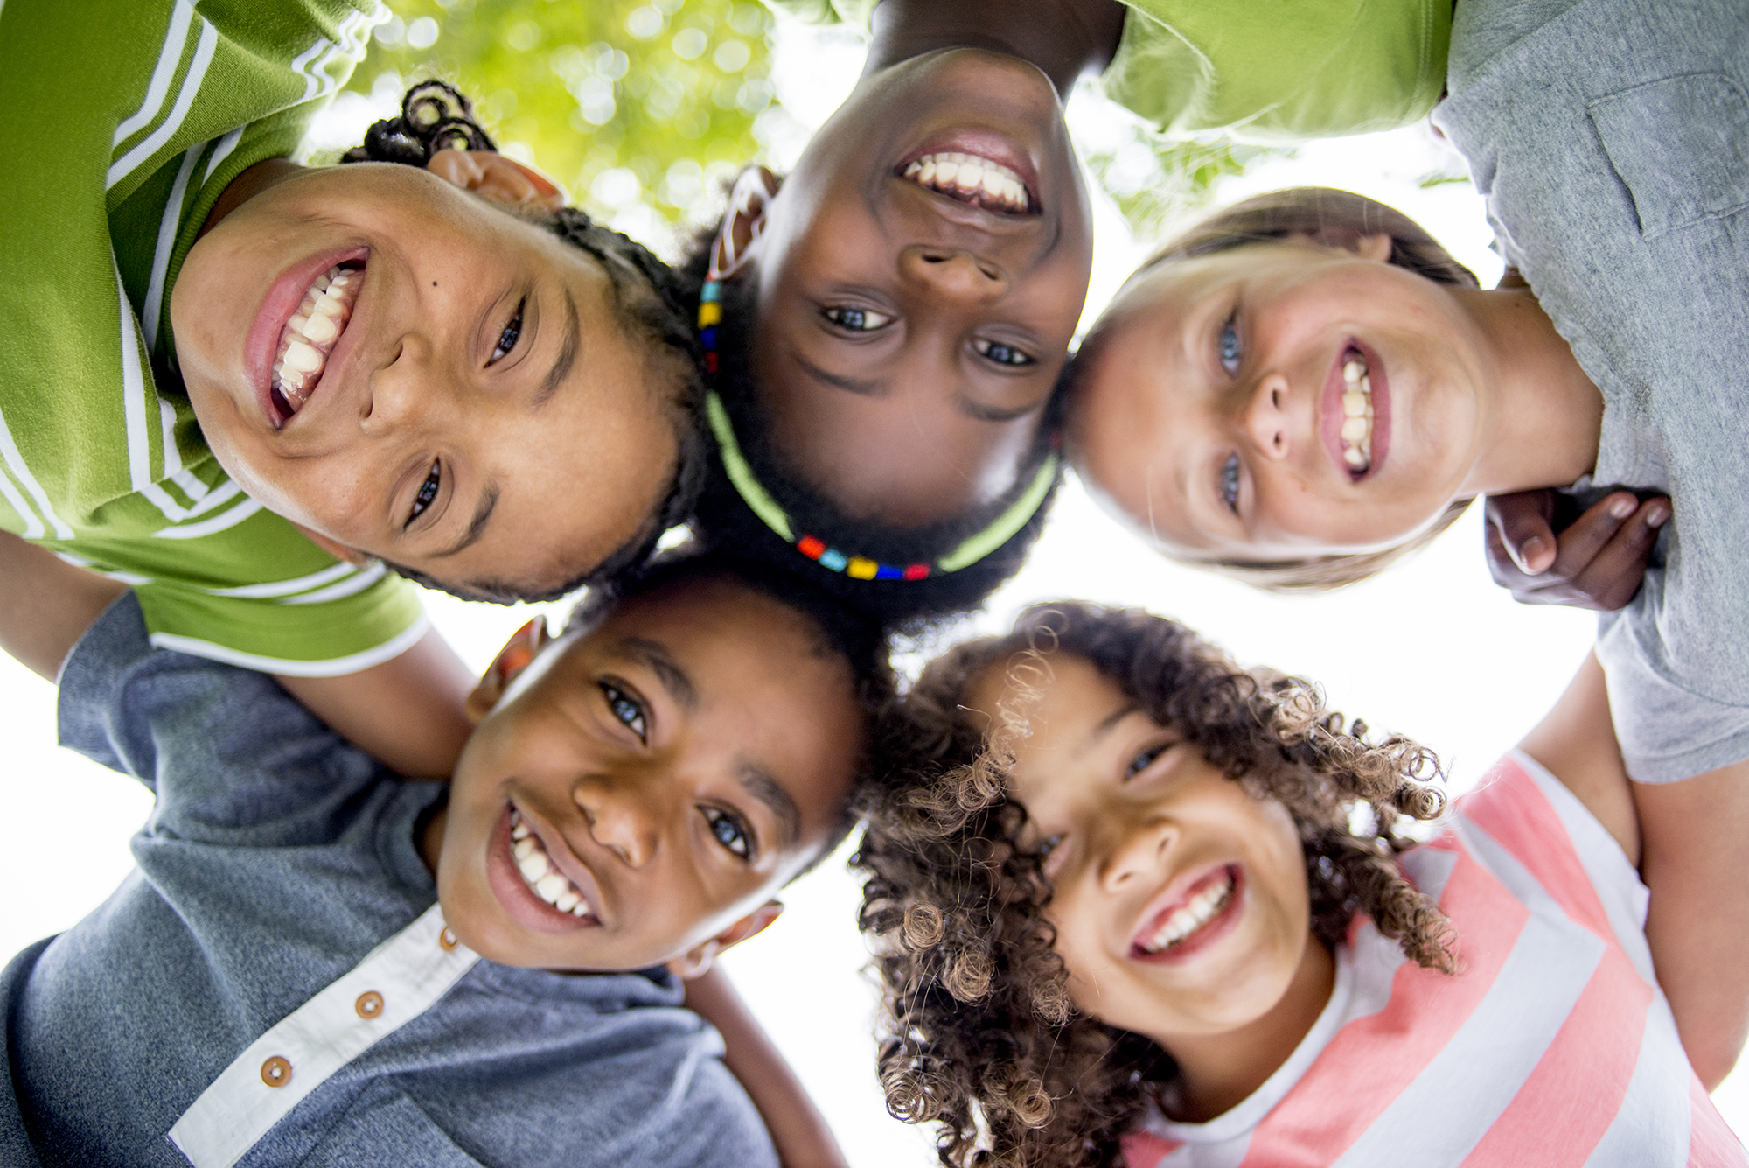
Writing Reflection:
Write about a time when you felt left out, talked about, or pushed aside.
What made you feel better?
How did others to support you?
What did you want others to say to you?
What can you do the next time you see someone messing with someone else?
Notes:
The class could work on common guidelines and help hold each other accountable for stepping in and being an active by stander when something goes too far.
Practice what we can say, e.g., "dude.. C'mon.. That's not cool.." Try diversion strategies – "let's go shoot some hoops."

Slide 14
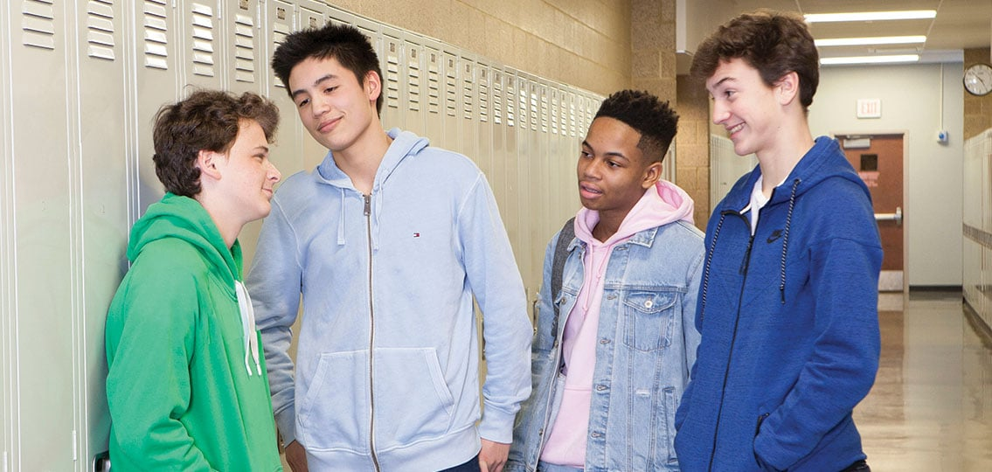
Strategies to interrupt bullying
Distract - "Let's go shoot some hoops"
Interrupt- "C'mon, that's not cool"
Defuse – Talk to the target. Invite them to walk away with you. "Hey.. Want to get some hot cheetos?"
Notes:
What works best for you?

Slide 15

More Strategies
T- Tolerance
R – Respect
U – Understanding
C – Compassion
E – Empathy
Write an example of how you demonstrate each of these terms.
Notes:
Homework –
Homework expanded – watch TV. Cite an example of each of these characteristics.

Slide 16
For More Info and Resources
Students
Educators
Please ask your school based PSW or counselor!
Have conversations with teachers
Ask a parent or teacher to help you find some online resources or search it up yourself!
Please visit our Human Relations Diversity and Equity webpage
Please see 5212.2 Bullying and Hazing for a complete guide to what you can do about bullying at school

Slide 17


Human Relations, Diversity, and Equity

Slide 18
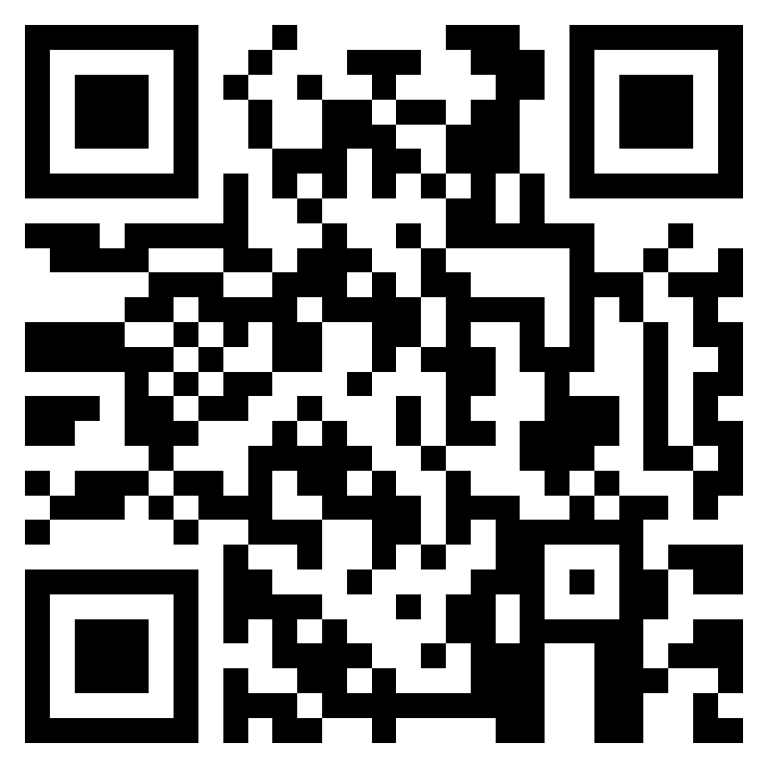
Teacher Feedback
Notes:
Teacher, please complete a brief survey by scanning the QR code or using the link below
https://forms.office.com/r/i9UqyyxzTT

