Slide 1
Janet Yellen - Stories of Excellence
Student Health & Human Services
Office of Human Relations, Diversity & Diversity
July 2022

Slide 2
Would you rather...
Be stuck on an island with someone who doesn't stop talking
Be stuck on an island alone

Slide 3
Objectives
Learn about Janet Yellen
01
Discuss Yellen’s academic achievements
02
Identify how Yellen's work as a woman impacts young girls and women today
03

Slide 4
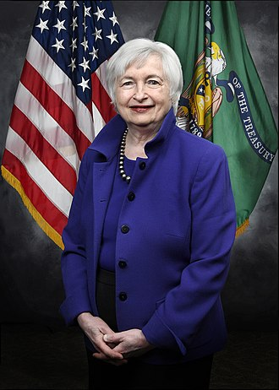
Who is Janet Yellen?
An American economist, civil servant, policy maker
In January 2021, Yellen became the first woman to hold the position of United States Secretary of the Treasury

Slide 5
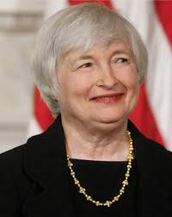
Education
Yellen grew up in Brooklyn to a family of Jewish ancestry. Her mother taught elementary school and her father was a physician.
Yellen graduated from Pembroke College in Brown University in 1967 with a B.A. in economics
She received her M.A. and Ph.D. in economics from Yale in 1971
Yellen was the only woman to earn her Ph.D. from Yale that year.

Slide 6
Let's Chat
Today, about 13.1% of Americans earn their Master's, Professional Degree, or Doctorate and about 2% of the world's population has a doctorate.
In 1971, Yellen earned both her MA & PhD, paving the way for her future career.
How and why do you think she was able to achieve this?

Slide 7
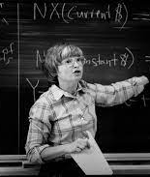
Early Career
Yellen became an Assistant Professor at Harvard and a Professor at UC Berkeley, teaching and researching economics.
In 1982, Yellen was only the second woman to earn tenure.
Yellen has been awarded the Haas School's outstanding teaching award twice.

Slide 8
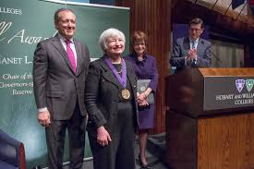
Making History
Secretary Yellen became the first woman to serve as U.S. secretary of the treasury, and the first person in American history to lead the three most powerful economic bodies in the Federal government of the United States: the Treasury Department, the Federal Reserve, and the White House Council of Economic Advisers.

Slide 9
Let's Chat – Check out
Janet Yellen has made history in her education and career as a woman.
What do you think this does for young women working on their educations and starting their careers?

Slide 10
Office of Human Relations, Diversity & Equity

Slide 11
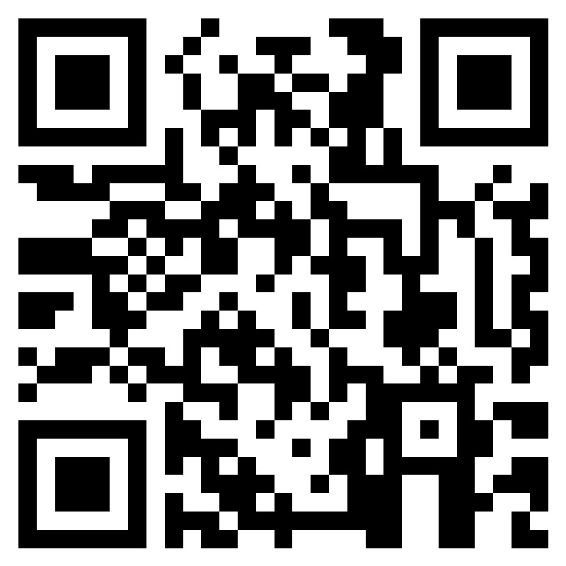
Teacher Feedback
Notes:
Teacher, please complete a brief feedback form using the QR code or the link below
https://forms.office.com/r/i9UqyyxzTT

