Slide 1
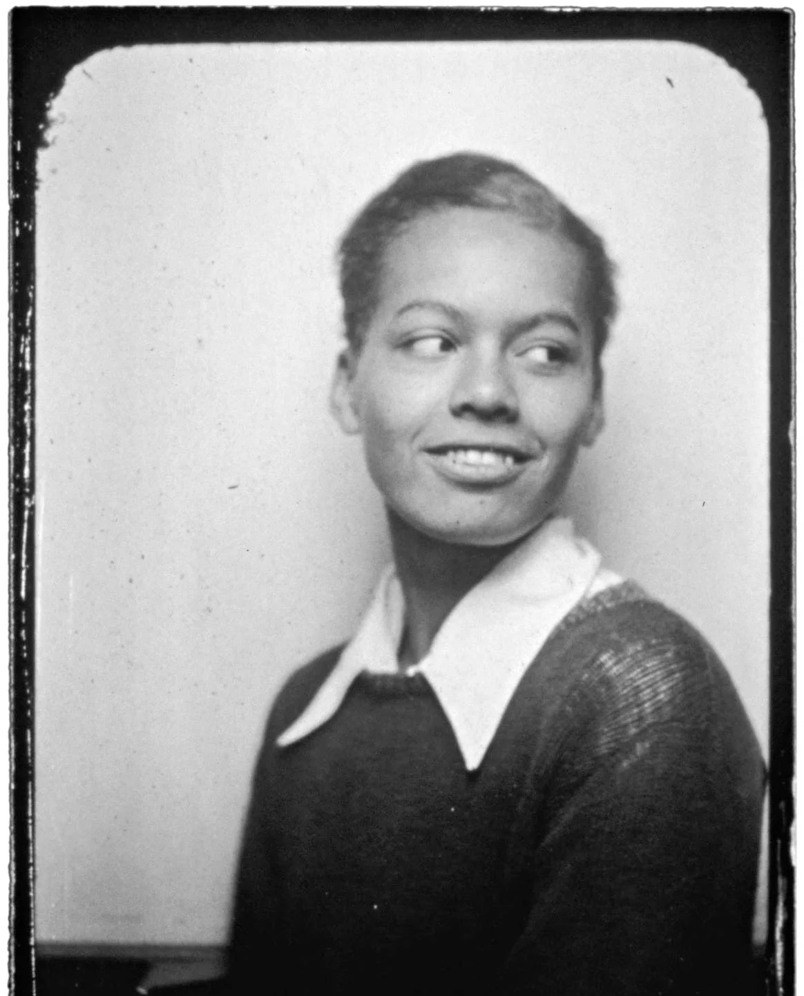
Pauli Murray
Stories of Excellence
Student Health & Human Services
Office of Human Relations, Diversity & Equity
July 2022

Slide 2
Welcome
Would you rather ride in a spaceship, or a submarine?
Spaceship
Submarine

Slide 3
Objectives
Learn about Pauli Murray
Review the intersectionality of Pauli Murray's Civil Rights Activism
Reflect on the impact of the era in which Pauli lived on her life.

Slide 4
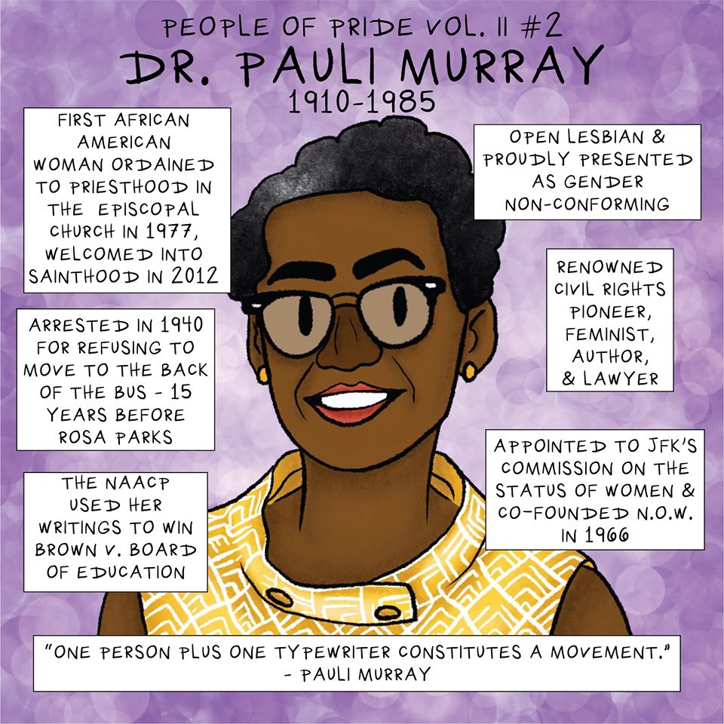
Dr. Pauli Murray

Slide 5
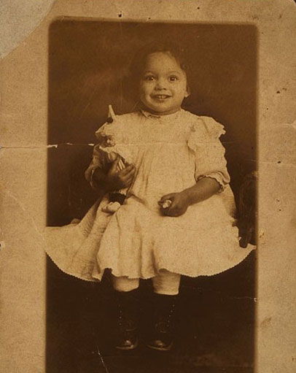
Who Is Pauli Murray?
Pauli was born in Maryland in 1910.
Pauli was the fourth of six siblings.
Pauli's mother died when Pauli was 3 years old, and her father experienced devastating symptoms of typhoid fever and was committed to a hospital long term.
Shortly after her mom died, Pauli was sent to live with her aunts in North Carolina.

Slide 6
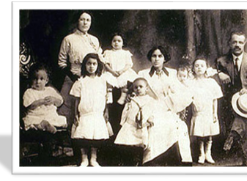
United Nations in Miniature
Pauli was known to refer to her family as the "United Nations in Miniature" due to the mixed racial origins.
Pauli's ancestors included enslaved Black people, white enslavers, Native peoples, Irish and free Black people.
At 16 years old, Pauli moved to New York to finish high school and lived with her cousin Maude.
Maude and her family were "white passing", and their neighbors were not pleased to have Pauli living in their neighborhood.

Slide 7
Reflection
Pauli moved to live with cousin Maude in 1926. Maude and her family were "white passing", and their neighbors were not pleased to have Pauli living in their neighborhood.
That was almost 100 years ago.
Do you think much has changed?

Slide 8
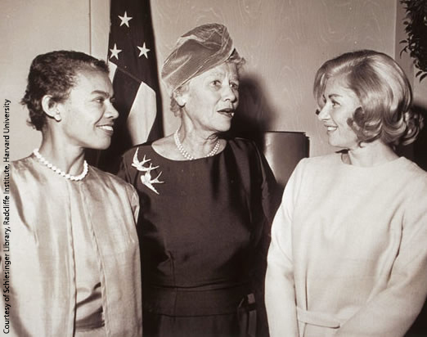
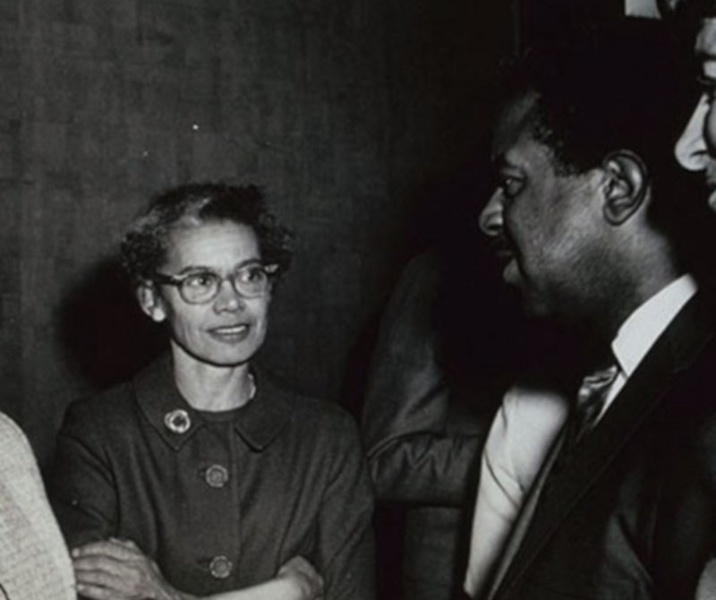
Civil Rights Activist
Pauli became active in the Civil Rights Movement in 1938.
Pauli took on the all-white University of North Carolina, participated in the work to end segregation on public transport, as well as issues of equal opportunity employment.
Through her activism, Pauli gained the trust and friendship of Eleanor Roosevelt, Thurgood Marshall, Martin Luther King Jr., and worked with organizations such as the NAACP, the National Organization for Women, the Fellowship of Reconciliation and the Congress of Racial Equality.

Slide 9
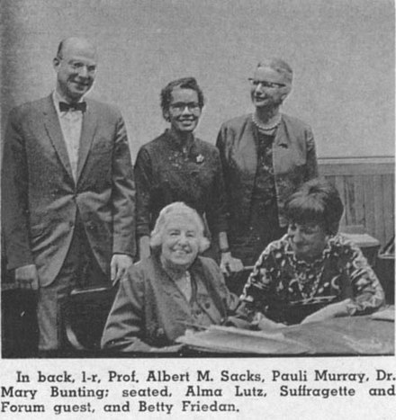
Intersectionality
Pauli worked closely with civil rights leaders such as Bayard Rustin and Martin Luther King Jr., but took issue with the way these men dominated leadership of the movements.
Pauli was dissatisfied with the amount of work women were doing in the movement, and the lack of decision-making they were granted.
Pauli also worked closely with Betty Friedan and the National Organization for Women.
However, ultimately Pauli left the organization because it became clear to her that NOW was not appropriately addressing the issues of Black women.

Slide 10
Reflection
Pauli was discouraged by the Civil Rights Movement of the 1960's because she didn't think it amplified Black Women.
Pauli was discouraged by the Women's Movement of the 1960's because she didn't think it amplified Black Women.
60 years later, do you think we are doing enough to amplify Black Women?

Slide 11
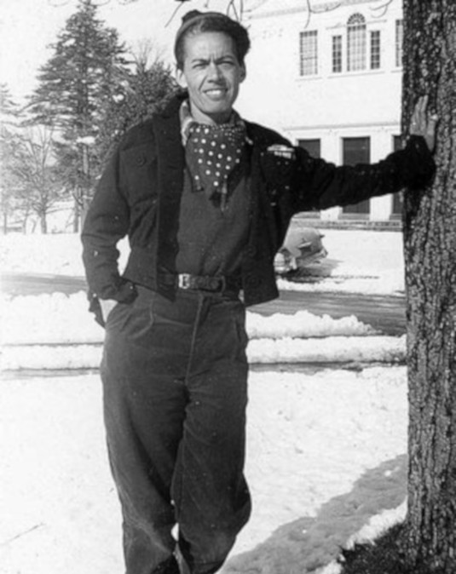
Gender Identity
While in college, Pauli wrestled with gender identity.
Pauli officially changed her birth name from Anna Pauline to Pauli.
In fact, during this time, Pauli attempted to access gender-affirming treatments including hormone therapies but was denied.
Pauli became acutely aware of the oppression she faced as a woman while in law school at Howard University.

Slide 12
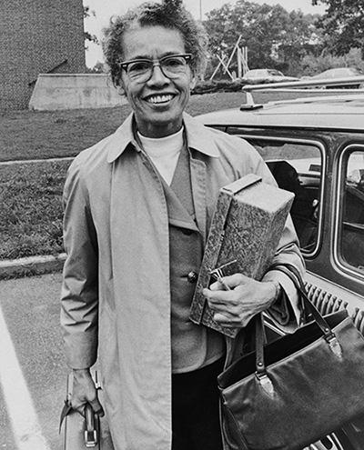
Gender Identity
Pauli coined the term "Jane Crow" to describe her experience of intersectional oppression as a Black woman.
Though socially perceived as a woman, Pauli actively used the phrase "he/she personality" in correspondence with family members.
In her later writings, Pauli utilized "she/her/hers" pronouns.
Historians do not know how Pauli would choose to identify if she were living today.
But it is clear that Pauli's gender identity was fluid over her lifetime.

Slide 13
Pauli and Pronouns
Notes:
3minutes
https://www.youtube.com/watch?v=pJ-Ms0e_aAw

Slide 14
Reflection
Pauli was born in 1910. Historians believe Pauli may have identified as either transgender or gender non-conforming.
Do you think Pauli's experience living as her authentic self would have been different had she been born a hundred years later?

Slide 15
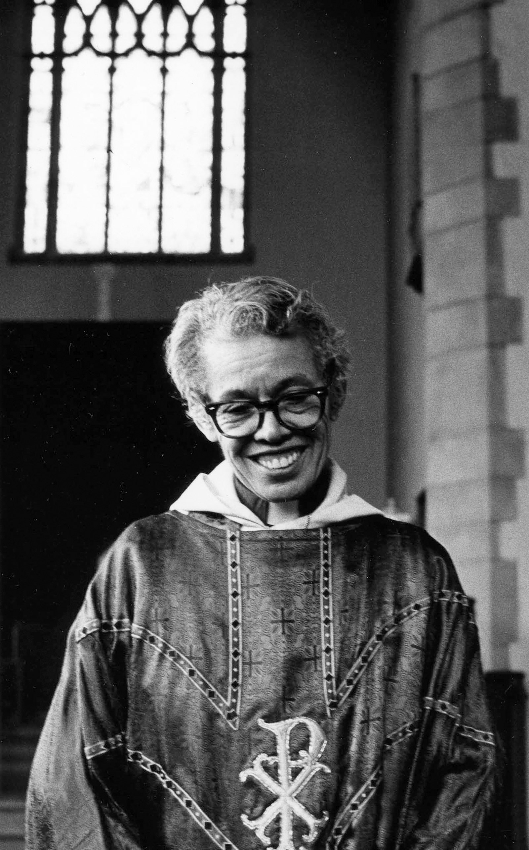
Religion and End of Life
When she was 67 years old, Pauli became the first Black Woman in the United States to become an Episcopal priest.
Pauli found inspiration through the church and spent much of her later life engaging in ministry with sick parishioners.
Pauli died when she was 75 years old of cancer.
Later that year, the Episcopal Church honored Pauli as one of it's Holy Women, Holy Men. This honor is reserved for "people whose lives have exemplified what it means to follow in the footsteps of Jesus and make a difference in the world".

Slide 16
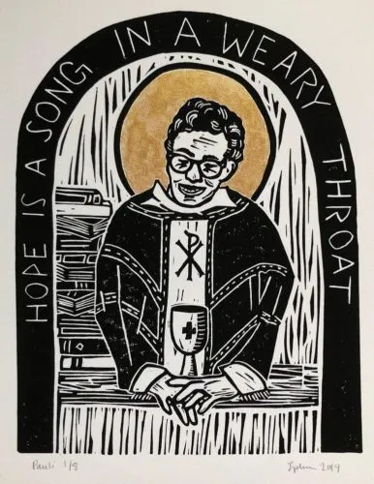
Her Legacy Lives On
In 2015, the National Trust for Historic Preservation designated Pauli's childhood home as a National Treasure.
In 2016 Yale University named a new residential college after Pauli, Pauli Murray College.
In 2018 Pauli was made a permanent part of the Episcopal Church's calendar of saints.

Slide 17
Check Out
Prehistoric Times
Civil Rights Era
Today
Roaring 20's
If you could live during any era, which would you choose?

Slide 18
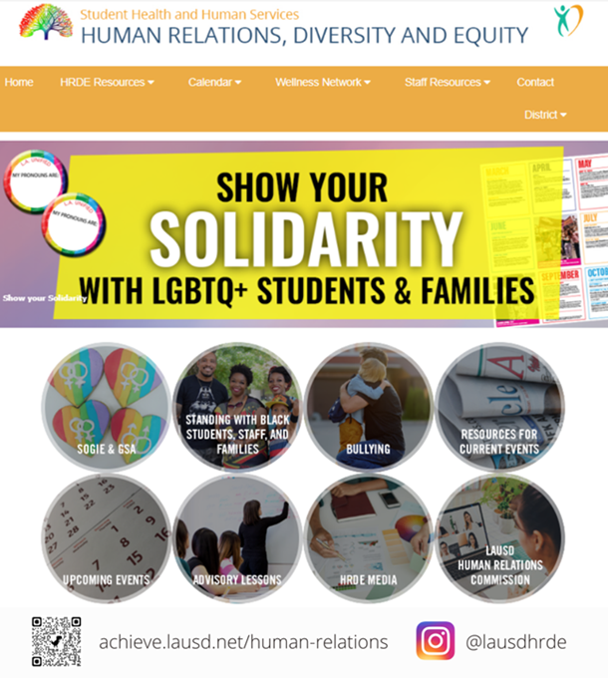
Human Relations, Diversity & Equity

Slide 19
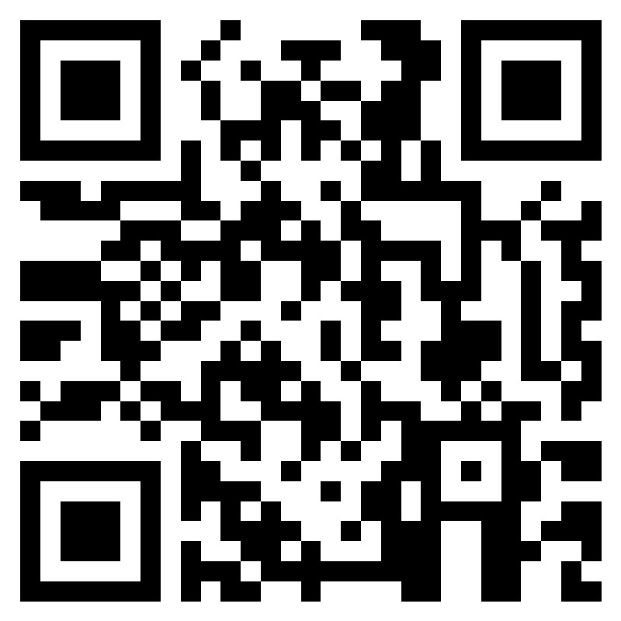
Teacher Feedback
Notes:
Teacher please complete a brief feedback survey by scanning the QR code or using the link below.
https://forms.office.com/r/i9UqyyxzTT

