Slide 1
Harvey Milk
Student Health & Human Services
Office of Human Relations, Diversity & Equity
June 2022

Slide 2
Welcome: Would you rather....
Have supersensitive taste
Have supersensitive hearing

Slide 3
Objectives
Identify his importance in American LGBTQ+ history
Learn who Harvey Milk was

Slide 4
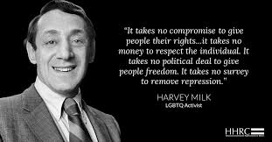

Slide 5
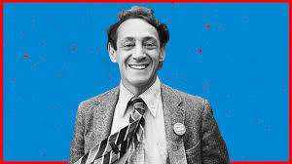
Who was Harvey Milk?
Harvey Bernard Milk (May 22, 1930 – November 27, 1978) was a middle-class Jewish kid from New York whose grandfather founded a synagogue.
Milk was the first openly gay elected official in California. He was elected to the San Francisco Board of Supervisors.
Although he was the most pro-LGBT politician in the United States at the time, politics and activism were not his early interests.
He was neither open about his sexuality nor civically active until he was 40, after his experiences in the counteractive movement of the 1960's

Slide 6
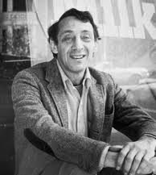
Who was Harvey Milk?
Milk served almost eleven months in office, during which he sponsored a bill banning discrimination in public accommodations, housing, and employment on the basis of sexual orientation.
The Supervisors passed the bill by a vote of 11–1, and it was signed into law by Mayor George Moscone.

Slide 7
November 27, 1978
Dan White was a disgruntled employee who had quit his job in a fit of anger.
On November 27, 1978, he snuck into city hall and shot and killed Mayor George Moscone then Harvey Milk.

Slide 8
The Twinkie defense
White's defense was that he suffered diminished capacity from eating Twinkies and other sugary foods.
Dan White was convicted of voluntary manslaughter

Slide 9
How Harvey Milk Changed the Gay Rights Movement
Notes:
13:42 minutes
https://youtu.be/69xLk1nn5z4

Slide 10
May 22 is Harvey Milk Day in LAUSD. What do you think is the most important thing Harvey Milk did for LGBTQ+ people?

Slide 11
Flashback: Meet San Francisco Supervisor Harvey Milk
Notes:
https://youtu.be/O9iYasWREzE
5:07

Slide 12
Did you know who Harvey Milk was before this presentation?
What are 2 things you learned about Harvey Milk?
Do you think this history is important for students to learn?

Slide 13
Check out
Lord of the Rings
Star Wars
Which is better?

Slide 14
Office of Human Relations, Diversity & Equity

Slide 15
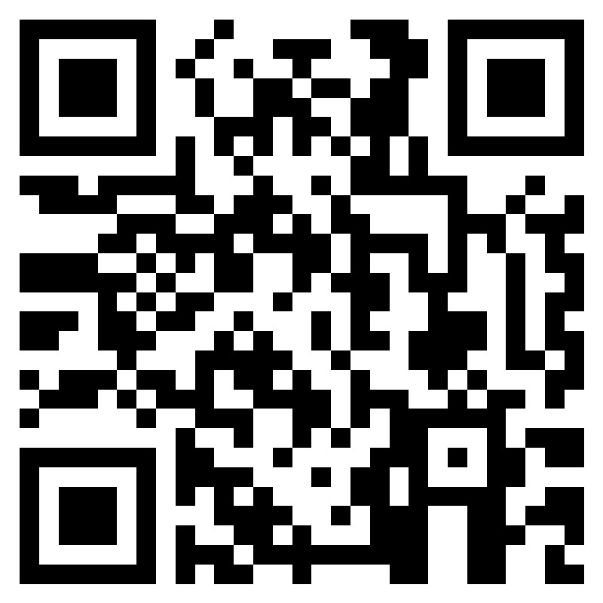
Teacher Feedback Survey
Notes:
Teacher, please scan the QR code or click the link to complete a brief survey:
https://forms.office.com/r/i9UqyyxzTT

