Slide 1
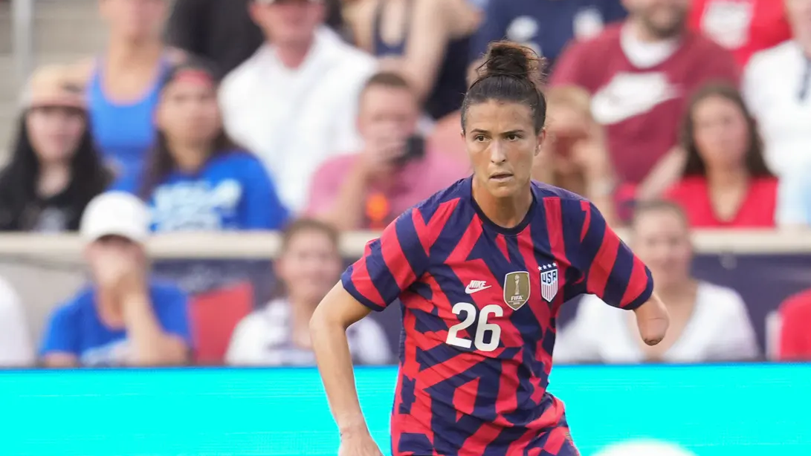
Stories:
Carson Pickett
Student Health and Human Services
Office of Human Relations, Diversity & Equity
August 2022

Slide 2
Welcome
Where would you rather live?
On a farm
On another planet
Underwater

Slide 3
Objectives
Learn about Carson Pickett
Discuss ableism in sports
Reflect on how to make sports more inclusive for all

Slide 4
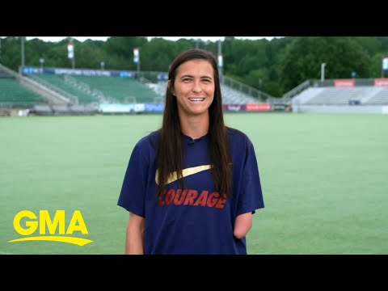
Who is Carson Pickett?
Notes:
https://www.youtube.com/watch?v=NbQ32P3T0yw
5:18
Never let anyone turn your sky into a ceiling.

Slide 5

Reflection
In the video, Carson says that her dad told her “Never let anyone turn your sky into a ceiling".
What do you think he meant by that?

Slide 6
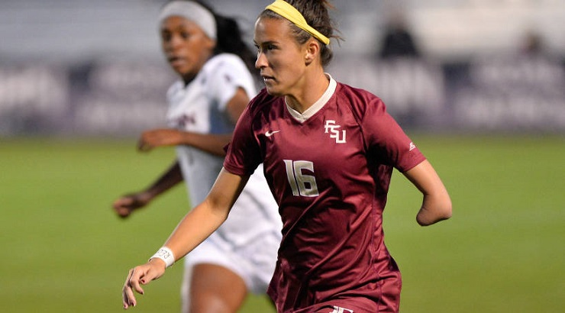
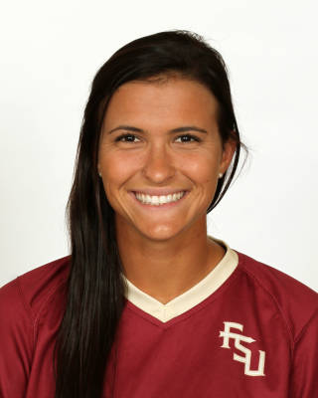
Early Life
Carson Pickett was born on September 15, 1993 in South Carolina and raised in Florida.
Carson was born with a congenital limb difference. Specifically, she was born without a left forearm and hand.
In college, Carson played soccer for the Florida State Seminoles, leading the team to their first NCAA Division 1 Women's Soccer Championship!

Slide 7
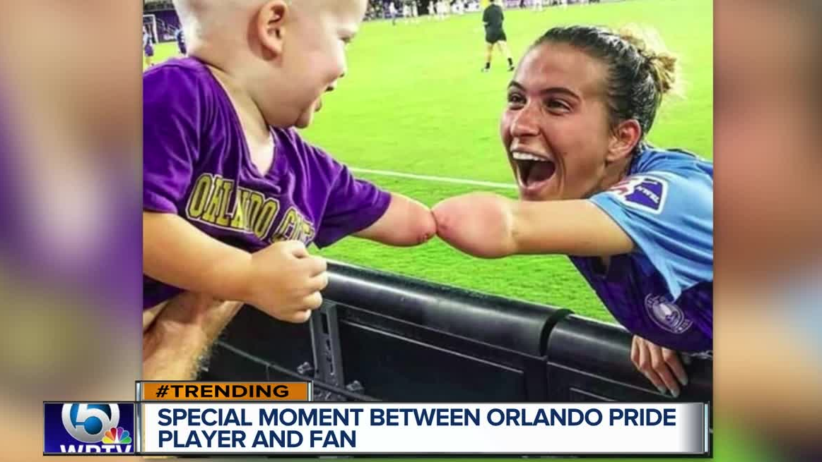
Gone Viral
In 2019 a photo of Carson greeting a fan who also has a limb difference went viral!

Slide 8
Reflection
The picture of Carson and the toddler went viral in 2019.
Why do you think people loved the photo?

Slide 9

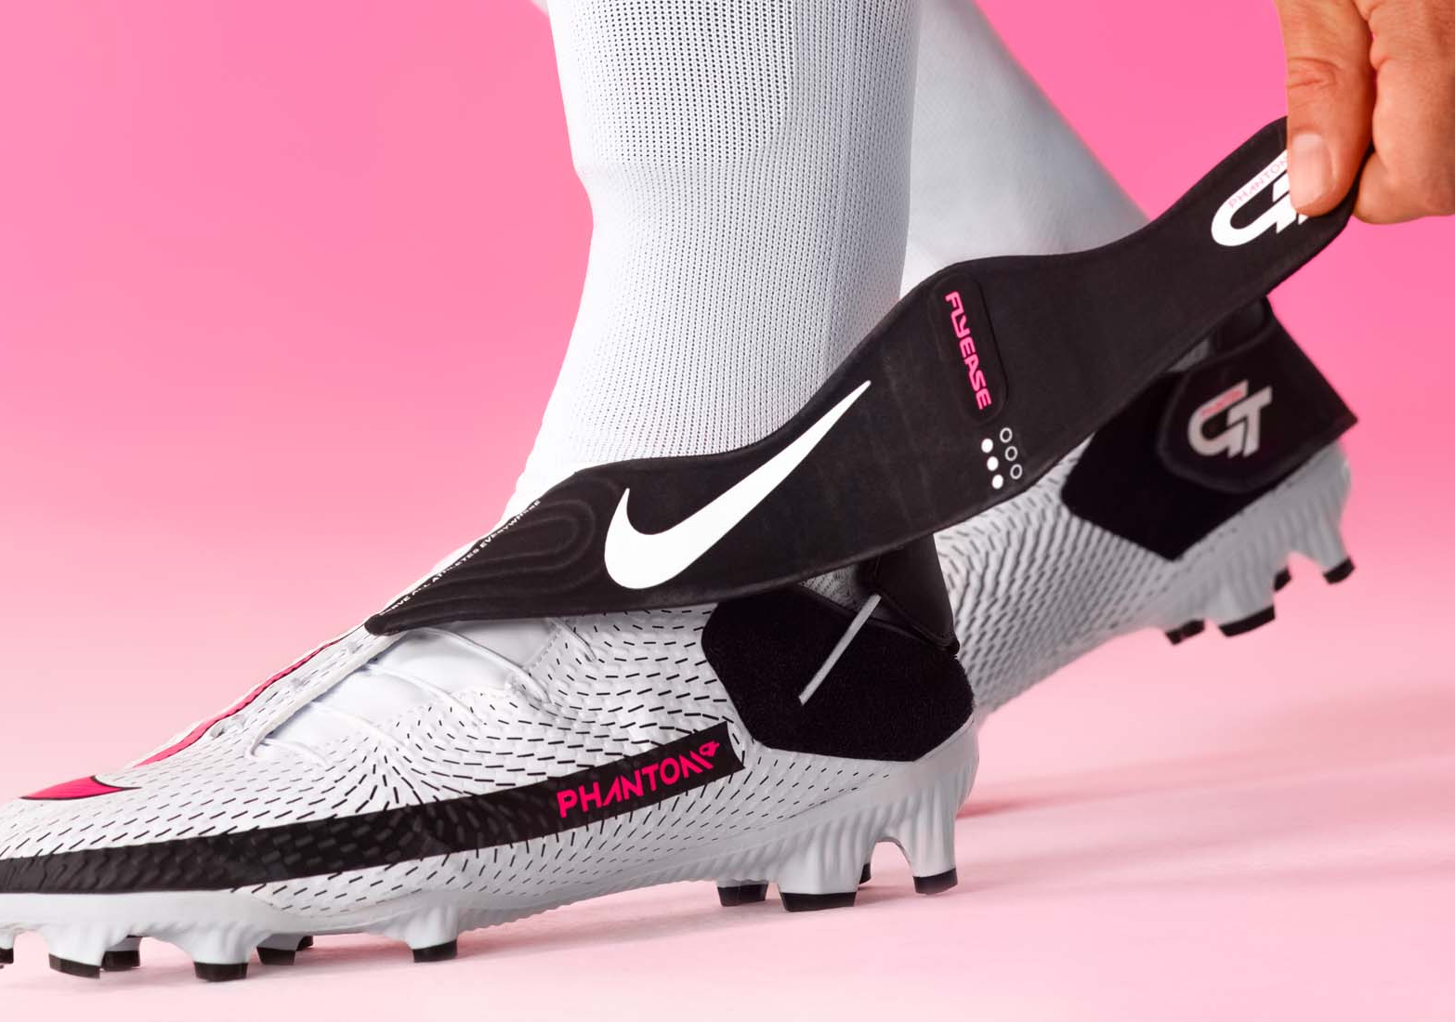
Making a Difference
Carson worked closely with Nike to develop adaptive soccer shoes so differently-abled folks could get their shoes on.
Saying of the collaboration, "Honestly, my first reaction when I saw the Phantom GT Academy FlyEase was relief. I thought about my younger self and what it would have meant for me if something like this existed when I was growing up. I feel like this boot represents me and anybody else who is unique. FlyEase is very easy for anybody to put on quickly, which I love."

Slide 10
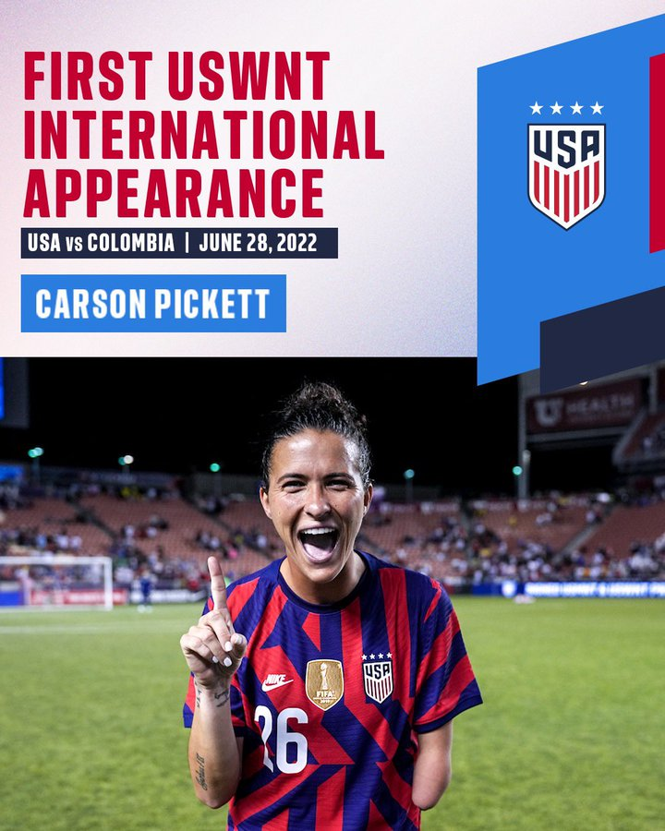
Making History
On June 28, 2022, Carson made her debut for the United States Women's National Team (USNWT) against Columbia, becoming the first player with a limb difference to play for the USNWT.

Slide 11
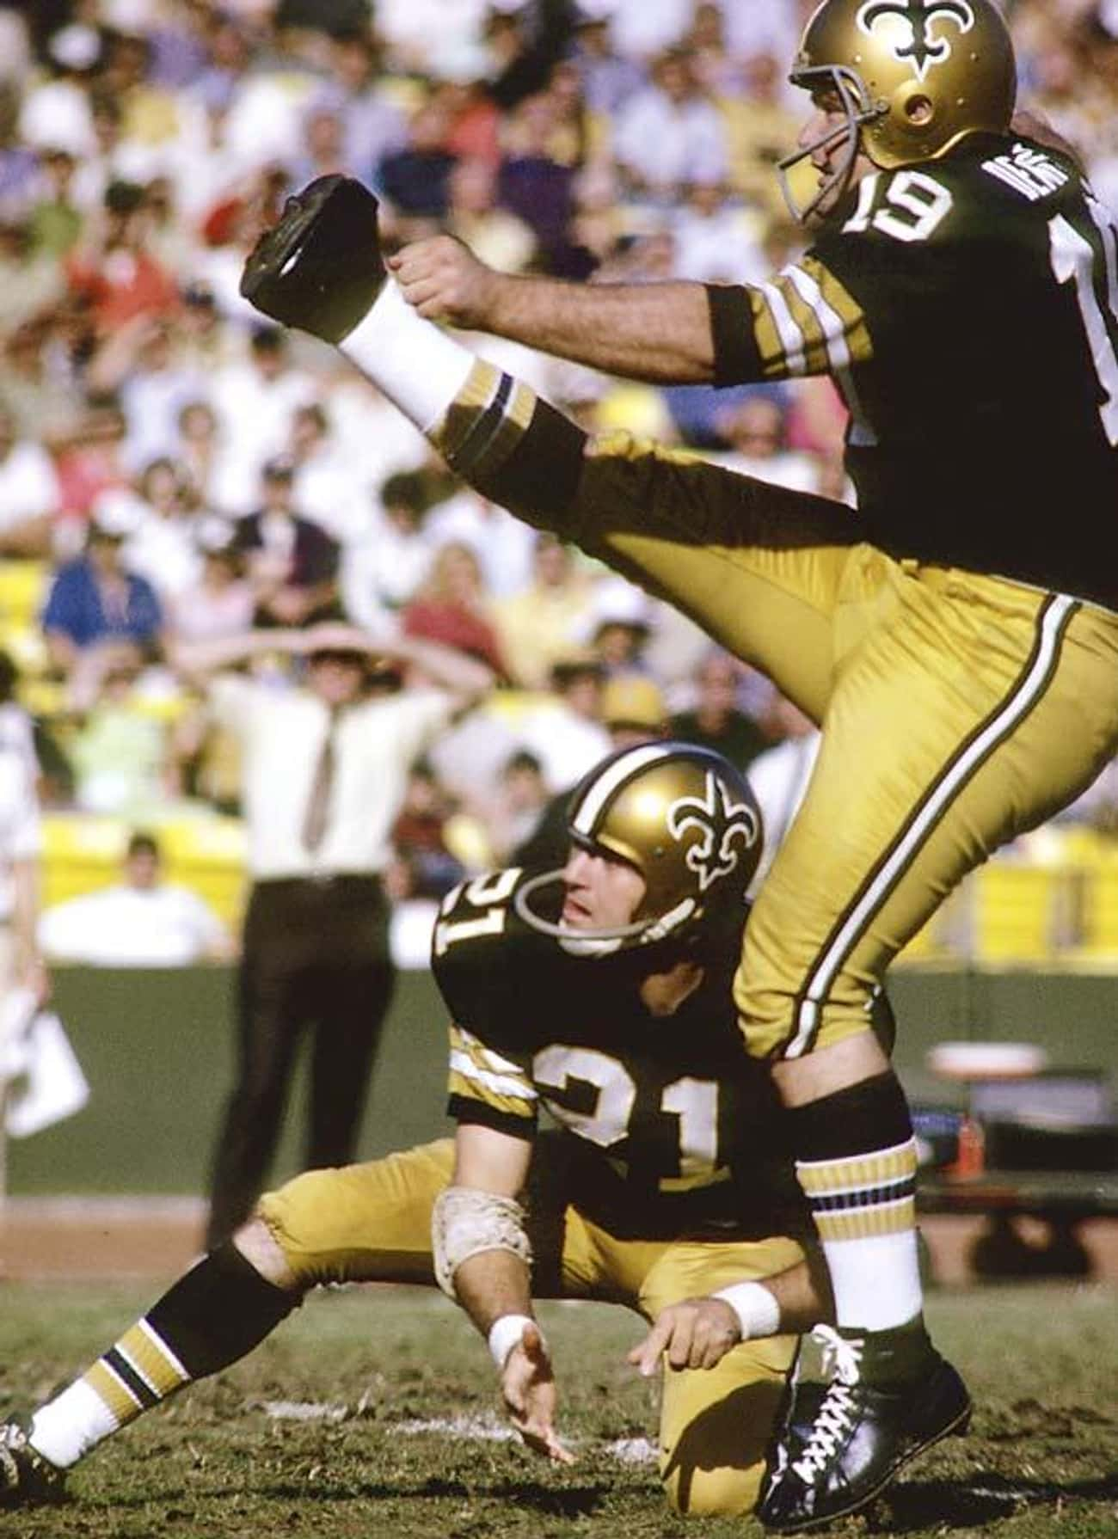
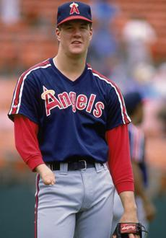
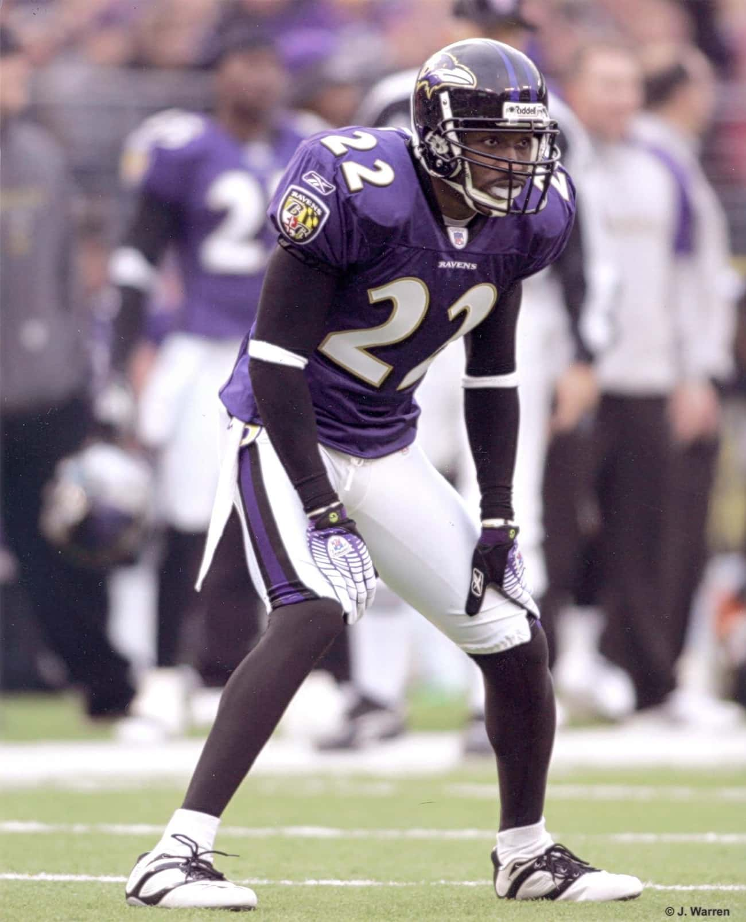
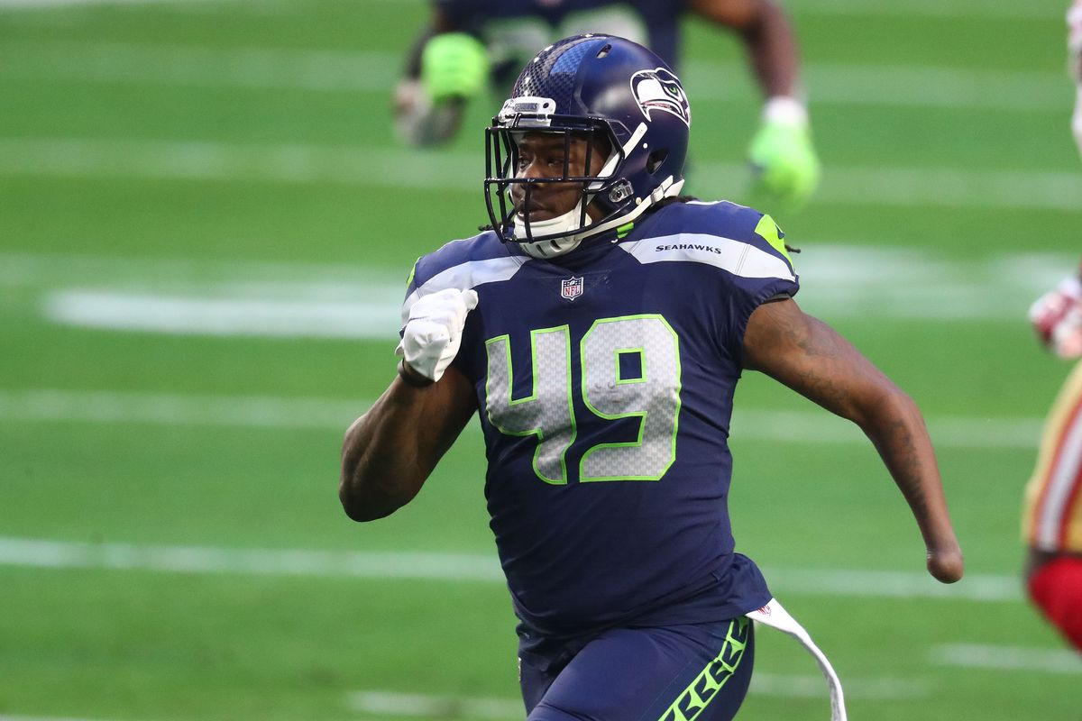
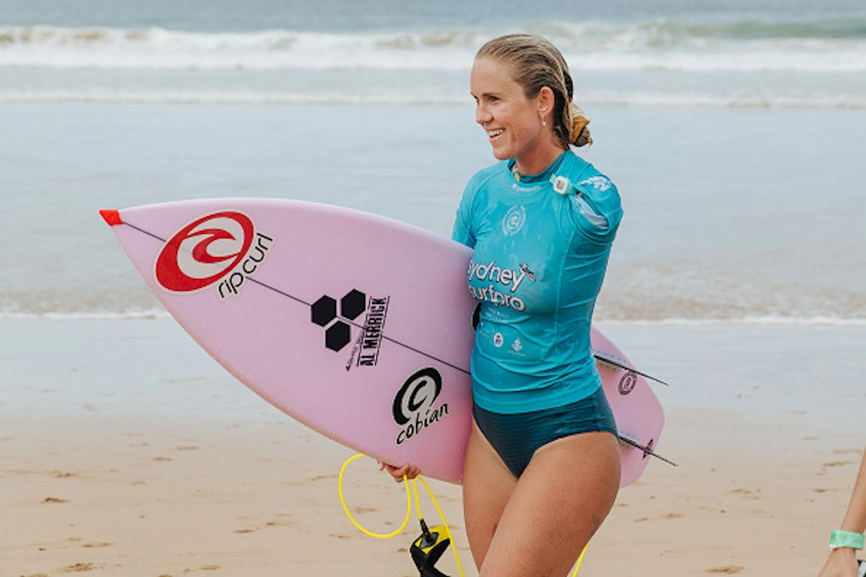
In Good Company
Carson Pickett joins other athletes competing at the professional level with various degrees of disabilities.
Notes:
From left to right:
Jim Abbott – limb difference – Professional Baseball
Samari Rolle – Epilepsy – Professional Football
Tom Dempsey – no toes on right foot, no fingers on right hand - Professional Football
Shaquem Griffin – limb difference – professional football
Bethany Hamilton – lost arm in shark attack – Pro Surfer

Slide 12
Reflection
Only the elitest of athletes make it into professional sports, very few with disabilities.
Do you think it would be possible to make professional sports more inclusive of all?
How?

Slide 13
Check Out
What would your super power be?
X-Ray Vision
Walk on Water
Read People's Minds

Slide 14
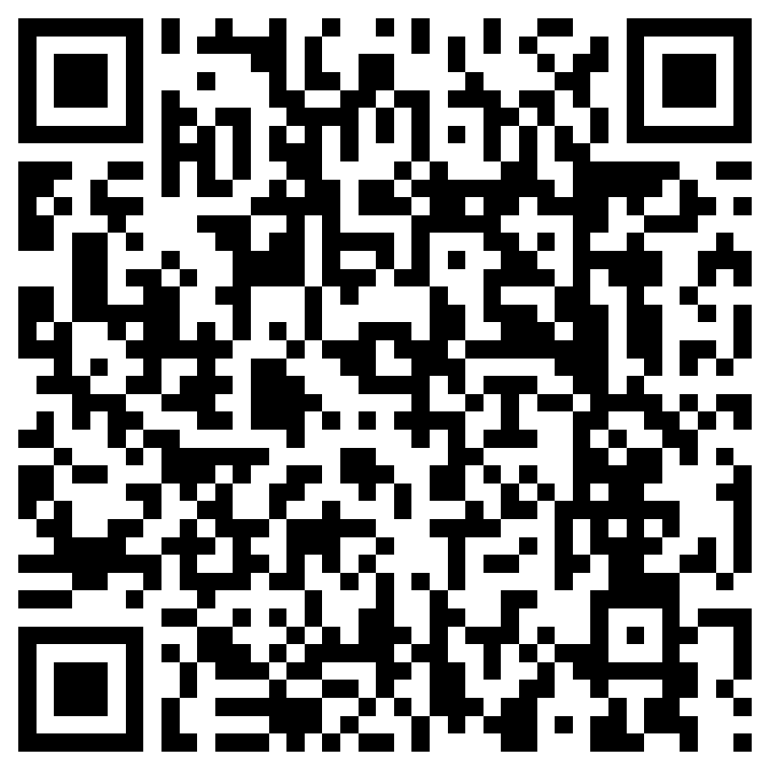
Feedback
Notes:
Teacher, please scan the QR code or click the link below to complete a brief feedback survey
https://forms.office.com/Pages/ResponsePage.aspx?id=oUAqBCixxEqGSAFv-hIUh7oXrttstiBCsAXIu5FQ_QRUN09SMFZDT0FaNE9PSTBRTk9CME42WURWUy4u

Slide 15

Human Relations, Diversity & Equity

