Slide 1

Lunar New Year
Student health & human services
Office of human relations, diversity & equity
June 2022

Slide 2
Would you rather...
Always say what's on your mind
Never speak again

Slide 3
Objectives
Learn
About Lunar New Year
Learn
about the traditions

Slide 4

When is Lunar New Year?
Ranges from January 21st to February 20th and lasts 15 days.
It marks the beginning of Spring and is also called the Spring Festival.
It is celebrated by approximately 20% of the world!
2021 was the year of the Ox
2022 was the year of the Tiger
2023 is the year of the Rabbit

Slide 5

The traditions - Taboos
Negative words are forbidden, including: death, sick, empty, pain, ghost, poor, break, kill
Don't break ceramic or glass-it's your connection to prosperity and fortune!
Don't clean or throw things out during this time – you may throw away good fortune!
Don’t use scissors, knives or other sharp objects – this could cut your stream of wealth & success
Don't visit the wife's family – this would mean that there are problems in the marriage

Slide 6
The traditions - Taboos
Don't demand debt repayment – you'll bring bad luck to both parties
Avoid fighting and crying – a peaceful end will mean a peaceful year
Avoid taking medicine – or you could end up being sick all year!
Don't give a New Year's blessing to someone still in bed – they'll end up in bed all year
Don't give clocks as a gift – you'd be paying your last respects

Slide 7
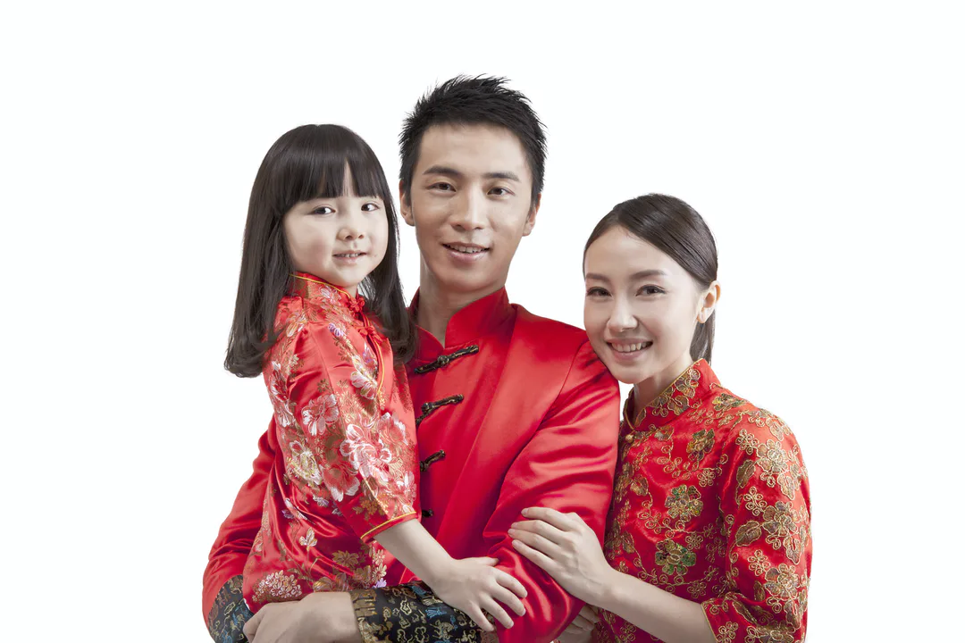
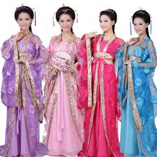
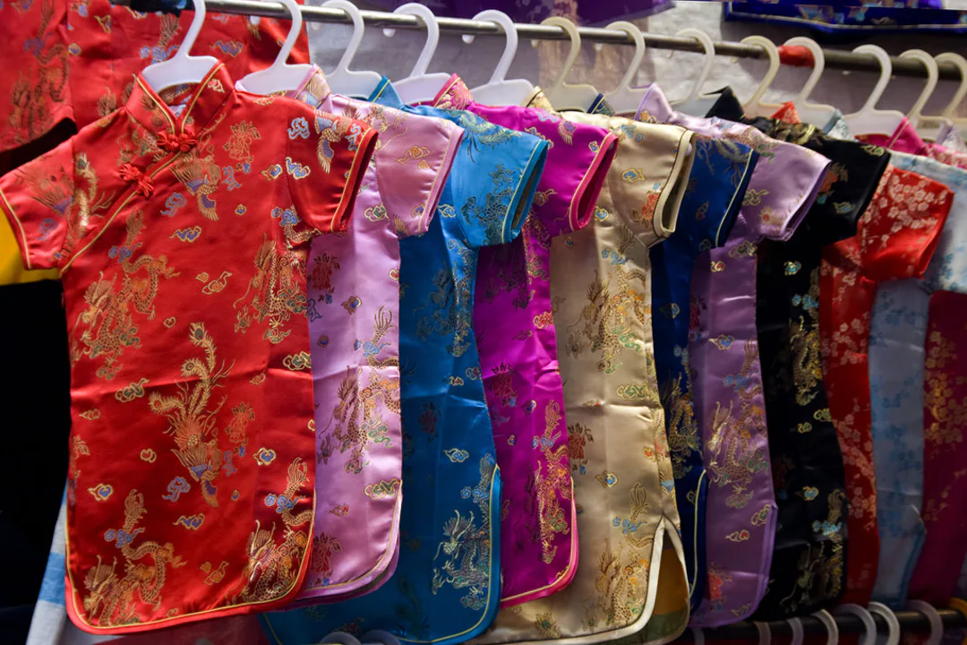
What to Wear
A new Tang suit for men or women
A new Qipao for women: a "long shirt"
A new Hanfu for women: a shirt and skirt combination

Slide 8

What will we eat?
Spring Rolls
Dumplings
Noodles
Steamed fish
Steamed chicken
Nian Gao "New Year Cake"
Vegetables
Hot pot

Slide 9

Bet you didn't know: Lunar New Year
Notes:
Play the video for the students 2:41
Bet You Didn't Know: Chinese New Year | History - YouTube

Slide 10

Time to share
What are 2 things you learned from this presentation?

Slide 11
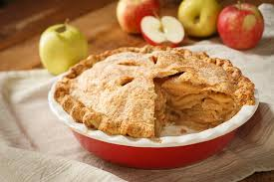
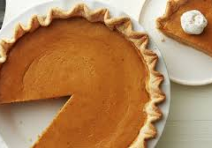
Which would you rather eat?

Slide 12
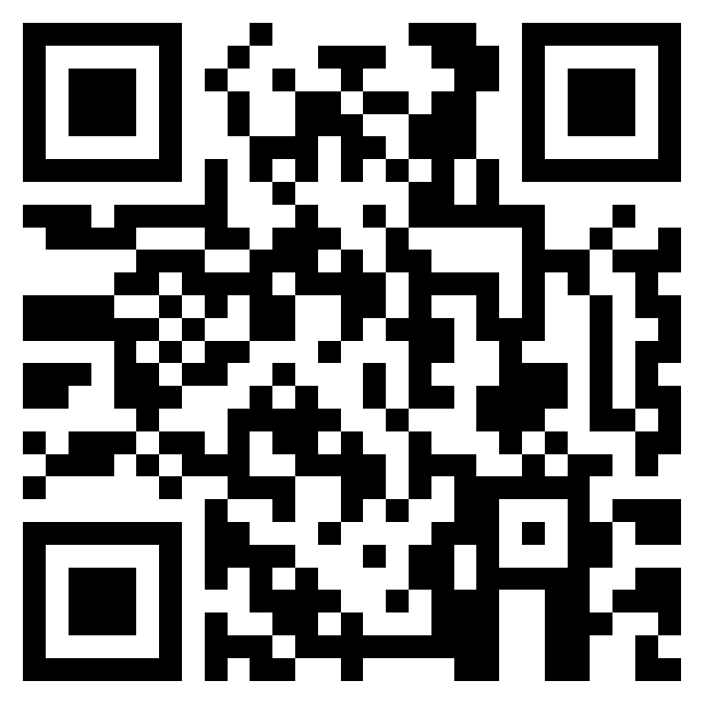
Teacher Feedback Survey
Notes:
Teacher, please scan the QR code or click the link to complete a brief feedback survey.
https://forms.office.com/r/i9UqyyxzTT

Slide 13

Human Relations, Diversity & Equity

