Slide 1

Let's talk about...
Feelings
Student Health and Human Services
Office of Human Relations, Diversity and Equity
June 2022
Notes:
Please feel free to encourage student participation whichever way you are most comfortable: in the Zoom chat, on a previously shared Jamboard, in break out groups, or all together in a grid view. There will be a lot of opportunities for participation throughout this presentation

Slide 2

What is your favorite food?
Notes:
Invite the students to share in answer this welcome question through whichever platform you prefer.

Slide 3

Objectives
Review current knowledge of feelings vocabulary
Dialogue about the importance of acknowledging and working through feelings
Discuss the benefits that feelings can provide
Notes:
Read the objectives aloud to the students.

Slide 4

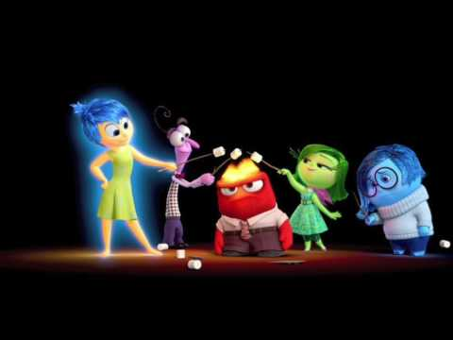
Guess the Feeling
Notes:
Play the video for the students. 3:16
Inside Out: Guessing the feelings. - YouTube

Slide 5
Reflection
What are the 5 major feelings you saw in the video?
Which one do you think is most common among kids your age? why?
Notes:
Engage students in the reflection utilizing whichever modality you prefer.

Slide 6



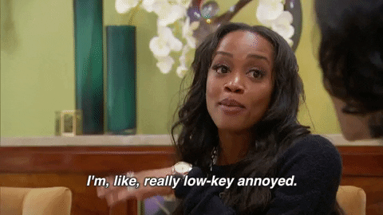
Feelings are normal.
Every human being has feelings.
It is a normal part of being alive.
In fact, you're probably having feelings right now.
Notes:
Read the slide for the students. Invite the students to share out which feelings are being protrayed in the pictures.

Slide 7
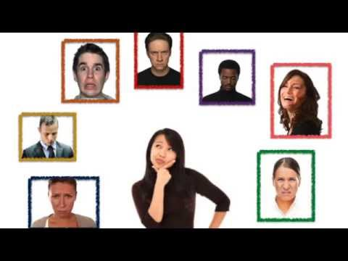
Emotions are Essential
Notes:
Play the video for the students. 3:34
Identifying our feelings - YouTube

Slide 8
Emotions are Essential
Feelings help us to communicate what we need
Emotions are essential for survival by motivating us to act fast
Emotions are involuntary
Emotions are used in specific situations or thoughts
Emotions are temporary – they do not last forever
Notes:
Read the slide aloud for the students.

Slide 9
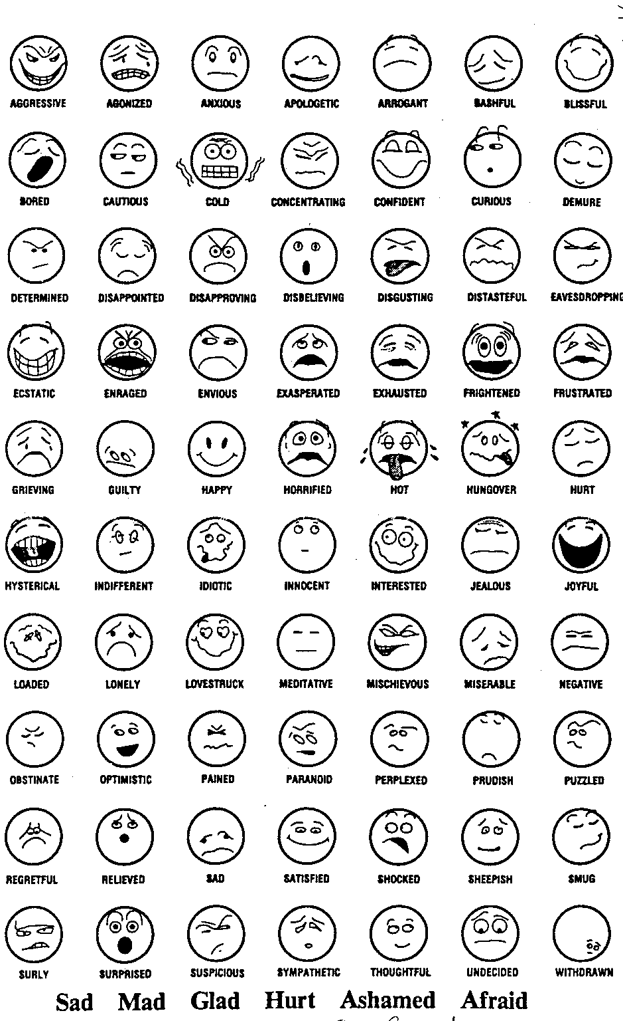
Feelings become easier to manage when we can name them.
Did you know must adults don't even know how to name their feelings?
Let's see how many feeling words we can come up with as a class.
Reflection
Notes:
Read the slide aloud for the students. Invite the students share out and create a list of all the feeling words they can come up with.

Slide 10
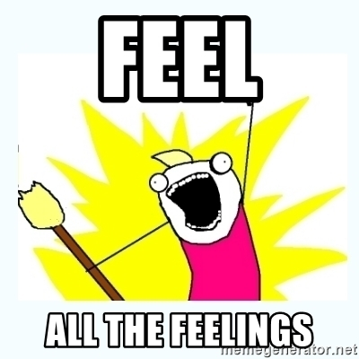
Name the Feelings
By learning to identify your emotions you can also learn to not be controlled by them.
Try to focus on what you're feeling, what caused that emotion, and try to name it!
Notes:
Read the slide aloud for the students. Remind them that you all now have a long list of feeling words that they can begin using to identify their own feelings.

Slide 11
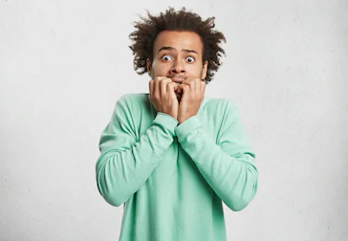
Fear
Fear is response to threats to our life or wellbeing.
Fear helps motivate us to escape from danger.
Notes:
Read the slide aloud for the students.

Slide 12
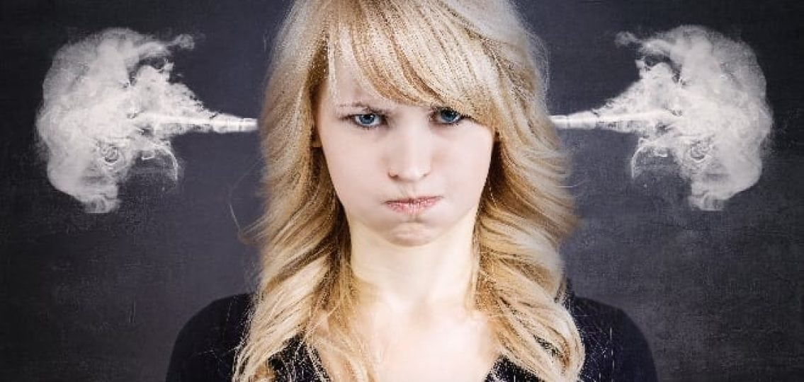
Anger
Anger is a response to feeling disrespected, threatened or attacked.
Anger allows us to focus on self-defense.
Notes:
Read the slide aloud for the students.

Slide 13
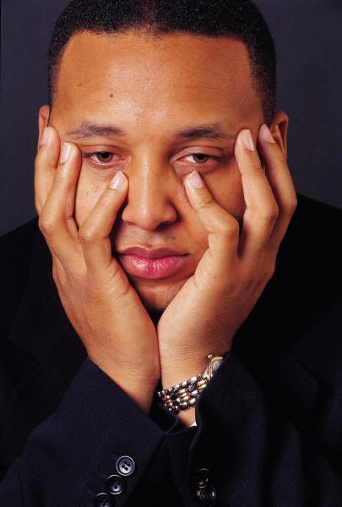
Sadness
Sadness is a response to the loss of someone or something that is important to us.
Sadness helps us focus on what is valued and communicate to others that we need help .
Notes:
Read the slide aloud for the students.

Slide 14
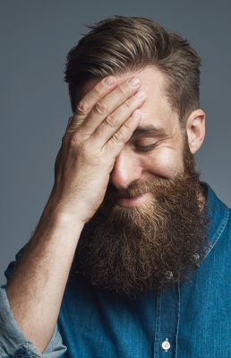
Shame/Embarrassment
Shame is the response to personal characteristics or behavior that are dishonored in our community.
Shame helps us to avoid social transgressions, and if these occur, to make amends.
Notes:
Read the slide aloud for the students.

Slide 15
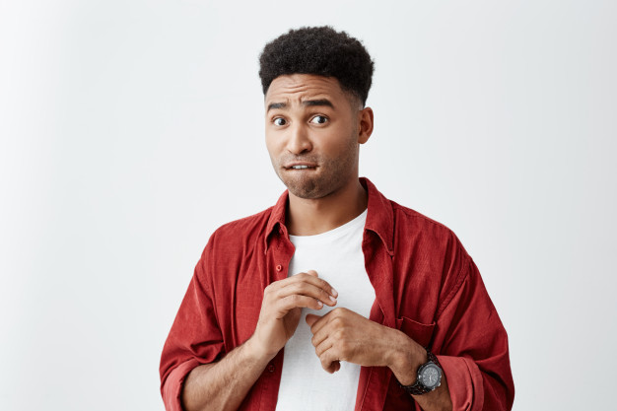
Guilt
Guilt is related to actions where we violated our own values.
Guilt allows us to repair some of these violations
Notes:
Read the slide aloud for the students.

Slide 16
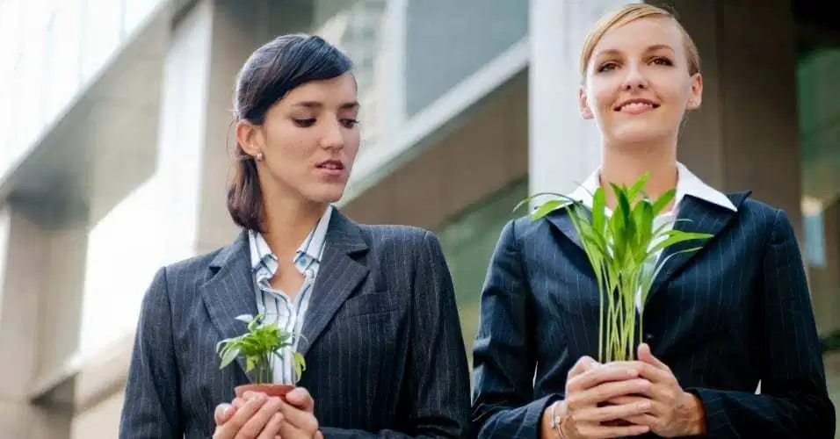
Envy/Jealousy
Envy is a response to not having things that we want or need.
Envy allows us to work hard to obtain what other people have
Notes:
Read the slide aloud for the students.

Slide 17

Joy
Joy is a response to good things happening in our life or in the lives of others that we care about .
Joy allows us to continue those activities that create pleasure.
Notes:
Read the slide aloud for the students.

Slide 18
Reflection
Did you notice that each of those feelings had a benefit or a way that it helps?
Have you ever thought about feelings in this way before?
What's it like to think of feelings as being helpful?
Notes:
Engage the students in a reflection utilizing whichever platform you deem most appropriate.

Slide 19

Check Out
Name one feeling you've had this week.
Bonus: What is the benefit of that feeling?
Notes:
Engage student in check out using whichever platform you deem most appropriate.

Slide 20

Human Relations, Diversity & Equity

Slide 21
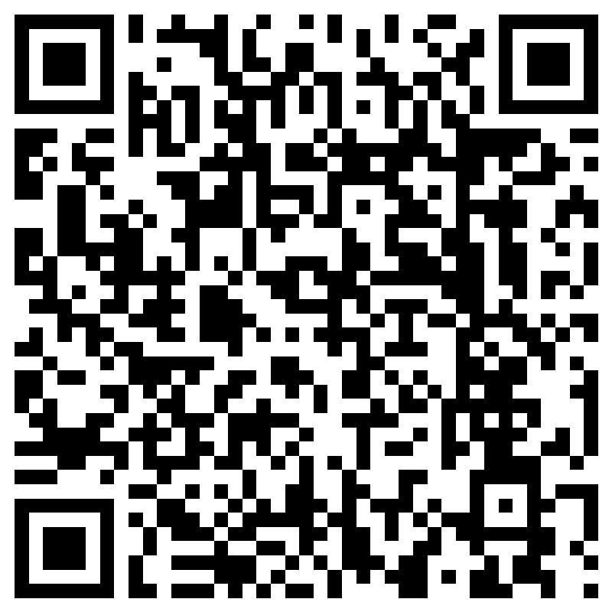
Teacher Feedback Survey
Notes:
Teacher, please scan the QR code or click the link below to take a brief feedback survey
https://forms.office.com/r/i9UqyyxzTT

