Slide 1
Hanukkah
Student Health & Human Services
Office of Human Relations, Diversity & Equity
June 2022

Slide 2
Welcome
Mac n Cheese
Grilled Cheese
Would you rather have...

Slide 3
Objectives
Identify the traditions of Hanukkah
Learn the history of Hanukkah
Learn about Hanukkah

Slide 4
What is Hanukkah?
Jewish Festival of Lights and it remembers the rededication of the second Jewish Temple in Jerusalem, in Israel
This happened in the 160s BCE/BC (before Jesus was born)
Hanukkah lasts for eight days and starts on the eve of the Kislev 25, the month in the Jewish calendar that occurs at about the same time as December.

Slide 5
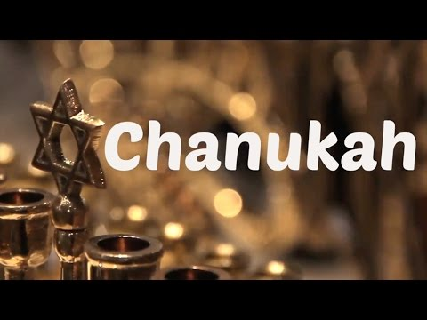
What is Hanukkah?
Notes:
https://youtu.be/VvFqBimGuIQ
3:52

Slide 6
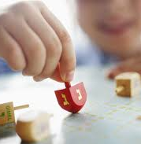
When is Hanukkah?
Because the Jewish calendar is lunar (it uses the moon for its dates), Kislev can happen from late November to late December.

Slide 7
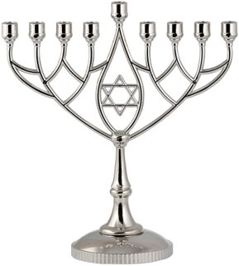
Lighting of the Candles
During Hanukkah, on each of the eight nights, a candle is lit in a special menorah (candelabra) called a 'hanukkiyah'.
There is a special ninth candle called the 'shammash' or servant candle which is used to light the other candles. The shammash is often in the center of the other candles and has a higher position.
On the first night one candle is lit, on the second night, two are lit until all are lit on the eighth and final night of the festival.
Traditionally they are lit from left to right.

Slide 8
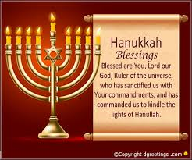
The Prayer
A special blessing, thanking God, is said before or after lighting the candles and a special Jewish hymn is often sung.
The menorah is put in the front window of houses so people passing can see the lights and remember the story of Hanukkah.
Most Jewish families and households have a special menorah and celebrate Hanukkah.

Slide 9
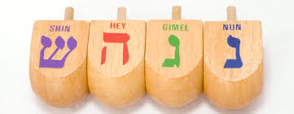
The Traditions
Hanukkah is also a time for giving and receiving presents and gifts are often given on each night.
Lots of games are played during the time of Hanukkah. The most popular is 'dreidel' (Yiddish) or 'sivivon' (Hebrew).
It's a four sided top with a Hebrew letter on each side. The four letter are the first letter of the phrase 'Nes Gadol Hayah Sham' which means 'A great miracle happened there' (in Israel, 'there' is changed to 'here' so it's 'Nes Gadol Hayah Po').
Each player put a coin, nut or chocolate coin in a pot and the top is spun. If the letter is 'nun' (נ) come up nothing happens, if it's 'gimel' (ג) the player wins the pot, if it's 'hay' (ה) you win half the pot and if it's 'shin' (for 'there' ש) or 'pe' (for 'here' פ) you have to put another item into the pot and the next person has a spin!

Slide 10
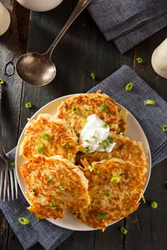
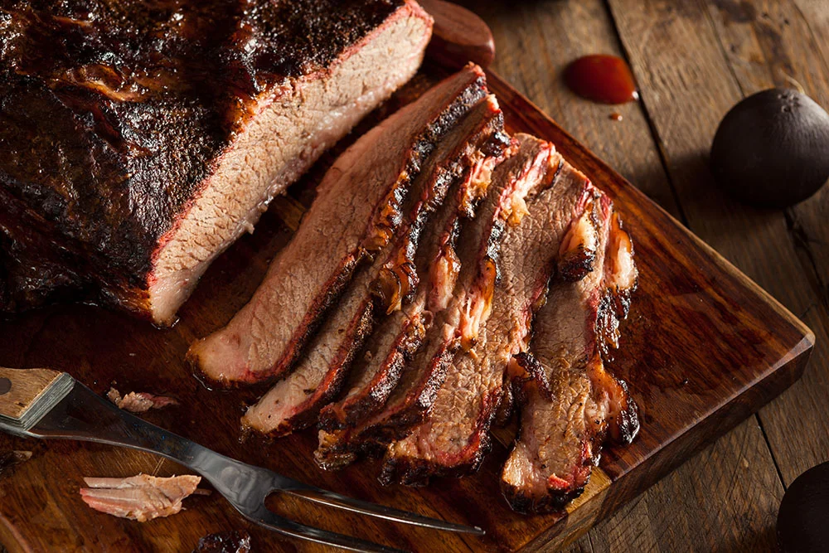
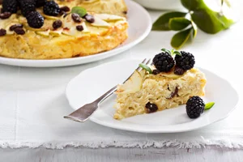
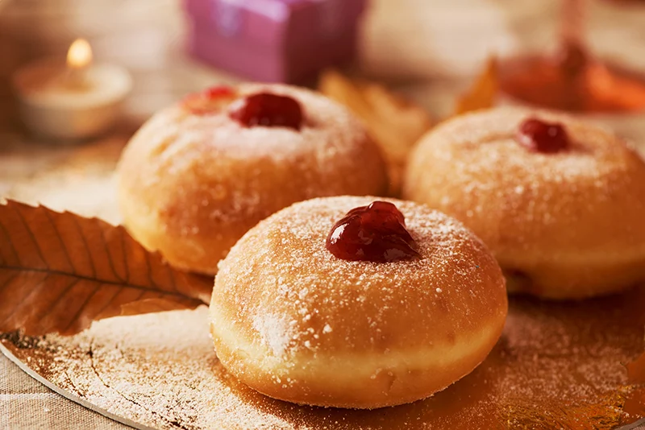
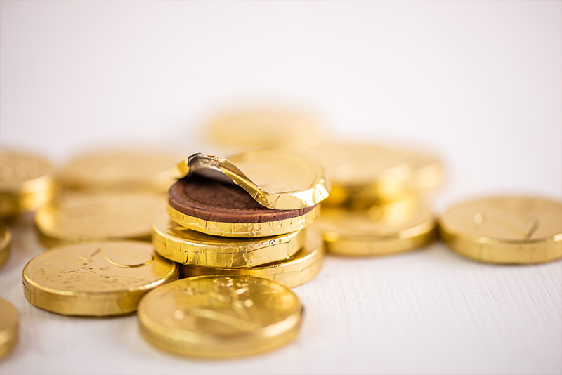
The Food
Latkes, also known as potato pancakes
Brisket
Kugel is a traditional Jewish egg noodle casserole
jelly-filled donut or sufganiyot in Hebrew
chocolate Hanukkah gelt

Slide 11
Share Out
What are 2 new things you learned about Hanukkah?
What do you think is the best part of Hanukkah?

Slide 12
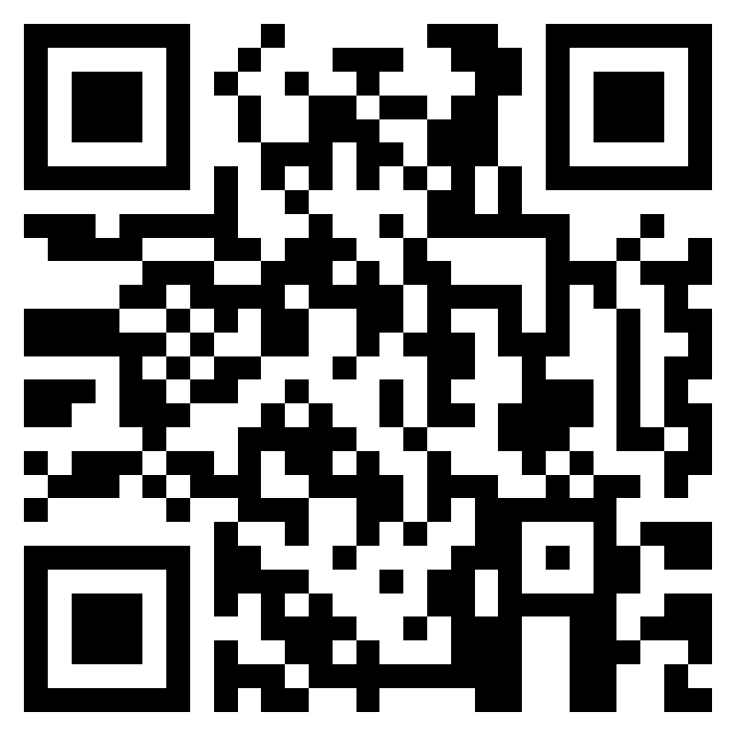
Teacher Feedback Survey
Notes:
Teacher, please scan the QR code or click the link to complete a brief feedback survey: https://forms.office.com/r/i9UqyyxzTT

Slide 13

Human Relations, Diversity and Equity

