Slide 1
“traditional”
Gender Roles
…but why?
Student health and human services
Human relations, diversity & Equity
June 2022
Notes:
Please feel free to encourage student participation whichever way you are most comfortable: in the Zoom chat, on a previously shared Jamboard, in break out groups, or all together in a grid view. There will be a lot of opportunities for participation throughout this presentation.

Slide 2

Welcome!
Let's start by using our fingers to show, 1-5, how much we know about what "gender roles" means. Show me a 1 if you have never heard of gender roles before, or a 5 if you feel like an expert! (Or somewhere in the middle!)
Notes:
Feel free to change up the check in you have a check in you prefer!

Slide 3
Objectives
Review
Review basic understanding of commonly accepted gender roles in todays society.
Discuss
Discuss the ways in which gender is presented to children, and the messaging that is sent at an early age.
Introduce
Introduce individuals who have broken down binary gender barriers and found success doing what they love.
Notes:
Read the objectives aloud for students.

Slide 4

Gender Roles
Notes:
Play the video: 3:25
Girl toys vs boy toys: The experiment - BBC Stories - YouTube

Slide 5

What are gender roles?
When you think of things girls “should” like, what do you think of?
When you think of things boys “should” like, what do you think of?
Notes:
Based on your prior knowledge, as well as the video you were shown, what kinds of things do you think girls "should" like? What kinds of things do you think "boys" should like?

Slide 6
How do we learn about gender roles?
What is your earliest memory of gender roles?
From a young age, kids are taught that “boys like blue” and “girls like pink”.
Can you think of any other very stereotypical gender roles you learned as a small child?
Notes:
Read these questions aloud to the students. Invite them to provide resposes... some responses may include:
Boys are better at sports
Girls are better at art
Boys can’t cry
Girls are dramatic
Etc.

Slide 7
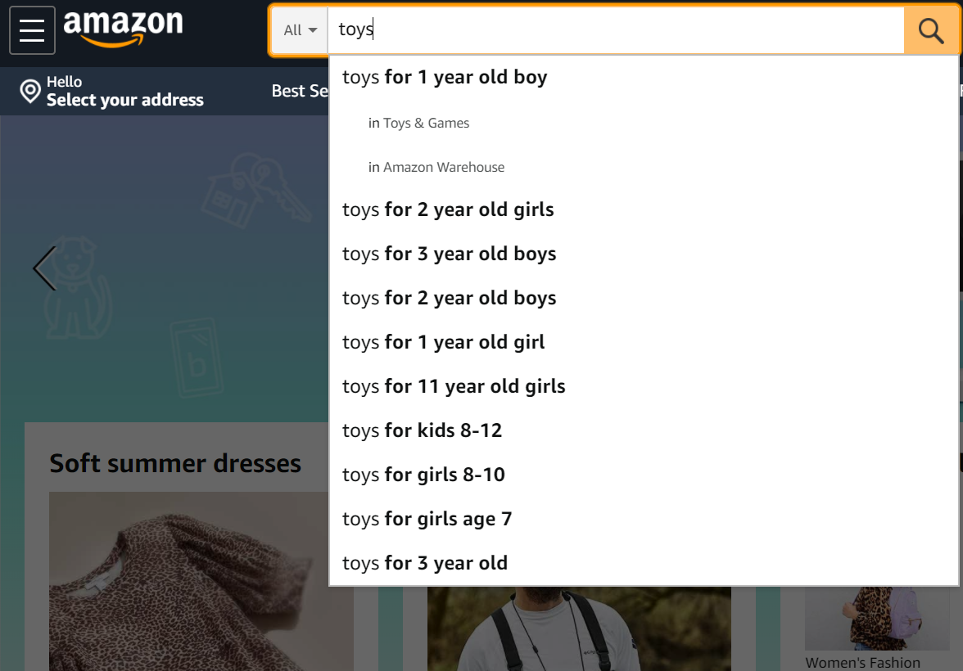
How are gender roles presented to kids?
Clothing, toys, games, movies all present a binary view of gender to children from birth.
Example: a simple search for TOYS pops up various gendered toy options.
Why do you think that is?
What is the difference between “boy” toys and “girl” toys?
Notes:
Read this slide aloud for the students. Invite them to respond to the questions on the slide. Point out how all that was typed into the search box is "toys", but Amazon automatically pulls up gendered options.
Bonus Question: Can anyone recall from the video we saw what were some of the marked differences between the boy toys and the girls toys?
Answer: girls: doll and soft toys
boys toys teach spatial awareness and physical confidence - men hugely dominate careers prizing maths, spatial awareness and physical confidence
are boys born better at these? or do they learn it through the gendered toys they are given
When children play spatial awareness games frequently, their brains change physicall within just 3 months

Slide 8
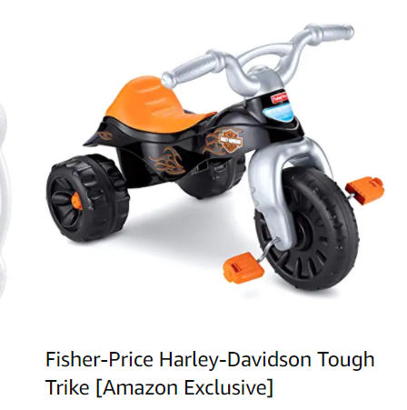
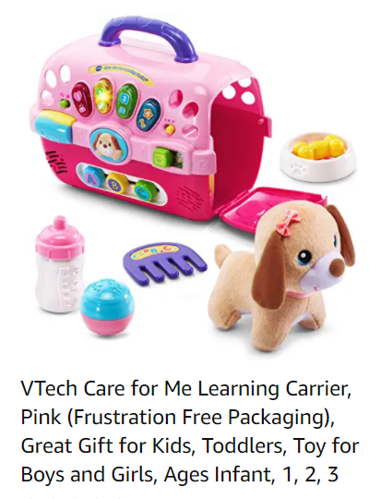
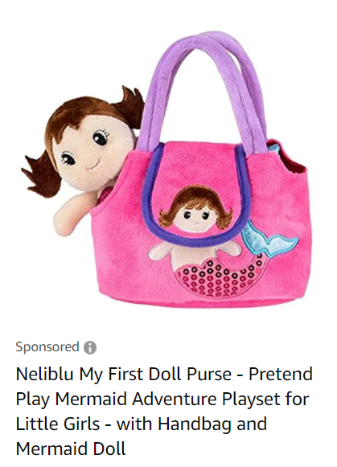
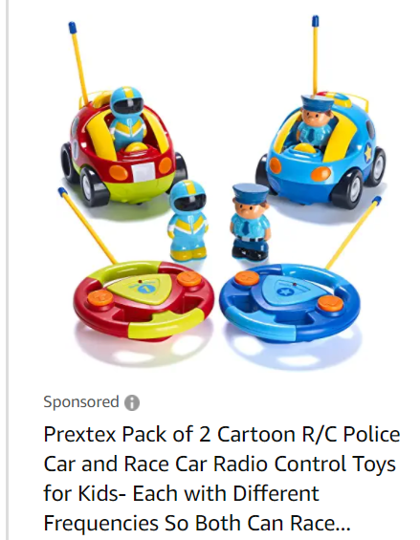
What is the messaging kids are getting from this?
Which toys do you think are "toys for 2 year old girls"?
Which toys do you think are "toys for 2 year old boys"?
Based on the video we watched, what long term effects might there be from limiting children's toys to these gendered options?
Notes:
Read the slide for the students. Invite the students to report on what difference they see. Invite them to share if they have ever wanted to play with toys that were generally attributed to a gender different than their own.

Slide 9
How are gender roles presented to kids?
Clothes brands also separate their clothing by the gender binary – boys vs. girls.
Notes:
Invite the students to reflect on how even childrens clothing is divided by gender. This means that children are getting messaging from all angle regarding what I means to be a boy or a girl.

Slide 10
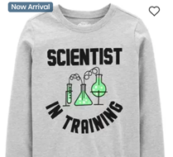
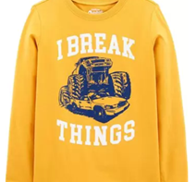
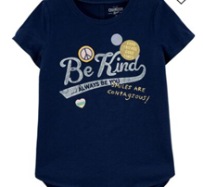
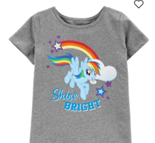
What is the messaging kids are getting from this?
Notes:
Invite the students to guess which clothes are boy clothes vs. Girl clothes . Invite the students to reflect on the questions below.
What kind of messaging is that sending?
What are some of the potential long term impacts of kids getting this type of gendered messaging from such a young age?

Slide 11
But why?
Have you ever stopped to question why gender roles are the way they are?
Have you ever wanted to do or like something that was typically associated with your gender?
Did stereotypical gender roles keep you from pursuing something you were passionate about?
Notes:
Read the questions aloud to the students. Invite them to share and reflect on their answers.

Slide 12

Not anymore!
Notes:
Play the video: 2:01
Who is Alyssa Nakken? - YouTube

Slide 13

Not anymore!
Notes:
Play video for students 3:10
https://www.youtube.com/watch?v=2W3qEBmLW0A

Slide 14
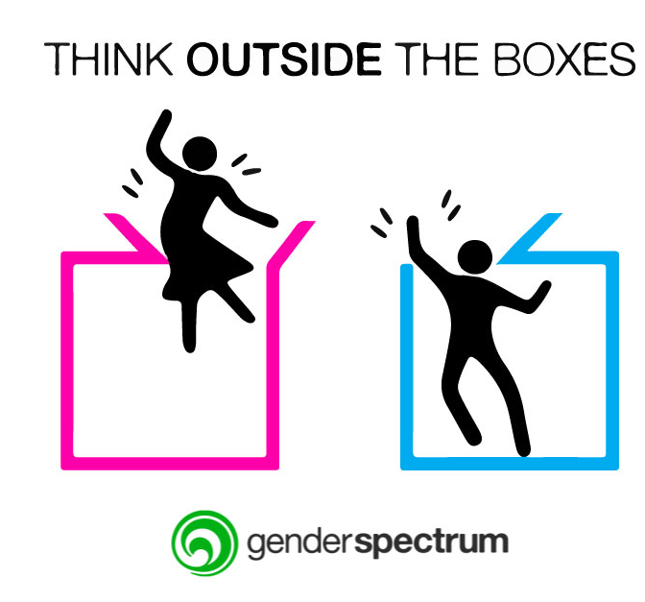
Take action!
How can you help to break down gender stereotypes and gender roles?
Notes:
Ask the students the question on the slide. Invite the students to share their responses to the question posed.

Slide 15

Closing
Show me a 1 if you don't really care about gender roles
Show me a 2 if you think it's wrong to stereotype people based on the gender binary
Notes:
Ask the students to take a moment to reflect on how much they thought they understood about gender roles at the beginning of this discussion. Then, ask them to share by using our fingers to show, 1-2, how they feel about gender roles now that the know more about them. Show a 1 if they don't really care about it or a 2 if they think it's wrong to stereotype people based on the gender binary. Invite students to share if time permits or they feel comfortable.

Slide 16

Human relations, diversity and equity

Slide 17

Teacher Feedback Survey
Notes:
Teacher, please scan the QR code or click the link to complete the brief feedback survey.
https://forms.office.com/r/i9UqyyxzTT

