Slide 1
Help!
Student Health and Human Services
Office of Human Relations, Diversity & Equity
Notes:
Please feel free to encourage student participation whichever way you are most comfortable: in the Zoom chat, on a previously shared Jamboard, in break out groups, or all together in a grid view. There will be a lot of opportunities for participation throughout this presentation.

Slide 2
What is something that you consider yourself to be very good at?
Notes:
Invite the students to share (however you choose) something they consider themselves to be very good at as a quick warm up.

Slide 3
Objectives
Explore help seeking and help giving behaviors
Reflect on your own ideas about asking for help
Learn best practices for asking for help
Discuss how to be a helper
Notes:
Read the objectives to the students

Slide 4
People are hard-wired to be helpful
Helping others may boost
Mood
Self-Esteem
Sense of Belonging
Notes:
Read the slide for the students. Explain that it is human nature to be helpful

Slide 5
Reflection
Share about the last time you helped someone.
Notes:
Encourage the students to share about the last time they helped someone. If students have trouble coming up with examples, ask the following questions:
Did you help with chores at home?
Do you help a friend with their homework?
Why do people help each other?
Teacher:
Choose whatever platform you like for students to reflect on helping. They could find examples of helping on google image.
Focus on how it makes us feel good to help someone else.

Slide 6
Asking for help: not human nature
People are hardwired to want to do things on their own – to be independent minded.
There are many reasons why asking for help makes people feel uneasy
I get embarrassed.
I don’t want to be judged
They might say "no"
Notes:
Tell the students that it even though humans are hardwired to help, it is NOT human nature to ask for help. Rather, people are hardwired to want to do things on their own – to be more independent minded. Review the 3 reasons listed as to why it may be difficult to ask for help.

Slide 7
USE ALL YOUR STRENGTH
Notes:
Play the video for the students (1:44)
https://www.youtube.com/channel/UCpt0yt-SqX2Pa45CFztlviw

Slide 8
Reflection
Why do you think the speaker continued to say "use all your strength?"
Notes:
Invite the students to reflect on why the speaker continued to say "use all your strength'.

Slide 9
NORMALIZING ASKING FOR HELP
Notes:
Share the video with the students. (4:35)
https://www.youtube.com/watch?v=yXz9aoHdnnk&t=264s

Slide 10
Best ways to ask for help
In person (34% more likely to get a "Yes")
Be specific
Be direct
Be positive
Be understanding
Notes:
Review these best practices for asking for help. Time permitting, invite the students to engage in role play to practice asking for help using these criteria.

Slide 11
Let’s Practice
Let’s pretend we need our teacher’s help with a math problem. How are you going to ask?
E-MAIL
TEXT
IN PERSON
Notes:
Could be school related, or personal.

Slide 12
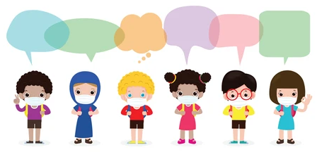
What will you say?
Can I maybe get some help if you aren’t too busy?
I’im so sorry to bother you but can I ask you a question?
Teacher, can you help me with this math problem?
I really hate math and don’t understand why we need to learn it so you’re going to need to explain that again.

Slide 13
What if they say no?
Ask
again
Ask
someone else
Punch
a wall
Ask
if they can point you towards another resource

Slide 14
In real life…

Slide 15
Depends on the problem…
Who can we ask for help?
Friends
Classmates
Parents / Caregivers
Coaches
Cousins
Teacher

Slide 16
Reflection
Who else can you ask for help?
Notes:
Invite the students to reflect on why the speaker continued to say "use all your strength'.

Slide 17
Who do I ask for help?
Sometimes we need help from our friends/peers
Sometimes we need help from grownups
How do we know which is which?

Slide 18
I don’t know what book to read. Can you help?
Peer
Grown up

Slide 19
I’m having a conflict with my friend. Can you help?
Peer
Grown up

Slide 20
I have an uncomfortable secret Can you help?
Peer
Grown up
Notes:
If safety is involved, it probably should go to a grown up

Slide 21
I don’t know where my phone is. Can you help?
Peer
Grown up

Slide 22
Reflection
What is something you could ask for help with?
Notes:
Invite the student to share their ideas about specific things they could ask for help with.

Slide 23
Check out
If you could be an expert at something, what would you want to be an expert at?
Notes:
Teacher: chose whatever platform you like for the check out.
Extension – have the students keep a list of times they helped someone, witnessed an act of helping, or engaged in their own help seeking behavior.

Slide 24
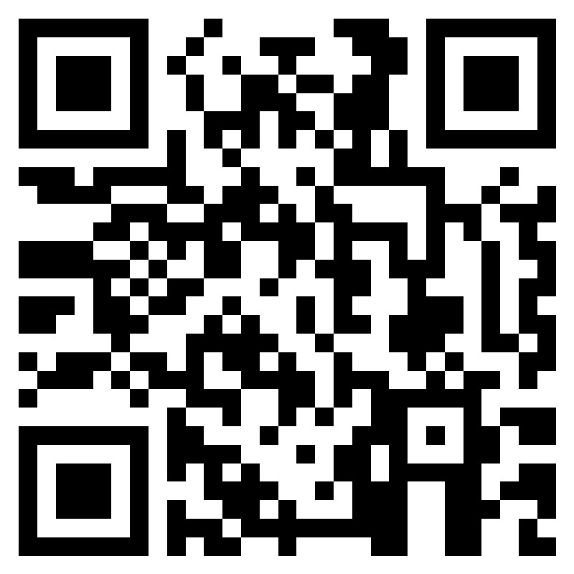
Teacher Feedback Survey
Notes:
Teacher please complete the feedback survey by scanning the QR code or clicking the link below:
https://forms.office.com/r/i9UqyyxzTT

Slide 25
Human Relations, Diversity & Equity

