Slide 1

SAP Ariba
Training for LAUSD Requestors

Slide 2
Prerequisites
Agenda
1
Welcome & Introductions
2
Guided Buying Access, Navigation and Preferences
3
Create a Catalog Requisition
4
Create a Non-catalog Requisition
5
Creating an STO Requisition
6
Goods Receipts
7
Team Shopping & Upcoming Features

Slide 3
Class Schedule – 3 hours for AM Session. 3 hours for PM session.
Classroom Session Part A
8:00AM – Start of Morning Session
8:00 AM – Welcome and Introductions
8:05 AM – GB Navigation, Preferences and Delegation
9:00 AM - Create a catalog PR On Behalf Of (OBO) another person
    Split accounting
10:00 AM - Create a Non-catalog PR along with reviewing Forms. .
10:30 AM – Mass edit
        Mass Edit Ship to Location
        Mass Edit Funding
  10:55 – How to Search for a Supplier, and search for a Contract
11:00 - End of Morning Session
Classroom Session Part B
12:30 PM - Start of Afternoon Session
    12:30 PM Review Morning Session
12:45 AM – Create a Non-Catalog PR for an Asset
1:15 PM – Create an STO Order from the Internal catalog
1:45 PM – Goods Receipt as Preparer or Requestor & Edit a GR
2:15 PM – Edit a PR and PO
2:25 PM – How to Close a Purchase Order.
2:45 PM – Access Prepackaged reports from GB Home dashboard
3:00 PM – Team Shopping
3:15 PM – Q & A and Wrap-Up
3:30 PM – End of Afternoon Session

Slide 4
Welcome & Introductions

Slide 5





Ground Rules
Please add your questions to the Zoom chat window.
Avoid the temptation to do email
Listen during instructive sessions
No mobile phones
Return from breaks on time
Avoid the rabbit holes…
There will be many

Slide 6

Welcome & Introductions
Ryan Allshouse
Focused on Training and Change Management
Over 20 years of experience in Ariba as a customer and as an Ariba Employee in the Education department.
Location – Longmont, Colorado (Just North of Boulder, CO)
Notes:
Facilitator should use this opportunity to establish credibility with learners.

Slide 7
Quick Vocabulary Lesson
Key Term | Description
P2P core | Ariba interface for power users and the Purchasing Team
Guided Buying GB | Ariba interface for most users (e.g. requesters, approvers, etc.)
PR | Purchase Requisition
PO | Purchase Order
GR | Goods Receipt
Watcher | A user included in the approval flow who will receive notifications and can view the document but does not need to approve or deny.
Guided Buying Tile | A tile on the Guided Buying landing page is a link to a form, an external page, or a catalog.
Guided Buying App Settings | Same as P2P Core User Preferences.

Slide 8
Guided Buying Access & Navigation

Slide 9
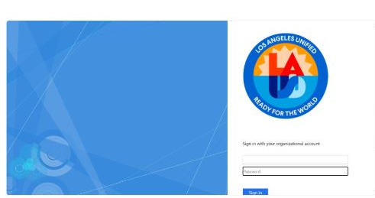
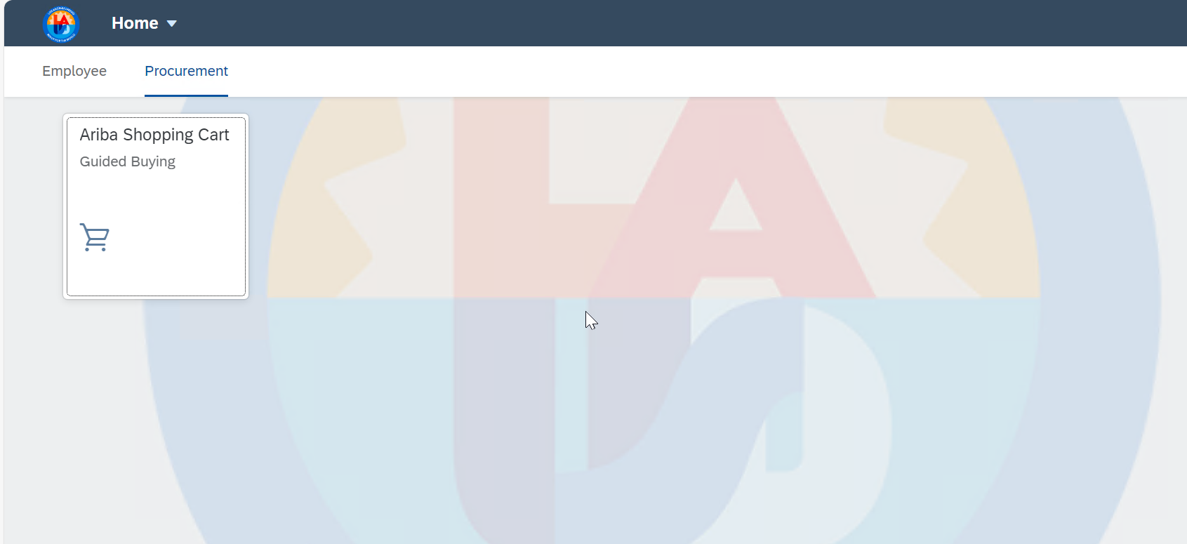
Accessing Ariba Guided Buying
Access ESS - https://ess.lausd.net/ and then enter your password.​
Once you have authenticated yourself using ESS, click on the tab titled "Procurement" ​
Next, click the tile titled "Ariba Shopping Cart" to access Ariba Guided Buying.
Ariba uses Single Sign On, so that you do not need to maintain a separate username and password for Ariba. As soon as you click the tile, it will take you directly to the Ariba Guided Buying Home page.​

Slide 10
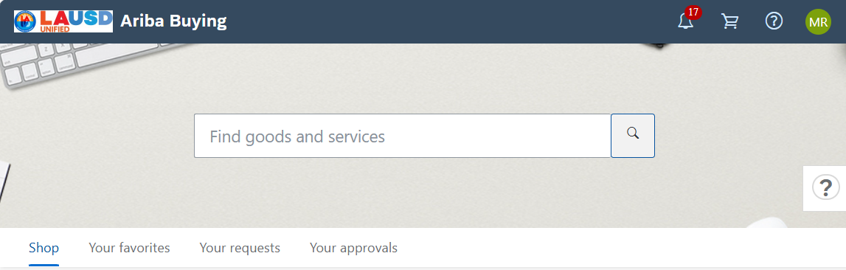
Ariba Guided Buying Overview (cont’d)
The LAUSD Logo acts as a “Home” button. From anywhere in Ariba, click the LAUSD logo to return to the Home page.

Slide 11
Ariba Guided Buying Overview (cont’d)
The Bell icon is where you will find notifications. In addition to sending notifications to your outlook email, all notifications will be displayed by clicking on the bell icon.

Slide 12
Ariba Guided Buying Overview (cont’d)
The Shopping cart icon allows you to access your shopping cart. Items that have been added to your shopping cart can be accessed by clicking on the shopping cart icon.

Slide 13
Ariba Guided Buying Overview (cont’d)
The question mark with a circle around it is the Help icon. Click the Help icon to open.

Slide 14
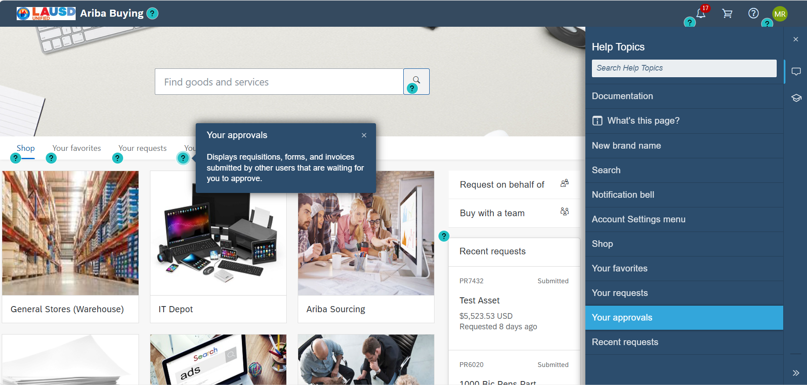
Ariba Guided Buying Overview (cont’d)
Mouse over any of the question marks on the screen to see a description of the item.
Optionally, users can search the Help Topics using the search field.

Slide 15
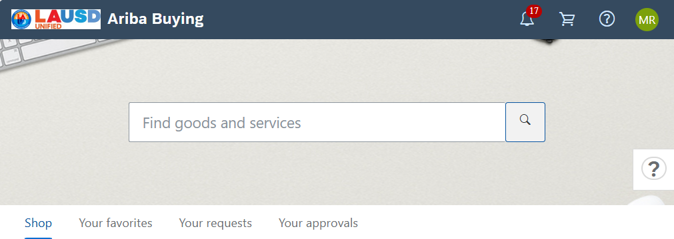
Ariba Guided Buying Overview (cont’d)
The main search field allows users to search Catalogs, part numbers, supplier names, or forms.

Slide 16
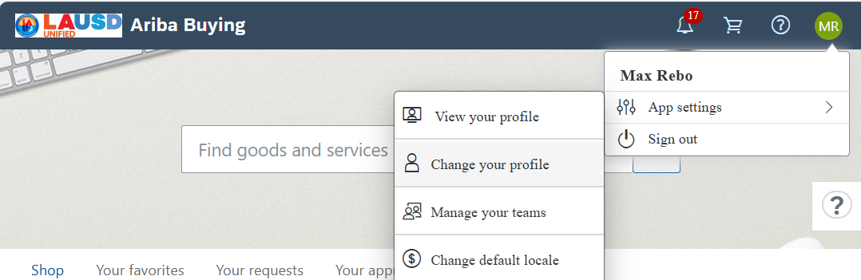
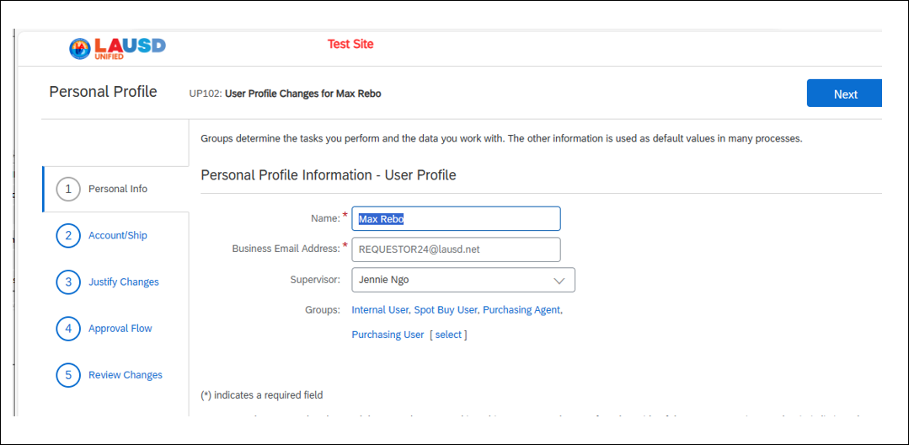
Ariba Guided Buying Overview (cont’d)
To change your profile, click your initials, and then click App settings and then click Change your profile.
Go through the Profile fields, and update any of the accounting or shipping fields on your Profile.

Slide 17
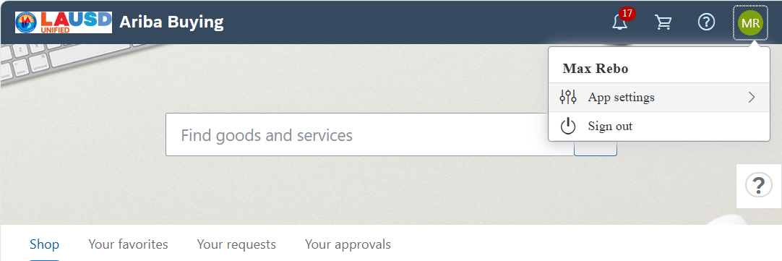
Ariba Guided Buying Overview (cont’d)
To update your email preferences, click on your initials and then click App settings

Slide 18
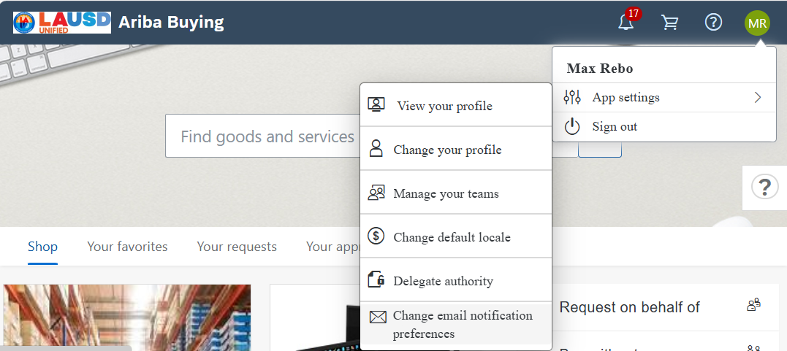
Ariba Guided Buying Overview (cont’d)
Click Change email notification Preferences

Slide 19
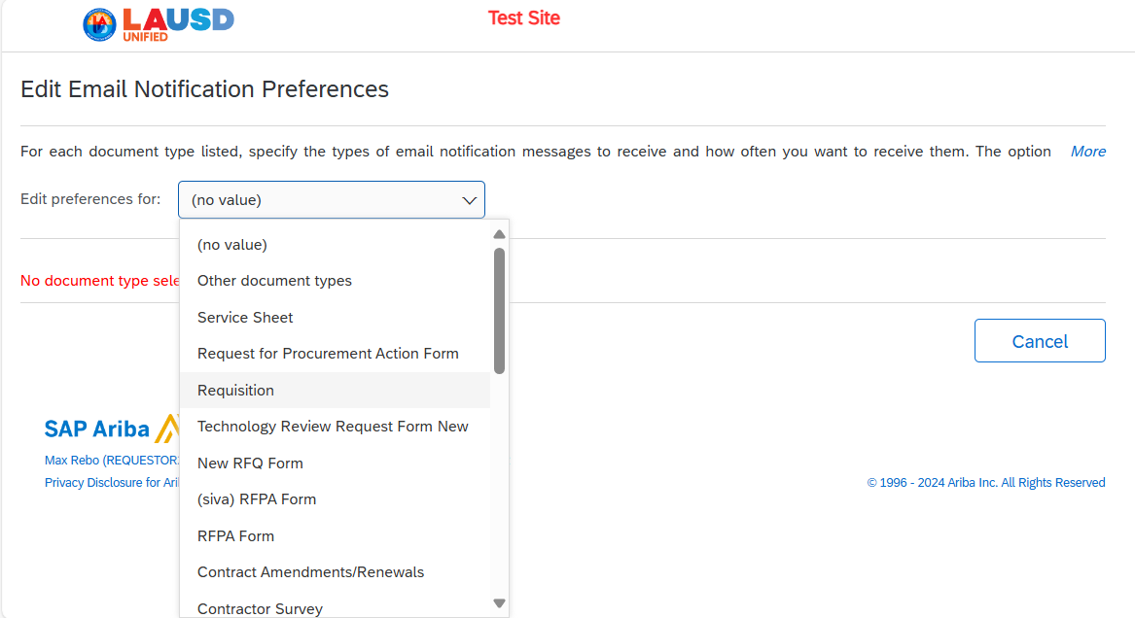
Ariba Guided Buying Overview (cont’d)
There are many document types to choose from, but the most common preferences type is “Requisition.”

Slide 20
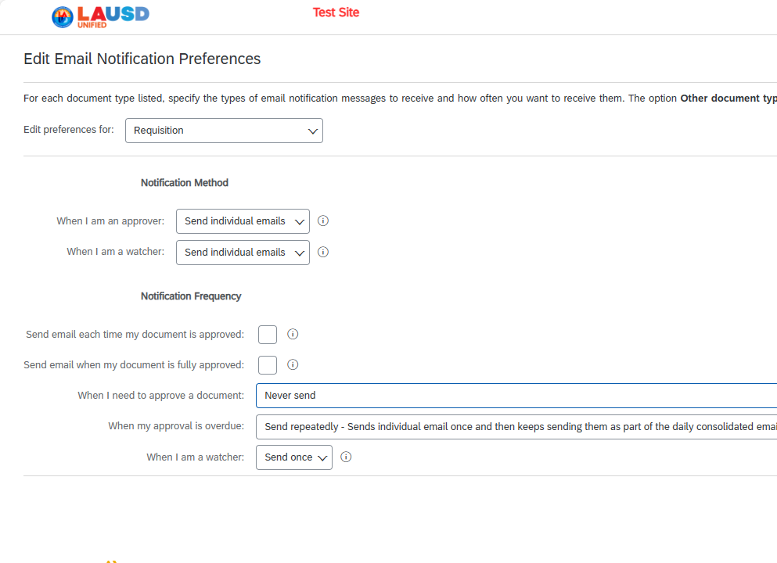
Ariba Guided Buying Overview (cont’d)
Choose the notification method that best fits your needs. Users have the option to choose individual emails, or consolidated emails.
For each notification frequency selection users can choose:
Never Send
Send once
Send repeatedly

Slide 21
Ariba Guided Buying Overview (cont’d)
To Delegate your approval authority, click on your initials in the upper right corner. Click App settings, and then click Delegate authority

Slide 22
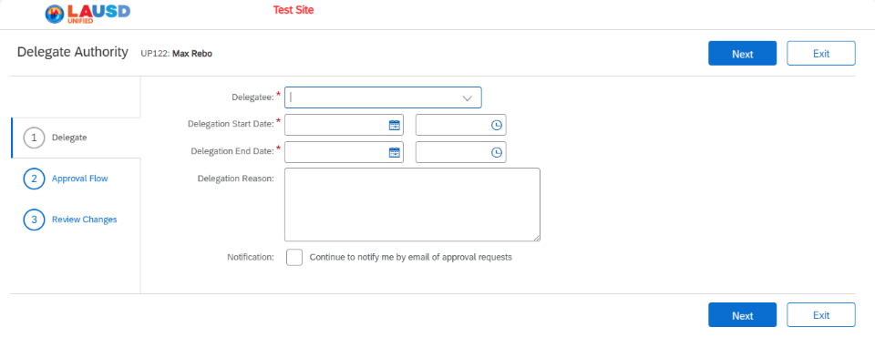
Overview of the Home Tab
When delegating your approval authority to someone, you are delegating 100 percent of your approval to that person. This includes any approvable document such as requisition approval and receiving.
Your delegatee can receive goods and services in Ariba during the delegation period that you set.
Complete the 3-step wizard and then click submit

Slide 23
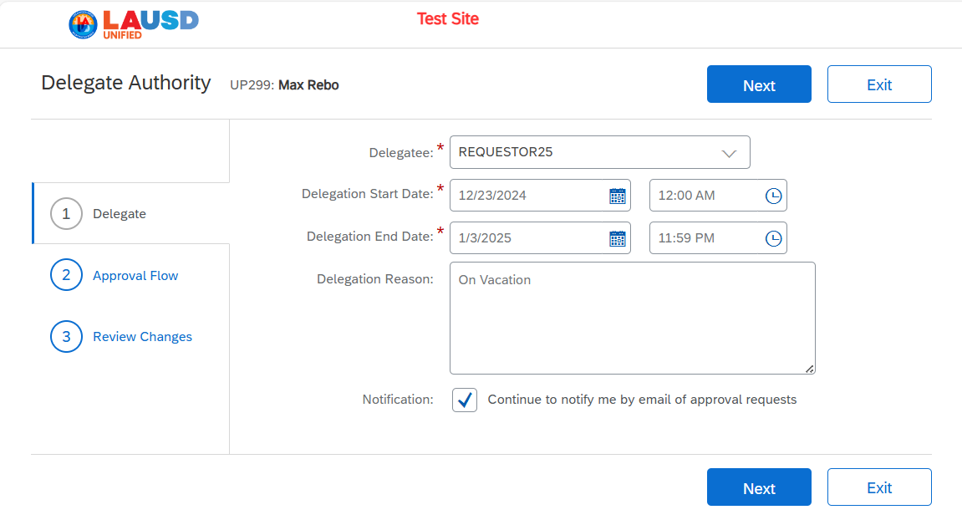
Overview of the Home Tab (cont’d)
Fill out the Delegatee the start date for the delegation and the end date of the delegation.
Optionally, type in the Delegation Reason to remind the delegatee why he or she is receiving the delegation to approve.
Additionally, check the box, to continue to receive email notifications during the delegation time period

Slide 24
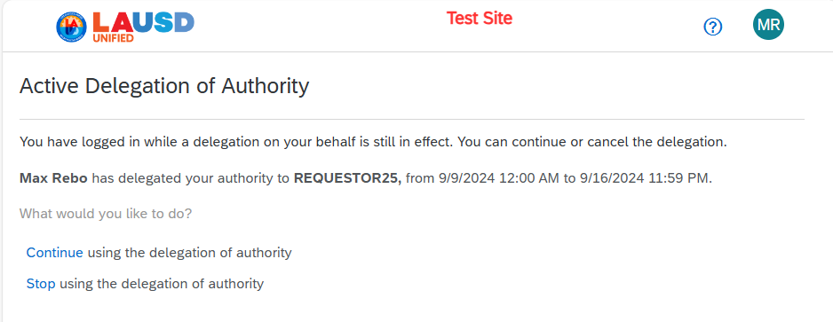
Overview of the Home Tab (cont’d)
If you delegate your authority to another person, if you log in during that active delivery period, the Ariba system will prompt you to either:
1. Continue using the delegation of authority.
Or choose
2. Stop using the delegation of authority.

Slide 25
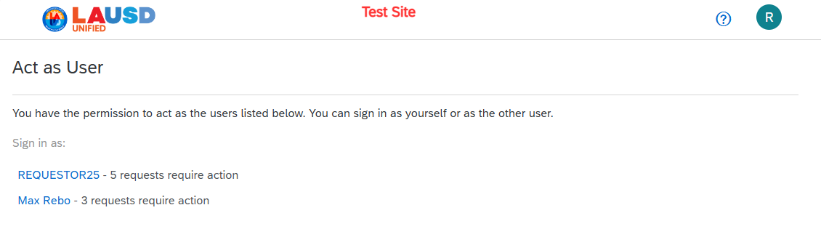
Overview of the Home Tab (cont’d)
When the delegatee logs in, this person has the choice to be themselves (REQUESTOR25), or the Delegator (Max Rebo)

Slide 26
Course Summary
Key Takeaways
Ariba uses Single Sign On (SSO) Technology. Access ESS, enter your password, and click on the Guided Buying tile.
The Bell icon shows your notifications. These are the same notifications that are sent to your email.
The Main Search field allows users to search across catalogs, suppliers, and part numbers
Commonly purchased items can be saved to a "Favorites" list.
Your Preferences are found by clicking on your initials. The most common preferences that users need to access are:
  Change your Profile: Accounting and Shipping information set in your Profile will default to Requisitions.
  Change email notification preferences: Adjust the type of alerts and the frequency of the alerts sent from Ariba
  Delegate Approval Authority: Allows users to delegate approval authority to someone else while unable to approve. Approving also includes Receiving.

Slide 27
Create a Catalog Requisition on Behalf of Another Person.

Slide 28
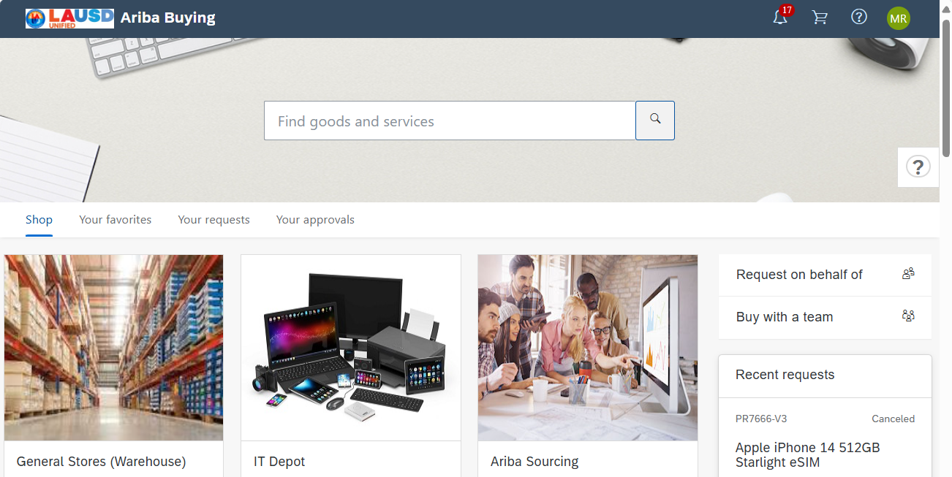
Create a Catalog Requisition
By default, you will create a requisition on behalf of yourself. If you are creating a requisition on behalf of another person, click “Request on behalf of”
Notes:
Trainer will talk on slide

Slide 29
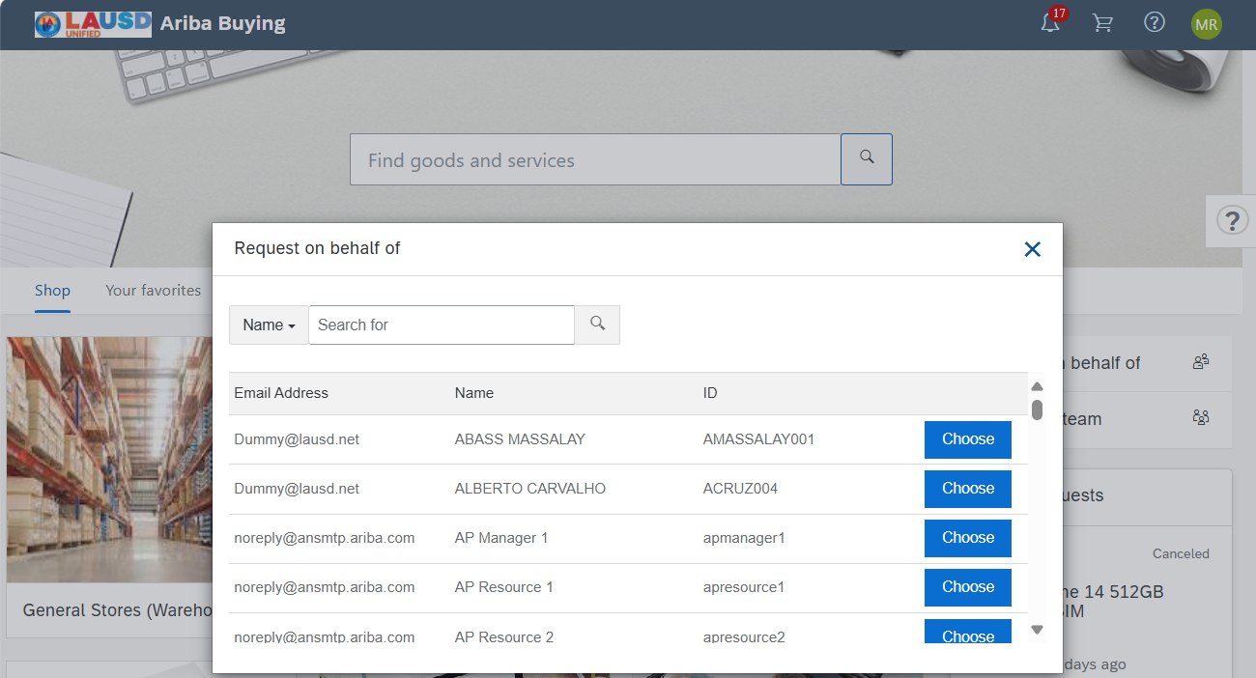
Create a Catalog Requisition
When creating a requisition on behalf of someone else you become the “Preparer” of the requisition, and the on behalf of person is known as the “Requester”.
The requisition, will pull the default information from the on behalf of person. For example, the delivery address, any default accounting information, and will follow the requester’s approval flow.
Type in the name of the person.
Notes:
Trainer will talk on slide

Slide 30
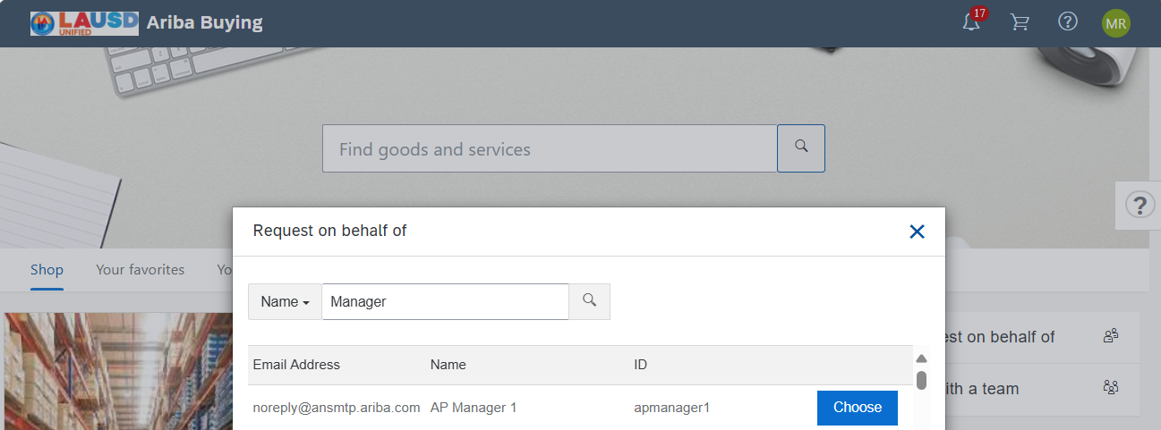
Create a Catalog Requisition
I will search for a sample user named AP Manager 1. You will search for the name of the person that you are creating the requisition on behalf of.
Notes:
Trainer will talk on slide

Slide 31
Create a Catalog Requisition on Behalf of Yourself.

Slide 32
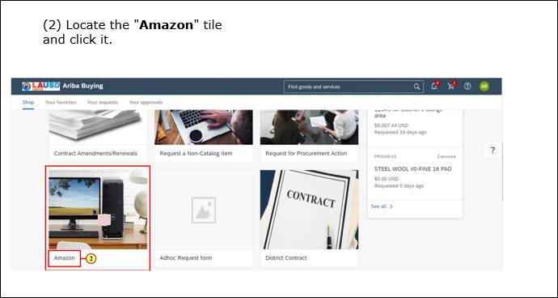
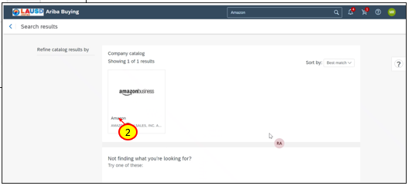
Create a Catalog Requisition
(1)
Use the tiles in Ariba Guided Buying to locate available catalogs. Additionally, you can search for the supplier in the main search window.
Click on the supplier’s name to access the catalog
Notes:
Trainer will talk on slide

Slide 33
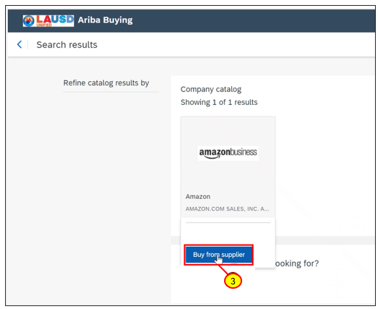
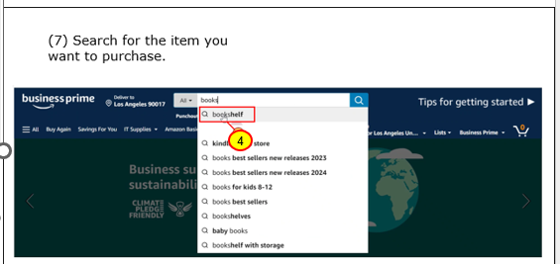
Create a Catalog Requisition (cont’d)
Click “Buy from supplier”
Use the supplier website functionality to add items to your shopping cart.
Notes:
Trainer will talk on slide

Slide 34
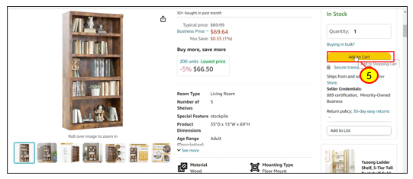
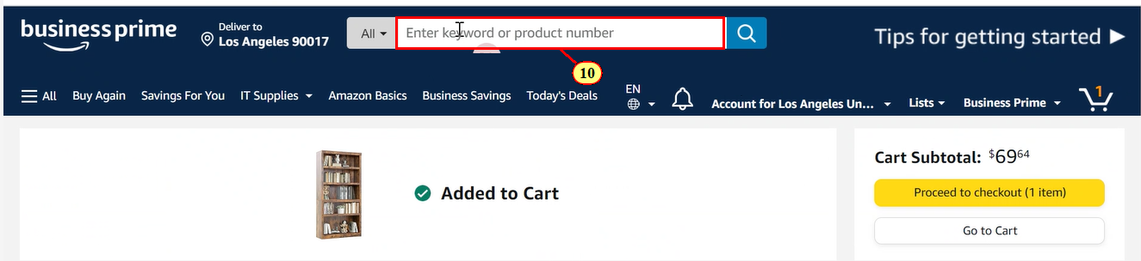
Create a Catalog Requisition (cont’d)
Add items to your shopping cart.
Notes:
Trainer will talk on slide

Slide 35
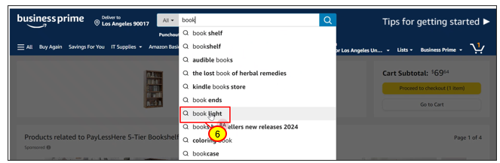
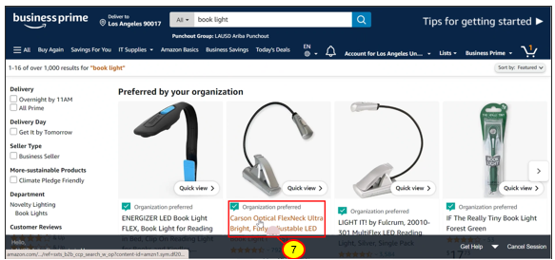
Create a Catalog Requisition (cont’d)
Continue to add items, until you are ready to check out.
Notes:
Trainer will talk on slide

Slide 36
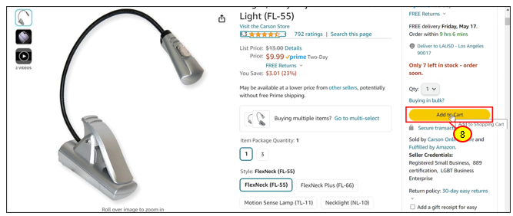
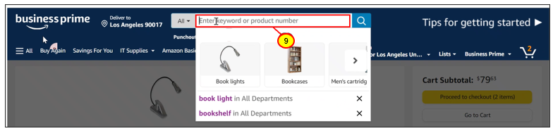
Create a Catalog Requisition
Continue to add items, until you are ready to check out.
Notes:
Trainer will talk on slide

Slide 37
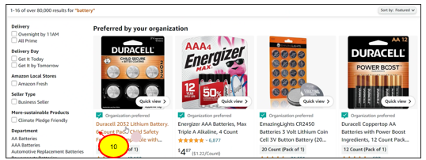
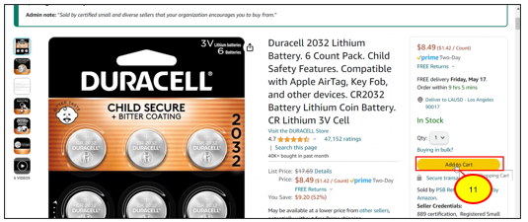
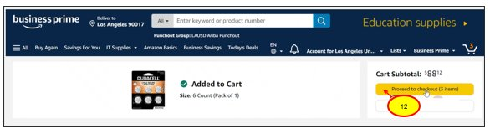
Create a Catalog Requisition (cont’d)
Continue to add items, until you are ready to check out.
Once done, you can proceed to check out.
Notes:
Trainer will talk on slide

Slide 38
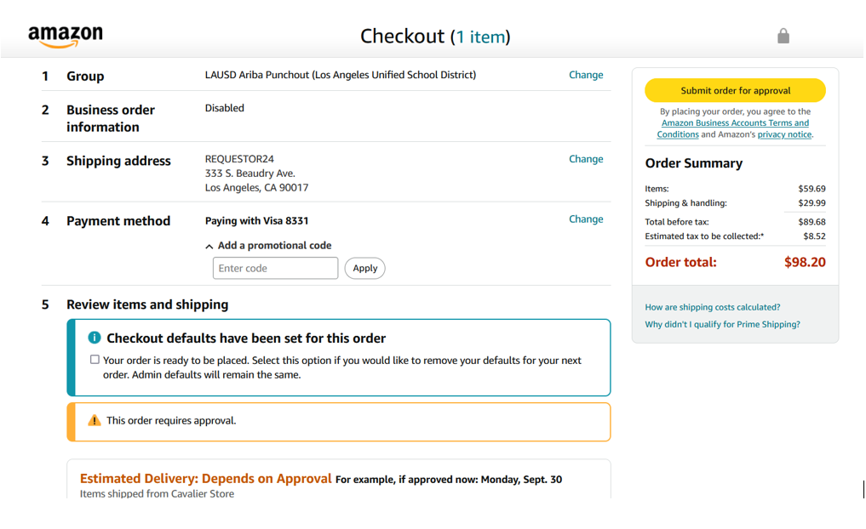
Create a Catalog Requisition (cont’d)
Notes:
Trainer will talk on slide

Slide 39
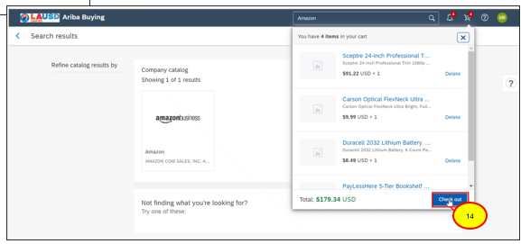
Create a Catalog Requisition (cont’d)
Click Checkout or the equivalent button. Each Punchout catalog is managed by the supplier, so some buttons will be slightly different from one catalog to another.
Notes:
Trainer will talk on slide

Slide 40
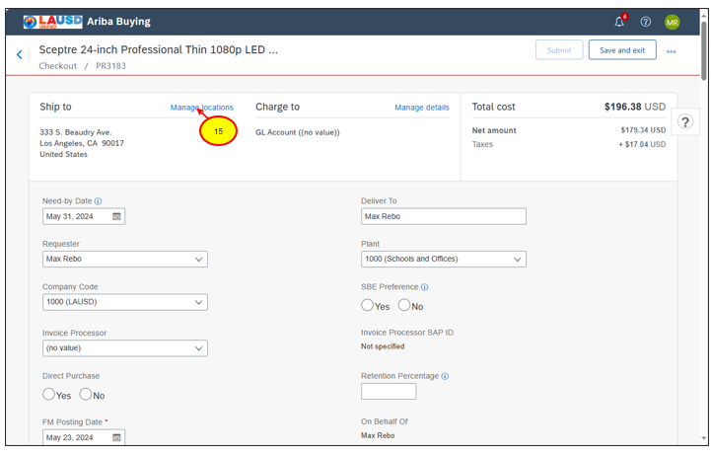
Create a Catalog Requisition (cont’d)
To do a mass change across all line items, click Manage locations
Notes:
Trainer will talk on slide

Slide 41
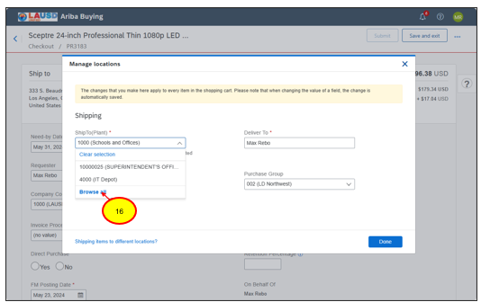
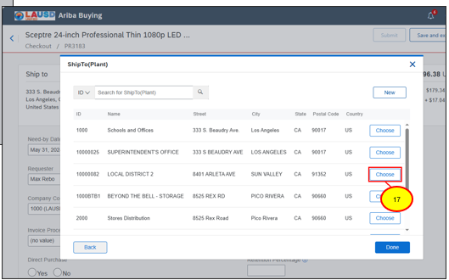
Create a Catalog Requisition (cont’d)
Click the downward arrow on the “Ship to plant” field and select the required ship to location.
Click Choose to select the new ship-to location.
Notes:
Trainer will talk on slide

Slide 42
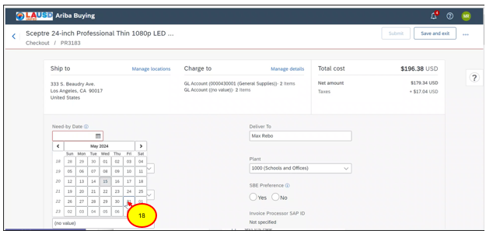
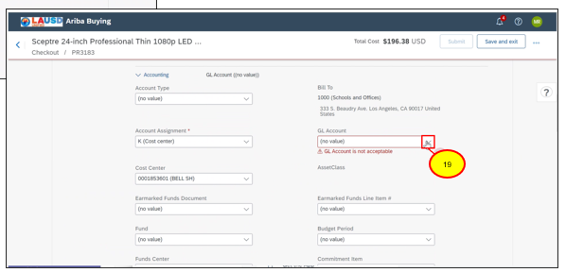
Create a Catalog Requisition (cont’d)
Choose a realistic need by date for the items.
Complete the accounting fields
Notes:
Trainer will talk on slide

Slide 43
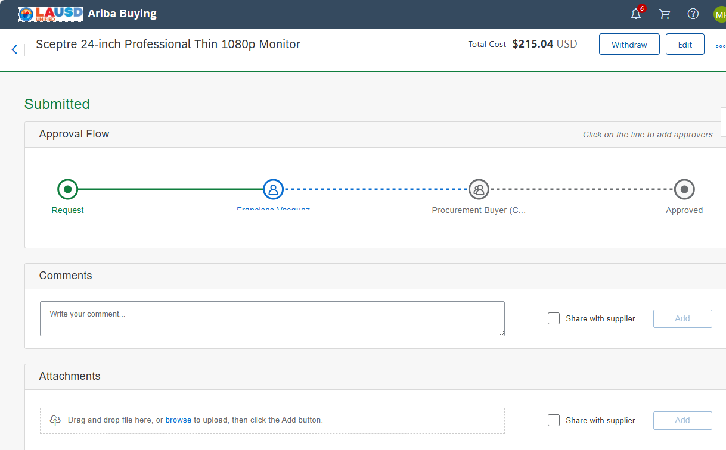
Create a Catalog Requisition (cont’d)
Based on the Requisition attributes the system will create the required approval flow.
Approvers highlighted in Blue are the active approvers
Notes:
Trainer will talk on slide

Slide 44
Course Summary
Key Takeaways
Catalogs that are available for shopping will be found on the Guided Buying home page.
Punchout catalogs, such as Amazon and CDW work in the same way. Punch out to the supplier catalog page, add items to your shopping cart, checkout to pull the shopping cart back into Ariba for approval.
Once you have added all the required items, complete the fields on the Requisition checkout page.
Users have two mass edit options:
  Ship to location
  Accounting / Funding information

Slide 45
Create a Non-Catalog Requisition

Slide 46
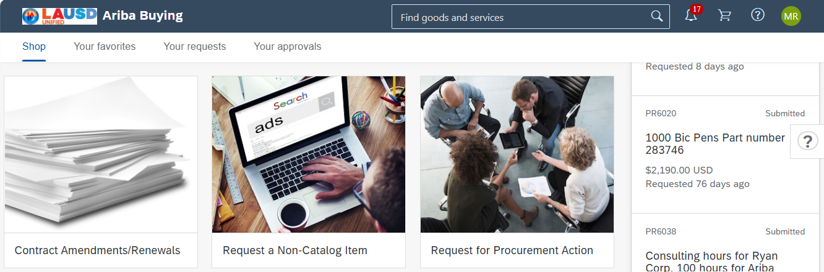
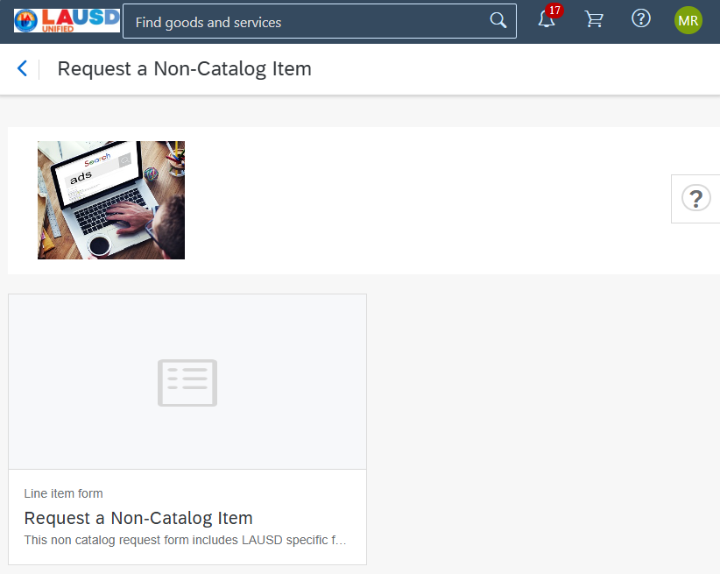
Create a Non-Catalog Requisition
To add a Non-Catalog line item, click the tile titled Request a Non-Catalog Item.
Then click the link with the same name.
Notes:
Trainer will talk on slide

Slide 47
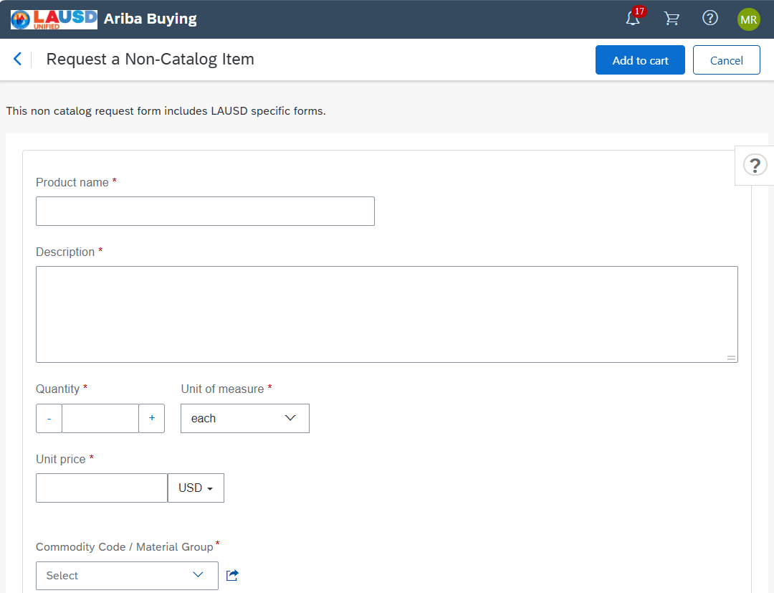
Create a Non-Catalog Requisition (cont’d)
Complete the non-catalog item form. All fields are required except the Supplier field.
The Product name and description should be unique and descriptive enough so that the Purchasing team understands exactly what you are wanting to purchase. Next enter the quantity required, the unit of measure for this item, and the Unit Price.
Notes:
Trainer will talk on slide

Slide 48
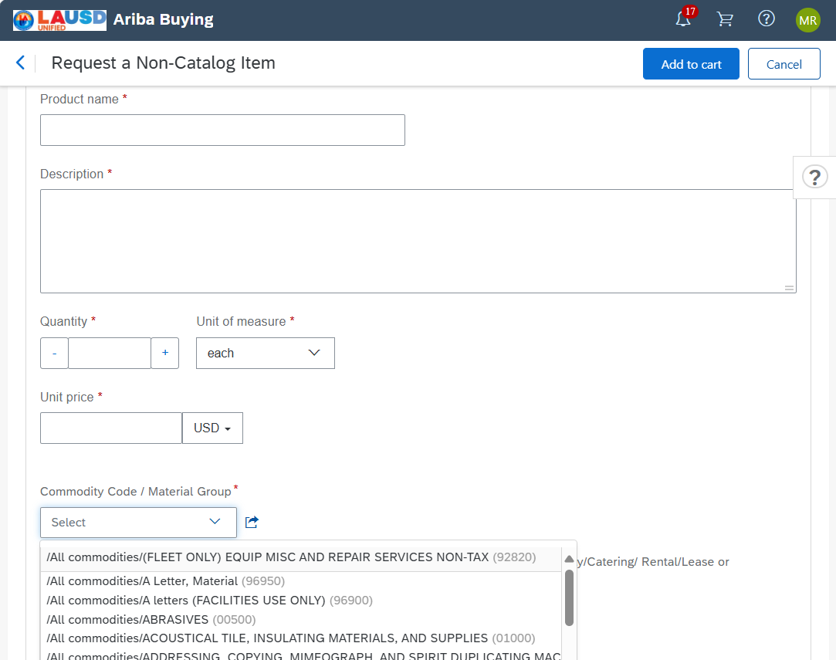
Create a Non-Catalog Requisition (cont’d)
Choose the Commodity Code/Material Group that best fits this line item. If the item is an asset, the user must choose a Commodity code / Material Group that is tied to an Asset. If you are unsure, please contact the purchasing team for help.
Notes:
Trainer will talk on slide

Slide 49
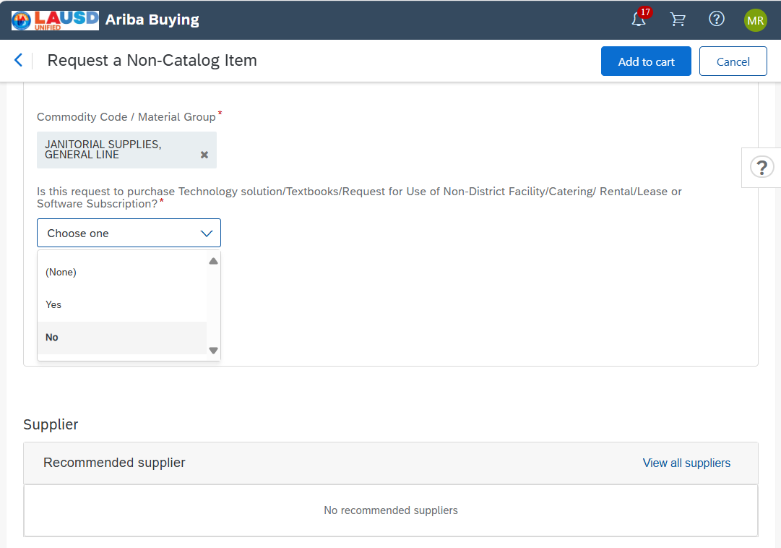
Create a Non-Catalog Requisition (cont’d)
The next question is to determine if the item being requested needs additional detail. Read the question carefully, and then choose either Yes or No.
If you answer “Yes” the system will ask a series of follow up questions. Read each question carefully and respond appropriately.
Notes:
Trainer will talk on slide

Slide 50
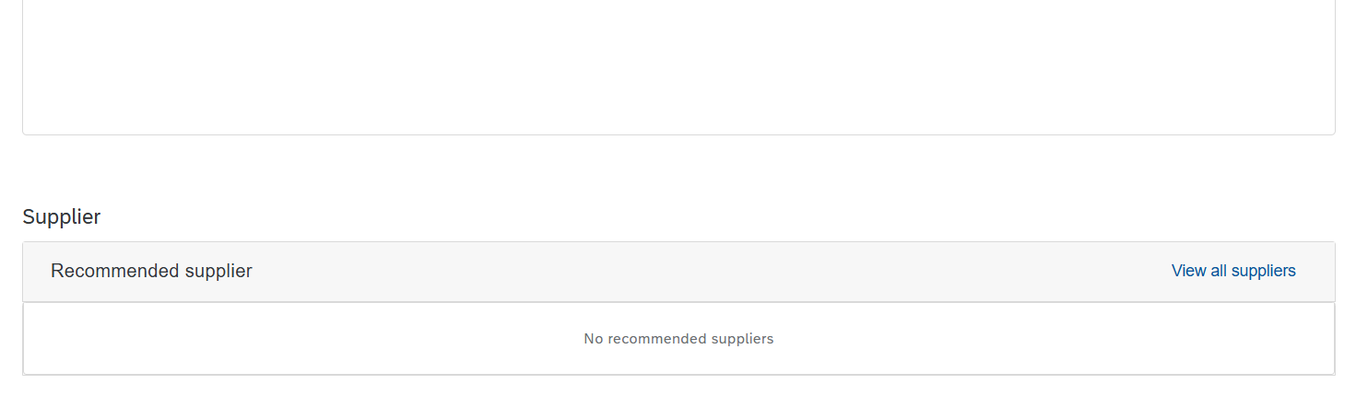
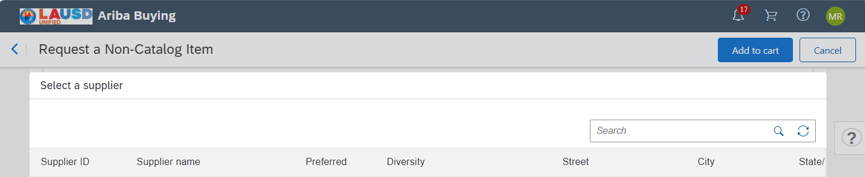
Create a Non-Catalog Requisition (cont’d)
You have the ability to recommend a supplier for this purchase. Click "View all suppliers".
Search for the supplier's name.
Notes:
Trainer will talk on slide

Slide 51
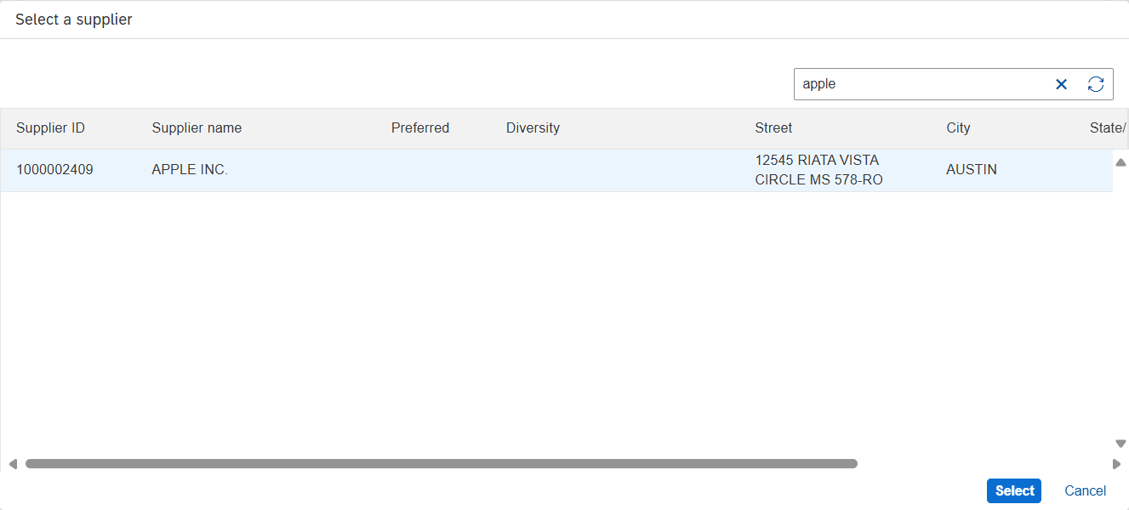
Create a Non-Catalog Requisition (cont’d)
Click on the supplier’s name, and then click “Select.”
If you do not find the supplier that you want to recommend, you can leave the supplier field blank and enter your supplier recommendation in the comments section of the requisition .
Notes:
Trainer will talk on slide

Slide 52
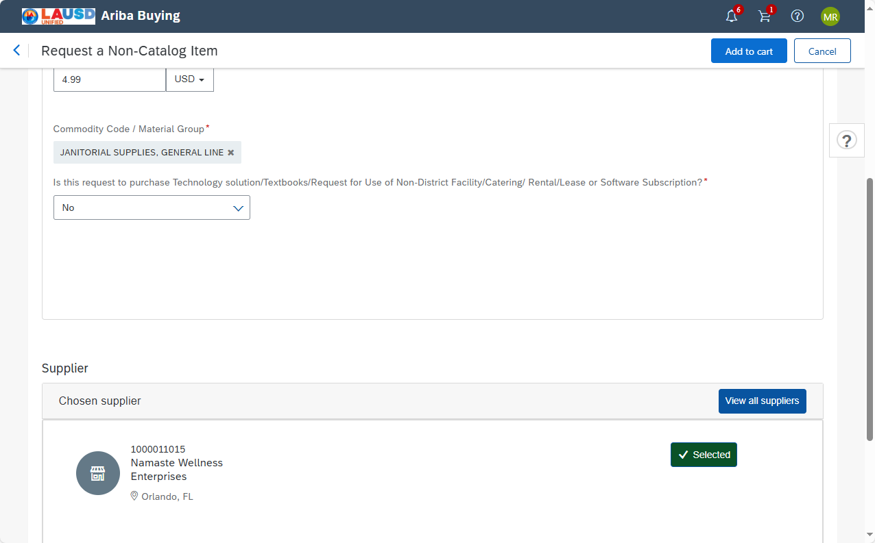
Create a Non-Catalog Requisition (cont’d)
Verify all the fields, and then click Add to cart.
Notes:
Trainer will talk on slide

Slide 53
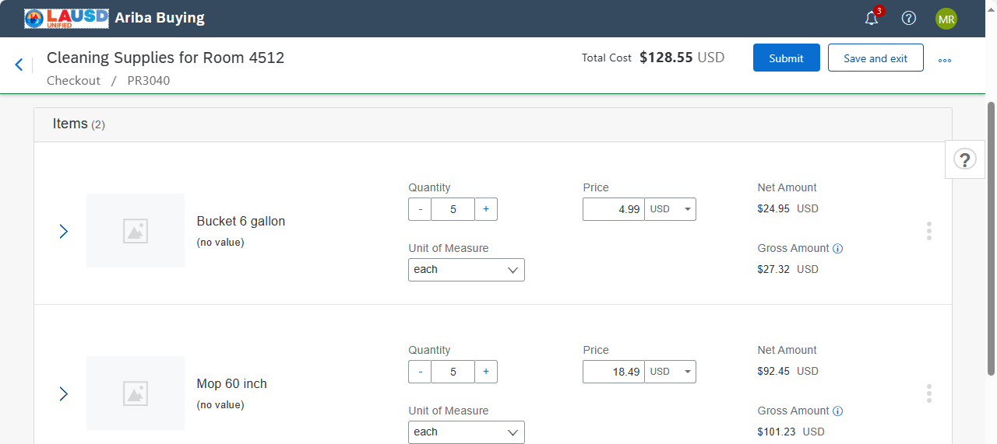
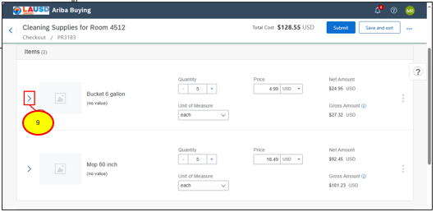
Create a Non-Catalog Requisition (cont’d)
Repeat the process as many times as required. You can add as many line items as needed.
To expand the line-item details to enter accounting and shipping details, click the right facing arrow.
Notes:
Trainer will talk on slide

Slide 54


Create a Non-Catalog Requisition (cont’d)
To expand the Accounting details, click the right facing arrow.
If you need to split the amount of this line item between multiple funds, click Split Accounting.
Notes:
Trainer will talk on slide

Slide 55


Create a Non-Catalog Requisition (cont’d)
Choose the split percentage for each split. In this case we will charge 60% to the cost center shown.
Scroll down.
Notes:
Trainer will talk on slide

Slide 56


Create a Non-Catalog Requisition (cont’d)
The second split we will choose a different cost center, but the process is the same if you are charging to a project, grant or any other funding source.
Notes:
Trainer will talk on slide

Slide 57


Create a Non-Catalog Requisition (cont’d)
The total percentage for all splits must equal 100%. The previous split we entered 60%, for this split we will enter the remaining 40%.
Make sure that the amounts are correct
Notes:
Trainer will talk on slide

Slide 58

Create a Non-Catalog Requisition (cont’d)
Users can copy line items by clicking on the 3 dots to the right of the line item, and then click “Copy.”
This will copy the entire line item including the accounting information, ship to and line-item details. Copy the line and then change the details as required
Notes:
Trainer will talk on slide

Slide 59

Mass Edit of Locations
For Mass Edit of Locations, click on Manage Locations
Notes:
Trainer will talk on slide

Slide 60


Mass Edit of Locations (cont’d)
Click on Browse All and then click on Choose to make edits
Notes:
Trainer will talk on slide

Slide 61

Mass Edit of Funding etc (cont’d)
For Mass Edits of Funding, click Manage Details
Notes:
Trainer will talk on slide

Slide 62

Mass Edit of Funding etc (cont’d)
On the Manage Details screen, make the mass changes. Click Done.
Notes:
Trainer will talk on slide

Slide 63


Create a Non-Catalog Requisition (cont’d)
After completing all the updates, you have the option to Save and Exit or Submit. Save and Exit will save the requisition in “Composing status” and allow the user to submit the PR when ready.
For this example, we will submit the PR for approval.
Notes:
Trainer will talk on slide

Slide 64

Create a Non-Catalog Requisition (cont’d)
Once submitted, it has been sent for approval.
Notes:
Trainer will talk on slide

Slide 65
Course Summary
Key Takeaways
To Create a Non-Catalog item, locate the tile titled Request a Non-Catalog Item on the Guided Buying home dashboard
Complete the Non-Catalog Request form with as much detail as possible.
Choosing a supplier is optional. If you know the supplier that you want to purchase from, you can select the supplier at the bottom of the form.
In the Accounting section of each Non-Catalog line item, users can split the cost of the item across multiple funds. For example, splitting the cost of a line item across 2 cost centers by percentage.
Clicking the three (3) dots to the right of a requisition line item will give you the option to copy a line item or delete a line item.
When ready, submit the requisition for approval.

Slide 66
Create a Non-Catalog PR Tied to a Contract

Slide 67



Create a Non-Catalog Requisition Tied to a Contract
When creating a Non-Catalog item tied to a contract, you need to know how the Contract Compliance document was created. There are three (3) options when creating a Contract Compliance Document for Non-Catalog items.
1 – Supplier level – All items tied to this Supplier will be applied to the contract.
2 – Commodity level – When the supplier and the commodity code match the Contract Compliance document, the items will be applied to the contract.
3 – Item Level – When the supplier and the Supplier Part number match, the item will be applied to the contract.
*At LAUSD Commodity level will be common.
Notes:
Trainer will talk on slide

Slide 68

Create a Non-Catalog Requisition Tied to a Contract
Once all the items have been added to the shopping cart, click Checkout.
Notes:
Trainer will talk on slide

Slide 69


Create a Non-Catalog Requisition Tied to a Contract
We verified the Supplier and the Commodity code that is identified on the Contract Compliance Document associated with this Contract.
When Creating this Requisition line item, we made sure that the supplier and the commodity code match the Contract Compliance Document.
The Ariba system, automatically associated the contract number C251 to this Requisition line item.
Notes:
Trainer will talk on slide

Slide 70

Create a Non-Catalog Requisition Tied to a Contract
It is possible that there are multiple contracts associated with the supplier and the Commodity Code.
Click the downward arrow, and then click Browse all.
Notes:
Trainer will talk on slide

Slide 71

Create a Non-Catalog Requisition Tied to a Contract
Running a search, we can see that there are two contracts associated with this supplier and commodity code combination.
Select the appropriate contract.
Notes:
Trainer will talk on slide

Slide 72
How to Search for a Supplier

Slide 73

How to Search for a Supplier
On the Guided Buying Home Dashboard scroll down to the tile titled “Search for Suppliers”
Notes:
Trainer will talk on slide

Slide 74

How to Search for a Supplier
In the supplier search window, enter the name of the supplier
Click the magnifying glass to execute the search.
Notes:
Trainer will talk on slide

Slide 75

How to Search for a Supplier
The search results will show all results with the word Apple in the name.
If the supplier you are looking for is not found, please work with the Procurement team to request a new supplier.
Notes:
Trainer will talk on slide

Slide 76

How to Search for a Supplier
To return to Guided Buying, click on the “HOME” link.
Notes:
Trainer will talk on slide

Slide 77

How to Search for a Supplier
Next, locate the “News” portlet and click on the Guided Buying link.
Notes:
Trainer will talk on slide

Slide 78
How to Search for a Contract

Slide 79
How to Search for a Contract
On the Guided Buying Home Dashboard scroll down to the tile titled “Contracts”
Notes:
Trainer will talk on slide

Slide 80

How to Search for a Supplier
Currently, users are only able to see Contracts where they are listed as the Contract owner.
LAUSD is working with Ariba to increase visibility to the contracts. If the functionality changes, we will send additional communication and training on this functionality.
Notes:
Trainer will talk on slide

Slide 81
How to Search for a Supplier
To access the Contract, click on the Contract ID
Notes:
Trainer will talk on slide

Slide 82
Create an Asset Request

Slide 83

Create an Asset Request
On the Ariba Guided Buying Interface we select request a Non – Catalog Item Tile to Add the items as Assets.
Assets are differentiated with other items on the basis of account assignment. Account Assignment A is used for Assets.
As per LAUSD Procurement Policy Item greater than USD 5000 will be considered as an Asset.
Notes:
Trainer will talk on slide

Slide 84

Create an Asset Request
Click on this tile for Request a Non-Catalog Item to proceed further.
Notes:
Trainer will talk on slide

Slide 85

Create an Asset Request (cont’d)
Add all the required details for the first line item to be used as an Asset.
Notes:
Trainer will talk on slide

Slide 86

Create an Asset Request (cont’d)
Add all the required details for the second line item to be used as an Asset.
Notes:
Trainer will talk on slide

Slide 87

Create an Asset Request (cont’d)
Checkout both the Items to be added in Purchase Requisition.
Notes:
Trainer will talk on slide

Slide 88

Create an Asset Request (cont’d)
We can see the Policy for Asset Procurement for which we have to use Account Assignment A.
Notes:
Trainer will talk on slide

Slide 89



Create an Asset Request (cont’d)
For Asset Purchases, make sure that the Account Assignment is set to A (Asset)
The Requester must choose a Temporary Asset Number from the list. Temp Asset numbers are identified with a description “Temporary Asset for Ariba” Choose any Temporary asset number
Notes:
Trainer will talk on slide

Slide 90
Create an Asset Request (cont’d)
The Asset Class and the GL Account must be the same. The Asset class will default from the Commodity Code/Material Group that you selected. If the Asset Class is blank, you have selected the wrong Commodity Code/Material Group. Go back and change it to one that is set for an Asset.
Enter the Asset Class number in the GL search. Please make sure that the GL Account is the same as the Asset Class.
Notes:
Trainer will talk on slide

Slide 91

Create an Asset Request (cont’d)
Once all the relevant details are added click on Submit.
Notes:
Trainer will talk on slide

Slide 92

Create an Asset Request (cont’d)
Approval flow for Asset Procurement which includes Asset Manager for further processing in Asset Work Bench.
Once the Buyer Approves, it will be sent to the Asset Manager and then it can be accessed in Asset Workbench.
The Asset Management team will create an Asset number and replace the temporary asset number with the newly created one.
Notes:
Trainer will talk on slide

Slide 93

Create an Asset Request (cont’d)
After Buyer Approval, the Asset Manager can access the Asset WorkBench.
Notes:
Trainer will talk on slide

Slide 94

Create an Asset Request (cont’d)
Asset Workbench has all the relevant requests for Assets only. We will access our request.
Notes:
Trainer will talk on slide

Slide 95

Create an Asset Request (cont’d)
Update the relevant information for Assets in Workbench like Asset Class and Asset line type.
Notes:
Trainer will talk on slide

Slide 96

Create an Asset Request (cont’d)
To Split the Asset based on quantity click on 3 dots for the line item and select Split.
Notes:
Trainer will talk on slide

Slide 97


Create an Asset Request (cont’d)
Update the line field for splitting the quantity and then Click on Split
You will be able to see the split quantity for Assets. Click on Done.
Notes:
Trainer will talk on slide

Slide 98

Create an Asset Request (cont’d)
Request is sent to external system SAP ECC.
Notes:
Trainer will talk on slide

Slide 99



Create an Asset Request (cont’d)
After a few minutes, you will see that system returned an Asset number from our SAP ECC system which confirms the creation of Assets for both of our line items.
Notes:
Trainer will talk on slide

Slide 100
Course Summary
Key Takeaways
When creating a Non-Catalog Requisition for an asset, it is critical to choose the correct Commodity Code / Material Group. If you need help, contact the Purchasing team.
The Requester must change the Account Assignment to A - Asset
The Requester must choose a Temporary Asset Number from the list of Asset numbers.
If the Asset class is blank, you have selected the wrong Commodity Code / Material Group. Change it before proceeding.
The GL Account number must match the Asset class number.
The Asset Manager team will be included in the approval flow.

Slide 101
Create a Stock Transfer Order (STO)

Slide 102

Create a Stock Transfer Order (STO)
From the Guided Buying Home Page, click the General Stores Warehouse tile.
Notes:
Trainer will talk on slide

Slide 103

Create a Stock Transfer Order (STO) (cont’d)
Search for the item(s) that you wish to purchase. Leave the word warehouse to indicate that you are searching the General Stores Warehouse
Notes:
Trainer will talk on slide

Slide 104


Create a Stock Transfer Order (STO) (cont’d)
Locate the item and click “Add to cart
Update the quantity as needed.
Notes:
Trainer will talk on slide

Slide 105


Create a Stock Transfer Order (STO) (cont’d)
If more items are required, close the shopping cart and repeat the process as needed.
Notes:
Trainer will talk on slide

Slide 106


Create a Stock Transfer Order (STO) (cont’d)
Add the other items to your shopping cart and update the quantity.
Notes:
Trainer will talk on slide

Slide 107

Create a Stock Transfer Order (STO) (cont’d)
Update the required fields
Notes:
Trainer will talk on slide

Slide 108


Create a Stock Transfer Order (STO) (cont’d)
For STO orders, there is a new Delivery Priority field in the requisition header. Click on the downward arrow.
Regular Delivery = 3 days.
Will Call = Available same day if order is received by noon, or next day if after noon.
Overnight = Delivery next day if order is received by noon, or 2 days if received after noon.
Same Day = same day if the order is received by noon, or next day if order is received after noon.
Future Delivery = Allows user to choose a future delivery date.
Notes:
Trainer will talk on slide

Slide 109


Create a Stock Transfer Order (STO) (cont’d)
Once you have selected a delivery priority, please make sure that all items are being delivered to the same location.
The General Stores Warehouse does not allow multiple ship-to locations on the same order.
Notes:
Trainer will talk on slide

Slide 110


Create a Stock Transfer Order (STO) (cont’d)
In some cases, there is an approver required for the requisition. Click Submit to start the approval process.
Notes:
Trainer will talk on slide

Slide 111
Course Summary
Key Takeaways
The General Stores Warehouse is an available tile on the Guided Buying Home page
Add items to your shopping cart just like any other catalog
STO Orders have a new field titled "Delivery Priority"
Based on the Delivery Priority and the size and weight of the items being purchased, there may be additional fees for overnight delivery for heavy or large items.

Slide 112
Create a Good Receipt Notification (Receiving)

Slide 113

Create a Goods Receipt/Receiving
Notes:
Trainer will talk on slide

Slide 114

Create a Goods Receipt/Receiving (cont’d)
From the main menu, click Your requests
Notes:
Trainer will talk on slide

Slide 115

Create a Goods Receipt/Receiving (cont’d)
Now click, To receive
Notes:
Trainer will talk on slide

Slide 116

Create a Goods Receipt/Receiving (cont’d)
POs that are ready for receiving will display on this page. If you need additional details from the purchase Order, click the PO number in blue (e.g. 800030052)
Notes:
Trainer will talk on slide

Slide 117

Create a Goods Receipt/Receiving (cont’d)
Clicking Receive All will automatically populate the “accepted” field with the quantity available for receipt on each line item. It is a big time safer for orders with a lot of line items.
Notes:
Trainer will talk on slide

Slide 118

Create a Goods Receipt/Receiving (cont’d)
After the accepted column has been populated. Click “Submit.”
Notes:
Trainer will talk on slide

Slide 119

Create a Goods Receipt/Receiving (cont’d)
After clicking Submit, you will receive a confirmation that the items have been received.
Click OK to continue.
Notes:
Trainer will talk on slide

Slide 120

Create a Goods Receipt/Receiving (cont’d)
To receive line items one at a time, simply enter the quantity accepted to the right of each line item.
Notes:
Trainer will talk on slide

Slide 121

Create a Goods Receipt/Receiving (cont’d)
Repeat the process for each item received.
Notes:
Trainer will talk on slide

Slide 122

Create a Goods Receipt/Receiving (cont’d)
When finished, click Submit
Notes:
Trainer will talk on slide

Slide 123

Create a Goods Receipt/Receiving (cont’d)
At the bottom of the page, you will see all the receiving transactions. Receiving IDs will start with RCXXXX.
Notes:
Trainer will talk on slide

Slide 124

Create a Goods Receipt/Receiving (cont’d)
To search for a fully received Purchase Order, enter the PO ID in the search field.
Notes:
Trainer will talk on slide

Slide 125

Create a Goods Receipt/Receiving (cont’d)
This Purchase Order has been fully received, if needed click Edit
Notes:
Trainer will talk on slide

Slide 126

Create a Goods Receipt/Receiving (cont’d)
Users have the option to Reopen the Purchase Order.
Notes:
Trainer will talk on slide

Slide 127

Create a Goods Receipt/Receiving (cont’d)
Now that the order has been reopened, users may have the need to reverse a receipt.
Notes:
Trainer will talk on slide

Slide 128

Create a Goods Receipt/Receiving (cont’d)
Users can enter a negative number to reverse a receiving transaction.
For example, if a user receives quantity 8, and after further inspection only 6 units are acceptable, the user will enter -2 to reverse 2 items from the receipt.
Notes:
Trainer will talk on slide

Slide 129

Create a Goods Receipt/Receiving (cont’d)
Notice that the total received for the first line items is now 6.
When finished, click Submit.
Notes:
Trainer will talk on slide

Slide 130

Create a Goods Receipt/Receiving (cont’d)
The Purchase Order is now open for receiving.
Notes:
Trainer will talk on slide

Slide 131

Create a Goods Receipt/Receiving On Behalf of Someone.
If a user delegates authority to you, when you log in to Ariba, the system will ask who you want to be. In this example, the top selection (REQUESTOR25) is the person that is logged in. The second selection is a user that has delegated to REQUESTOR25. To Receive on Behalf of the delegatee, simply click on the name.
Notes:
Trainer will talk on slide

Slide 132

Create a Goods Receipt/Receiving On Behalf of Someone.
You are now acting as REQUESTOR24 (Max Rebo)
Click on “Your requests”
Notes:
Trainer will talk on slide

Slide 133

Create a Goods Receipt/Receiving On Behalf of Someone.
Click “To receive”
Here you have full functionality to receive goods or services on any Purchase Orders that requires receiving regardless of when the order was created.
Notes:
Trainer will talk on slide

Slide 134
Course Summary
Key Takeaways
Access orders that are ready to be received by clicking, Your requests, and then To Receive.
Users have the option to choose Accept all on the receiving screen. This will automatically fill in the available amount into the Accepted column. This is a time saver when orders have a lot of line items.
Users can receive a partial order by entering the actual quantity received into the Accepted column. The remaining amount will be available for additional receipts.
The system does not permit any overage tolerance when receiving. You cannot exceed the ordered amount.
To reverse or back out a receipt, enter the amount as a negative number in the accepted column.
If edits are required to a fully received order, the order must be reopened before entering a negative amount in the accepted field.

Slide 135
How to Edit a PR, PO, and GR.

Slide 136

How to Edit a PR
When a Purchase Requisition is in Composing status, users can edit the requisition by clicking Edit. This will put the Requisition in edit mode.
Notes:
Trainer will talk on slide

Slide 137

How to Edit a PR
When a Purchase Requisition is in “Submitted status, users can edit the requisition by clicking Edit or Withdraw. Edit will pull the PR out of the approval cycle and put the PR in Composing status in Edit mode.
Withdraw will pull the PR out of the approval cycle and put the PR in Composing status. To edit the PR users will need to access the PR and click Edit.
Notes:
Trainer will talk on slide

Slide 138

How to Edit a PO
To Edit a Purchase Order, the status of the order must be in Ordered.
Click on the PO number
Notes:
Trainer will talk on slide

Slide 139

How to Edit a PO
To Edit a PO, you must start from the Purchase Requisition (PR). Click on the PR number.
Notes:
Trainer will talk on slide

Slide 140

How to Edit a PO
Users have the option to request either a Change to the Purchase Order (PO) or a request to Cancel the PO.
Notes:
Trainer will talk on slide

Slide 141

How to Edit a PO
Click “Change requisition”
Notes:
Trainer will talk on slide

Slide 142


How to Edit a PO
For this example, we will change the deliver to Address
We have updated the ship to address, and now click Submit.
Notes:
Trainer will talk on slide

Slide 143

How to Edit a PO
Notice that the Requisition number now contains V2 at the end of the PR number
Click View requisition
Notes:
Trainer will talk on slide

Slide 144

How to Edit a PO
The Edited PO must be approved before the change will be sent to the Supplier.
Notes:
Trainer will talk on slide

Slide 145

How to Edit a PO
The approver will see the V2 at the end of the Purchase Requisition indicating that this is a change request to the Purchase Order
Notes:
Trainer will talk on slide

Slide 146

How to Edit a PO
Once the change to the Purchase Requisition is fully approved, the supplier will receive an updated Purchase Order.
Notes:
Trainer will talk on slide

Slide 147

How to Cancel a PO
Next, we will cancel a Purchase Order.
Under the Your requests, click on Purchase order and locate the Purchase Order that you wish to Cancel. Click on the Purchase order number.
Notes:
Trainer will talk on slide

Slide 148

How to Cancel a PO
To Cancel a Purchase Order (PO) you must start from the Purchase Requisition (PR). Click on the PR number.
Notes:
Trainer will talk on slide

Slide 149

How to Cancel a PO
Click Cancel request
Notes:
Trainer will talk on slide

Slide 150

How to Cancel a PO
Enter a comment describing why you would like to cancel this Purchase Order.
Click the checkbox to the left of “Share comments with suppliers”
Then, click Cancel requisition.
Notes:
Trainer will talk on slide

Slide 151

How to Cancel a PO
The Requisition has rolled to Version 3 (V3), and the status is Canceled.
Notes:
Trainer will talk on slide

Slide 152


How to Cancel a PO
The status is now Canceled, and the funds have been released back to the available budget.
In the history section of the requisition, we can see that the Purchase Order has been successfully cancelled and a cancellation notice was sent to the supplier.
Notes:
Trainer will talk on slide

Slide 153
How to Cancel a Goods Receipt (GR)
Cancelling or backing out a good receipt is fully covered in the above section titled “Create a Goods Receipt Notification (Receiving).” Please refer to those slides for instructions.
Notes:
Trainer will talk on slide

Slide 154
How to Close a Purchase Order
Close short.

Slide 155
How to close a Purchase Order
For now, if a user needs to close a Purchase Order the process is to contact the Purchasing Department and request that the PO be closed.
The LAUSD team is working on a new way to close POs. When that is rolled out to the Production environment, there will be additional details communicated along with a training guide.
Notes:
Trainer will talk on slide

Slide 156
Access Prepackaged Reports

Slide 157


How to Access Prepackaged Reports
On the Guided Buying Home Dashboard, scroll down to the tile titled “Prepackaged Reports”
Notes:
Trainer will talk on slide

Slide 158


How to Access Prepackaged Reports
There are hundreds of prepackaged reports available. Review the list of reports and find the one that fits your needs. For this example, we will run a Purchase Order Report.
Notes:
Trainer will talk on slide

Slide 159


How to Access Prepackaged Reports
Each selection on the first page has sub-menus with different reports. In the Purchase Order sub-menu we will run a report showing Purchase Order Summary by Supplier.
Notes:
Trainer will talk on slide

Slide 160

How to Access Prepackaged Reports
First choose a date range for your report. You can choose a relative date range such as 2 years, 3 quarters, or 5 weeks.
Alternatively, users can choose a fixed date range where the user will choose a start and end date from the calendar
Notes:
Trainer will talk on slide

Slide 161
How to Access Prepackaged Reports
Users can choose different filters. For example, users can search Purchase Orders issued to all suppliers or click on the downward arrow and select a smaller subset of suppliers.
When finished refining the report attributes, click “View Report”
Notes:
Trainer will talk on slide

Slide 162

How to Access Prepackaged Reports
Users have the option to Export report data into Microsoft Excel
To change the report attributes, click Edit.
The report defaults to the Pivot table view.
Notes:
Trainer will talk on slide

Slide 163

How to Access Prepackaged Reports
The Chart tab, shows the data in a chart format.
To change the Chart options, use the fields shown here. For example, to change the Chart type from a Column graph to a Pie graph, click on the blue Column button
Notes:
Trainer will talk on slide

Slide 164
Team Shopping

Slide 165

Team Shopping
Team shopping allows users to collaborate with other users when purchasing.
When you buy with a team, you allow other users in your team to edit your request before submission. They can change fields, delete items, or add additional items. All contributors in the team have the same permissions as the preparer or requestor.
Additionally, you can turn on Team Receiving which will allows team members to receive goods or services
To Manage your teams, click on your initials, then App Settings, and then Manage your Team.
Notes:
Trainer will talk on slide

Slide 166


Team Shopping (cont’d)
Click on the + button.
Update the Team Name here.
Users can create up to 50 different teams.
Notes:
Trainer will talk on slide

Slide 167

Team Shopping (cont’d)
Add Team members. Add as many as you like.
Lastly, click Create.
Notes:
Trainer will talk on slide

Slide 168

Team Shopping (cont’d)
Creating a team requisition.
On the Guided Buying Home Dashboard, click Buy with a team
Notes:
Trainer will talk on slide

Slide 169

Team Shopping (cont’d)
Choose the team that will be included as part of this requisition.
Notes:
Trainer will talk on slide

Slide 170

Team Shopping (cont’d)
Decide if you want to allow team receiving or not. This means that anyone listed on the team can create a good receipt for this order. The default is set to allow team receiving.
Then click Start.
Notes:
Trainer will talk on slide

Slide 171

Team Shopping (cont’d)
In the upper left corner of the screen, you will see a note reminding that you are shopping as the "Sales Team."
Shop using the catalogs or create a non-catalog request in the same manner as if you were shopping as an individual.
Notes:
Trainer will talk on slide

Slide 172
Course Summary
Key Takeaways
All Guided Buying users can shop using teams.
Create as many unique teams as needed.
Add and remove team members as needed.
Choose if you want to enable team receiving or not.
To create a team requisition, click "Buy with a team" on the Guided buying home page.

