Slide 1
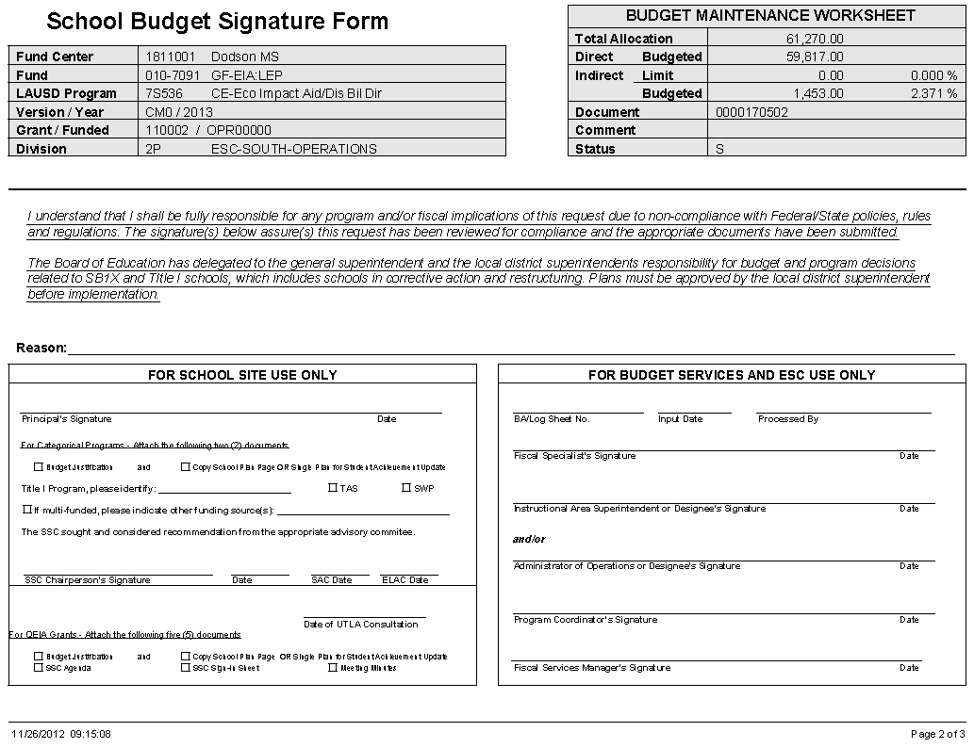
Assurance Page of the SPSA
The school planning sheet for parent involvement activities must be developed with parent recommendations for the projected expenditures from all categorical funds.
Reason for expenditure
Principal’s Signature
To be compliant, the ELAC & SAC “Recommendation” Date
MUST be prior to or the same date
as the SSC Chairperson’s and Principal’s date
UTLA date
SSC Chair’s Signature

