Slide 1


Updated 12/1/2023
2023-2024 Summative ELPAC and Summative Alternate ELPAC Administration Coordinator Training
This PowerPoint is available on the Student Testing Branch Website in Coordinator Resources https://www.lausd.org/testing
This presentation will be used to facilitate your school-based training.

Slide 2
Reminders…
Information provided in this presentation is subject to change.
This presentation must be completed in a single sitting.
You must be in attendance for the entire presentation to receive credit.
Attendance will be tracked based on your total time in the Zoom session.
Completion will be recorded on MyPLN and reflected in the Principal's Portal.

Slide 3
Agenda
Before Testing​ | During Testing​ | After Testing​
Important Information for Coordinators​ Critical Information and Timeline ​ Data Readiness​ Training Requirements ​ Moodle Training​ Monitoring Completion of TE Requirements​ ELPAC TOMS Accounts ​ Accessibility Resources​ Entering Supports, Accommodations, and Domain Exemptions​ Technology ​ | Monitoring Completion​ Preparing for Test Administration​ Creating a Test Session​ Summative ELPAC Test Administration​ K-2 Reading and Listening​ K-2 Writing​ K-12 Speaking​ 3-12 Reading, Listening, and Writing​ DEI Summative Alternate ELPAC Test Administration​ STAIRS​ | Returning K-2 Writing Materials​ Score Reporting​ Post-test Documentation​ Crisis Alert Response System (CARS) and Audits​ New! ELPAC Interim Assessments​ Resources​

Slide 4
Before Testing:
Critical Information and Timeline

Slide 5
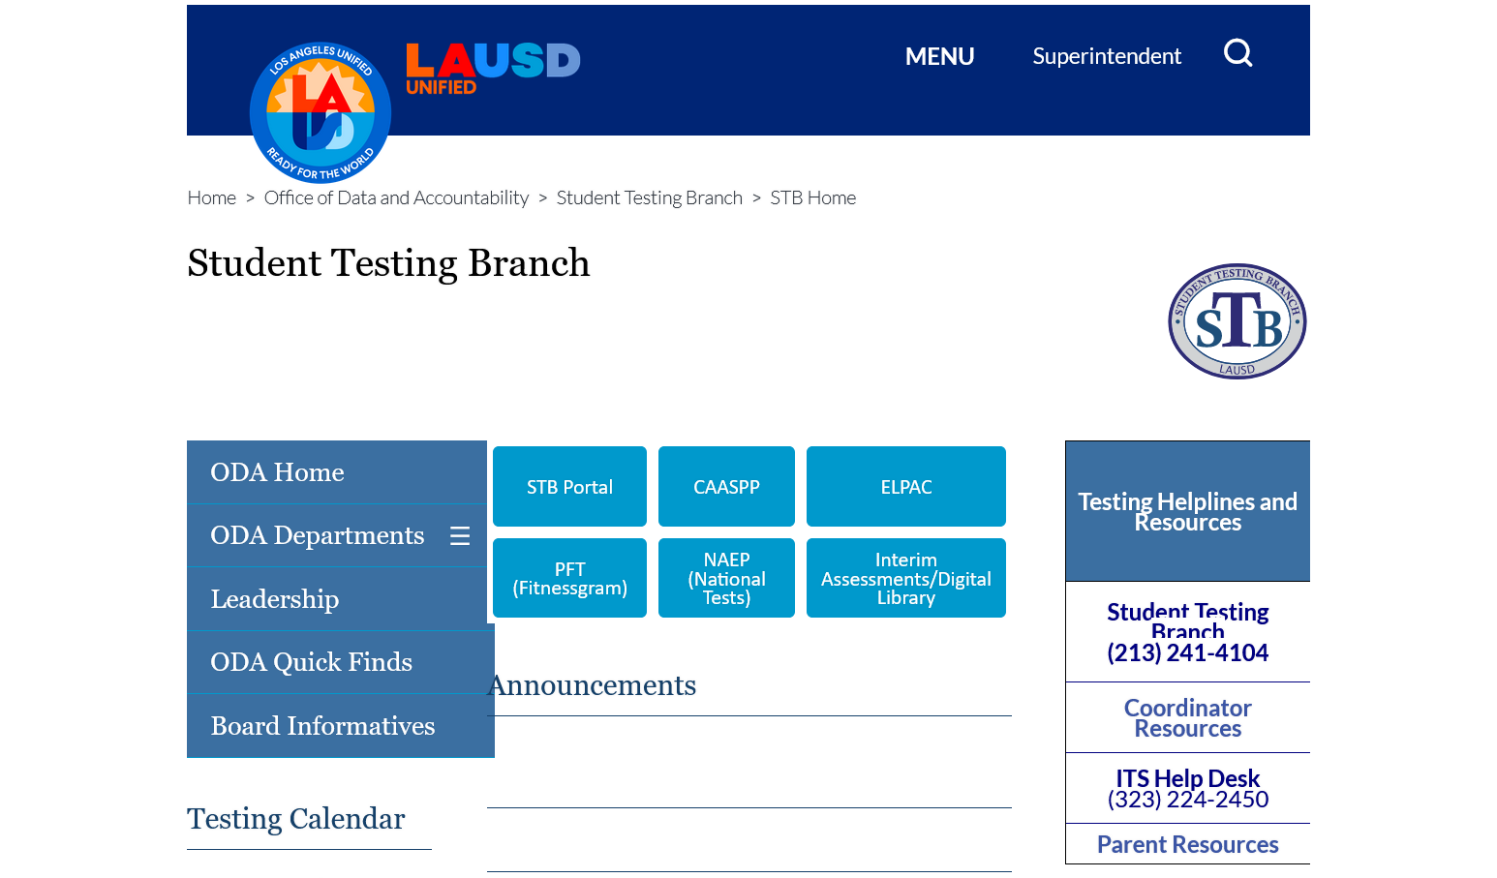
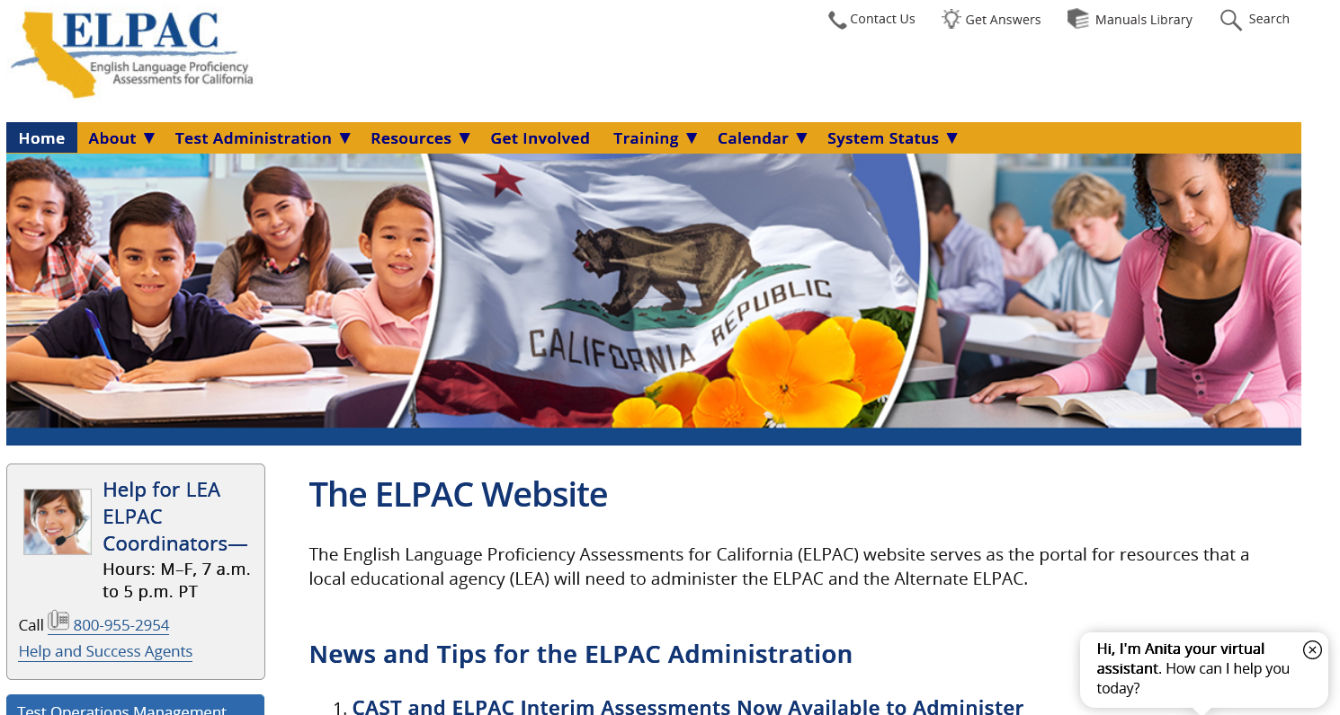
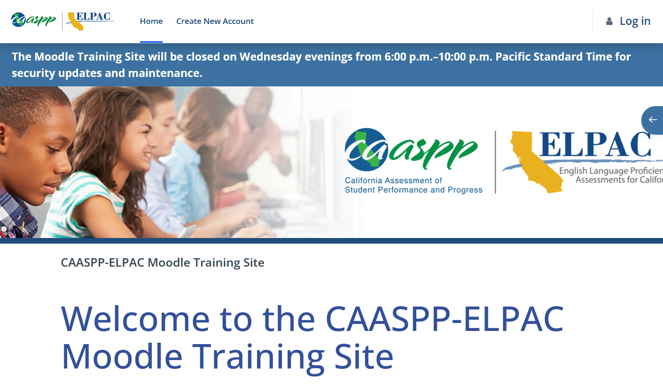
Important Websites to Bookmark
Student Testing Branch | ELPAC | Moodle
https://www.lausd.org/testing | https://www.elpac.org/ | https://moodle.caaspp-elpac.org/
Notes:
Bookmark these 3 important websites for quick access.

Slide 6
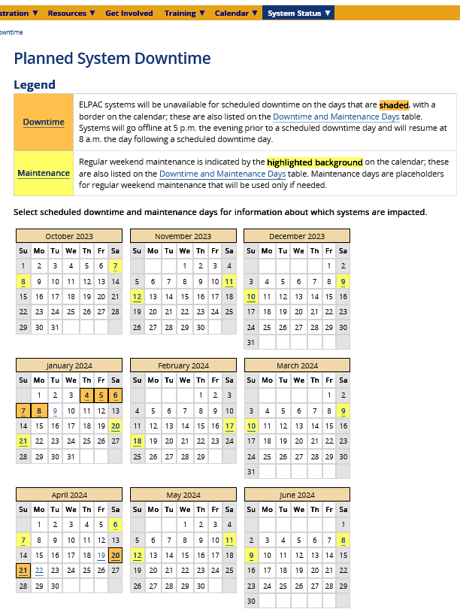
ELPAC Website – Planned Downtime
Indicates downtime and system maintenance dates.
  January 4-8 and 20-21
  February 17-18
  March 9-10
  April 6-7 and 20-21
  May 11-12
  June 8-9
Notes:
Mark your calendar for the planned system downtime and maintenance dates. ELPAC Coordinators and Test Examiners will not have access to any ELPAC systems during this time.

Slide 7

Testing Audits
Three Audit Blocks
  Fall/Winter, 2023
  Winter/Spring, 2023/2024
  Spring 2024
Testing Programs to be Audited
  ELPAC
  CAASPP
  Interim Assessments
STB will contact the school Principal and the CAASPP & ELPAC Coordinators with detailed information.

Slide 8
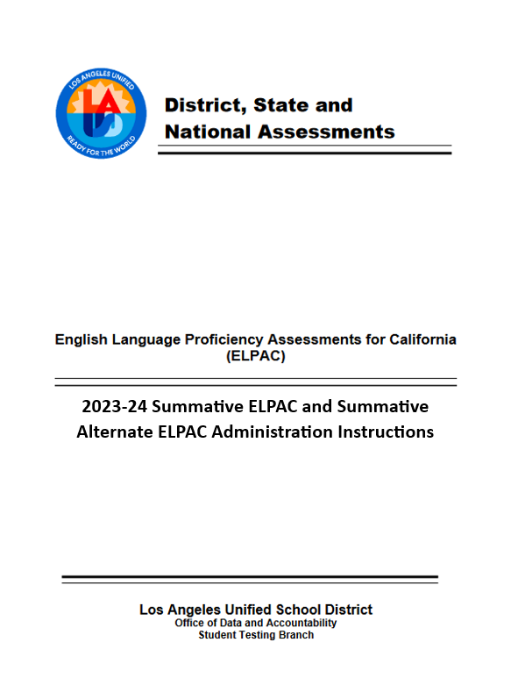
Coming Soon...
2023-24 Summative ELPAC and Alternate ELPAC Administration Instructions.
Will be posted in Coordinator Resources in January 2024.
Outlines test administration and contains Post-Test Documentation Attachments, guidelines for completing K-2 Writing Books and more!

Slide 9
Coordinator Support
Office Hours for ELPAC Coordinators
  Receive support from STB Administrators
    Have this presentation available as a reference
  Access the link to Office Hours in Coordinator Resources
    8:30 am – 9:30 am
    2:45 pm - 3:45 pm
      Office Hours will not be available on Friday afternoons.
STB Help Desk
  Mon-Fri 7:30 am – 4:00 pm (excluding holidays)
  (213) 241-4104

Slide 10
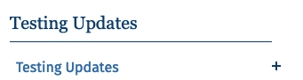
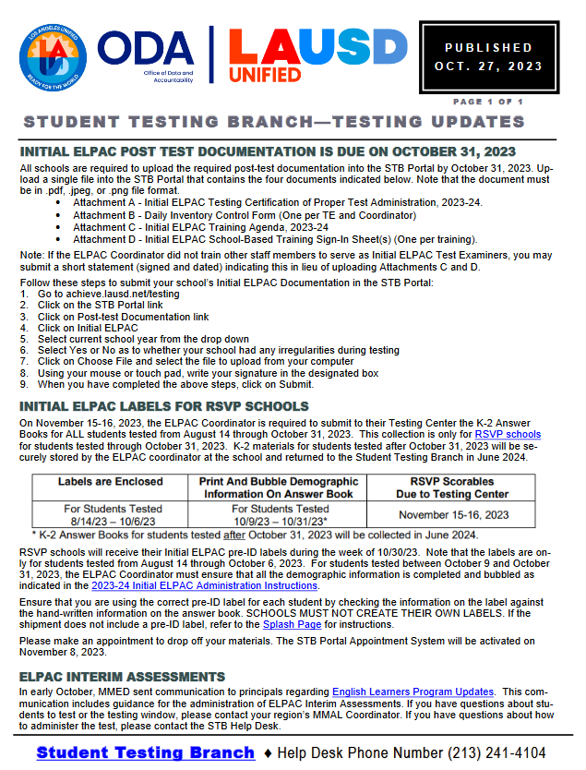
STB Updates
Provides Coordinators with instructions, reminders, and new information.
Weekly STB Update is automatically emailed to Testing Coordinators designated in the Principal's Portal.
  The Testing Point of Contact Training can be completed in MyPLN for individuals who wish to be placed on the distribution list for the remainder of the school year
  STB Updates can also be accessed through the Coordinator Resources page on the STB Website.
Notes:
Any other individual at the school site who would like to be placed on the Testing Update distribution list will need to complete the 2023-24 Testing Point of Contact Training in MyPLN.

Slide 11
Summative ELPAC Coordinator Checklist
Review the Summative ELPAC Coordinator Checklist to identify key tasks to be completed before, during, and after testing.
  Available in Coordinator Resources
Notes:
The Summative ELPAC Coordinator Checklist is a useful tool that will help you organize key tasks in a timely manner.
Located in Coordinator Resources

Slide 12
Key Dates: Grades K-2
K-2 District-Wide Testing Window | Delivery of Test Materials to Schools | Materials Due to Testing Center
April 2 - May 3 A school may choose to assess K-2 students prior to this date based on school needs to meet the May 3, 2024 deadline. (See REF-139909.1) Eligible students enrolled after May 3, 2024 must be tested by May 30, 2024. All domains must be administered, and Speaking scores entered in the DEI by May 30, 2024. | K-2 Summative Writing Answer Books Deliveries start the week of 1/15/2024 Materials will be delivered to schools whose Principal and Coordinator have completed all ELPAC requirements. Inventory and securely store upon receipt. Additional books can be ordered through the STB Portal. K-2 Summative Writing Answer Books Pre-ID Labels Schools will receive pre-ID labels prior to the first turn-in date. | K-2 Summative Writing Answer Books Collection April 22-23 May 6-7 June 3-4, 2024 (for newly enrolled students) ------------------------------------------------------ FINAL ELPAC Collection June 3-4, 2024 Turn in completed Summative K-2 Writing Books for students enrolled AFTER May 3, 2024 Turn in ALL Initial and Summative Non-Scoreables
Notes:
Note the window for K-2 administration and the collection dates

Slide 13
Key Dates: Grades 3-12
Grades 3-12 District-Wide Testing Window | Delivery of Test Materials to Schools
February 1 – March 22, 2024 ALL eligible students in grades 3-12 must be tested by March 22. Eligible students enrolled after March 22 must be tested by May 30, 2024 All domains must be administered, and Speaking scores entered in the DEI by May 30, 2024. | Earbuds Deliveries start the week of 1/8/2024. Earbuds will be used for ELPAC and CAASPP Summative Assessments. ELs in grades 3-12 will only receive 1 set of earbuds to use for both assessments.
Notes:
Note the window for K-2 administration and the collection dates

Slide 14
ELPAC Timeline
Dec Jan Feb March April May Jun
Initial ELPAC: Continue to administer to eligible students (ends June 11)
Summative and Summative Alternate ELPAC
February 1 – March 22
(Grades 3-12)
Newly Enrolled students must be tested by May 30.
Summative and Summative Alternate ELPAC
April 2– May 3
(Grades K-2)
Newly Enrolled students must be tested by May 30.
A school may choose to assess K-2 students prior to this date based on school needs to meet the May 3, 2024 deadline.
CAASPP: March 5– May 24
Fitnessgram
February 1 – March 17
Notes:
Be mindful of additional State and District assessments occurring during the Summative ELPAC window

Slide 15

Summative ELPAC Testing Schedule
Schedule must follow District-wide testing windows.
  K-2: April 2 - May 3
  3-12: February 1 – March 22, 2024
K-2 schools that wish to start testing earlier, should enter the actual test dates in the calendar.
The ELPAC Coordinator will submit the school’s testing schedule through the STB Portal by January 19, 2024.
Share with staff and parents.
Notes:
Enter the dates your school is actually going to be testing.

Slide 16

How to Submit the Testing Schedule

Slide 17
Parent Notification
    Parent exemptions do not apply for ELPAC!
Schools are required to notify parents before testing students.
MMED will mail the Summative ELPAC Parent Notification Letter on January 8, 2024 for ELs enrolled as of that date.
  ELPAC Coordinators will need to send the Parent Notification for students enrolled after January 8, 2024.
    The Parent Notification letter will be posted on the MMED website.
    https://achieve.lausd.net/Page/180
    EL Federal and State Programs > Forms
Notes:
According to State Regulations, parent exemptions do not apply for ELPAC. The State requires schools to notify parents before testing begins.

Slide 18
Action Items
Mark your calendars with the Key Dates.
Inventory and securely store your K-2 Writing Answer books upon receipt.
Enter your school's testing schedule in the STB Portal.

Slide 19
Before Testing
Data Readiness

Slide 20
Who is Eligible for the Summative ELPAC?
The Summative ELPAC is a computer-based annual assessment to measure an English Learner’s (ELs) progress towards English language proficiency.
All English Learners must take the Summative ELPAC annually until they are officially reclassified in TOMS.
  Summative ELPAC
  Summative Alternate ELPAC
Notes:
The Summative ELPAC measures the English language proficiency of English learners.

Slide 21
Who is Eligible for the Summative Alternate ELPAC?
Students who meet ALL of the following three requirements will be administered the Summative Alternate ELPAC:
Student has an ELAS of EL
Student has a Significant Cognitive Disability
Student has the Alternate ELPAC indicated on their Individualized Education Program (IEP) in Section K prior to the assessment
  IEP Team resources
    Alternate Assessment Decision-Making Tool
    Assessment IEP Team Guidance
STB will assign the Alternate ELPAC to eligible students on January 12, 2024.
    Some students already have been assigned.
Coordinators will confirm the correct assignment in TOMS and make changes as required by the IEP.
Coordinators will assign the assessment to students who become eligible after this date.
Notes:
There are three requirements for the Summative ALT ELPAC

Slide 22
Which Summative ELPAC Assessment is Administered?
Student’s ELAS is EL in TOMS
Student does NOT have an IEP.
Student has an IEP.
Student will be administered the
Summative ELPAC.
Student’s IEP
DOES NOT indicate the Alternate ELPAC.
Section K of student’s IEP indicates the Alternate ELPAC.
The ELPAC Coordinator will assign the Summative Alternate ELPAC in TOMS, if it was not assigned by STB.
Notes:
You have verified the student's ELAS is TBD in TOMS.
Next step is to determine which summative ELPAC to administer.
No IEP, administer the summative ELPAC
Student with an IEP, however it does not indicate Alternate Assessment, administer the Summative ELPAC
Student with an IEP and Section K indicates ALT ELPAC. Assign Summative Alternate ELPAC in TOMS. Administer the Summative Alternate ELPAC

Slide 23
Verifying Summative ELPAC Eligibility
Frequently download the Summative ELPAC and Summative Alternate ELPAC Student Eligibility Report in TOMS.
  Cross Reference with MiSiS.
    TOMS information supersedes MiSiS.
Verify IEPs (Section K) to identify students who have the Alternate ELPAC indicated on their IEP.
  Work with SpEd Staff
Assign the Summative Alternate ELPAC to eligible students in TOMS (if not assigned by STB)
  Test Assignment will be indicated on the Eligibility Report when you download it again.
Notes:
To verify eligibility review student demographic data information in TOMS
First, access the Summative ELPAC and Summative Alternate ELPAC Student Eligibility Report
Verify IEP, look at Section K
Assign Summative ALT ELPAC in TOMS

Slide 24
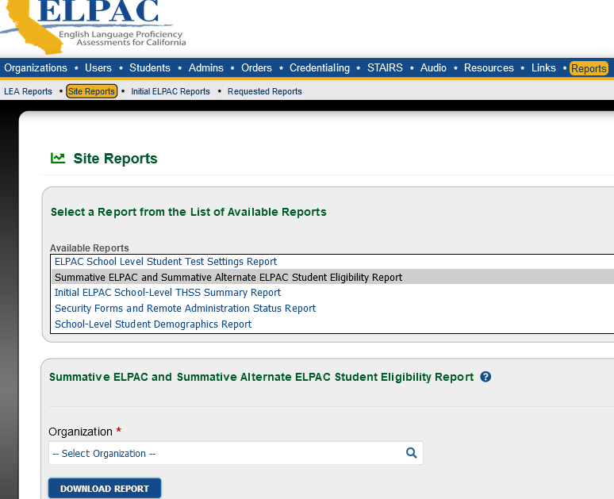
Student Eligibility Report
Summative ELPAC and Summative Alternate ELPAC Student Eligibility Report provides a list of students who must take the Summative ELPAC.
Check this report to view the students who have the Alternate ELPAC assigned (if applicable).
  Cross Reference with Section K Report.
  Assign the Alternate ELPAC to students who become eligible throughout the window.
    Students will also be assigned the CAAs if in grades 3 and above.
1
2
3
4
Notes:
The Summative ELPAC and Summative Alternate ELPAC Student Eligibility Report is the first report you will want to generate from TOMS.
Download this report frequently throughout the school year.

Slide 25
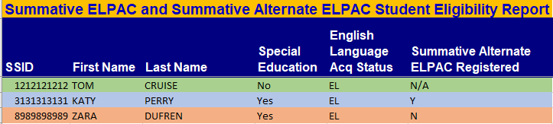
Summative ELPAC Student Eligibility Report
Student does not receive SpEd services and is not eligible for Alternate ELPAC.
Student is not assigned the Alternate ELPAC; check Section K.
Student has been assigned the Summative Alternate ELPAC.
Notes:
Pay close attention to Column "Z." Students who have a "YES" in this column have been assigned the Summative Alternate.

Slide 26
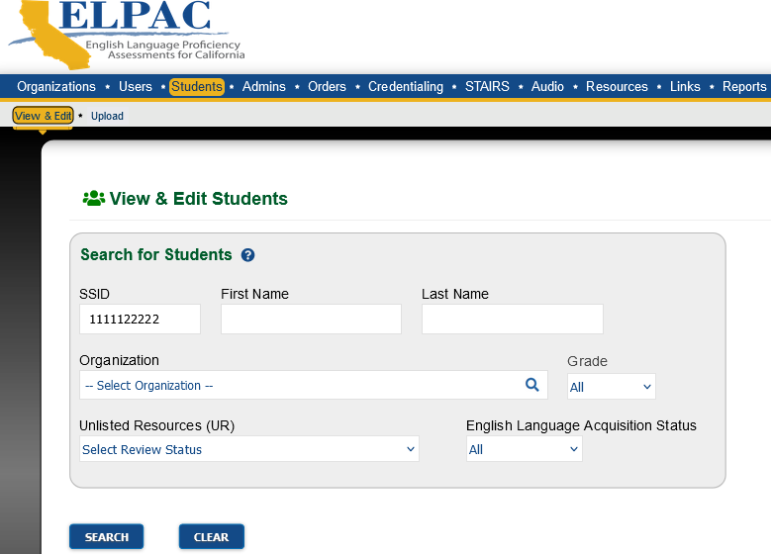
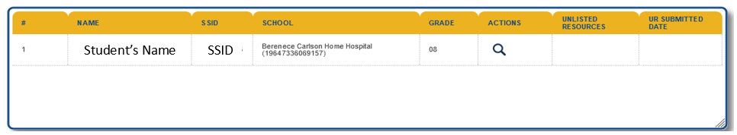
Viewing Individual Student Information in TOMS
Enter SSID to search for individual students.
Search
Click to View
Notes:
To search for an individual Student Profile in TOMS, it is always best to search by SSID number.

Slide 27
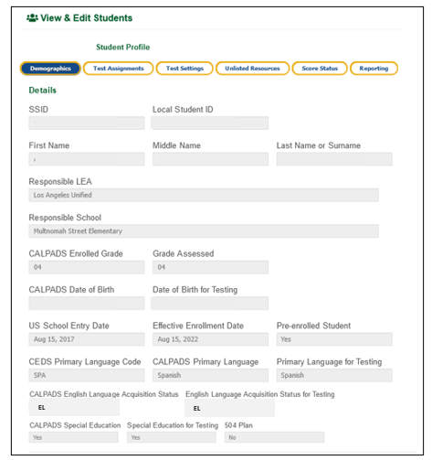
Student Profile Page in TOMS
Verify that the grade level is correct.
  High Schools- administer the ELPAC BEFORE any grade level changes take place.
ELAS Status must be EL
Indicator for Special Education
  Must indicate "YES" for accommodations to be entered or for the student to be assigned the Summative Alternate ELPAC.
    Check for ALT ELPAC designation on IEP.
1
2
3
Notes:
Student Profile contains valuable student information. Some of the student data displayed:
Grade level
English Language Acquisition Status, know as ELAS
Special Ed indicator

Slide 28
Assigning the Summative Alternate ELPAC in TOMS
After verifying eligibility, ELPAC Coordinators will assign the Summative Alternate ELPAC to eligible students in TOMS (if they were not assigned by STB.
  TOMS How to Enter Student Test Assignments One by One Video
Notes:
See the link listed for instructions on how to enter test assignments by the one-by-one method in TOMS

Slide 29
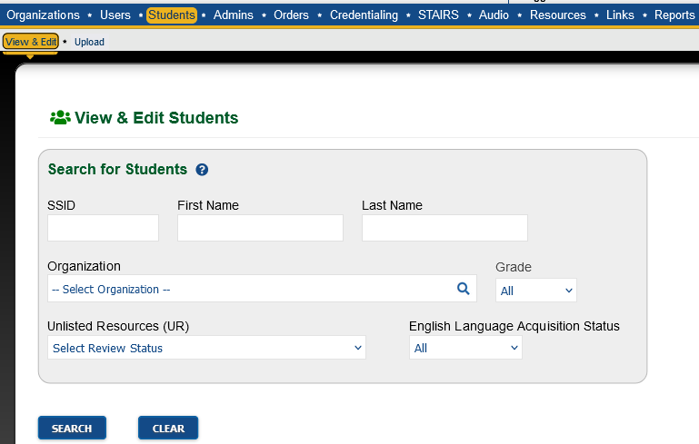
Assigning the Summative Alternate ELPAC in TOMS
1. Enter SSID
2. Search
3. View
Notes:
The next 2 slides list the steps for assigning the Summative ALT ELPAC in TOMS.
Search for the student by SSID

Slide 30
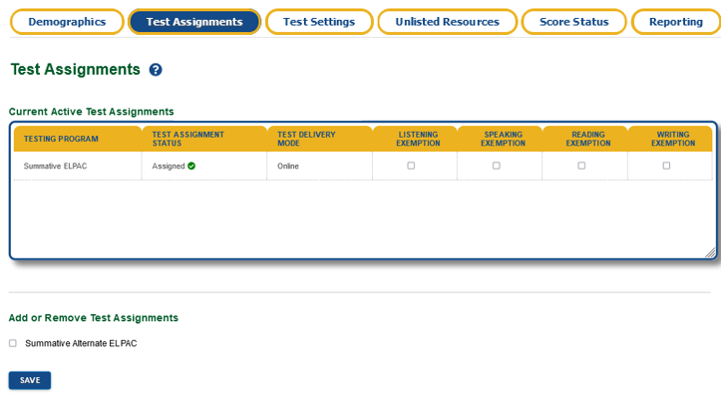
Assigning the Summative Alternate ELPAC in TOMS
Select
Save
Notes:
Select Test Assignments, click the Summative Alternate ELPAC box, and then click the Save button.
You will need to wait 24-48 hours for the update to process

Slide 31
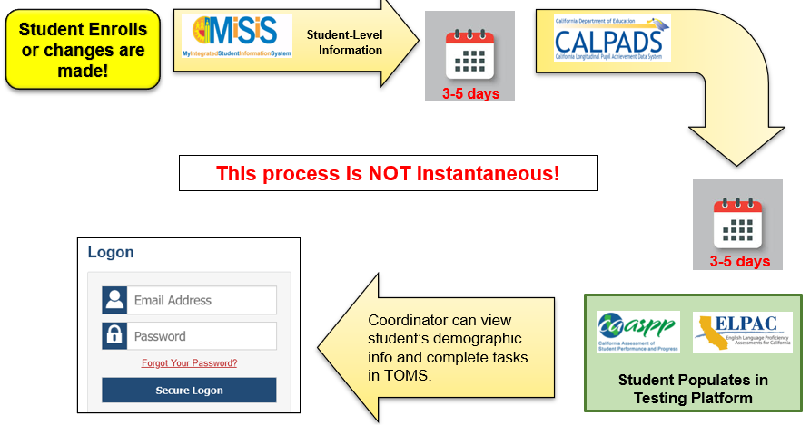
Data Flow Process
  Student demographic data changes in CALPADS can take 5-10 business days or longer to process.
  Grade level changes will affect grade level of assigned tests.
            CAASPP tests may be affected.
  Demographic changes in MISIS will delay students accessing assigned tests.
  Special education indicator must be reflected in TOMS before assigning ALT ELPAC or Accommodations.

Slide 32
New Enrollees
  Continue to check Summative ELPAC eligibility in TOMS for new enrollees.
    Allow 2 weeks for data to sync.
    Check the Completion Status Portal to verify test completion.
          The student will not be able to test if they already completed the Summative ELPAC at a previous school.
    If student requires the Initial ELPAC, administer that first.
        Student will have an ELAS of TBD in TOMS.

Slide 33
Data Corrections
  Contact State Reporting Services Branch (SRSB) at 213-241-2450
    Eligible students who have been enrolled for more than 2 weeks and cannot access tests
    Dual enrollment issues
    Demographic errors
    ELAS discrepancies

Slide 34
Summative ELPAC Reports
Name of Report | Purpose
Summative ELPAC and Summative Alternate ELPAC Student Eligibility Report | Indicates students who are eligible to test per TOMS.
Security Forms and Remote Administration Status Report | Indicates which TEs signed the TOMs Affidavit. Required before TEs can access assessments.
ELPAC School-Level Test Assignment Report | Indicates if a student is assigned the Summative ELPAC or an Alternate Language Assessment.
ELPAC School-Level Test Settings Report | Shows the designated supports and accommodations you entered in TOMS for students
ELPAC School-Level Student Score Report PDFs | Print Summative ELPAC Score Reports once available
ELPAC School-Level STAIRS and Appeals Report | Monitor submitted STAIRS and Appeals
Notes:
Here is a list of some of the Summative ELPAC reports available to Coordinators
These reports will assist with managing responsibilities before, during, and after testing

Slide 35
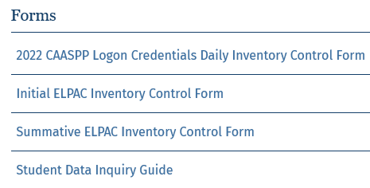
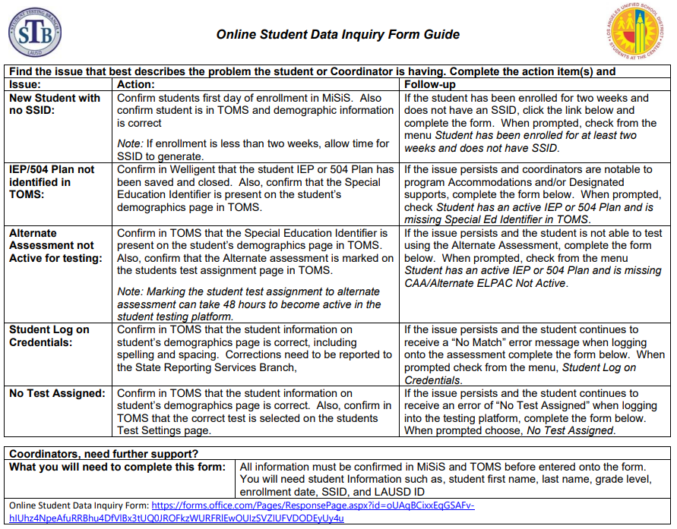
Online Student Data Inquiry Form
Access the Student Data Inquiry Guide in STB’s Coordinator Resources
Find the issue that is occurring.
If you can confirm the related Actions for the issue, click on the link to access the Online TOMS Student Data Inquiry Forms.
Notes:
Coordinators can access the form in Coordinator Resources

Slide 36
Action Items
Download your school site's Summative ELPAC and Summative Alternate ELPAC Student Eligibility Report.
Verify with your SpEd Team who will take the Summative Alternate ELPAC per the IEP.

Slide 37
Before Testing
Training Requirements

Slide 38
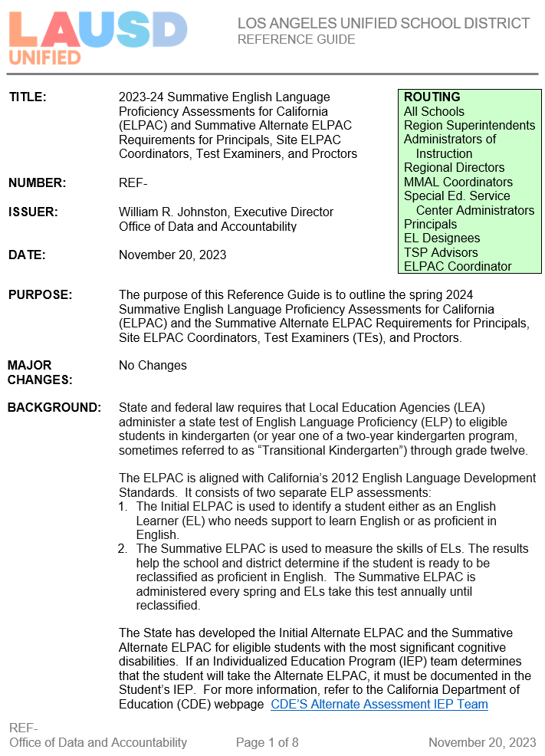
Policy Document
Reference Guide 147312- 2023-24 Summative English Language Proficiency Assessments for California (ELPAC) and Summative Alternate ELPAC Requirements for Principals, Coordinators, and Proctors
Will be posted in E-Library
Notes:
Reference Guide 147312 outline the 2023-24 Summative ELPAC and Summative Alternate ELPAC requirements for Principals, Site ELPAC Coordinators, Test Examiners (TE), and Proctors.

Slide 39
Site ELPAC Coordinators
Each school must always have at least one, fully trained ELPAC Coordinator on site or testing cannot begin nor proceed.
  Contact STB and your Region MMAL Team for guidance if there will be a change in ELPAC Coordinator at any point throughout the year.
    Do not wait until the last minute!
  School’s TE accounts will be deleted if there is not a fully-trained ELPAC coordinator on site.
Principals may designate a 2nd ELPAC Coordinator (must complete all Coordinator training requirements) by contacting James Overturf (james.overturf@lausd.net).
  The 2nd coordinator SUPPORTS the primary ELPAC Coordinator and may not have access to all platforms as the primary coordinator.
Notes:
The District requires each school to have one fully trained ELPAC coordinator throughout the year. The ELPAC coordinator will manage and oversee each of these assessments
Initial and Initial Alternate ELPAC
Summative and Summative Alternate ELPAC
If any time throughout the year you move, change assignments, go on leave, your principal will need to designate someone in your absence or to take your place.

Slide 40
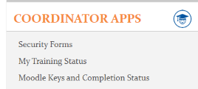
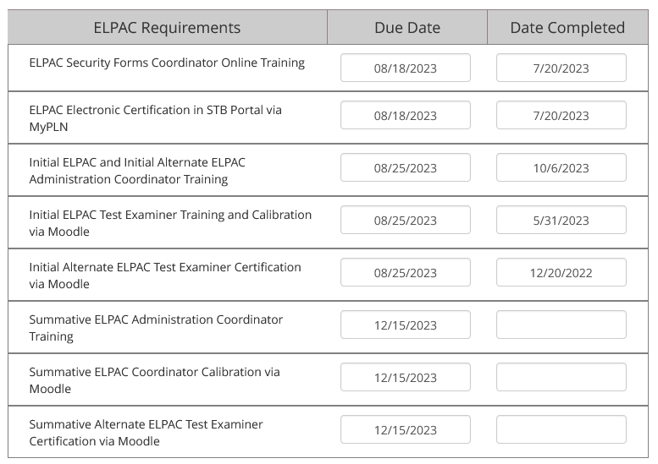
STB Portal-My Training Status
All ELPAC Coordinators (regardless of designation date) must complete all Initial ELPAC and Summative ELPAC Coordinator Training Requirements to receive a TOMS account.
Notes:
The My Training Status page displays the ELPAC Coordinator’s Completion of Training Requirements (there is a delay for the information to sync)

Slide 41
Summative ELPAC Coordinator Requirements
ALL ELPAC Coordinator Requirements must be completed by January 30, 2024, or all ELPAC accounts for the school will be deleted.
2023-24 Summative ELPAC and Summative Alternate ELPAC Administration Coordinator Training
  Facilitated by STB
2023-24 LAUSD Summative ELPAC Test Examiner Training and Calibration
  Facilitated by Region MMAL Team
  Completed in Moodle
These two trainings can be completed in any order.
2023-24 LAUSD Summative Alternate ELPAC Test Examiner Certification
  Completed during your work hours
All ELPAC Coordinators must complete this training.
Notes:
Keep this flowchart handy for your records.

Slide 42
Summative ELPAC Test Examiner Training Reminders
ELPAC Coordinators will use and adapt this presentation to facilitate their school-based training.
Agenda and Sign-In Sheets are provided in the 2023-24 Summative ELPAC Administration Instructions (ATT. C and D)
  This agenda lists all mandated training topics and can be edited to fit site needs.
  Maintain Sign-in sheets and agenda(s) for all Summative ELPAC school-based trainings.
    These will be uploaded to the STB Portal next semester.
      Refer to 2023-24 Summative ELPAC Administration Instructions
        Coming January 2024
        Will be posted in Coordinator Resources
All testing documentation must be maintained on site for 2 years.

Slide 43
Summative ELPAC Test Examiner Requirements
2023-24 ELPAC Security Form TE and Proctor Requirements (MyPLN) 2023-24 ELPAC Security Form Test Examiner and Proctor Training 2023-24 ELPAC Security Affidavit Complete on LAUSD Network Coordinators must designate Summative ELPAC TEs in the STB Portal after completion of both requirements. Moodle accounts will be created by STB for designated TEs who do not have a Moodle account 1-2 business days after designation. | Affidavit is signed in STB Portal via MyPLN. Satisfies the ELPAC Security Requirements for ALL ELPAC assessments for the 2023-24 school year.
2023-24 Summative ELPAC and Summative Alternate ELPAC Administration School-based Training Use this presentation and add school logistics | Provide Moodle Key(s) to trained TEs after completion of requirements 1-2.
2023-24 LAUSD Summative ELPAC Test Examiner Training and Calibration (Moodle) TEs will calibrate for the grade level(s) they will administer the test Collect Calibration certificate from each Test Examiner One comprehensive certificate for Speaking and Writing per grade | https://moodle.caaspp-elpac.org/ Collect Calibration Certificates
Notes:
Maintain copies of school-based training agenda and sign-in sheets. These will be uploaded to the STB Portal
Maintain copies of Moodle TE Calibration Certificates

Slide 44

Summative ELPAC Test Examiner Requirements
2023-24 ELPAC Security Form TE and Proctor Requirements (MyPLN)
  ELPAC Security Forms TE and Proctor Training
  Sign Affidavit (must be on the LAUSD Network to sign)
Coordinator designates TE in the STB Portal.
If needed, STB creates a Moodle account.
Moodle account created.
2023-24 Summative ELPAC and Summative Alternate ELPAC Administration School-based Training
  Facilitated by ELPAC Coordinator
1-2 business days
2023-24 LAUSD Summative ELPAC Test Examiner Training and Calibration
  Coordinator provides TEs with the Moodle key.
Coordinator creates TE TOMS account.
TE logs into their ELPAC TE role in TOMS and signs the affidavit.
TE can create Summative ELPAC test sessions.
2-3 hours

Slide 45
Summative Alternate ELPAC Test Examiner Requirements
2023-24 ELPAC Security Form TE and Proctor Requirements (MyPLN) 2023-24 ELPAC Security Form Test Examiner and Proctor Training 2023-24 ELPAC Security Affidavit Complete on LAUSD Network Coordinators must designate Summative ELPAC TEs in the STB Portal after completion of both requirements. Moodle accounts will be created by STB for designated TEs who do not have a Moodle account 1-2 business days after designation. | Affidavit is signed in STB Portal via MyPLN. Satisfies the ELPAC Security Requirements for ALL ELPAC assessments for the 2023-24 school year.
2023-24 Summative ELPAC and Summative Alternate ELPAC Administration School-based Training Use this presentation and add school logistics | Provide Moodle Key(s) to trained TEs after completion of requirements 1-2.
2023-24 LAUSD Summative Alternate ELPAC Test Examiner Certification (Moodle) Collect certificate from each Test Examiner | https://moodle.caaspp-elpac.org/ Collect Completion Certificates
Notes:
Maintain copies of school-based training agenda and sign-in sheets. These will be uploaded to the STB Portal
Maintain copies of Moodle TE Calibration Certificates

Slide 46
Summative ALT ELPAC Test Examiner Requirements
2023-24 ELPAC Security Form TE and Proctor Requirements (MyPLN)
  ELPAC Security Forms TE and Proctor Training
  Sign Affidavit (must be on the Network to sign)
Coordinator designates TE in the STB Portal.
If needed, STB creates a Moodle account.
Moodle account created.
2023-24 Summative ELPAC and Summative Alternate ELPAC Administration School-based Training
  Facilitated by Site ELPAC Coordinator
1-2 business days
2023-24 LAUSD Summative Alternate ELPAC Test Examiner Certification
  Coordinator provides TE with Moodle key.
Coordinator creates TE TOMS account.
TE logs into their ELPAC TE role in TOMS and signs the affidavit.
TE can create Summative Alternate ELPAC test sessions.
2-3 hours

Slide 47
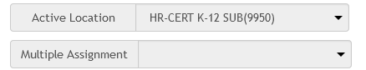
Training Requirements for Teacher Assistants, Paraprofessionals, and Substitute Teachers
The school site administrator will have the option to utilize the following LAUSD employees to assist with the administration of the 2023-24 Summative ELPAC as a Test Examiner (subject to funding restrictions*).
  Trained substitute teachers
  Trained paraprofessionals (may not administer Alternate ELPAC)
  Trained teacher assistants (may not administer Alternate ELPAC)
Individuals must complete all Summative ELPAC Test Examiner (TE) Training Requirements.
Substitutes should select your school as a multiple assignment when signing the ELPAC Affidavit.
*Contact your Region MMAL Team if you have any questions regarding funding restrictions.
Student Teachers may not serve as Test Examiners or Proctors.
They may not have access to any ELPAC training or test materials.
Notes:
Any Teacher Assistants, Paraprofessionals, or substitute teachers administering the Summative ELPAC must complete all Test Examiner Training requirements.
It is important for substitutes to select your school in the Multiple Assignment drop down box when signing the ELPAC Affidavit in the STB Portal
Paraprofessionals and Teacher Assistants may not administer the Summative ALT ELPAC
Student teachers cannot have access to any ELPAC assessments or materials

Slide 48
ELPAC Test Examiner Responsibilities
Complete all required Summative ELPAC trainings and review all policy and test administration documents.
Administer all domains of the Summative ELPAC.
Provide logon credentials to students in a secure manner.
View student information in the Test Administrator Interface prior to testing to ensure that the correct student receives the proper test with the appropriate resources.
Report all potential security incidents to their ELPAC Coordinator.
Perform data and score entry in DEI.
Notes:
It is the Test Examiner's responsibility to ensure proper test administration using materials, entering scores in the correct systems and reporting any incidents to the school site ELPAC Coordinator. The Test Examiner must do the following:
Complete all required Summative ELPAC trainings and review all policy and test administration documents.
Administer all domains of the Summative ELPAC
Provide logon credentials to students in a secure manner
View student information in the Test Administrator Interface prior to testing to ensure that the correct student receives the proper test with the appropriate resources
Report all potential security incidents to their ELPAC Coordinator
Perform data and score entry in DEI and THSS

Slide 49
Summative ELPAC Proctor Requirements
  Proctors are required when:
  Testing more than 20 students in grades 3-12.
  Testing more than 10 students in 2nd grade Writing.
2023-24 ELPAC Security Form TE and Proctor Requirements (MyPLN) 2023-24 ELPAC Security Form Test Examiner and Proctor Training 2023-24 ELPAC Security Affidavit Complete on LAUSD Network | Affidavit is signed in STB Portal via MyPLN. Satisfies the ELPAC Security Requirements for ALL ELPAC assessments for the 2023-24 school year.
2023-24 Summative ELPAC and Summative Alternate ELPAC Administration School-based Training Use this presentation and add school logistics
Notes:
Maintain copies of school-based training agenda and sign-in sheets. These will be uploaded to the STB Portal
Proctors do not complete Moodle or receive TOMS accounts.

Slide 50
ELPAC Proctor Responsibilities
Complete all required Summative ELPAC trainings and review all policy and test administration documents.
Actively monitor students when testing
  Walk up and down the aisles.
  Ensure students are not using unauthorized electronic devices.
Proctors are required when:
  Testing more than 20 students in grades 3-12.
  Testing more than 10 students in 2nd grade Writing.
Proctors do not receive TOMS accounts.
Notes:
The purpose of a trained proctor is to assist with test administration. Proctors do not need a TOMS account, however the proctor must participate all required ELPAC trainings and review policy and test administration documents. During testing, actively monitoring means walking up and down the aisles and ensuring students are not using unauthorized electronic devices. As the ELPAC Coordinator, you should assign a proctor during group administration when tests are administered to groups of 20+ in grades 3-12 and groups of 10+ when administering the grade two writing test.

Slide 51
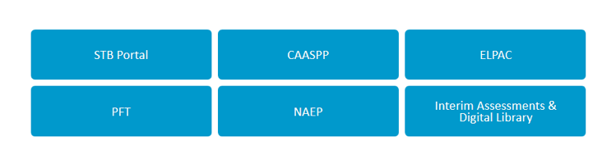
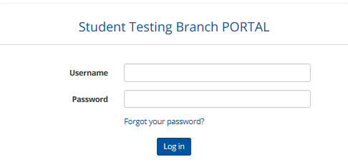
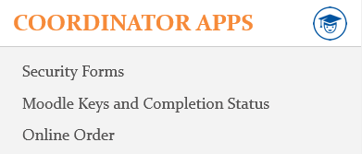
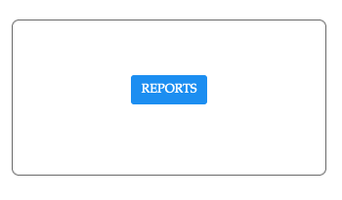
Designating TEs in the STB Portal
Navigate to STB Website: https://www.lausd.org/testing
1
2
3
4
Notes:
To access the Security Affidavit Report from STB Portal, follow steps 1-4.

Slide 52
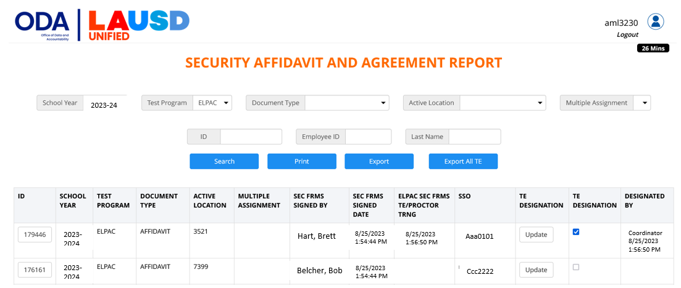

Designating TEs in the STB Portal
2. Select your school to view substitutes.
1. Select Testing Program.
3. Both requirements must be completed to designate.
4. Click the box to designate the individual as an ELPAC TE.
5. Click "Designate (All Selected)"
Notes:
The ELPAC Coordinator must designate all ELPAC TEs in the STB before sharing the Moodle key
TEs who require a Moodle account will have one created by STB in 1-2 business days

Slide 53
Monitoring Completion of TE & Proctor Requirements
If a site employee is not populating on the Affidavit and Agreement Report, they DID NOT sign the ELPAC Affidavit; they only marked it COMPLETE in MyPLN.
  Guide them to sign the affidavit directly in the STB Portal.
    Log into the STB Portal
    Select SECURITY FORMS
    Select ELPAC
    Read, sign, and click CERTIFY/SUBMIT
    Completion will immediately populate in the STB Portal
If a substitute is not populating on the Report, select your school in the Multiple Assignment dropdown menu.
  If they still do not populate, have them complete the steps listed above and select your school as a multiple assignment.
  If they already signed and are unable to add your school, call STB.
Notes:
Troubleshooting the Affidavit and Agreement Report

Slide 54
Action Items
Access Summative ELPAC Reference Guide in E-Library (link on STB homepage).
Complete all of the Coordinator training requirements to receive your TOMS Account.
Identify Test Examiners/Proctors who need to be trained.
Meet with your Principal regarding scheduling Summative ELPAC training for staff.
Prepare agenda(s) and sign-in sheets for school-based 2023-24 Summative ELPAC and Summative Alternate ELPAC Administration School-based Training.
Contact STB and your Region MMAL Team for guidance if there will be a change in ELPAC Coordinator at any point throughout the year.

Slide 55
Before Testing
Moodle Training

Slide 56
Moodle Accounts
A Moodle account is required to access the platform.
  Moodle account is NOT related to TOMS or LAUSD SSO.
  Moodle account is only created ONCE in an individual’s lifetime.
  Previous users will use their existing Moodle account.
STB will create a Moodle account for 1st time users ONLY.
  Coordinators- Account created upon designation in Principal’s Portal.
  TEs- Account created AFTER Coordinator designates them in the STB Portal.
  User will receive an email from moodlesupport@scoe.net
    Save username
No LAUSD employee should create a Moodle account! ALL accounts are managed by STB!
Notes:
The Moodle training platform is used for all ELPAC assessments.

Slide 57
Moodle Enrollment Keys
Moodle enrollment keys allow access to specific ELPAC trainings in the LAUSD section of Moodle.
  Each school has a set of unique Moodle Keys for each ELPAC Assessment:
    Summative ELPAC
    Summative Alternate ELPAC
  The keys will not work if you are accessing the incorrect course.
Contact STB for Moodle key support; DO NOT email Moodle.
  The Moodle Team will not provide you with Moodle Keys.
Newly designated ELPAC Coordinators will receive access to ELPAC Moodle Keys in the STB Portal 1-2 business days AFTER both of the following are completed:
  Coordinator is designated in the Principal’s Portal.
  Principal and Coordinator complete Security Requirements.
Notes:
Coordinators distribute their school’s Moodle keys to eligible TEs

Slide 58
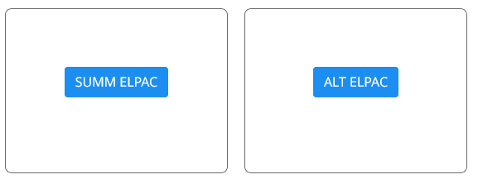
Accessing the Moodle Keys in STB Portal
ELPAC Coordinators will securely distribute the school’s Summative or Summative Alternate ELPAC Moodle enrollment key to individuals who have been designated as TEs in the STB Portal.
Notes:
This is how you will access the Moodle Keys from the STB Portal.

Slide 59
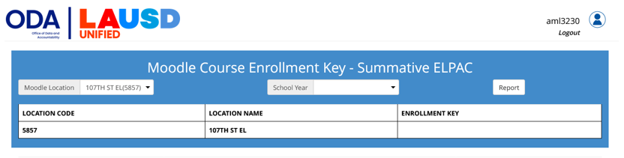
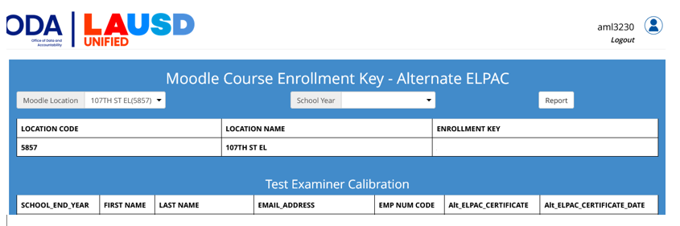
Accessing the Moodle Keys in STB Portal
Moodle keys can be accessed 1-2 business days AFTER the Principal and designated ELPAC Coordinator have completed ELPAC Security Requirements.
Notes:
If the principal or Coordinator have not completed ELPAC Security Requirements or if the coordinator has not been designated in the Principal’s Portal, the Moodle keys will not be available
Only the primary ELPAC Coordinator has access to the Moodle keys.
ELPAC Coordinators will not be able to attend ELPAC Calibration training with their Region EL Coordinators if they cannot access the Moodle key.

Slide 60
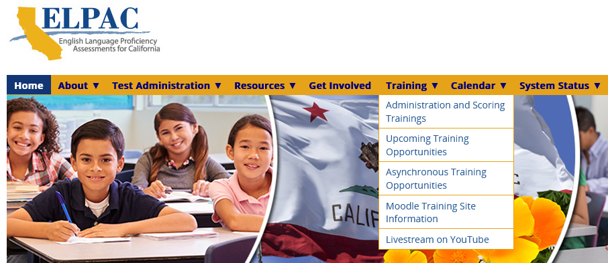

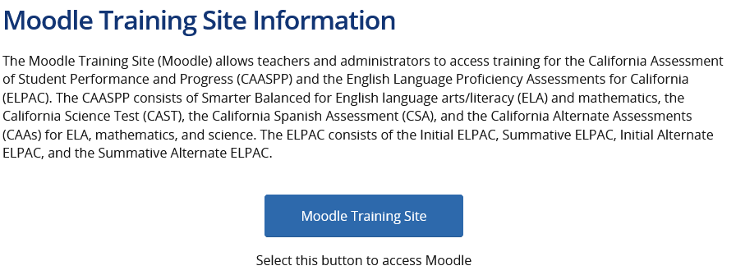
Accessing the Moodle Website
Access the Moodle website 2 ways:
STB homepage (Quick Links)
elpac.org
1
2
Quick Guide:
Enrolling in ELPAC Moodle Courses

Slide 61
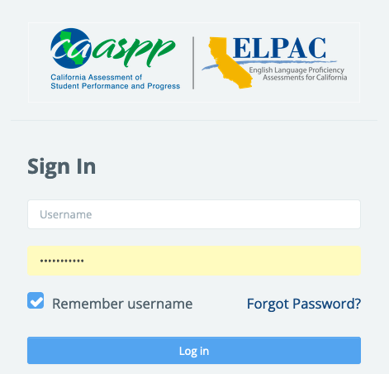
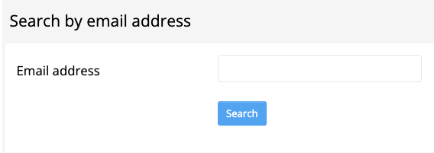
Forgot Moodle Username or Password?
Navigate to the Moodle homepage: https://moodle.caaspp-elpac.org
Select Forgot Password
Search by email address ONLY (enter LAUSD email)
  DO NOT search by Username.
An email will be sent from moodlesupport@scoe.net
If an email is not received, contact moodlesupport@scoe.net for assistance.
Notes:
Provide these instructions to your Test Examiners.

Slide 62
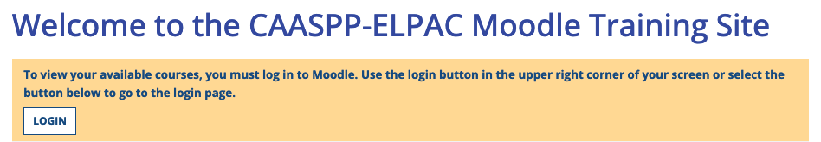
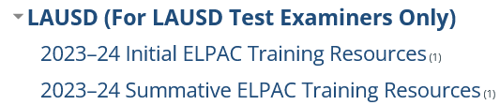
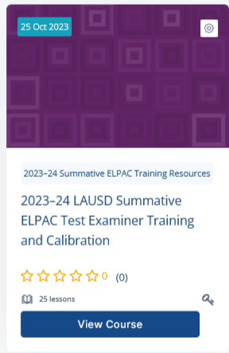
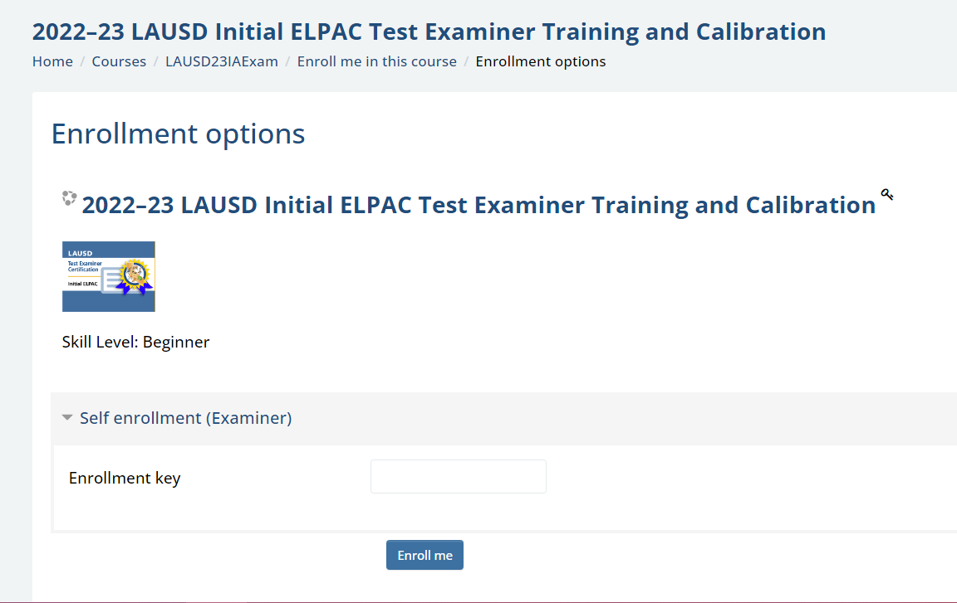
Accessing the Summative ELPAC Moodle Course
Log in to the Moodle website
  https://moodle.caaspp-elpac.org
Scroll down to the LAUSD Section on the Moodle homepage.
  Select 2023-24 Summative ELPAC Training Resources.
Select 2023-24 LAUSD Summative ELPAC Test Examiner Training and Calibration.
  This course is for TEs and Coordinators.
Enter your school's Summative ELPAC Moodle Enrollment Key when prompted.
Enter the key exactly as it is in the STB Portal.

Slide 63
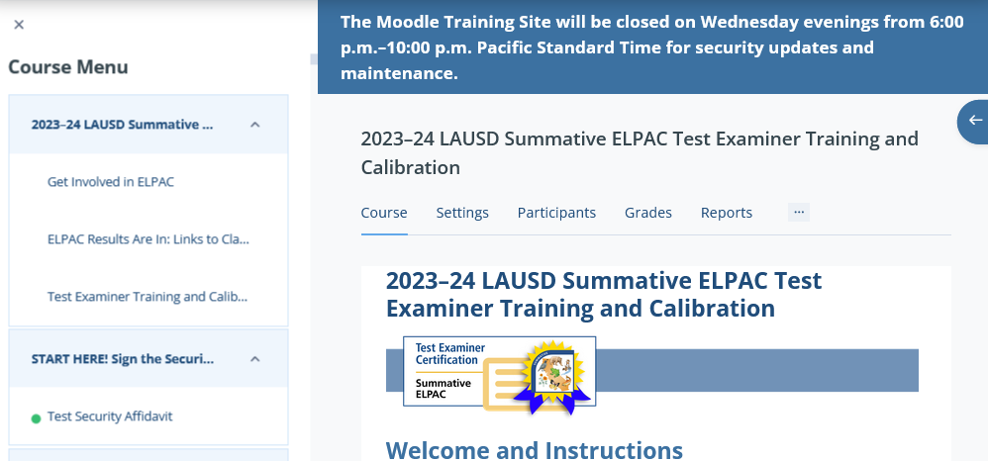

Accessing the Summative ELPAC Moodle Course
Keep the COURSE MENU OPEN!
A green dot will appear after you pass each calibration quiz. This will help you track your progress.
1. Read the Instructions
2. Sign the Affidavit
3. Watch the Mandatory Video

Slide 64
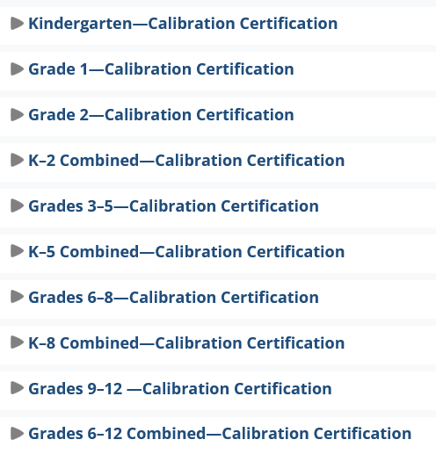
Completing the Summative ELPAC Moodle Course
  4. Complete Appropriate Training for your Role:
  Coordinators complete calibration for their school's span.
  Test Examiners complete calibration for the grades they will administer the test.

Slide 65
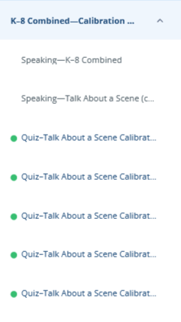

Completing the Summative ELPAC Moodle Course
Keep the COURSE MENU OPEN!
A green dot will appear after you pass each calibration quiz.
Once all calibration quizzes have been completed, click on the Speaking Certificate of Calibration link and the certificate will be emailed to you.
      Credit will not be reflected until the link is clicked.
  Completion will be reflected in the STB Portal Moodle Page in 1-2 business days.
Notes:
Coordinators will collect ELPAC certificates of completion from all TEs

Slide 66
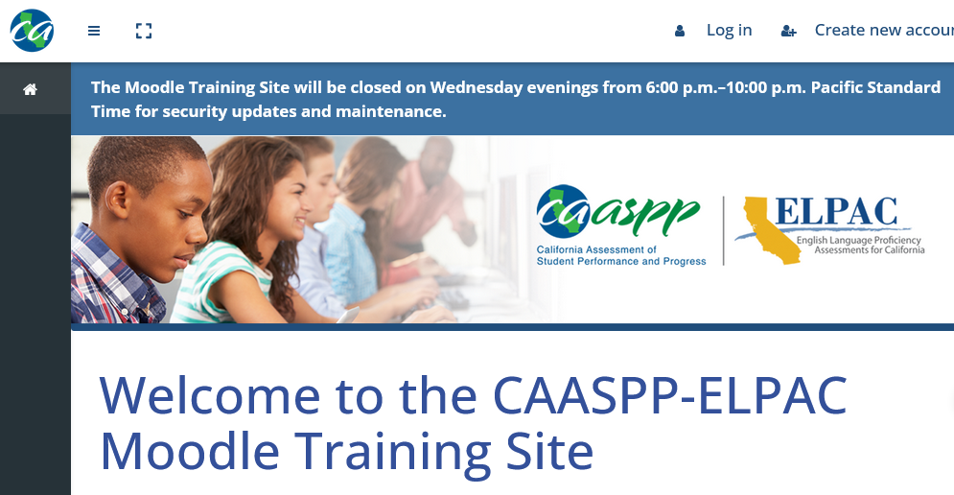
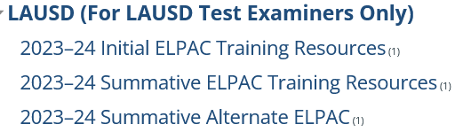
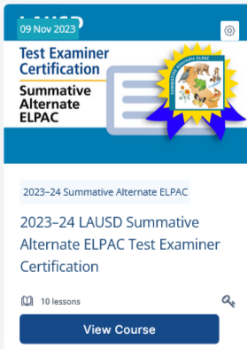
Accessing the Summative Alternate ELPAC Moodle Course
Log in to the Moodle website
  https://moodle.caaspp-elpac.org
Scroll down to the LAUSD Section on the Moodle homepage.
  Select 2023-24 Summative Alternate ELPAC.
Click on the course title.
Enter your school’s Summative Alternate ELPAC Moodle Enrollment Key when prompted.
Enter the key exactly as it is in the STB Portal.
Notes:
Reminder! There is a different key for the Summative Alternate ELPAC.

Slide 67
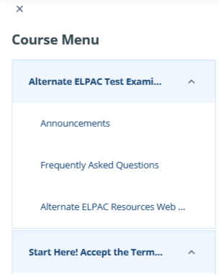
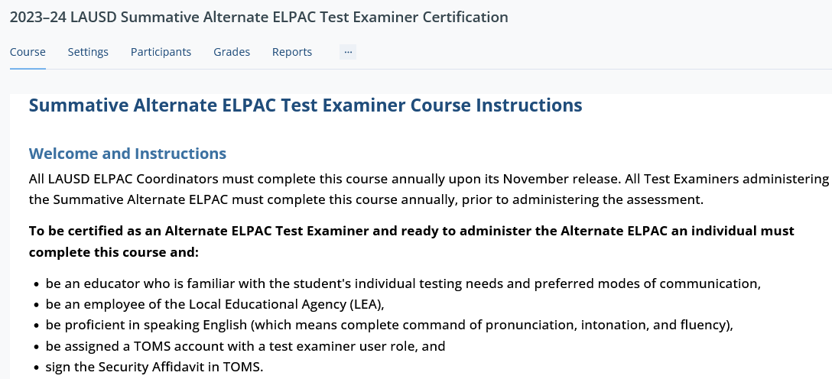

Accessing the Summative Alternate ELPAC Moodle Course
1. Read the Instructions
2. Sign the Affidavit
Keep the COURSE MENU OPEN!
A green dot will appear after you complete section.

Slide 68
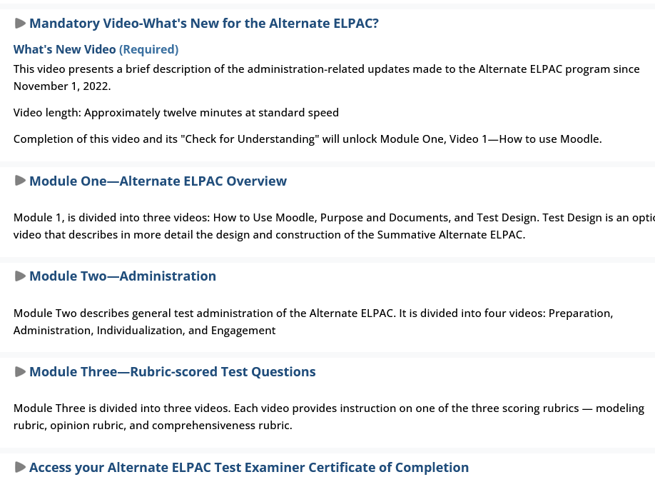

Accessing the Summative Alternate ELPAC Moodle Course
3. View the "What's New for the Alternate ELPAC" video.
4. Complete the 3 Modules and all of the Check for Understandings.
5. After completing Module 3, click on "Access your Alternate ELPAC Test Examiner Certificate of Completion.
Click the Certificate of Completion link and the certificate will be emailed to you.
  Completion will be reflected in the STB Portal in 1-2 business days.
Notes:
Coordinators will collect ELPAC certificates of completion from all TEs

Slide 69
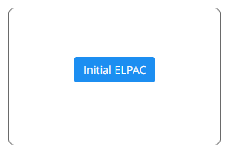
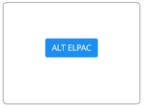
Monitoring Completion of Moodle Training
Navigate to STB Website: https://achieve.lausd.net/testing
1
2
3
4

Slide 70
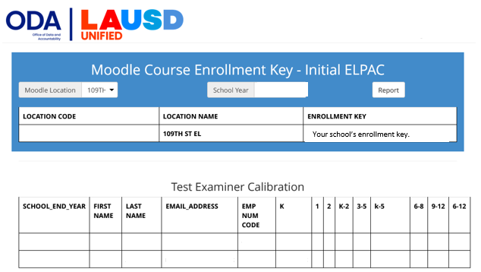
Completion of Summative ELPAC Moodle
Individuals who have completed Moodle Training will be indicated here within 1-2 business day after the TE completed the course.
Notes:
You can access a list of TEs that complete the Moodle training from the STB Portal.

Slide 71
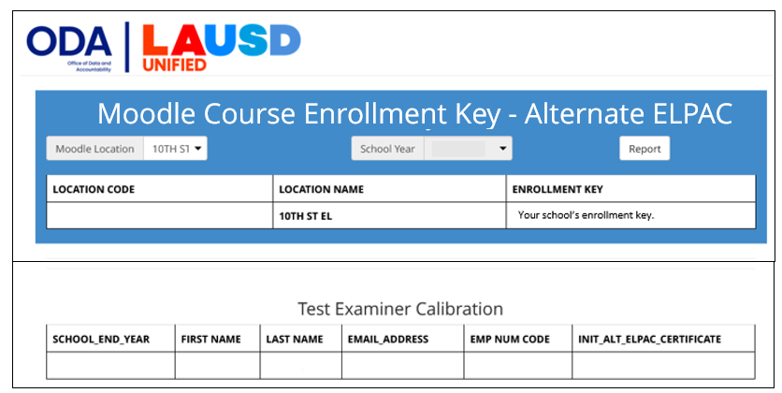
Completion of Summative ALT ELPAC Moodle
Individuals who have completed Moodle Training will be indicated here within 1-2 business day after the TE completed the course.
Notes:
You can access a list of TEs that complete the Moodle training from the STB Portal.

Slide 72
Action Items
Share the Moodle key(s) with TEs that have completed 2023-24 ELPAC Security Form TE and Proctor Requirements.
Share the Quick Guide for enrolling in the Summative ELPAC Moodle training(s) with TEs who have completed 2023-24 ELPAC Security Form TE and Proctor Requirements.
Monitor Completion of Moodle training(s) in the STB Portal and collect Moodle Completion Certificates.

Slide 73
Before Testing
ELPAC TOMS Accounts

Slide 74

ELPAC Coordinator TOMS Accounts
The Coordinator must complete all Summative ELPAC training requirements by January 30 (including Alternate ELPAC Moodle training) or TOMS accounts will be deleted for all school site TEs and the Coordinator.
Notes:
TOMS accounts are the gateway to test administration and allow access to start tests and secure materials. Therefore, our office has developed a process for identifying who should receive accounts based on their role and within STB we have a number of checks and balances for created ELPAC Coordinator TOMS accounts AFTER all Principal and Coordinator training requirements have been completed and verified. There are several functions allowable with the ELPAC Coordinator TOMS account to support you with management and proper test administration to all eligible students.

Slide 75
ELPAC Test Examiner TOMS Accounts
ELPAC Test Examiner TOMS accounts are created by the school’s ELPAC Coordinator after verifying completion of:
  ELPAC Security Form Training
  ELPAC Affidavit
  Summative ELPAC school-based training
  Moodle training(s)
ELPAC TE TOMS accounts allows for the following:
  Administer ELPAC assessments to students
  Data and score entry in DEI
  Access completion status reports and test results
Notes:
Once, you, the ELPAC Coordinator have met the training requirements and have been issued a TOMS account, one of your duties is to create ELPAC Test Examiner TOMS accounts. Note who can serve as a TE, the specific training requirements and how to monitor completion of the requirements were outlined on previous slides

Slide 76

Security
Staff who are granted TOMS accounts are permitted to access secure and confidential information and resources.
Do not share account credentials with any other employee or person.
Memorize or store account logon information in a secure location; do not request computer to store or remember password.
Do not disclose or share any secure material in any format with anyone else.
Notes:
Note that employees of our district who serve as Test Examiners are required to sign an ELPAC Security Affidavit in STB Portal and when logging into ELPAC TOMS for the first time. The state also has an authentication process set up for TOMS account holders who are logging into TOMS on a different device.

Slide 77


Creating Test Examiner Accounts
Did you verify the completion of security requirements in the STB Portal?
Did you designate the individual in the STB Portal?
Do you have the TE’s Moodle calibration certificate(s)?
Did the TE participate in the school-based training?
If TOMS accounts are created for untrained TEs, STB will delete the accounts.
Notes:
We ask you to please be cautious before logging into to TOMS with your ELPAC Coordinator role and creating accounts. You should first, ask yourself three important question:
Did you verify the completion of requirements in the STB Portal?
Did you designate the individual in the STB Portal?
Do you have the TE’s Moodle calibration certificate(s)?
By doing so, you will prevent unauthorized access to secure materials and ensure that TEs are properly trained to administer tests to students at grade levels for which they were trained.

Slide 78

Creating Test Examiner Accounts
ELPAC Coordinators can add users to TOMS individually or through batch file upload, using a template, to add several users at once.
Batch
”Upload”
Individual
“ADD”
Use only LAUSD Emails
Complete all fields
Next
Notes:
When you are ready to create accounts, you have choices. You can either create the accounts one by one or for several users using the batch file upload template available on the TOMS Users page. This slide calls out the buttons and fields you will need to create the user’s profile prior to adding the role.

Slide 79

Creating Test Examiner Accounts
Select "ELPAC
Test Examiner”
Next
Notes:
This is a screenshot of the next page.

Slide 80

Creating Test Examiner Accounts
Confirm that all information is correct. If the email was entered incorrectly, the TE will not be able to access TOMS.
Save
Notes:
This page is very important as it allows you to save the user profile and assigned role.

Slide 81



Creating Test Examiner Accounts
An email will be sent to the TE with a link to create their password.
The TE will have 30 min. to click the link.
  If the link expires, TEs can receive a new email by selecting Request one now from the TOMS logon screen.
Click here to receive a new email link.
Notes:
Be mindful of when you create accounts for TEs as the link will expire in 30 min.

Slide 82



Signing the TOMS ELPAC Affidavit
AFTER CREATING THEIR PASSWORD, TEs must sign the
TOMS affidavit.
1. Access TOMS via elpac.org
2. Click the ELPAC TE Role and the affidavit will populate.
IMPORTANT!
TEs Sign Multiple Affidavits!
STB Portal
Moodle
TOMS
3. Read the affidavit, sign, and submit.
ELPAC test sessions can be created in 2-3 hours.
Notes:
Please be sure to inform the individual/s you have created accounts for in advance. They will need to be prepared to finalize the creation of the account by completing steps 1-3 on this slide. As mentioned, they should also be informed that there are multiple affidavits to sign. Having signed the TOMS affidavit in advance of test administration is key because otherwise they will not see ELPAC as an option in the TA Interface.

Slide 83

Signing the TOMS ELPAC Affidavit
If the TOMS affidavit has not been signed, ELPAC Assessments will not be visible in the TA Interface and sessions cannot be created.
TEs will NOT be able to administer the Summative ELPAC until 2-3 hours AFTER signing the affidavit in TOMS.
  This can affect your testing schedule!
Coordinators should download the Security Forms and Remote Administration Status Report to see who has/has not signed the TOMS Affidavit.
Notes:
Check the Security Forms and Remote Administration Status Report frequently.

Slide 84

Creating Test Examiner Accounts
Coordinator creates the TE account in TOMS after verifying the completion of requirements.
TE accesses the link through their email to set up password.
TE logs into their TE role in TOMS and signs the affidavit.
TE can test students.
2-3 hours

Slide 85
Action Items
Verify the completion of TE requirements on STB Portal prior to creating TOMS Account.
Review Creating Test Examiner Accounts slides and create ELPAC Test Examiner accounts in TOMS.
  Use only LAUSD emails.
  Review the information entered before finalizing and creating the account.
Remind TEs to monitor their LAUSD email for the activation email from ca-assessments@ets.org .
  Check junk/clutter folder.
Download the Security Forms and Remote Administration Status Report in TOMS to identify TEs who need to sign the TOMS ELPAC Affidavit.
  Instruct TEs to sign at least 24 hours prior to testing.

Slide 86
Before Testing
Accessibility Resources

Slide 87

LAUSD- Accessibility and Accommodations Guidelines
REF- 2023-24 LAUSD Accessibility and Accommodations Guidelines for English Language Proficiency Assessments for California (ELPAC) and California Assessment of Student Performance and Progress (CAASPP).
Contains Attachment A.
  Used to assign designated supports to students.
Available in Coordinator Resources and E-Library in December.
Notes:
The LAUSD policy document provides guidance for schools on the use of accessibility resources including universal tools, designated supports and accommodations for both testing programs, ELPAC and CAASPP.

Slide 88

Accessibility Resources
https://www.elpac.org/resources/accessibility-resources/
Notes:
Under the Test Administration tab on the ELPAC website, there is a link to information pertaining accessibility resources
Links to the most recent California Assessment Accountability Resources Matrix and to relevant manuals

Slide 89

Moodle Accessibility Resources
Videos are in the Summative ELPAC Training course in Moodle.

Slide 90


California Assessment Accessibility Resource Matrix
This matrix describes all the available accessibility resources for ELPAC
  Accessibility resources are features or supports that are part of the assessment.
  Accessibility resources allow students to participate in an assessment that results in a fair and accurate estimate of each student’s achievement.
  https://www.cde.ca.gov/ta/tg/ca/accessibilityresources.asp
Share with IEP Team members and download a copy for your resources!
Notes:
The California Assessment Accountability Resources Matrix is a document that identifies which accessibility resources are available for both CAASPP and ELPAC assessments

Slide 91


California Assessment Accessibility Resource Matrix
Embedded: The resource is provided as digitally delivered components of the secure browser
Non-embedded: The resource is provided separately from the secure browser and must be provided by the school.
Notes:
The California Assessment Accountability Resources Matrix indicates if the support is embedded or nonembedded, and contains a brief description
”Yes” means that the support is available for the indicated test
ELPAC -CBA column refers to resources available for Summative ELPAC
ELPAC –A refers to resources available to Alternate ELPAC
Embedded supports are available through the testing platform and nonembedded supports are provided by the school outside of the testing platform

Slide 92
California Assessment Accessibility Resource Matrix
Universal Tools
  Available to all students on the basis of student preference and selection.
    Breaks
    Digital Notepad
    Embedded highlighter
Notes:
Additional paperwork is not required for students to use Universal Tools

Slide 93

California Assessment Accessibility Resource Matrix
Designated Supports
  Available for use by any student for
  whom the need has been indicated by an educator or team of educators (with parent or guardian and student input as appropriate) and are regularly
  used in the classroom.
    Recommended-Pause/Replay the audio for listening and Speaking
  Use Attachment A from REF
    Principal needs to sign ATT A before the coordinator enters the designated supports in TOMS.
  A student’s IEP or Section 504
  plan may indicate the need for a designated support.
Notes:
Attachment A is required for students to use Designated Supports
Students with IEPs/504 Plans may have designated supports listed on the IEP, if not, ATT A may be used

Slide 94
California Assessment Accessibility Resource Matrix
Accommodations
  Only for students who have an IEP or Section 504 Plan
  Accommodations are listed on the IEP or Section 504 Plan
    Text to Speech
    ASL
Unlisted Resources
  Are non-embedded supports specified in IEP or Section 504 Plan.
  If the unlisted resource changes the construct of the test, the student will be given the lowest obtainable scale score.
Notes:
Accommodations and Unlisted Resources may only be used by students who have an IEP or Section 504 Plan indicated in TOMS
The ELPAC Coordinator will enter the accommodations indicated on the IEP or Section 504 Plan in TOMS

Slide 95


California Assessment Accessibility Resource Matrix
Part 4 of the Matrix provides guidance regarding designated supports and accommodations for alternate assessments.
Alternate ELPAC Accessibility and Accommodations Guidelines
  This document provides additional guidance for maximizing accessibility in the Alternate ELPAC.
Notes:
Note that Part 4 of the matrix has an additional section to address supports that are available for Alternate ELPAC through the online testing interface. Some students may need additional supports that are used during daily instruction. Please share the Alternate ELPAC Accessibility Guidelines document with your special education teachers.

Slide 96


Accessibility Resources Demonstration Videos
The following link provides demonstrations of select universal tools, designated supports, and accommodations allowed as part of the ELPAC.
  https://www.elpac.org/training/uaag/
  Beneficial for students, teachers, and IEP teams.
  Available in Spanish.
Notes:
Teachers, SpEd staff, and students will benefit from viewing the demonstration videos.

Slide 97

Professional Development for Staff
Review Matrix and demonstration videos
  Teachers will be prepared for Summative ELPAC
Accessibility Resources Virtual Training Series
  https://www.elpac.org/training/ar-training-series/
  Module A: Matching Accessibility Resources to Students' Needs
  Module B: Using Accessibility Resources in Daily Instruction
Notes:
Start training regarding accessibility resources now to prepare for Summative ELPAC.
The Accessibility Resources Virtual Training Series will help teachers and SpEd staff to see the connection between instruction and accessibility resources.

Slide 98
Action Items
Collaborate with your school's SpEd Team to discuss and review the accessibility resources available for the current school year.​
Familiarize yourself with the California Assessment Accessibility Resource Matrix and share with SpEd Team and TEs.​
Review Accessibility Resources Demonstration videos with TEs.​
Distribute Attachment A to TEs.​
Plan Accessibility Resources PD for TEs.

Slide 99
Before Testing
Entering Supports, Accommodations, and Domain Exemptions

Slide 100

Preparing to Enter Supports & Accommodations
Supports must be entered in TOMS by the ELPAC Coordinator at least 2-3 days before the student logs into a domain.
Obtain the following reports from Elementary APEIS, Special Education Administrator/Designee, or Section 504 Plan Designee:
  Welligent Section K Report for Summative and Alternate ELPAC
    Indicates required Accessibility Resources listed in IEP.
  Welligent Section 504 Plan Report for ELPAC
Collect the designated supports Attachment A.
Notes:
Supports should be entered at least 2-3 days prior to testing the student. It is imperative that you manage your time to collect the signed attachments and the Section K pages from the case carrier or administrator over Special Education.

Slide 101

Entering Supports and Accommodations
1
Do you have the IEP documentation and Attachments?
2. Enter SSID
3
Notes:
Entering the designated supports and accommodations in TOMS is a task that can only be done by the ELPAC Coordinator. This requires using the documentation (IEP, 504 Plan, designated support attachments) and accessibility guidelines in tandem to enter the supports in TOMS. This screenshot of the student's test settings page calls out the three radio buttons you will use to access the student's profile pages one by one.

Slide 102

Entering Supports and Accommodations
4
5. Test Settings
Notes:
These screenshots outline steps 4 and 5 where you will use the magnifying glass to get to the student's profile page and access the test settings section.

Slide 103


Entering Accommodations
To enter Accommodations, Special Education Indicator must be “YES”
Click to select.
Open the dropdown menu to select.
Notes:
Note that the test settings page will indicate YES that the students is in the special education program. The accommodations section check boxes can only be clicked for students if there is a YES indicator on that page.

Slide 104

Entering Accommodations
Notes:
This is a screenshot of the Accommodations section, there is a section for both non-embedded and embedded resources.

Slide 105



Entering Designated Supports
Don’t forget to click UPDATE or your entries will not be saved!
Notes:
This is a screenshot of the Designated Supports section, there is a section for both non-embedded and embedded resources.

Slide 106

Entering Unlisted Resources
To add any Unlisted Resources, please refer to the slides in the Resources Section of this presentation.
Notes:
Contact STB for support if the student requires unlisted resources. These are nonembedded resources that may change the construct being measured. IEP Teams should make decisions based on the needs of students but note that unlisted resources that do change the construct of what is being tested causes the student to receive the lowest obtainable scale score (LOSS) for the affected domain.

Slide 107

Entering Domain Exemptions
Used when a student’s IEP or Section 504 plan specifies that the student has a disability for which there are no appropriate accommodations for assessment in one or more domains.
1. Search for the student in TOMS and select Test Assignments.
2. Enter the Domain Exemptions
indicated on the IEP.
Domain exemptions must be entered for the domains in which the student cannot test per the IEP or Section 504 Plan.
3. Save
Notes:
There is only one exception to students not being administered an ELPAC domain and that is when a student’s IEP or Section 504 plan specifies that the student has a disability for which there are no appropriate accommodations for assessment in one or more domains. It is important to note that domain exemptions are allowable only if there are no available resources or unlisted resources that provide the student access to THAT domain. You will not be able select two domain exemptions that are part of the same composite score. Selection one domain exemption in a composite score automatically grays out the other domain so you can not select it for exemption.
Oral Language Composite=Listening and Speaking
Written Language Composite=Reading and Writing

Slide 108

Test Settings Report
Download the ELPAC School Level Student Test Settings Report to verify that test settings have been entered.
  TOMS Reports > Site Reports
Notes:
Test Examiners must know what supports and accommodations each student is required to have for testing
Develop a process for sharing this information with your Special Education team

Slide 109
Action Items
Before entering accommodations, confirm that “YES” is indicated on the SpEd flag identifier on the student's demographic page in TOMS.
Enter supports and accommodations based on the most current SIGNED IEP.
Collect the completed Attachment A then enter the designated supports into TOMS.
Generate the ELPAC School Level Student Test Settings Report to verify that test settings have been entered.

Slide 110
Before Testing
Technology

Slide 111
Systems Needed for Summative ELPAC
Test Operations Management System (TOMS)
  The Coordinator confirms student registrations, assigns student test settings, and accesses Student Score Reports (SSRs).
Test Administrator (TA) Interface
  The Test Examiner logs on to the TA Interface to initiate, approve, and monitor student testing.
Data Entry Interface (DEI)
  Speaking scores are transferred from the Student Score Sheet into the DEI immediately after test is submitted.
  For more information, refer to the Data Entry Interface training video in Moodle.
Secure Browser
  A secure online testing environment in which a device is restricted from accessing prohibited computer applications, copying, or otherwise sharing test data.
  LAUSD managed devices will be updated by ITS
  Access https://ca.portal.cambiumast.com/ to update non LAUSD managed devices school purchased devices (except Chromebooks)
Notes:
There are five important systems you will access to manage and or administer the ELPAC test. These systems are interrelated and share details about the student's profile, test settings.

Slide 112
Operating Systems and Secure Browsers
MacOS​ | iOS​ | Chrome OS​ | Windows​
macOS 13 builds and sub-versions released in May 2023 and later All macOS 12.6 builds and sub-versions released in May 2023 and later All macOS 11.6 builds and sub-versions released in May 2023 and later macOS 14, released in September 2023 Desktop secure browser v16 Desktop secure browser v16.5 for macOS 14 ​ | iPadOS 17 (upon release and acceptance) iPadOS 16 builds and sub-versions released May 2023 and later iPadOS 15 builds and sub-versions released in May 2023 and later | Long-term support candidate (LTC) ChromeOS version 114 and above Long-term support (LTS) ChromeOS version 108 and above ChromeOS version 113 (stable) and above | Windows 10 builds and sub-versions released in May 2023 and later Windows 11 builds and sub-versions released in May 2023 and later Presumed new version to be released in September 2023 Job Access With Speech (JAWS®) versions 2021, 2022, and 2023 Desktop secure browser v16 ​ ​
Check ca.portal.cambiumast.com for the latest updates

Slide 113
ITS Support Plan
Testing Issues
Technical Issues
Teachers/students unable to access the test
Test expiration
Potential testing irregularity
Issues with proctoring test
Student Testing Branch Help Desk
213-241-4104
Create Ticket with ITS
  Testing device(s) not working
  Secure Browser not working
  Testing devices losing connectivity
  Need help getting devices ready
URL: css.lausd.net or Call 213-241-5200
To escalate urgent technical device issues, contact your IT Support Supervisor. For other IT related escalations, please contact your IT Liaison.
  IT Points of Contact https://docs.google.com/spreadsheets/d/1az5lLCck5blEj1NqQy4bp7kfhyr1yvtNvTN24dtjBF4/edit#gid=0

Slide 114
Testing Device Requirements
Audio Requirements
  Devices must have built-in speakers or external speakers.
    Sound output must be adjustable.
  One-on-one administrations (K-2 all domains and K-12 Speaking)
    Test Examiner listens along with the student.
  Group administrations (grades 3-12 except Speaking)
    Headphones or headsets are required for students.
Recording Requirements
  Use devices with built-in recording or microphone capabilities.
Once the test session has started, adjusting the audio volume will require the student to logout of the test.
Notes:
The tests include the need for both listening and recording. TEs and students should have access to devices with these specifications.

Slide 115
Technology For Test Administration
TE Device
A computer with a microphone.
  Requires a mouse, touchpad, or touch screen.
  A current version of one of the following web browsers:
    Chrome
    Firefox
Student Device
A computer or tablet with a microphone.
  Requires a mouse, touchpad, or touch screen.
  Tablet must have an external keyboard.
  Secure Browser must be installed on the device.
Notes:
This might be a good slide to share with Test Examiners and students in preparation for testing and useful as a checklist when administering practice tests.

Slide 116
Action Items
Confirm that all student devices have Secure Browser downloaded according to the Supported Secure Browser Versions for Student Testing page.
Ensure TE web browsers (Chrome or Firefox) are updated according to Operating Systems and Permitted Browsers page and type of device being used.
  Clear web cache and cookies.
For further technical support, contact ITS (213) 241-5200.

Slide 117
During Testing
Monitoring Test Completion

Slide 118

ELPAC Website
Completion Status
Monitor test completion status for ELPAC domains
Run Reports several times per week
This portal will provide the most accurate completion reports!
Notes:
As mentioned earlier in the presentation, the ELPAC Website is the gateway to various systems needed to perform your tasks. The landing page provides the radio buttons to access these systems. The Completion Status system is one and accessible here.

Slide 119



Plan and Manage Testing Report
1
2
3
Notes:
Follow the steps indicated to access the Plan and Manage Testing Portal

Slide 120

Plan and Manage Testing Report
Your school populates
1. Select test
2. Select Filters
3. Generate (View) or Export Report
Notes:
Select your test
Apply filters such as:
Students who have completed any opportunity
Students who have not completed any opportunity
Students whose test have expired
Generate or Export the Report to view or export the report

Slide 121

Plan and Manage Testing Report
Check the status of the test.
If the Expiration Date column indicates a date, a STAIRS needs to be completed to REOPEN the test.
Notes:
Run this report frequently to monitor completion status for the school site
If a students test is paused, they must log in and complete the test prior to the test expiring

Slide 122
Plan and Manage Testing Report
Summative ELPAC |  | Summative Alternate ELPAC
Grades K-2 | Grades 3-12 | All Grades
Speaking Test Speaking Online DEI Reading Test Listening Test The Writing test will not be indicated because it is not a computer-based test. | Speaking Test Speaking Online DEI Reading Test Listening Test Writing Test | Summative Alternate ELPAC
Notes:
Note this slide, as it will be helpful when reading the completion status report and making decisions about students or groups of students whose tests may not be complete, including the entry of scores when applicable.

Slide 123
Action Items
Review the steps for generating the Completion Status from the ELPAC website with TEs.
  Most common reports generated:
    Have not completed an assessment.
    Completed and students in progress.
    Student testing information only for the SSID entered

Slide 124
During Testing
Preparing for Test Administration

Slide 125


Accessing Practice and Training Tests
Test Examiners should use Practice Tests with students before administering the test.
Available through ELPAC website.
Practice navigating through the test (TEs and students).
Identify accessibility supports for individual students.
Identify student technical skills challenges.
  Student may need a Designated Interface Assistant or a Test Navigation Assistant
Notes:
This slide calls out the ELPAC landing page where the TEs and students may access the practice tests. The radio button takes the user to a page with these three option

Slide 126

Form Numbers
There are ten different test forms for the Summative ELPAC
TEs will need the school’s form number to download DFA from TOMS
Use the lookup tool to view the assigned test form for the Summative ELPAC 2023-24 administration.
  Enter your school’s name and ensure that it is an LAUSD school
If a new student enrolls with a paused domain and their previous school has a different form number, use the previous school’s form number to complete the paused domain.
Contact STB for the DFA

Slide 127
Student Logon Credentials
Student logon credentials include personally identifiable information (PII), which is secure and is protected by federal privacy laws.
Student’s First Name
  The name must be typed exactly as it appears in TOMS
  TOMS will indicate a Preferred Name if one was entered in MiSiS
Student’s SSID
Notes:
Students require their Student log on credentials, which include the child's first name and Student Statewide Identification number or SSID. This information is private and protected by federal laws. Anyone with access to the PII must have a security affidavit on file and keep the log on credentials secure.

Slide 128

MiSiS Smarter Balanced Label & Student Rosters
3. Complete Fields
1. Reports
Coordinators will use their Categorical Coordinator Role to access labels and rosters. Request access from your Principal through oneAccess.
4. View Report
2. Testing > Student Testing Label/State Testing Roster
Notes:
This information is available in MiSiS. An administrative role approved by your principal will give you access.

Slide 129
MiSiS Student Rosters
ELPAC Coordinators should generate a roster for each teacher administering ELPAC.
  Column B: Preferred Name- Preferred names must be used when reading names out loud and when students log in.
  Columns D and E: Logon Credentials- First Name (Legal or Preferred Name) and SSID
  Column J: Same (*) First Name- A “Y” for any student indicates that there are two or more students with the same first name enrolled in the class
If a student cannot sign-in, verify the data in TOMS
A | B | C | D E |  | F | G | H | I | J
Last Name | Preferred Name (P) | Middle Name | Smarter Balanced Logon Credentials |  | Grade | Teacher | Period | District ID | Same (*) First Name
 |  |  | First Name | SSID
Notes:
The coordinator generates the student roster for each teacher administering tests. If the student cannot log on, check the student’s information on TOMS to verify if it matches the information on the roster. If a student has a preferred name (column B), that name should be used if read out loud. If there is no preferred name, the column will be blank.
Columns D and E are the logon credentials, legal first name and SSID (state). If there is an asterisk by the student’s name in Column J, that means there is another student with the same first name in the class, therefore, teachers must be careful that the correct student’s information is given to the correct student.

Slide 130

MiSiS Labels – Student Logon Credentials
Securely Stored by the Coordinator
TEs sign out/in daily
Logon Credentials:
First Name or Preferred Name
SSID Number
There are two or more students with the same name in the class.
Grade
Period
LAUSD ID #
Teacher Name
Student’s Last Name
Preferred Name:
  If preferred name exists, it is bold, and followed by (P).
  If preferred name does not exist, only last name and Middle Initial are displayed.
Notes:
This slide shows a sample student testing label. It has the student’s logon credentials (first name and SSID) on the top left. Towards the right is an asterisk if another student in the class has the same first name. Below that will be their last name and a preferred name, if any. Underneath that line will be the grade, period, district ID and teacher name.

Slide 131

MiSiS: Labels – Student Logon Credentials
Label Details
30 labels per page
AVERY 5160, MACO 3000 or equivalent
Type: Address Label
  Height: 1”
  Width: 2.63”
Page size: 8.5” x 11”
Smarter Balanced Labels Job Aid
Notes:
The labels to be used have 30 labels per page. Avery 5160, MACO 3000 or an equivalent label can be used. Click on the Smarter Balanced Labels Job Aid for help, if needed.

Slide 132

ELPAC Daily Inventory Control Form
TEs and ELPAC Coordinators will check out/in the following materials each day of testing using the Daily Inventory Control Form:
Student Logon Credentials
DFA (if not using electronic version)
Scratch paper
K-2 Writing Answer Books*
Student Score Sheet for Speaking*
  *Not applicable for Alternate ELPAC
Located in Coordinator Resources.
Notes:
Daily Inventory Control Forms should be prepared ahead of time and used when checking materials in/out for testing each day. This must be used to keep track of materials even if you are the only TE for ELPAC. This form is certified by the ELPAC Coordinator and may be requested in an audit or for post test documentation.

Slide 133
ELPAC Preparing for Test Administration (PFA)
The Preparing for Administration (PFA) document is a nonsecure document and should be used PRIOR to test administration.
  Prepares TEs for test administration and allows them to become familiar with testing guidelines.
  Contains the planning and preparation content previously found in the DFA.
PFAs are posted in the Manuals and Instructions web page on the ELPAC website.
  PFA for K-2
  PFA for grades 3-12
Notes:
The PFA assists TEs with preparing for ELPAC. The PFAs are NOT SECURE.

Slide 134
Summative ELPAC Estimated Testing Times
The Summative ELPAC is an untimed test.
  Students are allowed as much time as they need to complete their responses in each domain.
The test should be administered over the course of several days.
The estimated minutes on the ELPAC website are provided as a basis for planning.
  https://www.elpac.org/test-administration/sa-estimated-test-time/
  Actual testing times may be longer or shorter.
Notes:
For planning purposes, you and the TEs should first know that the ELPAC is an untimed test. That means some students will definitely require more time than others. Estimated times should only be used as a basis for planning and the TE should be prepared to administer the test over several days if needed.

Slide 135
Test Security
Click on the link to review the Summative ELPAC security requirements:
  Tables 1- 4 describe security requirements for the test environment during various stages of testing.
    The test environment refers to all aspects of the testing situation while students are testing.
Prepare the following signage for TEs:
  Testing - Do Not Disturb
  Unauthorized Electronic Devices May Not Be Used At Any Time During the Testing Session
Ensure that students and adults do not have access to digital, electronic, or manual devices (e.g., cellphones, smart watches) during testing
Notes:
Review the tables during your school based-training

Slide 136

Summative ELPAC Directions for Administration (DFAs)
The DFAs for the Summative ELPAC include test day instructions and must be used by the ELPAC TE to administer tests to students.
Download from TOMS > Resources.
Contains test administration scripts.
DFAs are SECURE MATERIALS
  Hard copies must be checked out/in each day of testing.
DFAs must not be emailed nor shared electronically.
Notes:
DFAs are required for administration of the ELPAC test. They are secure, therefore, only available to Test Examiners who have met the requirements and have a TOMS account. They should NEVER be emailed or shared electronically. You may print a copy for the TEs but they must be checked in/out to maintain security.

Slide 137
Summative ELPAC DFAs
DFAs are organized by grade level
  K-2
    Individual DFAs for each grade level
      Kindergarten
      1st grade
      2nd grade
  3-12
    DFAs by grade span
      3rd -5th
      6th -8th
      9th -12th
DFAs must be used EVERY TIME a domain is administered!
Notes:
Please make note of this slide. It outlines the use of DFAs by grade level/span. Again, there is no exception to the use of DFAs. It is a non-negotiable.

Slide 138
Action Items
Generate and securely store student logon credentials.
  Must have MiSiS role: Categorical Coordinator.
Encourage TE(s) to utilize practice/training tests.
Review PFA.
Prepare K-2 Writing Answer Books.
Prepare rooms for testing and distribute signage.
Download, print, and/or guide TE(s) to the DFA(s).
Prepare Inventory Control Forms for TEs to check out/in testing materials.

Slide 139
During Testing
Creating a Test Session

Slide 140


How To Start an ELPAC Test Session
Printable How to Start an ELPAC Test Session documents are available.
Non-secure
2 versions
  Initial/Summative ELPAC
  Initial/Summative Alternate ELPAC
Notes:
You may want to print and share these documents with TEs during your school site administration training.
This information is no longer in the DFA.

Slide 141

Creating a Test Session
Test Administrator Interface.
Test Examiners create ELPAC testing sessions and monitor testing.
  A test session is created for all domains except K-2 Writing.
Notes:
To create an OPERATIONAL Test Session, click on the Test Administration interface tab on elpac.org

Slide 142

Creating a Test Session
x
Start a NEW Test Session that students will immediately join.
Do NOT preschedule sessions.
Do not pre-preschedule sessions.
Click here to start a NEW test session.
Notes:
DO NOT create Test Sessions ahead of time. We are administering tests in person, in the moment and there is no need to schedule a session and generate a session ID.

Slide 143


Creating a Test Session
TE’s name indicated here.
Session ID
Select Test
Notes:
Note the colors for the different ELPAC assessments
Click the assessment you wish to administer
Note the session ID is now generated on this page

Slide 144

Creating a Summative ELPAC Test Session
2. Verify the tests you selected.
1. Select the grade level and domains you will administer during the test session.
3. DO NOT change.
4. Click “Start Operational Session.”
Notes:
Select the grade level of the test(s) you wish to administer
Select the domain
Verify that you selected the correct tests
Click "Start Operational Session"
In-person is the default session type

Slide 145
Reminders
Students in grades 3-12 should not be given the Speaking test as an option to select since they DO NOT navigate it for themselves.
  TEs log into the Secure Browser for all Speaking administrations
After starting the operational session, write down the generated Session ID Number and share with students in grades 3-12 who are taking Summative ELPAC domains (except Speaking).
  Write the Session ID on the board so it is visible to students.
TEs should document all Session IDs for their records.
Notes:
Writing the session ID on the board will allow students to easily rejoin the session in case their test is paused or they lose connectivity.

Slide 146



Log in to Test Session Using Secure Browser
Windows/Mac
iPad
Chromebooks
Access Secure Browser BEFORE logging into Chromebook​
Click on “Apps”​
Select “Secure Test Browser”​
Notes:
This slide shows how to access the secure browser using different devices.
Note: When using a Chromebook, the secure browser will be accessed BEFORE logging into the Chromebook.

Slide 147

Signing Into a Test Session
Information needed to log into a Test Session
First Name as it appears in TOMS
  Student may have a Preferred Name
SSID
Session ID
Notes:
Verify that students have an SSID and are assigned the correct ELPAC assessment in TOMS BEFORE starting testing

Slide 148
Signing Into a Test Session
Summative ELPAC
  TEs log into all domains for K-2 students and the Speaking domain for students in grades 3-12.
    TEs are only allowed to log in for a student when the student is physically present and ready to begin testing.
    VERIFY that the correct SSID is being used to log in for the student!
  Students in grades 3-12 log in for themselves (for Listening, Reading, and Writing unless they have been assigned the Designated Interface Assistant in TOMS.
Summative Alternate ELPAC
  TEs log in for all students.
Notes:
For assessments where the TE navigates for the student, TEs are only allowed to log in for a student when the student is physically present and ready to begin testing.

Slide 149



Logon to Test Session
If the information is correct, select the [Yes] button to move on.
Choose the test on the Your Tests screen.
A student request is sent to the TA Interface and the student is taken to the Waiting for Approval screen.
Notes:
If there are NO TESTS AVAILABLE
Verify student eligibility in TOMS
If the student just became eligible, it may take another day for the system to sync

Slide 150

Logon to Test Session
TE must verify that the student selected the correct test.
TE must verify that the student’s Test Settings are correct by selecting the eyeball icon.
Verify Test
Click the eyeball icon to verify Test Settings
Click the checkmark if the student does not have any assigned designated supports or accommodations.
Notes:
TEs must verify that students are logging into the correct domain, if not, the student should not be allowed into the test session.
TEs must verify that students have any required accommodations or designated supports assigned by clicking on the eyeball icon

Slide 151

Logon to Test Session
Verify that the designated supports and accommodations are correct.
If settings are correct, click the green checkmark to approve the student.
If test settings are not correct, do not allow the student to test (click the red X).
Notes:
TEs must verify that student’s test settings are correct, if not, the student should not be allowed into the test session.

Slide 152

Logon to Test Session
Once the teacher gives approval, the Instructions and Help screen appears.
Select the [Begin Test Now] button.
TEs will monitor progress
  TA Interface
  Walking around the testing room

Slide 153



Logon to Test Session
Depending on the domain being administered and/or the student’s assigned accessibility resources, the following checks will be completed:
Audio/Video Check
Text-to-Speech Sound Check
Audio Video and Recording Device Check

Slide 154
Action Items
Verify that students have the correct test assigned in TOMS before beginning a test session.
Remind TEs to check the eyeball icon to verify accommodations and designated supports have been made available before approving students into the test session.

Slide 155
During Testing
Test Administration

Slide 156

Pause Rules - Listening and Reading Only
When can a test be paused?
If the student does not finish the assessment by the end of the testing session
If the student needs a break
Test inactivity
Technical issues such as a power outage
A student’s camera is not working (Remote Administration only)
https://www.caaspp.org/rsc/pdfs/CAASPP-ELPAC-Pause-Rules.pdf
Notes:
TEs should remind students of the pause rules

Slide 157
Test Expiration
Once a test opportunity expires, the student cannot complete nor review the test unless a Re-open Appeal is submitted through STAIRS by the site ELPAC Coordinator.
The state will eventually score the ELPAC, but the results may not be accurate if any domain(s) expired.
Summative ELPAC |  | Summative Alternate ELPAC
Speaking and Writing | Listening and Reading | Ongoing Availability
Expires 20 calendar days after the student first logs on to the domain. | Expires 45 calendar days after the student first logs on to the domain.
Notes:
Run your Plan and Manage Testing Report frequently.
The Speaking and Writing domains will expire 20 calendar days after the student first logs on to the domain.
The Listening and Reading domains will expire 45 calendar days after the student first logs on to the domain.
Reports several times per week to check for paused or expired tests.

Slide 158

Student Score Sheets for Grades K-12
Speaking scores must be documented on the Student Score Sheet for EVERY STUDENT and are to be entered immediately into the DEI after testing the student.
  DO NOT simultaneously enter the scores into the DEI while testing students.
All student information must be completed, including the date the scores were entered in the DEI.
The ELPAC Coordinator must securely store Student Score Sheets until the student receives Summative ELPAC scores.
    Score Sheets are in the DFAs!
Notes:
Securely store Student Score Sheets until 2024 SUMMATIVE ELPAC results are in

Slide 159


Stopping Markers
Follow instructions in the DFA!
Used in the following situations:
  When the student has not provided any responses up to the stopping marker.
  When the student has not provided any correct responses up to the stopping marker.

Slide 160
Scratch Paper
A student can use blank scratch paper to make notes, record responses, or create graphic organizers.
Only plain paper or lined paper is appropriate for ELPAC.
A student can use a whiteboard with marker.
Scratch paper is to be immediately destroyed after each test session if the student's test will be paused more than 20 minutes.

Slide 161
Action Items
Print out Pause Rules for TE(s).
Make sure TEs use DFAs for every administration.
  Provide hard copies if needed (must be checked out/in each day of testing)
Remind TEs to adhere to the Stopping Marker Guidance in the DFA when applicable.
Provide Student Score Sheets to TEs for Speaking.

Slide 162
During Testing
K-2 Reading, Listening, and Writing

Slide 163
K-2 Reading and Listening
K-2 Administration (Individual Administration)
Grade | Domain | Test Examiner Use In-Person DFA | Student
K-2 | Reading Listening | TE creates an In-Person session in the TA Interface on one device. TE logs into the SECURE BROWSER for the student on another device. TE administers the test using the DFA. TE navigates the test for the student and enters responses. | Student views Test Examiner’s screen. Student provides responses.

Slide 164
K-2 Writing Domain
K-2 Administration K-1: Individual Administration 2nd Grade: No more than 10 students or else a proctor is required
Grade | Domain | Test Examiner Use In-Person DFA | Student
K-2 | Writing | TE must ensure they distribute the correct Writing Answer Book to the student. TE administers the test using the DFA and monitors student. | Student writes responses directly in Writing Answer Book.

Slide 165
During Testing
K-12 Speaking

Slide 166
K-12 Speaking
K-12 Administration (Individual Administration)
Grade | Domain | Test Examiner Use In-Person DFA | Student
K-12 | Speaking | TE creates an In-Person test session in the TA Interface. TE logs into the SECURE BROWSER for the student on another device. TE administers the test using the DFA TE records prompt and the student’s responses. TE scores in the moment and documents scores on Student Score Sheet. TE enters Speaking scores in the DEI immediately after testing. | Student views TE’s screen. Student provides responses.
The student DOES NOT log in or navigate through the test for the SPEAKING Domain!

Slide 167
Voice Capture Requirements
If the Test Examiner has difficulty recording due to technology, they may proceed with testing the student without recording.
  Contact ITS for support before testing another student.
Listen and score the student’s entire response in the moment.
Test Examiner does not play the recorded responses.
A student’s response should not be re-recorded.
Notes:
The recorded responses are NOT for TE use

Slide 168
K-12 Speaking
Scores must be transferred from Student Score Sheet and entered in the DEI immediately after testing the student.
  Coordinators must verify in the Completion Status platform that K-12 Speaking scores were entered in the DEI.
Use one browser for administering the test and a different browser for entering scores in the DEI.
Notes:
TEs must enter scores immediately after testing the student
Coordinators must use the Plan and Mange Testing Report to verify that scores were submitted

Slide 169
During Testing
Grades 3-12 Reading, Listening, and Writing

Slide 170
3-12 Reading, Listening, and Writing
3-12 Administration (Individual Administration or up to 20 Students)
Grade | Domain | Test Examiner Use DFA | Student
3-12 | Reading Listening Writing | TE creates an In-Person test session in the TA Interface using the DFA. TE monitors using TA Interface. | Student logs into SECURE BROWSER Need SSID Need Session ID Students enter responses independently unless they have the designated support of Designated Interface Assistant (DIA).

Slide 171
3-12 Reading, Listening, and Writing
Group Administration
  Sessions containing more than 20 students require a proctor.
    Proctors must complete all training requirements before being allowed in the testing room.
  Test Examiner is required to monitor all students using the Test Administrator Interface with minimal distraction during the assessment.

Slide 172
During Testing
Data Entry Interface*
*Not Applicable for Alternate ELPAC

Slide 173


Data Entry Interface (DEI)
Enter scores for Speaking Domain (K-12)
Enter scores for Writing Domain (K-2)
Scores are transferred from Student Score Sheets
1
2
3
DEI Instructional video is included in the Moodle training.
Notes:
DEI training video is located in the Moodle Calibration course
Although the training video states that TEs can enter scores into the DEI at the same time they are testing students, this is NOT LAUSD policy. LAUSD policy requires that TEs document the scores on the Student Score Sheet and then enter the scores into the DEI.

Slide 174
Data Entry Interface (DEI)
Enter student information into DEI platform
  First name
  SSID
Sign In
1
2
The DEI screen looks similar to the Student logon screen except it doesn’t have a field for the session ID.
It is recommended to use a different browser when accessing the DEI.
3

Slide 175

Data Entry Interface (DEI)
Refer to student score sheet and select the matching score (“Score 0,” “Score 1,” etc.) in the DEI for each item.

Slide 176

Entering Scores in the DEI
If a Stopping Marker Rule was used for Speaking as indicated in the DFA:
  Enter scores up to the Stopping Marker
  For the remaining questions, no more score entry is necessary at this point. Select the [End Test] button at the top of the screen in the DEI.
The student’s overall score will be negatively affected if the stopping marker is used incorrectly.
Check the Completion Status Report and Score Sheet to verify If the Stopping marker was used prematurely.
A STAIRS case will need to be submitted to REOPEN the test and DEI.
Notes:
You may want to provide this slide to your TEs as a reference
Verify that the score sheet provides evidence

Slide 177

Data Entry Interface (DEI)
An orange triangle indicates that the TE forgot to enter a score.
Go back to that item to enter the score from the Student Score Sheet
A STAIRS will need to be submitted in TOMS to report any DEI/Speaking test errors.
Notes:
After clicking SUBMIT TEST, wait for the screen to show the submission verification

Slide 178
Action Items
        Ensure that all Speaking scores for grades K-12 have been entered into the DEI immediately after testing.
        Review the score sheets to ensure proper use of the stopping marker.
        Review training videos in Moodle.

Slide 179
During Testing
Summative Alternate ELPAC Test Administration

Slide 180
Summative Alternate ELPAC Test Administration
The Summative Alternate ELPAC is always administered one-on-one and in-person.
  Administered by a test examiner who is very familiar with the student and their primary communication modes.
  Administered on a computer or similar device using the secure browser.
  Students will not be expected to interact directly with the computer.
    The one-on-one administration model will allow for the TEs to interact with the computer on behalf of a student.
Summative Alternate ELPAC Online Test Administration Manual
  https://ca-toms-help.ets.org/initial-alt-elpac-otam/overview/test-overview/
Notes:
We will now review some of the test administration details as they pertain specifically to the Alternate ELPAC.
Note that due to some of the unique qualities of the students who qualify to take this assessment, it is very important that the selection of Test Examiners are trained LAUSD employees who are most familiar with the student and know their primary communication modes.
There are places within the test that allow for individualization, the interaction with the computer.

Slide 181

Summative Alternate ELPAC Estimated Testing Times
The Summative Alternate ELPAC is an untimed test.
Students should be given as much time as possible to engage with the test.
  https://www.elpac.org/test-administration/alternate/alt-elpac-estimated-test-time/
Notes:
Please review the estimated testing times
Actual testing times may be longer or shorter

Slide 182
Form Numbers
There are two different test forms for the Summative Alternate ELPAC.
TEs will need the school’s form number to download DFA from TOMS.
Use the lookup tool to view the assigned test form for the Summative ELPAC 2023-24 administration.
  Enter your school’s name and ensure that it is an LAUSD school.
Notes:
The PFA must be reviewed prior to administering the test
It contains information to help TEs prepare

Slide 183
Preparing for Summative Alternate ELPAC Administration
Preparing for Administration (PFA)
Nonsecure document
Available on the Manuals and Instructions page on elpac.org
  https://www.elpac.org/s/pdf/Summative-Alt-ELPAC-PFA.2023-24.pdf
PFA must be used to prepare for test administration.
Notes:
The PFA must be reviewed prior to administering the test
It contains information to help TEs prepare

Slide 184
Summative Alternate ELPAC DFAs
Available in TOMS > Resources
Include test day instructions and the test administration script.
Must be used by the ELPAC TE to administer tests to students.
PRINTED DFAs are SECURE MATERIALS and must be checked out/in each day of testing!
Notes:
DFAs are secure materials
Printed copies must be checked out/in with the coordinator each day of testing

Slide 185
Optional Individualization
Test questions may be individualized based on the student’s IEP.
  Notated as “IND” within the DFA.
  Allows an opportunity to provide real objects, manipulatives, and picture cards as appropriate.
Picture cards are in TOMS > Resources.
  Secure Material
  Two-sided printing is recommended.
  If you are unable to print double-sided, attach the front and back of each picture card together.
Notes:
Some students may require test questions to be individualized
TEs may use Alternate ELPAC picture cards or objects stated in the DFA
Picture cards are considered secure materials

Slide 186
Second Scoring
Second scoring is the process of having a second test examiner (who has completed training for the Alternate ELPAC administration) score student's rubric-scored items simultaneously, yet independently, from the student's primary TE.
  A subset of schools will be required to participate in second scoring.
Check to see if your school is selected to participate in second scoring.
  https://www.elpac.org/test-administration/alternate/alt-elpac-second-scoring-assignment

Slide 187
Second Scoring
The second TE must have access to the DFA and be present during the entirety of the administration along with the student and primary TE.
All second scores must be documented on the answer recording sheet in the appendices of the DFA.
Scores are then entered into the Data Entry Interface (DEI) by the second scorer immediately after the student completes testing.
  https://www.elpac.org/s/pdf/ALT-ELPAC-Second-Scoring-Handout.2020-21.pdf
  How to Second Score Video
Notes:
Second Scorers must be present when testing the student.

Slide 188
Summative Alternate ELPAC Administration
K-12 Administration (Individual Administration)
Grade | Test Examiner Must use DFA from TOMS | Student
K-12 | TE creates an In-Person session in the TA Interface on one device. TE logs into the SECURE BROWSER for the student on another device. TE administers the test using the DFA (Picture Cards may be needed). TE navigates the test for the student and enters responses. | Student views Test Examiner’s screen. Student provides responses.
If your school is selected for second scoring, don’t forget to have your second scorer present and scoring independently!

Slide 189
Action Items
Provide hard copies of the Summative Alternate ELPAC DFAs to TEs if necessary.
Review PFA
Prepare picture cards.
Ensure test is administered one-on-one and in-person.

Slide 190
During Testing
Crisis Alert Response System

Slide 191
Crisis Alert Response System (CARS)
State Scorers identify Writing responses (or digital notes) that indicate:
  Abuse
  Bullying
  Trauma
  Threats
  Key words (die, kill, etc.)
The Alerts are sent to the Superintendent and the Student Testing Branch.
The Student Testing Branch contacts the Principal, Student Health and Human Services, and Region Administrator of Operations via email.
Following District protocols, a school counselor or other designated staff member must speak to the student.
Principal must EMAIL the Student Testing Branch when the situation has been addressed.
  The state will continue to send Alerts to the Superintendent until the Principal completes this step.
Notes:
Principals are informed by STB via email
Principals must ensure that the student is spoken to regarding the content
School will follow-up with necessary protocols
Principal will inform STB that the situation was addressed

Slide 192
During Testing
STAIRS

Slide 193
Test Security Incidents
Test security incidents are behaviors prohibited because they give a student an unfair advantage or because they compromise the secure administration of the assessments.
Whether intentional or by accident, failure to comply with security and administration rules, either by staff or students, constitutes a test security incident.
Each TE and Proctor must immediately report any testing irregularity to the site ELPAC Coordinator.
All testing incidents need to be immediately reported in the Security and Test Administration Incident Reporting System (STAIRS) in TOMS by the site ELPAC Coordinator.
  Security Breaches must also be reported to STB immediately after the STAIRS is filed.
Some incidents may require that an Appeal be submitted to reset, reopen, or restore.
After the STAIRS is submitted, a confirmation email will be sent indicating if any further action is needed.
Notes:
Call STB for support

Slide 194
Examples of Test Security Incidents
Expired or accidentally submitted tests.
Student was administered the incorrect assessment.
Student took the test using another student’s SSID.
Student took the test using a duplicate SSID.
Social media discussion/posting of secure materials (Security Breach).
Secure test materials were discussed, retained or copied (Security Breach).
Notes:
Call STB for support

Slide 195

STAIRS
ELPAC Coordinators gather information regarding the incident including:
  Date of incident
  SSIDs of student(s) involved
Select ONLINE for all assessments, including K-2 Writing.
Security breaches must be entered in TOMS immediately by the Coordinator.
Call STB to report any security breach after completing the STAIRS.
Notes:
All testing incidents must be reported in STAIRS
Any security breach must be reported in STAIRS and to STB before the end of the school day

Slide 196

Creating a STAIRS Report
If a Reset, Reopen, or Restore is required, ensure that it is indicated in the Appeal type section before submitting.
  A 200-character description of the issue and steps to avoid the incident from occurring again, may be required prior to submitting.
Notes:
Call STB for support

Slide 197

STAIRS
If your STAIRS is rejected:
Select “Search STAIRS” and enter the STAIRS ID
Review and follow the instructions in the Notes section
Submit a new STAIRS
Notes:
Review the comments from the person who processed your STAIRS
Resubmit the STAIRS following the guidance in the Notes

Slide 198
Action Items
      If you have any questions, contact STB prior to submitting STAIRS.
      Be sure to have student(s) SSID number(s) when creating a STAIRS.
      Be sure to follow-up on all STAIRS submitted.

Slide 199
After Testing
Returning K-2 Writing Materials
Destroying Secure Materials

Slide 200
Preparing Writing Answer Books for Submission
Every K-2 Writing Answer Book must have a Pre-ID label, or all demographic information bubbled in as indicated in the 2023-24 Summative ELPAC Administration Instructions.
Schools will only use state-generated labels provided by STB.
  DO NOT create your own labels.
Directions for applying labels and completing K-2 Writing Answer Book demographic information will be provided along with the labels.
Notes:
Follow the guidance in the Summative ELPAC Administration Instructions regarding bubbling the K-2 Writing Books that you did not receive labels for.

Slide 201

Returning K-2 Writing Answer Books for Scoring
All schools will return their K-2 Writing Answer Books to their Region’s Testing Center on the following dates:
April 22-23
May 6-7
  Coordinators will turn in Writing Answer Books for newly enrolled students on June 3-4, 2024.
Notes:
Do not drop off materials to anyone other than STB personnel.

Slide 202
Nonscoreable Materials Collection
All schools will return their Nonscoreable Initial and Summative ELPAC materials to their Region’s Testing Center on June 3-4, 2024.
  Initial ELPAC Writing Books (Completed, blank, and voided)
  Summative ELPAC Writing Books (Blank and voided)
    Schools who do not turn in their materials on these dates will be required to turn in their materials to the Central Testing Center by June 11, 2024.
ELPAC materials may not remain on campus over the summer.
Notes:
Do not drop off materials to anyone other than STB personnel

Slide 203

Destroying Secure Materials
Notes:
Ensure all secure materials are destroyed.

Slide 204
After Testing
Score Reporting

Slide 205

Student Score Reports (SSRs)
After the first release of scores in May 2024, it will take about 4-5 weeks for scores to be released in TOMS.
It will take longer to receive K-2 Score Reports as Writing Answer Books have to be scored by the state.
STB will notify Coordinators when Score Reports are available in TOMS.
ELPAC Coordinators can access ELPAC School-Level Student Score Report PDFs in TOMS under the Site Reports tab.
  Available in multiple languages.
Parents can access SSRs in the Parent Portal

Slide 206
After Testing
Post-Test Documentation

Slide 207
Post-Test Documentation for Summative ELPAC Training
ELPAC Coordinators must keep complete documentation of training and test administration for 2 years.
  Copy of Testing Schedule
  ATT A and B from Summative ELPAC Administration Instructions
  Agendas and sign-in sheets for Summative ELPAC school-based trainings (ATT C and D)
  Moodle Certificates
  Inventory Control forms
  ELPAC STAIRS and Appeals Report (TOMS)
The following documents must be uploaded into STB Portal next semester (Refer to 2023-24 Summative ELPAC and Alternate ELPAC Administration Instructions)
  Scan all documents and upload as a single PDF or jpeg file
    ATT A- Certification of Proper Test Administration
    ATT B- Daily Inventory Control Forms (1 per TE and Coordinator)
    ATT C- Dated Summative ELPAC Training Agenda(s)
    ATT D- Summative ELPAC School-Based Training Sign-in Sheet(s)
Notes:
Scan all documents as a single file
Upload one file to the STB Portal

Slide 208
Next Steps
Review this presentation several times.
Print Coordinator Checklist.
Calendar key dates.
Complete all remaining training requirements.
Submit your testing schedule in the STB Portal
Schedule staff training.

Slide 209


2023-24 Feedback & Acknowledgement Form
Mark this Webinar COMPLETE​
    2. Launch and complete the Feedback and Acknowledgement Form​
Completion credit will be indicated in your MyPLN Completed Transcript after STB verifies your attendance.
Notes:
Go back to MyPLN and mark Task 1 complete
Activate and Launch Task 2 and complete the Google Form
After we vet the attendance records...Zoom Webinar and MyPLN reports, OUR OFFICE will mark you complete and you will see the calendar icon for this session in your completed transcript. You may use the calendar icon record as official proof of completion.

Slide 210

Student Testing Branch
(213) 241-4104
7:30 am – 4:00 pm

Slide 211
Resources
Links and Unlisted Resources

Slide 212
Resources
Alternate ELPAC Accessibility and Accommodations Guidelines
  Alternate ELPAC Accessibility and Accommodations Guidelines
Decision Making/IEP Team Resources
  Alternate Assessment Decision Confirmation Worksheet
  Alternate Assessment IEP Team Guidance
Parent Resources
  Alternate ELPAC Parent Guide to Understanding (PDF)
Scoring
  Alternate ELPAC Participation and Scoring (PDF)
General Information
  Alternate ELPAC Website
  Alternate ELPAC Resources Page
  CDE Alternate ELPAC Page

Slide 213
Resources
ELPAC Website - https://elpac.org
STB Website - https://achieve.lausd.net/testing
MMED - https://achieve.lausd.net/mmed#spn-content
Division of Special Education - http://achieve.lausd.net/sped
Parent Resources - https://www.elpac.org/resources/parent-resources/
Summative ELPAC Guidance - https://www.elpac.org/test-administration/summative/
ELPAC FAQs - https://www.elpac.org/resources/faq/
Reference Guides and Videos - https://www.elpac.org/test-administration/qrgs-and-videos/
Manuals and Instructions - https://www.elpac.org/test-administration/instructions/

Slide 214

Entering Unlisted Resources
1. Search for the student in TOMS and select Unlisted Resources.
2. Click to enter Unlisted Resources indicated on IEP or Section 504 Plan.
4. Submit
Note: By submitting the form, the Coordinator is affirming that the student uses the requested Unlisted Resources regularly in the classroom.
3. Add other Unlisted Resources (if applicable)
Notes:
Contact STB for supports if the student requires unlisted resources. These are nonembedded resources that may change the construct being measured. IEP Teams should make decisions based on the needs of students but note that unlisted resources that do change the construct of what is being tested causes the student to receive the lowest obtainable scale score (LOSS) for the affected domain.
This screen outlines the five steps involved in selecting the Initial ELPAC accessibility resources in TOMS and confirming the use of unlisted resources are used during the regular instructional setting.

Slide 215



Entering Unlisted Resources
1. Click “Add”
2. Select Domain
3. Select Student Needs
Notes:
This slide displays screenshots of the TOMS resources page where you will add the resource/s, select ELPAC and the specific domain for which the unlisted resource is applied and select the student need/s that justify the unlisted resource.

Slide 216

Entering Unlisted Resources
4. Complete all fields.
5. Save
Notes:
In addition to selecting the student need/s that justify the use of the unlisted resources, the state requires you to input additional information to support the selecting the resources. Hence, why you should have consulted with the case carrying teacher or SpEd administrator prior to accessing the unlisted resources page.

Slide 217

MiSiS Preferred Name
Search for the student and click on [Census].
Select [Identifying Information].

Slide 218

MiSiS Preferred Name
If a Preferred Name has been entered, it will be indicated here.

