Slide 1


Updated 9/12/2023
2023-24 CAASPP Fall Coordinator Training
This PowerPoint is available on the Student Testing Branch Website in Coordinator Resources https://www.lausd.org/testing
This presentation will be used to facilitate your school-based training.

Slide 2
Reminders…
Information provided in this presentation is subject to change.
This presentation must be completed in a single sitting.
You must be in attendance for the entire presentation to receive credit.
Attendance will be tracked based on your total time in the Zoom session.
Completion will be recorded on MyPLN and reflected in the Principal's Portal.

Slide 3
Agenda
CAASPP Program Overview, Critical Links, STB Updates, and CAASPP Coordinator Primary Responsibilities
Student Eligibility, Parent Notification, Parent Exemptions, and Participation Rate
Training Requirements
Moodle Training
Monitoring Completion Test Examiner Requirements for CAA Science
Preparing for Test Administration
Test Administration
Security and Test Administration Incident Reporting System (STAIRS)
New California Science Test (CAST) Interim Assessments
2023-24 LAUSD Comprehensive Assessment Program
Interim Assessments Systems and Purpose
Interim Assessments Viewing System
Interim Assessments Hand Scoring System
School Site Professional Development Topics and Training Requirements
Creating TOMS accounts
Monitoring Test Completion
Student Logon Credentials
Accessibility Resources
Entering Supports and Accommodations
Technology
Creating Test Sessions
California Educator Reporting System (CERS)
Crisis Alert Response System (CARS) and State Audits
Region Data Coordinators

Slide 4
Training Objectives
Training Objectives
To provide School Site CAASPP Coordinators with a comprehensive training that will enable them to guide their school in the administration of the CAA for Science and use of the Smarter Balanced Interim Assessments including:
Administering and Scoring the CAA for Science
Administering and Scoring the Interim Assessments
California Educator Reporting System (CERS)

Slide 5
Guidance for Coordinators
CAASPP Program Overview
Critical Links
STB Updates
CAASPP Coordinator Primary Responsibilities

Slide 6
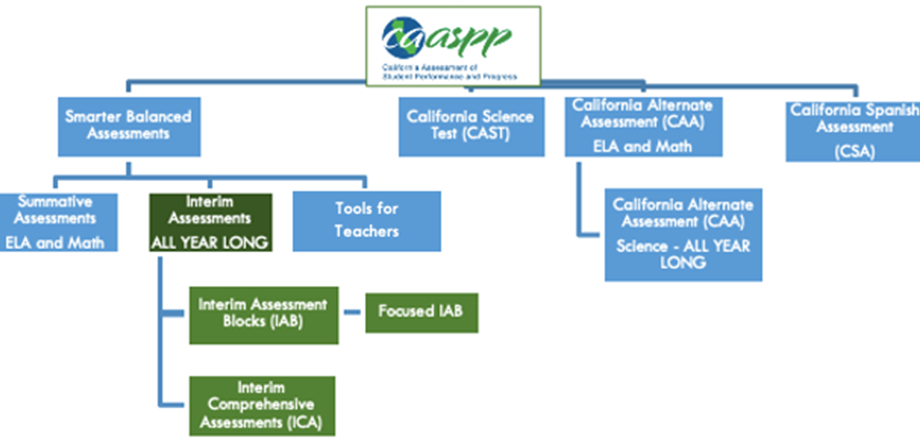
California Assessment of Student Performance and Progress (CAASPP) System

Slide 7
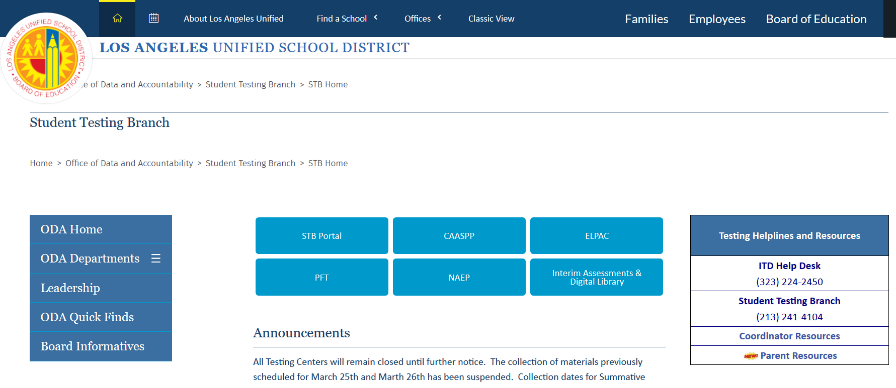
Critical Link #1: STB Website
https://www.lausd.org/testing
The STB Portal is only accessible through the STB homepage and while logged into the LAUSD Network.
1
Notes:
Bookmark STB website. STB Portal and Coordinator Resources contains valuable District resources.

Slide 8
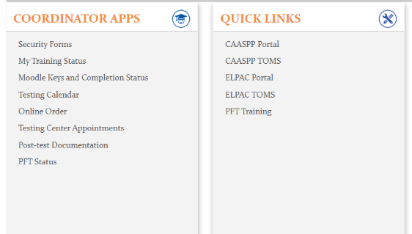
STB Portal
Access Security Affidavits and Reports.
Review YOUR completion of training requirements.
Access Moodle Keys and Moodle completion.
Upload post-test documentation.
The STB Portal can only be accessed via the LAUSD Network or VPN.
Notes:
An added feature to the STB Portal landing page is a message board. This will provide important announcements and reminders.

Slide 9
STB Coordinator Resources
https://www.lausd.org/testing
2
Notes:
Bookmark STB website. STB Portal and Coordinator Resources contains valuable District resources.

Slide 10
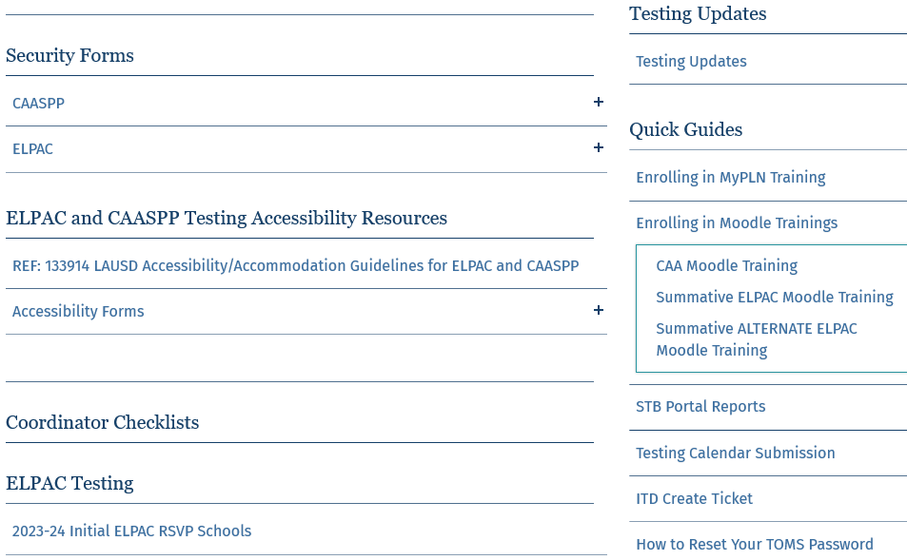
STB Coordinator Resources
Affidavits for non-district BIIs.
Accessibility Resources Documentation
Notes:
New Resources are added throughout the year.

Slide 11
Coordinator Support
Office Hours for CAASPP Coordinators
Receive support from STB Administrators
Have this presentation available to refer to during Office Hours
Starting August 28
8:30 am – 9:30 am
2:45 pm - 3:45 pm (New time!)
Office Hours will not be available on Friday afternoons.
Access the link to Office Hours in Coordinator Resources
Student Testing Branch Help Desk
Mon-Fri: 7:30 am – 4:00 pm (excluding holidays)
(213) 241-4104

Slide 12
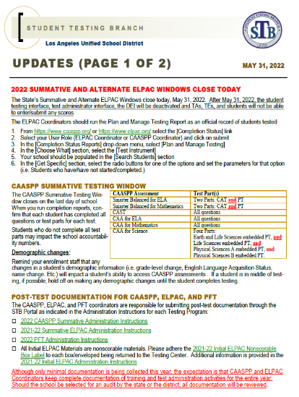
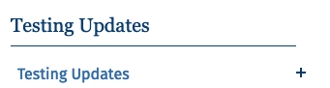
STB Updates
Provides Coordinators with instructions, reminders, and new information.
Weekly STB Update is automatically emailed to:
Designated Testing Coordinators
Testing Point of Contacts
STB Updates can also be accessed through the Coordinator Resources page on the STB Website.
Notes:
We will post in Coordinator Resources

Slide 13
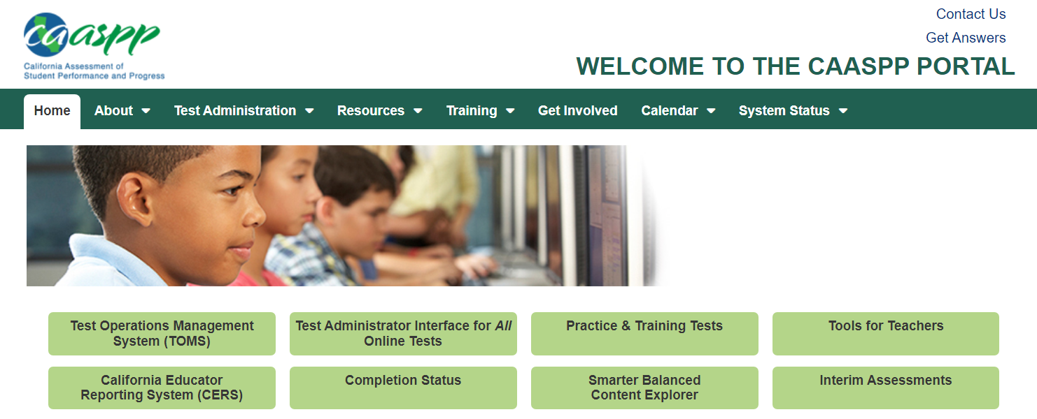
Critical Link #2: CAASPP.org
https://www.caaspp.org/

Slide 14
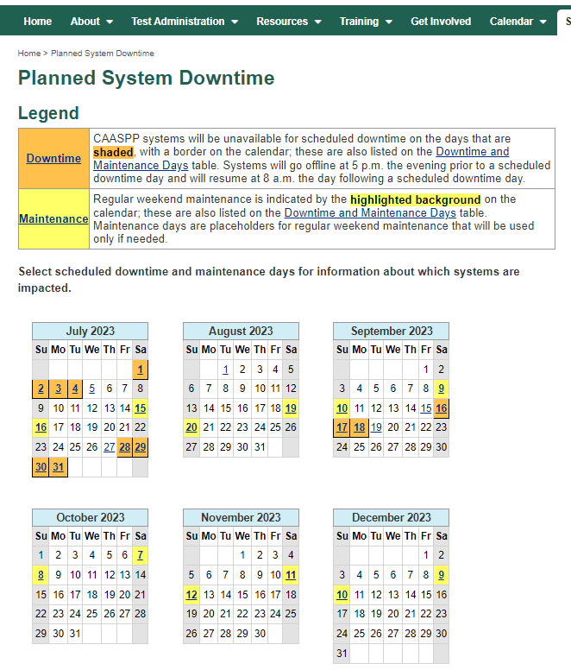
CAASPP Website – Planned Downtime
Indicates downtime and system maintenance dates.
August 19-20
September 9-10 and 16-18
October 7-8
November 11-12
December 9-10
Notes:
Mark your calendar for the planned system downtime and maintenance dates. Coordinators and Test Examiners will not have access to any systems during this time.

Slide 15
CAASPP Coordinator Primary Responsibilities
Maintain test security
Manage Test Operations Management System (TOMS) accounts
Work with technology personnel to ensure timely device setup
Report and manage testing incidents and irregularities
Under the direction of the Principal, oversee all before, during, and after testing responsibilities
Attend and/or complete all requirements and trainings
Read and become familiar with all Student Testing Branch publications, including policy documents, Administration Instructions and Testing Updates
Reference Guides and Memorandums

Slide 16
CAASPP Coordinator Primary Responsibilities
Provide information to parents about State and National mandated assessments
Review the following documents:
State and National Mandated Testing Calendars
CAA for Science and Interim Assessments Requirements for Principals, Coordinators and Support Staff
CAASPP Summative Assessments Requirements for Principals, Coordinators and Support Staff
Differential Memorandum
Don't hesitate to seek guidance from STB

Slide 17
Action Items
Bookmark the STB homepage, STB Portal, TOMS, and CAASPP websites.
Note the Planned System Downtime dates.
Inform Principal and/or other staff about STB Updates and MyPLN Testing Point-of-Contact class

Slide 18
California Alternate Assessment
For Science
Student Eligibility
Parent Notification
Parent Exemptions
Participation Rate

Slide 19

CAA for Science Testing Window
CAA for Science Testing Window
September 19 - June 11, 2024
Each PT is administered shortly after the student has received instruction on the related science content.
Test examiners (TEs) administer the four embedded PTs in any order, at any time, throughout the year.
CAASPP Coordinators will manage completion.
1
2
3
Spread out the four PTs.
4

Slide 20
CAA for Science Student Eligibility
The CAAs are for students who meet both of the following requirements:
Student has the most significant cognitive disabilities
Student’s individualized education program (IEP) team has designated the use of an alternate assessment on statewide summative assessments.
Eligible students are those whose disability prevents them from taking the Smarter Balanced Summative Assessments for ELA and mathematics and the California Science Test.

Slide 21
CAA for Science Student Eligibility
The CAA for Science is for students in grades 5, 8, 11 and 12 (Grade 12 if they have not already taken it in high school).
It is delivered one on one by a trained CAA test examiner familiar to the student.
If CAA for Science is indicated in TOMS, student is automatically assigned Alt ELPAC (if EL) and CAA for ELA and Math.

Slide 22
Assigning the CAA for Science
Eligible students will be assigned the CAA for Science by STB on September 12, 2023.
This assignment is based on the current IEP assessment designation.
CAASPP Coordinators must assign the CAA for Science for students who are eligible for the CAA for Science after this date.
CAASPP Coordinators are also responsible for updating the test assignment for new students and students’ whose IEPs change.
Work with Special Education Team to verify eligible students.

Slide 23
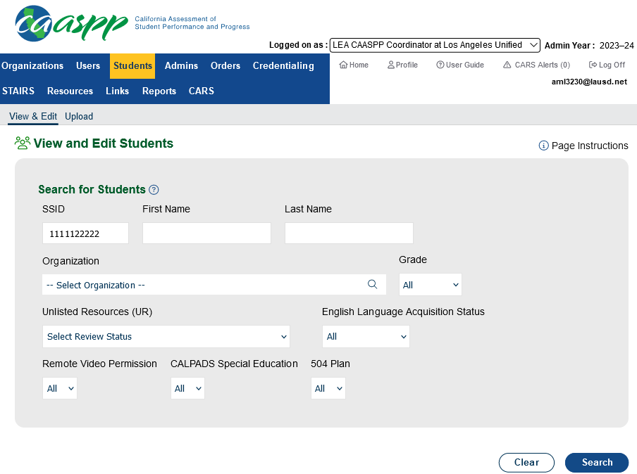

Assigning the CAA for Science
Log into TOMS and click the STUDENTS tab.
Search for the student by entering the SSID.
Click the magnifying glass.

Slide 24
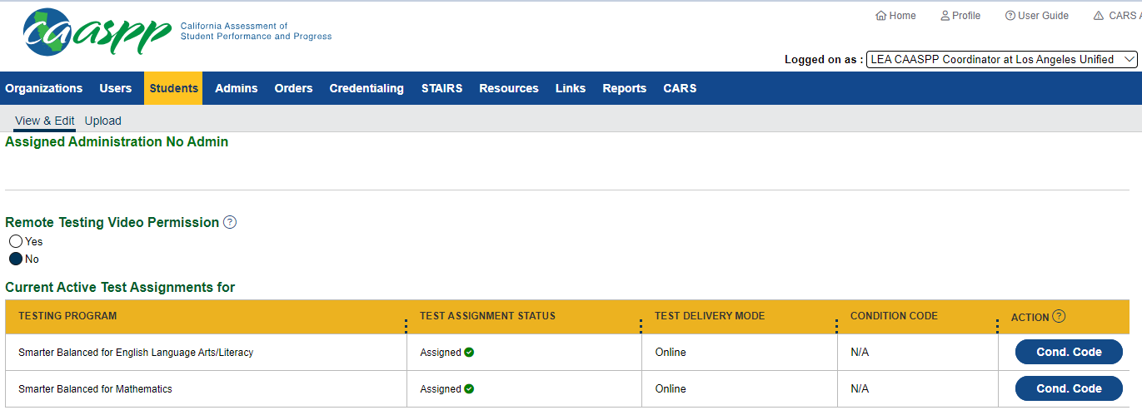
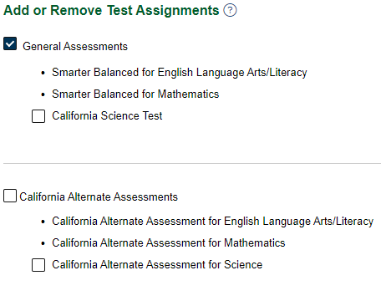
Assigning the CAA for Science
Under Add or Remove Test Assignments, click California Alternate Assessments
Students will be assigned the CAA for ELA/Math and the Alternate ELPAC (if eligible)
How to Enter Student Test Assignments One by One

Slide 25
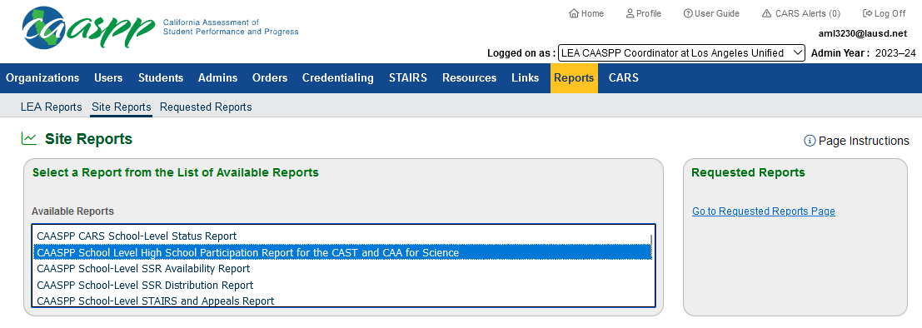
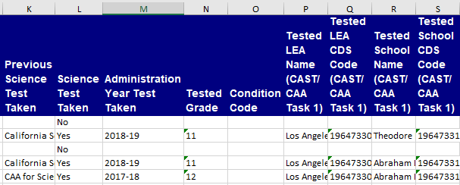
Student Participation: CAA for Science
High School Coordinators can verify CAST Eligibility by downloading the School Level High School Participation Report for the CAST and CAA for Science from TOMS.

Slide 26
CAASPP Summative Parent Notification
Pursuant to California Code of Regulations, Title 5, Section 852
Schools shall notify parents about student participation in the CAASPP system.
Notification must be sent every year.
Letter template available on the Student Testing Branch Webpage. (English and Spanish)
The letter informs parents of the availability of exemptions from CAASPP testing.

Slide 27
CAASPP Summative Parent Notification
Pursuant to California Code of Regulations, Title 5, Section 852
Parent/Guardian who elect to exempt their students:
Must submit request in writing to the school.
Letter must be test and content specific.
Request must be submitted each year.
School should have a process in place to collect parent requests.
CAASPP Coordinator must flag exempted students in TOMS through the Test Assignments tab as soon as the letter is received.
District Employees shall not solicit or encourage any written exemption request on behalf of any student or groups of students.

Slide 28
CAASPP Summative Parent Notification
Schools SHALL NOT send letters, surveys, or any other correspondence asking if a parent wishes to exempt their students from state testing.
District Employees shall not solicit or encourage any written exemption request on behalf of any student or groups of students.

Slide 29
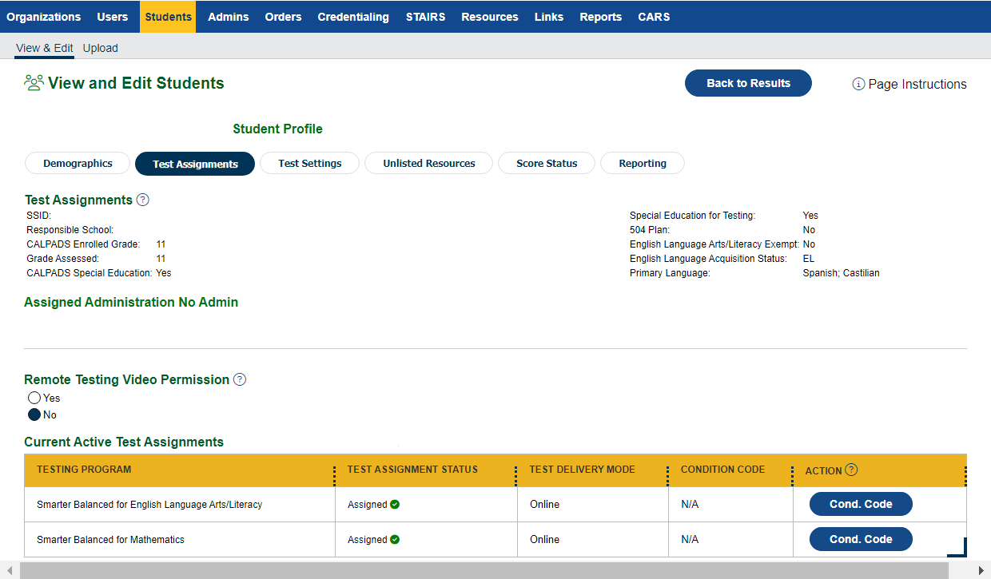
Entering Parent Exemptions in TOMS
Search for the student in TOMS.
Select TEST ASSIGNMENTS.
Select CONDITION CODE for the test the parent requested an exemption.

Slide 30
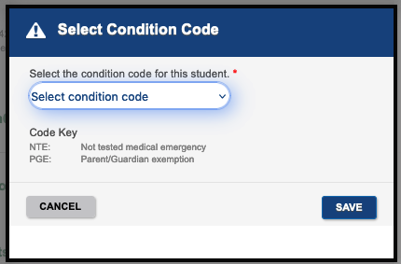
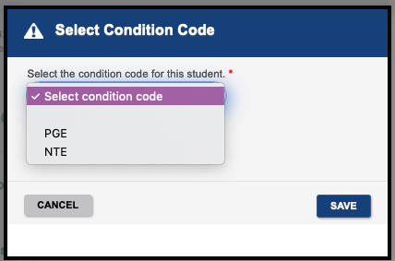
Entering Parent Exemption in TOMS
Select the reason for the exemption from the dropdown.
PGE- Parent/Guardian Exemption
NTE- Not Tested Medical Emergency
i.e., hospitalization
Click SAVE
Maintain documentation at the school site and keep with testing paperwork.
Medical documents
Parent exemption letters

Slide 31

CAASPP Testing Student Participation
100%
Participation
It is the expectation of the district that ALL students be afforded every opportunity to complete all required State assessments within each testing window unless they are exempt from testing by either:
Parent Exemption
EL Newcomer Status (Not applicable for CAAs)
California School Dashboard
https://www.caschooldashboard.org/
Notes:
The goal for CAASPP testing is 100% student participation. It is the expectation of the district that all students complete all required state assessments within each testing window unless they are exempt from testing by either parent exemption or EL newcomer status.

Slide 32
Accountability: California Dashboard
The methodology looks at the number of students needed to bring the participation rate for the District, school, or student group up to the 95 percent participation rate target set under the Every Student Succeeds Act.
Each of these students will be assigned a Distance from Standard (DFS) based on the assignment of a Lowest Obtainable Scale Score (LOSS):
For English language arts/literacy (ELA), a DFS of -279 will be applied.
For mathematics, a DFS of -247 will be applied.
CAA for Science is not currently part of the California School Dashboard.

Slide 33
Action Item
Determine the windows for the Four CAA for Science administrations.
Work with IEP Team to identify eligible students.

Slide 34
California Alternate Assessment
For Science
☑ Training Requirements

Slide 35
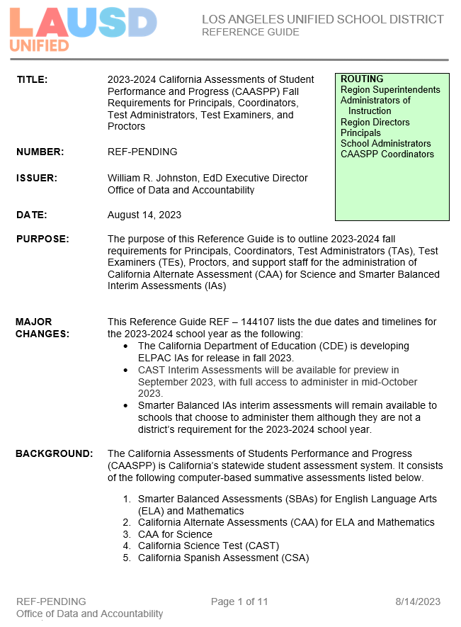
Policy Document
Lists the requirements for the following staff:
Principal
CAASPP Coordinator
Test Examiner (TE)
Test Administrator (TA)
Proctors
Notes:
Reference Guide 143508 outline the 2023-24 Initial ELPAC and Initial Alternate ELPAC requirements for Principals, Site ELPAC Coordinators, Test Examiners (TE), and Proctors.

Slide 36
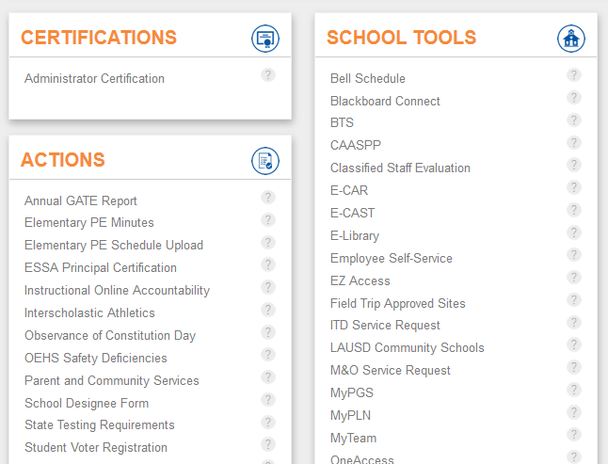
CAASPP Requirements for Principals
Principals complete their requirements in the Principal’s Portal
Electronically certify 2023-24 CAASPP Security Affidavit and Agreement
Designate a CAASPP Coordinator
Trained CAASPP Coordinators will not receive their TOMS account until after their Principal completes these requirements.

Slide 37
CAASPP Requirements for Coordinators (Fall)
ALL CAASPP Coordinators are required to complete
the CAA for Science Moodle Training.

Slide 38
CAASPP Requirements for Coordinators (Fall)
2023-24 CAASPP Security Forms Requirements Curriculum
Security Forms Training
2023-24 CAASPP Security Affidavit and Agreement
2023-24 Fall CAASPP Administration Coordinator Training
CAA for Science
Interim Assessments
2023-24 CAA for Science Training (via Moodle)
General Section
Science Section
Coordinators will receive their TOMS accounts after all requirements have been completed.

Slide 39
CAASPP Requirements for Test Examiners (TEs)
2023-24 CAASPP Security Form TE and Proctor Requirements Curriculum (MyPLN)
2023-24 CAASPP Security Form TA, TE, and Proctor Training (MyPLN)
2023-24 CAASPP Security Affidavit - electronic submission in STB Portal via MyPLN
Coordinators will designate CAA for Science TEs in the STB Portal after the completion of these requirements.
2023-24 Fall CAASPP Administration School-based Training (facilitated by CAASPP Coordinator)
Maintain sign-in sheets and agendas
CAASPP Coordinators will use and adapt this presentation to facilitate their CAA for Science school-based training.
2023-24 CAA Test Examiner Tutorial (Moodle)
General Section
CAA for Science Section
Collect Certificates of Completion

Slide 40

Long-Term Substitute Teachers
Substitute Teachers who need to complete CAA for Science training requirements have to select your school in the Multiple Assignment field when signing the CAASPP Affidavit and Agreement so you can view them in the STB Portal.
If they forget to do this at the time of signing the affidavit, call the STB Help Desk at 213-241-4104.

Slide 41
CAASPP Requirements for Proctors
2023-24 CAASPP Security Form TE and Proctor Requirements Curriculum (MyPLN)
2023-24 CAASPP Security Form TA, TE, and Proctor Training (MyPLN)
2023-24 CAASPP Security Affidavit - electronic submission in STB Portal via MyPLN
Coordinators will designate CAA for Science TEs in the STB Portal after the completion of these requirements.
2023-24 Fall CAASPP Administration School-based Training (facilitated by CAASPP Coordinator)
Maintain sign-in sheets and agendas

Slide 42
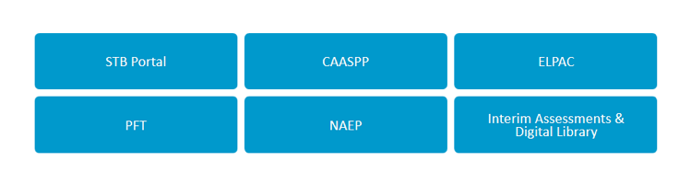
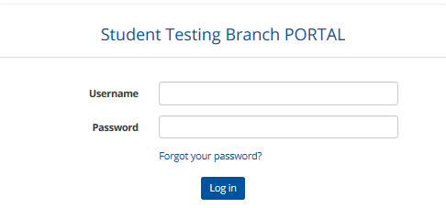
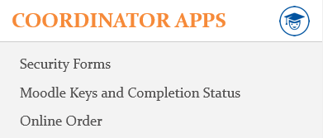
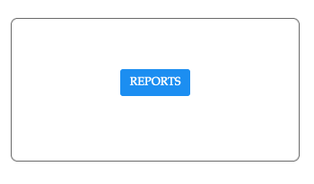
Designating Test Examiners (TEs) in the STB Portal
Navigate to STB Website: https://www.lausd.org/testing
1
2
3
4
Notes:
To access the Security Affidavit Report from STB Portal, follow steps 1-4.

Slide 43
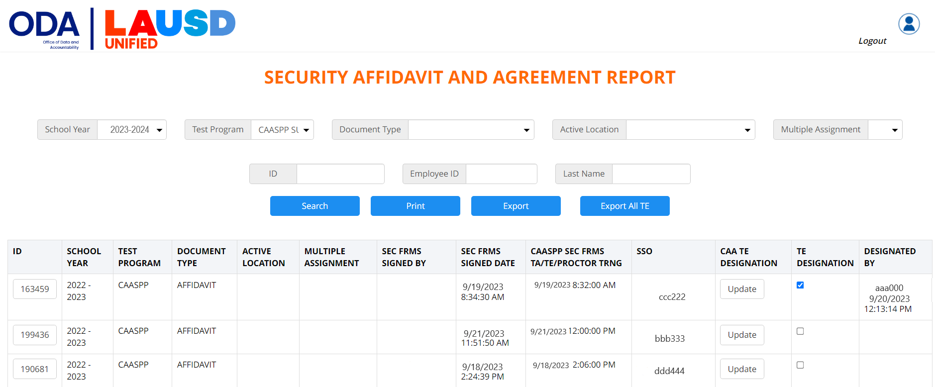

Designating Test Examiners (TEs) in the STB Portal
2. Select your school to view substitutes.
1. Select Testing Program.
3. Both requirements must be completed to designate TEs.
5. Click "Designate (All Selected)"
4. Click the box to designate the individual as a CAA TE.
Notes:
The CAASPP Coordinator must designate all CAA TEs in the STB before sharing the Moodle key
TEs who require a Moodle account will have one created by STB in 1-2 business days

Slide 44
Action Items
Schedule CAA for Science Training
Complete CAA for Science Moodle Training

Slide 45
California Alternate Assessment
For Science
☑ Moodle Training

Slide 46
Moodle Accounts
A Moodle account is required to access the platform.
Moodle account is NOT related to TOMS or LAUSD SSO.
Moodle account is only created ONCE in an individual’s lifetime.
Previous users will use their existing Moodle account.
STB will create a Moodle account for 1st time users ONLY.
Coordinators – STB creates account for coordinators upon designation in Principal’s Portal.
Test Examiners (TEs) – Account are created AFTER the Coordinator designates them in the STB Portal.
User will receive an email from moodlesupport@scoe.net
Save username
No LAUSD employee should create a Moodle account! ALL accounts are managed by STB!

Slide 47
Moodle Enrollment Keys
Moodle enrollment keys allow access to specific trainings in the LAUSD section of Moodle.
Each school has a unique Moodle Key for the CAA Training
CAASPP Coordinators will receive access to the CAA Moodle Key in the STB Portal 1-2 business days AFTER both of the following are completed:
Coordinator is designated in the Principal’s Portal.
Principal and Coordinator complete Security Requirements.
CAASPP Coordinators will distribute the Moodle Key AFTER designating the TE in the STB Portal.
The Moodle Team will not provide you with Moodle Keys.
Contact STB for Moodle key support; DO NOT email Moodle.
The keys will not work if you are accessing the incorrect course.
Notes:
The Moodle training platform is used for CAA training.
Coordinators distribute their school’s Moodle keys to eligible TEs

Slide 48
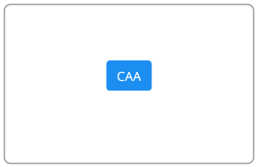
Accessing the Moodle Keys in STB Portal
CAASPP Coordinators will securely distribute the school’s CAA Moodle enrollment key to individuals who have been designated as TEs in the STB Portal.
1
2
Keys will be available mid-September
Moodle keys can be accessed 1-2 business days AFTER the Principal and designated CAASPP Coordinator have completed CAASPP Security Requirements.

Slide 49
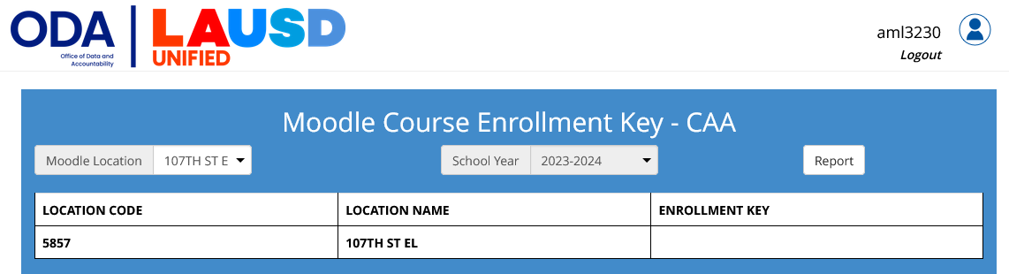
Accessing the Moodle Keys in STB Portal
3
Enrollment key will be visible here.
Notes:
If the principal or Coordinator have not completed CAASPP Security Requirements or if the coordinator has not been designated in the Principal’s Portal, the Moodle keys will not be available
Only the primary CAASPP Coordinator has access to the Moodle key.

Slide 50
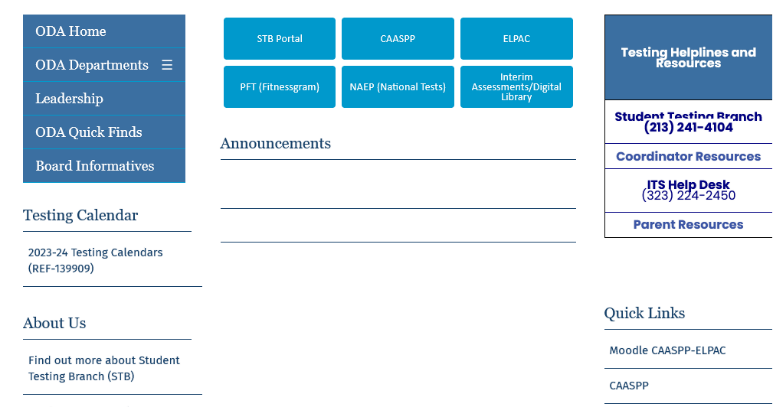
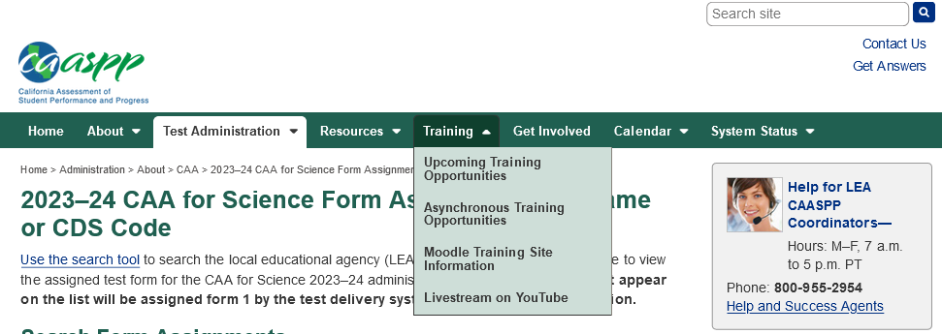
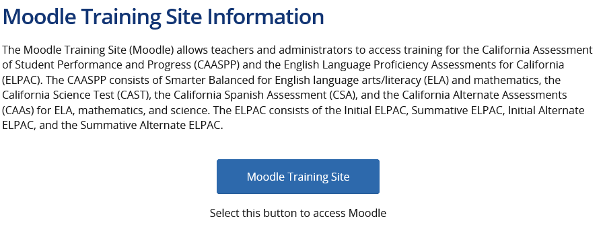
Accessing the Moodle Website
Access the Moodle Website Two Ways:
STB Homepage https://www.lausd.org/testing
CAASPP Homepage https://www.caaspp.org/
2
1

Slide 51
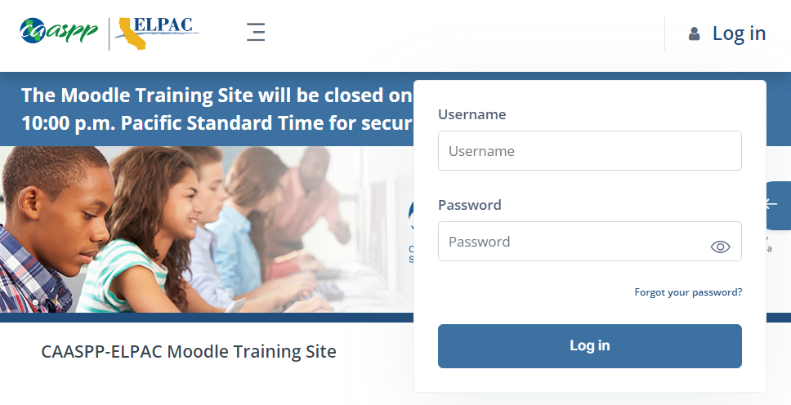
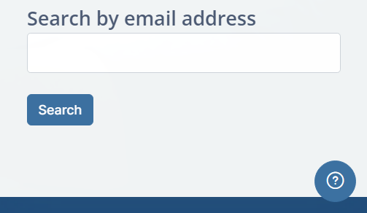
Forgot Moodle Password?
If your TEs forgot their Moodle username and/or password, direct them to the Moodle website. https://moodle.caaspp-elpac.org
Select Forgot Password
Search by email address ONLY (enter LAUSD email)
An email will be sent from moodlesupport@scoe.net
1
2
If an email is not received, contact moodlesupport@scoe.net for assistance.
Notes:
Provide these instructions to your Test Examiners.

Slide 52
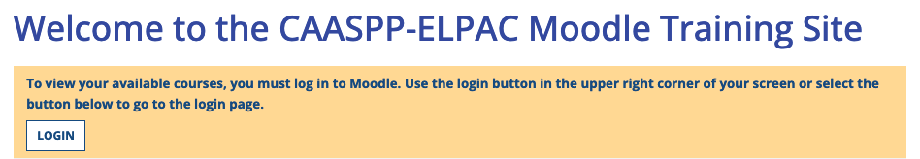
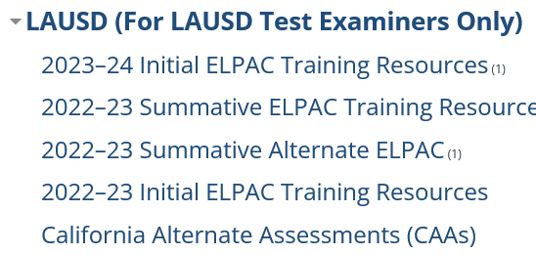
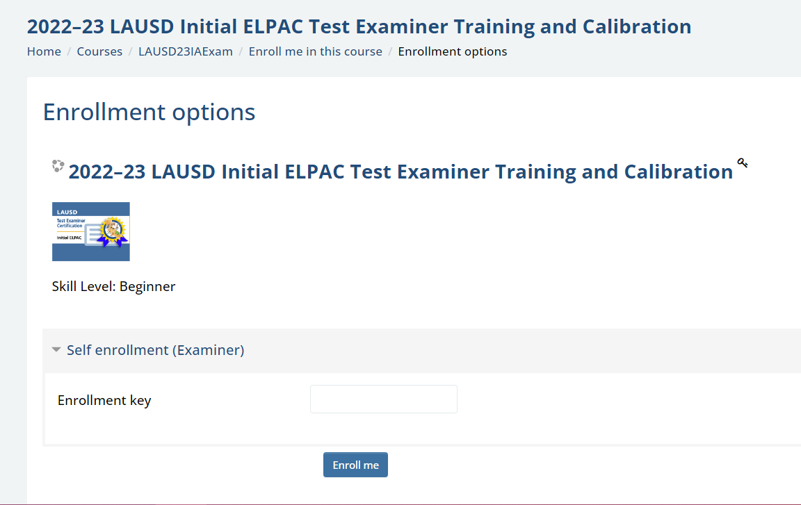
Accessing the CAA Training in Moodle
Log in to the Moodle website https://moodle.caaspp-elpac.org
Scroll down to the LAUSD Section on the Moodle homepage.
Select California Alternate Assessments (CAAs)
Select View Course
Enter your school's CAA Moodle Enrollment Key when prompted.
Enter the key exactly as it is in the STB Portal.

Slide 53
Accessing the CAA Training in Moodle
Read the course instructions
Sign the Affidavit
Complete the General Section
Watch all videos
Complete all Check for Understandings
Complete the Science Section
Watch all videos
Complete all Check for Understandings
Click on the Certificate of Completion
Completion will be reflected in the STB Portal in 1-2 business days
A Quick Guide will be available once the course is released.
Notes:
The next set of slides provide instructions for accessing the CAA Moodle Course in the Moodle platform. Share these instructions with your TEs.

Slide 54
Action Items
Identify Test Examiners (TEs) who will be administering the CAA for Science.
Verify that you can log into the Moodle website.

Slide 55
California Alternate Assessment
For Science
Monitoring Completion Test Examiner Requirements for CAA Science

Slide 56
Monitoring Completion of TE and Proctor Security Requirements
Navigate to STB Website: https://www.lausd.org/testing
1
2
3
4
Notes:
Follow steps 1-4 to access the Security Affidavit Report from STB Portal.

Slide 57
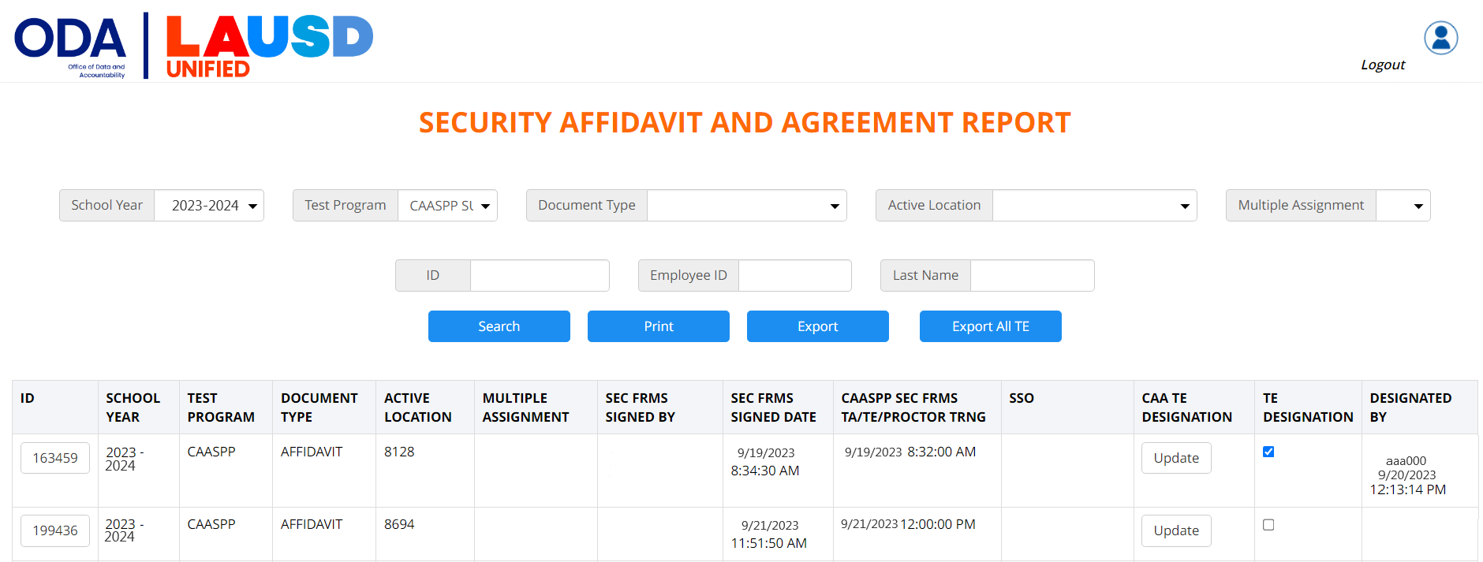
Monitoring Completion of TE and Proctor Security Requirements
2. Select your school to view substitutes.
1. Select Testing Program.
3. Verify completion of both Security Requirements and designation.
4. Proctors are not designated.
Notes:
Process for monitoring completion of TE and Proctor training is the same as last year.

Slide 58
Monitoring Completion of TE and Proctor Security Requirements
If a site employee is not populating on the Affidavit and Agreement Report, they DID NOT sign the CAASPP Affidavit; they only marked it COMPLETE in MyPLN.
Guide them to sign the affidavit directly in the STB Portal.
Log into the STB Portal
Select SECURITY FORMS
Select CAASPP
Read, sign, and click CERTIFY/SUBMIT
Completion will immediately populate in the STB Portal
If a substitute is not populating on the Report, select your school in the Multiple Assignment dropdown menu.
If they still do not populate, have them complete the steps listed above and select your school as a multiple assignment.
If they already signed and are unable to add your school, call STB.
Notes:
Troubleshooting the Affidavit and Agreement Report

Slide 59
Monitoring Completion of TE Moodle Training
Navigate to STB Website: https://www.lausd.org/testing
1
2
3
4

Slide 60
Monitoring Completion of TE Moodle Training
A list of individuals who have completed the CAA for Science Moodle Training will be listed below the Moodle Key table 1-2 business days after the training was completed.
Coordinators must also collect and maintain a hard copy of the CAA for Science Moodle Certificate of Completion.

Slide 61
Action Items
Verify TEs have completed their Security Requirements.
Verify Moodle completion before creating TOMS accounts.

Slide 62
California Alternate Assessment
For Science
Preparing for Test Administration

Slide 63
CAA For Science Overview
The CAA for Science is administered as four separate embedded performance tasks (PTs) that are integrated into each student's instruction.
Each PT contains ten test questions specific to one of the three science domains (Earth and Space Sciences, Life Sciences, and Physical Sciences).
Each PT is administered to the student in a one-on-one setting by a trained test examiner who is familiar with the student.
Each PT should be administered shortly after the student has received instruction on the related science content.
Test examiners (TEs) administer the four embedded PTs in any order, at any time, throughout the year.

Slide 64
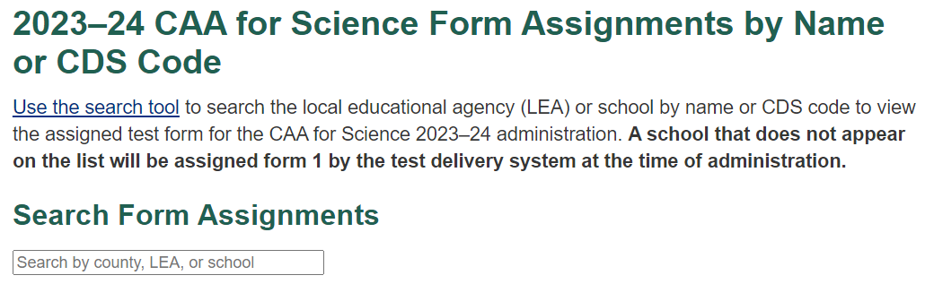
CAA For Science Form Assignments
Schools have been assigned a Form Assignment for CAA for Science administration.
TEs need to know the school’s 2023-24 Form Assignment to download the correct Direction for Administration (DFA).
If students started a CAA for Science PT at another school and did not complete it, the current school needs to use the previous school’s form assignment DFA when testing the students.
Notes:
Share the school’s Science form number with TEs. This may be different than the form number for ELA/Math. If a new student enrolls and has a paused test, the coordinator will need to verify the previous school's form number. If the form number is different, the school will need to use the previous school's form number DFA to finish administering the test. Contact STB for the correct DFA.

Slide 65
CAA Preparing for Test Administration (PFAs)
The Preparing for Administration (PFA) document is a new nonsecure document and should be used PRIOR to test administration.
Prepares TEs for test administration and allows them to become familiar with testing guidelines.
Contains the planning and preparation content previously found in the DFA.
Does not contain secure questions
PFAs are posted in the CAA web page on the CAASPP homepage.
CAA PFA

Slide 66

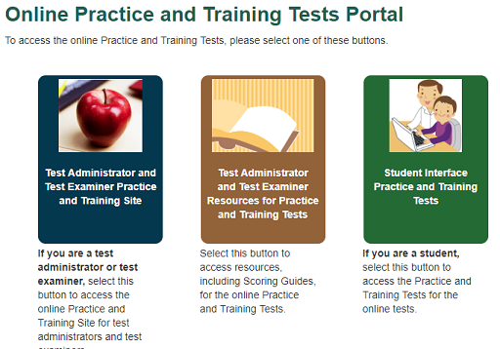
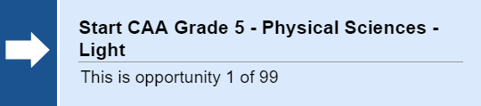

CAA Training and Practice Tests
Acessible through the caaspp.org homepage

Slide 67
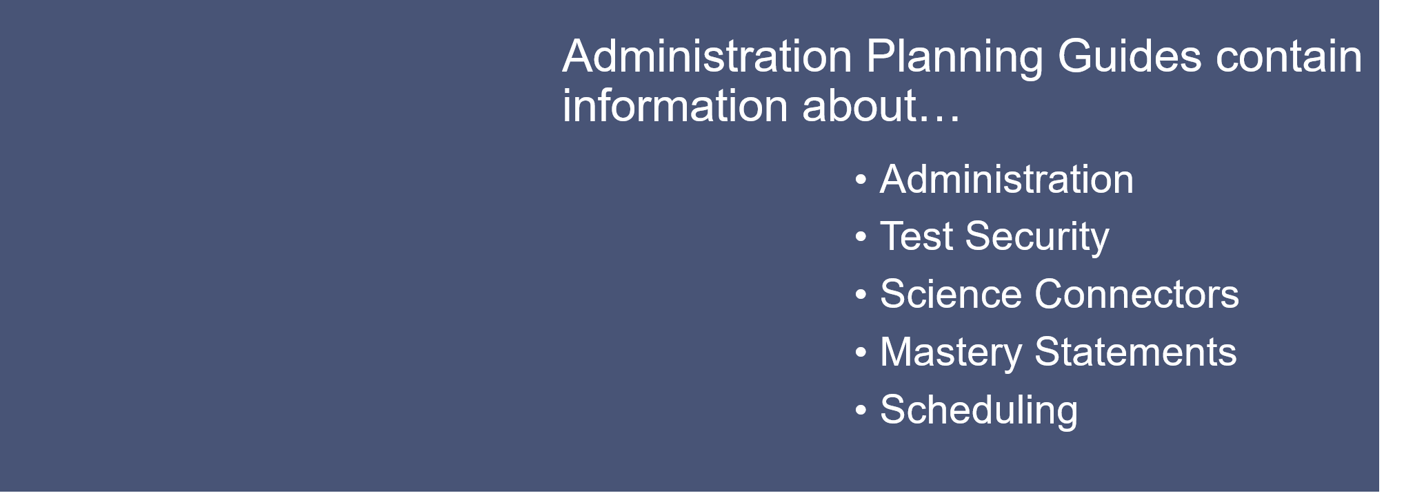
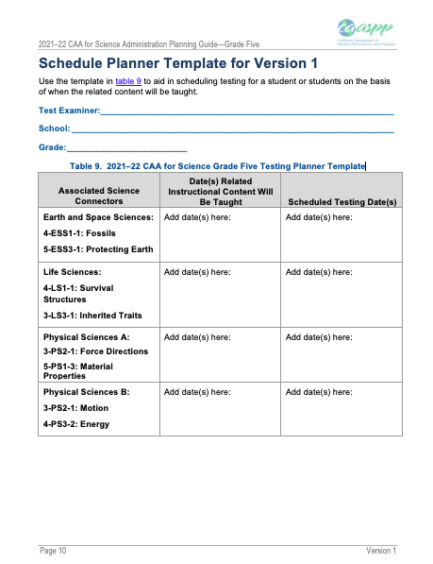
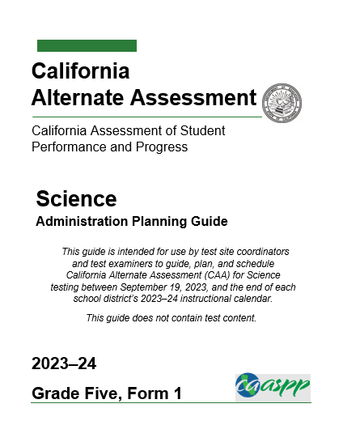
CAA For Science Preparation
The Administration Planning Guide provide guidance on embedding the assessment into the instructional calendar.
Organized by Form Number and grade level

Slide 68

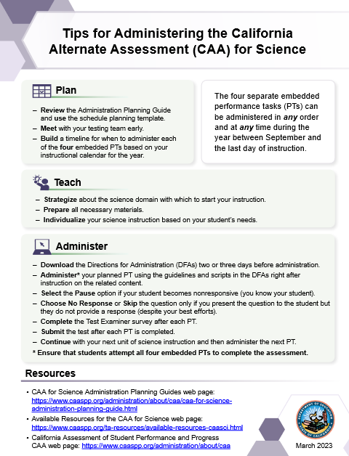
CAA for Science Resources
Planning Guides
Resources and Training Materials
Tips for Administering the CAA for Science
Response Options for Alternate Assessments

Slide 69
Action Items
Identify your school’s CAA for Science Form Number.
Share resources with CAA for Science TEs.

Slide 70
California Alternate Assessment
For Science
Test Administration

Slide 71
Test Security
Click on the link to review the CAASPP security requirements:
Tables 1- 4 describe security requirements for the test environment during various stages of testing.
The test environment refers to all aspects of the testing situation while students are testing.
Prepare the following signage for TEs:
Testing - Do Not Disturb
Unauthorized Electronic Devices May Not Be Used At Any Time During the Testing Session
Notes:
Review the tables during your school based-training

Slide 72
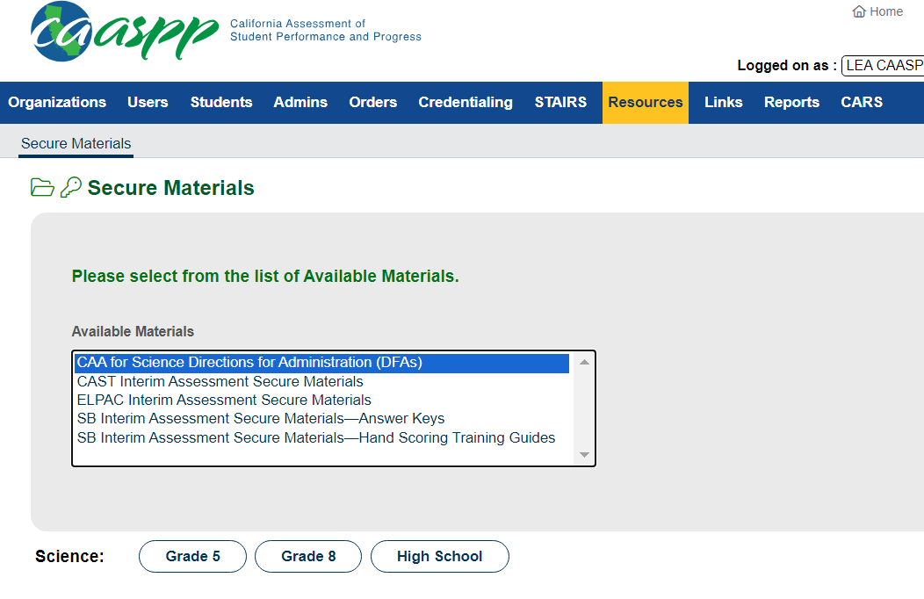
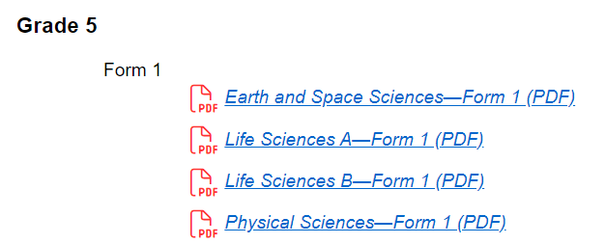
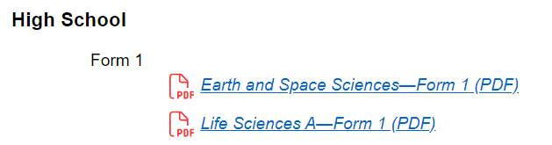
CAA Directions for Administration (DFAs)
The DFAs for the CAA for Science include test day instructions and must be used by the TE to administer tests to students.
Download from TOMS > Resources.
Contains test administration scripts.
DFAs are SECURE MATERIALS
Hard copies must be checked out/in each day of testing.
DFAs must not be emailed nor shared electronically.
Notes:
DFAs are required for administration of the CAA. They are secure, therefore, only available to Test Examiners who have met the requirements and have a TOMS account. They should NEVER be emailed or shared electronically. You may print a copy for the TEs but they must be checked in/out to maintain security.

Slide 73
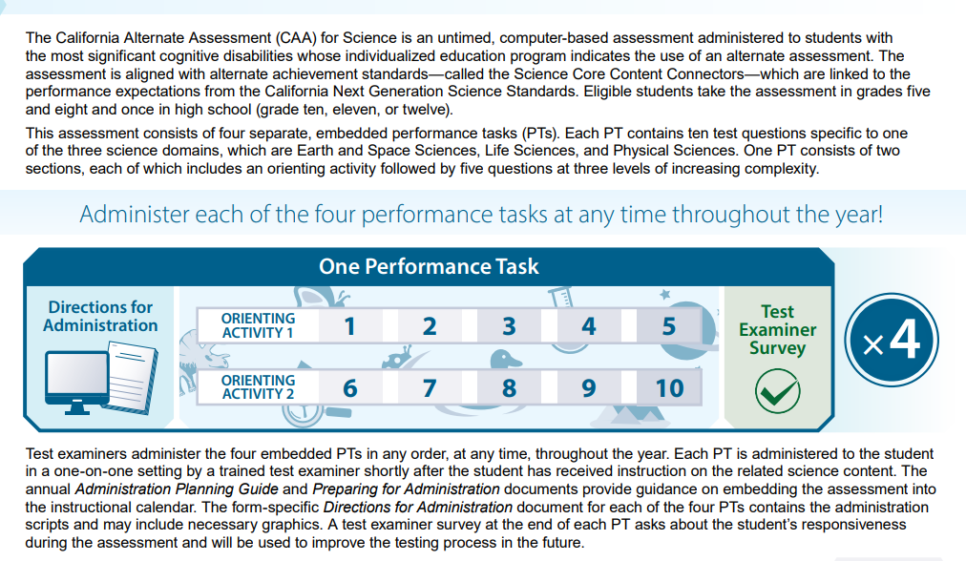
Organization of the CAA For Science
Resources
■ California Department of Education CAA for Science web page: https://www.cde.ca.gov/ta/tg/ca/caascience.asp
■ California Assessment of Student Performance and Progress CAAs General Information web page: https://www.caaspp.org/administration/about/caa/index.html

Slide 74
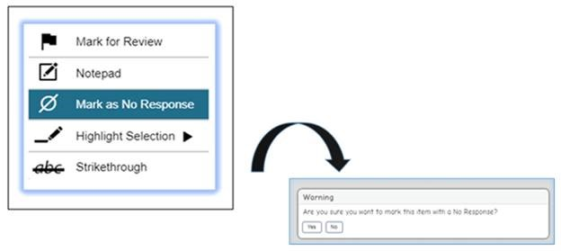
CAA For Science – No Response Option
Mark as No Response option is a last resort.

Slide 75
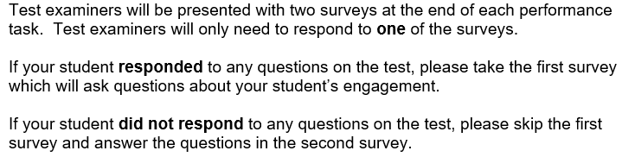

CAA For Science Survey
Test Examiner Surveys

Slide 76
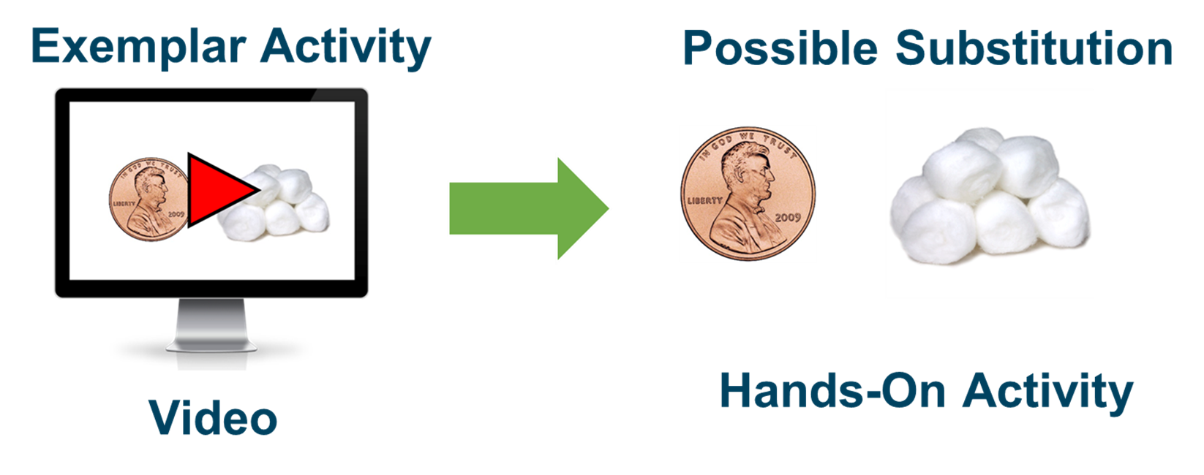
CAA For Science Administration
Individualization and Orienting Activities

Slide 77
Action Items
Review CAA for Science Overview.
Prepare DFAs for TEs if providing hard copies.

Slide 78
California Alternate Assessment
For Science
Security and Test Administration Incident Reporting System (STAIRS)

Slide 79
Test Security Incidents
Test security incidents are behaviors prohibited because they give a student an unfair advantage or because they compromise the secure administration of the assessments.
Whether intentional or by accident, failure to comply with security and administration rules, either by staff or students, constitutes a test security incident.
It is the responsibility of each TE and Proctor to immediately report any testing irregularity to the site CAASPP Coordinator.
All testing incidents need to be immediately reported in the Security and Test Administration Incident Reporting System (STAIRS) in TOMS by the site CAASPP Coordinator.
Security Breaches must also be reported to STB immediately after the STAIRS is filed.
Some incidents may require that an Appeal be submitted to reset, reopen, or restore.
After the STAIRS is submitted, a confirmation email will be sent indicating if any further action is needed.

Slide 80
Examples of Test Security Incidents
Expired or accidentally submitted tests.
Student was administered the incorrect assessment.
Student took the test using another student’s SSID.
Student took the test using a duplicate SSID.
Social media discussion/posting of secure materials (Security Breach).
Secure test materials were discussed, retained or copied (Security Breach).
Notes:
Call STB for support

Slide 81
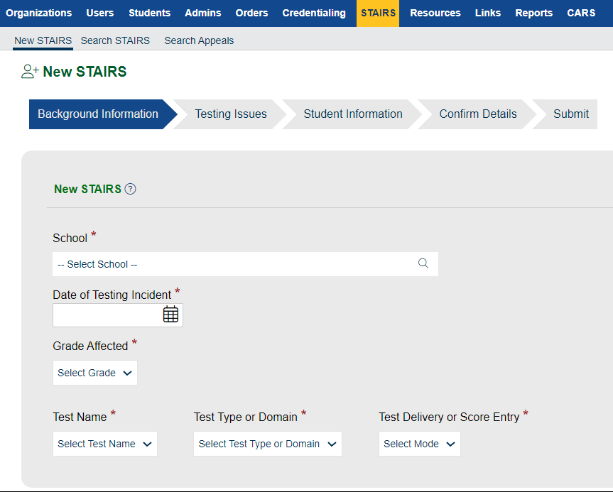
STAIRS
CAASPP Coordinators gather information regarding the incident including:
Date of incident
SSIDs of student(s) involved
Security breaches must be entered in TOMS immediately by the Coordinator.
Call STB to report any security breach after completing the STAIRS.
Notes:
All testing incidents must be reported in STAIRS
Any security breach must be reported in STAIRS and to STB directly

Slide 82
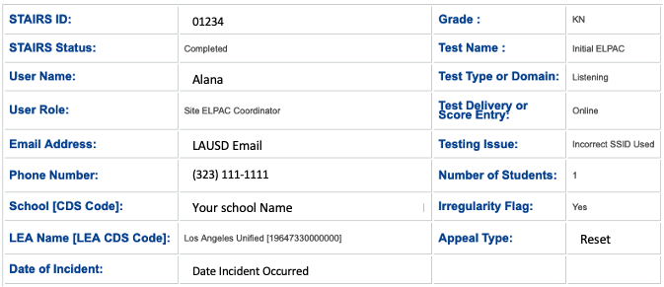
Creating a STAIRS Report
If a Reset, Reopen, or Restore is required, ensure that it is indicated in the Appeal type section before submitting.
A 200-character description of the issue and steps to avoid the incident from occurring again, may be required prior to submitting.
Notes:
Call STB for support

Slide 83

Reviewing a Submitted STAIRS
If your STAIRS is rejected
Select “Search STAIRS” and enter the STAIRS ID
Review and follow the instructions in the Notes section
Submit a new STAIRS if needed

Slide 84
Action Items
If you have any questions, contact STB prior to submitting STAIRS.
Be sure to have student(s) SSID number(s) when creating a STAIRS.
Be sure to follow-up on all STAIRS submitted.

Slide 85
Interim Assessments
New California Science Test (CAST) Interim Assessments

Slide 86
CAST Interim Assessments
Coming soon!
California Science Test (CAST) Interim Assessments
The CAST Interim Assessments will join the Smarter Balanced Interim Assessments for English language arts/literacy and mathematics as state-provided interim assessments.

Slide 87
CAST Interim Assessment Release Plan
September 19, 2023—Preview Access for Educators
Interim assessment forms will be available in the Interim Assessment Viewing System.
Secure hand scoring materials and answer keys will be available in the Test Operations Management System (TOMS).
October 19, 2023—Administration and Results Access
Interim assessment forms will be available in the Test Delivery System (TDS) for administering to students.
Items requiring hand scoring will be available in either the Teacher Hand Scoring System (THSS).
After hand scoring is completed, the following data will be available in the California Educator Reporting System (CERS):
Overall scale scores
Performance levels
Custom aggregate reports
Key and distractor analysis

Slide 88
CAST Interim Assessment Release Plan Cont…
Late January 2024 – Test items and student responses will be viewable in CERS.
Late July 2024 - Individual Student Reports (ISRs) will be available in CERS.

Slide 89
CAST Interim Assessments Overview
IAs provide meaningful information for gauging student progress toward mastery of the skills measured by the summative assessments.
The Interim Assessments can be used in multiple ways:
Support student learning – e.g., Used during daily instruction
Monitor Student Progress – e.g., Administered after a period of instruction
Used by school and district staff for professional development

Slide 90
CAST Interim Assessments Overview Cont…
Interim assessments provide an additional opportunity to try out accessibility supports with students and actual test items to evaluate effectiveness.
How an assessment is administered can impact how the data is provided and how it should be interpreted.
Standardized Administration
Students complete the IA individually following the administration procedure used for the summative assessments.
The results can be considered an assessment of what students know.
Non-standardized Administration
Students complete the IA under conditions that are not consistent with the administration requirements of the summative assessment.
Some examples of Non standardized administration might include, but are not limited to, the following:
Administering tests while students answer cooperatively in pairs, in small groups, or as a whole class

Slide 91
Interim Assessments
2023-24 LAUSD Comprehensive Assessment Program

Slide 92

LAUSD Comprehensive Assessment Program
MEM-6700.4: 2023-24 LAUSD Comprehensive Assessment Program, is available in E-Library
Smarter Balanced Interim Assessment Blocks (IABs) for ELA and Math are no longer required assessments in LAUSD
Schools and Teachers may choose which assessments to administer and when to administer each assessment:
For new students (i.e. Grade 3 and grade 11)
For new Teachers
Used for practice
To allow students to practice using designated Supports and Accommodations
To test the school’s technology readiness for Summative Assessments
As a Formative Assessment Tool to Drive Instruction and Inform teachers of student progress/readiness for summative Assessments

Slide 93
Interim Assessments
Systems and Purpose

Slide 94
Interim Assessments Security
Interim Assessment material is not for public use, display, or distribution
Material may not be posted in any public place, including online
Material may not be reproduced in any form or sent home
Material may not be shared with parents/guardians or the public
All users with access to Interim Assessments should take the necessary measures to maintain the integrity of the assessments.
CAASPP Coordinators will ensure that employees sign the Interim Assessment Acknowledgement Form in the STB Portal before having access to Interim Assessments.

Slide 95
Interim Assessment Types
Interim Comprehensive Assessments (ICAs)
Assess the full range of targets, similar to the summative.
Examples:
Grade 3 ELA
Grade 3 Math
Interim Assessment Blocks (IABs)
Assess 3–8 targets in Math or ELA/literacy.
Examples:
Grade 3 ELA, Reading Literary Texts
Grade 3 Math, Operations and Algebraic Thinking
Focused Interim Assessment Blocks (FIABs)
Assess 1-3 targets in Math or ELA/Literacy
Examples:
Grade 3 ELA, Text Analysis (Literary)
Grade 3 Math: Multiply and Divide Within 100

Slide 96

Interim Assessments System and Purpose
Module 1: Introducing the Smarter Balanced Interim Assessments Video
Slides pertaining to this topic are included in the CAASPP Resources section in Coordinator Resources
Access the Introducing the Smarter Balanced Interim Assessments through the following link:
https://www.cde.ca.gov/ta/tg/sa/iavideoseries.asp

Slide 97



Interim Assessments by Grade Level
Interim Assessments At a Glance
This document lists, by grade level or grade span, all available CAASPP and ELPAC Interim Assessments.
Interim Assessments by Grade Level:
Lists the available IAs and associated standards
Total number of items on each IA
Provides the number of constructed response and essay items that require local hand scoring (by TA)

Slide 98
Action Item
Bookmark and become familiar with available Interim Assessments websites and related resources.
Download the Interim Assessment by grade level documents and share with staff.

Slide 99
Interim Assessments
Viewing System

Slide 100
Interim Assessment Viewing System
Module 2a and 2b: Interim Assessments Viewing System and the Interim Assessments Viewing System Demonstration videos
Provide information on how to log into and navigate the Interim Assessment Viewing System
Describe how the viewing system can be used by educators to prepare for the administration of interim assessments.
Interim Assessments Viewing System Video:
https://www.cde.ca.gov/ta/tg/sa/iavideoseries.asp
VIDEO 1
Interim Assessments Viewing System Demonstration Video:
https://www.cde.ca.gov/ta/tg/sa/iavideoseries.asp
VIDEO 2

Slide 101
Action Item
Become familiar with Interim Assessment Viewing System and the various uses of the system
Revisit Interim Assessment purpose and Limitations of its use as per this presentation
Limited access to only those individuals within the District who have a professional interest in the use of the assessments
_________________________________________

Slide 102
Interim Assessments
Hand Scoring System

Slide 103
Teacher Hand Scoring System
Most Interim Assessment items are scored by the Smarter Balanced test delivery engine.
Hand scoring of constructed-response items and performance tasks is a local responsibility.
Results for individual students are generated only after the constructed-response item scores and performance task scores are inputted into the Teacher Hand Scoring System (THSS). (Processing time of up to 48 hours)
Scoring is supported by training guides, rubrics, exemplars (i.e., anchor and practice papers).

Slide 104
Training Guides and Exemplars
Training Guides and Exemplars for all constructed response items and performance tasks are accessible in TOMS.
Schools can access these secure materials for professional development and training purposes.

Slide 105

Training Guides and Exemplars
1
2
3

Slide 106

Training Guides and Exemplars
1
2

Slide 107



Training Guides and Exemplars

Slide 108



Training Guides and Exemplars

Slide 109

Hand Scoring Video
Module 4b: Interim Assessment Hand Scoring Demonstration Video
Slides pertaining to this topic are included in the CAASPP Resources section in Coordinator Resources
2 additional videos are available:
Interim Assessment Hand Scoring System
Interim Assessment Training Guides and Exemplars
Access the Interim Assessment Hand Scoring Demonstration Video through the following link:
https://www.cde.ca.gov/ta/tg/sa/iavideoseries.asp

Slide 110
Action Items
Become familiar with the steps and procedures for accessing and navigating the IA Hand Scoring System.
Prepare and facilitate the Professional Development session for your teachers around the scoring of an IAB.
_________________________________________

Slide 111
Interim Assessments
School Site Professional Development Topics
Training Requirements

Slide 112
School Site Professional Development
CAA for Science for Coordinator and if applicable teachers
IA Acknowledgement Form for Teachers to Sign
IA System Overview – Video
IA Security Reminder
IAs Available by Grade
IA Viewing System – Video
Supports and Accommodations Available – Videos linked on
For students with no IEP or 504 plan – Teacher discretion
For students WITH and IEP or 504 plan – Welligent Section K Roster
Student log on labels in MiSiS
Creating a Test Session – Show the video OR walk through the slides, etc – Video
Hand Scoring System - show the small video – Video
CERS – (California Educator Reporting System) – Video
IOC on mandated assessments
Must have a dated Sign-in with each agenda.
Save Agenda and Sign-ins in school’s testing files for 2 years

Slide 113
Principal’s Requirements
Completed in Principal’s Portal
CAASPP
Electronically sign the 2023-24 CAASPP Security Agreement and Affidavit
Designate a 2023-24 Site CAASPP Coordinator
ELPAC
Electronically sign the 2023-24 ELPAC Security Agreement and Affidavit
Designate a 2023-24 Site ELPAC Coordinator
PFT
Designate a 2023-24 Physical Fitness Test Coordinator (For schools with students in grades 5, 7, and 9 only)
Designate a 2023-24 Technology Coordinator
Designate a 2023-24 Point of Contact for Testing
Principal’s TOMS Educator account is created by STB within 1-2 business days after completion of these requirements.

Slide 114
IA Requirements – IA Administrators
LAUSD Interim Assessments Acknowledgement Form (In STB Portal)
2023-24 CAASPP Fall Training (facilitated by Site CAASPP Coordinator)
IA Administrator TOMS account will be created by the School CAASPP Coordinator AFTER the user completes all these requirements

Slide 115

Signing the Acknowledgment Form
Navigate to STB Website: https://www.lausd.org/testing
1
2
3
4

Slide 116
IA Requirements – Proctors
2023-24 CAASPP Summative TA, TE and Proctor Requirement via MyPLN
2023-24 CAASPP Security Affidavit - electronic submission in STB Portal via MyPLN
2023-24 CAASPP Fall Training (facilitated by CAASPP Coordinator)
Proctors DO NOT receive TOMS accounts

Slide 117
Confirm Completion of Acknowledgment Form
Navigate to STB Website: https://www.lausd.org/testing
1
2
3
4
The report will include the names and information of all the teachers at the school site who have successfully submitted their CAASPP Interim Assessment Acknowledgement Form.

Slide 118

Verifying Completion of the Acknowledgement Form
Select Interim Assessment
Select your school to view substitutes
2023-24
Verify that the Acknowledgement form was signed
TOMS accounts can be created after verifying the acknowledgement form is signed and participants have completed the school-based training

Slide 119
Action Items
Meet with Principal to schedule PD time
Prepare Agenda and Sign-in for PD
Determine what teachers need to be part of the PD
Communicate all training requirements to respective staff
Provide staff with instructions and time to complete requirements
Verify the completion of the Acknowledgement Form in the STB Portal

Slide 120
General Session
Creating TOMS Accounts

Slide 121
Security
Staff who are granted TOMS accounts are permitted to access secure and confidential information and resources.
Do not share account credentials with any other employee or person.
Memorize or store account logon information in a secure location; do not request computer to store or remember password.
Do not disclose or share any secure material in any format with anyone else.
Notes:
Note that employees of our district who serve as Test Examiners are required to sign a CAASPP Security Affidavit in STB Portal and when logging into CAASPP TOMS for the first time. The state also has an authentication process set up for TOMS account holders who are logging into TOMS on a different device.

Slide 122
Creating CAASPP TOMS Accounts
One-by-One
Uploading a group of users from a blank file
Download Excel Template from TOMS, add users as needed
Upload the file into TOMS
How to Add Users by Batch File Upload in TOMS (Video; 06:22) (Video Link)

Slide 123

Creating CAASPP TOMS Accounts – Cont...

Slide 124

Creating TOMS Accounts
CAA TE Accounts
Did you verify the completion of requirements in the STB Portal?
Did you designate the individual in the STB Portal?
Do you have the TE’s Moodle calibration certificate(s)?
Did they participate in the school-based training?
If TOMS accounts are created for untrained TEs, STB will delete the accounts.
Interim Assessment IA Administrator-Only Accounts
Did you verify the completion of the Acknowledgement Form in the STB Portal?
Did they participate in the school-based training?
If TOMS accounts are created for untrained TEs, STB will delete the accounts.
Notes:
We ask you to please be cautious before logging into to TOMS with your CAASPP Coordinator role and creating accounts. You should first, ask yourself three important question:
Did you verify the completion of requirements in the STB Portal?
Did you designate the individual in the STB Portal?
Do you have the TE’s Moodle calibration certificate(s)?
By doing so, you will prevent unauthorized access to secure materials and ensure that TEs are properly trained to administer tests to students at grade levels for which they were trained.

Slide 125

Creating TOMS Accounts
Batch
”Upload”
Individual
“ADD”
Use only LAUSD Emails
Complete all fields
Next
Notes:
When you are ready to create accounts, you have choices. You can either create the accounts one by one or for several users using the batch file upload template available on the TOMS Users page. This slide calls out the buttons and fields you will need to create the user’s profile prior to adding the role.

Slide 126

Creating TOMS Accounts
Select "CAASPP Test Examiner” for CAA TEs. Select IA-Administrator Only for Interim Assessment.
Next
Notes:
This is a screenshot of the next page.

Slide 127

Creating TOMS Accounts
Confirm that all information is correct. If the email was entered incorrectly, the TE will not be able to access TOMS.
Save
Notes:
This page is very important as it allows you to save the user profile and assigned role.

Slide 128



Creating TOMS Accounts
An email will be sent to the user with a link to create their password.
The TE will have 30 min. to click the link.
If the link expires, TEs can receive a new email by selecting Request one now from the TOMS logon screen.
Click here to receive a new email link.
Notes:
Be mindful of when you create accounts for TEs as the link will expire in 30 min.

Slide 129



Signing the TOMS CAASPP Affidavit
AFTER CREATING THEIR PASSWORD, CAA TEs must sign the
TOMS affidavit.
1. Access TOMS via caaspp.org
2. Click the CAASPP TE Role and the affidavit will populate.
IMPORTANT!
TEs Sign 3 Affidavits!
STB Portal
Moodle
TOMS
3. Read the affidavit, sign, and submit.
CAA for Science test sessions can be created in 2-3 hours.
Notes:
Please be sure to inform the individual/s you have created accounts for in advance. They will need to be prepared to finalize the creation of the account by completing steps 1-3 on this slide. As mentioned, they should also be informed that there are multiple affidavits to sign. Having signed the TOMS affidavit in advance of test administration is key because otherwise they will not see CAA as an option in the TA Interface.

Slide 130


Signing the TOMS CAASPP Affidavit
If the TOMS affidavit has not been signed, CAA for Science Assessments will not be visible in the TA Interface and sessions cannot be created.
TEs will NOT be able to administer the CAA for Science until 2-3 hours AFTER signing the affidavit in TOMS.
This can affect your testing schedule!
No CAA for Science assessments are available to select!
Coordinators should download the Security Forms and Remote Administration Status Report to see who has/has not signed the TOMS Affidavit.
Notes:
Check the Security Forms and Remote Administration Status Report frequently.

Slide 131
General Session
Monitoring Test Completion

Slide 132
CAASPP Website
Completion Status
This Report provides the most accurate and up-to-date results
Monitor test completion status for CAASPP
Run Reports several times per week
Notes:
As mentioned earlier in the presentation, the CAASPP Website is the gateway to various systems needed to perform your tasks. The landing page provides the radio buttons to access these systems. The Completion Status system is one and accessible here

Slide 133



Plan and Manage Testing Report
1
2
3
Notes:
Follow the steps indicated to access the Plan and Manage Testing Portal

Slide 134

Plan and Manage Testing Report
Your school populates
1. Select Test
2. Select Filters
3. Generate (View) or Export Report
Notes:
Select your test
Apply filters such as:
Students who have completed any opportunity
Students who have not completed any opportunity
Students whose test have expired
Generate or Export the Report to view or export the report

Slide 135

Plan and Manage Testing Report
Check the status of the test.
If the Expiration Date column indicates a date, a STAIRS needs to be completed to REOPEN the test.
Notes:
Run this report frequently to monitor completion status for the school site
If a students test is paused, they must log in and complete the test prior to the test expiring

Slide 136
General Session
Student Logon Credentials

Slide 137
Student Logon Credentials
Student logon credentials include personally identifiable information (PII), which is secure and is protected by federal privacy laws.
Student’s First Name
The name must be typed exactly as it appears in TOMS
TOMS will indicate a Preferred Name if one was entered in MiSiS
Student’s SSID
Notes:
Students require their Student log on credentials, which include the child's first name and Student Statewide Identification number or SSID. This information is private and protected by federal laws. Anyone with access to the PII must have a security affidavit on file and keep the log on credentials secure.

Slide 138

MiSiS Smarter Balanced Label & Student Rosters
3. Complete Fields
1. Reports
Coordinators will use their Categorical Coordinator Role to access labels and rosters. Request access from your Principal through oneAccess.
4. View Report
2. Testing > Student Testing Label/State Testing Roster
Notes:
This information is available in MiSiS. An administrative role approved by your principal will give you access.

Slide 139
MiSiS Student Rosters
CAASPP Coordinators should generate a roster for each teacher administering Interim Assessments or the CAA for Science.
Column B: Preferred Name- Preferred names must be used when reading names out loud and when students log in.
Columns D and E: Logon Credentials- First Name (Legal or Preferred Name) and SSID
Column J: Same (*) First Name- A “Y” for any student indicates that there are two or more students with the same first name enrolled in the class
If a student cannot sign-in, verify the data in TOMS
A | B | C | D E |  | F | G | H | I | J
Last Name | Preferred Name (P) | Middle Name | Smarter Balanced Logon Credentials |  | Grade | Teacher | Period | District ID | Same (*) First Name
 |  |  | First Name | SSID
Notes:
The coordinator generates the student roster for each teacher administering tests. If the student cannot log on, check the student’s information on TOMS to verify if it matches the information on the roster. If a student has a preferred name (column B), that name should be used if read out loud. If there is no preferred name, the column will be blank.
Columns D and E are the logon credentials, legal first name and SSID (state). If there is an asterisk by the student’s name in Column J, that means there is another student with the same first name in the class, therefore, teachers must be careful that the correct student’s information is given to the correct student.

Slide 140

MiSiS Labels – Student Logon Credentials
Securely Stored by the Coordinator
TEs sign out/in daily
Logon Credentials:
First Name or Preferred Name
SSID Number
There are two or more students with the same name in the class.
Grade
Period
LAUSD ID #
Teacher Name
Student’s Last Name
Preferred Name:
If preferred name exists, it is bold, and followed by (P).
If preferred name does not exist, only last name and Middle Initial are displayed.
Notes:
This slide shows a sample student testing label. It has the student’s logon credentials (first name and SSID) on the top left. Towards the right is an asterisk if another student in the class has the same first name. Below that will be their last name and a preferred name, if any. Underneath that line will be the grade, period, district ID and teacher name.

Slide 141

MiSiS: Labels – Student Logon Credentials
Label Details
30 labels per page
AVERY 5160, MACO 3000 or equivalent
Type: Address Label
Height: 1”
Width: 2.63”
Page size: 8.5” x 11”
Smarter Balanced Labels Job Aid
Notes:
The labels to be used have 30 labels per page. Avery 5160, MACO 3000 or an equivalent label can be used. Click on the Smarter Balanced Labels Job Aid for help, if needed.

Slide 142
Test Security and Student Logon Credentials
Student logon credentials (i.e., SSID and Confirmation Code) are to be considered secure and confidential information that grant access to a student’s Personal Identifiable Information (PII).
Schools must establish procedures to maintain all student logon credentials secure by returning them to the CAASPP Coordinator at the end of testing each day.
Schools must train all staff that will be handling student logon credentials on the established procedures and guidelines for maintaining the security of student logon credentials
Schools are to report to the Student Testing Branch if student logon credentials are compromised, using the CAASPP System—Test Administration Testing Incident or Impropriety Report Form located at the Student Testing Branch web site.
Notes:
Daily Inventory Control Forms should be prepared ahead of time and used when checking in/out materials for testing each day.

Slide 143

CAASPP Daily Inventory Control Form
TAs will check out/in the following materials each day of testing using the Daily Inventory Control Form:
Student Logon Credentials
Scratch paper
CAA DFA (if not using electronic version)*
CAA for Science Picture Cards*
*Not applicable to Interim Assessments
Located in Coordinator Resources
Notes:
Daily Inventory Control Forms should be prepared ahead of time and used when checking in/out materials for testing each day. This form is certified by the ELPAC Coordinator and may be requested in an audit or for post test documentation.

Slide 144
General Session
Accessibility Resources

Slide 145

LAUSD- Accessibility and Accommodations Guidelines
REF 133914- 2022-23 LAUSD Accessibility and Accommodations Guidelines for English Language Proficiency Assessments for California (ELPAC) and California Assessment of Student Performance and Progress (CAASPP).
Contains Attachment B
Used to assign designated supports to students.
Available in eLibrary and Coordinator Resources
Notes:
The LAUSD policy document provides guidance for schools on the use of accessibility resources including universal tools, designated supports and accommodations for both testing programs, ELPAC and CAASPP. Note that our office will release an updated document once the state has published the new Matrix, expected to be released in January.

Slide 146


California Assessment Accessibility Resource Matrix
This matrix describes all the available accessibility resources for ELPAC and CAASPP
Accessibility resources are features or supports that are part of the assessment.
Accessibility resources allow students to participate in an assessment that results in a fair and accurate estimate of each student’s achievement.
https://www.cde.ca.gov/ta/tg/ca/accessibilityresources.asp
Share with IEP Team members and download a copy for your resources!
Notes:
The California Assessment Accountability Resources Matrix is a document that identifies which accessibility resources are available for both CAASPP and ELPAC assessments

Slide 147


California Assessment Accessibility Resource Matrix
Embedded: The resource is provided as digitally delivered components of the secure browser
Non-embedded: The resource is provided separately from the secure browser and must be provided by the school.
Notes:
The California Assessment Accountability Resources Matrix indicates if the support is embedded or nonembedded, and contains a brief description
”Yes” means that the support is available
Embedded supports are available through the testing platform and nonembedded supports are provided by the school outside of the testing platform

Slide 148
California Assessment Accessibility Resource Matrix
Universal Tools
Available to all students on the basis of student preference and selection
Breaks
Digital Notepad
Embedded highlighter
Notes:
Additional paperwork is not required for students to use Universal Tools

Slide 149

California Assessment Accessibility Resource Matrix
Designated Supports
Available for use by any student for whom the need has been indicated by an educator or team of educators (with parent or guardian and student input as appropriate) and are regularly used in the classroom.
Use Attachment B from REF-133914
Principal needs to sign ATT B before the coordinator enters the designated supports in TOMS.
A student’s IEP or Section 504 plan may indicate the need for a designated support.
Notes:
Attachment B is required for students to use Designated Supports
Students with IEPs/504 Plans may have designated supports listed on the IEP, if not, ATT B may be used

Slide 150

California Assessment Accessibility Resource Matrix Designated Supports

Slide 151

California Assessment Accessibility Resource Matrix Designated Support – Stacked Translation

Slide 152
California Assessment Accessibility Resource Matrix
Accommodations
Only for students who have an IEP or Section 504 Plan
Accommodations are listed on the IEP or Section 504 Plan
Text to Speech
ASL
Unlisted Resources
Are non-embedded supports specified in IEP or Section 504 Plan.
If the unlisted resource changes the construct of the test, the student will be given the lowest obtainable scale score.
Notes:
Accommodations may only be entered for students who have an IEP or Section 504 Plan indicated in TOMS
The CAASPP Coordinator will enter the accommodations indicated on the IEP or Section 504 Plan in TOMS

Slide 153

California Assessment Accessibility Resource Matrix
Part 4 of the Matrix provides guidance regarding designated supports and accommodations for alternate assessments.
Notes:
Note that Part 4 of the matrix has an additional section to address supports that are available for Alternate Assessments through the online testing interface. Some students may need additional supports that are used during daily instruction.

Slide 154


Accessibility Resources Demonstration Videos
The following link provides demonstrations of select universal tools, designated supports, and accommodations allowed as part of the CAASPP.
http://www.caaspp.org/training/caaspp/uaag.html
Beneficial for students, teachers, and IEP teams.
Available in Spanish.
Start reviewing with teachers now for Summative CAASPP administration!
Notes:
Teachers, SpEd staff, and students will benefit from viewing the demonstration videos.

Slide 155

Professional Development for Staff
Review Matrix and demonstration videos
Teachers will be prepared for Summative CAASPP
Accessibility Resources Virtual Training Series
Module A: Matching Accessibility Resources to Students' Needs
Module B: Using Accessibility Resources in Daily Instruction
Notes:
The Accessibility Resources Virtual Training Series will help teachers and SpEd staff to see the connection between instruction and accessibility resources.

Slide 156
Action Items
Collaborate with your school's SpEd Team to discuss and review the accessibility resources available for the current school year.​
Familiarize yourself with the California Assessment Accessibility Resource Matrix.​ and share with SpEd Team and TEs.​
Review Accessibility Resources Demonstration videos with TEs.​
Plan Accessibility Resources PD for TEs.

Slide 157
General Session
Entering Supports and Accommodations

Slide 158
Entering Supports and Accommodations for CAA Science
Supports must be entered in TOMS by the CAASPP Coordinator at least 2 days before the student logs into a test.
Obtain the following from Elementary APEIS or Special Education Administrator/Designee for eligible students with existing IEPs:
CAA for Science Section K
Indicates Alternate ELPAC for eligible students.
Indicates required Accessibility Resources listed in IEP.

Slide 159

Preparing to Enter Supports & Accommodations
Indicates Accommodations and Designated Supports

Slide 160

Entering Supports and Accommodations for CAA Science

Slide 161

Entering Supports and Accommodations for CAA Science
Have your Section K Report handy.
Log in to TOMS and search students by SSID.
Click the magnifying glass.
Click TEST SETTINGS.

Slide 162

Entering Supports and Accommodations for CAA Science

Slide 163

Entering Supports and Accommodations for CAA Science

Slide 164

Entering Supports and Accommodations for CAA Science

Slide 165

Entering Supports and Accommodations for CAA Science
Don't forget to click UPDATE at the bottom of the page to save your entries.

Slide 166

Entering Supports & Accommodations for Interim Assessments
For the Interim Assessments
The Test Administrator Sets Accommodations or Designated Supports for Each Interim Assessment at the time that they will approve the student to start the assessment

Slide 167


Entering Supports & Accommodations for Interim Assessments

Slide 168

Getting to Know the Supports and Accommodations
http://sampleitems.smarterbalanced.org/

Slide 169
Process for Assigning Accommodations and Designated Supports
Accommodations or Designated Supports for
Students WITH IEP or Section 504 Plan
Coordinators may start to input Accommodations and Designated Supports in TOMS as per IEP or Section 504 Plan for the CAA for Science.
Teachers MUST set Accommodation or Designated Supports in teacher interface at the time of taking the Interim Assessment.
Teacher may allow students to try Accommodations or Designated Supports other than the ones specified on the IEP or Section 504 Plan during Interim Assessments.
All Accommodations or Designated Supports used for assessments should also be part of the student’s instructional program.
If an Accommodation or Designated Support will be used for the Summative Assessment that is not on the IEP or Section 504 Plan, the school is to hold an IEP team meeting to add the Accommodation or Designated Support to student’s IEP prior to the beginning of the Smarter Balanced Summative Assessments.
Attachment B from REF-133914 can be used to document any additional Designated Supports not in IEP/Section 504 prior to the beginning of the Smarter Balanced Summative Assessments.
Designated Supports for
Students WITH NO IEP or Section 504 Plan
Coordinators may start to input Designated Supports in TOMS as per Attachment B from REF-133914 for CAA for Science.
Teachers MUST set Designated Supports in teacher interface at the time of taking the Interim Assessment.
Teacher may allow students to try Designated Supports other than the ones specified on Attachment B from REF-133914 during Interim Assessments.
All Designated Supports used for assessments should also be part of the student’s instructional program.
If a Designated Support will be used for the Summative Assessment, it must be documented on Attachment B from REF-133914 prior to the beginning of the Smarter Balanced Summative Assessments.

Slide 170
Action Items
Collaborate with your school's SpEd Team to discuss and review the accessibility resources available for the current school year.​
Familiarize yourself with the California Assessment Accessibility Resource Matrix.​ and share with SpEd Team and TEs.​
Review Accessibility Resources Demonstration videos with TEs.​
Plan Accessibility Resources PD for TEs.

Slide 171
General Section
Technology

Slide 172
Systems Needed for CAASPP
Test Operations Management System (TOMS)
The Coordinator confirms student registrations, assigns student test settings, and accesses Student Score Reports (SSRs).
Test Administrator (TA) Interface
The Test Examiner logs on to the TA Interface to initiate, approve, and monitor student testing.
Secure Browser
The secure browser is a secure online testing environment in which a device is restricted from accessing prohibited computer applications (local or internet-based), copying, or otherwise sharing test data.
The student or TE logs on to take the test through the Secure Browser.
LAUSD managed devices will be updated by ITS
Access https://ca.portal.cambiumast.com/ to update non LAUSD managed devices school purchased devices (except Chromebooks)
Notes:
There are five important systems you will access to manage and or administer the ELPAC test. These systems are interrelated and share details about the student's profile, test settings.

Slide 173
Technology Needed for Testing
CAASPP and ELPAC Technical Specifications and Configuration Guide for Online Testing Manual
Operating System | Permitted Browsers
iOS | Mobile Secure Browser (current app)
ChromeOS | Ensure you are using the most recent version of Chrome or Firefox.
Windows
Linux
macOS/OSx
Notes:
The state's testing systems are very sensitive to programming and updates and require the use of these specific browsers. It is important that teacher and student devices are checked and updated to ensure that the permitted browsers are available and meet the requirements BEFORE testing.

Slide 174


Operating Systems and Secure Browsers
Secure Browser v16 is now available through the Secure Browsers web page on the ELPAC website. Secure Browser v15 support will expire October 31, 2023.
MacOS​ | iOS​ | Chrome OS​ | Windows​
MacOS 11.6-13 ​ Secure Browser 15.0​ or 15.5 ​ ​ | iOS 15.4+​ Secure Browser v8​ | ChromeOS v102+​ ​ Secure Browser v8​ | Windows 10 21H2​ Secure Browser 15.0​ ​ ​
​ | ​ | ​ | ​
Check ca.portal.cambiumast.com for the latest updates

Slide 175
Technology For Test Administration
TE Device
A computer with a microphone.
Requires a mouse, touchpad, or touch screen.
A current version of one of the following web browsers:
Chrome
Firefox
Student Device
A computer or tablet with a microphone.
Requires a mouse, touchpad, or touch screen.
Tablet must have an external keyboard.
Secure Browser must be installed on the device.
Notes:
This might be a good slide to share with Test Examiners and students in preparation for testing and useful as a checklist when administering practice tests.

Slide 176
ITS Support Plan
Testing Issues
Technical Issues
Teachers/students unable to access the test
Test expiration
Potential testing irregularity
Issues with proctoring test
Student Testing Branch Help Desk: 213-241-4104
Create Ticket with ITS
Testing device(s) not working
Secure Browser not working
Testing devices losing connectivity
Need help getting devices ready
URL: css.lausd.net or Call 213-241-5200
To escalate urgent technical device issues, contact your IT Support Supervisor. For other IT related escalations, please contact your IT Liaison.
IT Points of Contact https://docs.google.com/spreadsheets/d/1az5lLCck5blEj1NqQy4bp7kfhyr1yvtNvTN24dtjBF4/edit#gid=0

Slide 177
Action Items - Technology
Confirm that all student devices have Secure Browser downloaded according to the Supported Secure Browser Versions for Student Testing page.
Ensure TE web browsers (Chrome or Firefox) are updated according to Operating Systems and Permitted Browsers page and type of device being used.
Clear web cache and cookies.
For further technical support, contact ITS (213) 241-5200.

Slide 178
General Section
Creating Test Sessions

Slide 179

Creating a Test Session
The Test Session ID is created by the teacher in the Test Administrator Interface using their TOMS logon credentials.
The Session ID should be created just before students are to log into the test.
The Session ID should be posted so students can view it from their seat.

Slide 180

Creating a Test Session cont.
1

Slide 181


Creating a Test Session cont.
Session ID
2

Slide 182

Creating a Test Session cont.
3
4
5
6

Slide 183
Creating a Test Session cont.
8. Select Standardized/ Benchmark or Nonstandardized (Not applicable for CAAs)
7. Select In-Person Session
9. Start the Session

Slide 184

Student Logs Into the Test
The student’s logon credentials include the student’s personally identifiable information (PII), which is secure and is protected by federal privacy laws.

Slide 185
Creating a Test Session cont.
Interim Assessments
The TA sets supports and accommodations at the time of testing.
Add supports BEFORE approving the student
CAA for Science
The CAASPP Coordinator enters supports and accommodations at least 2 days prior to testing.

Slide 186
Creating a Test Session cont.

Slide 187
Action Items
Practice creating and managing a test session using the Practice Test system.
Demonstrate and train teachers in the creating and managing of a test session using the Practice Test system.

Slide 188
General Section
California Educator Reporting System (CERS)

Slide 189
California Educator Reporting System (CERS)
Assessment Name
Interim Assessments
English Language Proficiency Assessments for California (ELPAC)
Summative ELA and Mathematics
California Alternate Assessment (CAA) Summative ELA and Math
California Spanish Assessment (CSA)
California Science Test (CAST)
CAA Science
Alternate ELPAC

Slide 190
California Educator Reporting System (CERS) Cont.
Module 5a: Understanding the Reporting System for Educators
Module five consists of two demonstration videos for the California Educator Reporting System (CERS). The first demonstration video is designed for educator use and the second video is designed for administrator use.
This ten-minute video demonstrates how educators can use CERS to view item-, student-, and group-level assessment results data.
Access the Understanding the Reporting System for Educators or Understanding the Reporting System for Educators through the following link:
https://www.cde.ca.gov/ta/tg/sa/iavideoseries.asp

Slide 191
Action Items
Become familiar with the steps and procedures for accessing and navigating the IA Reporting System (CERS)
Prepare and facilitate the professional development session for your teachers around accessing of the IAB score reports
___________________________________________________________________
___________________________________________________________________

Slide 192
General Section
Crisis Alert Response System (CARS)
State Audits

Slide 193
Crisis Alert Response System (CARS)
State Scorers identify Writing responses (or digital notes) that indicate:
Abuse
Bullying
Trauma
Threats
Key words (die, kill, etc.)
The Alerts are sent to the Superintendent and the Student Testing Branch.
The Student Testing Branch contacts the Principal, Student Health and Human Services, and Region Administrator of Operations via email.
Following District protocols, a school counselor or other designated staff member must speak to the student.
Principal must EMAIL the Student Testing Branch when the situation has been addressed.
The state will continue to send Alerts to the Superintendent until the Principal completes this step.
Notes:
Principals are informed by STB via email
Principals must ensure that the student is spoken to regarding the content
School will follow-up with necessary protocols
Principal will inform STB that the situation was addressed

Slide 194

Testing Audits
Three Audit Blocks
Fall/Winter, 2023
Winter/Spring, 2023/2024
Spring 2024
Testing Programs to be Audited
ELPAC
CAASPP
Interim Assessments
STB will contact the school Principal and the CAASPP & ELPAC Coordinators with detailed information.

Slide 195

2023-24 Feedback & Acknowledgement Form
Mark this Webinar COMPLETE​
2. Launch and complete the Feedback and Acknowledgement Form​
Completion credit will be indicated in your MyPLN Completed Transcript after STB verifies your attendance.
Notes:
Go back to MyPLN and mark Task 1 complete
Activate and Launch Task 2 and complete the Google Form
After we vet the attendance records...Zoom Webinar and MyPLN reports, OUR OFFICE will mark you complete and you will see the calendar icon for this session in your completed transcript. You may use the calendar icon record as official proof of completion.

Slide 196
Support Contact Information
CDE Interim Assessments Web Page
http://www.cde.ca.gov/ta/tg/sa/sbacinterimassess.asp
ETS CAASPP Web Site
http://www.caaspp.org
Student Testing Branch
http://achieve.lausd.net/testing
213-241-4104
Division of Instruction
http://achieve.lausd.net/instruction#spn-content
213-241-5333
Division of Special Education
http://achieve.lausd.net/sped
213-241-6701

Slide 197




Regional Data Coordinators
NORTH | SOUTH | EAST | WEST
Michele Parsons michele.parsons@lausd.net | Mario Apodaca mario.apodaca@lausd.net | Yolanda Campos yolanda.campos@lausd.net | Guadalupe Garibay gxg1959@lausd.net

Slide 198

Student Testing Branch
(213) 241-4104
7:30 am – 4:00 pm

