Slide 1
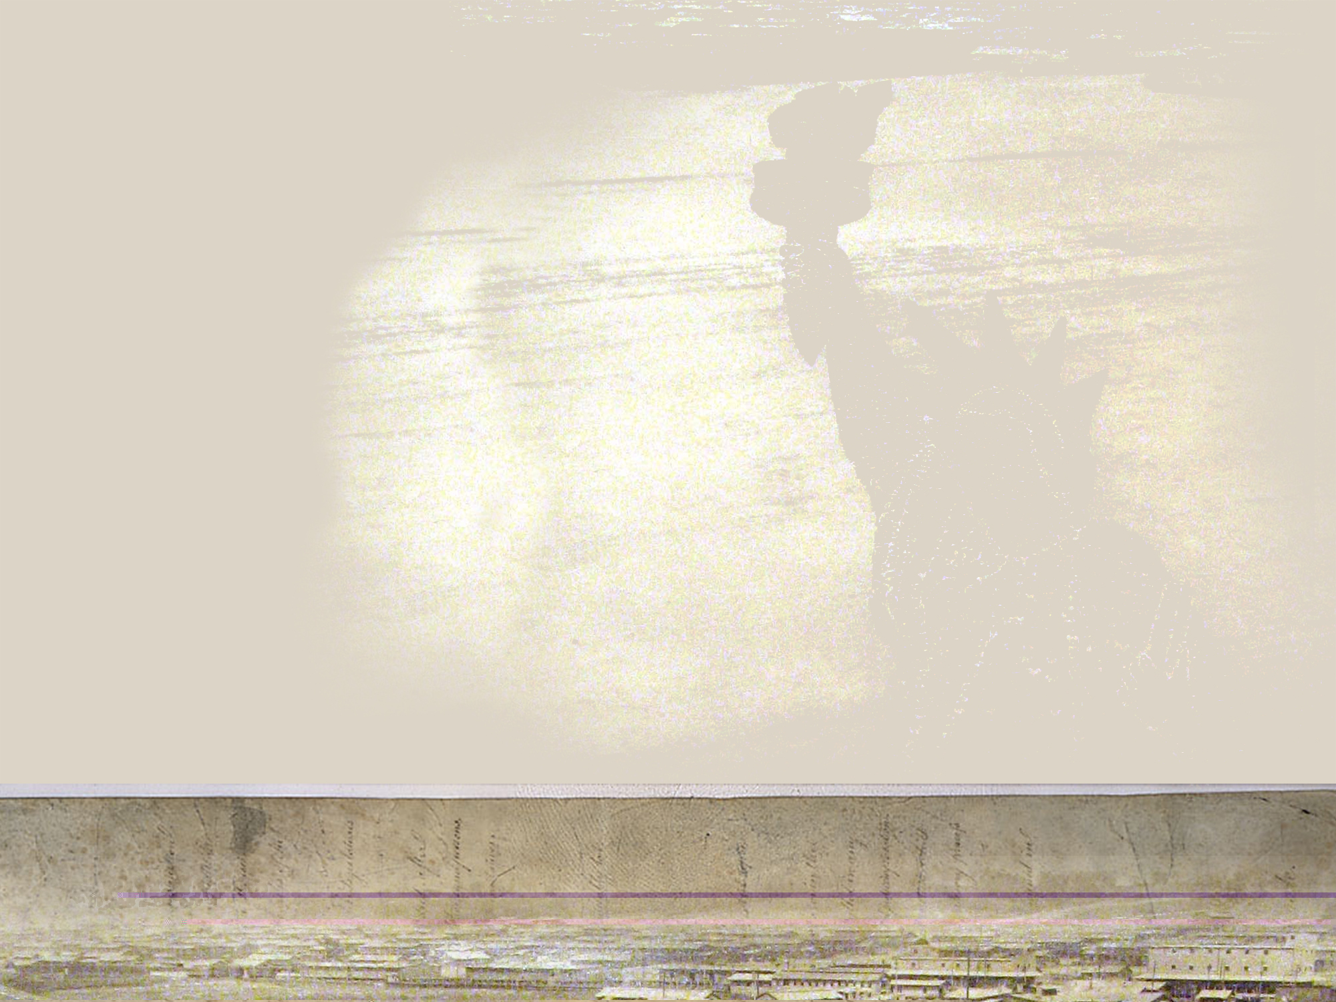
Historical Inquiry and the Common Core
Elementary History-Social Science
Winter Symposium
January, 2015

Slide 2
Objectives
Participants will understand the process of Historical Inquiry
Participants will understand how to use multiple pieces of informational text and close reading to help students to think critically about past events
Participants will understand how to connect History-Social Science and ELA Common Core State Standards
Participants will review an Inquiry Based Lesson
Notes:
2

Slide 3
Research has shown that even young children benefit from engaging in the study of history in ways similar to historians (Ashby & Lee, 1996; Levstik & Barton, 1996; VanSledright, 2002).
Talk to your partner:
What does it mean to think like a historian?

Slide 4
When students “do history” they move beyond reading a single account of what happened in the past from a textbook and they begin to investigate the past by asking questions, reading primary and secondary sources, and using the same “tools” as historians do to think deeply about history.

Slide 5
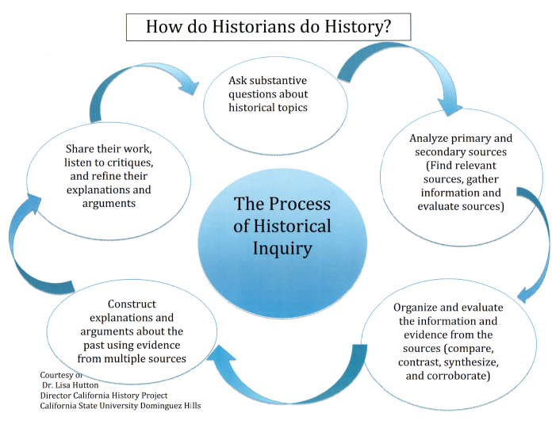

Slide 6
What are Historical Sources?
An historical source is something that tells us about History. It is evidence.
  It may be a document, a picture, a sound recording, a book, a film, a television program, or an object.
There are two main types of historical sources:
  Primary Sources and Secondary Sources
    Primary source = something that originates from the past
    Secondary source = something that has been written (or made) recently, about the past
Notes:
.

Slide 7
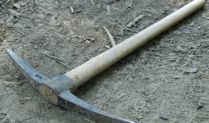
What can we infer about life at the time of the gold rush?

Slide 8
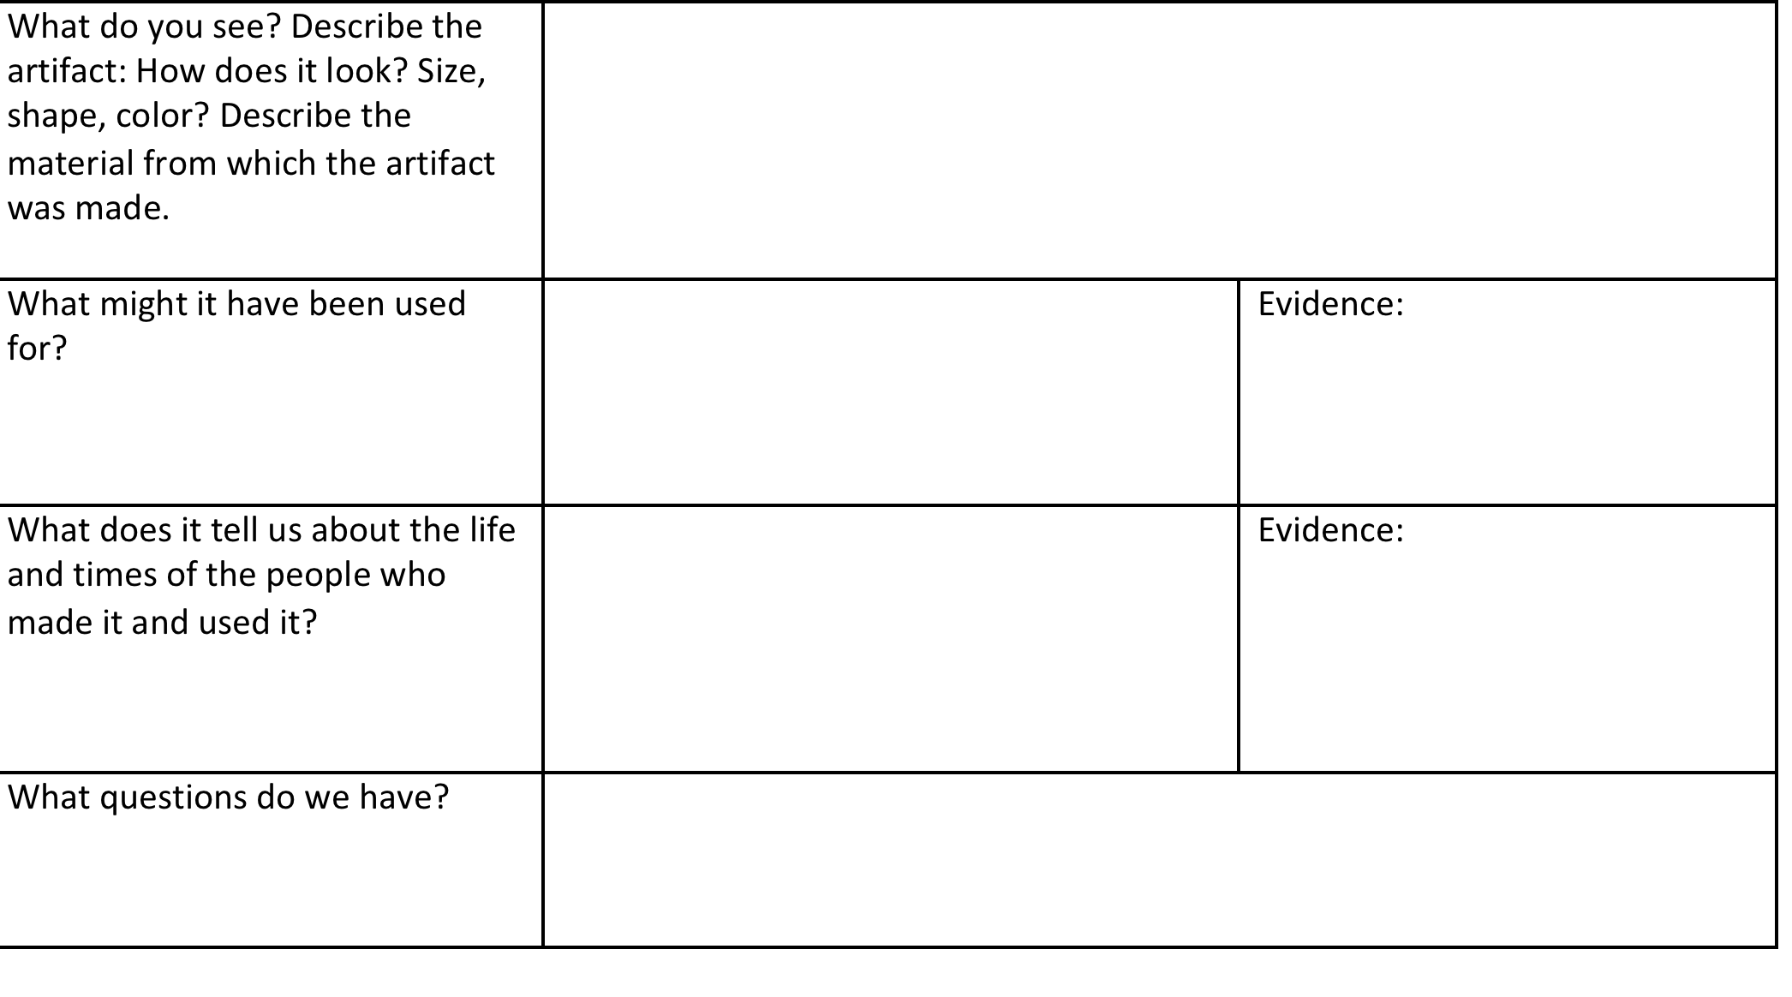
Artifact Analysis

Slide 9
Artifact Gallery Walk
By examining these artifacts, what can we infer about life at the time of the gold rush?
Directions:
Start at one poster and examine the artifact with your group. Each group has a different colored pen.
Talk to your partners and write your observations on the poster.
When the teacher calls time, move clockwise to the next poster.

Slide 10
Historians Tools

Slide 11
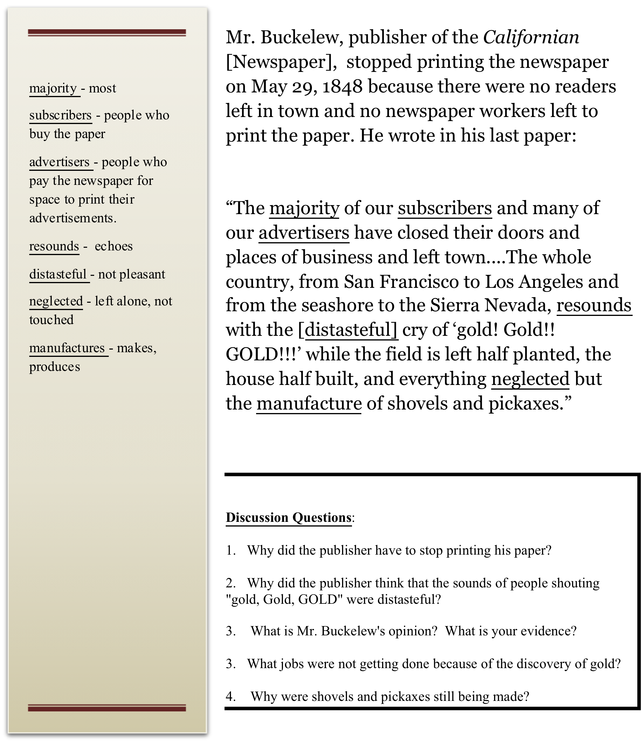
Document A

Slide 12
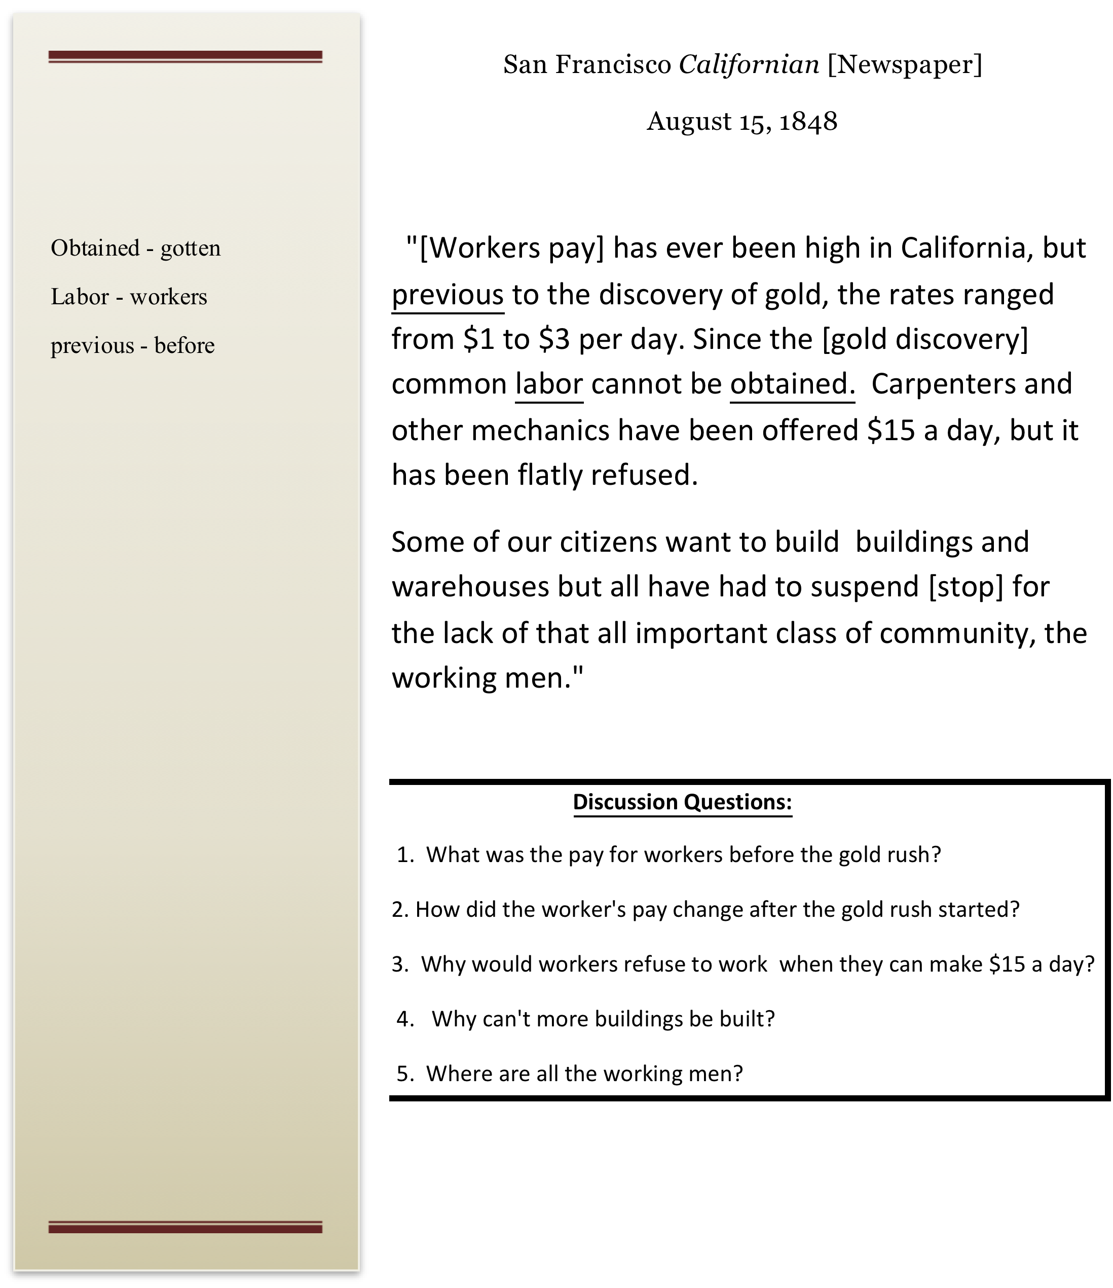
Document B

Slide 13
Discussion: Getting Ready to Write…
How did the discovery of gold affect California?
Prepare for discussion: I will show you the image again. Then you will have a few minutes to look again at the two documents you analyzed.
Be ready to talk to your partners about one way that the discovery of gold affected California.
You will need to tell your partner three things:

Slide 14
Tell your partners these three things:
Claim (A claim is an opinion based on evidence in history)
      One way that the gold rush affected California was…
Evidence
      My evidence is…
      According to source ___,…
Analysis
      This evidence shows…
      This is important because…

Slide 15
How did the discovery of Gold affect California?
  One way that the gold rush affected California was that there was nobody left to do the regular work. So many men went to the gold fields that nobody was left to do other kinds of work. According to Document A, carpenters were offered $15 a day but they refused. Document B said that fields were left and houses were half built. This shows how many people thought they were going to get rich. They left their homes and jobs to go to the gold fields.
  Sample Journal Entry

