Slide 1



Family & Medical
Leave Act (FMLA)
California Family
Rights Act (CFRA)
09.13.2024

Slide 2






Goal
To provide Food Service Managers (FSM) with a basic Understanding of Family Medical Leave Act (FMLA) and California Family Rights Act (CFRA) protected absences and/or leaves.
To provide FSM with an understanding of FMLA and CFRA procedures and required certification
To assist FSM with recognizing reasons why an employee may
Request FMLA and CFRA.
Notes:
Read Slide.
The Goal of this training is:
To provide Food Service Managers (FSM) with a basic understanding of Family Medical Leave Act (FMLA) and California Family Rights Act (CFRA) protected absences and/or leaves
To assist FSM with recognizing reasons why an employee may request FMLA and CFRA
To provide FSM with an understanding of FMLA and CFRA procedures and required certification.

Slide 3

What is FMLA and CFRA
Family and Medical Leave Act (FMLA) is a federal statute.
California Family Rights Act (CFRA) is a state statute.
These federal and state statutes balance the needs of employees and their families with the demands of the workplace.
FMLA and CFRA promote stability and economic security for employees and their families.
Notes:
Read Slide.
What are FMLA and CFRA?
Family and Medical Leave Act (FMLA) is a federal statute
California Family Rights Act (CFRA) is a state statute
These federal and state statutes balance the needs of employees and their families with the demands of the workplace.
FMLA and CFRA promote stability and economic security for employees and their families

Slide 4

FMLA Leave Entitlement
FMLA provides up to 12 workweeks of job-protected leave to eligible employees during a 12-month period for the following reasons:
Birth of an employee’s child.
Placement of a child with an employee for adoption or foster care.
For an employee’s own serious health condition.
To care for an employee’s child, parent or spouse who has a serious health condition, including incapacity due to pregnancy, childbirth or related medical condition.
Any qualifying exigency related to the covered active duty of an employee’s spouse, child, or parent in the U.S. Armed Forces.
Birth of an employee’s child
Placement of a child with an employee for adoption or foster care
For an employee’s own serious health condition
Notes:
Read Slide.
FMLA Leave Entitlement
FMLA provides up to 12 workweeks of job-protected leave to eligible employees for the following reasons:
Birth of an employee’s child
Placement of a child with an employee for adoption or foster care
For an employee’s own serious health condition

Slide 5


CFRA Leave Entitlement
CFRA provides up to 12 workweeks of job-protected leave to eligible employees during a 12-month period for the following reasons:
Birth of an employee’s child.
  Leave must be completed prior to the child’s first birthday.
Placement of a child with an employee for adoption or foster care.
For an employee’s own serious health condition.
Birth of an employee’s child
Placement of a child with an employee for adoption or foster care
For an employee’s own serious health condition
Notes:
Read Slide.
FMLA Leave Entitlement
FMLA provides up to 12 workweeks of job-protected leave to eligible employees for the following reasons:
Birth of an employee’s child
Placement of a child with an employee for adoption or foster care
For an employee’s own serious health condition

Slide 6

CFRA Leave Entitlement
CFRA provides up to 12 workweeks of job-protected leave to eligible employees during a 12-month period for the following reasons:
To care for an employee’s spouse, domestic partner, child, parent, grandparent, grandchild, sibling, or designated person who has a serious health condition, including incapacity due to pregnancy, childbirth or related medical condition.
Any qualifying exigency related to the covered active duty of an employee’s spouse, domestic partner, child, or parent in the U.S. Armed Forces.
Birth of an employee’s child
Placement of a child with an employee for adoption or foster care
For an employee’s own serious health condition
Notes:
Read Slide.
FMLA Leave Entitlement
FMLA provides up to 12 workweeks of job-protected leave to eligible employees for the following reasons:
Birth of an employee’s child
Placement of a child with an employee for adoption or foster care
For an employee’s own serious health condition

Slide 7

FMLA and CFRA Eligibility
Employment with the District for a combined total of at least 12 months at any time. This includes full or part-time, temporary, probationary, or seasonal employment.
Worked at least 130 days during the year or 12-month period immediately preceding the start of the FMLA or CFRA absence or leave.
Notes:
Read Slide.
FMLA and CFRA Eligibility
Employment with the District for a combined total of at least 12 months at any time. This includes full or part-time, temporary, probationary, or seasonal employment.
Worked at least 130 days during the year or 12 month period immediately preceding the start of the FMLA or CFRA absence or leave.

Slide 8
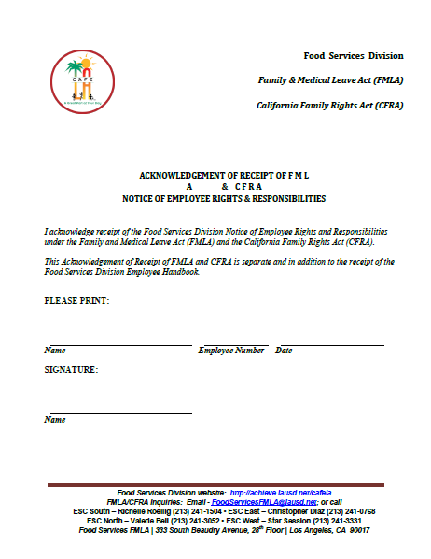
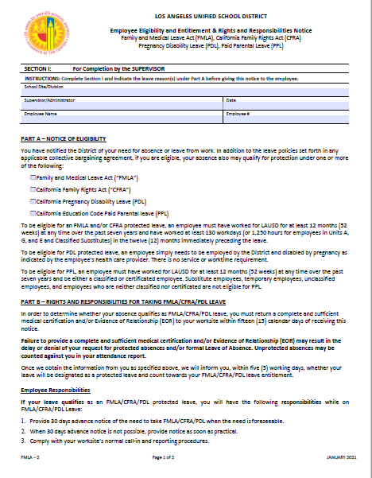
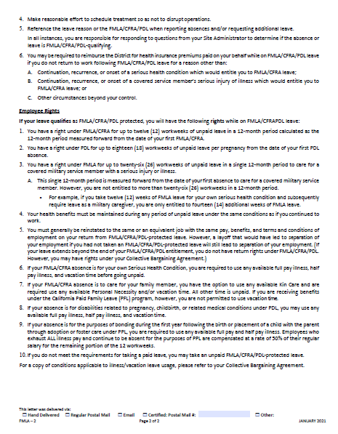
Family Medical Leave Act Forms
Completed by the FSM for FSW or AFSS for FSM.
Acknowledgement of Receipt
FMLA Employee Eligibility and Entitlement & Rights and Responsibilities Notice
Notes:
The Acknowledgement of Receipt (on the left side) is completed by employees when the manager gives the employee the Employee Eligibility & Entitlement and Rights & Responsibilities Notice (on the right side) and the Health Care Provider Certification Form. The forms can be found on the Food Services Division website, under Human Resources.

Slide 9
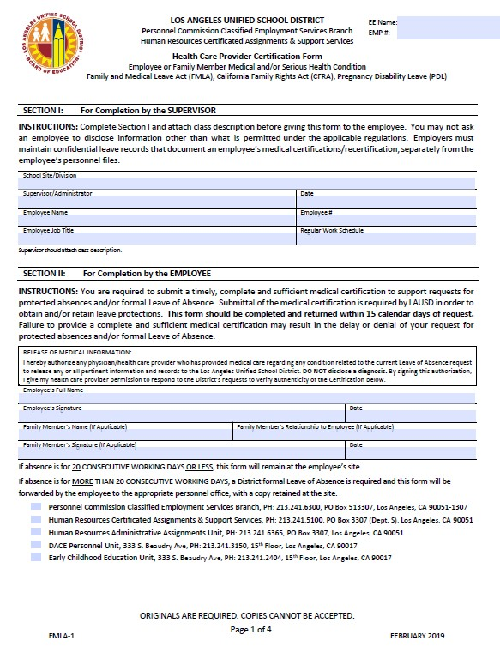
Family Medical Leave Act Forms
Health Care Provider Certification Form:
All employees must submit a completed Health Care Provider Certification Form which includes employee and health care provider information to the Food Service Manager.
Notes:
The Health Care Provider Certification Form is completed by employees and their health care provider to protect qualified absences from disciplinary action. This form is not used to report an absence.

Slide 10

Family Medical Leave Act Forms
Page 1 is completed by the FSM or AFSS.
Pages 2 and 3 must be completed by the Health Care Provider.
Notes:
(Read slide)

Slide 11
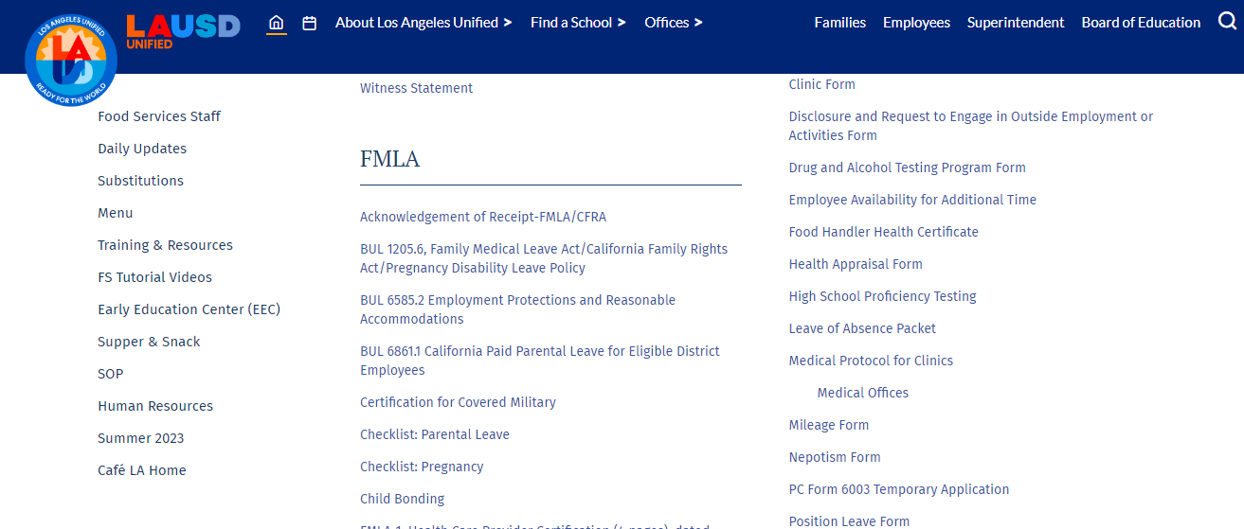

Where To Find FMLA Forms
Notes:
This illustrates the Food Services Division website and where to find FMLA forms.

Slide 12
    Definition of Serious Health Condition
A Serious Health Condition is an illness, injury (including Workers’ Compensation), impairment, physical or mental condition that involves inpatient care or a regimen of continuing treatment by a health care provider, including the examples listed below:
Impatient Care
Chronic Conditions
Incapacity and Treatment
Permanent or Long-Term Conditions
Pregnancy or Parental Care
Conditions Requiring Multiple Treatments
Notes:
Read Slide.
Definition of Serious Health Condition
A Serious Health Condition is an illness, injury (including Workers’ Compensation), impairment, physical or mental condition that involves inpatient care or a regimen of continuing treatment by a health care provider, including the examples listed below:
Inpatient Care
Incapacity and Treatment
Pregnancy or Prenatal Care
Chronic Conditions
Permanent or Long-term Conditions
Conditions Requiring Multiple Treatments

Slide 13

How to Apply for FMLA
When an employee requests FMLA, provide the employee a copy of the following documents:
A Health Care Provider Certification Form, dated March 27, 2023.
An Employee Eligibility and Entitlement & Rights and Responsibilities Notice.
An Acknowledgement of Receipt of FMLA/CFRA.
The Health Care Provider Certification Form needs to be completed by:
  The immediate supervisor or FSM.
  The employee.
  The employee’s Health Care Provider.
Notes:
Read Slide.
How to Apply for FMLA
When an employee requests FMLA, provide the employee a copy of the following documents:
A Health Care Provider Certification Form, dated January 2021
An Employee Eligibility and Entitlement & Rights and Responsibilities Notice
An Acknowledgement of Receipt of FMLA/CFRA
The Health Care Provider Certification Form needs to be completed by:
The immediate supervisor or Food Service Manager
The Employee
The Employee’s Health Care Provider

Slide 14
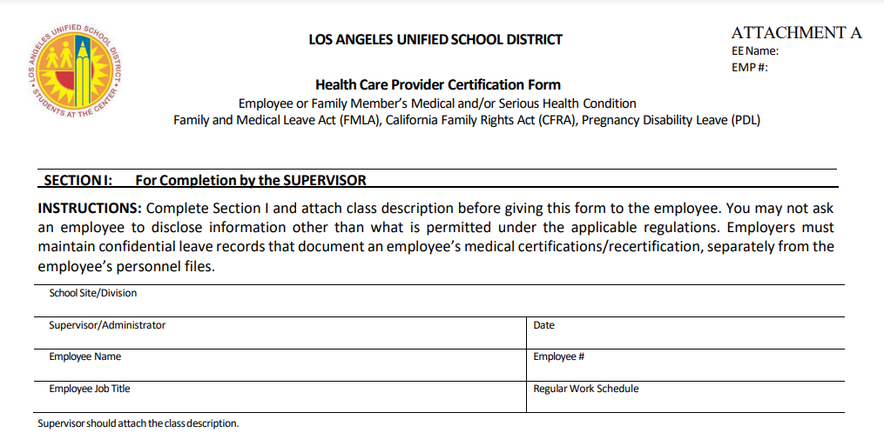
How to Apply for FMLA
Notes:
(Read slide)

Slide 15
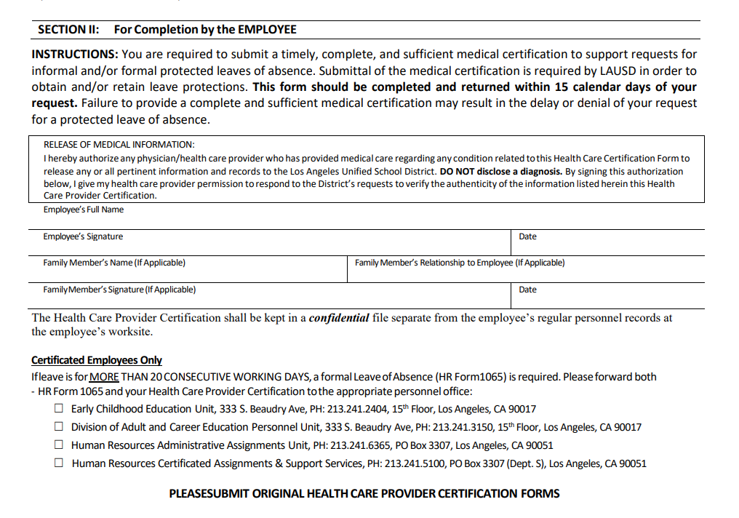
Health Care Provider Certification
Notes:
(Read slide)

Slide 16
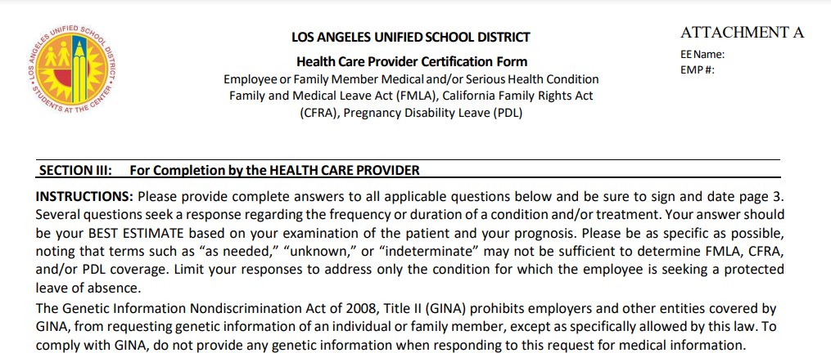
Health Care Provider Certification
Notes:
(Read slide)

Slide 17
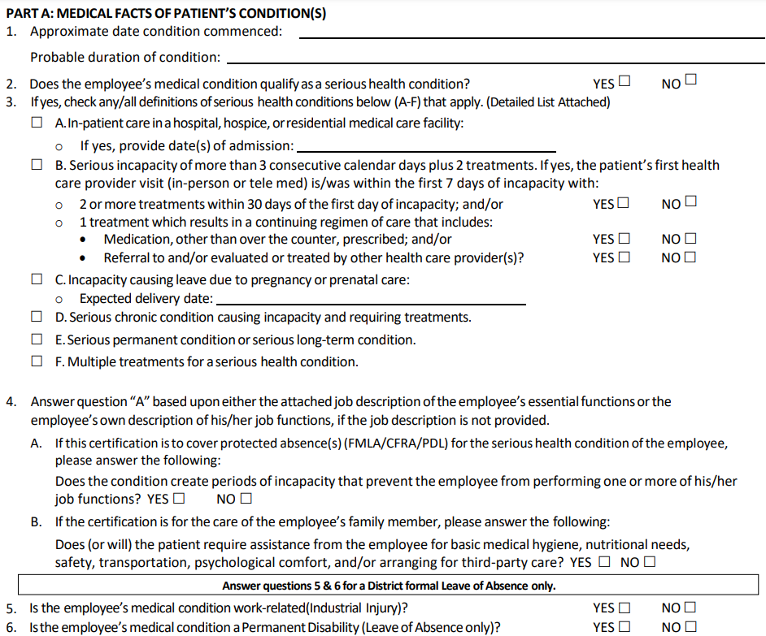
Health Care Provider
Certification
Notes:
(Read slide)

Slide 18
Health Care Provider
Certification
Notes:
(Read slide)

Slide 19
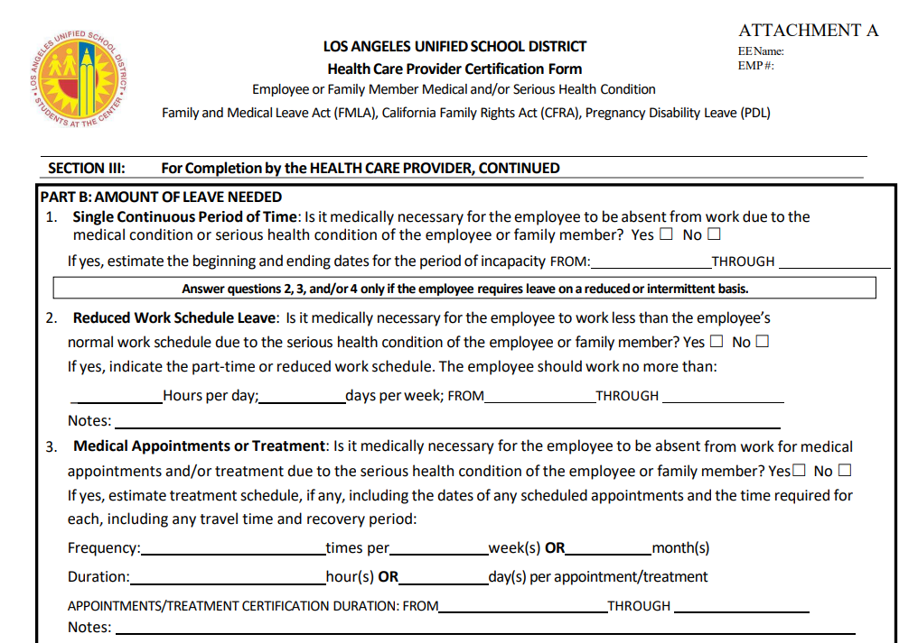
Health Care Provider
Certification
Notes:
(Read slide)

Slide 20
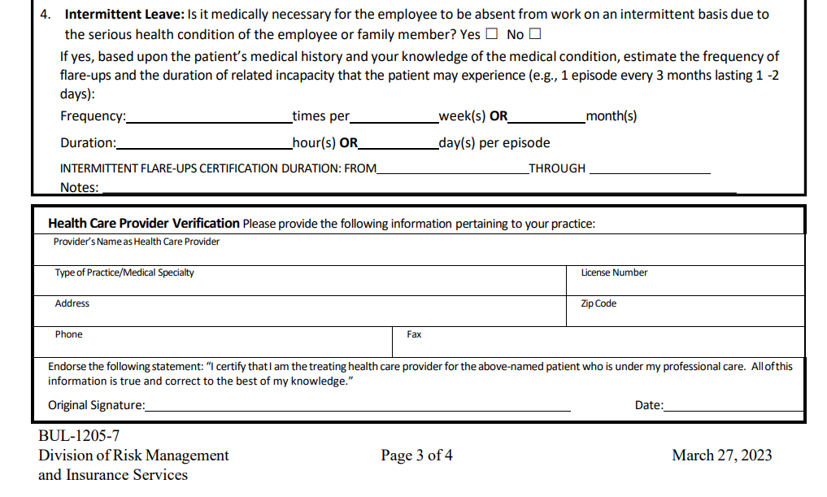
Health Care Provider
Certification
Notes:
(Read slide)

Slide 21

Employee
Responsibilities
Employees are responsible for the following:
Provide at least 30 days notice to the FSM if the employee’s medical condition is unforeseeable. The employee must provide notice as soon as practicable.
Notify FSM as soon as practical using normal call-in procedures if illness and/or injury is unplanned.
Identify absence as FMLA related when notifying FSM of absence.
Notes:
Read Slide.
How to Apply for FMLA
When an employee requests FMLA, provide the employee a copy of the following documents:
A Health Care Provider Certification Form, dated January 2021
An Employee Eligibility and Entitlement & Rights and Responsibilities Notice
An Acknowledgement of Receipt of FMLA/CFRA
The Health Care Provider Certification Form needs to be completed by:
The immediate supervisor or Food Service Manager
The Employee
The Employee’s Health Care Provider

Slide 22


Employee
Responsibilities
Employees are responsible for the following:
Submit all Certification of Health Care Provider Forms to FSM, AFSS, or designated Food Services Division Senior Human Resources Representative electronically via email within 15 calendar days.
Schedule medical appointments outside work hours, if possible, to minimize disruption of site operations.
Adhere to return to work procedures as highlighted in the Food Services Employee Handbook.
Notes:
Read Slide.
How to Apply for FMLA
When an employee requests FMLA, provide the employee a copy of the following documents:
A Health Care Provider Certification Form, dated January 2021
An Employee Eligibility and Entitlement & Rights and Responsibilities Notice
An Acknowledgement of Receipt of FMLA/CFRA
The Health Care Provider Certification Form needs to be completed by:
The immediate supervisor or Food Service Manager
The Employee
The Employee’s Health Care Provider

Slide 23
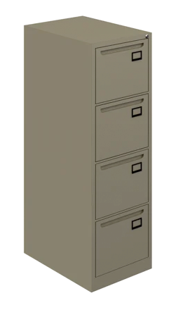

FSM Responsibilities
At the beginning of the school year, give each FSW the following:
A Health Care Provider Certification Form, dated March 27, 2023.
Employee Eligibility and Entitlement & Rights and Responsibilities Notice.
An Acknowledgement of Receipt of FMLA/CFRA.
Keep the signed form in the employee’s file.
Notes:
Read Slide.
How to Apply for FMLA
When an employee requests FMLA, provide the employee a copy of the following documents:
A Health Care Provider Certification Form, dated January 2021
An Employee Eligibility and Entitlement & Rights and Responsibilities Notice
An Acknowledgement of Receipt of FMLA/CFRA
The Health Care Provider Certification Form needs to be completed by:
The immediate supervisor or Food Service Manager
The Employee
The Employee’s Health Care Provider

Slide 24
FSM Responsibilities
At the beginning of the school year, give each FSW the following:
Recognize Reasons for FMLA and CFRA.
Provide Health Care Provider Certification Form to employees who are absent three (3) days or more.
Have the employee sign the Acknowledgement of Receipt each time you provide a copy of FMLA forms.
Record absences on Absence/Tardy/FMLA Log.
Track and monitor employee’s use of approved FMLA and CFRA. Your school’s timekeeper may assist with this information.
Notes:
Read Slide.
How to Apply for FMLA
When an employee requests FMLA, provide the employee a copy of the following documents:
A Health Care Provider Certification Form, dated January 2021
An Employee Eligibility and Entitlement & Rights and Responsibilities Notice
An Acknowledgement of Receipt of FMLA/CFRA
The Health Care Provider Certification Form needs to be completed by:
The immediate supervisor or Food Service Manager
The Employee
The Employee’s Health Care Provider

Slide 25


FSM Responsibilities
At the beginning of the school year, give each FSW the following:
Make sure that the employee completes Certification/Request of Absence for Illness, Family Illness, New Child, Form 60.ILL, and submits it to the timekeeper at the school site for both intermittent and continuous absences.
Make sure that the employee completes a Leave of Absence Packet when absent for twenty (20) or more consecutive workdays.
Follow Food Services policies and procedures when an employee has excessive absences or is Absent Without Authorization (AWOA) and does not have approved FMLA/CFRA job-protection for the absences.
Notes:
Read Slide.
How to Apply for FMLA
When an employee requests FMLA, provide the employee a copy of the following documents:
A Health Care Provider Certification Form, dated January 2021
An Employee Eligibility and Entitlement & Rights and Responsibilities Notice
An Acknowledgement of Receipt of FMLA/CFRA
The Health Care Provider Certification Form needs to be completed by:
The immediate supervisor or Food Service Manager
The Employee
The Employee’s Health Care Provider

Slide 26


Where to send FMLA
Forms
Send all FMLA Health Care Provider Certification Form to the Food Services Human Resources Representative via email or school mail:
Los Angeles Unified School District
Food Services Division, 28th Floor
333 South Beaudry Avenue
Los Angeles CA 90017
Food Services Managers should keep the original Health Care Provider Certification Form in the employee’s file at the school location.
Notes:
Read Slide.
How to Apply for FMLA
When an employee requests FMLA, provide the employee a copy of the following documents:
A Health Care Provider Certification Form, dated January 2021
An Employee Eligibility and Entitlement & Rights and Responsibilities Notice
An Acknowledgement of Receipt of FMLA/CFRA
The Health Care Provider Certification Form needs to be completed by:
The immediate supervisor or Food Service Manager
The Employee
The Employee’s Health Care Provider

Slide 27




Who Designates FMLA and CFRA?
Food Services Human Resources Representatives designate FMLA and CFRA.
Human Resources Representatives may:
  Contact the employee’s Health Care Provider to authenticate information in Part A and/or Part B.
  Request recertification if additional FMLA and/or CFRA leave is requested.
  Deny FMLA and CFRA job-protection when information is incomplete, insufficient, or contradictory.
Notes:
Read Slide.
How to Apply for FMLA
When an employee requests FMLA, provide the employee a copy of the following documents:
A Health Care Provider Certification Form, dated January 2021
An Employee Eligibility and Entitlement & Rights and Responsibilities Notice
An Acknowledgement of Receipt of FMLA/CFRA
The Health Care Provider Certification Form needs to be completed by:
The immediate supervisor or Food Service Manager
The Employee
The Employee’s Health Care Provider

Slide 28


FMLA and CFRA Designation Notice
The Food Services Human Resources Representatives will send the employee one of the following documents via email:
Attachment C: Approval Designation Notice
Attachment D: Designation Not Approved Notice
Note: A copy of the Designation Notice is also sent to the Food Service Manager and Timekeeper at the school site.
Notes:
Read Slide.
How to Apply for FMLA
When an employee requests FMLA, provide the employee a copy of the following documents:
A Health Care Provider Certification Form, dated January 2021
An Employee Eligibility and Entitlement & Rights and Responsibilities Notice
An Acknowledgement of Receipt of FMLA/CFRA
The Health Care Provider Certification Form needs to be completed by:
The immediate supervisor or Food Service Manager
The Employee
The Employee’s Health Care Provider

Slide 29
Where To Find Resources
Notes:
This illustrates the Food Services Division website and where to find FMLA forms.

Slide 30
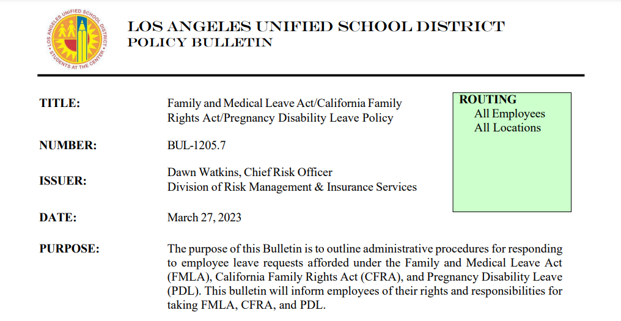
BUL 1205.7, Family and Medical Leave Act Policy
Notes:
This illustrates the Food Services Division website and where to find FMLA forms.

Slide 31
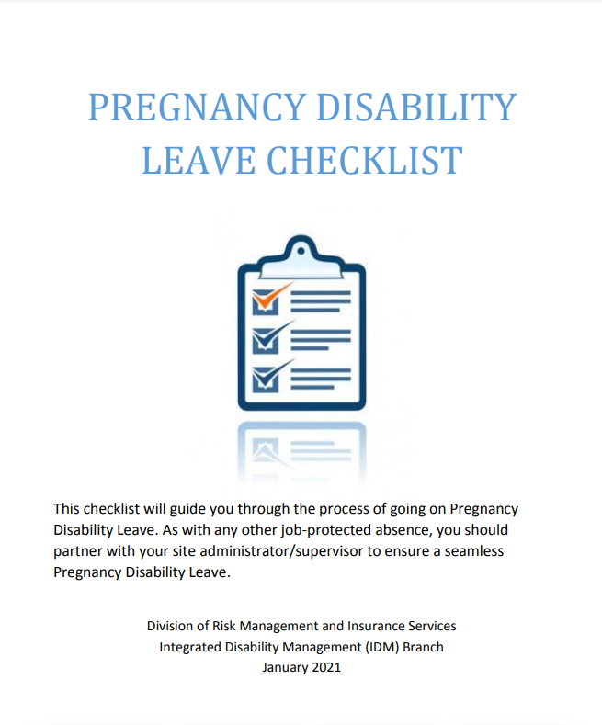
Pregnancy Disability Leave Checklist
Notes:
This illustrates the Food Services Division website and where to find FMLA forms.

Slide 32
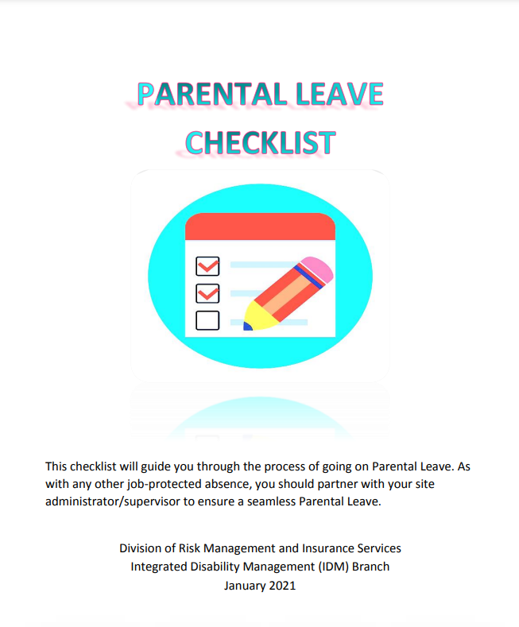
Parental Leave Checklist
Notes:
This illustrates the Food Services Division website and where to find FMLA forms.

Slide 33
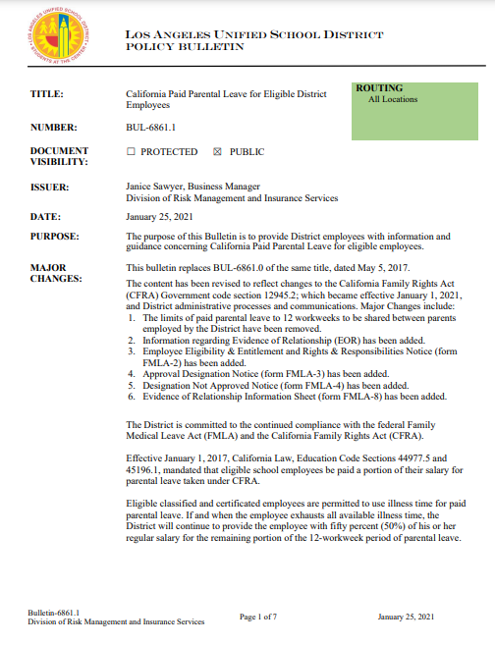
Paid Parental Leave (PPL) Checklist
Notes:
This illustrates the Food Services Division website and where to find FMLA forms.

Slide 34
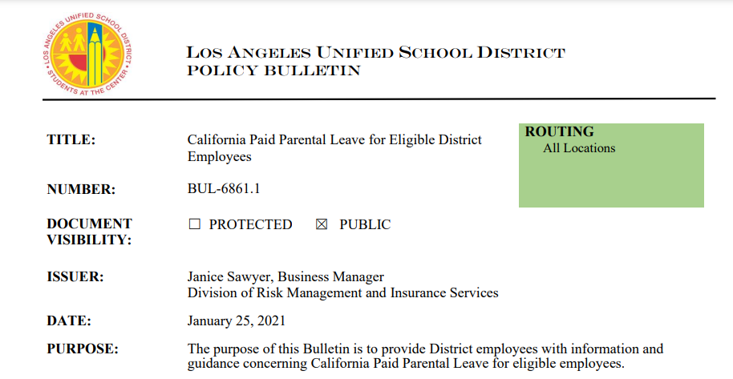
BUL 6861.1, California Paid Parental Leave for Eligible District
Employees
Notes:
This illustrates the Food Services Division website and where to find FMLA forms.

Slide 35



Resources
LAUSD Division of Risk Management and Insurance Services,
Integrated Disability Management Website.
Food Services Division Website, Human Resources Page.
Notes:
This illustrates the Food Services Division website and where to find FMLA forms.

Slide 36



Questions?
Notes:
This illustrates the Food Services Division website and where to find FMLA forms.

Slide 37



Thank You!
You guys are
the best!!!
Notes:
This illustrates the Food Services Division website and where to find FMLA forms.

