Slide 1
Math 8 Transformational Geometry Unit 4
Notes:
Facilitator notes
Time: n/a
Handouts/participant activity: n/a
Focus points:
Title Page

Slide 2
Purpose
Provided is a lesson for teachers to use to help students understand and analyze bivariate data. Included are the following:
Standards
Transformational Geometry Learning Progression
Lesson Agenda
Getting Ready for the Lesson (Resources and Tips)
Vocabulary Activities
Lesson
(Presentation and Video)
Textbook Connections
Additional Resources
Notes:
Facilitator notes
Time: 2-3 minutes
Handouts/participant activity: n/a
Focus points:
Review the components that this PD provides:
Standards
Learning Progressions
Lesson Agenda
Resources & Tips
Vocabulary Activities
Lesson
Textbook Connections
Additional Resources

Slide 3
Common Core Standards
8.G.4 Understand that a two-dimensional figure is similar to another if the second can can be obtained from the first by a sequence of rotations, reflections, translations, and dilations; given two similar two-dimensional figures, describe a sequence that exhibits the similarity between them.
(Understand, 1) (Understand, 2)

Slide 4
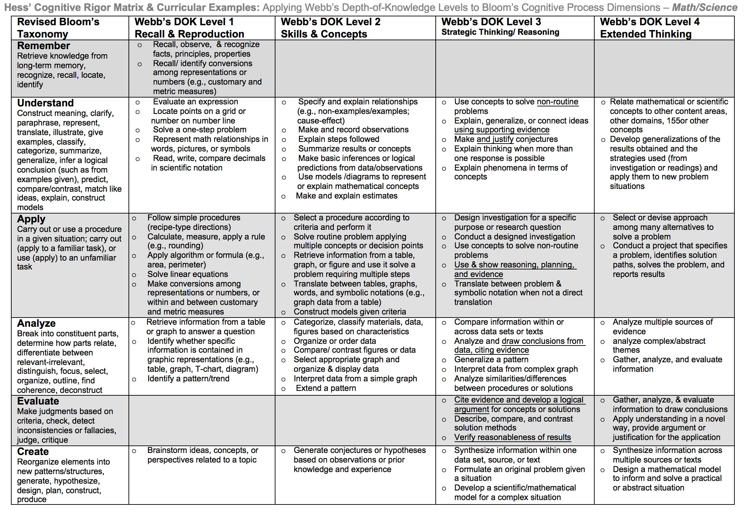
Notes:
Remember we must teach at the highest level on the Cognitive rigor matrix. The blue circle indicates where we must scaffold to get our students to the highest level the standards is assessing

Slide 5
Math Practices
MP 1
Make sense of problems and persevere in solving them.
MP 2
Reason abstractly and quantitatively.
MP 4
Model with mathematics
Notes:
Facilitator notes
Time: 1-2 minutes
Handouts/participant activity: n/a
Focus points:
Review the math practices associated with the lesson being presented.

Slide 6
Transformational Geometry Prerequisite Skills: CC Math 7
http://commoncoretools.me/wp-content/uploads/2014/12/ccss_progression_gk6_2014_12_27.pdf
Notes:
Facilitator notes
Time: 2-3 minutes
Handouts/participant activity: n/a

Slide 7
Middle School Focus
Grade 6
Grade 7
Grade 8
Understand congruence and similarity using physical models, transparencies, or geometry software.
Solve real-world and mathematical problems involving area, surface area and volume
Draw, construct and describe geometrical figures and describe the relationships between them.
Solve real-life and mathematical problems involving angle measure, area, surface area, and volume.
Solve real-world and mathematical problems involving volume of cylinders, cones, and spheres.
Source: California Framework
Notes:
2 – 3 minutes
Facilitator’s Notes:
What are those standards that you must focus on and which ones are not part of your course with the new shifts in standard under common core?
Grade 6
Solve real-world and mathematical problems involving area, surface area and volume
Grade 7
Draw, construct and describe geometrical figures and describe the relationships between them.
Solve real-life and mathematical problems involving angle measure, area, surface area, and volume.
Grade 8
Understand congruence and similarity using physical models, transparencies, or geometry software.
Solve real-world and mathematical problems involving volume of cylinders, cones, and spheres.
Let the participants know that they will use this handout in a later activity.

Slide 8
High School Focus
Geometry
Experiment with transformations in the plane.
Algebra 2
Translate between the geometric description and the equation for a conic section.
Understand congruence in terms of rigid motions.
Prove geometric theorems.
Make geometric constructions.
Understand similarity in terms of similarity transformations.
Prove trigonometric ratios and solve problems involving right triangles.
Source: California Framework
Notes:
2 – 3 minutes
Facilitator’s Notes:
What are those standards that you must focus on and which ones are not part of your course with the new shifts in standard under common core?
Algebra 1
No geometry standards are emphasized
Geometry
Experiment with transformations in the plane.
Understand congruence in terms of rigid motions.
Prove geometric theorems.
Make geometric constructions.
Understand similarity in terms of similarity transformations.
Prove trigonometric ratios and solve problems involving right triangles.
Algebra 2
Translate between the geometric description and the equation for a conic section.
Let the participants know that they will use this handout in a later activity.

Slide 9
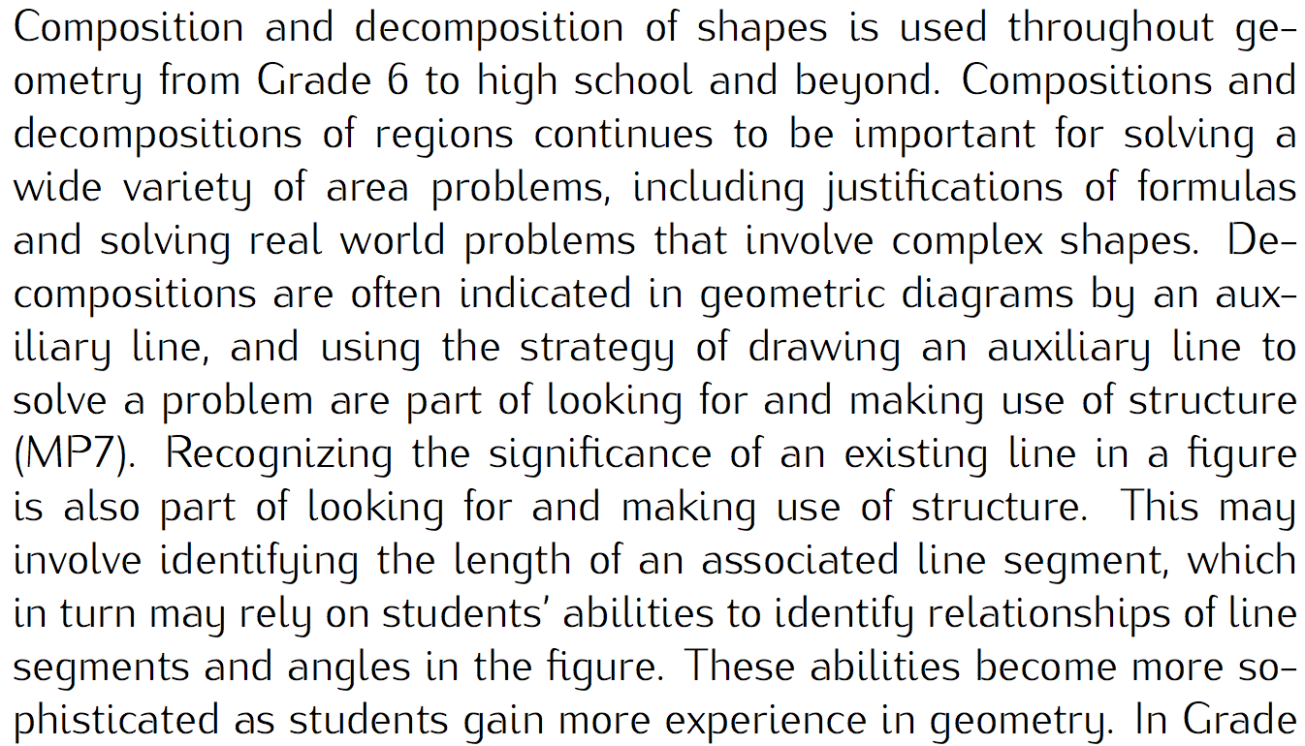
Learning Progression: Transformational Geometry
http://commoncoretools.me/wp-content/uploads/2014/12/ccss_progression_gk6_2014_12_27.pdf
Notes:
Facilitator notes
Time: 2-3 minutes
Handouts/participant activity: n/a
Focus points:
Let’s take closer look at the California Department of Education’s description of the High Schools Math course.

Slide 10
Lesson Agenda
Vocabulary
Lesson: Pizza Pizza!!!
Textbook Connections
Notes:
Facilitator notes
Time: 2-3 minutes
Handouts/participant activity: n/a
Focus points:
Review the lesson agenda prior to implementation

Slide 11
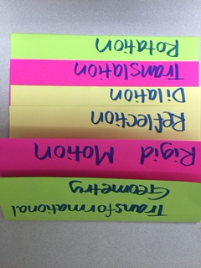
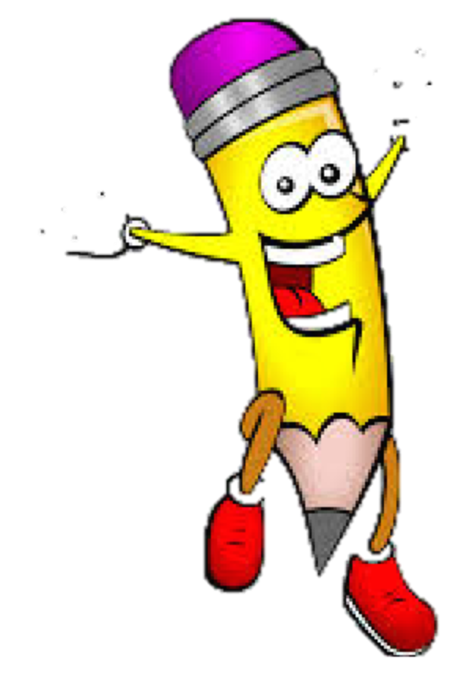
Needed Vocabulary
Transformational Geometry
Rigid Motion
Reflections
Dilation
Translation
Rotation
Or you could use: Word Map, Frayer Model, etc.
Layered Book Example
Notes:
Facilitator notes
Time: 4-5 minutes
Handouts/participant activity: n/a
Focus points:
This shows a list of required academic language vocabulary that is needed for the lesson. In addition, a strategy, “Layered Book” is shown with the suggestion that there are alternative strategies that can be used as well.

Slide 12
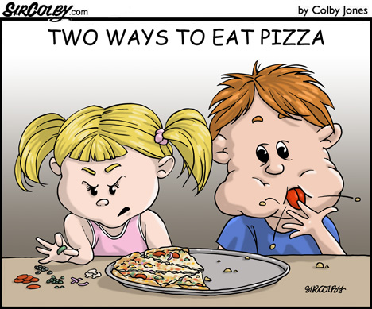
Pizza Pizza!!!!!
Notes:
Facilitator notes
Time: 2 minutes
Handouts/participant activity: n/a
Focus points:
We will be looking at a lesson that is broken into three parts
Act 1: Introduction to a video without any information The visual is clear. There aren’t any words. And it’s visceral.
Act 2: Students will decide on what resources will your students need before they can resolve their conflict?
Act 3: Conclusion The students solve the problem and watch a clip to check the answer

Slide 13
ACT 1
Notes:
Facilitator notes
Time: 10 minutes
Handouts/participant activity: Video will need to be shown more than once
Focus points:
Introduce the central conflict of your story/task clearly, visually, viscerally, using as few words as possible.
Show the video
Have the students write the first question that comes to their mind.
Have the participants share the questions with a neighbor to see if they have the same question or different.
Popcorn the questions out. Take a few

Slide 14
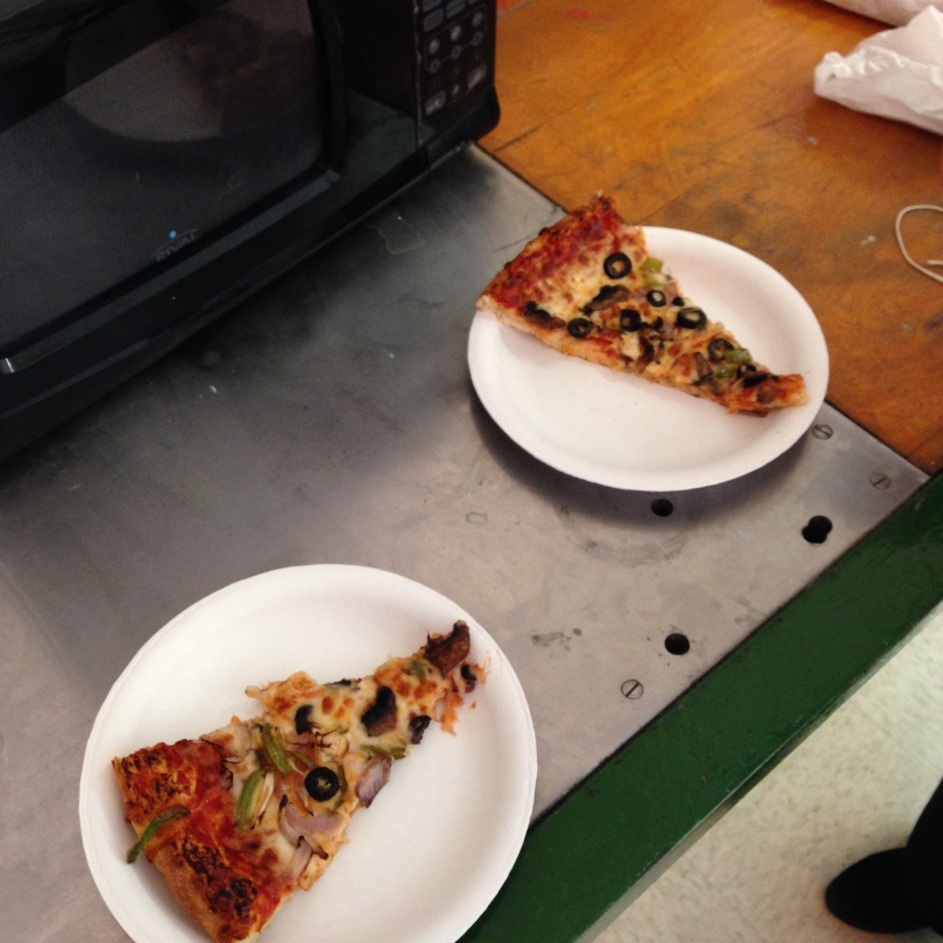
ACT 1
You may want to ask guiding questions.
Write down a question that comes to mind.
Notes:
Facilitator notes
Time: 5-7 minutes
Handouts/participant activity: **fix animation
Focus points:
Introduce the central conflict of your story/task clearly, visually, viscerally, using as few words as possible.
Have the teachers write the first question that comes to their mind.
Have the participants give you their questions, after taking a few question, find one that is similar to the one you want to ask.
Scaffold sample questions that the teachers may want to use with the students. You may need to use guiding questions to get the students to start thinking about the question they may want to ask.
Sample Questions:
What was going on in the video?
Why do you think she was pointing at the different slices of pizza?
(Ask the teachers what guiding questions they can think of.)

Slide 15
ACT 1
You will not always get the question you want.
Question: Are the two slices of Pizza congruent?
What is your guess?
Notes:
Facilitator notes
Time: 5 minutes
Handouts/participant activity: Have participants assume the role of the student for this slide
Focus points:
Restate the question that they will try to answer. Make sure the teacher understands that you may not get the same question for verbatim. They have to scaffold or guide the students to the question that is closely aligned with the one Dan Meyer poses on his site.
Have the participants record their initial estimations. Share them out, and write it on the White board or Post it paper. (In the classroom, teachers may opt to type or use Smart Board to record questions.
Take responses for the participants.

Slide 16
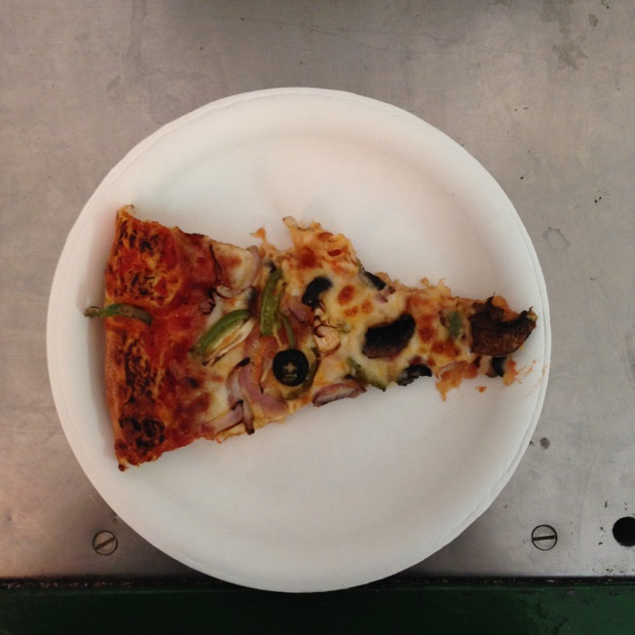
ACT 2
What information do you need or is necessary to answer the question?
Reflect
Rotate
Translate
Notes:
Facilitator notes
Time: 5 minutes
Handouts/participant activity: n/a
Focus points:
In Act 2, the teacher elicit the needed information from the students.
The teacher will jot down needed information on chart based on student responses:
Meyer Note: the protagonist/student overcomes obstacles, looks for resources, and develops new tools.
Jot the needed information the student asked for on the white board or post.
Once all of the needed information is on the white board and discuss what is really needed. Then show the pictures with the information.

Slide 17
ACT 3
Notes:
Facilitator notes
Time: 5 minutes
Handouts/participant activity: Have participants assume the role of the student for this slide
Focus points:
Participants will calculate their answers, and share their solutions in pairs.
Play the video again.

Slide 18
ACT 3
Have the students create there own
congruency problems using
transformations.
What are ways to extend the activity?
Notes:
Facilitator notes
Time: 5 minutes
Handouts/participant activity: Have participants assume the role of the student for this slide
Focus points:
Participants will calculate their answers, and share their solutions in pairs.
Play the video again.

Slide 19
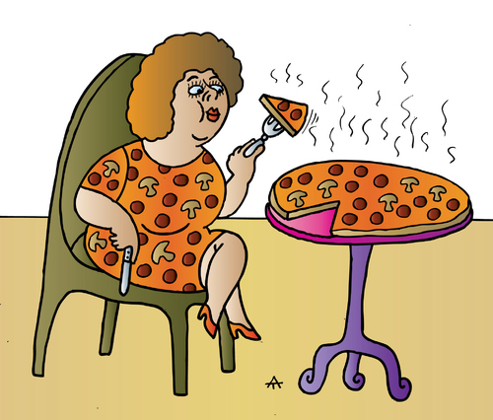
Dan Meyer’s Three Acts
Act 1: Introduce the central conflict of your story/task clearly, visually, viscerally, using as few words as possible
Students are asked to develop a question
Act 2:The protagonist/student overcomes obstacles, looks for resources, and develops new tools.
Students are asked to determine needed information
Act 3: Resolve the conflict and set up a sequel/extension
Students are asked to determine the reasonableness of their answer.
threeacts.mrmeyer.com
Notes:
Facilitator notes
Time: 5 minutes
Handouts/participant activity: Handout #_____ (Dan Meyer’s Three Acts)
Focus points:
Restate the Three Acts and have participants notate critical parts of each of the three acts.
Act 1: Act one attempts to lower barriers to entry. It’s visual. It requires very little literacy from the student.
Act 2: Try to find a framework for modeling in mathematics that doesn’t include a line like, students need to identify variables that represent essential features.” If students aren’t grappling with the question, “What’s important here and how would I get it?” they may be doing lots of valuable mathematics, but they aren’t modeling.
Act 3: Show the answer. The Common Core’s modeling framework asks students to “validate the conclusions” of their models. Showing the answer acknowledges the messiness inherent to mathematical modeling and allows students to discuss possible sources of error and then account for them with newer, better models.

Slide 20
Getting Ready
Pre-assessment- used to determine understanding of prerequisite skills
Prerequisite skills include
Knowing what a translation, rotation, and reflection are.
Notes:
Facilitator notes
Time: 2-3 minutes
Handouts/participant activity: n/a
Focus points:
Review what standards should be covered in a pre-assessment activity. This shows what students should have already learned prior to your course. Using a pre-assessment activity will assist students in frontloading prior knowledge before beginning new learning.

Slide 21
Misconceptions and Anticipated Issues
Common Issues
Suggested Questions and Prompts
Translate rather than reflect the shape
Confuse the term clockwise and counter clockwise
Uses an inefficient combination of transformations
What if were to place a mirror on the x-axis, what would the reflected image look like?
Think about the directions of the hands on a clock.
Is there a single or two transformations?
Notes:
Facilitator notes
Time: 2-3 minutes
Handouts/participant activity: n/a
Focus points:
These are guided questions to improve our students’ learning when misconceptions may occur.

Slide 22
Required Resources
Materials Required
Special Materials:
Large Post Its
Notes:
Facilitator notes
Time: 2-3 minutes
Handouts/participant activity: n/a
Focus points:
Review the list of resources needed for the lesson and where to find materials online.

Slide 23
Planning and Time
Activities | Time | Notes
Preparation | 1 hours | Includes creating a pre-assessment, making copies, obtaining materials
Pre-lessons | 1 hours | Review of the different transformations
Vocabulary | 1 hour | Defining Transformational Geometry, Rigid Motion, Reflection, Dilation, Translation, and Rotation
Pizza Pizza Task-Lesson | 1 hours | Explanation and completion of work
Practice and Additional Tasks | 2 hours | Additional Textbook practice, Illustrative Mathematics Tasks
Total Time | 6 hours
Notes:
Facilitator notes
Time: 1 - 2 minutes
Handouts/participant activity: n/a
Focus points:
Suggested pacing for this lesson

Slide 24
Textbook Connection California Math Course 2
Textbook Inquiry Lab:
How does a combination of transformations differ from a single transformation? How are they the same?
Page 505
Textbook Lesson:
Lesson 7-1 Congruence and Transformations Page 509
On-line Resources:
eTool Kit
On-line PD

Slide 25
Textbook Connection Go Math Course 3
Textbook Explore Activity:
Combining Transformation page 305
Textbook Lesson:
Lesson 9.5 Congruent Figures page 306
On-line Resources
Professional Development Video
Interactive Student Edition

Slide 26
Textbook Connection CPM Course 3
Course 3:
6.1.2 Rigid Transformations on a Coordinate Graph
6.1.3 Describing Transformations
6.1.4 Using Rigid Transformations
6.2.2 Dilations and Similar Shapes
6.2.3 Identifying Similar Shapes
6.2.4 Similar Figures and Transformations
Online Technology:
Student eTool
RT Tool
Transformation Challenge 1 and 2

Slide 27
Additional Resources
MARS Task – Representing and Combining Transformations
Illustrative Mathematics - www.illustrativemathematics.org
Are They Similar
Khan Academy - www.khanacademy.org
Engage NY: Grade 8 Mathematics Module 2, Topic A and B
Notes:
Facilitator notes
Time: 3 - 4 minutes
Handouts/participant activity: n/a
Focus points:
This is a list of additional resources surrounding the standards that may be used. If time permits, as a department, explore these sites.

Slide 28
Need Help?
Contact your
Secondary Math Coordinator

