Slide 1
Math 8 Function to Model Relationships between Quantities Unit 3
Notes:
Facilitator notes
Time: n/a
Handouts/participant activity: n/a
Focus points:
Title Page

Slide 2
Purpose
Provided is a lesson for teachers to use to help students understand and analyze function. Included are the following:
Standards
Function
Learning Progression
Lesson Agenda
Getting Ready for the Lesson (Resources and Tips)
Vocabulary Activities
Lesson
(Presentation and Video)
Textbook Connections
Additional Resources
Notes:
Facilitator notes
Time: 2-3 minutes
Handouts/participant activity: n/a
Focus points:
Review the components that this PD provides:
Standards
Learning Progressions
Lesson Agenda
Resources & Tips
Vocabulary Activities
Lesson
Textbook Connections
Additional Resources

Slide 3
Common Core Standards
8.F.3 Interpret the equations
y = mx + b as defining a linear functions, whose graph is a straight line; give examples of functions that are not linear.
(Understand, 2) (Remember, 1)

Slide 4
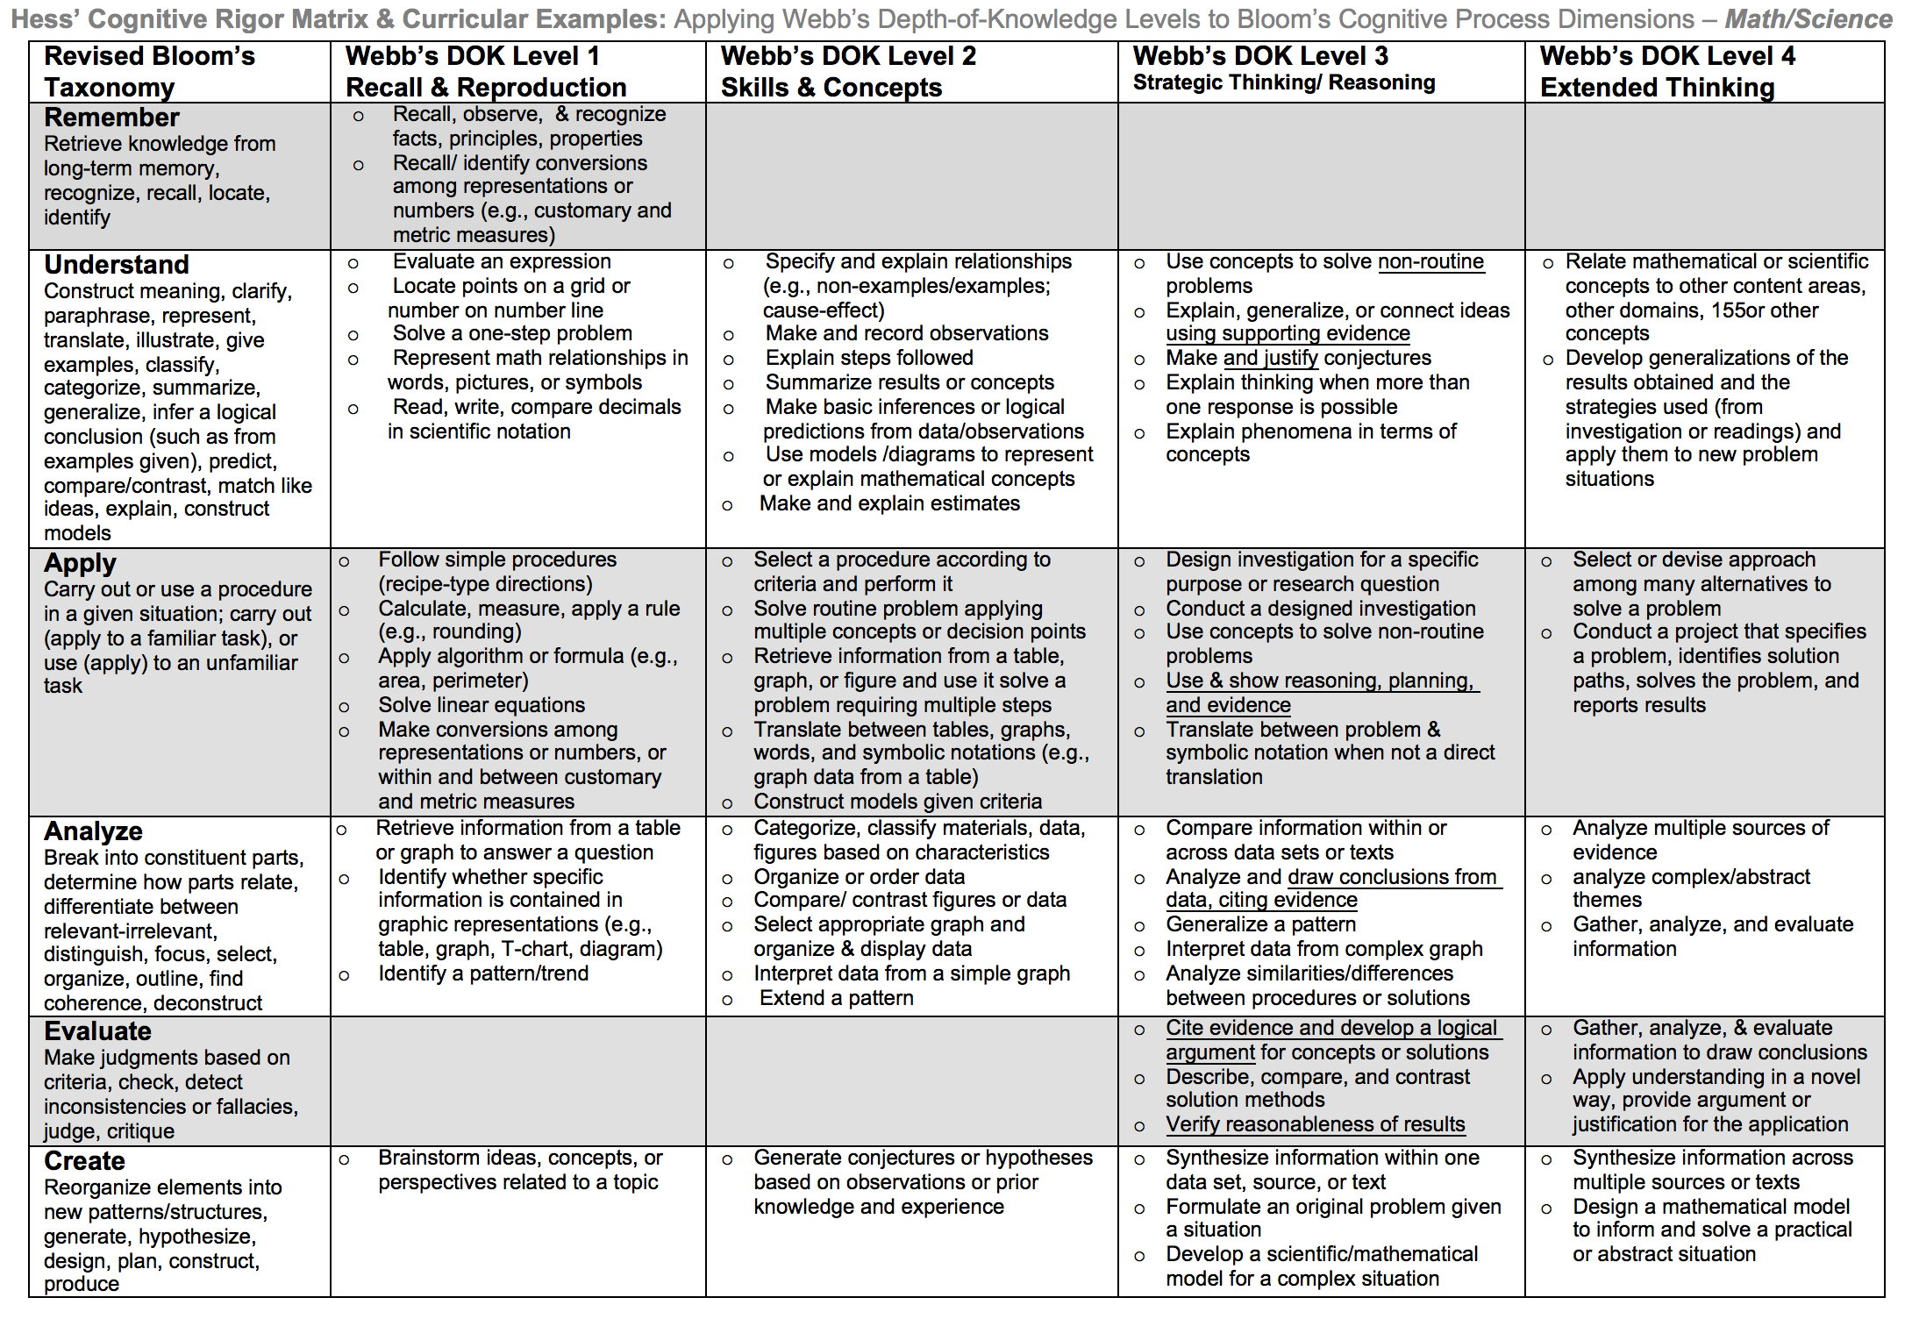
Notes:
Remember we must teach at the highest level on the Cognitive rigor matrix. The blue circle indicates where we must scaffold to get our students to the highest level the standards is assessing

Slide 5
Math Practices
MP 1
Make sense of problems and persevere in solving them.
MP 3
Construct viable arguments and critique the reasoning of others.
MP 4
Model with mathematics.
Notes:
Facilitator notes
Time: 1-2 minutes
Handouts/participant activity: n/a
Focus points:
Review the math practices associated with the lesson being presented.

Slide 6
Transformational Geometry Prerequisite Skills: CC Math 7
http://commoncoretools.me/wp-content/uploads/2014/12/ccss_progression_gk6_2014_12_27.pdf
Notes:
Facilitator notes
Time: 2-3 minutes
Handouts/participant activity: n/a

Slide 7
Middle School Focus
Grade 6
Grade 7
Grade 8
Define, evaluate, and compare functions.
Understand ratio concepts and use ratio reasoning to solve problems.
Analyze proportional relationships and use them to solve real-world and mathematical problems.
Use functions to model relationships between quantities.
Source: California Framework
Notes:
2 – 3 minutes
Facilitator’s Notes:
What are those standards that you must focus on and which ones are not part of your course with the new shifts in standard under common core?
Grade 6
Solve real-world and mathematical problems involving area, surface area and volume
Grade 7
Draw, construct and describe geometrical figures and describe the relationships between them.
Solve real-life and mathematical problems involving angle measure, area, surface area, and volume.
Grade 8
Understand congruence and similarity using physical models, transparencies, or geometry software.
Solve real-world and mathematical problems involving volume of cylinders, cones, and spheres.
Let the participants know that they will use this handout in a later activity.

Slide 8
High School Focus
Geometry
Experiment with transformations in the plane.
Algebra 2
Interpret functions that arise in application in term of the context.
Understand similarity in terms of similarity transformations.
Translate between the geometric description and the equation for a conic section.
Algebra 1
Understand the concepts of a function and use function notation.
Interpret functions that arise in applications in terms of the context.
Analyze functions using different representations.
Analyze functions using different representations.
Source: California Framework
Notes:
2 – 3 minutes
Facilitator’s Notes:
What are those standards that you must focus on and which ones are not part of your course with the new shifts in standard under common core?
Algebra 1
No geometry standards are emphasized
Geometry
Experiment with transformations in the plane.
Understand congruence in terms of rigid motions.
Prove geometric theorems.
Make geometric constructions.
Understand similarity in terms of similarity transformations.
Prove trigonometric ratios and solve problems involving right triangles.
Algebra 2
Translate between the geometric description and the equation for a conic section.
Let the participants know that they will use this handout in a later activity.

Slide 9
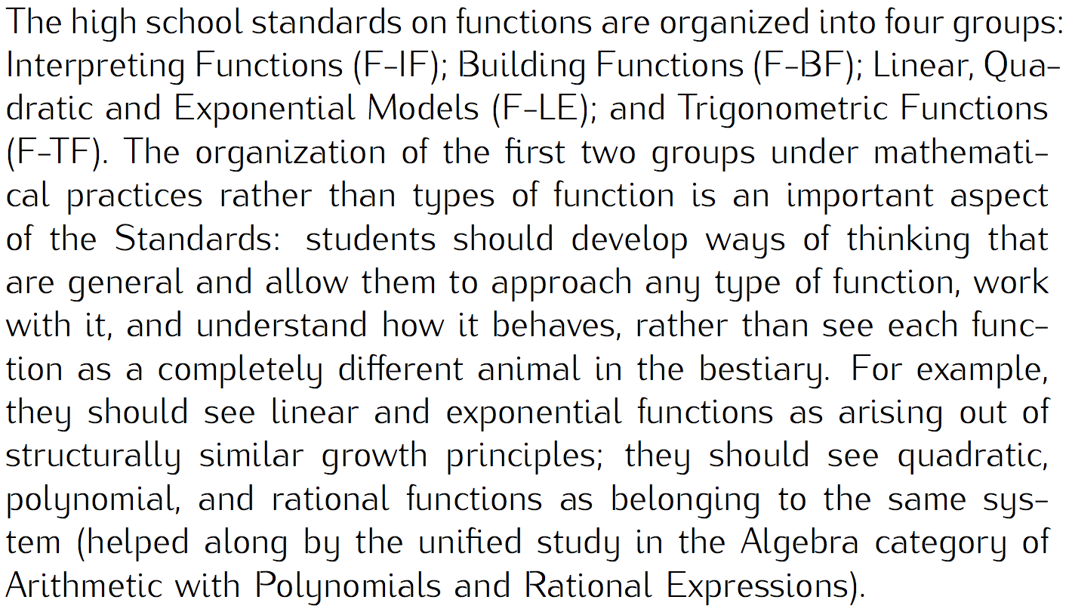
Learning Progression: Transformational Geometry
http://commoncoretools.me/wp-content/uploads/2014/12/ccss_progression_gk6_2014_12_27.pdf
Notes:
Facilitator notes
Time: 2-3 minutes
Handouts/participant activity: n/a
Focus points:
Let’s take closer look at the California Department of Education’s description of the High Schools Math course.

Slide 10
Lesson Agenda
Vocabulary
Video: What Makes the Graph of Proportional Relationships Different from Other Graphs?
Lesson: Understanding the Significance of the Y-Intercept by Comparing Proportional and Non-Proportional Relationships
Textbook Connections
Notes:
Facilitator notes
Time: 2-3 minutes
Handouts/participant activity: n/a
Focus points:
Review the lesson agenda prior to implementation

Slide 11
Understanding the Significance of the Y-Intercept by Comparing Proportional and Non-Proportional Relationships
Planning for Instruction
Notes:
Facilitator notes
Time: 1 minute
Handouts/participant activity: n/a
Focus points:
Title Page for lesson

Slide 12
Getting Ready
Pre-assessment: Used to determine understanding of prerequisite skills
Prerequisite skills include:
7.RP.2
Recognize and represent proportional relationships between quantities.
Decide whether two quantities are in a proportional relationships.
Identify the constant of proportionality in tables, graphs, equations, diagrams, and verbal descriptions of proportional relationships.
Represent proportional relationship by equations.
Notes:
Facilitator notes
Time: 2-3 minutes
Handouts/participant activity: n/a
Focus points:
Review what standards should be covered in a pre-assessment activity. This shows what students should have already learned prior to your course. Using a pre-assessment activity will assist students in frontloading prior knowledge before beginning new learning.

Slide 13
Misconceptions and Anticipated Issues
Common Issues
Suggested Questions
Students may not understand that y = kx produces a different graph from y = mx + b.
Students may assume that all linear graphs go through the origin.
What distinguishing characteristics do you notice in the graphs? tables? equations?
How do these help you?
How do each of the representations compare to each other?
How can you represent your ideas so that everyone can understand them?
Notes:
Facilitator notes
Time: 2-3 minutes
Handouts/participant activity: n/a
Focus points:
These are guided questions to improve our students’ learning when misconceptions may occur.

Slide 14
Required Resources
Materials Required
Special Materials:
Coordinate Plane
Handouts:
LearnZillion presentation handouts
LearnZillion additional worksheets
https://learnzillion.com/lesson_plans/164-understand-the-significance-of-the-y-intercept-by-comapring-proportional-y-mx-and-non-proportional-y-mx-b-relationships
Notes:
Facilitator notes
Time: 2-3 minutes
Handouts/participant activity: n/a
Focus points:
Review the list of resources needed for the lesson and where to find materials online.

Slide 15
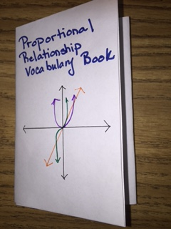
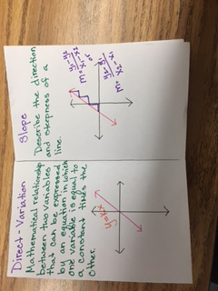
Needed Vocabulary
Proportional
Non-Proportional
Direct Variation
Slope
Y-Intercept
Linear Function
Or you could use: Word Map, Frayer Model, etc.
Magic Booklet
Notes:
Facilitator notes
Time: 4-5 minutes
Handouts/participant activity: n/a
Focus points:
This shows a list of required academic language vocabulary that is needed for the lesson. In addition, a strategy, “Layered Book” is shown with the suggestion that there are alternative strategies that can be used as well.

Slide 16
LearnZillion
For this lesson you need to create an account to access the handouts from LearnZillion.
This is a free account and you will have access to many more lessons.
Notes:
Facilitator notes
Time: 4-5 minutes
Handouts/participant activity: n/a
Focus points:
This is an introduction to the Learnzillion.com website where today’s lesson was pulled from. Teachers can sign up for a free account and have full access.

Slide 17
Understanding the Significance of the Y-Intercept by Comparing Proportional and Non-Proportional Relationships
https://learnzillion.com/lesson_plans/164-understand-the-significance-of-the-y-intercept-by-comapring-proportional-y-mx-and-non-proportional-y-mx-b-relationships
Notes:
Facilitator notes
Time: 15 - 20 minutes
Handouts/participant activity: n/a
Focus points:
Click on the hyper link to take you to the lesson. Lesson includes: PowerPoint, Video, and handouts. As a department, we will explore this resources together

Slide 18
Planning and Time
Activities | Time | Notes
Preparation | 1 hours | Includes creating a pre-assessment, making copies, obtaining materials
Pre-lessons | 1 hours | Review of 7.RP.2
Vocabulary | 1 hour | Defining Proportional, Non-Proportional, Direct Variation, Slope, Y-Intercept, and Linear Functions
Proportional Relationships | 1 hours | Explanation and completion of work
Practice and Additional Tasks | 2 hours | Additional Textbook practice, Illustrative Mathematics Tasks
Total Time | 6 hours
Notes:
Facilitator notes
Time: 1 - 2 minutes
Handouts/participant activity: n/a
Focus points:
Suggested pacing for this lesson

Slide 19
Textbook Connection California Math Course 3
Real World Link:
Linear and Nonlinear Functions page 327
Textbook Lesson:
Lesson 4-7 Linear and Nonlinear Functions page 328
On-line Resources:
eTool Kit
Online PD
Watch Animation

Slide 20
Textbook Connection Go Math Course 3
Textbook Explore Activity:
Combining Transformation page 305
Textbook Lesson:
Lesson 9.5 Congruent Figures page 306
Online Resources
Professional Development Video
Interactive Student Edition

Slide 21
Textbook Connection CPM Course 3
Course 3:
3.1.2 How can I make a prediction?
3.1.3 What is a graph and how is it useful?
3.1.4 How should I graph?
3.1.5 How can I graph it?
3.1.6 What make a complete graph?
3.1.7 What is wrong with this graph?
7.2.1 What is the equation of the line?
8.1.1 Is the graph linear?
8.3.1 Can I predict the output?
Online Technology:
Student eTool

Slide 22
Additional Resources
MARS Task – Representing and Combining
Interpreting Distance
Matching Situations, Graphs, and Linear Equations
Illustrative Mathematics - www.illustrativemathematics.org
Introduction to Linear Functions
Khan Academy - www.khanacademy.org
Engage NY: Grade 8 Mathematics Module 5,
Topic A, Lessons 4, 5, 6, and 8
Notes:
Facilitator notes
Time: 3 - 4 minutes
Handouts/participant activity: n/a
Focus points:
This is a list of additional resources surrounding the standards that may be used. If time permits, as a department, explore these sites.

Slide 23
Need Help?
Contact your
Secondary Math Coordinator

