Slide 1
Math 7 Statistics and Probability Unit 4
Notes:
Facilitator notes
Time: n/a
Handouts/participant activity: n/a
Focus points:
Title Page

Slide 2
Purpose
Provided is a lesson for teachers to use to help students understand and analyze Statistics and Probability. Included are the following:
Standards
Statistics and Probability Learning Progression
Lesson Agenda
Getting Ready for the Lesson (Resources and Tips)
Vocabulary Activities
Lesson
(Presentation and Video)
Textbook Connections
Additional Resources
Notes:
Facilitator notes
Time: 2-3 minutes
Handouts/participant activity: n/a
Focus points:
Review the components that this PD provides:
Standards
Learning Progressions
Lesson Agenda
Resources & Tips
Vocabulary Activities
Lesson
Textbook Connections
Additional Resources

Slide 3
Common Core Standards
7.SP.8 Find probabilities of compound events using organized lists, tables, tree diagrams, and simulation.
b. Represent sample spaces for compound events using methods such as organized lists, tables and tree diagrams. For an event described in everyday language (e.g., “rolling double sixes”), identify the outcomes in the sample space which compose the event.
(Understand, 2) (Understand, 1)
Notes:
Facilitator notes
Time: 2-3 minutes
Handouts/participant activity: n/a
Focus points:
Identifying the standards for lesson and unwrapping them.

Slide 4
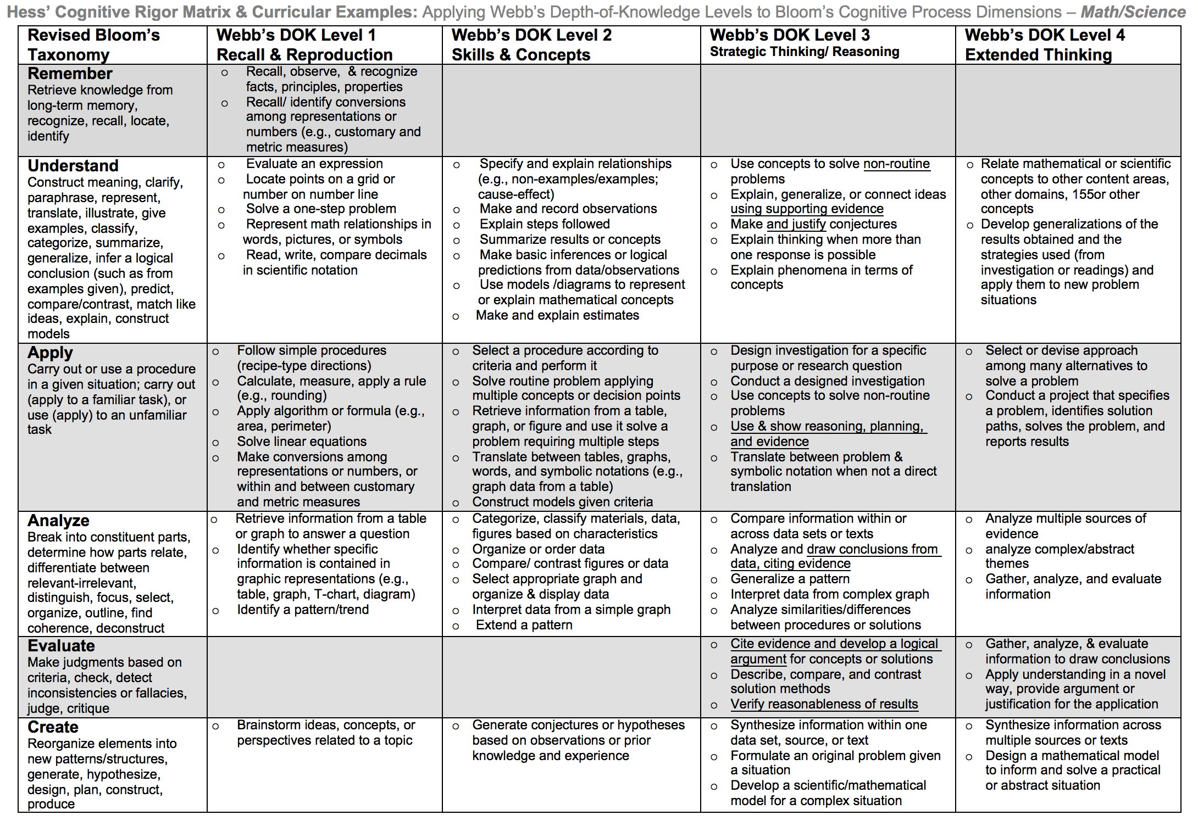
Notes:
Facilitator notes
Time: 2-3 minutes
Handouts/participant activity: n/a
Focus points:
Light blue & Green circles indicate the appropriate levels of DOK as required by the standards
The Blue circles fill in the instructional paths needed to assist students in reaching those DOK levels.

Slide 5
Math Practices
MP 1
Make sense of problems and persevere in solving them.
MP 2
Reason abstractly and quantitatively.
MP 4
Model with mathematics.
MP 5
Use appropriate tools strategically.
Notes:
Facilitator notes
Time: 1-2 minutes
Handouts/participant activity: n/a
Focus points:
Review the math practices associated with the lesson being presented.

Slide 6
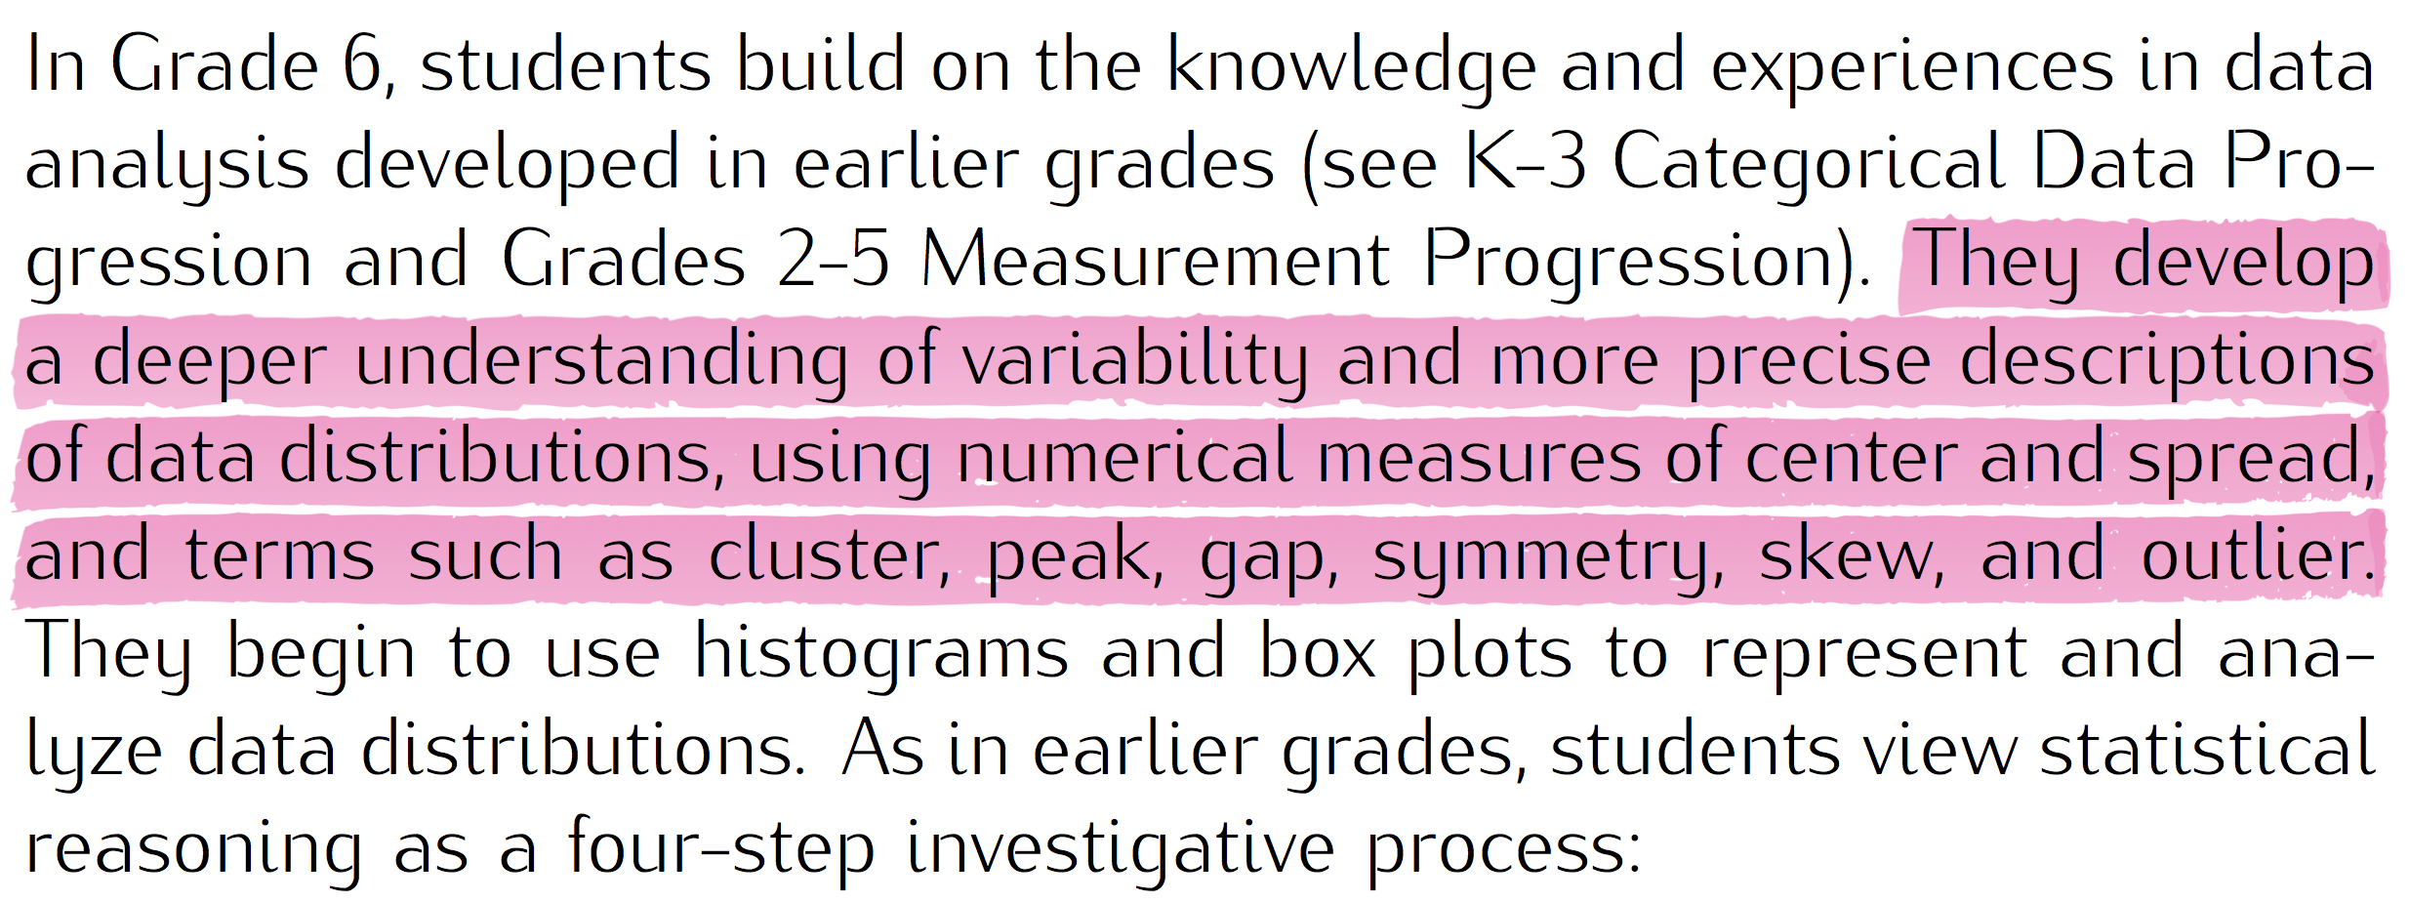
Statistics and Probability Prerequisite Skills: CC Math 6
https://commoncoretools.files.wordpress.com/2011/12/ccss_progression_sp_68_2011_12_26_bis.pdf
Notes:
Facilitator notes
Time: 2-3 minutes
Handouts/participant activity: n/a

Slide 7
Middle School Focus
Grade 6
Grade 7
Use random sampling to draw inferences about a population
Grade 8
Investigate patterns of association in bivariate data
Develop understanding of statistical variability
Summarize and describe distributions
Draw informal comparative inferences about two populations
Investigate chance processes and develop, use, and evaluate probability models
Source: California Framework
Notes:
2 – 3 minutes
Facilitator’s Notes:
What are those standards that you must focus on and which ones are not part of your course with the new shifts in standard under common core?
Grade 6
Develop understanding of statistical Variability
Grade 7
Investigate chance processes and develop, use, and evaluate probability models
Grade 8
Investigate patterns of association in bivariate data
Let the participants know that they will use this handout in a later activity.

Slide 8
High School Focus
Algebra 1
Summarize, represent, and interpret data on a single count or measurement variable
Geometry
Understand independence and conditional probability and use them in interpret data
Algebra 2
Summarize, represent, and interpret data on a single count or measurement variable
Summarize, represent, and interpret data on two categorical and quantitative variables
Interpret linear models
Use the rules of probability to compute probabilities of compound events in a uniform probability model
Use probability to evaluate outcomes of decisions
Understand and evaluate random processes underlying statistical experiments
Make inferences and justify conclusions from sample surveys, experiments, and observational studies
Use probability to evaluate outcomes of decisions
Source: California Framework
Notes:
2 – 3 minutes
Facilitator’s Notes:
What are those standards that you must focus on and which ones are not part of your course with the new shifts in standard under common core?
Algebra 1
Summarize, represent, and interpret data on two categorical and quantitative variables
Interpret linear models
Geometry
Use the rules of probability to compute probabilities of compound events in a uniform probability model
Use probability to evaluate outcomes of decisions
Algebra 2
Make inferences and justify conclusions from sample surveys, experiments, and observational studies
Let the participants know that they will use this handout in a later activity.

Slide 9
Learning Progression: HS Statistics and Probability
https://commoncoretools.files.wordpress.com/2011/12/ccss_progression_sp_68_2011_12_26_bis.pdf
CCSS Domain Progression
Notes:
Facilitator notes
Time: 2-3 minutes
Handouts/participant activity: n/a
Focus points:
Let’s take closer look at the California Department of Education’s description of the High Schools Math course.

Slide 10
Lesson Agenda
Vocabulary
Video: Representing the probability of compound events using organized tree diagrams
Lesson: What’s for Dinner?
Textbook Connections
Notes:
Facilitator notes
Time: 2-3 minutes
Handouts/participant activity: n/a
Focus points:
Review the lesson agenda prior to implementation

Slide 11
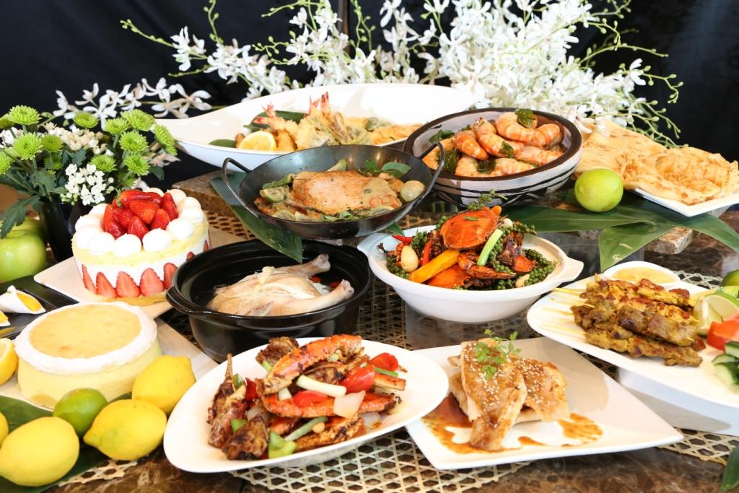
Representing the Probability of Compound Events Using Organized Tree Diagrams
Planning for Instruction
Notes:
Facilitator notes
Time: 1 minute
Handouts/participant activity: n/a
Focus points:
Title Page for lesson

Slide 12
Getting Ready
Pre-assessment: Used to determine understanding of prerequisite skills
Prerequisite skills include:
6.SP.4 to 6.SP.5
Summarize and describe distributions
Display numerical data
Summarize numerical data sets in relation to their context
Notes:
Facilitator notes
Time: 2-3 minutes
Handouts/participant activity: n/a
Focus points:
Review what standards should be covered in a pre-assessment activity. This shows what students should have already learned prior to your course. Using a pre-assessment activity will assist students in frontloading prior knowledge before beginning new learning.

Slide 13
Misconceptions and Anticipated Issues
Common Issues
Suggested Strategies/Resources
Students may think that because an event continues to occur that the likelihood of a new event occurring increases.
Students may believe that in random events involving selection, the results are dependent on numbers rather than on ratios between numbers.
Students may believe that experimental probability and theoretical probability are always equal.
Use the additional practice worksheets from LearnZillion lesson.
Understand if the event is independent or dependent.
Understand experimental probability vs. theoretical probability.
Notes:
Facilitator notes
Time: 2-3 minutes
Handouts/participant activity: n/a
Focus points:
These are guided questions to improve our students’ learning when misconceptions may occur.

Slide 14
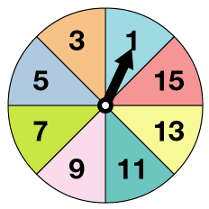
Required Resources
Materials Required
Special Materials:
Frequency Table
Spinners
Handouts:
LearnZillion presentation handouts
LearnZillion additional worksheets
https://learnzillion.com/lesson_plans/871-representing-the-probability-of-compound-events-using-organized-tree-diagrams
Notes:
Facilitator notes
Time: 2-3 minutes
Handouts/participant activity: n/a
Focus points:
Review the list of resources needed for the lesson and where to find materials online.

Slide 15
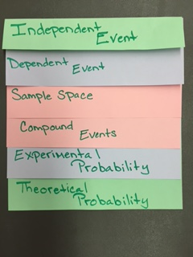
Needed Vocabulary
Independent Event
Dependent Event
Sample Space
Compound Events
Experimental Probability
Theoretical Probability
Or you could use: Word Map, Frayer Model, etc.
Layered Book Example
Notes:
Facilitator notes
Time: 4-5 minutes
Handouts/participant activity: n/a
Focus points:
This shows a list of required academic language vocabulary that is needed for the lesson. In addition, a strategy, “Layered Book” is shown with the suggestion that there are alternative strategies that can be used as well.

Slide 16
LearnZillion
For this lesson you need to create an account to access the handouts from LearnZillion.
This is a free account and you will have access to many more lessons.
Notes:
Facilitator notes
Time: 4-5 minutes
Handouts/participant activity: n/a
Focus points:
This is an introduction to the Learnzillion.com website where today’s lesson was pulled from. Teachers can sign up for a free account and have full access.

Slide 17
Adding Rational Numbers Using a Number Line
https://learnzillion.com/lesson_plans/871-representing-the-probability-of-compound-events-using-organized-tree-diagrams
Notes:
Facilitator notes
Time: 15 - 20 minutes
Handouts/participant activity: n/a
Focus points:
Click on the hyper link to take you to the lesson. Lesson includes: PowerPoint, Video, and handouts. As a department, we will explore this resources together

Slide 18
Planning and Time
Activities | Time | Notes
Preparation | 2 hours | Includes creating a pre-assessment, making copies, obtaining materials
Pre-lessons | 1 hours | Review of 6th and/or 7th grade SP standards
Vocabulary | 1 hour | Defining Independent Event, Dependent Event, Sample Space, Compound Events, Experimental Probability, and Theoretical Event
Task-Lesson | 2 hours | Explanation and completion of work
Practice and Additional Tasks | 2 hours | Additional worksheets from LearnZillion, Textbook practice, Illustrative Mathematics Tasks
Total Time | 9 hours
Notes:
Facilitator notes
Time: 1 - 2 minutes
Handouts/participant activity: n/a
Focus points:
Suggested pacing for this lesson

Slide 19
Textbook Connection California Math Course 2
Textbook Inquiry Lab:
How can one event impact a second event in a probability experiment? Pages 773 - 774
Textbook Lesson:
Lesson 9-7 Independent and Dependent Events Pages 775 – 782
On-line Resources:
Videos: Dependent Events, Probability of Independent Events, Real-World Examples
eTool Kit
Online PD

Slide 20
Textbook Connection Go Math Course 2
Textbook Explore Activity:
Exploring Compound Probability page 381
Textbook Lesson:
Lesson 12.3 Experimental Probability of Compound Events pages 382 – 386
Online Resources
Professional Development Video

Slide 21
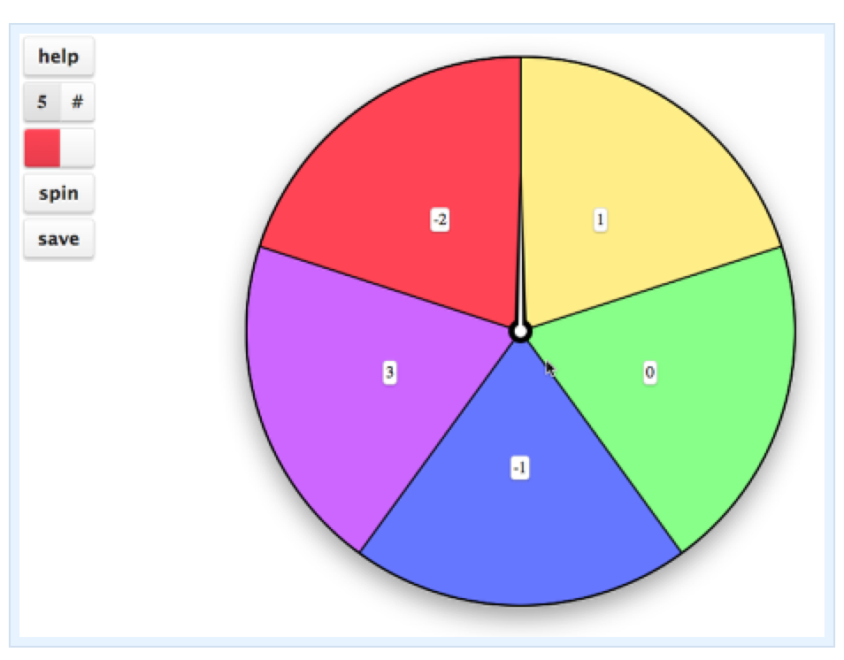
Textbook Connection CPM Course 2
Course 2:
5.2.5 Probability Trees
5.2.6 Compound Events
Online Technology:
Spinner Tool

Slide 22
Additional Resources
Illustrative Mathematics - www.illustrativemathematics.org
Waiting Times
Sitting Across from Each Other
Rolling Twice
Tetrahedral Dice
Red, Green, or Blue?
Khan Academy - www.khanacademy.org
Engage NY: Grade 7 Mathematics Module 5, Topic A, Lesson 7
Notes:
Facilitator notes
Time: 3 - 4 minutes
Handouts/participant activity: n/a
Focus points:
This is a list of additional resources surrounding the standards that may be used. If time permits, as a department, explore these sites.

Slide 23
Need Help?
Contact your
Secondary Math Coordinator

