Slide 1
Math 7 Number Systems Unit 2
Notes:
Facilitator notes
Time: n/a
Handouts/participant activity: n/a
Focus points:
Title Page

Slide 2
Purpose
Provided is a lesson for teachers to use to help students understand and analyze integers. Included are the following:
Standards
Number Systems Learning Progression
Lesson Agenda
Getting Ready for the Lesson (Resources and Tips)
Vocabulary Activities
Lesson
(Presentation and Video)
Textbook Connections
Additional Resources
Notes:
Facilitator notes
Time: 2-3 minutes
Handouts/participant activity: n/a
Focus points:
Review the components that this PD provides:
Standards
Learning Progressions
Lesson Agenda
Resources & Tips
Vocabulary Activities
Lesson
Textbook Connections
Additional Resources

Slide 3
Common Core Standards
7.NS.1 Apply and extend previous understandings of addition and subtraction to add and subtract rational numbers; represent addition and subtraction on a horizontal or vertical number line diagram.
(Apply, 2) (Understand, 2)
Notes:
Facilitator notes
Time: 2-3 minutes
Handouts/participant activity: n/a
Focus points:
Identifying the standards for lesson and unwrapping them.

Slide 4
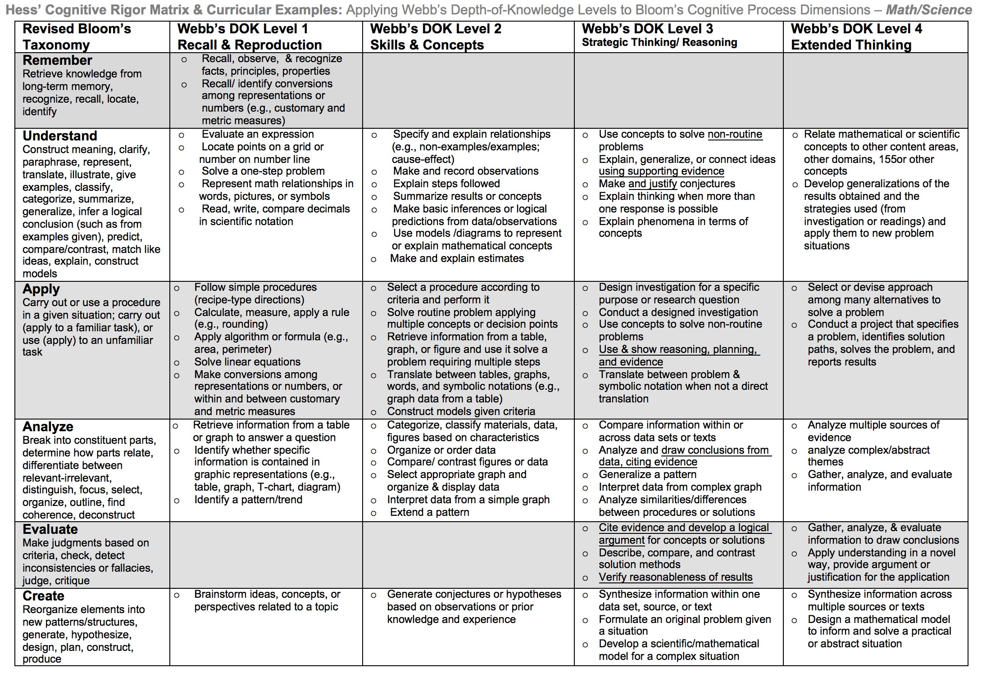
Notes:
Facilitator notes
Time: 2-3 minutes
Handouts/participant activity: n/a
Rust, & Green circles indicate the appropriate levels of DOK as required by the standards
The Blue circles fill in the instructional paths needed to assist students in reaching those DOK levels.

Slide 5
Math Practices
MP 1
Make sense of problems and persevere in solving them.
MP 2
Reason abstractly and quantitatively.
MP 4
Model with mathematics
MP 7
Look for and make use of structure
Notes:
Facilitator notes
Time: 1-2 minutes
Handouts/participant activity: n/a
Focus points:
Review the math practices associated with the lesson being presented.

Slide 6
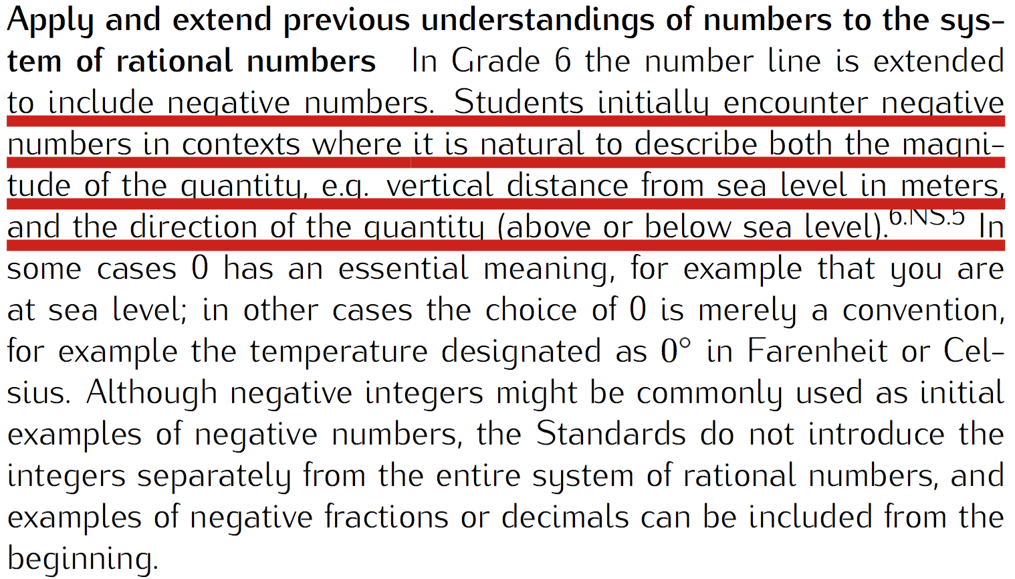
Number Systems Prerequisite Skills: CC Math 6
http://commoncoretools.me/wp-content/uploads/2013/07/ccssm_progression_NS+Number_2013-07-09.pdf
Notes:
Facilitator notes
Time: 2-3 minutes
Handouts/participant activity: n/a
Focus points:
The CA Framework also describes how students may accelerate to prepare for higher mathematics courses by compacting courses (animate circles around “compacted” and “accelerated”).
Compacting means to compress content, which may entail the teacher and students working at a faster pace to complete the content. There is no skipping of standards within the compacted courses to accelerate to higher mathematics courses.
With the California standards, student would simply skip course to get ahead. With the Common Core standards, students can still get ahead, but can no longer skip courses or rather standards. Therefore they must move at a faster pace.

Slide 7
Middle School Focus
Grade 6
Represent positive and negative numbers on a number line
Grade 7
Operations with integers using a number line
Grade 8
Know that there are irrational numbers
Divide fractions
Operations with positive and negative fractions
Source: California Framework
Notes:
2 – 3 minutes
Facilitator’s Notes:
What are those standards that you must focus on and which ones are not part of your course with the new shifts in standard under common core?
Grade 6
Develop understanding of numbers to the system of rational numbers
Grade 7
Operations of numbers using a number line
Grade 8
Know that there are numbers that are not rational and use approximate them by rational number
Let the participants know that they will use this handout in a later activity.

Slide 8
High School Focus
Algebra 1
Perform arithmetic operations with rational numbers
Geometry
Use coordinates to prove simple geometric theorems algebraically
Algebra 2
Perform arithmetic operations with complex numbers
Use properties of rational and irrational numbers
Perform arithmetic operations on polynomials
Rewrite rational expressions
Source: California Framework
Notes:
2 – 3 minutes
Facilitator’s Notes:
What are those standards that you must focus on and which ones are not part of your course with the new shifts in standard under common core?
Algebra 1
Develop understanding of rational numbers and polynomials
Geometry
Use coordinates to prove simple geometric theorems algebraically
Algebra 2
Understand operations with complex numbers
Let the participants know that they will use this handout in a later activity.

Slide 9
Learning Progression: HS Number and Quantity
http://commoncoretools.me/wp-content/uploads/2013/07/ccssm_progression_NS+Number_2013-07-09.pdf
CCSS Domain Progression
Notes:
Facilitator notes
Time: 2-3 minutes
Handouts/participant activity: n/a
Focus points:
Let’s take closer look at the California Department of Education’s description of the High School Connections.
Read the highlighted portion.

Slide 10
Lesson Agenda
Vocabulary
Video: Adding Rational Numbers Using a Number Line
Lesson: Who Won?
Textbook Connections
Notes:
Facilitator notes
Time: 2-3 minutes
Handouts/participant activity: n/a
Focus points:
Review the lesson agenda prior to implementation

Slide 11
Model Addition of Rational Numbers Using a Number Line
Planning for Instruction
Notes:
Facilitator notes
Time: 1 minute
Handouts/participant activity: n/a
Focus points:
Title Page for lesson

Slide 12
Getting Ready
Pre-assessment: Used to determine understanding of prerequisite skills
Prerequisite skills include:
6.NS.5 to 6.NS.8
Understand that positive and negative numbers are used to describe quantities having opposite direction or values
Understand a rational number as a pong on the number line
Understand order and absolute value of rational numbers
Notes:
Facilitator notes
Time: 2-3 minutes
Handouts/participant activity: n/a
Focus points:
Review what standards should be covered in a pre-assessment activity. This shows what students should have already learned prior to your course. Using a pre-assessment activity will assist students in frontloading prior knowledge before beginning new learning.

Slide 13
Misconceptions and Anticipated Issues
Common Issues
Suggested Strategies/Resources
Addition always results in a larger value.
Not understanding that the movement is continuous, it must start again where it was left off the last time.
Thinking that addition is always movement to the right on the number line.
Use the additional practice worksheets from LearnZillion lesson.
Recognize that the second move should start where the previous move stopped.
Recognize if the value is positive, they move to the right. Recognize if the value is negative, they move to the left.
Notes:
Facilitator notes
Time: 2-3 minutes
Handouts/participant activity: n/a
Focus points:
These are guided questions to improve our students’ learning when misconceptions may occur.

Slide 14
Required Resources
Materials Required
Special Materials:
Number Lines
Handouts:
LearnZillion presentation handouts
LearnZillion additional worksheets
https://learnzillion.com/lesson_plans/283-adding-rational-numbers-using-a-number-line
Notes:
Facilitator notes
Time: 2-3 minutes
Handouts/participant activity: n/a
Focus points:
Review the list of resources needed for the lesson and where to find materials online.

Slide 15
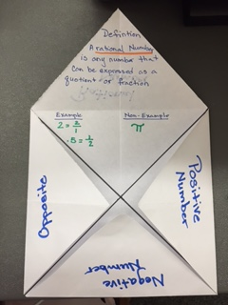
Needed Vocabulary
Rational Numbers
Positive Numbers
Negative Numbers
Number Line
Or you could use: Word Map, Frayer Model, etc.
Foldable Book Example
Notes:
Facilitator notes
Time: 4-5 minutes
Handouts/participant activity: n/a
Focus points:
This shows a list of required academic language vocabulary that is needed for the lesson. In addition, a strategy, “Layered Book” is shown with the suggestion that there are alternative strategies that can be used as well.

Slide 16
LearnZillion
For this lesson you need to create an account to access the handouts from LearnZillion.
This is a free account and you will have access to many more lessons.
Notes:
Facilitator notes
Time: 4-5 minutes
Handouts/participant activity: n/a
Focus points:
This is an introduction to the Learnzillion.com website where today’s lesson was pulled from. Teachers can sign up for a free account and have full access.

Slide 17
Adding Rational Numbers Using a Number Line
https://learnzillion.com/lesson_plans/283-adding-rational-numbers-using-a-number-line
Notes:
Facilitator notes
Time: 15 - 20 minutes
Handouts/participant activity: n/a
Focus points:
Click on the hyper link to take you to the lesson. Lesson includes: PowerPoint, Video, and handouts. As a department, we will explore this resources together

Slide 18
Planning and Time
Activities | Time | Notes
Preparation | 2 hours | Includes creating a pre-assessment, making copies, obtaining materials
Pre-lessons | 1 hours | Review of 6th and/or 7th grade NS standards
Vocabulary | 1 hour | Defining Rational, Positive, Negative, and Opposite Numbers
Integers Task-Lesson | 2 hours | Explanation and completion of work
Practice and Additional Tasks | 2 hours | Additional worksheets from LearnZillion, Textbook practice, Illustrative Mathematics Tasks
Total Time | 9 hours
Notes:
Facilitator notes
Time: 1 - 2 minutes
Handouts/participant activity: n/a
Focus points:
Suggested pacing for this lesson

Slide 19
Textbook Connection California Math Course 2
Textbook Inquiry Lab:
When is the sum of two integers a negative number? Pages 199 - 292
Textbook Lesson:
Lesson 3-2 Add Integers Pages 203 - 2010
On-line Resources:
Brain POP Adding and Subtracting Integers
eTool Kit
Online PD

Slide 20
Textbook Connection Go Math Course 2
Textbook Explore Activity:
Modeling Sums of Integers with the Same Sign pages 7 – 8
Adding on a Number Line page 13-14
Textbook Lesson:
Lesson 1.1 Adding Integers wit the Same Sign pages 9 – 12
Lesson 1.2 Adding Integers wit Different Signs pages 15 - 18
Online Resources
Professional Development Video

Slide 21
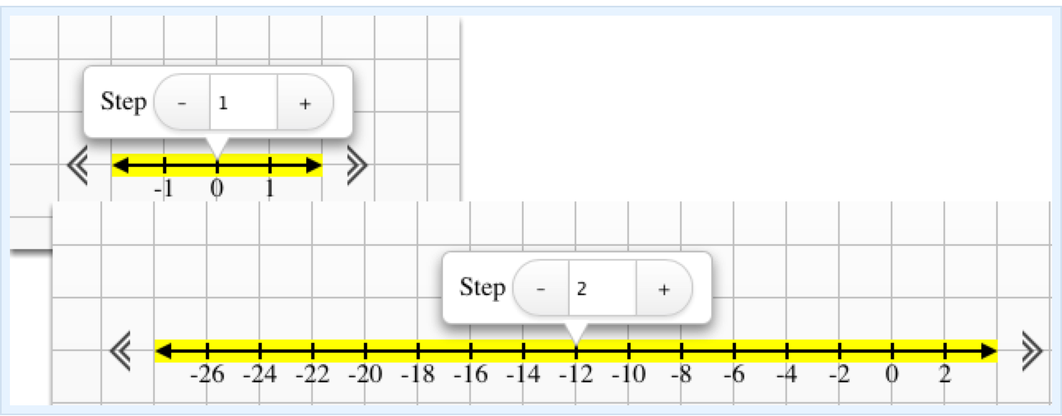
Textbook Connection CPM Course 2
Course 2:
2.2.2 Adding Integers and Rational Numbers
2.2.3 More Addition of Integers and Rational Numbers
Online Technology:
RT Tool
Transformation Challenge 1 and 2
Student e-tool

Slide 22
Additional Resources
Illustrative Mathematics - www.illustrativemathematics.org
Operation on the Number Line
Distance on the Number Line 2
Comparing Freezing Points
Difference and Distance
Distance Between Houses
Khan Academy - www.khanacademy.org
MARS: Using Positive and Negative Numbers in Context
Engage NY: Grade 7 Mathematics Module 2, Topic A
Notes:
Facilitator notes
Time: 3 - 4 minutes
Handouts/participant activity: n/a
Focus points:
This is a list of additional resources surrounding the standards that may be used. If time permits, as a department, explore these sites.

Slide 23
Need Help?
Contact your
Secondary Math Coordinator

