Slide 1
CC Math 6: Expressions and Equations Unit 3

Slide 2
Purpose
Provided is a lesson for teachers to use to help students understand how to construct and analyze function tables. Included are the following resources:
Standards
Expressions and Equations Learning Progression
Lesson Agenda
Getting Ready for the Lesson (Resources and Tips)
Vocabulary Activities
Lesson
(Presentation and Video)
Textbook Connections
Additional Resources
Notes:
Facilitator notes
Time: 2-3 minutes
Handouts/participant activity: n/a
Focus points:
Review the components that this PD provides:
Standards
Learning Progressions
Lesson Agenda
Resources & Tips
Vocabulary Activities
Lesson
Textbook Connections
Additional Resources

Slide 3
Common Core Standards
6.EE.9 Use variables to represent two quantities in a real-world problem that change in relationship to one another; write an equation to express one quantity, thought of as the dependent variable, in terms of the other quantity, thought of as the independent variable. Analyze the relationship between the dependent and independent variables using graphs and tables, and relate these to the equation.
(Understand, 3) (Apply, 3) (Analyze, 3)
Notes:
Facilitator notes
Time: 2-3 minutes
Handouts/participant activity: n/a
Focus points:
Identifying the standards for lesson and unwrapping them.

Slide 4
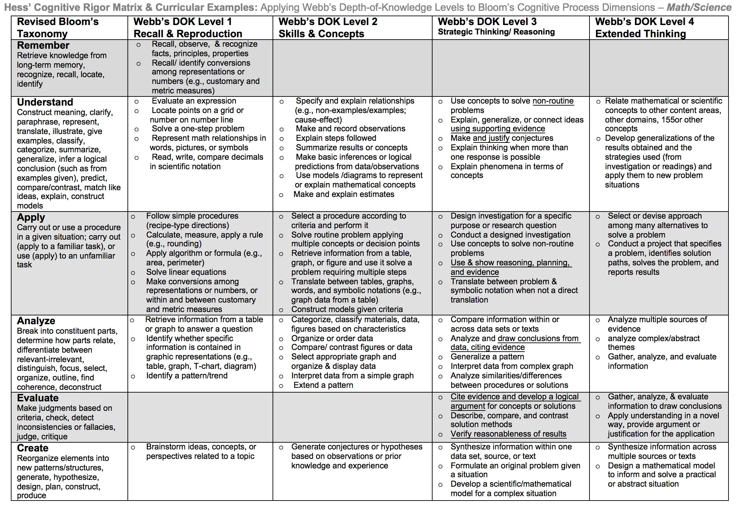
Notes:
Facilitator notes
Time: 2-3 minutes
Handouts/participant activity: n/a
Focus points:
Yellow, Red, & Green circles indicate the appropriate levels of DOK as required by the standards
The Blue circles fill in the instructional paths needed to assist students in reaching those DOK levels.

Slide 5
Math Practices
MP1
Make sense of problems and persevere in solving them.
MP8
Look for and express regularity in repeated reasoning.
Notes:
Facilitator notes
Time: 1-2 minutes
Handouts/participant activity: n/a
Focus points:
Review the math practices associated with the lesson being presented.

Slide 6
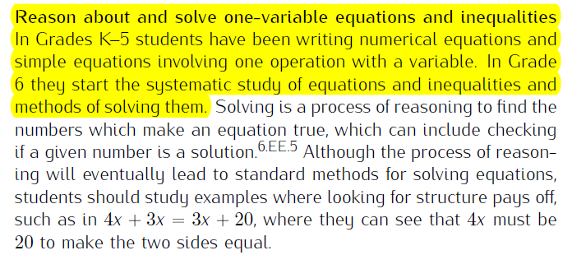
Expressions & Equat Prerequisite Skills: CC Math 6
https://commoncoretools.files.wordpress.com/2011/04/ccss_progression_ee_2011_04_25.pdf
Notes:
Facilitator notes
Time: 2-3 minutes
Handouts/participant activity: n/a
Focus points:
Review the prerequisite skills the students completed prior to 6th grade and connect to what they will study during the CC Math 6 course.

Slide 7
Progressions in Grade Level Standards
Grades K – 5
Connecting standards
Writing numerical expressions
Interpreting numerical expressions without evaluating them.
6th Grade
Applying and extending previous understandings of arithmetic to algebraic expressions.
Reason about and solve one-variable equations and inequalities.
Represent and analyze quantitative relationships between dependent and independent variables.
7th Grade
Use properties of operations to generate equivalent expressions.
Solve multi-step and real-life mathematical problems posed with positive and negative rational numbers in any form.
Solve real-life and mathematical problems using numerical and algebraic expressions and equations.
8th Grade
**New Course
Work with radicals and integer exponents.
Understand the connections between proportional relationships, lines, and linear equations.
Analyze and solve linear equations and pairs of simultaneous equations.
Source: https://commoncoretools.files.wordpress.com/2011/04/ccss_progression_ee_2011_04_25.pdf-
Notes:
Facilitator notes
Time: 2-3 minutes
Handouts/participant activity: n/a
Focus points:
There are major changes at each grade level with the domain of statistics and probability that have caused a shift in standards from CST time to Common Core Standards
Major points- Statistics and probability are no longer in Grades K – 5. Standards have switched between the 6th and 7th grade. There is also a completely new course for 8th grade students, which is CC Math 8. Therefore, the are now standards that were shifted from CST courses and into this new Common Core Course.

Slide 8
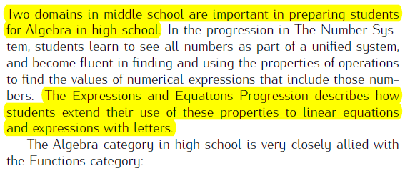
Learning Progression: Road to HS Algebra
http://commoncoretools.me/wp-content/uploads/2012/12/ccss_progression_algebra_2012_12_04.pdf
Notes:
Facilitator notes
Time: 2-3 minutes
Handouts/participant activity: n/a
Focus points:
Let’s take closer look at the California Department of Education’s description of the CC Math 8 course.
Read the highlighted portion
The state framework shows the importance of the Grade 8 Math Course and how it has became the new gateway course for higher level math, as well as how Algebra 1 had shifted to high school.

Slide 9
Lesson Agenda
Vocabulary
Video: Recognize how an equation relates independent and dependent variables
Lesson: Pancake Mix
Textbook Connections
Notes:
Facilitator notes
Time: 2-3 minutes
Handouts/participant activity: n/a
Focus points:
Review the lesson agenda prior to implementation

Slide 10
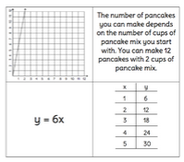
Core Lesson
Recognize how an equation relates independent and dependent variables
Notes:
Facilitator notes
Time: 1 minute
Handouts/participant activity: n/a
Focus points:
Title Page for lesson

Slide 11
Getting Ready
Pre-assessment- used to determine understanding of prerequisite skills
Prerequisite skills include
6 EE.1
Write and evaluate numerical expressions involving whole number exponents.
6 EE.2A
Write expressions that record operations with numbers and letters standing for numbers.
6 EE.6
Use variables to represent numbers and write expressions when solving a real-world or mathematical problem; understand that a variable can represent an unknown number, or, depending on the purpose at hand, any number in a specified set.
Source: http://curtismapper.pic.ucla.edu/MapApp/app/#/map
Notes:
Facilitator notes
Time: 2-3 minutes
Handouts/participant activity: n/a
Focus points:
Review what standards should be covered in a pre-assessment activity. This shows what students should have already learned prior to your course. Using a pre-assessment activity will assist students in frontloading prior knowledge before beginning new

Slide 12
Misconceptions and Anticipated Issues
Common Issues
Suggested Strategies/Resources
Plotting points (y,x) instead of (x,y).
Viewing the relationship shown in an equation backwards. For example, y = 6x, students may think this means that x is 6 times larger than y.
Not being able to identify the independent and dependent variables in a written context.
Use a whole-class discussion to review order of plotting points.
Use a whole-class discussion to analyze and interpret the relationship shown within several sample equations.
Teacher models how to identify independent and dependent variables using think-aloud strategy during whole-class discussion.
Notes:
Facilitator notes
Time: 2-3 minutes
Handouts/participant activity: n/a
Focus points:
These are guided questions to improve our students’ learning when misconceptions may occur.
These are guided questions to improve our students’ learning.

Slide 13
Required Resources
Materials Required
Special Materials:
Graph paper for each student
Handouts:
LearnZillion presentation handouts
LearnZillion additional worksheets
https://learnzillion.com/lesson_plans/681-recognize-how-an-equation-relates-independent-and-dependent-variables
Notes:
Facilitator notes
Time: 2-3 minutes
Handouts/participant activity: n/a
Focus points:
Review the list of resources needed for the lesson and where to find materials online.

Slide 14
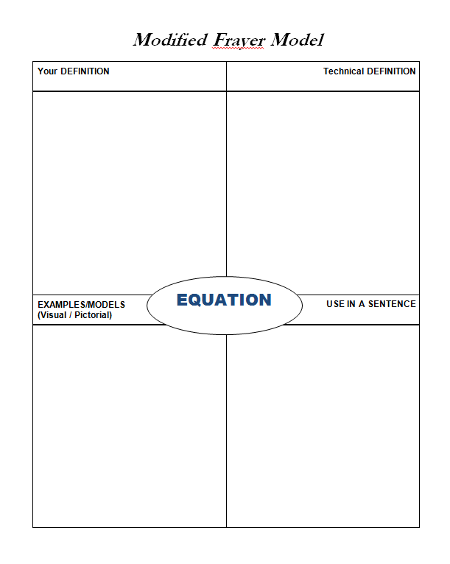
Needed Vocabulary
Equation
Alternative tools:
Word Map, Layered Book, etc.
Frayer Model Example
Notes:
Facilitator notes
Time: 4-5 minutes
Handouts/participant activity: n/a
Focus points:
This shows a list of required academic language vocabulary that is needed for the lesson. In addition, a strategy, “Layered Book” is shown with the suggestion that there are alternative strategies that can be used as well.

Slide 15
Learnzillion
For this lesson you need to create an account to access the handouts from Learnzillion.
This is a free account and you will have access to many more lessons.
Notes:
Facilitator notes
Time: 4-5 minutes
Handouts/participant activity: n/a
Focus points:
This is an introduction to the Learnzillion.com website where today’s lesson was pulled from. Teachers can sign up for a free account and have full access.

Slide 16
Understand and solve unit rate problems by using graphs of equivalent ratios
https://learnzillion.com/lesson_plans/681-recognize-how-an-equation-relates-independent-and-dependent-variables
Notes:
Facilitator notes
Time: 15 - 20 minutes
Handouts/participant activity: n/a
Focus points:
Click on the hyper link to take you to the lesson. Lesson includes: PowerPoint, Video, and handouts. As a department, we will explore this resources together

Slide 17
Planning and Time
Activities | Time | Notes
Preparation | 2 hours | Includes creating a pre-assessment, making copies, obtaining materials
Pre-lessons | 2 hours | Review of 6th grade EE standards
Vocabulary | 1 hour | Defining equation, dependent and independent variables
Pancake Task-Lesson | 2 hours | Explanation and completion of work
Practice and Additional Tasks | 3 hours | Additional worksheets from LearnZillion, Textbook practice, Illustrative Mathematics Tasks
Total Time | 10 hours
Notes:
Facilitator notes
Time: 1 - 2 minutes
Handouts/participant activity: n/a
Focus points:
Suggested pacing for this lesson

Slide 18
Textbook Connection: California Math
Textbook Course 1 Section 8.1
Problem-Solving Investigation: Making a Table, Pages 611-612
Classwork: Page 582-584, problems 1 – 7
Homework: Page 584, problems 8-13
Extra Practice: Course 1 Resources by Chapter Section 8.1
Lesson 8.1 HW Practice
Lesson 8.1 Extra Practice: Completing Function Tables
Student Re-teaching Section 8.1
Re-teaching: Function Tale
Assessment Book Course 1 Section 8.1
Self-Check Quick 8.1
Notes:
Facilitator notes
Time: 1-2 minutes
Handouts/participant activity: n/a
Focus points:
Connections to the California Math textbook for this specific standard / concept. As a department we may want to review this as well to compare to the Learnzillion lesson.

Slide 19
Additional Resources
Illustrative Mathematics - www.illustrativemathematics.com
Chocolate Bar Sales
https://www.illustrativemathematics.org/content-standards/tasks/806
Khan Academy - www.khanacademy.org
Inside Mathematics
Gym Task
http://www.insidemathematics.org/assets/common-core-math-tasks/gym.pdf
Mathematics Assessment Project
Modeling: Car Skid Marks
http://map.mathshell.org/lessons.php?collection=8&unit=6210#task588
Notes:
Facilitator notes
Time: 3 - 4 minutes
Handouts/participant activity: n/a
Focus points:
This is a list of additional resources surrounding the standards that may be used. If time permits, as a department, explore these sites.

Slide 20
Textbook Connection: Go Math
Lesson 12.2: Independent and Dependent Variables in Tables and Graphs
Classwork Page 344, Problems 1 – 5
Homework Page 345-346, Problems 6-10
Lesson 12.3: Writing Equations From Tables
Classwork Page 350, Problems 1 – 6
Homework Page 351-352, Problems 7-15
Lesson 12.4: Representing Algebraic Relationships in Tables and Graphs
Classwork Page 356, Problems 1 – 4
Homework Page 357-358, Problems 5-14
Notes:
Facilitator notes
Time: 1-2 minutes
Handouts/participant activity: n/a
Focus points:
Connections to the Go Math textbook for this specific standard / concept. As a department we may want to review this as well to compare to the Learnzillion lesson.

Slide 21
Textbook Connection CPM
8.1.2 What is Typical Value?
Classwork, Pages 382-383
Homework, Pages 384-388
8.1.3 How else can I describe the data ?
Classwork, Pages 389-392
Homework, Page 393
Notes:
Facilitator notes
Time: 1-2 minutes
Handouts/participant activity: n/a
Focus points:
Connections to the CPM textbook for this specific standard / concept. As a department we may want to review this as well to compare to the Learnzillion lesson.

Slide 22
Need Help?
Contact your
Secondary Math Coordinator

