Slide 1
Geometry - Conic Section Unit 4
Notes:
Facilitator notes
Time: n/a
Handouts/participant activity: n/a
Focus points:
Title Page

Slide 2
Purpose
Provided is a lesson for teachers to use to help students understand how to create an equation of a circle using the Pythagorean Theorem. Included are the following:
Standards
Learning Progression
Lesson Agenda
Getting Ready for the Lesson (Resources and Tips)
Vocabulary Activities
Lesson
(Presentation)
Textbook Connections
Additional Resources
Notes:
Facilitator notes
Time: 2-3 minutes
Handouts/participant activity: n/a
Focus points:
Review the components that this PD provides:
Standards
Learning Progressions
Lesson Agenda
Resources & Tips
Vocabulary Activities
Lesson
Textbook Connections
Additional Resources

Slide 3
Common Core Standards
Derive the equation of a circle of given center and radius using the Pythagorean Theorem; complete the square to find the center and radius of a circle given by an equation.
(Create, 2) (Analyze, 2)
Notes:
Facilitator notes
Time: 2-3 minutes
Handouts/participant activity: n/a
Focus points:
Identifying the standards for lesson and unwrapping them.

Slide 4
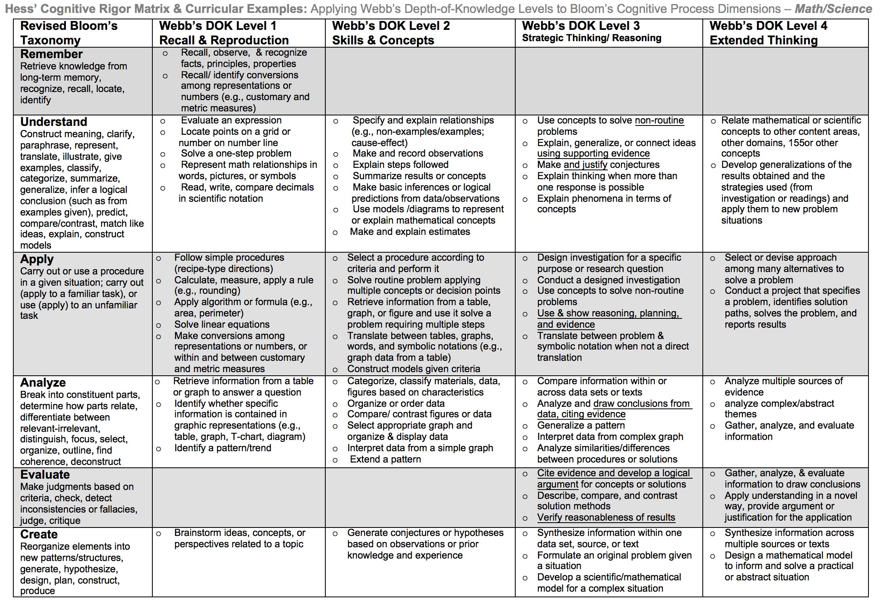
Notes:
Facilitator notes
Time: 2-3 minutes
Handouts/participant activity: n/a
Focus points:
Orange & Purple circles indicate the appropriate levels of DOK as required by the standards
The arrows fill in the instructional paths needed to assist students in reaching those DOK levels.

Slide 5
Math Practices
MP1
Make sense of problems and persevere in solving them.
MP2
Reason abstractly and quantitatively.
Notes:
Facilitator notes
Time: 1-2 minutes
Handouts/participant activity: n/a
Focus points:
Review the math practices associated with the lesson being presented.

Slide 6
Middle School Focus
Grade 6
Reason about and solve one-variable equations and inequalities.
Represent and analyze quantitative relationships between dependent and independent variables.
Grade 7
Solve real-life and mathematical problems using numerical and algebraic expressions and equations.
Solve real-life and mathematical problems involving angle measure, area, surface area, and volume.
Grade 8
Understand and apply the Pythagorean Theorem.
Source: California Framework
Notes:
Facilitator notes
Time: 2-3 minutes
Handouts/participant activity: n/a
Focus points:
What are those standards that you must focus on and which ones are not part of your course with the new shifts in standard under common core?

Slide 7
High School Focus
Algebra I
Creating Equations
Create equations that describe numbers or relationship.
Geometry
Expressing Geometric Properties with Equations
Translate between the geometric description and the equation for a conic section.
Use coordinates to prove simple geometric theorems algebraically.
Algebra II
Creating Equations
Create equations that describe numbers or relationship.
Source: California Framework
Notes:
Facilitator notes
Time: 2-3 minutes
Handouts/participant activity: n/a
Focus points:
What are those standards that you must focus on and which ones are not part of your course with the new shifts in standard under common core?

Slide 8
Lesson Agenda
Vocabulary
Lesson:
Task: Jessica’s Walk Home
Connecting Concepts: Circles and Pythagorean Theorem
Practice Exercises
Video Presentation
Textbook Connections
Notes:
Facilitator notes
Time: 2-3 minutes
Handouts/participant activity: n/a
Focus points:
Review the lesson agenda prior to implementation

Slide 9
Deriving Success
Planning for Instruction with Equations of a Circle
Notes:
Facilitator notes
Time: 1 minute
Handouts/participant activity: n/a
Focus points:
What you will need and need to know to be successful when implementing this lesson.

Slide 10
Getting Ready
Pre-assessment- used to determine understanding of prerequisite skills
Prerequisite skills include
7.G.4
Know the formulas for the area and circumference of a circle and use them to solve problems; give an informal derivation of the relationship between the circumference and area of a circle.
8.G.6 – 8
Explain a proof of the Pythagorean Theorem and its converse.
Apply the Pythagorean Theorem to determine unknown side lengths in right triangles in real-world and mathematical problems in two and three dimensions.
Apply the Pythagorean Theorem to find the distance between two points in a coordinate system.
Algebra-A.CED.2
Create equations in two or more variables to represent relationships between quantities; graph equations on coordinate axes with labels and scales.
Geometry-G.C.2
Identify and describe relationships among inscribed angles, radii, and chords. Include the relationship between central, inscribed, and circumscribed angles; inscribed angles on a diameter are right angles; the radius of a circle is perpendicular to the tangent where the radius intersects the circle. 1
Notes:
Facilitator notes
Time: 2-3 minutes
Handouts/participant activity: n/a
Focus points:
Review what standards should be covered in a pre-assessment activity. This shows what students should have already learned prior to and during your course before teaching the standard for this lesson. Using a pre-assessment activity will assist teachers in frontloading prior knowledge before beginning new learning.

Slide 11
Misconceptions and Anticipated Issues
Common Issues
Suggested Strategies/Resources
Incorrectly identifies the center of the circle
Incorrectly identifies the equation of the circle
Incorrectly uses the Pythagorean theorem to figure out the equation
Places coordinates values incorrectly in the equation
Errors when completing the square
Not able to connect the process of completing the square and the equation of a circle
Provide additional practice
Additional practice with writing the equation of a circle. Have students match circles to equation that represents the circle using the related MARS task.
Have students check their equation by graphing on coordinate grid or calculator. Review the Pythagorean theorem and have students review related videos from Khan academy.
Have students create a circle that matches the equation.
Provide additional practice
Provide the video lesson
Notes:
Facilitator notes
Time: 2-3 minutes
Handouts/participant activity: n/a
Focus points:
These are guided questions to improve our students’ learning when misconceptions may occur.

Slide 12
Required Resources
Materials Required
Frayer’s Model
Graph/Coordinate Grid Paper
Graphing Calculator
Written assignments of problems
LearnZillion additional worksheets
Notes:
Facilitator notes
Time: 2-3 minutes
Handouts/participant activity: n/a
Focus points:
Review the list of resources needed for the lesson and where to find materials online.

Slide 13
Planning and Time
Activities | Time | Notes
Preparation | 2 hours | Includes creating a pre-assessment, making copies, obtaining materials
Pre-lessons | 2 hours | Review of 7th and 8th grade, Algebra and Geometry related standards
Vocabulary | 1 hour | Defining Conic section, circle and Pythagorean Theorem
Jessica’s Walk Home Task, Completing the Square Task and Related Activities | 2 hour | Explanation and completion of work
Practice and Additional Tasks | 3 hours | Exercise Set A, B and/or C for both tasks, Textbook practice, MARs Task
Total Time | 10 hours
Notes:
Facilitator notes
Time: 1 - 2 minutes
Handouts/participant activity: n/a
Focus points:
Suggested pacing for this lesson

Slide 14
Act 1
Derive the equation of a circle of given center and radius using the Pythagorean Theorem
Notes:
Facilitator notes
Time: n/a
Handouts/participant activity: n/a
Focus points:
Title Page- for the first part of the standard

Slide 15
Needed Vocabulary: Conic Section, Circle, Pythagorean Theorem
Definition Characteristic
Examples Non-Examples
Complete a Frayer’s Model for each vocabulary word
Conic Section
Or you could use: Word Map, Layered Book, etc.
Notes:
Facilitator notes
Time: 4-5 minutes
Handouts/participant activity: n/a
Focus points:
This shows a list of required academic language vocabulary that is needed for the lesson. In addition, a strategy, “Frayer’s Model” is shown with the suggestion that there are alternative strategies that can be used as well.

Slide 16
Derive the equation of a circle: using the Pythagorean Theorem
https://learnzillion.com/lessons/280-derive-the-equation-of-a-circle-using-the-pythagorean-theorem
Notes:
Facilitator notes
Time: 4-5 minutes
Handouts/participant activity: n/a
Focus points:
Go to the LearnZillion website and access the associated lesson. Download worksheet and access the presentation and video.

Slide 17
Jessica’s Walk Home
Notes:
Facilitator notes
Time: 10 minutes
Handouts/participant activity: n/a
Focus points:
Provide the task and have students work on the task and assist with the following guided questions
What do you notice about the diagram?
What kind of technique can we use to find the distance?
Would it be the same distance if Jessica’s house was 8 blocks west instead of east? What if the school was 6 blocks south instead of north?
What kind of triangle could help us solve this problem?
How can the triangle help us solve the problem?

Slide 18
Task Continued
Notes:
Facilitator notes
Time: 5 - 10 minutes
Have students complete this related task and use the following questions:
What do you think the equation of a circle would look like? Have we seen it before?
What types of different equations have we learned?
What are the coordinates of the center of the circle?
Could we draw anything that would help us create an equation?
How can I find the distance between two points on a graph?
Handouts/participant activity: n/a
Focus points:
The first step in the lesson is to have students work towards formulating the question that goes with the situation they will eventually explore with candy. Following the steps listed the teacher will engage students in a discussion that would help them relate proportions to a mixture.

Slide 19
Task Debrief
What knowledge did you use to relate C to M?
How did you set up your equation?
Reveal the solution
Discuss the Big Idea
Connection of the Pythagorean Theorem and the center and/or equation of a circle.
Notes:
Facilitator notes
Time: 5 - 10 minutes
Handouts/participant activity: n/a
Focus points:
As a whole class ask the students the debrief questions and use the following guiding questions to help the students formulate their answers:
What is the vertical distance between point M and D?
What is the horizontal distance between point C and D?
How can this triangle help in creating an equation for this circle?
What is the formula for the Pythagorean Theorem?

Slide 20
Closing
Notes:
Facilitator notes
Time: 4-5 minutes
Handouts/participant activity: n/a
Focus points:
Have students work in pairs or individually to complete the closing problem. You can use this problem to determine if students need additional explanation.

Slide 21
Choose the Next Option
Based on the formative assessment results
Option A- Exercises Set A, B and/or C
Option B- Video presentation of the lesson
Option C- Assessment
Notes:
Facilitator notes
Time: 10 - 15 minutes
Handouts/participant activity: Exercises Set A, B and/or C
Focus points:
Teachers will need to complete the formative assessment with the students to determine the next path. Do they have them complete the exercises or do they have them watch the video. Have participants actually view the video and complete 1 or more of the exercises and the assessments. Teachers may or may not use all of the options in their classroom.

Slide 22
Act 2
Complete the square to find the center and radius of a circle given by an equation
Notes:
Facilitator notes
Time: n/a
Handouts/participant activity: n/a
Focus points:
Title Page- for the second part of the standard

Slide 23
Needed Vocabulary: Completing the Square
Definition Characteristic
Examples Non-Examples
Frayer’s Model
Completing
the Square
Or you could use: Word Map, Layered Book, etc.
Notes:
Facilitator notes
Time: 4-5 minutes
Handouts/participant activity: n/a
Focus points:
This shows a list of required academic language vocabulary that is needed for the lesson. In addition, a strategy, “Frayer’s Model” is shown with the suggestion that there are alternative strategies that can be used as well.

Slide 24
Derive the equation of a circle: using the Pythagorean Theorem
https://learnzillion.com/lesson_plans/1428
Notes:
Facilitator notes
Time: 4-5 minutes
Handouts/participant activity: n/a
Focus points:
Go to the LearnZillion website and access the associated lesson. Download worksheet and access the presentation and video.

Slide 25
Completing the Square
Notes:
Facilitator notes
Time: 5 - 10 minutes
Handouts/participant activity: n/a
Focus points:
Provide the task and have students work on the task and assist with the following guided questions
What is the first step in completing the square?
Why are there boxes are both sides?
How do I factor a trinomial?
How can I check my answer?

Slide 26
Task Continued
Notes:
Facilitator notes
Time: 5 - 10 minutes
Have students complete this related task and use the following questions:
What is the standard form of the equation of a circle?
What are some possible values of k?
Is it possible to have a circle with a radius of 0?
Handouts/participant activity: n/a
Focus points:
The first step in the lesson is to have students work towards formulating the question that goes with the situation they will eventually explore with candy. Following the steps listed the teacher will engage students in a discussion that would help them relate proportions to a mixture.

Slide 27
Task Debrief
How can the equation be solved by completing the square?
What kind of expression can we set up to solve part a?
Why would we set the inequality greater 0?
Notes:
Facilitator notes
Time: 5 - 10 minutes
Handouts/participant activity: n/a
Focus points:
As a whole class ask the students the debrief questions

Slide 28
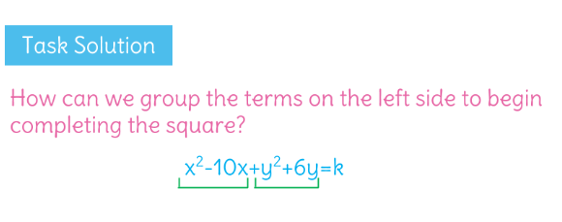
Task Debrief Continued
Notes:
Facilitator notes
Time: 5 - 10 minutes
Handouts/participant activity: n/a
Focus points:
As a whole class ask the students the debrief question in the task and use the following guiding questions for to assist students:
How can the equation be solved by completing the square?
What kind of expression can we set up to solve part a?
Why would we set the inequality greater 0?

Slide 29
Closing
Notes:
Facilitator notes
Time: 4-5 minutes
Handouts/participant activity: n/a
Focus points:
Provide the solution to the previous the question on the previous slide. The intent of the Big Idea is to summarize the important mathematical concepts the task is meant to elicit. Consider asking students to explain the concepts on each slide in their own words and to connect each to the relevant part of the task.

Slide 30
Choose the Next Option
Based on the formative assessment results
Option A- Exercises Set A, B and/or C
Option B- Video presentation of the lesson
Option C- Assessment
Notes:
Facilitator notes
Time: 10 - 15 minutes
Handouts/participant activity: Exercises Set A, B and/or C
Focus points:
Teachers will need to complete the formative assessment with the students to determine the next path. Do they have them complete the exercises or do they have them watch the video. Have participants actually view the video and complete 1 or more of the exercises and the assessments. Teachers may or may not use all of the options in their classroom.

Slide 31
Textbook Connection Big Ideas
Lesson 10.7
Notes:
Facilitator notes
Time: 1-2 minutes
Handouts/participant activity: n/a
Focus points:
Connections to the Big Ideas textbook for this specific standard / concept. As a department we may want to review this as well to compare to the LearnZillion lesson.

Slide 32
Textbook Connection Spring Board
Lesson 27 - 1
Lesson 27 – 2
Activity 27
Notes:
Facilitator notes
Time: 1-2 minutes
Handouts/participant activity: n/a
Focus points:
Connections to the SpringBoard textbook for this specific standard/concept. As a department we may want to review this as well to compare to the LearnZillion lesson.

Slide 33
Textbook Connection CPM
Lesson 12.1.1
Lesson 12.1.2
Notes:
Facilitator notes
Time: 1-2 minutes
Handouts/participant activity: n/a
Focus points:
Connections to the CPM textbook for this specific standard/concept. As a department we may want to review this as well to compare to the LearnZillion lesson.

Slide 34
Additional Resources
Illustrative Mathematics - www.illustrativemathematics.org
Two-Way Tables and Probability
The Titanic 1: S.CP.1,4, and 6
The Titanic II: S.CP.2-6
Fred's Factory
But Mango is My Favorite…
Khan Academy - www.khanacademy.org
https://www.khanacademy.org/math/algebra2/conics_precalc/circles-tutorial-precalc/e/pythagorean-theorem-and-the-equation-of-a-circle
MARS Lesson
Sorting Equations of a Circle 1
http://map.mathshell.org/lessons.php?unit=9350&collection=8&redir=1
7th Grade Standards
Engage NY Common Core Curriculum
Module 5 – Statistics and Probability
Notes:
Facilitator notes
Time: 3 - 4 minutes
Handouts/participant activity: n/a
Focus points:
This is a list of additional resources surrounding the standards that may be used. If time permits, as a department, explore these sites.

Slide 35
Need Help?
Contact your
Secondary Math Coordinator

