Slide 1
Geometry - Statistics: Conditional Probability Unit 4
Notes:
Facilitator notes
Time: n/a
Handouts/participant activity: n/a
Focus points:
Title Page

Slide 2
Purpose
Provided is a lesson for teachers to use to help students understand and analyze bivariate data. Included are the following:
Standards
Statistics and Probability Learning Progression
Lesson Agenda
Getting Ready for the Lesson (Resources and Tips)
Vocabulary Activities
Lesson
(Presentation)
Textbook Connections
Additional Resources
Notes:
Facilitator notes
Time: 2-3 minutes
Handouts/participant activity: n/a
Focus points:
Review the components that this PD provides:
Standards
Learning Progressions
Lesson Agenda
Resources & Tips
Vocabulary Activities
Lesson
Textbook Connections
Additional Resources

Slide 3
Common Core Standards
S-CP.4Construct and interpret two-way frequency tables of data when two categories are associated with each object being classified. Use the two-way table as a sample space to approximate conditional probabilities.
(Understand, 2) (Analyze, 2) (Apply, 2)
Notes:
Facilitator notes
Time: 2-3 minutes
Handouts/participant activity: n/a
Focus points:
Identifying the standards for lesson and unwrapping them.

Slide 4
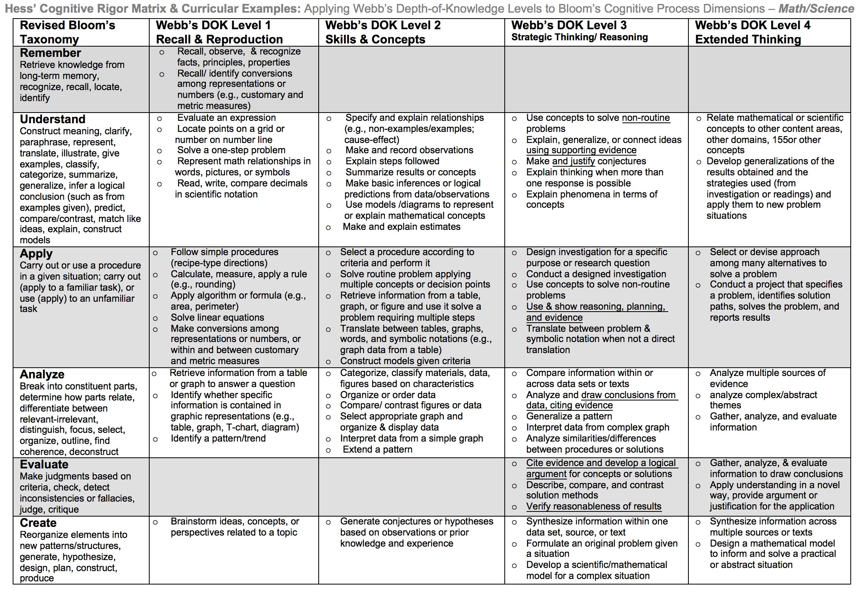
Notes:
Facilitator notes
Time: 2-3 minutes
Handouts/participant activity: n/a
Focus points:
Orange, Red, & Purple circles indicate the appropriate levels of DOK as required by the standards
The arrows fill in the instructional paths needed to assist students in reaching those DOK levels.

Slide 5
Math Practices
MP1
Make sense of problems and persevere in solving them.
MP2
Reason abstractly and quantitatively.
Notes:
Facilitator notes
Time: 1-2 minutes
Handouts/participant activity: n/a
Focus points:
Review the math practices associated with the lesson being presented.

Slide 6
Statistics & Probability Prerequisite Skills: CC Math 7 and 8
http://commoncoretools.me/wp-content/uploads/2012/06/ccss_progression_sp_hs_2012_04_21_bis.pdf
In Grades 7 and 8, students encountered the development of basic
probability, including chance processes, probability models, and
sample spaces. In high school, the relative frequency approach to
probability is extended to conditional probability and independence,
rules of probability and their use in finding probabilities of compound
events, and the use of probability distributions to solve problems involving
expected value. As seen in the making inferences section
above, there is a strong connection between statistics and probability.
This will be seen again in this section with the use of data in
selecting values for probability models.
Notes:
Facilitator notes
Time: 2-3 minutes
Handouts/participant activity: n/a
Focus points:
The CA Framework also describes how students progression through specific domains/conceptual categories
Highlight what students focus on in grades 7 and 8 with Statistics and Probability, which is basic probability, including chance processes, probability models and sample spaces.

Slide 7
Middle School Focus
Grade 6
Develop understanding of statistical variability.
Summarize and describe distributions.
Grade 7
Use random sampling to draw inferences about a population.
Draw informal comparative inferences about two populations.
Investigate chance processes and develop, use, and evaluate probability models.
Grade 8
Investigate patterns of association in bivariate data.
Source: California Framework
Notes:
Facilitator notes
Time: 2-3 minutes
Handouts/participant activity: n/a
Focus points:
What are those standards that you must focus on and which ones are not part of your course with the new shifts in standard under common core?
Grade 6
Develop understanding of statistical variability.
Summarize and describe distributions.
Grade 7
Use random sampling to draw inferences about a population.
Draw informal comparative inferences about two populations.
Investigate chance processes and develop, use, and evaluate probability models.
Grade 8
Investigate patterns of association in bivariate data.

Slide 8
High School Focus
Algebra I
Summarize, represent, and interpret data on a single count or measurement variable.
Summarize, represent, and interpret data on two categorical and quantitative variables.
Interpret linear models.
Geometry
Conditional Probability and the Rules of Probability
Understand independence and conditional probability and use them to interpret data.
Use the rules of probability to compute probabilities of compound events in a uniform probability model.
Using Probability to Make Decisions Use probability to evaluate outcomes of decisions
Algebra II
Interpreting Categorical and Quantitative Data Summarize, represent, and interpret data on a single count or measurement variable.
Making Inferences and Justifying Conclusions Understand and evaluate random processes underlying statistical experiments.
Make inferences and justify conclusions from sample surveys, experiments, and observational studies.
Using Probability to Make Decisions Use probability to evaluate outcomes of decisions.
Source: California Framework
Notes:
Facilitator notes
Time: 2-3 minutes
Handouts/participant activity: n/a
Focus points:
What are those standards that you must focus on and which ones are not part of your course with the new shifts in standard under common core?
Algebra I
Summarize, represent, and interpret data on a single count or measurement variable.
Summarize, represent, and interpret data on two categorical and quantitative variables.
Interpret linear models.
Geometry
Conditional Probability and the Rules of Probability
Understand independence and conditional probability and use them to interpret data.
Use the rules of probability to compute probabilities of compound events in a uniform probability model.
Using Probability to Make Decisions Use probability to evaluate outcomes of decisions
Algebra II
Interpreting Categorical and Quantitative Data Summarize, represent, and interpret data on a single count or measurement variable.
Making Inferences and Justifying Conclusions Understand and evaluate random processes underlying statistical experiments.
Make inferences and justify conclusions from sample surveys, experiments, and observational studies.
Using Probability to Make Decisions Use probability to evaluate outcomes of decisions.

Slide 9
Learning Progression: HS Statistics & Probability
http://commoncoretools.me/wp-content/uploads/2012/06/ccss_progression_sp_hs_2012_04_21_bis.pdf
Notes:
Facilitator notes
Time: 2-3 minutes
Handouts/participant activity: n/a
Focus points:
Let’s take closer look at the California Department of Education’s description focus for High School Statistics and Probability.
Read the highlighted portion
The state framework states the importance of the High School Math Courses providing a deeper look at bivariate data with categorical associations.

Slide 10
Learning Progression: HS Statistics & Probability
http://commoncoretools.me/wp-content/uploads/2012/06/ccss_progression_sp_hs_2012_04_21_bis.pdf
Understand independence and conditional probability and use
them to interpret data In developing their understanding of conditional probability and independence, students should see two types of problems, one in which the uniform probabilities attached to outcomes leads to independence and one in which it does not.
Notes:
Facilitator notes
Time: 2-3 minutes
Handouts/participant activity: n/a
Focus points:
Let’s continue to take closer look at the California Department of Education’s description of the High School Statistics and Probability.
Read the boxed portion
The state framework shows the importance of having students work with 2 types of problems (independent and dependent).

Slide 11
Lesson Agenda
Vocabulary
Lesson: Sweet Task
Textbook Connections
Notes:
Facilitator notes
Time: 2-3 minutes
Handouts/participant activity: n/a
Focus points:
Review the lesson agenda prior to implementation

Slide 12
Sweet Success
Planning for Instruction with Conditional Probability
Notes:
Facilitator notes
Time: 1 minute
Handouts/participant activity: n/a
Focus points:
Title Page for lesson

Slide 13
Getting Ready
Pre-assessment- used to determine understanding of prerequisite skills
Prerequisite skills include
7 SP 1 – 8
Use random sampling to draw inferences about a population.
Draw informal comparative inferences about two populations.
Investigate chance processes and develop, use, and evaluate probability models.
8 SP 1 - 4
Investigate patterns of association in bivariate data.
S.ID.5- Summarize categorical data for two categories in two-way frequency tables. Interpret relative frequencies in the context of the data (including joint, marginal, and conditional relative frequencies). Recognize possible associations and trends in the data.
Notes:
Facilitator notes
Time: 2-3 minutes
Handouts/participant activity: n/a
Focus points:
Review what standards should be covered in a pre-assessment activity. This shows what students should have already learned prior to your course. Using a pre-assessment activity will assist teachers in frontloading prior knowledge before beginning new learning.

Slide 14
Misconceptions and Anticipated Issues
Common Issues
Suggested Strategies/Resources
Using the wrong total from the frequency table
Misunderstanding between the connection of joint frequency, marginal frequency, conditional relative frequency
Finding the wrong probability
Incorrect calculations when dividing and dividing the wrong values
Not able to read the symbol for conditional probability
Provide additional practice
Use more than 1 vocabulary organizer to address key vocabulary
Have students use manipulatives, such as the candy to help to identify sample
Allow students to use a calculator
Review notation during the lesson
Notes:
Facilitator notes
Time: 2-3 minutes
Handouts/participant activity: n/a
Focus points:
These are guided questions to improve our students’ learning when misconceptions may occur.

Slide 15
Required Resources
Materials Required
“A Sweet Task” Activity Worksheet (located at the end of this lesson)
A large bag of plain M&Ms and a large bag of regular Skittles – Each team of two students should receive 30 of each candy type
Bag of trail mix or snack mix in a transparent bag
Preformatted spreadsheets which will sum the rows/columns (rows represent the type of candy and columns represent the colors)
Written assignments of problems
Notes:
Facilitator notes
Time: 2-3 minutes
Handouts/participant activity: n/a
Focus points:
Review the list of resources needed for the lesson and where to find materials online.

Slide 16
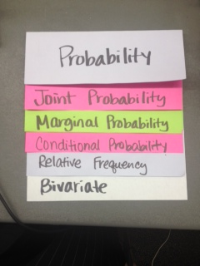
Needed Vocabulary
Probability
Marginal Probability
Joint Probability
Bivariate
Conditional Probability
Two-Way Table
Relative Probability
Or you could use: Word Map, Frayer Model, etc.
Layered Book Example
Notes:
Facilitator notes
Time: 4-5 minutes
Handouts/participant activity: n/a
Focus points:
This shows a list of required academic language vocabulary that is needed for the lesson. In addition, a strategy, “Layered Book” is shown with the suggestion that there are alternative strategies that can be used as well.

Slide 17
A Sweet Task Lesson
Create a two-way frequency table
Convert your number into relative frequency numbers
Identify joint and marginal frequencies
Calculate conditional relative frequencies
Notes:
Facilitator notes
Time: 1-2 minutes
Handouts/participant activity: n/a
Focus points:
This shows a list of the specific concepts that are in the lesson.

Slide 18
Formulating the Question
Look at this bag of trail mix, what is your favorite ingredient in the trail or snack mix and what happens when you share the mix with their families or friends?
Do they just eat the pieces they like and leave the rest?
What are the actual proportions of each type of piece?
What might you include in order to create a “perfect” mix to share with your family?
Notes:
Facilitator notes
Time: 4-5 minutes
Handouts/participant activity: n/a
Focus points:
The first step in the lesson is to have students work towards formulating the question that goes with the situation they will eventually explore with candy. Following the steps listed the teacher will engage students in a discussion that would help them relate proportions to a mixture.

Slide 19
Introduction of Task
Divide into pairs
Task
“You and your partner will determine the probabilities of drawing different types of candy from our own two-ingredient candy mix of M&Ms and Skittles.”
Notes:
Facilitator notes
Time: 4-5 minutes
Handouts/participant activity: n/a
Focus points:
The next step is to introduce the task to the students and divide them into pairs.

Slide 20
Preliminary Questions
What is the probability of picking a green M&M would be out of this “mix”?
What would be the probability that, if you pick a Skittle, it would be yellow.
“If you know a candy is red, is it more likely to be an M&M or a Skittle?”
How can we find out the answers to these questions?
Notes:
Facilitator notes
Time: 4-5 minutes
Handouts/participant activity: n/a
Focus points:
Once the students are divided into to pairs, the teacher will ask preliminary questions regarding probability.

Slide 21
Distribution of M&M’s
M&M'S MILK CHOCOLATE: 24% cyan blue, 20% orange, 16% green, 14% bright yellow, 13% red, 13% brown.
M&M'S PEANUT: 23% cyan blue, 23% orange, 15% green, 15% bright yellow, 12% red, 12% brown.
M&M'S DARK: 17% cyan blue, 16% orange, 16% green, 17% bright yellow, 17% red, 17% brown.
M&M'S PEANUT BUTTER and ALMOND: 20% cyan blue, 20% orange, 20% green, 20% bright yellow, 10% red, 10% brown.
From: http://www.exeter.edu/documents/mandm.pdf
Notes:
Facilitator notes
Time: 1-2 minutes
Handouts/participant activity: n/a
Focus points:
The teacher will provide distribution date for M&M’s

Slide 22
Distribution of Skittles
Skittle colors are reportedly distributed evenly with 20% of each color
Red, Orange, Yellow, Green, Purple
Notes:
Facilitator notes
Time: 1-2 minutes
Handouts/participant activity: n/a
Focus points:
The teacher will provide distribution data Skittles.

Slide 23
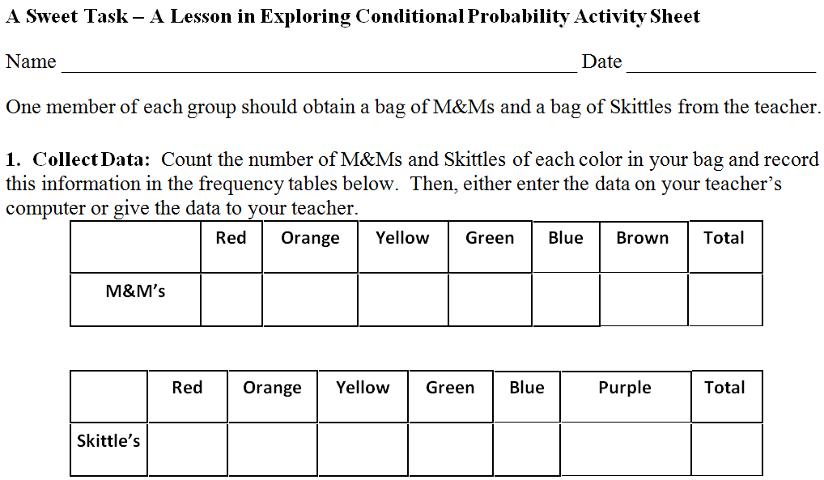
Getting Started
Sample Size
The samples (n = 30 each) of plain M&Ms and Skittles to each pair.
Complete Activity Sheet Part 1
Notes:
Facilitator notes
Time: 5 - 10 minutes
Handouts/participant activity: n/a
Focus points:
Participants will complete the activity sheet part 1 as if they were students. This will allow the participants to have an idea of the process and possible issues that may arise in their classroom when implementing the task.

Slide 24
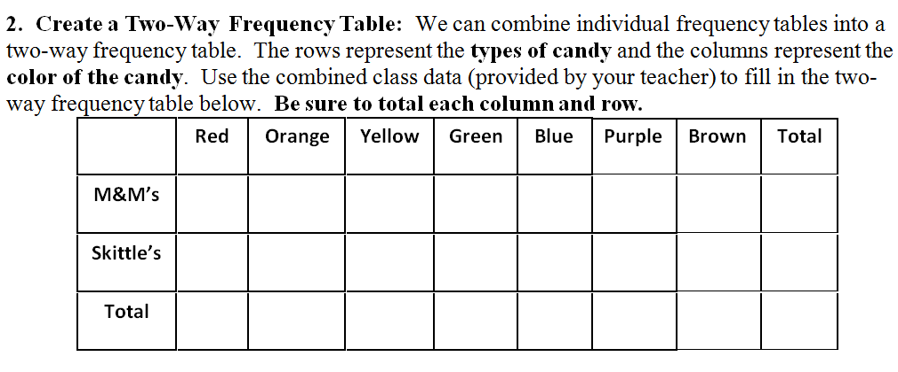
Whole Class Discussion
Complete As a Class- Part 2
Notes:
Facilitator notes
Time: 5 - 10 minutes
Handouts/participant activity: n/a
Focus points:
Participants will complete the activity sheet part 2 as if they were students. This will allow the participants to have an idea of the process and possible issues that may arise in their classroom when implementing the task.

Slide 25
Check Point
Checkpoint #1
Have you copied the data onto their Activity Sheets?
How do you find the probability of an event? The probability of an event = Number of ways the event can occur divided by the Number of possible outcomes. An example is:
What is the probability of choosing a blue candy =
Number of blue candies in the class sample / The total number of candies.
Notes:
Facilitator notes
Time: 1 - 2 minutes
Handouts/participant activity: n/a
Focus points:
During the lesson there are check points that the teacher will provide to make sure that all students are ready to move on to the next step. The first check point occurs after activity #2. Review the information in the slide for check point #1.

Slide 26
Vocabulary Review
Joint Frequency
Marginal Frequency
We read a two-way frequency table in a similar way as a regular frequency table. For example, the number of orange Skittles is listed where the “Orange” column and the “Skittles” row meet.
We can also find the total number of blue candies in the bag. We just look at the total of the “Blue” column.
Notes:
Facilitator notes
Time: 1 - 2 minutes
Handouts/participant activity: n/a
Focus points:
Even though the students will have had vocabulary front loading after activities after check point #1 this will be an opportunity to review 2 key academic vocabulary terms in the context of this task.

Slide 27
Pair Share
Notes:
Facilitator notes
Time: 5 - 10 minutes
Handouts/participant activity: n/a
Focus points:
Participants will complete the activity sheet part 3 as if they are students. This will allow the participants to have an idea of the process and possible issues that may arise in their classroom when implementing the task.

Slide 28
Check Point
Checkpoint #2
Check answers for Question 3 problems a through h.
Recall
Marginal probability is concerned with the probability that one characteristic occurs and is found using the numbers in the bottom row or right column in the numerator, and the table total in the denominator.
Joint probability addresses two characteristics occurring at the same time, and is found using the cells in the middle of the table in the numerator and the table total in the denominator.
Notes:
Facilitator notes
Time: 1 - 2 minutes
Handouts/participant activity: n/a
Focus points:
During the lesson there are check points that the teacher will provide to make sure that all students are ready to move on to the next step. The next check point occurs after activity #3. Review the information in the slide for check point #2.

Slide 29
Finding Conditional Probability with Counts:
Imagine that your friend chooses a candy piece from the class “mix”. She looks at it, tells you that it is red, but doesn’t tell you if it is an M&M or a Skittle.
Notes:
Facilitator notes
Time: 1 - 2 minutes
Handouts/participant activity: n/a
Focus points:
Students need to understand conditional probability in context. Teachers will pose this question to students to start the discussion.

Slide 30
Finding Conditional Probability with Counts:
Imagine that your friend chooses a candy piece from the class “mix”. She looks at it, tells you that it is red, but doesn’t tell you if it is an M&M or a Skittle.
Knowing that your friend has a red candy in her hand, we can find the probability that it is a red M&M. This is called the conditional probability of an event because we already know something (a condition) about the event in question.
Notes:
Facilitator notes
Time: 1 - 2 minutes
Handouts/participant activity: n/a
Focus points:
Students need to understand conditional probability in context. Teachers will continue the discussion by adding additional information.

Slide 31
Pair Share Continued
Notes:
Facilitator notes
Time: 5 - 10 minutes
Handouts/participant activity: n/a
Focus points:
Participants will complete the activity sheet part 4 as if they are students. This will allow the participants to have an idea of the process and possible issues that may arise in their classroom when implementing the task.

Slide 32
Pair Share Continued
Notes:
Facilitator notes
Time: 5 - 10 minutes
Handouts/participant activity: n/a
Focus points:
Participants will complete the activity sheet part 4 as if they are students. This will allow the participants to have an idea of the process and possible issues that may arise in their classroom when implementing the task.

Slide 33
Check Point
What is the answer was to problem 1 and then what does this tell us?
Follow this process for each problem
Do you know the likelihood that a candy is an M&M given that you know it is red (answer from Question 4, part b).
Compare this to the probability determined in Question 5, part d, the probability that a candy is a Skittle if it is red. What do you notice about these two probabilities?
“What is the probability of picking a green M&M given our data?” and “If we choose a Skittle, what is the probability that it would be yellow?”.
Notes:
Facilitator notes
Time: 1 - 2 minutes
Handouts/participant activity: n/a
Focus points:
During the lesson there are check points that the teacher will provide to make sure that all students are ready to move on to the next step. The final check point occurs after activity #5. Review the information in the slide for the final check point.

Slide 34
Planning and Time
Activities | Time | Notes
Preparation | 2 hours | Includes creating a pre-assessment, making copies, obtaining materials
Pre-lessons | 2 hours | Review of 7th and/or 8th grade SP standards
Vocabulary | 1 hour | Defining Conditional Probability, including joint and marginal frequency
Sweet Task-Lesson | 2 hours | Explanation and completion of work
Practice and Additional Tasks | 2 hours | Additional worksheets from the Sweet Task, Textbook practice, Illustrative Mathematics Tasks
Total Time | 9 hours
Notes:
Facilitator notes
Time: 1 - 2 minutes
Handouts/participant activity: n/a
Focus points:
Suggested pacing for this lesson

Slide 35
Textbook Connection Big Ideas
Conditional Probability Standards are not included in the Big Ideas Geometry textbook
Notes:
Facilitator notes
Time: 1-2 minutes
Handouts/participant activity: n/a
Focus points:
Connections to the Big Ideas textbook for this specific standard / concept. As a department we may want to review this as well to compare to the Sweet Task lesson.

Slide 36
Textbook Connection Spring Board
Lesson 41- Conditional Probability
Classwork Page 594 – 599 Problems 1 – 8
Homework Page 600 Problems 9 – 11
Classwork Page 601 – 603 Problems 1 – 3
Homework Page 600 Problems 9 - 11
Lesson 42- Conditional Probability
Classwork Page 613 – Activity 42
Notes:
Facilitator notes
Time: 1-2 minutes
Handouts/participant activity: n/a
Focus points:
Connections to the SpringBoard textbook for this specific standard / concept. As a department we may want to review this as well to compare to the Sweet Task lesson.

Slide 37
Textbook Connection CPM
Lesson 10.2.1
Lesson 10.2.2
Lesson 10.2.3
Notes:
Facilitator notes
Time: 1-2 minutes
Handouts/participant activity: n/a
Focus points:
Connections to the CPM textbook for this specific standard / concept. As a department we may want to review this as well to compare to the Sweet Task lesson.

Slide 38
Additional Resources
Illustrative Mathematics - www.illustrativemathematics.org
Two-Way Tables and Probability
The Titanic 1: S.CP.1,4, and 6
The Titanic II: S.CP.2-6
Fred's Factory
But Mango is My Favorite…
Khan Academy - www.khanacademy.org
Engage NY Common Core Curriculum
Algebra II Module 4
https://www.engageny.org/resource/algebra-ii-module-4-topic-a-lesson-3-0
7th Grade Standards
Engage NY Common Core Curriculum
Module 5 – Statistics and Probability
Notes:
Facilitator notes
Time: 3 - 4 minutes
Handouts/participant activity: n/a
Focus points:
This is a list of additional resources surrounding the standards that may be used. If time permits, as a department, explore these sites.

Slide 39
Need Help?
Contact your
Secondary Math Coordinator

