Slide 1
Algebra 1 - Statistics: Bivariate & Categorical Data Unit 3
Notes:
Facilitator notes
Time: n/a
Handouts/participant activity: n/a
Focus points:
Title Page

Slide 2
Purpose
Provided is a lesson for teachers to use to help students understand and analyze bivariate data. Included are the following:
Standards
Statistics and Probability Learning Progression
Lesson Agenda
Getting Ready for the Lesson (Resources and Tips)
Vocabulary Activities
Lesson
(Presentation and Video)
Textbook Connections
Additional Resources
Notes:
Facilitator notes
Time: 2-3 minutes
Handouts/participant activity: n/a
Focus points:
Review the components that this PD provides:
Standards
Learning Progressions
Lesson Agenda
Resources & Tips
Vocabulary Activities
Lesson
Textbook Connections
Additional Resources

Slide 3
Common Core Standards
S-ID.5. Summarize categorical data for two categories in two-way frequency tables. Interpret relative frequencies in the context of the data. Recognize possible associations and trends in the data.
(Understand, 2) (Analyze, 2) (Analyze, 3)
Notes:
Facilitator notes
Time: 2-3 minutes
Handouts/participant activity: n/a
Focus points:
Identifying the standards for lesson and unwrapping them.

Slide 4
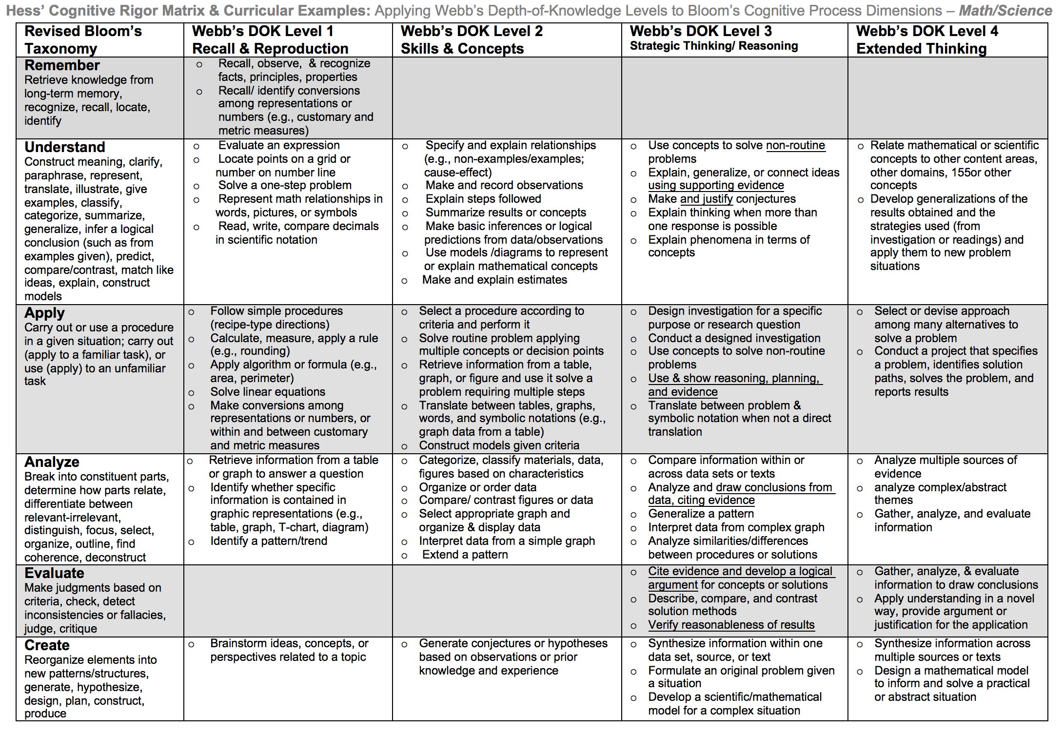
Notes:
Facilitator notes
Time: 2-3 minutes
Handouts/participant activity: n/a
Focus points:
Yellow, Red, & Green circles indicate the appropriate levels of DOK as required by the standards
The Blue circles fill in the instructional paths needed to assist students in reaching those DOK levels.

Slide 5
Math Practices
MP1
Make sense of problems and persevere in solving them.
MP2
Reason abstractly and quantitatively.
Notes:
Facilitator notes
Time: 1-2 minutes
Handouts/participant activity: n/a
Focus points:
Review the math practices associated with the lesson being presented.

Slide 6
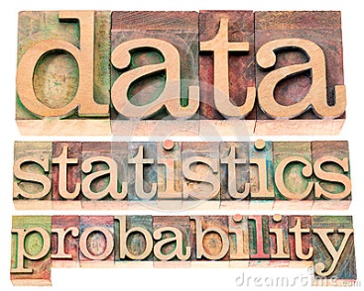
Statistics & Probability Prerequisite Skills: CC Math 8
http://commoncoretools.me/wp-content/uploads/2012/06/ccss_progression_sp_hs_2012_04_21_bis.pdf
Notes:
Facilitator notes
Time: 2-3 minutes
Handouts/participant activity: n/a
Focus points:
The CA Framework also describes how students may accelerate to prepare for higher mathematics courses by compacting courses (animate circles around “compacted” and “accelerated”).
Compacting means to compress content, which may entail the teacher and students working at a faster pace to complete the content. There is no skipping of standards within the compacted courses to accelerate to higher mathematics courses.
By compacting courses in the middle school grades, students can be allowed to enter Geometry by the time they enter high school.
With the California standards, student would simply skip course to get ahead. With the Common Core standards, students can still get ahead, but can no longer skip courses or rather standards. Therefore they must move at a faster pace.

Slide 7
Middle School Focus
Grade 6
Develop understanding of statistical variability.
Summarize and describe distributions.
Grade 7
Use random sampling to draw inferences about a population.
Draw informal comparative inferences about two populations.
Investigate chance processes and develop, use, and evaluate probability models.
Grade 8
Investigate patterns of association in bivariate data.
Source: California Framework
Notes:
Facilitator notes
Time: 2-3 minutes
Handouts/participant activity: n/a
Focus points:
What are those standards that you must focus on and which ones are not part of your course with the new shifts in standard under common core?
Grade 6
Develop understanding of statistical variability.
Summarize and describe distributions.
Grade 7
Use random sampling to draw inferences about a population.
Draw informal comparative inferences about two populations.
Investigate chance processes and develop, use, and evaluate probability models.
Grade 8
Investigate patterns of association in bivariate data.
Let the participants know that they will use this handout in a later activity.

Slide 8
High School Focus
Algebra I
Summarize, represent, and interpret data on a single count or measurement variable.
Summarize, represent, and interpret data on two categorical and quantitative variables.
Interpret linear models.
Geometry
Conditional Probability and the Rules of Probability
Understand independence and conditional probability and use them to interpret data.
Use the rules of probability to compute probabilities of compound events in a uniform probability model.
Using Probability to Make Decisions Use probability to evaluate outcomes of decisions
Algebra II
Interpreting Categorical and Quantitative Data Summarize, represent, and interpret data on a single count or measurement variable.
Making Inferences and Justifying Conclusions Understand and evaluate random processes underlying statistical experiments.
Make inferences and justify conclusions from sample surveys, experiments, and observational studies.
Using Probability to Make Decisions Use probability to evaluate outcomes of decisions.
Source: California Framework
Notes:
Facilitator notes
Time: 2-3 minutes
Handouts/participant activity: n/a
Focus points:
What are those standards that you must focus on and which ones are not part of your course with the new shifts in standard under common core?
Algebra I
Summarize, represent, and interpret data on a single count or measurement variable.
Summarize, represent, and interpret data on two categorical and quantitative variables.
Interpret linear models.
Geometry
Conditional Probability and the Rules of Probability
Understand independence and conditional probability and use them to interpret data.
Use the rules of probability to compute probabilities of compound events in a uniform probability model.
Using Probability to Make Decisions Use probability to evaluate outcomes of decisions
Algebra II
Interpreting Categorical and Quantitative Data Summarize, represent, and interpret data on a single count or measurement variable.
Making Inferences and Justifying Conclusions Understand and evaluate random processes underlying statistical experiments.
Make inferences and justify conclusions from sample surveys, experiments, and observational studies.
Using Probability to Make Decisions Use probability to evaluate outcomes of decisions.

Slide 9
Learning Progression: HS Statistics & Probability
http://commoncoretools.me/wp-content/uploads/2012/06/ccss_progression_sp_hs_2012_04_21_bis.pdf
Notes:
Facilitator notes
Time: 2-3 minutes
Handouts/participant activity: n/a
Focus points:
Let’s take closer look at the California Department of Education’s description of the CC Math 8 course.
Read the highlighted portion
The state framework shows the importance of the Grade 8 Math Course and how it has became the new gateway course for higher level math, as well as how Algebra 1 had shifted to high school.

Slide 10
Lesson Agenda
Vocabulary
Video: Calculate conditional probabilities for bivariate categorical data by using two-way tables
Lesson: M&M Task
Textbook Connections
Notes:
Facilitator notes
Time: 2-3 minutes
Handouts/participant activity: n/a
Focus points:
Review the lesson agenda prior to implementation

Slide 11
Sweet Success
Planning for Instruction with Analysis of Bivariate Data
Notes:
Facilitator notes
Time: 1 minute
Handouts/participant activity: n/a
Focus points:
Title Page for lesson

Slide 12
Getting Ready
Pre-assessment- used to determine understanding of prerequisite skills
Prerequisite skills include
7 SP 1 – 8
Use random sampling to draw inferences about a population.
Draw informal comparative inferences about two populations.
Investigate chance processes and develop, use, and evaluate probability models.
8 SP 1 - 4
Investigate patterns of association in bivariate data.
Notes:
Facilitator notes
Time: 2-3 minutes
Handouts/participant activity: n/a
Focus points:
Review what standards should be covered in a pre-assessment activity. This shows what students should have already learned prior to your course. Using a pre-assessment activity will assist students in frontloading prior knowledge before beginning new learning.

Slide 13
Misconceptions and Anticipated Issues
Common Issues
Suggested Strategies/Resources
Using the wrong total from the frequency table
Misunderstanding between the connection of joint frequency, marginal frequency, conditional relative frequency
Finding the wrong probability
Incorrect calculations when dividing and dividing the wrong values
Not able to read the symbol for conditional probability
Use the additional practice worksheets from learnzilllion lesson
Use more than 1 vocabulary organizer to address key vocabulary
Have students use manipulatives, such as the cups in the task to correctly identify the sample being used and use additional worksheets from learnzillion lesson
Allow students to use a calculator
Review notation during the lesson
Notes:
Facilitator notes
Time: 2-3 minutes
Handouts/participant activity: n/a
Focus points:
These are guided questions to improve our students’ learning when misconceptions may occur.

Slide 14
Required Resources
Materials Required
Special Materials:
6 cups (clear is preferable) per group
1 regular serving size bag of candy-coated milk chocolates for each group
1 regular serving size bag of candy-coated chocolates with peanuts for each group OR
1 bag per group of candy-coated milk chocolates manipulatives cut and assembled in a baggie
1 bag per group of candy-coated milk chocolates with peanuts manipulatives cut and assembled in a baggie (use standard cut-outs on colored paper to differentiate)
Handouts:
Learnzillion presentation handouts
Learnzillion additional worksheets
https://learnzillion.com/lesson_plans/1030
Notes:
Facilitator notes
Time: 2-3 minutes
Handouts/participant activity: n/a
Focus points:
Review the list of resources needed for the lesson and where to find materials online.

Slide 15
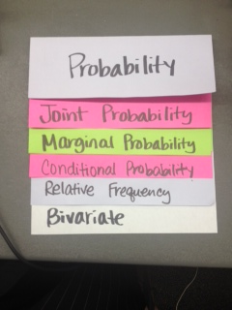
Needed Vocabulary
Probability
Marginal Probability
Joint Probability
Bivariate
Conditional Probability
Two-Way Table
Relative Probability
Or you could use: Word Map, Frayer Model, etc.
Layered Book Example
Notes:
Facilitator notes
Time: 4-5 minutes
Handouts/participant activity: n/a
Focus points:
This shows a list of required academic language vocabulary that is needed for the lesson. In addition, a strategy, “Layered Book” is shown with the suggestion that there are alternative strategies that can be used as well.

Slide 16
Learnzillion
For this lesson you need to create an account to access the handouts from Learnzillion.
This is a free account and you will have access to many more lessons.
Notes:
Facilitator notes
Time: 4-5 minutes
Handouts/participant activity: n/a
Focus points:
This is an introduction to the Learnzillion.com website where today’s lesson was pulled from. Teachers can sign up for a free account and have full access.

Slide 17
Calculate conditional probabilities for bivariate categorical data by using two-way tables
https://learnzillion.com/lesson_plans/1030
Notes:
Facilitator notes
Time: 15 - 20 minutes
Handouts/participant activity: n/a
Focus points:
Click on the hyper link to take you to the lesson. Lesson includes: PowerPoint, Video, and handouts. As a department, we will explore this resources together

Slide 18
Planning and Time
Activities | Time | Notes
Preparation | 2 hours | Includes creating a pre-assessment, making copies, obtaining materials
Pre-lessons | 2 hours | Review of 7th and/or 8th grade SP standards
Vocabulary | 1 hour | Defining Conditional Probability, including joint and marginal frequency
M&M Task-Lesson | 2 hours | Explanation and completion of work
Practice and Additional Tasks | 2 hours | Additional worksheets from LearnZillion, Textbook practice, Illustrative Mathematics Tasks
Total Time | 10 hours
Notes:
Facilitator notes
Time: 1 - 2 minutes
Handouts/participant activity: n/a
Focus points:
Suggested pacing for this lesson

Slide 19
Textbook Connection Big Ideas
Textbook Algebra 1 Section 11.4
Classwork: Page 609-613 problems 1 – 5
Homework: Page 614-616 problems 1 - 32
Extra Practice: Algebra 1 Resources by Chapter Section 10.3
Practice A and B page 405 - 407
Enrichment and Extension page 407 - 408
Puzzle Time Page 408
Student Journal Algebra 1 Section 11.4
Two-Way Tables and Probability Page 344 - 348
Assessment Book Algebra 1 Section 10.3
Page 145 - 147
Notes:
Facilitator notes
Time: 1-2 minutes
Handouts/participant activity: n/a
Focus points:
Connections to the Big Ideas textbook for this specific standard / concept. As a department we may want to review this as well to compare to the Learnzillion lesson.

Slide 20
Textbook Connection Spring Board
Lesson 40-1 Bivariate Data
Classwork Page 595 – 598 Problems 1 – 7
Homework Page 600 Problems 12 - 15
Notes:
Facilitator notes
Time: 1-2 minutes
Handouts/participant activity: n/a
Focus points:
Connections to the SpringBoard textbook for this specific standard / concept. As a department we may want to review this as well to compare to the Learnzillion lesson.

Slide 21
Textbook Connection CPM
S-ID 5 is not in CPM
Notes:
Facilitator notes
Time: 1-2 minutes
Handouts/participant activity: n/a
Focus points:
Connections to the CPM textbook for this specific standard / concept. Please note, CPM does not address this standard. This is when a resource such as Learnzillion comes in handy.

Slide 22
Additional Resources
Illustrative Mathematics - www.illustrativemathematics.com
Two-Way Tables and Probability
The Titanic 1: S.CP.1,4, and 6
The Titanic II: S.CP.2-6
Fred's Factory
But Mango is My Favorite…
Khan Academy - www.khanacademy.org
Engage NY Common Core Curriculum
Algebra II Module 4
https://www.engageny.org/resource/algebra-ii-module-4-topic-a-lesson-3-0
7th Grade Standards
Engage NY Common Core Curriculum
Module 5 – Statistics and Probability
Notes:
Facilitator notes
Time: 3 - 4 minutes
Handouts/participant activity: n/a
Focus points:
This is a list of additional resources surrounding the standards that may be used. If time permits, as a department, explore these sites.

Slide 23
Need Help?
Contact your
Secondary Math Coordinator

