Slide 1
Algebra 1 - Functions: Interpret & Building Functions Unit 5
Notes:
Facilitator notes
Time: n/a
Handouts/participant activity: n/a
Focus points:
Title Page

Slide 2
Purpose
Provided is a lesson for teachers to use to help students understand and analyze bivariate data. Included are the following:
Standards
Statistics and Probability Learning Progression
Lesson Agenda
Getting Ready for the Lesson (Resources and Tips)
Vocabulary Activities
Lesson
(Online and Interactive)
Textbook Connections
Additional Resources
Notes:
Facilitator notes
Time: 2-3 minutes
Handouts/participant activity: n/a
Focus points:
Review the components that this PD provides:
Standards
Learning Progressions
Lesson Agenda
Resources & Tips
Vocabulary Activities
Lesson
Textbook Connections
Additional Resources

Slide 3
Common Core Standards
F.IF.4 For a function that models a relationship between two quantities, interpret key features of graphs and tables in terms of the quantities, and sketch graphs showing key features given a verbal description of the relationship.
F.IF.5 Relate the domain of a function to its graph and, where applicable, to the quantitative relationship it describes.
(Analyze, 2) (Understand, 2) (Apply, 2)
Notes:
Facilitator notes
Time: 2-3 minutes
Handouts/participant activity: n/a
Focus points:
Identifying the standards for lesson and unwrapping them.

Slide 4
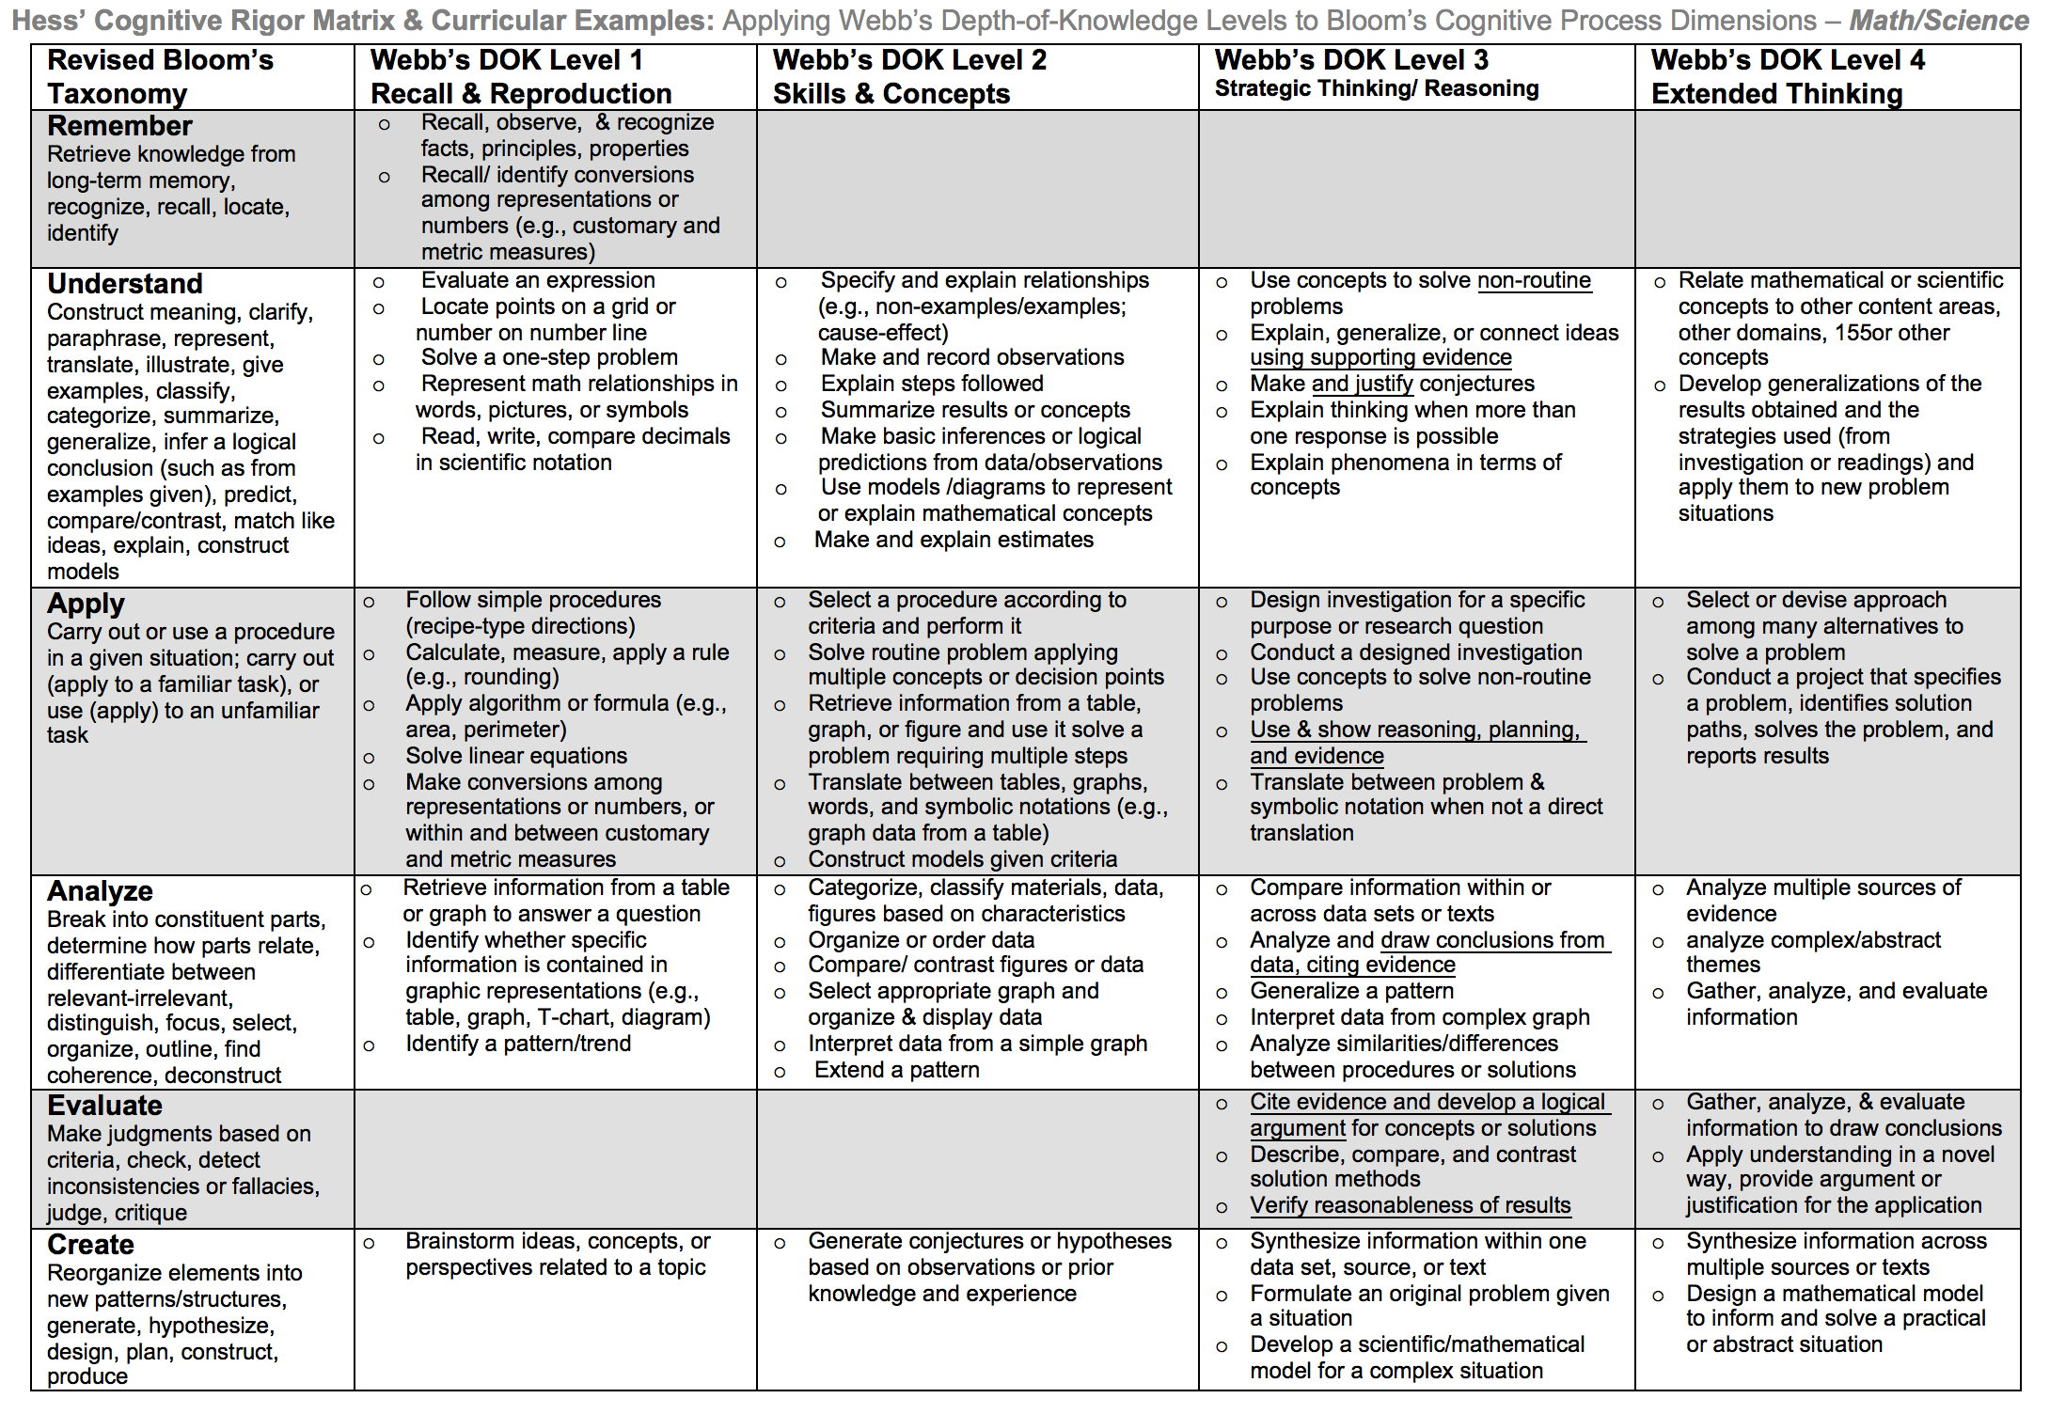
Notes:
Facilitator notes
Time: 2-3 minutes
Handouts/participant activity: n/a
Focus points:
Yellow, Red, & Green circles indicate the appropriate levels of DOK as required by the standards
The Blue circles fill in the instructional paths needed to assist students in reaching those DOK levels.

Slide 5
Math Practices
MP1
Make sense of problems and persevere in solving them.
MP3
Construct viable arguments & critique the reasoning of others.
MP4
Model with mathematics
MP5
Use appropriate tools strategically
Notes:
Facilitator notes
Time: 1-2 minutes
Handouts/participant activity: n/a
Focus points:
Review the math practices associated with the lesson being presented.

Slide 6
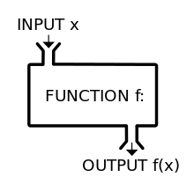
Functions Prerequisite Skills: CC Math 8
http://commoncoretools.me/wp-content/uploads/2013/07/ccss_progression_functions_2013_07_02.pdf
Notes:
Facilitator notes
Time: 2-3 minutes
Handouts/participant activity: n/a
Focus points:
The CA Framework also describes how students may accelerate to prepare for higher mathematics courses by compacting courses (animate circles around “compacted” and “accelerated”).
Compacting means to compress content, which may entail the teacher and students working at a faster pace to complete the content. There is no skipping of standards within the compacted courses to accelerate to higher mathematics courses.
By compacting courses in the middle school grades, students can be allowed to enter Geometry by the time they enter high school.
With the California standards, student would simply skip course to get ahead. With the Common Core standards, students can still get ahead, but can no longer skip courses or rather standards. Therefore they must move at a faster pace.

Slide 7
Middle School Focus
Grade 6
Understand ratio concepts and use ratio reasoning to solve problems
Grade 7
Analyze proportional relationships and use them to solve real-world and mathematical problems
Grade 8
Understand the connections between proportional relationships, lines, and linear equations.
Source: California Framework
Notes:
Facilitator notes
Time: 2-3 minutes
Handouts/participant activity: n/a
Focus points:
What are those standards that you must focus on and which ones are not part of your course with the new shifts in standard under common core?
Grade 6
Understand ratio concepts and use ratio reasoning to solve problems
Grade 7
Analyze proportional relationships and use them to solve real-world and mathematical problems
Grade 8
Understand the connections between proportional relationships, lines, and linear equations.
Let the participants know that they will use this handout in a later activity.

Slide 8
High School Focus
Algebra I
Interpret functions that arise in applications in terms of a context
Analyze functions using different representations.
Build a function that models a relationship between two quantities.
Build new functions from existing functions
Construct and compare linear, quadratic, and exponential models and solve problems
Interpret expressions for functions in terms of the situation they mode.
Geometry
Use coordinates to prove simple geometric theorems algebraically
Algebra II
Interpret functions that arise in applications in terms of a context
Analyze functions using different representations.
Build a function that models a relationship between two quantities.
Build new functions from existing functions
Construct and compare linear, quadratic, and exponential models and solve problems
Source: California Framework
Notes:
Facilitator notes
Time: 2-3 minutes
Handouts/participant activity: n/a
Focus points:
What are those standards that you must focus on and which ones are not part of your course with the new shifts in standard under common core?
Algebra I
Interpret functions that arise in applications in terms of a context
Analyze functions using different representations.
Build a function that models a relationship between two quantities.
Build new functions from existing functions
Construct and compare linear, quadratic, and exponential models and solve problems
Interpret expressions for functions in terms of the situation they mode.
Geometry
Use coordinates to prove simple geometric theorems algebraically
Algebra II
Interpret functions that arise in applications in terms of a context
Analyze functions using different representations.
Build a function that models a relationship between two quantities.
Build new functions from existing functions
Construct and compare linear, quadratic, and exponential models and solve problems

Slide 9
Learning Progression: HS Functions
http://commoncoretools.me/wp-content/uploads/2013/07/ccss_progression_functions_2013_07_02.pdf
Notes:
Facilitator notes
Time: 2-3 minutes
Handouts/participant activity: n/a
Focus points:
Let’s take closer look at the California Department of Education’s description of the CC Math 8 course.
Read the highlighted portion
The state framework shows the importance of the Grade 8 Math Course and how it has became the new gateway course for higher level math, as well as how Algebra 1 had shifted to high school.

Slide 10
Lesson Agenda
Vocabulary
Lesson: Incline Interactive Tool
Textbook Connections
Notes:
Facilitator notes
Time: 2-3 minutes
Handouts/participant activity: n/a
Focus points:
Review the lesson agenda prior to implementation

Slide 11
Motor Cross Incline
Planning for Instruction with Interpreting Functions
Notes:
Facilitator notes
Time: 1 minute
Handouts/participant activity: n/a
Focus points:
Title Page for lesson

Slide 12
Getting Ready
Pre-assessment- used to determine understanding of prerequisite skills
Prerequisite skills include
7 RP 1 – 3
Analyze Proportional Relationships.
Solve Real World Mathematical Problems.
8 F 1 – 3
Define, Evaluate and Compare Functions
Notes:
Facilitator notes
Time: 2-3 minutes
Handouts/participant activity: n/a
Focus points:
Review what standards should be covered in a pre-assessment activity. This shows what students should have already learned prior to your course. Using a pre-assessment activity will assist students in frontloading prior knowledge before beginning new learning.

Slide 13
Misconceptions and Anticipated Issues
Common Issues
Suggested Strategies/Resources
Students may assume that all linear graphs go through the origin.
How movement of real-life objects affect function representation.
What distinguishing characteristics do you notice in the graphs? tables? equations?
How do these help you?
How do each of the representations compare to each other?
How can you represent your ideas so that everyone can understand them?
Notes:
Facilitator notes
Time: 2-3 minutes
Handouts/participant activity: n/a
Focus points:
These are guided questions to improve our students’ learning when misconceptions may occur.

Slide 14
Required Resources
Materials Required
Special Materials:
Access to the Internet
http://www.shodor.org/interactivate/activities/Incline/
Handouts from Website:
Exploration Questions
Activity Function Flyer
Activity Function Machine
Activity Linear Function Machine
Activity Positive Linear Function Machine
Discussion about Independent and Dependent Variables
Worksheet Incline Exploration Questions
Notes:
Facilitator notes
Time: 2-3 minutes
Handouts/participant activity: n/a
Focus points:
Review the list of resources needed for the lesson and where to find materials online.

Slide 15
Needed Vocabulary
Function
Rate of Change
Independent Variables
Linear
Dependent Variables
Quadratic
Exponential
Or you could use: Word Map, Layered Book, etc.
Frayer’s Model
Notes:
Facilitator notes
Time: 4-5 minutes
Handouts/participant activity: n/a
Focus points:
This shows a list of required academic language vocabulary that is needed for the lesson. In addition, a strategy, “Layered Book” is shown with the suggestion that there are alternative strategies that can be used as well.

Slide 16
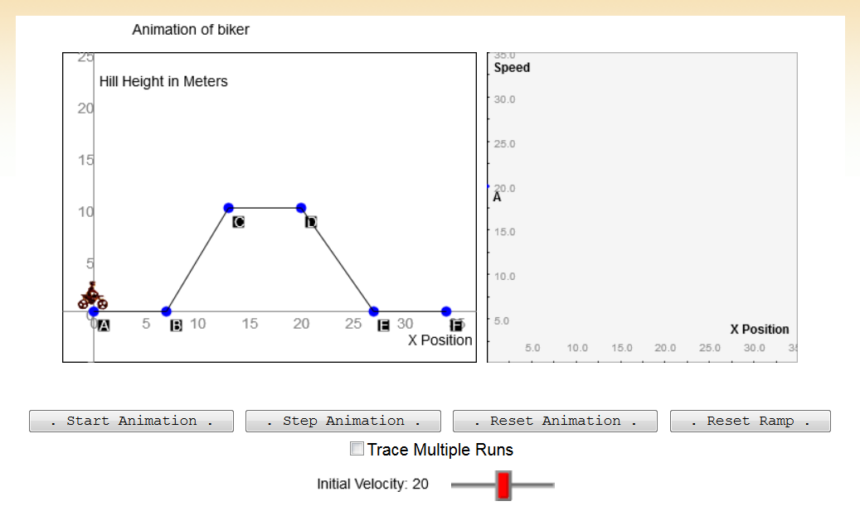
Demonstrating the relationship between dependent and independent variables
http://www.shodor.org/interactivate/activities/Incline/
Notes:
Facilitator notes
Time: 15 - 20 minutes
Handouts/participant activity: n/a
Focus points:
Click on the hyper link to take you to the lesson. Lesson includes: PowerPoint, Video, and handouts. As a department, we will explore this resources together

Slide 17
Planning and Time
Activities | Time | Notes
Preparation | 1 hours | Includes creating a pre-assessment, making copies, obtaining materials
Pre-lessons | 30 min | Review of 7th and/or 8th grade SP standards
Vocabulary | 1 hour | Defining Function, Rate of Change, Independent & Dependent Variable
Motor Cross Incline | 2 hours | Interactive Activity
Practice and Additional Tasks | 2 hours | Additional worksheets from shodor.org
Total Time | 6.5 hours
Notes:
Facilitator notes
Time: 1 - 2 minutes
Handouts/participant activity: n/a
Focus points:
Suggested pacing for this lesson

Slide 18
Textbook Connection Big Ideas
Lessons:
3.2 Linear Functions
3.5 Graphing Linear Equations in Slope-Intercept Form
6.3 Exponential Functions
8.4 Graphing
8.5 Using Intercept Form
9.2 Solving Quadratic Equations by Graphing
10.1 Graphing Square Root Functions
10.2 Graphing Cube Root Functions
Notes:
Facilitator notes
Time: 1-2 minutes
Handouts/participant activity: n/a
Focus points:
Connections to the Big Ideas textbook for this specific standard / concept. As a department we may want to review this as well to compare to the Learnzillion lesson.

Slide 19
Textbook Connection Spring Board
Lessons:
7-1 The Spring Experiment
7-2 The Falling Object Experiment
7-3 The Radioactive Decay Experiment
11-1 Identifying Arithmetic Sequence
11-2 Point-Slope From
11-3 Standard Form
11-4 Recursive Formulas
29-1 Modeling with a Quadratic Functions
29-2 Graphing and Analyzing a Quadratic Function
30-1 Translations of the Quadratic parent Functions
30-2 Stretching and Shrinking the Quadratic Parent Function
30-3 Multiple Transformation of the Quadratic Parent Function
33-1 Fitting Data with a Quadratic Function
33-2 Interpreting Solutions of Quadratic Equations
Notes:
Facilitator notes
Time: 1-2 minutes
Handouts/participant activity: n/a
Focus points:
Connections to the SpringBoard textbook for this specific standard / concept. As a department we may want to review this as well to compare to the Learnzillion lesson.

Slide 20
Textbook Connection CPM
Lessons:
1.1.3, 1.2.1, 1.2.4-1.2.5
2.1.3–2.2.3
7.1.1, 7.1.5-7.2.1
8.2.1, 8.2.3, 8.2.4
11.3.2-11.3.4, 11.3.5
Notes:
Facilitator notes
Time: 1-2 minutes
Handouts/participant activity: n/a
Focus points:
Connections to the CPM textbook for this specific standard / concept. Please note, CPM does not address this standard. This is when a resource such as Learnzillion comes in handy.

Slide 21
Additional Resources
Illustrative Mathematics - www.illustrativemathematics.com
Influenza Epidemic
Warming and Cooling
How is the Weather?
Logistic Growth Model, Explicit Version
The Canoe Trip, Variation 1
The High School Gym
Temperature Change
Average Cost
Khan Academy - www.khanacademy.org
Engage NY Common Core Curriculum
Math Assessment Project – map.mathshell.org
Notes:
Facilitator notes
Time: 3 - 4 minutes
Handouts/participant activity: n/a
Focus points:
This is a list of additional resources surrounding the standards that may be used. If time permits, as a department, explore these sites.

Slide 22
Need Help?
Contact your
Secondary Math Coordinator

