Slide 1
Algebra 2 – Trig Function Unit Circle Unit 4

Slide 2
Purpose
Provided is a lesson for teachers to use to help students understand unit circle and how it extends to trigonometric functions. Included are the following:
Standards
Learning Progression
Lesson Agenda
Getting Ready for the Lesson (Resources and Tips)
Vocabulary Activities
Lesson
(Presentation and Video)
Textbook Connections
Additional Resources
Notes:
Facilitator notes
Time: 2-3 minutes
Handouts/participant activity: n/a
Focus points:
Review the components that this PD provides:
Standards
Learning Progressions
Lesson Agenda
Resources & Tips
Vocabulary Activities
Lesson
Textbook Connections
Additional Resources

Slide 3
Common Core Standards
F-TF.2
Explain how the unit circle in the coordinate plane enables the extension of trigonometric functions to all real numbers, interpreted as radian measures of angles traversed counterclockwise around the unit circle.
(Understand, 2) (Analyze, 2)
Notes:
Facilitator notes
Time: 2-3 minutes
Handouts/participant activity: n/a
Focus points:
Identifying the standards for lesson and unwrapping them.

Slide 4
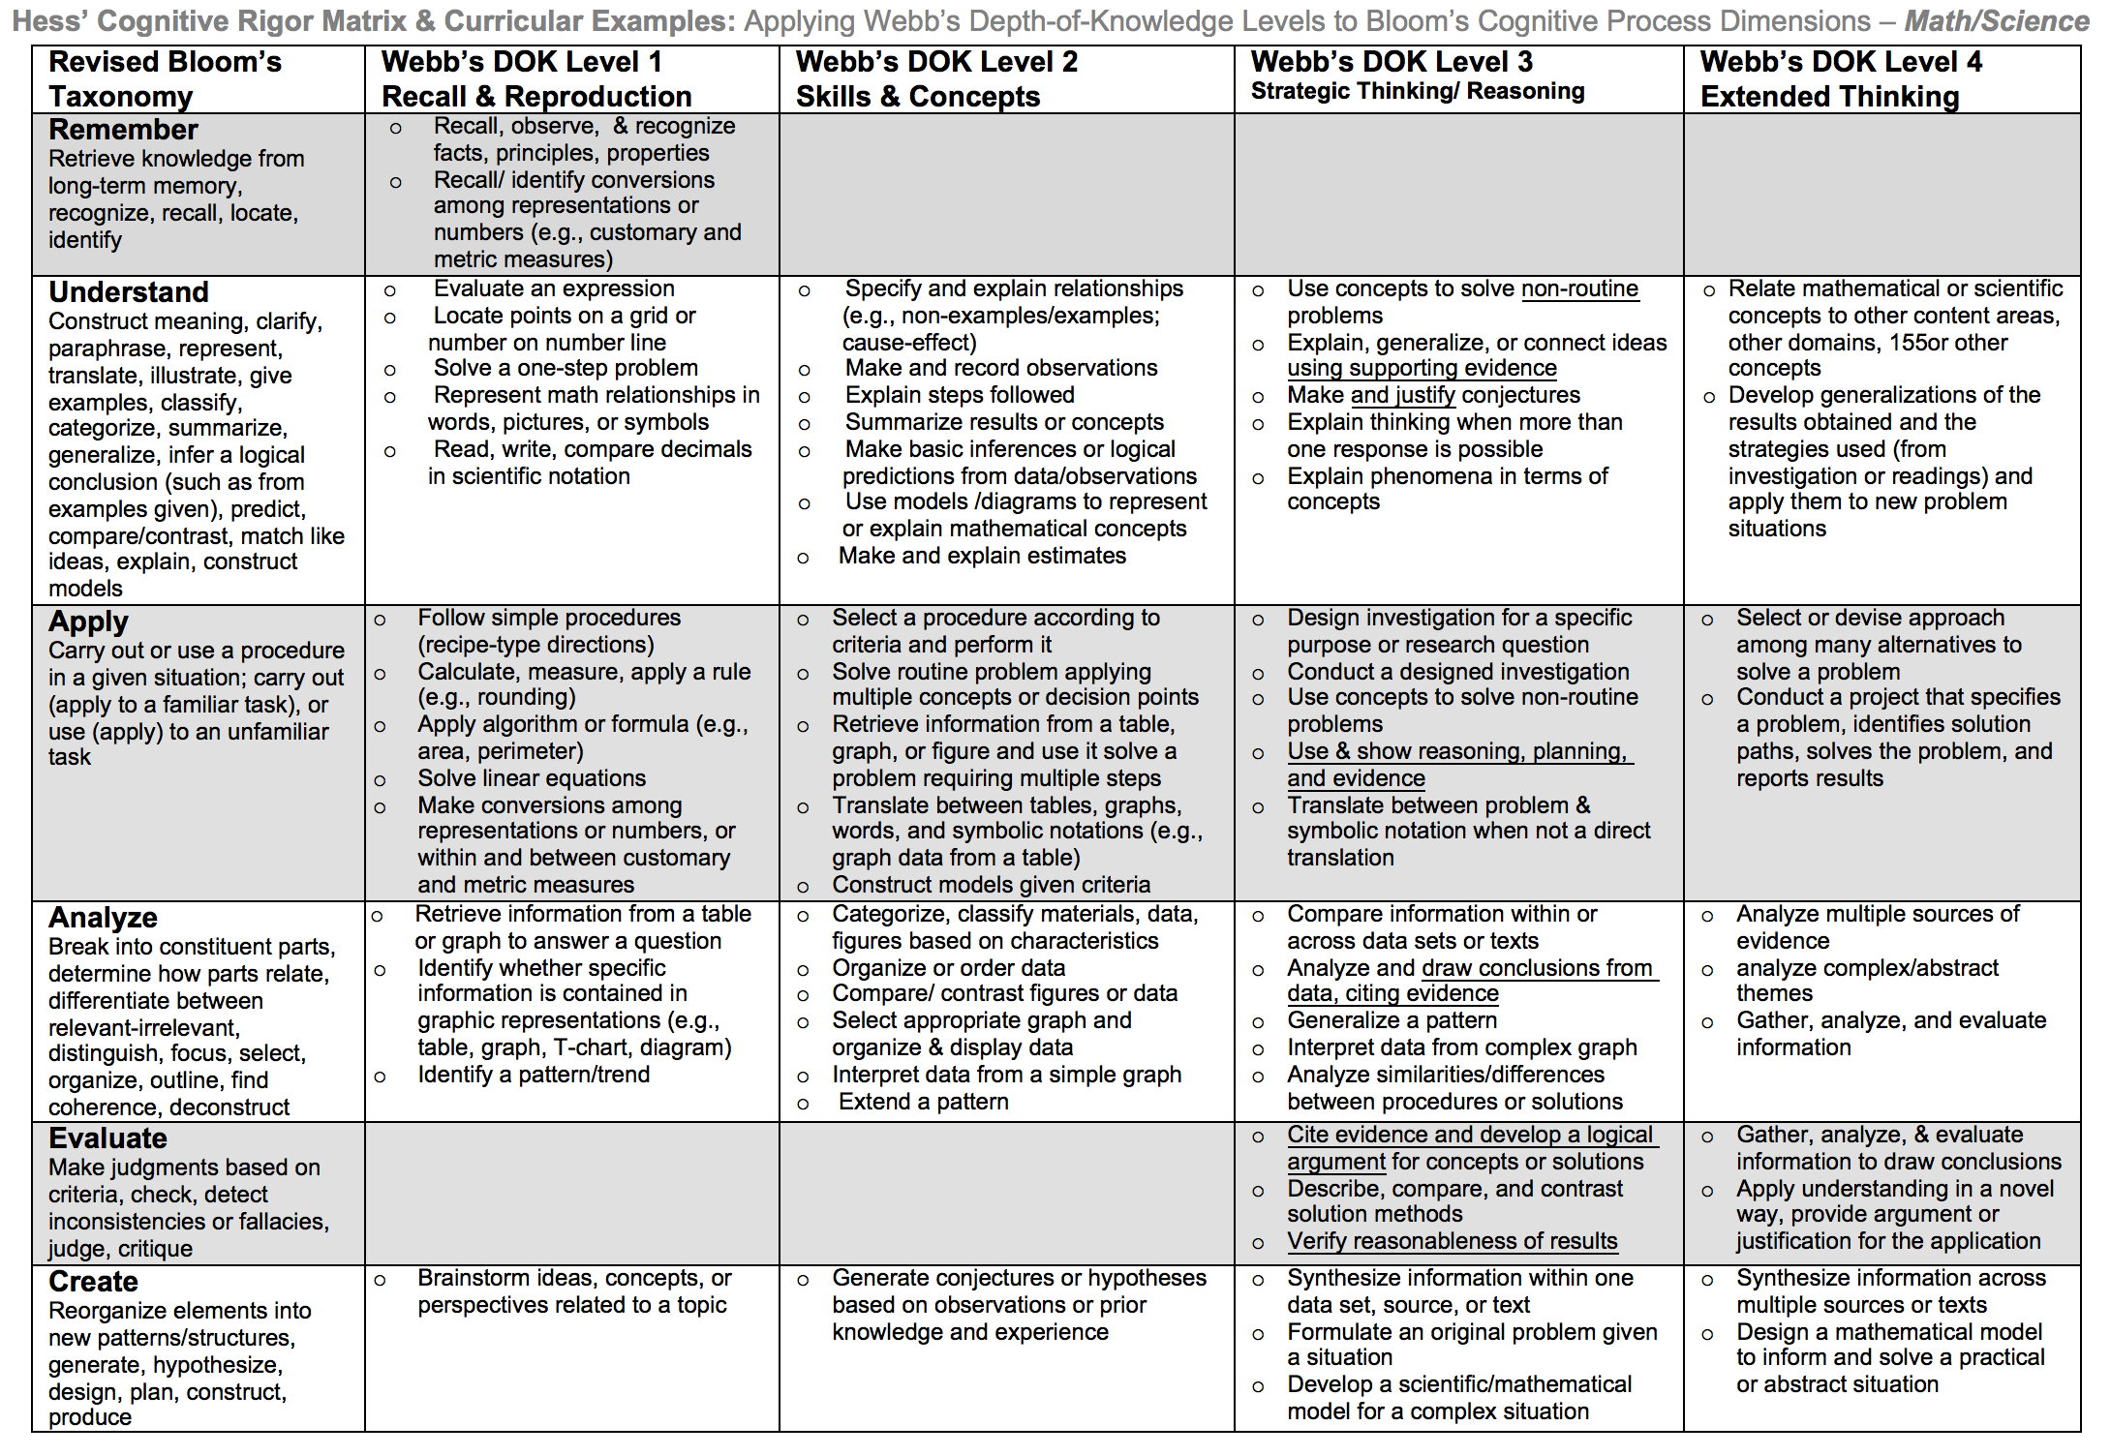
Notes:
Facilitator notes
Time: 2-3 minutes
Handouts/participant activity: n/a
Focus points:
Green & Blue circles indicate the appropriate levels of DOK as required by the standards
The Red circles fill in the instructional paths needed to assist students in reaching those DOK levels.

Slide 5
Math Practices
MP4
Model with mathematics
MP6
Attend to precision
Notes:
Facilitator notes
Time: 1-2 minutes
Handouts/participant activity: n/a
Focus points:
Review the math practices associated with the lesson being presented

Slide 6
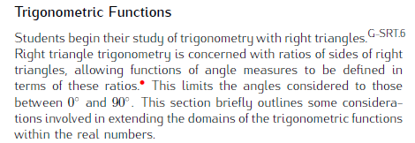
Trig Functions Prerequisite Skills: CC Geometry
http://commoncoretools.me/wp-content/uploads/2012/06/ccss_progression_sp_hs_2012_04_21_bis.pdf
Notes:
Focus points:
The CA Framework also describes how students may accelerate to prepare for higher mathematics courses by compacting courses (animate circles around “compacted” and “accelerated”).
Compacting means to compress content, which may entail the teacher and students working at a faster pace to complete the content. There is no skipping of standards within the compacted courses to accelerate to higher mathematics courses.
By compacting courses in the middle school grades, students can be allowed to enter Geometry by the time they enter high school.
With the California standards, student would simply skip course to get ahead. With the Common Core standards, students can still get ahead, but can no longer skip courses or rather standards. Therefore they must move at a faster pace.

Slide 7
Middle School Focus
Grade 6
Understand ratios and describe ratio relationships
Grade 7
Graph and compare proportional relationships
Grade 8
Use the Pythagorean Theorem to find missing measures in two dimensions and find the distance between two points in the coordinate plane
Source: California Framework
Notes:
2 – 3 minutes
Facilitator’s Notes:
What are those standards that you must focus on and which ones are not part of your course with the new shifts in standard under common core?
Grade 6
Develop understanding of ratio and its relationship
Grade 7
Graph and Compare proportional relationships
Grade 8
Use Pythagorean Theorem and find the distance between two points in the coordinate plane.
Let the participants know that they will use this handout in a later activity.

Slide 8
High School Focus
Algebra 1
Use function notation to evaluate and interpret functions.
Geometry
Concept of Circles and Triangles
Algebra 2
Find unknown side lengths and angle measures of right triangles
Use factoring to solve real-life problems
Translate, reflect, stretch, and shrink the graphs of linear functions
Explore inverses of functions
Evaluate trigonometric functions of any angle
Use sum and difference formulas to evaluate and simplify trigonometric expressions and to solve trigonometric equations
Write and graph trigonometric functions; transform the graphs of sine and cosine functions
Verify and use trigonometric identities
Understanding of right triangles
Understanding of similarity
Source: California Framework
Notes:
2 – 3 minutes
Facilitator’s Notes:
What are those standards that you must focus on and which ones are not part of your course with the new shifts in standard under common core?
Algebra 1
Develop understanding of function
Geometry
Understand the concept of circle and right triangles.
Algebra 2
Evaluate trigonometric function of any angle. Write and graph trig functions.
Let the participants know that they will use this handout in a later activity.

Slide 9
Learning Progression: Trig Function
http://commoncoretools.me/wp-content/uploads/2012/06/ccss_progression_sp_hs_2012_04_21_bis.pdf
Notes:
Focus points:
Let’s take closer look at the California Department of Education’s description of trig functions.

Slide 10
Lesson Agenda
Vocabulary
Video
Lesson: Describe the features of the graphs of sine and cosine by using the unit circle
Textbook Connections
Notes:
Facilitator notes
Time: 2-3 minutes
Handouts/participant activity: n/a
Focus points:
Review the lesson agenda prior to implementation

Slide 11
Trig Function-Unit Circle
Planning for Instruction with understanding Trig Functions using Unit Circles
Notes:
Facilitator notes
Time: 1 minute
Handouts/participant activity: n/a
Focus points:
Title Page for lesson

Slide 12
Getting Ready
Pre-assessment- used to determine understanding of prerequisite skills
Prerequisite skills include
F.BF.3
Identify the effect on the graph
8.G.B.7
Apply the Pythagorean Theorem to determine unknown side lengths in right triangles in real-world and mathematical problems in two and three dimensions
Notes:
Facilitator notes
Time: 2-3 minutes
Handouts/participant activity: n/a
Focus points:
Review what standards should be covered in a pre-assessment activity. This shows what students should have already learned prior to your course. Using a pre-assessment activity will assist students in frontloading prior knowledge before beginning new learning.

Slide 13
Misconceptions and Anticipated Issues
Common Issues
Suggested Strategies/Resources
The value of radius must always be positive
Mistake on evaluating trigonometric functions
Wrong interpretation of signs
Incorrect graph
Use the additional practice worksheets from learnzilllion lesson
Use more than 1 vocabulary organizer to address key vocabulary
Allow students to use a calculator
Analyze the graph and understand the location of radius
Notes:
These are guided questions to improve our students’ learning.

Slide 14
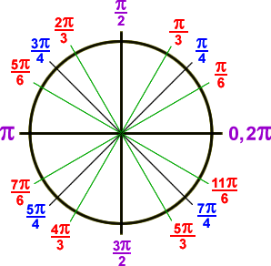
Required Resources
Materials Required
Special Materials:
Handouts:
Learnzillion presentation handouts
Learnzillion additional worksheets
https://learnzillion.com/lesson_plans/716
Notes:
Facilitator notes
Time: 2-3 minutes
Handouts/participant activity: n/a
Focus points:
Review the list of resources needed for the lesson and where to find materials online.

Slide 15
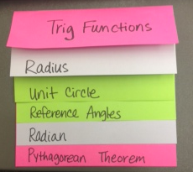
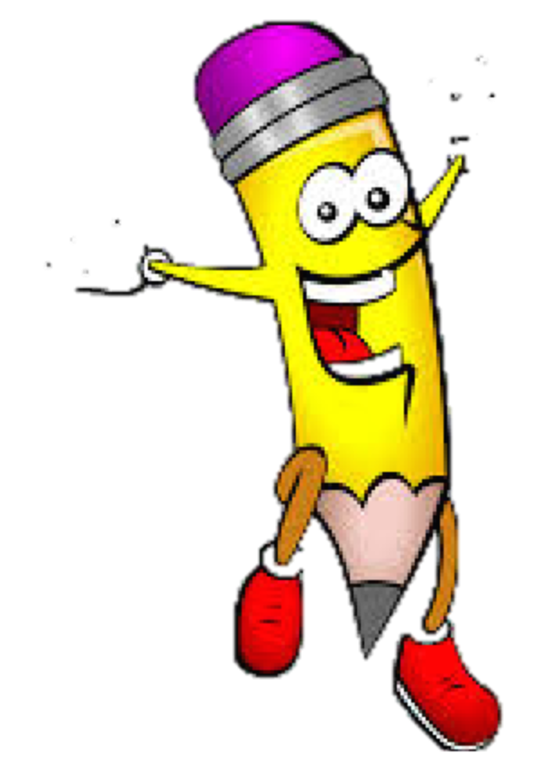
Needed Vocabulary
Trigonometry
Radius
Unit Circle
Reference Angles
Radian
Pythagorean Theorem
Or you could use: World Map, Frayer’s Model etc.
Layered Book Example
Notes:
Facilitator notes
Time: 4-5 minutes
Handouts/participant activity: n/a
Focus points:
This shows a list of required academic language vocabulary that is needed for the lesson. In addition, a strategy, “Layered Book” is shown with the suggestion that there are alternative strategies that can be used as well.

Slide 16
Learnzillion
For this lesson you need to create an account to access the handouts from Learnzillion.
This is a free account and you will have access to many more lessons.
Notes:
Facilitator notes
Time: 4-5 minutes
Handouts/participant activity: n/a
Focus points:
This is an introduction to the Learnzillion.com website where today’s lesson was pulled from. Teachers can sign up for a free account and have full access.

Slide 17
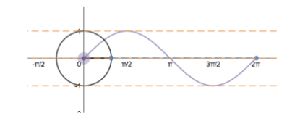
Trig Function using the Unit Circle
https://learnzillion.com/lesson_plans/716
Notes:
Facilitator notes
Time: 15 - 20 minutes
Handouts/participant activity: n/a
Focus points:
Click on the hyper link to take you to the lesson. Lesson includes: PowerPoint, Video, and handouts. As a department, we will explore this resources together

Slide 18
Planning and Time
Activities | Time | Notes
Preparation | 2 hours | Includes creating a pre-assessment, making copies, obtaining materials
Pre-lessons | 2 hours | Review of Algebra1 and Geometry Standards
Vocabulary | 1 hour | Defining Unit Circle
M&M Task-Lesson | 2 hours | Explanation and completion of work
Practice and Additional Tasks | 2 hours | Additional worksheets from LearnZillion, Textbook practice, Illustrative Mathematics Tasks
Total Time | 10 hours
Notes:
Facilitator notes
Time: 1 - 2 minutes
Handouts/participant activity: n/a
Focus points:
Suggested pacing for this lesson

Slide 19
Textbook Connection Big Ideas
Textbook Algebra 2 Section 9.3
Classwork: Page 477-481
Homework: Page 482-484
Extra Practice: Algebra 2 Resources by Chapter Section 9.3
Practice A and B page 301-302
Enrichment and Extension page 303
Puzzle Time Page 304
Student Journal Algebra 2 Section 9.3
Trigonometric Functions of Any Angles Page 252-256
Assessment Book Algebra 2 Section 9.3
Page 118-123
Notes:
Facilitator notes
Time: 1-2 minutes
Handouts/participant activity: n/a
Focus points:
Connections to the Big Ideas textbook for this specific standard / concept. As a department we may want to review this as well to compare to the Learnzillion lesson.

Slide 20
Textbook Connection Spring Board
Lesson 32-1 Placing the Unit Circle on the Coordinate Plane
Classwork Page 487-492
Homework Page 493
Notes:
Facilitator notes
Time: 1-2 minutes
Handouts/participant activity: n/a
Focus points:
Connections to the SpringBoard textbook for this specific standard / concept. As a department we may want to review this as well to compare to the Learnzillion lesson.

Slide 21
Textbook Connection CPM
7.1.6 Building a Unit Circle
Classwork Page 337-338
Homework Page 339-340
Notes:
Facilitator notes
Time: 1-2 minutes
Handouts/participant activity: n/a
Focus points:
Connections to the CPM textbook for this specific standard / concept. Please note, CPM does not address this standard. This is when a resource such as Learnzillion comes in handy.

Slide 22
Additional Resources
Illustrative Mathematics - www.illustrativemathematics.com
Trig Functions and the Unit Circle
Khan Academy - www.khanacademy.org
Engage NY Common Core Curriculum
Algebra II Module 2
https://www.engageny.org/resource/algebra-ii-module-2-topic-a-lesson-1
Notes:
Facilitator notes
Time: 3 - 4 minutes
Handouts/participant activity: n/a
Focus points:
This is a list of additional resources surrounding the standards that may be used. If time permits, as a department, explore these sites.

Slide 23
Need Help?
Contact your
Secondary Math Coordinator

