Slide 1
Algebra 2 – Statistics
Normal Distribution
Unit 5
Notes:
Facilitator notes
Time: n/a
Handouts/participant activity: n/a
Focus points:
Title Page

Slide 2
Purpose
Provided is a lesson for teachers to use to help students understand and analyze normal distribution. Included are the following:
Standards
Statistics and Probability Learning Progression
Lesson Agenda
Getting Ready for the Lesson (Resources and Tips)
Vocabulary Activities
Lesson
(Presentation and Video)
Textbook Connections
Additional Resources
Notes:
Facilitator notes
Time: 2-3 minutes
Handouts/participant activity: n/a
Focus points:
Review the components that this PD provides:
Standards
Learning Progressions
Lesson Agenda
Resources & Tips
Vocabulary Activities
Lesson
Textbook Connections
Additional Resources

Slide 3
Common Core Standards
S-ID.4. Use the mean and standard deviation of a data set to fit it to a normal distribution and to estimate population percentages. Recognize that there are data sets for which such a procedure is not appropriate. Use calculators, spreadsheets, and tables to estimate areas under the normal curve.
(Apply, 2) (Remember, 1) (Apply, 2)
Notes:
Facilitator notes
Time: 2-3 minutes
Handouts/participant activity: n/a
Focus points:
Identifying the standards for lesson and unwrapping them.

Slide 4
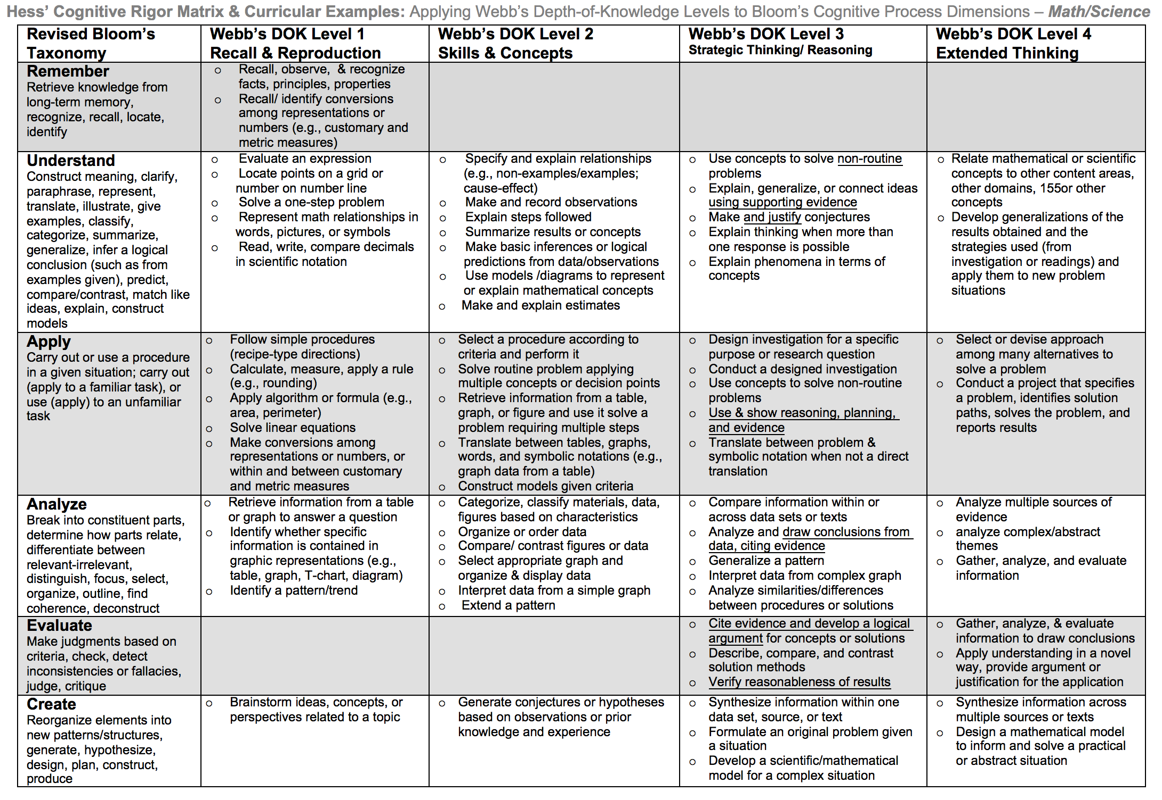
Notes:
Facilitator notes
Time: 2-3 minutes
Handouts/participant activity: n/a
Focus points:
Blue & Green circles indicate the appropriate levels of DOK as required by the standards
The Red circles fill in the instructional paths needed to assist students in reaching those DOK levels.

Slide 5
Math Practices
MP4
Model with mathematics
MP7
Look for and make use of structure
Notes:
Facilitator notes
Time: 1-2 minutes
Handouts/participant activity: n/a
Focus points:
Review the math practices associated with the lesson being presented

Slide 6
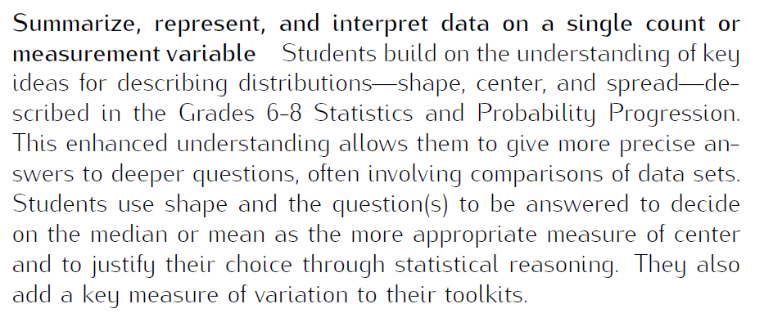
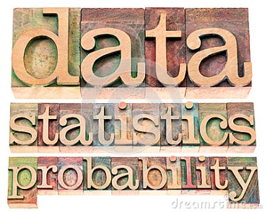
Statistics & Probability
Prerequisite Skills: CC Math 6-8
http://commoncoretools.me/wp-content/uploads/2012/06/ccss_progression_sp_hs_2012_04_21_bis.pdf
Notes:
Focus points:
The CA Framework also describes how students may accelerate to prepare for higher mathematics courses by compacting courses (animate circles around “compacted” and “accelerated”).
Compacting means to compress content, which may entail the teacher and students working at a faster pace to complete the content. There is no skipping of standards within the compacted courses to accelerate to higher mathematics courses.
By compacting courses in the middle school grades, students can be allowed to enter Geometry by the time they enter high school.
With the California standards, student would simply skip course to get ahead. With the Common Core standards, students can still get ahead, but can no longer skip courses or rather standards. Therefore they must move at a faster pace.

Slide 7
Middle School Focus
Grade 6
Develop understanding of statistical variability.
Summarize and describe distributions.
Grade 7
Use random sampling to draw inferences about a population.
Draw informal comparative inferences about two populations.
Investigate chance processes and develop, use, and evaluate probability models.
Grade 8
Investigate patterns of association in bivariate data.
Source: California Framework
Notes:
2 – 3 minutes
Facilitator’s Notes:
What are those standards that you must focus on and which ones are not part of your course with the new shifts in standard under common core?
Grade 6
Develop understanding of statistical variability.
Summarize and describe distributions.
Grade 7
Use random sampling to draw inferences about a population.
Draw informal comparative inferences about two populations.
Investigate chance processes and develop, use, and evaluate probability models.
Grade 8
Investigate patterns of association in bivariate data.
Let the participants know that they will use this handout in a later activity.

Slide 8
High School Focus
Algebra I
Summarize, represent, and interpret data on a single count or measurement variable.
Summarize, represent, and interpret data on two categorical and quantitative variables.
Interpret linear models.
Geometry
Conditional Probability and the Rules of Probability
Understand independence and conditional probability and use them to interpret data.
Use the rules of probability to compute probabilities of compound events in a uniform probability model.
Using Probability to Make Decisions Use probability to evaluate outcomes of decisions
Algebra II
Interpreting Categorical and Quantitative Data Summarize, represent, and interpret data on a single count or measurement variable.
Making Inferences and Justifying Conclusions Understand and evaluate random processes underlying statistical experiments.
Make inferences and justify conclusions from sample surveys, experiments, and observational studies.
Using Probability to Make Decisions Use probability to evaluate outcomes of decisions.
Source: California Framework
Notes:
2 – 3 minutes
Facilitator Notes
What are those standards that you must focus on and which ones are not part of your course with the new shifts in standard under common core?
Algebra I
Summarize, represent, and interpret data on a single count or measurement variable.
Summarize, represent, and interpret data on two categorical and quantitative variables.
Interpret linear models.
Geometry
Conditional Probability and the Rules of Probability
Understand independence and conditional probability and use them to interpret data.
Use the rules of probability to compute probabilities of compound events in a uniform probability model.
Using Probability to Make Decisions Use probability to evaluate outcomes of decisions
Algebra II
Interpreting Categorical and Quantitative Data Summarize, represent, and interpret data on a single count or measurement variable.
Making Inferences and Justifying Conclusions Understand and evaluate random processes underlying statistical experiments.
Make inferences and justify conclusions from sample surveys, experiments, and observational studies.
Using Probability to Make Decisions Use probability to evaluate outcomes of decisions.

Slide 9

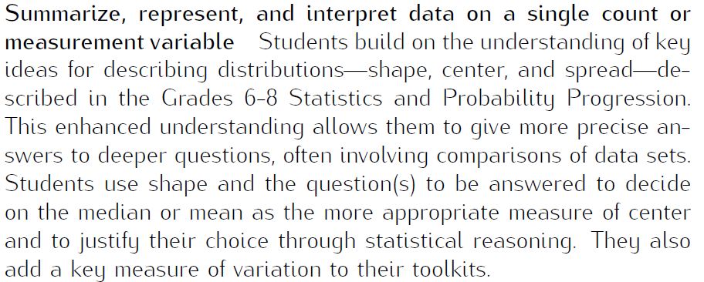
Learning Progression:
HS Statistics & Probability
http://commoncoretools.me/wp-content/uploads/2012/06/ccss_progression_sp_hs_2012_04_21_bis.pdf
Notes:
Focus points:
Let’s take closer look at the California Department of Education’s description of the CC Math 6-8 course.
Read the highlighted portion
The state framework shows the importance of the Grade 8 Math Course and how it has became the new gateway course for higher level math, as well as how Algebra 1 had shifted to high school.

Slide 10
Lesson Agenda
Vocabulary
Video:
Lesson: Understand the properties of normal distribution and identify situations that can be modeled by a normal distribution curve by examining distributions of one-variable distribution sets
Textbook Connections
Notes:
Facilitator notes
Time: 2-3 minutes
Handouts/participant activity: n/a
Focus points:
Review the lesson agenda prior to implementation

Slide 11
Normal Distribution
Planning for Instruction with understanding Normal Distribution
Notes:
Facilitator notes
Time: 1 minute
Handouts/participant activity: n/a
Focus points:
Title Page for lesson

Slide 12

Getting Ready
Pre-assessment- used to determine understanding of prerequisite skills
  Prerequisite skills include
    6.SP 2-3
      Understand that a set of data collected to answer a statistical question has a distribution which can be described by its center, spread, and overall shape.
      Recognize that a measure of center for a numerical data set summarizes all of its values with a single number, while a measure of variation describes how its values vary with a single number
    6.SP 5
      Summarize numerical data sets in relation to their context
Notes:
Facilitator notes
Time: 2-3 minutes
Handouts/participant activity: n/a
Focus points:
Review what standards should be covered in a pre-assessment activity. This shows what students should have already learned prior to your course. Using a pre-assessment activity will assist students in frontloading prior knowledge before beginning new learning.

Slide 13



Misconceptions and Anticipated Issues
Common Issues
Suggested Strategies/Resources
Using the wrong total from the frequency table
Misunderstanding the graph
Wrong interpretation of mean or median
Incorrect calculations for standard deviation
Use the additional practice worksheets from learnzilllion lesson
Use more than 1 vocabulary organizer to address key vocabulary
Allow students to use a calculator
Analyze the graph and understand the standard variation vs mean
Notes:
These are guided questions to improve our students’ learning.

Slide 14
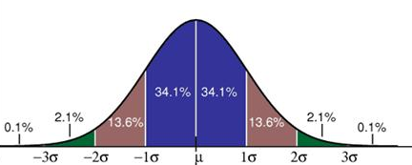

Required Resources
Materials Required
Handouts:
Learnzillion presentation handouts
Learnzillion additional worksheets
  https://learnzillion.com/lesson_plans/417
Notes:
Facilitator notes
Time: 2-3 minutes
Handouts/participant activity: n/a
Focus points:
Review the list of resources needed for the lesson and where to find materials online.

Slide 15
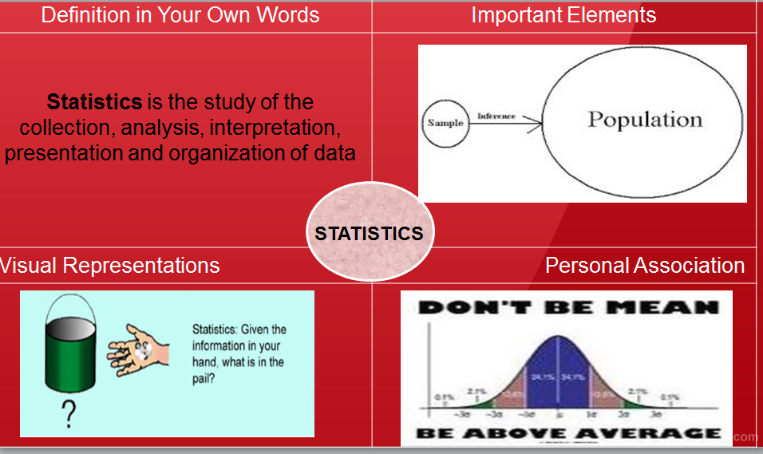

Needed Vocabulary
Normal Distribution
Data
Standard Deviation
Statistics
Median
Data Distribution
Or you could use: Layered book, Frayer’s Model etc.
Verbal & Visual Association Example
Notes:
Facilitator notes
Time: 4-5 minutes
Handouts/participant activity: n/a
Focus points:
This shows a list of required academic language vocabulary that is needed for the lesson. In addition, a strategy, “Verbal and Visual Association” is shown with the suggestion that there are alternative strategies that can be used as well.

Slide 16

Learnzillion
For this lesson you need to create an account to access the handouts from Learnzillion.
This is a free account and you will have access to many more lessons.
Notes:
Facilitator notes
Time: 4-5 minutes
Handouts/participant activity: n/a
Focus points:
This is an introduction to the Learnzillion.com website where today’s lesson was pulled from. Teachers can sign up for a free account and have full access.

Slide 17
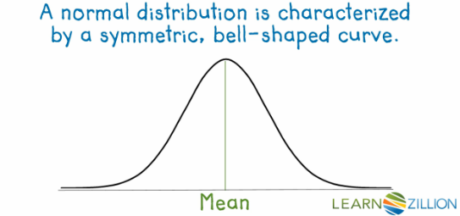
Normal Distribution
https://learnzillion.com/lesson_plans/417
Notes:
Facilitator notes
Time: 15 - 20 minutes
Handouts/participant activity: n/a
Focus points:
Click on the hyper link to take you to the lesson. Lesson includes: PowerPoint, Video, and handouts. As a department, we will explore this resources together

Slide 18
Planning and Time
Activities | Time | Notes
Preparation | 2 hours | Includes creating a pre-assessment, making copies, obtaining materials
Pre-lessons | 2 hours | Review of 6th grade SP standards
Vocabulary | 1 hour | Defining Normal Distribution
M&M Task-Lesson | 2 hours | Explanation and completion of work
Practice and Additional Tasks | 2 hours | Additional worksheets from LearnZillion, Textbook practice, Illustrative Mathematics Tasks
Total Time | 10 hours
Notes:
Facilitator notes
Time: 1 - 2 minutes
Handouts/participant activity: n/a
Focus points:
Suggested pacing for this lesson

Slide 19
Textbook Connection
Big Ideas
Textbook Algebra 2 Section 11.1
  Classwork: Page 600 problems 1 – 6
  Homework: Page 600-602 problems 7 - 36
Extra Practice: Algebra 2 Resources by Chapter Section 11.1
  Practice A and B page 375-376
  Enrichment and Extension page 377
  Puzzle Time Page 378
Student Journal Algebra 2 Section 11.1
  Using Normal Distribution Page 314-318
Assessment Book Algebra 2 Section 11.3
  Page 144
Notes:
Facilitator notes
Time: 1-2 minutes
Handouts/participant activity: n/a
Focus points:
Connections to the Big Ideas textbook for this specific standard / concept. As a department we may want to review this as well to compare to the Learnzillion lesson.

Slide 20
Textbook Connection
Spring Board
Lesson 36-1: Shapes of Distribution
  Classwork Page 553-556
  Homework Page 557
Lesson 36-2 : Characteristics of the Normal Distribution
  Classwork Page 558-560
  Homework Page 561
Notes:
Facilitator notes
Time: 1-2 minutes
Handouts/participant activity: n/a
Focus points:
Connections to the SpringBoard textbook for this specific standard / concept. As a department we may want to review this as well to compare to the Learnzillion lesson.

Slide 21
Textbook Connection
CPM
9.3.2 How can I make predictions?
The Normal Probability Density Function
  Classwork Page 477-480
  Homework Page 480-481
Notes:
Facilitator notes
Time: 1-2 minutes
Handouts/participant activity: n/a
Focus points:
Connections to the CPM textbook for this specific standard / concept. Please note, CPM does not address this standard. This is when a resource such as Learnzillion comes in handy.

Slide 22
Additional Resources
Illustrative Mathematics - www.illustrativemathematics.com
  SAT Scores
  Do you Fit In This Car?
  Should we Send Out a Certificate?
Khan Academy - www.khanacademy.org
Engage NY Common Core Curriculum
  Algebra II Module 4
    https://www.engageny.org/resource/algebra-ii-module-4-topic-b-lesson-8-0
Notes:
Facilitator notes
Time: 3 - 4 minutes
Handouts/participant activity: n/a
Focus points:
This is a list of additional resources surrounding the standards that may be used. If time permits, as a department, explore these sites.

Slide 23
Need Help?
Contact your
Secondary Math Coordinator

