Slide 1
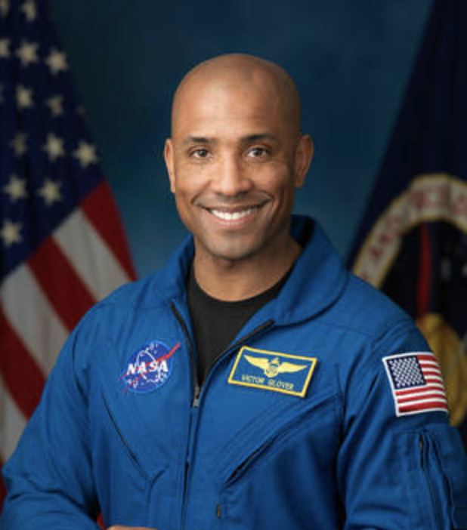
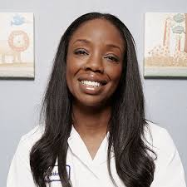
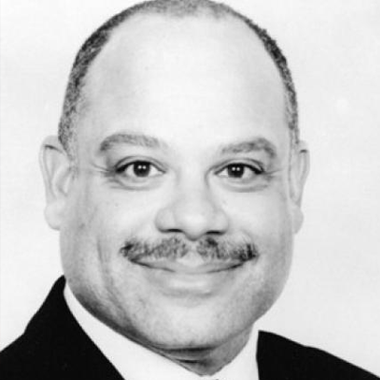
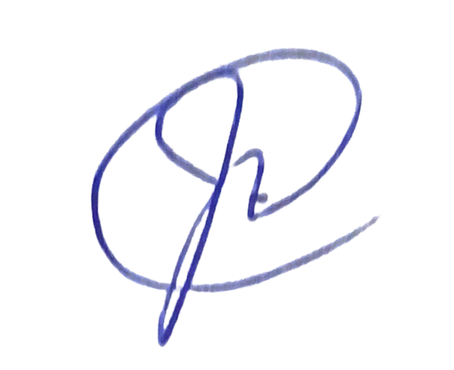
Academic English Mastery Program
Districtwide Written Word and Multimedia Contest
Honoring African American History Month
Task: Write an essay or create a multimedia presentation that vividly describes an African American who has impacted the field of STEM - Science, Technology, Engineering, and Mathematics. Describe the impact of their work on the greater society and how it has inspired others to pursue similar careers.
Contest Dates:
Monday, January 25 - Monday, March 1, 2021
Every school within L.A. Unified is invited to participate!
Examples of African Americans in the field of STEM: (Images are hyperlinked)
Victor J. Glover
Nadine Burke Harris
“The Pact”
Dr. Jameka Burge
Mark Dean
Please use the following link for guidelines and detailed instructions for submitting:
http://bit.ly/AEAMPEssay2021
Entries must be uploaded by 5:00 p.m. on March 1, 2021.
Please upload to: http://bit.ly/AEMPContestUploads2021
For more information, please contact Alison O’Quinn: alison.oquinn@lausd.net or
Andrea Goring: andrea.goring@lausd.net
Grand Prize Winners will be honored and their winning entries featured on the AEMP website. Each winning participant will receive certificates and prizes.
Approved by: _____ Dr. J. Michelle Rainey Woods, Interim Administrator, AEA

Slide 2
Written Word/Multimedia Entry Guidelines
Honoring African American History Month
Task: Write an essay or create a multimedia that vividly describes and tells about the impact that an African American has had in the field of STEM, Science, Technology, Engineering, and Mathematics. Describe the impact of their work on the greater society or how it has inspired others to pursue similar careers. Essays/multimedia presentations must be written to meet grade level standards.
Suggested School-based Activities
🞐Introduce contest school-wide
🞐Encourage use of criteria checklist and rubric
🞐Contest conducted to select one winner per grade level span
(K-1, 2-3, 4-5,-6-8, 9-12)
🞐Celebrate contest participants and winners
Submission Checklist:
🞐Upload winning submissions, one per span (K-1, 2-3, 4-5, 6-8, 9-12) to
http://bit.ly/AEMPContestUploads2021 by March 1, 2021, at 5:00 p.m.
🞐Essay or multimedia presentation
🞐Scored Written Word/Multimedia Contest Rubric and Title Page
🞐Receive email verification of the Parent Digital Publicity Authorization and
Release Form (Page 7)
Awarded schools will be notified by April 15, 2021 and winners will be honored at the
Council of Black Administrators 46ᵗᑋ Annual Black Child Conference.

Slide 3
K-12 Written Word Criteria
Honoring African American History Month
Kindergarten-1st Grade
🞐Draws a detailed picture or includes visual representation that describes the topic
🞐Writes a paper that states the topic, provides some facts, details and a sense of closure
🞐Includes a title page (name, grade and school)
2nd-3rd Grade
🞐Introduces the topic
🞐Provides multiple facts, detail and examples
🞐Uses multiple information sources
🞐Has an introduction and a conclusion
🞐Includes a title page (name, grade and school)
4th-5th Grade
🞐Topic is introduced and clearly communicated
🞐Clear focus maintained for the purpose of the audience
🞐Use of varied transitional strategies to clarify ideas
🞐Effective introduction and conclusion
🞐Uses multiple information sources
🞐Logical progression of ideas from beginning to end
🞐Includes a title page (name, grade and school)
6th-12th Grade
🞐Claim is clearly communicated and maintained for the purpose of the audience throughout
the essay
🞐Logical progression of ideas
🞐Effective introduction and conclusion organizational structure
🞐Organization is fully sustained between and within paragraphs
🞐Response is consistently and purposefully focused
🞐Uses multiple information sources
🞐Alternate and opposing arguments are clearly acknowledged or addressed
🞐Includes a title page (name, grade and school)

Slide 4
K-12 Multimedia Presentation Criteria
Honoring African American History Month
Presentations
🞐Introductory slide with school name, student name, grade level and title
🞐Includes 5-10 slides with visuals and written captions
🞐Displays visual text to provide information and supporting evidence
🞐The presentation clearly addresses the prompt
🞐Can include embedded advanced features such as videos and audio
🞐Suggested format: PowerPoint or Keynote
Video Submissions (i.e., skits, speeches, performances)
🞐Introductory title with school name, student name, grade level, and title
🞐3-5 minutes in length
🞐Displays visual text to provide information and supporting evidence
🞐Clear sound and verbal articulation
🞐The video clearly addresses the prompt
🞐Suggested format: iMovie and Explain Everything
Audio Submissions (i.e., songs, raps, spoken word, speeches)
🞐Introductory slide with school name, student name, grade level, and title
🞐3-5 minutes in length
🞐Provides information and supporting evidence
🞐Clear sound and verbal articulation
🞐The audio clearly addresses the prompt
🞐Suggested format: iMovie or Explain Everything
College and Career Readiness Anchor Standards
🞐Use technology, including the internet, to produce and publish writing and to interact and
collaborate with others
🞐Gather relevant information from multiple print and digital sources, assess the credibility
and accuracy of each source and integrate the information while avoiding plagiarism

Slide 5
Written Word/Multimedia Contest Rubric
The Written Word/Multimedia Presentation should exemplify informative/explanatory writing that is based on research and provides evidence to support their topic. Please use the following rubric to score your entries.
Score according to grade level criteria. | 4 Consistently Evident | 3 Frequently Evident | 2 Seldom Evident | 1 Never Evident | Comments
Focus Responds skillfully with all statements related to the prompt.
Organization Organizes information into paragraph structure using a clear topic sentence, facts, definitions, and concluding sentence.
Supporting Evidence Develops the topic skillfully with facts and definitions.
Grammar and Usage Demonstrates command of the conventions of standard English grammar and usage when writing or speaking.
Language Conventions Capitalization, Punctuation, and Spelling
*Multimedia Technical Requirements Includes 5 or more slides, graphics from outside sources, animations and advanced features/videos/ audio.
Essay Total Score ______/20 OR Multimedia Total Score ______/20
Student's Name _____________________________________________ Grade _________
School ____________________________________________________
Please copy and attach this rubric to the student's Written Word/Multimedia Project.
Upload winning submissions, one per span (K-1, 2-3, 4-5, 6-8, 9-12) to http://bit.ly/AEMPContestUploads2021 by March 1, 2021, at 5:00 p.m.

Slide 6
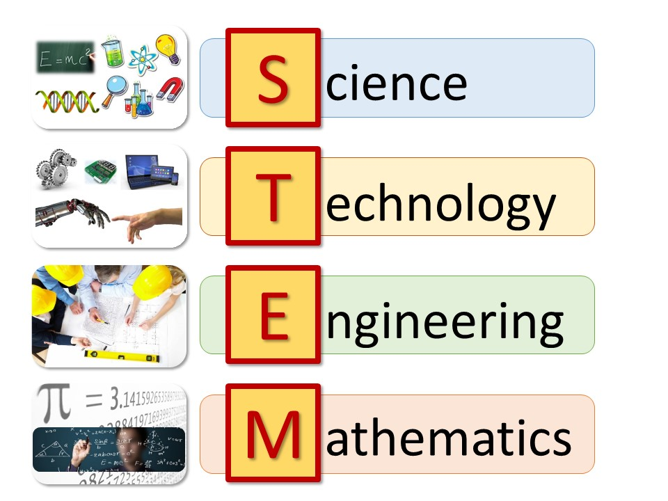
K-12 Multimedia Presentation Title Page
Honoring African American History Month
Student Name:
_________________________________________________________________
Title of Essay/Multimedia Presentation: _________________________________________________________________
Description/Inspiration for selecting this African American STEM leader:
_________________________________________________________________
_________________________________________________________________
_________________________________________________________________
_________________________________________________________________
Briefly describe the impact of their work on the greater society and how it has inspired others to pursue similar careers. _________________________________________________________________
_________________________________________________________________
_________________________________________________________________
_________________________________________________________________
School Name, staff contact person’s name and email address:
_________________________________________________________________
_________________________________________________________________
_________________________________________________________________
Student’s Home Address, Telephone Number:
_________________________________________________________________
_________________________________________________________________
Written Word/Multimedia Contest questions can be directed to:
Andrea Goring, Specialist, at andrea.goring@lausd.net, or
Alison O’Quinn, SEL Coordinator, LD East, alison.oquinn@lausd.net

Slide 7
Digital Publicity Authorization
and Release Form
Digital Publicity Authorization and Release Form must be submitted with each entry.
Please click on the link below to access the job aid that will guide you step by step to digitally fill in the Publicity Release form for the student.
Digital Parent/Guardian Publicity Authorization and Release Form (Virtual Graduation/Culmination) Quick Guide
Parents will receive an email verification which includes a copy of their signed Digital Publicity Authorization and Release Form. Please direct them to forward a copy to the school designee in charge of collecting submissions.

Slide 8
Written Word/Multimedia Entry Guidelines
Honoring African American History Month
List of African Americans who have impacted the field of STEM.
Archie Alexander
Harold Amos
Benjamin Banneker
Patricia Bath
Angela Benon
Dr. Keith Black
Marie Van Brittan Brown
Guion Bluford Jr
Dr. Jamika Burge
Dr. Nadine Burke
Kimberly Bryant
George Washington Carver
Herman Chinery-Hesse
May Chinn
Marie Maynard Daly
Mark Dean
Julian Manly Earls
Annie Easley
Aprille Ericsson-Jackson
Alan Emtage
Victor J. Glover, Jr.
Frank Greene
Bessie Blount Griffin
Lloyd Hall
James Andrew Harris
Walter Lincoln Hawkins
Mary Jackson
William M. Jackson
Shirley Ann Jackson
Erich Jarvis
Mae Jemison
Lonnie Johnson (inventor)
Katherine Johnson
Percy Lavon Julian
Rick Kittles
Vivien Thomas
Dorothy Johnson Vaughan
"The Pact” Dr. Sampson Davis
Dr. Rameck Hunt, and
Dr. George Jenkins
Additional Suggestions and Instructional Resources:
https://docs.google.com/document/d/1GlWTwpQtCTQLujfZ3NeX09R42p84S5jXRhtXpJgsAFA/edit?usp=sharing

